Slide 1
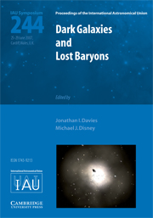
Pulsars
Pulsar Search Collaboratory
Team Disney
Modified Julian Date: 55764

Slide 2
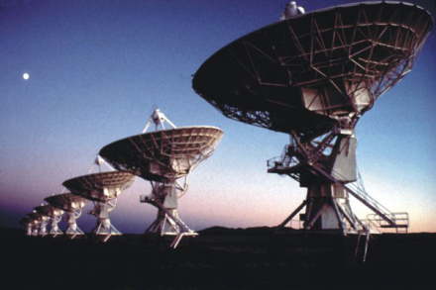
Introduction
Mission statement:
  To gain scientific skill in order to detect pulsars from radio data.
Radio astronomy is the study of electromagnetic emissions of celestial bodies in the universe.
Manmade objects also generate radio signals (RFI).

Slide 3
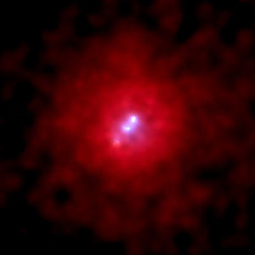
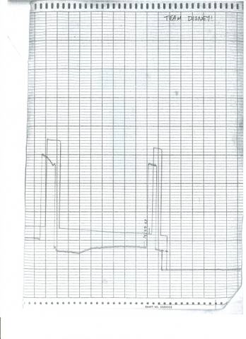
Onward to Discoveries
Forty-foot Telescope
Object: 3c 295
Distance: 5.6 billion light
years or 1.73 billion pc
RA: 14:09:33
DEC: 52:26:13
* Actual Jy is 23 Jy
500 Jy
~33 Jy

Slide 4
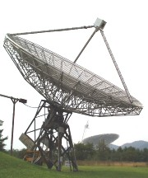
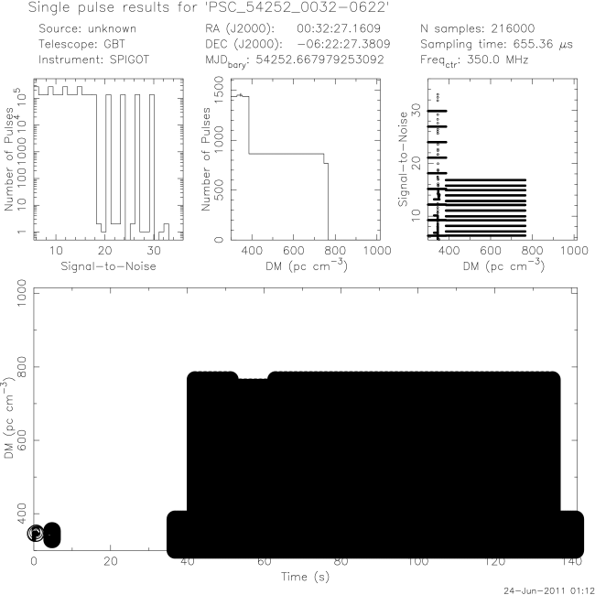
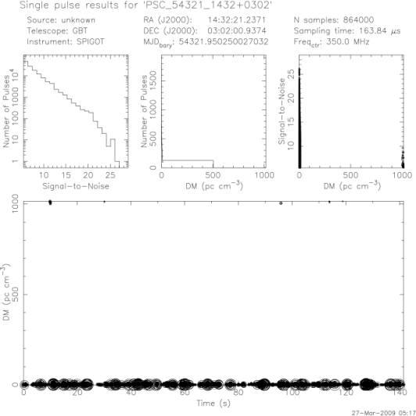
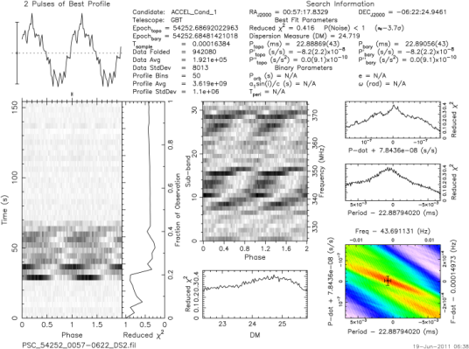
The Pulsar Evaluation
15 datasets were analyzed for pulsars
Results of evaluation:
  Bodacious RFI and noise
  Possible candidates
  Known pulsars
00:32 -06:22

Slide 5
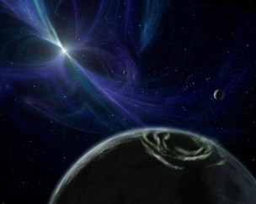
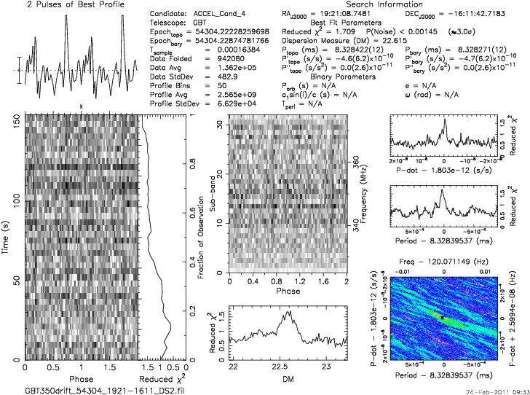
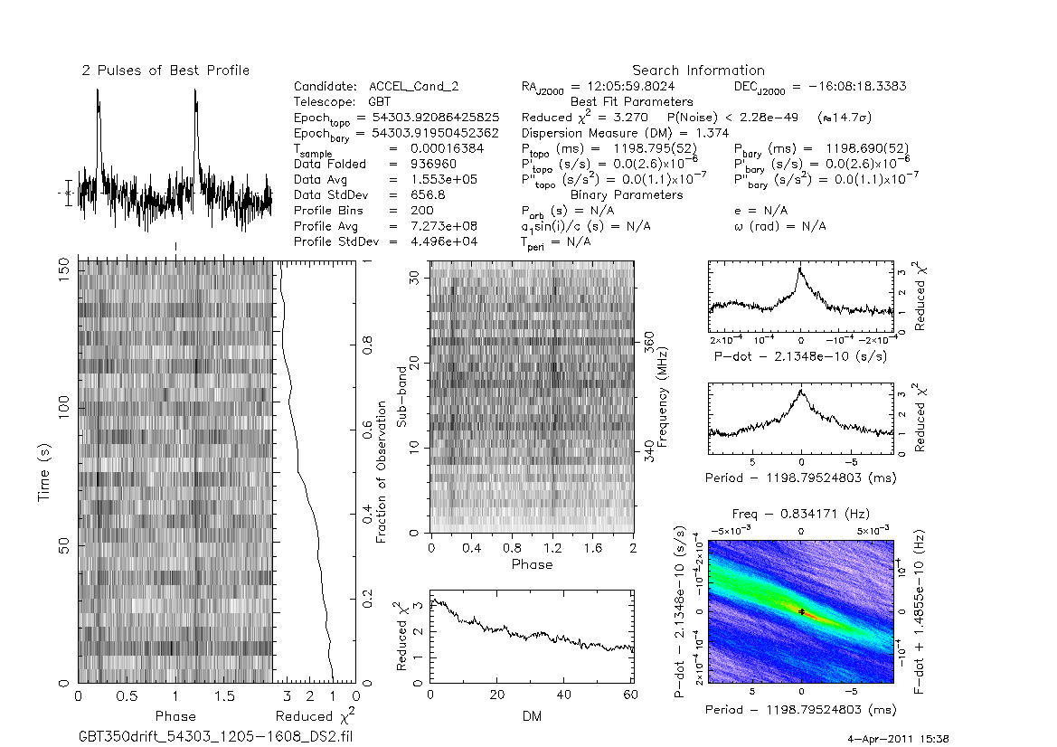
Pulsar Candidates
19:21 -16:11
*12:05 -16:08

Slide 6
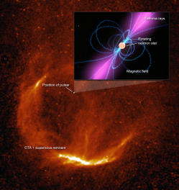
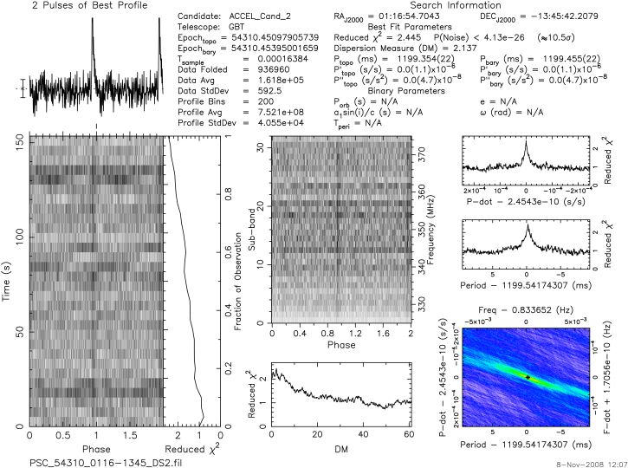
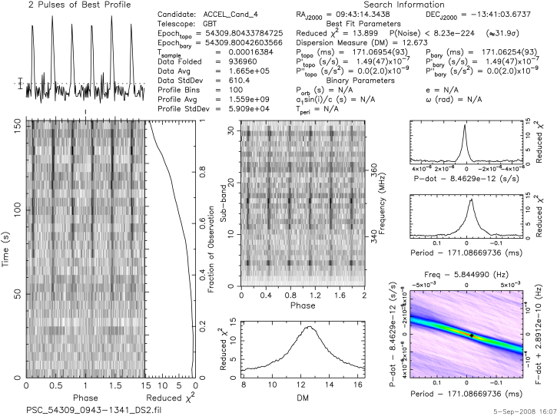
Known Pulsars
*J09:44 -13:54
*J01:08 -14:31

Slide 7
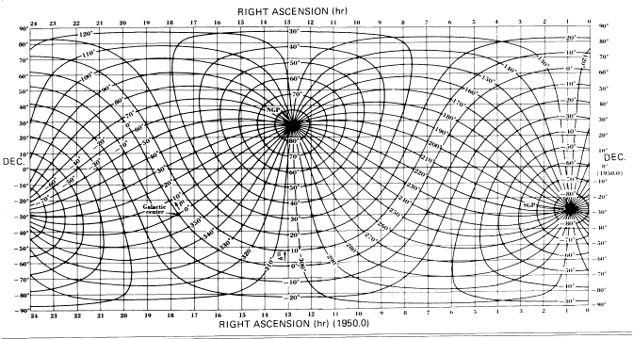
The GBT.
Observing time: 00:30-2:00
Contribution: Using PYTHON to direct the GBT and to grid data.
Candidates: 19:21-16:11, 22:43+69:39, 21:07-16:12

Slide 8
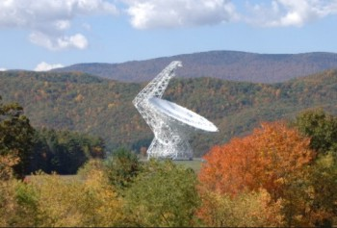
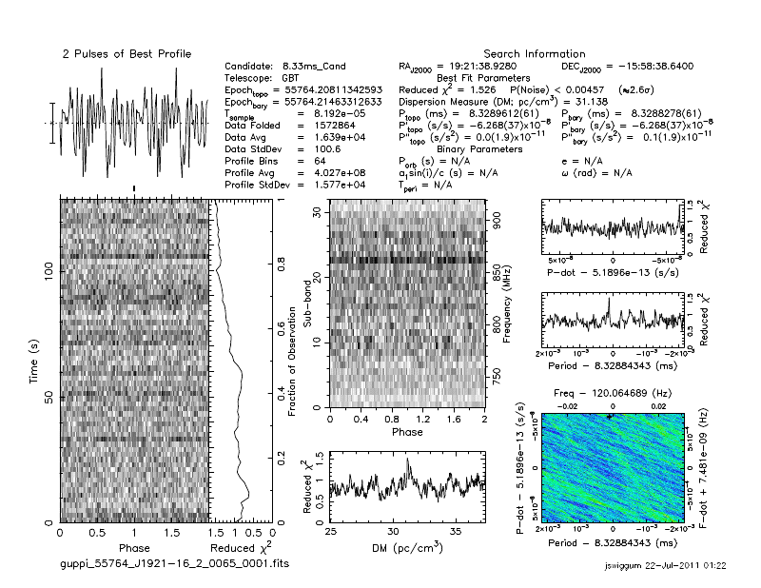
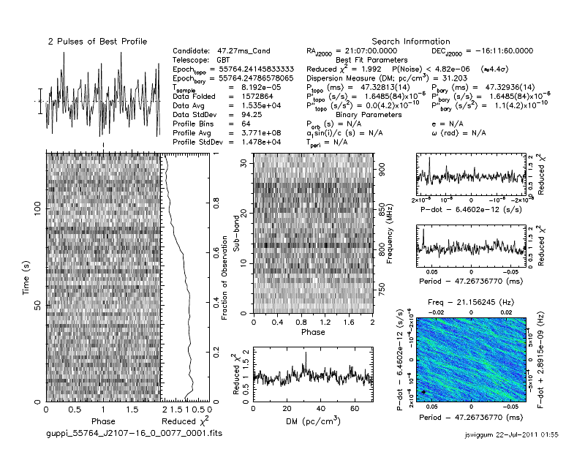
GBT Results
Unable to observe all plots
Mainly RFI or noise
19:21 -15:58
21:07 -16:11

Slide 9

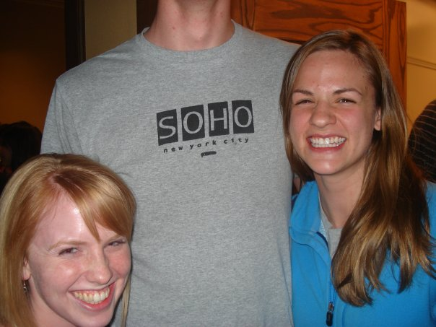

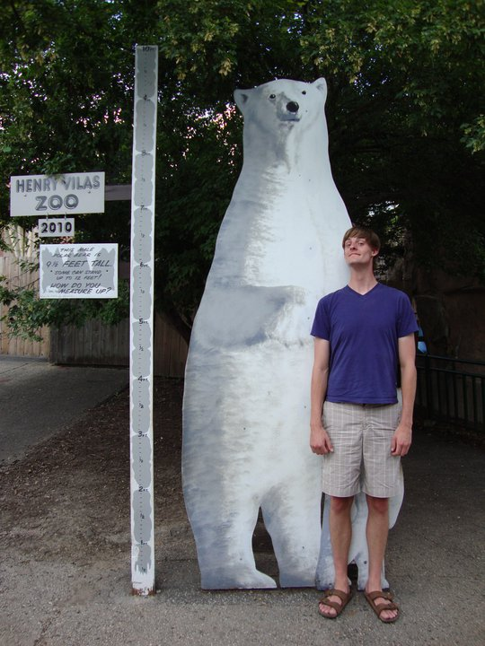


Joe Swiggum & Peter Gentile

Slide 10
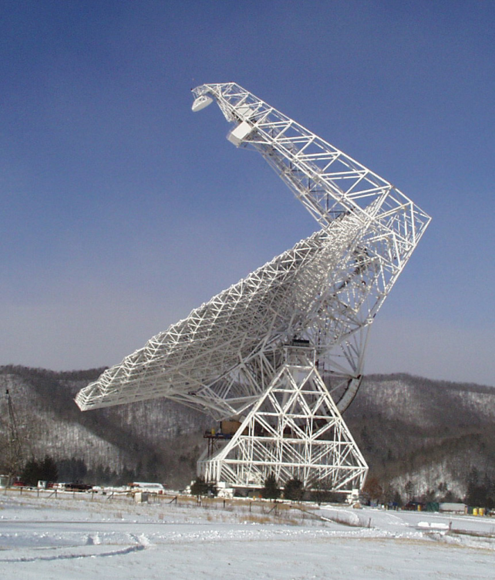
Conclusion
Observe Period/time
Be Prepared for Problems
  Patience is a Virtue
  Murphy’s Law
Be thorough in observation and experimentation
Be open to all impossible possibilities

Slide 11
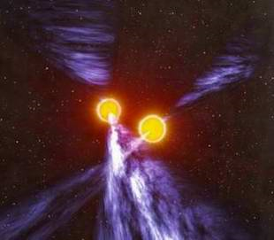
Acknowledgements
Sue Ann Heatherly
Sean Leake and all student mentors
Sarah Scoles
TO ALL TEACHERS!
Duncan and Maura
Ryan Lynch and Peter
The GBT for being the coolest telescope EVER
NRAO for making this possible and tolerating us in our wildest moments ☺

