Slide 1
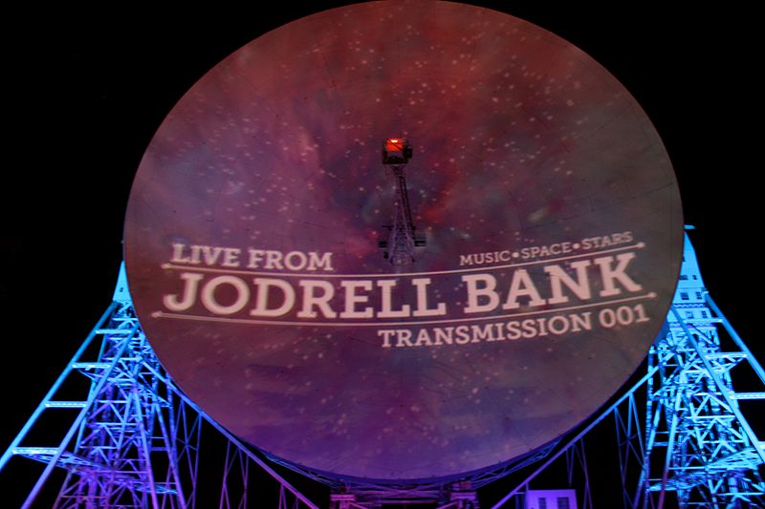

Team Presentation
July 22, 2011

Slide 2
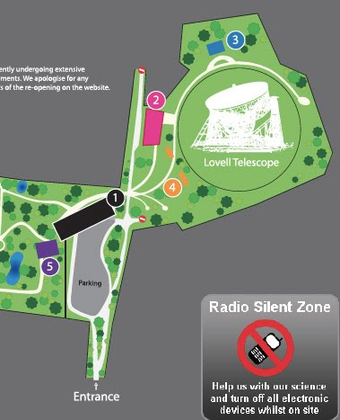
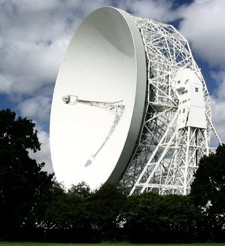
Jodrell Bank is the original arboretum for Manchester University. Immediately after World War II, first radio telescope was established there. Since that time, it has become the premier radio observatory for Great Britain, on its soil. It has the Lovell telescope (76 m instrument built in 1955) that is the third largest fully steerable radio telescope in the world and the source of many important astronomical discoveries over the years. Notice that the observatory is very landlocked and near many residential areas. But it is still in use today.

Slide 3
Abstract
Pulsars are highly magnetized, rotating neutron stars that emit a beam of electromagnetic radiation. The radiation can only be observed when the beam of emission is pointing towards the Earth. This is called the lighthouse effect and gives rise to the pulsed nature that gives pulsars their name. Some reasons that scientists look for pulsars is to study physical phenomena that they can not study in labs, such as black holes and the effects of extreme electromagnetic and gravitational fields moving through space at high speeds.
Our goal in looking at the given data sets was to become more familiar with the GBT and pulsar detection. Also, we were given data that had not previously been seen, making identifying an unknown pulsar, possible. Through these exercises, we hope to become more adapt at identifying pulsars, noise, and RFI.

Slide 4
Abstract
First, we cross-referenced the datasets given with the ATNF Catalog and DM checker. We made note of any known pulsars in proximity of our datasets and then analyzed 34 plots for each of our 15 pointings. We then compiled a list of the best candidates for further observation on the GBT. Using CLEO, we assured that all of our potential plots would above the horizon during a one hour GBT observation allotment.
Our conclusions were that the GBT data confirmed the known pulsar data, J1610-1322. The second plot analyzed was a possible pulsar candidate, 1219-1608 was not confirmed by 2nd GBT grid plot pointing. Our 3rd plot, 1736-0241, was located adjacent to a known pulsar, but could not be located during 2nd GBT grid plot pointing. Our 4th plot, 1202-1608, was not view during our allotted time, but will be up for review in the future as a possible pulsar.

Slide 5
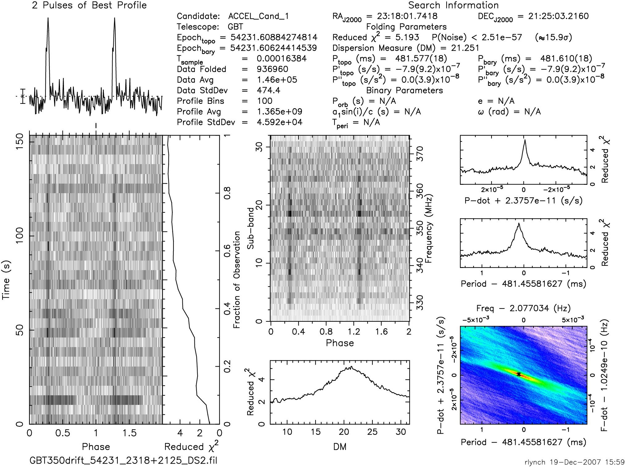
Distinguishing between types of plots

Slide 6
Average Pulse Profile
Time Domain Plot
Reduced Chi² needs to steadily increase and generally be higher greater than 3.
Looked for peaks well above the noise and wider than the peak width gauge.
Looked for dark bands running vertically and coincide with peaks in Avg. Pulse Profile

Slide 7
Dispersion Measure
Sub-band Plot
Looked for bell curve and DM greater than zero.
**Please Note: These steps help identify an ideal pulsar. Following these steps will not guarantee the detection of a pulsar. RFI can sometimes masquerade as a pulsar(transient emission) and sometimes a pulsar will not display all the ideal characteristics. User discretion advised.
Looked for dark bands running vertically and coincide with bands in Time Domain Plot

Slide 8
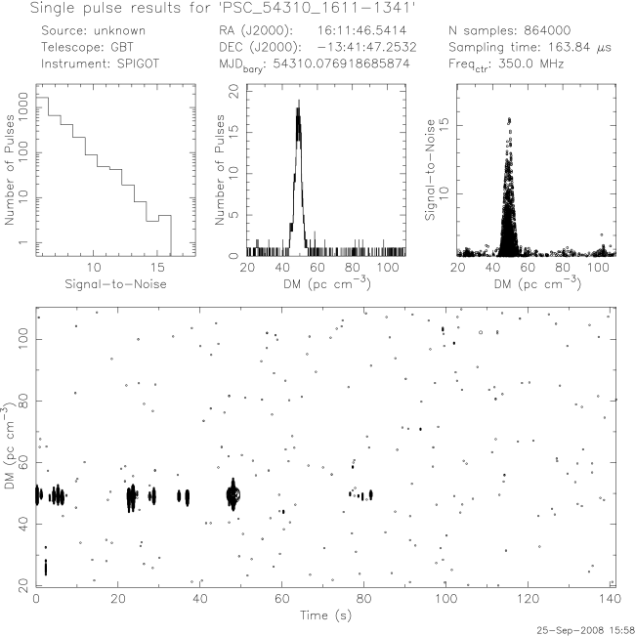
Looked for matching peaks at same DM in these 2 plots
Looked for stair step design
**Please Note: These steps help identify an ideal pulsar. Following these steps will not guarantee the detection of a pulsar. RFI can sometimes masquerade as a pulsar(transient emission) and sometimes a pulsar will not display all the ideal characteristics. User discretion advised.
Looked for characteristic signal shape
Looked for signal trend off DM baseline

Slide 9
Our data resulted in 75% noise, 23% RFI, and 2% Known Pulsar

Slide 10
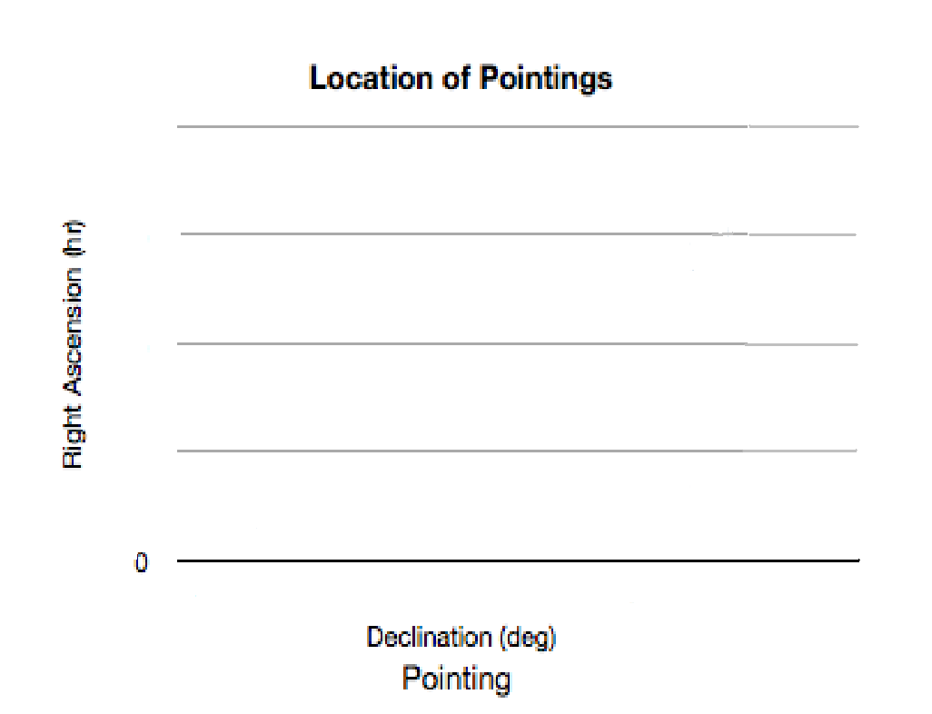
Jodrell Pointings Distribution in Sky
20:00
15:00
10:00
05:00
10:00
20:00
30:00
40:00
** Below you see a plot showing the location of pointings in Right Ascension and Declination.

Slide 11
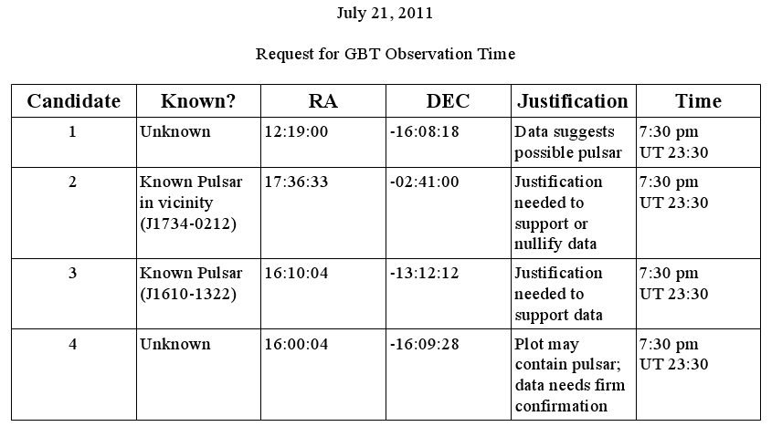
DATA ANALYSIS
We analyzed 15 pointings, each with about 34 plots. The following table displays our four best candidates.

Slide 12
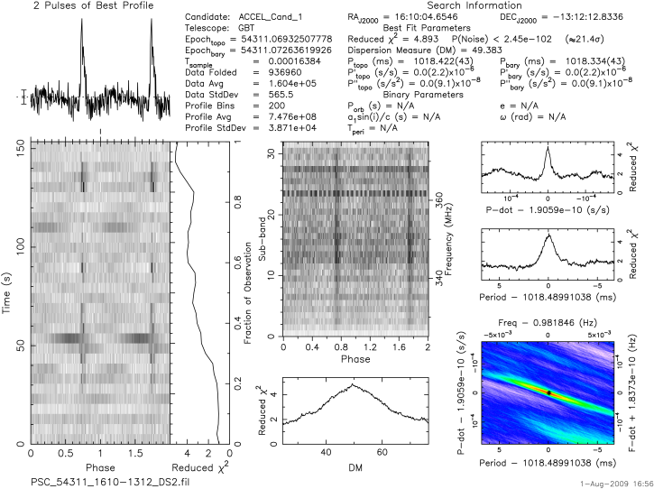
Known Pulsar found at 1610-1322

Slide 13
J1610-1322 Pointing at 800 MHz

Slide 14
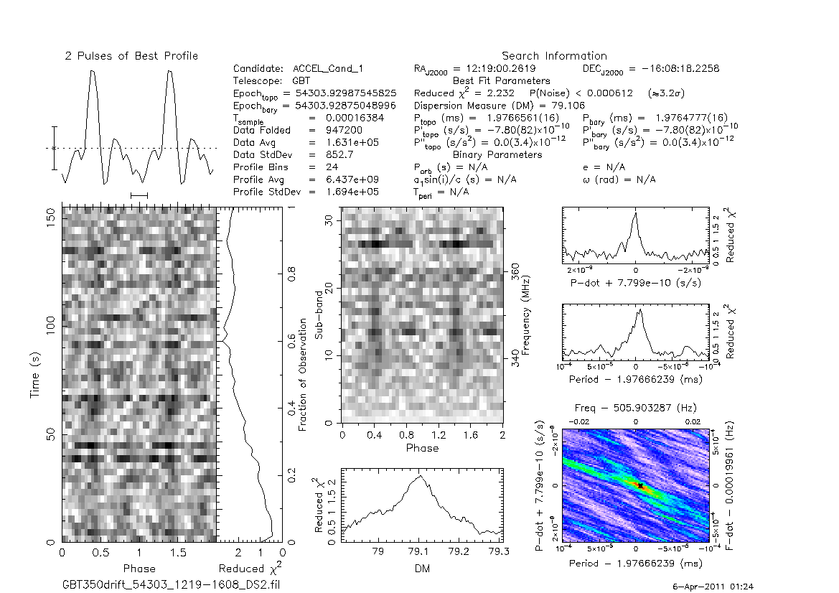
1219-1608 Possible pulsar

Slide 15
The second pointing was shot in a grid, searching for 1219-1608. This is the first of 6 grid pointing’s

Slide 16
2nd grid pointing

Slide 17
3rd grid pointing

Slide 18
4th grid pointing

Slide 19
5th grid pointing

Slide 20
6th grid pointing

Slide 21
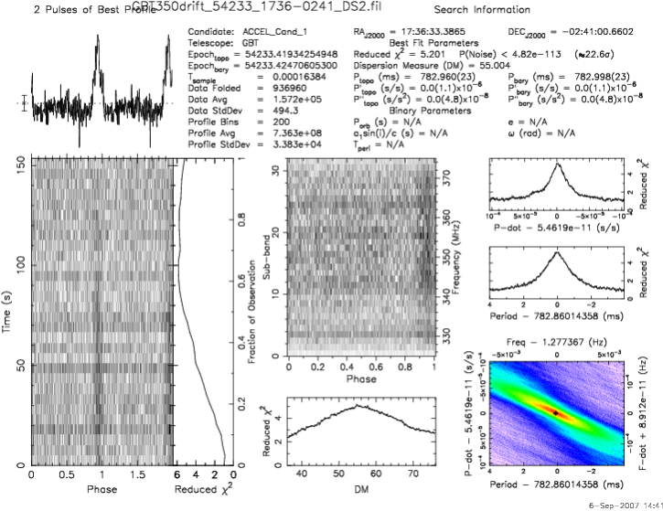
Our 3rd plot at 1736-0241
Possible Known pulsar

Slide 22
1736-0241 Pointing at 800MHZ

Slide 23

Our final plot 1202-1608
We did not have time to point to this location but we left this with the GBT and possibly point to this location next week.

Slide 24
Results
If you found any known pulsars? If so:
  how many?
  where are they located within our galaxy? (Use galactic coordinates)
  how far are they from Earth?
  what is their age?
  how strong is their magnetic field?
  is the RA and Dec of the pulsar different than the RA and Dec of your pointing? What does this tell you about the telescope?
Describe the RFI. Was it narrow band ( IE only at certain frequencies) or broadband?
  Was the frequency of the RFI many different frequencies or all the same frequencies?
  Was the RFI generally broadband or narrowband?
  How were the RFI pointings distributed on the sky? Was the RFI always in the same direction?
Any Pulsar Candidate Plots? What makes you think you might have a pulsar?

Slide 25
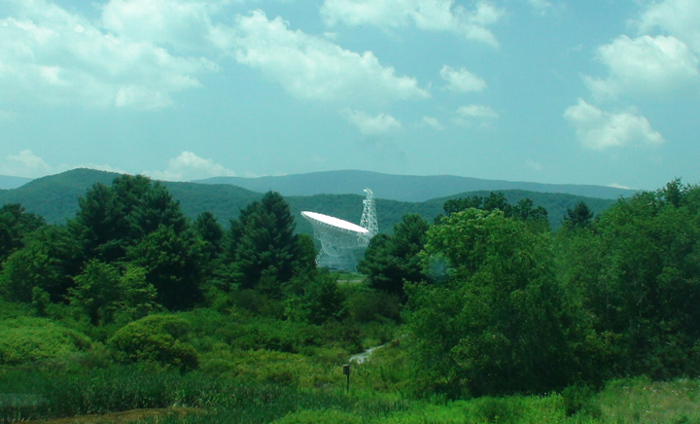
Acknowledgments:
PSC Staff : Sue Ann Heatherly, Duncan Lorimer,
Maura McLaughlin, Ryan Lynch, Sarah Scoles,
Ron Magdalena, Dave Frayer.
2. Director: Rachel Rosen
3. WVU
4. National Radio Astronomy Observatory
5. National Science Foundation
ATNF Pulsar Catalogue, Manchester, R. N., Hobbs, G. B.,
Teoh, A. & Hobbs, M., AJ, 129, 1993-2006 (2005)
7. Cafeteria Staff: Hope, Jeremiah, Sue, Amy, Cathy, Shirley, and
Jennifer

Slide 26
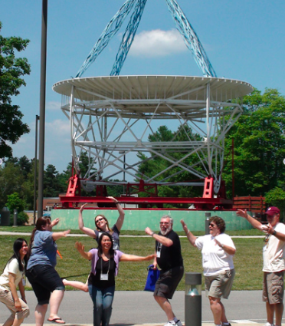

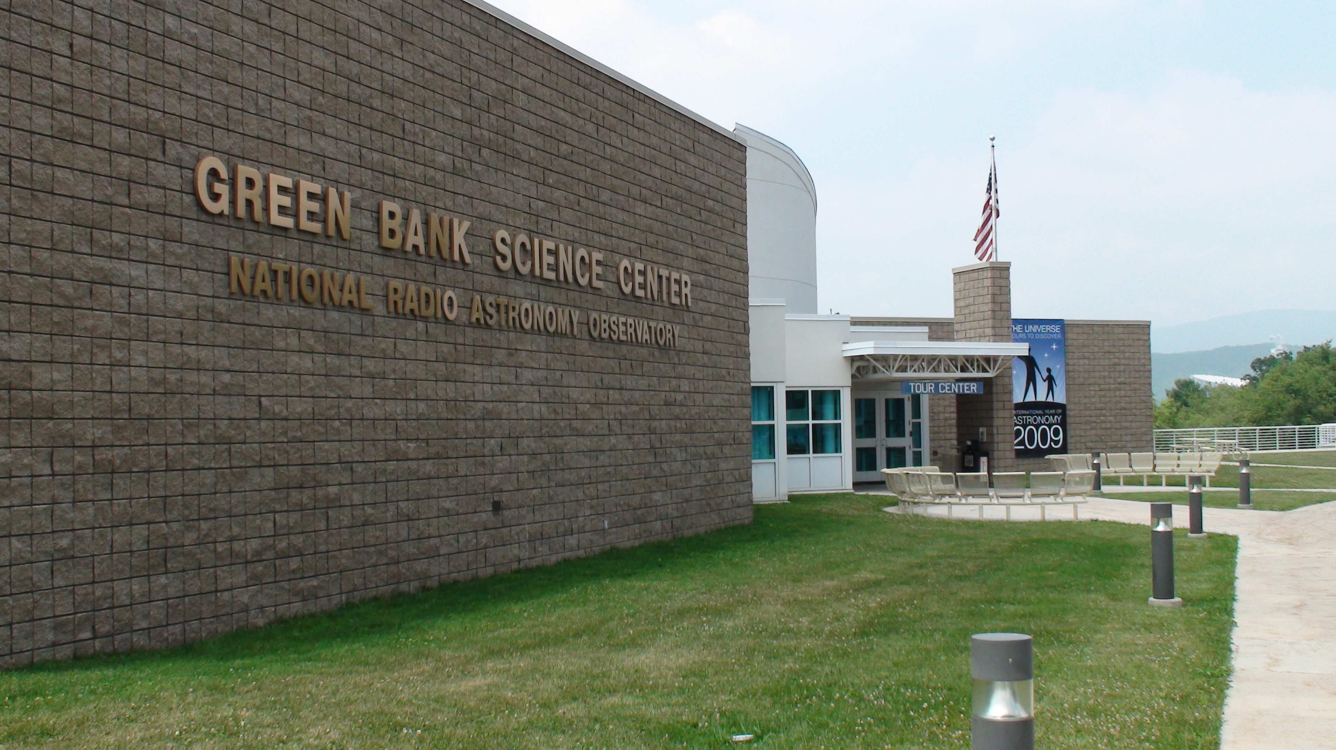


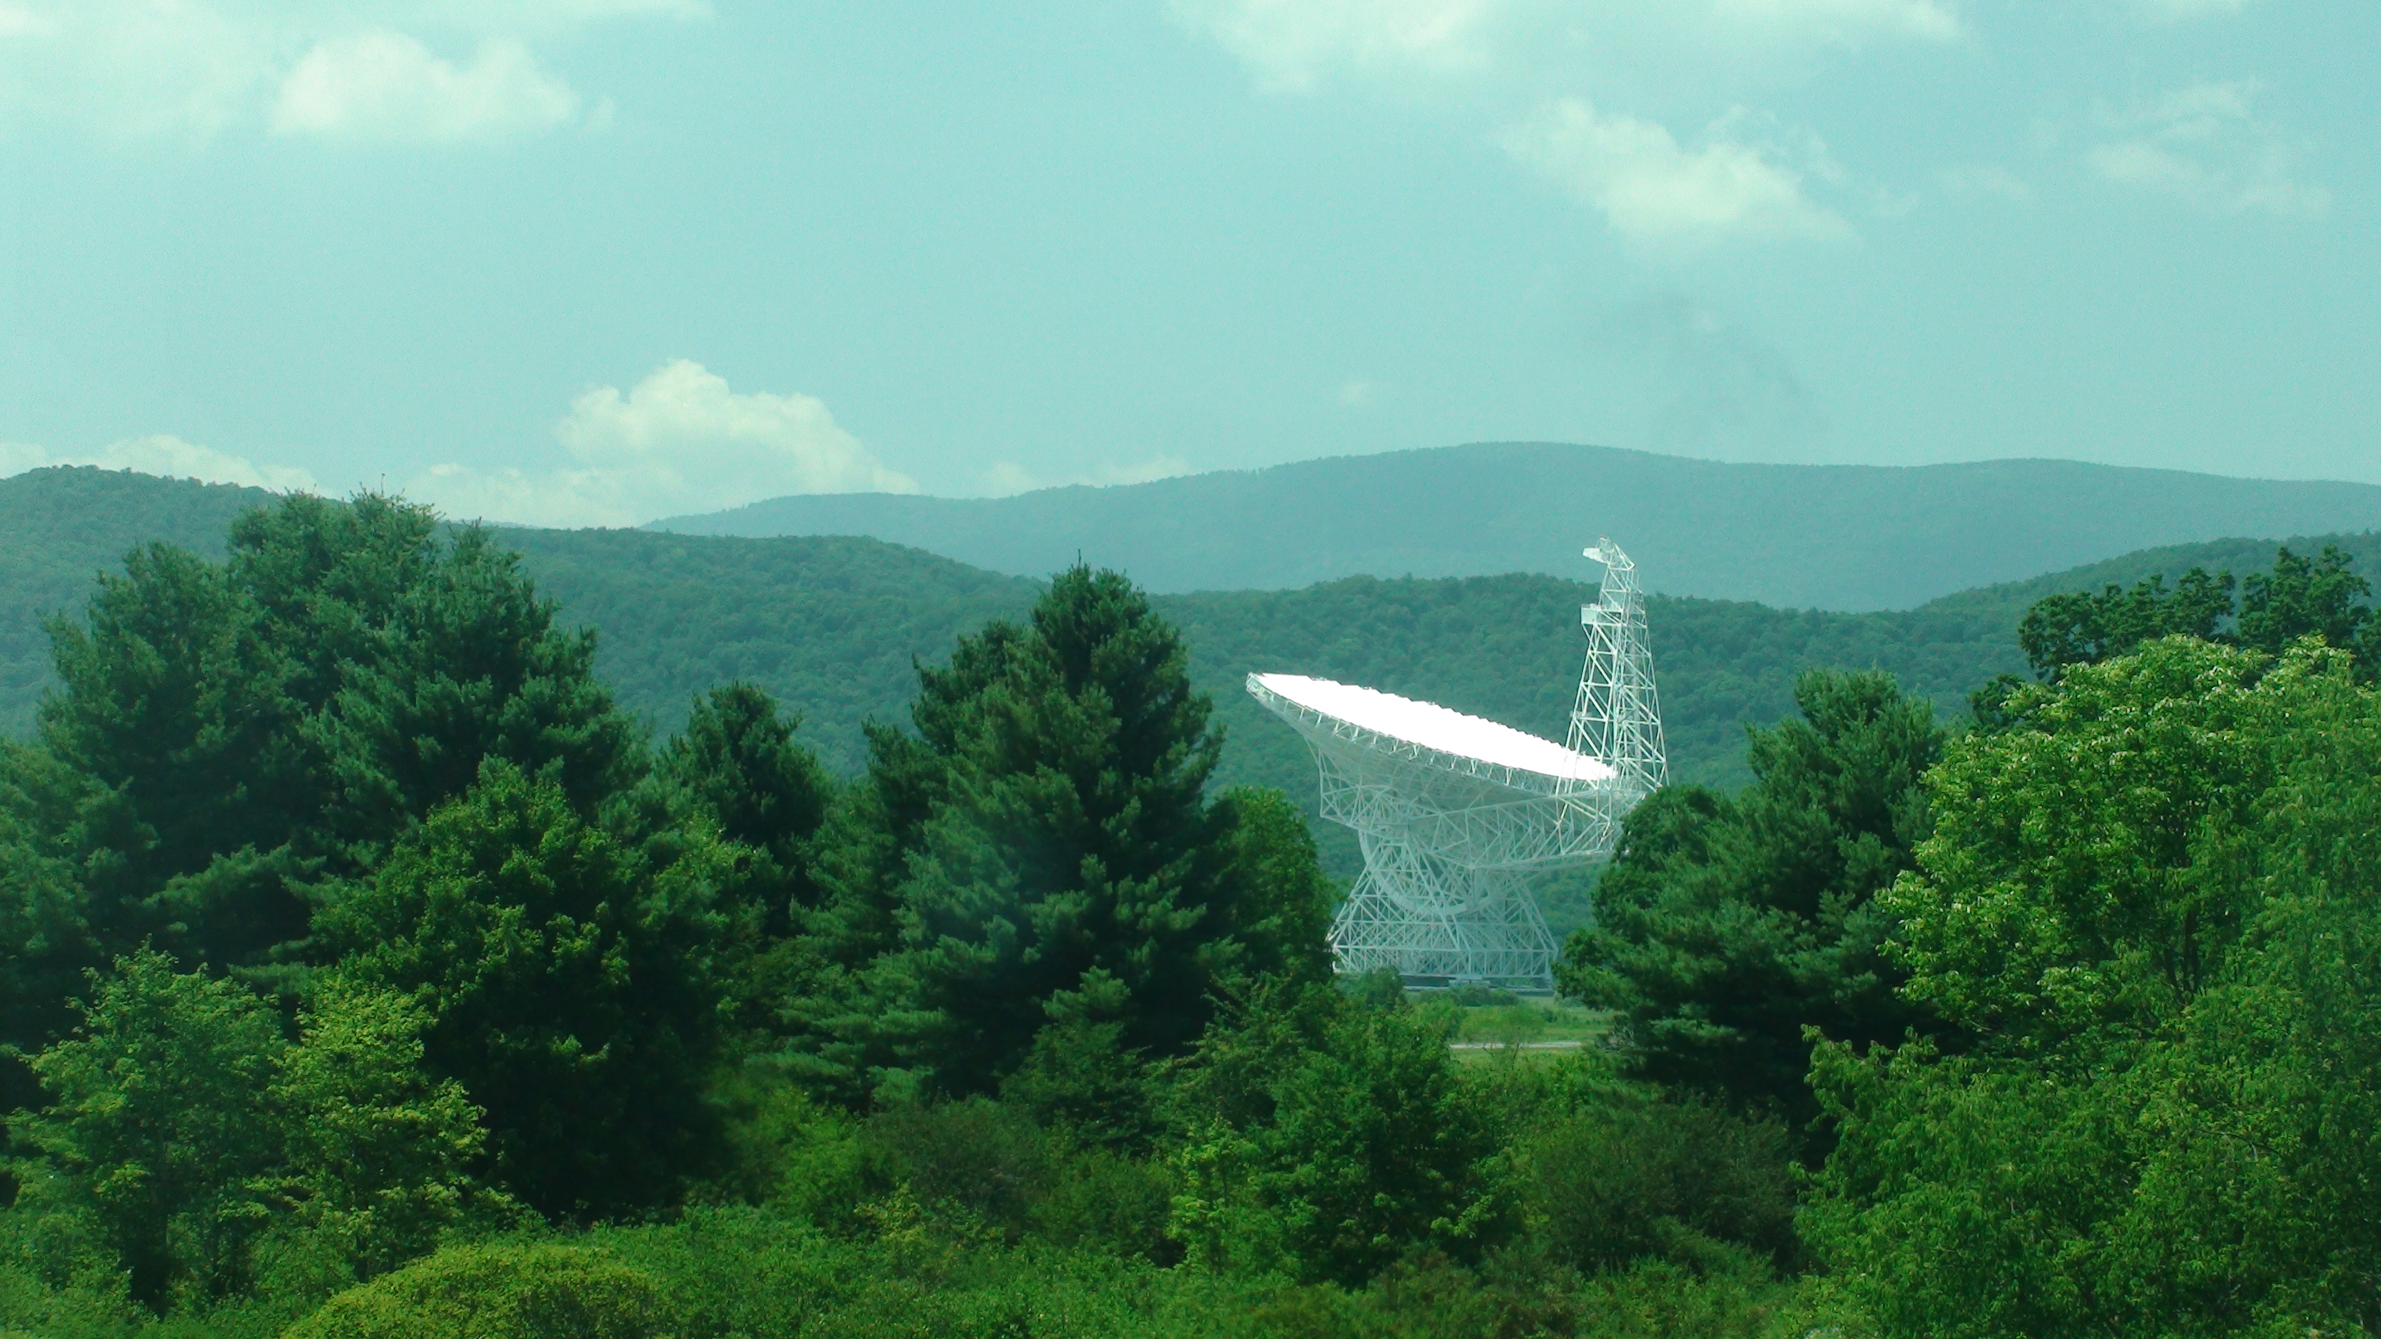
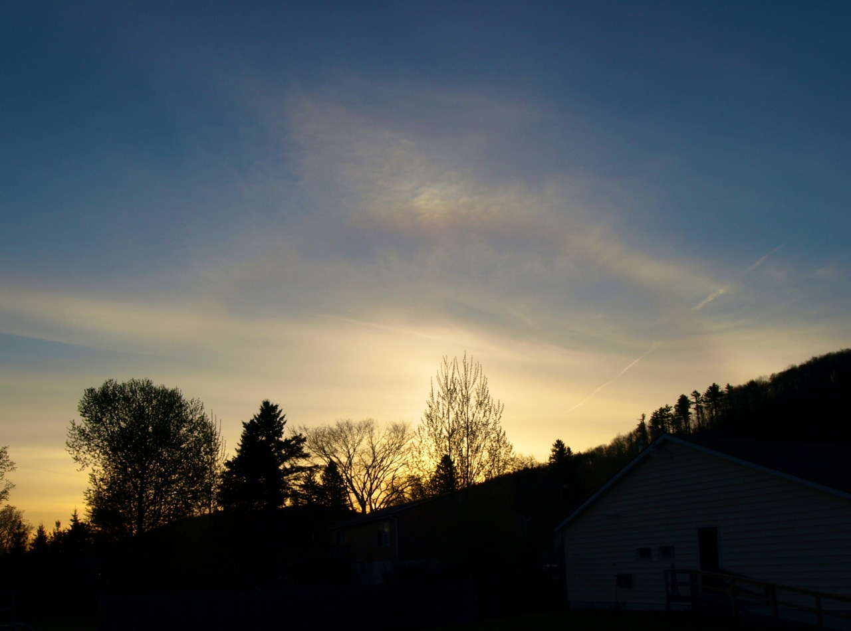
The End!

