Slide 1
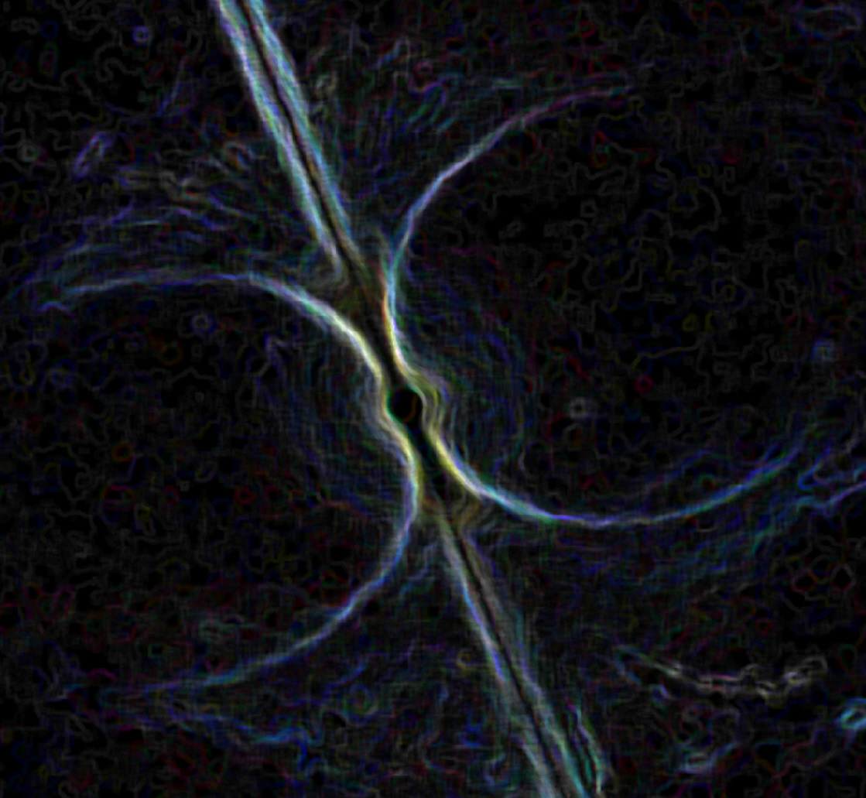
Team Hulse
Notes:
Intro to project
Show the data
Compare the results
Discussion
What questions going forward? What would you do if you still had time?

Slide 2
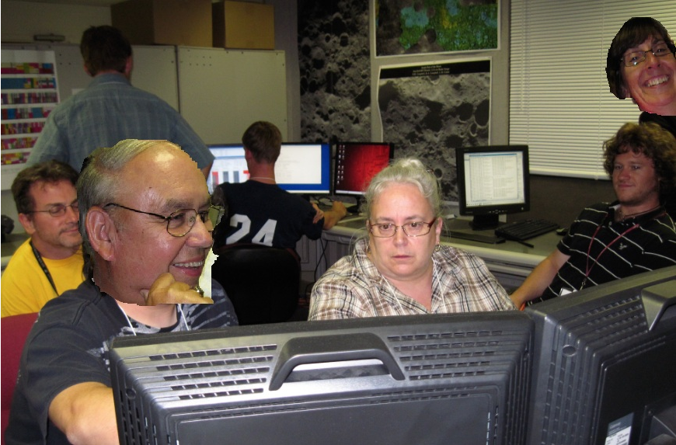
We’re pretty good with PhotoShop

Slide 3
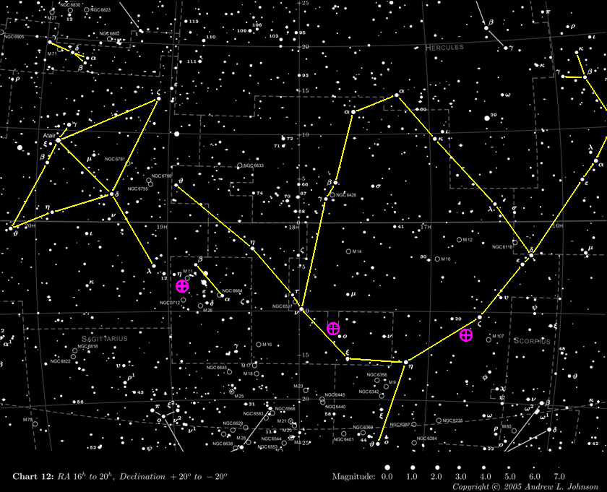
Sagitta
Altair
J1853-0649
Ophiuchus
Scutum
J1744-1134
Serpens Cauda
J1643-1224

Slide 4
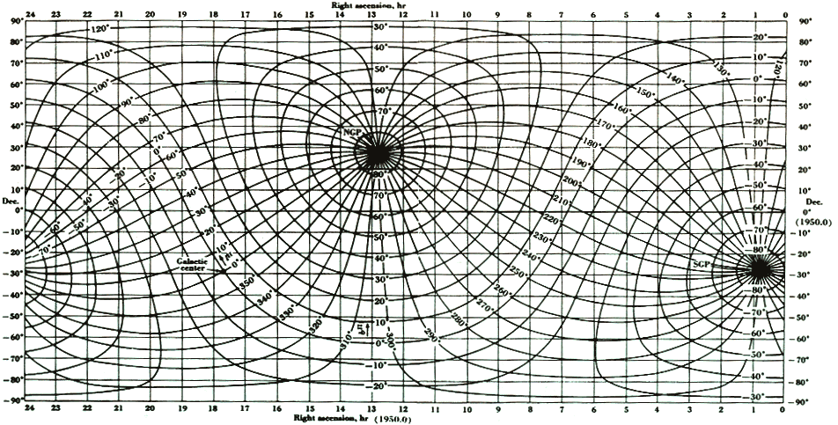
Notes:
(239.88:88.34) ,

Slide 5
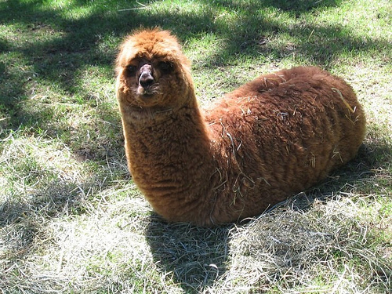
“J1630+8828”

Slide 6
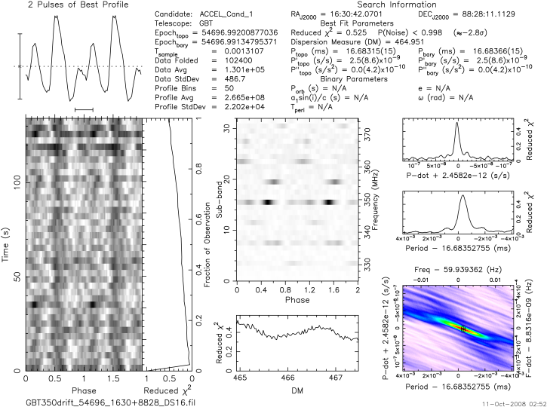
Notes:
RFI example

Slide 7
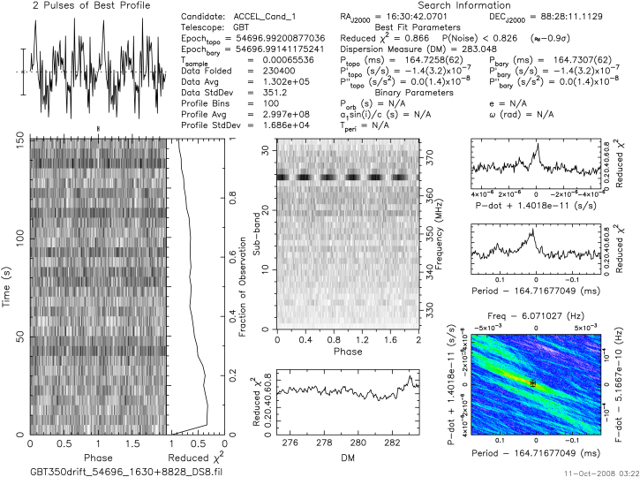
Notes:
RFI example

Slide 8
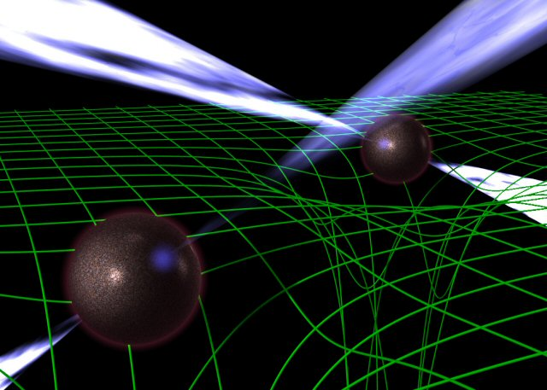
“J1643-1224”

Slide 9
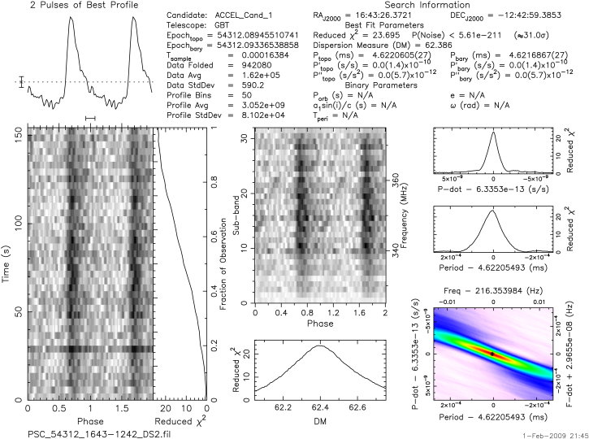
Notes:
16:43 at 350 MHz

Slide 10
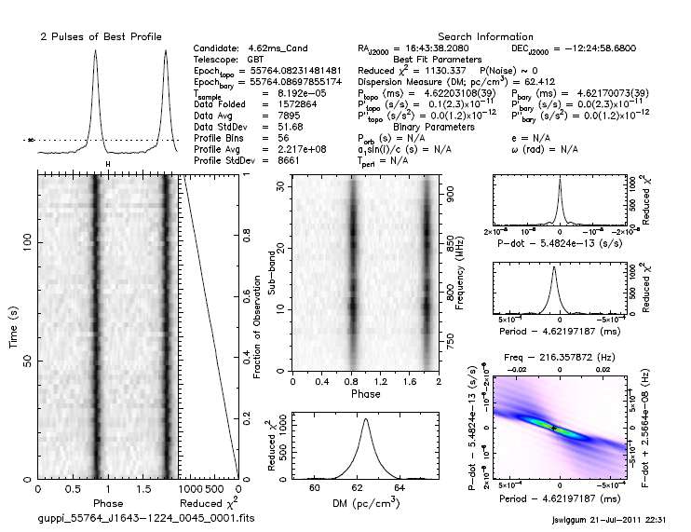
Notes:
16:43 at 820 MHz

Slide 11
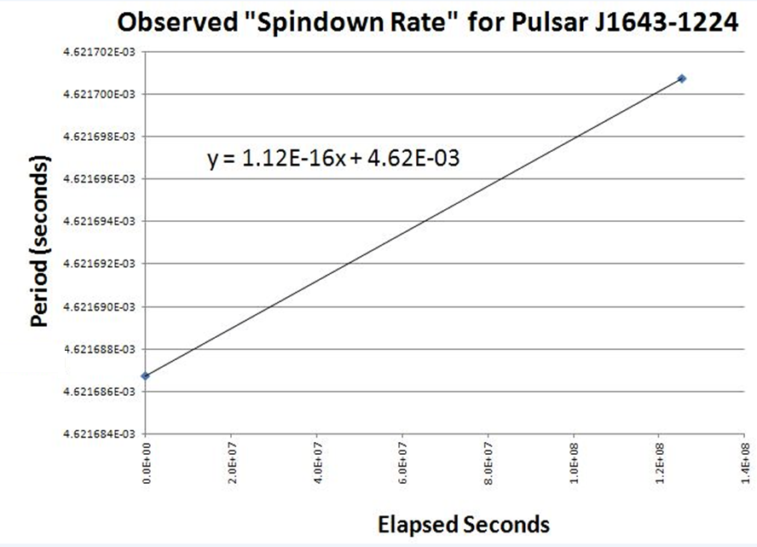

Slide 12
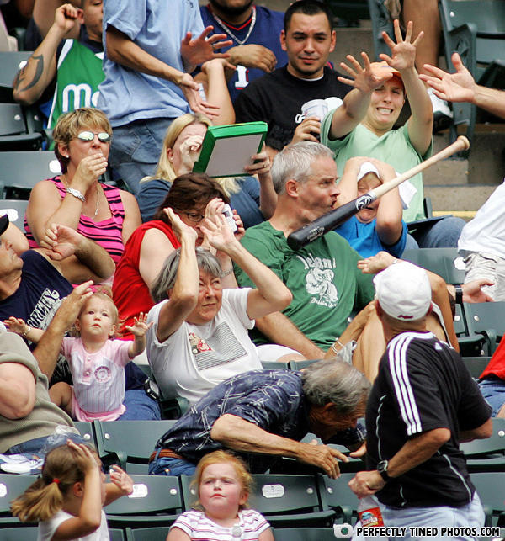
“J1744-1134”

Slide 13
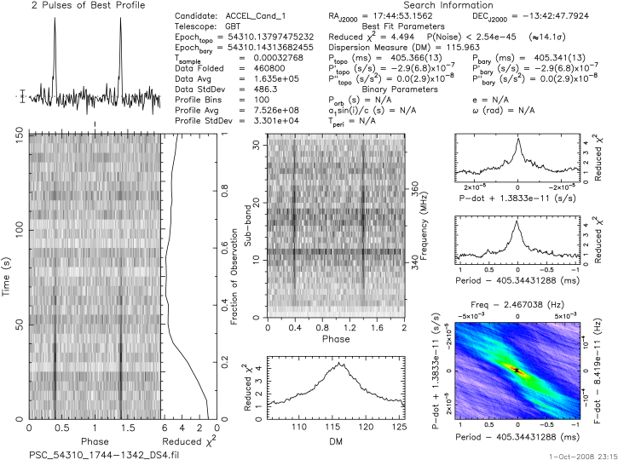
Notes:
17:44 at 350 MHz

Slide 14
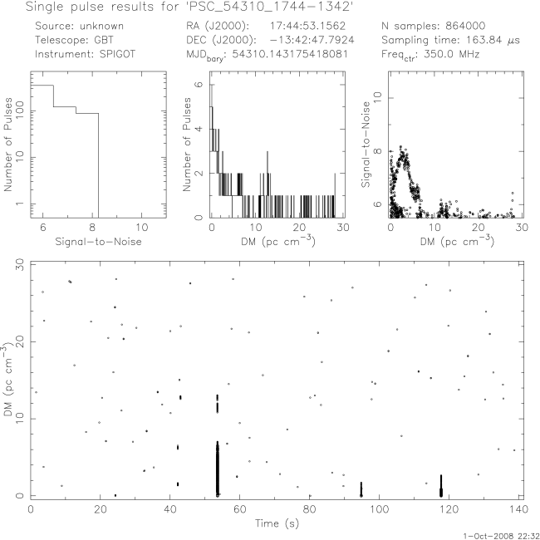
Notes:
17:44 at 350 MHz

Slide 15
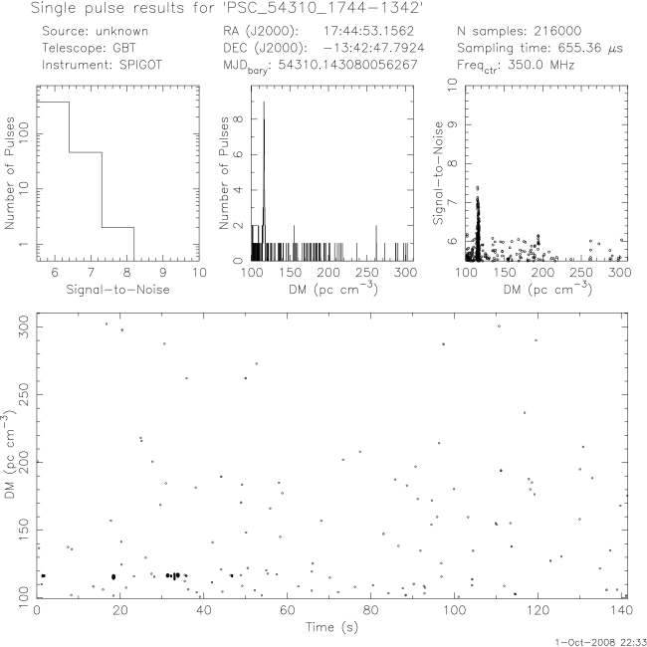
Notes:
17:44 at 350 MHz

Slide 16
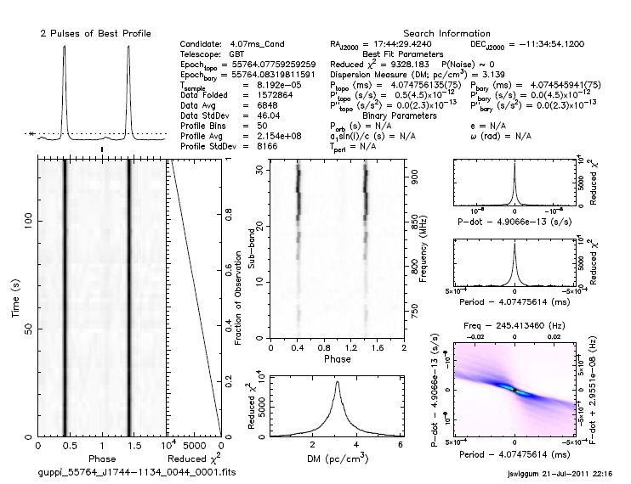
Notes:
17:44 at 820 MHz

Slide 17
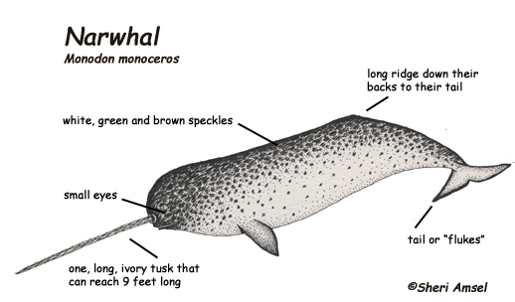
“1854-0649” …
or J1853-0649 they say

Slide 18
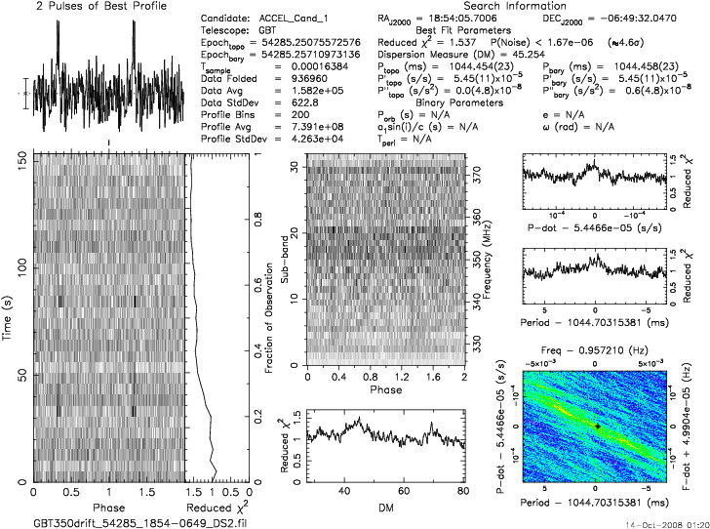
Notes:
18:54 at 350 MHz

Slide 19
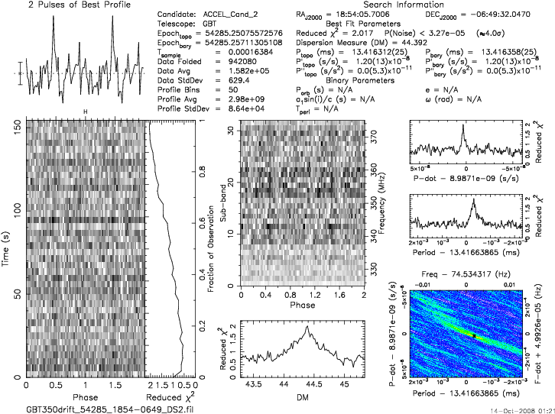
Notes:
18:54 at 350 MHz

Slide 20
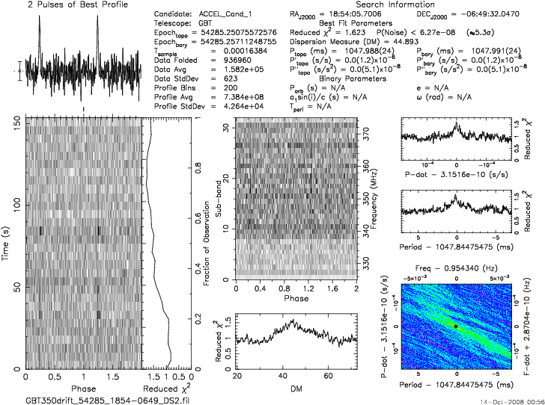
Notes:
18:54 at 350 MHz

Slide 21
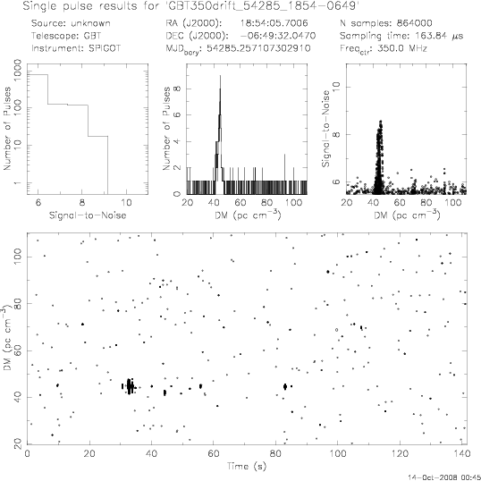
Notes:
Maura commented that this was “definitely a pulsar”
18:54 at 350 MHz

Slide 22
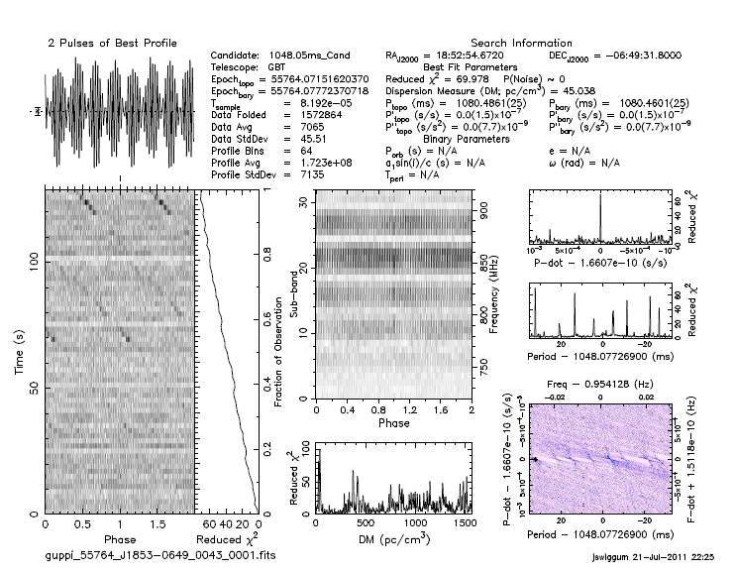
Notes:
18:54 at 820 MHz

Slide 23



350 MHz Viewing Area
$$θ=1.2\frac{λ}{D}$$
$$=1.2\frac{c}{Dν}$$
$$\frac{A_{820}}{A_{350}}=\frac{{350}^{2}}{{820}^{2}}=0.182$$
Viewable area approaches 100% with gridding
820 MHz Viewing Area

Slide 24
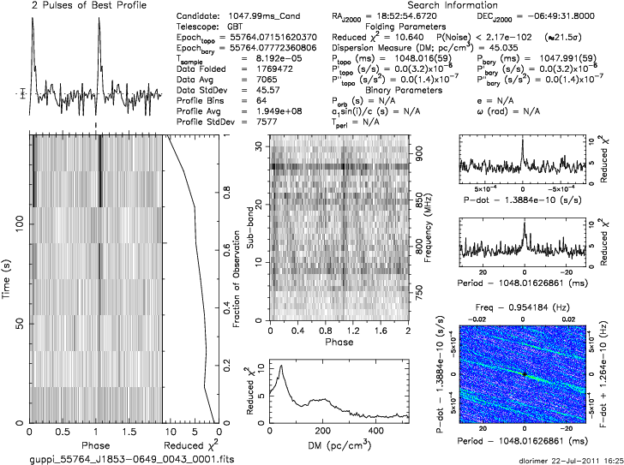

Slide 25

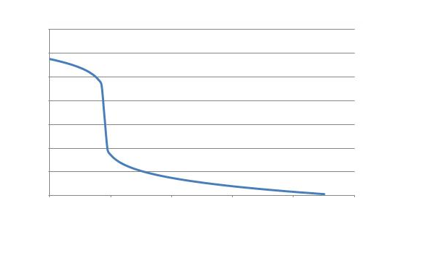
Interesting Anecdotal Inference

Slide 26
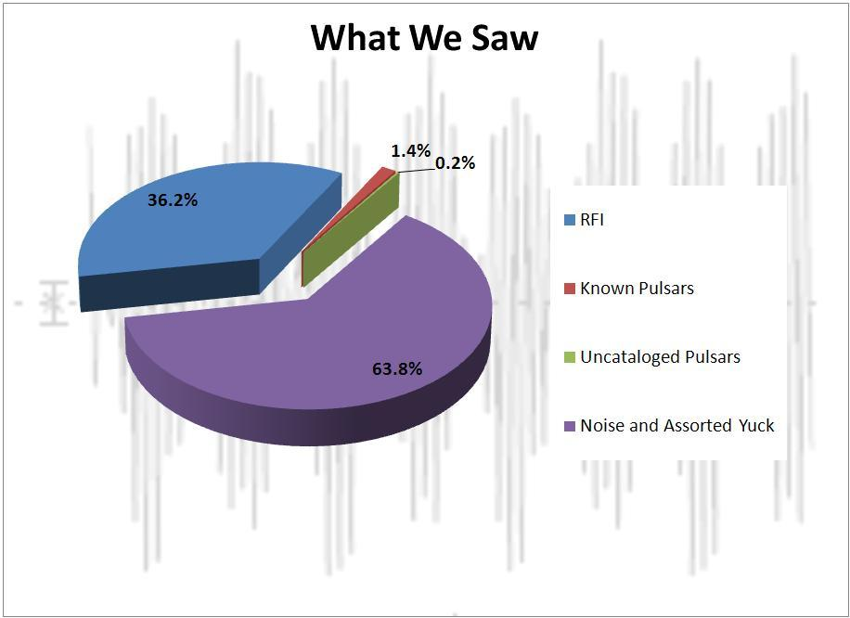

Slide 27
http://myurl.in/helpfulpulsardata

