Slide 1
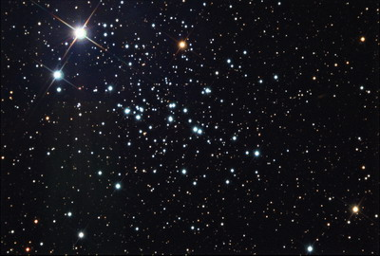
Pulsars
By: Team Taylor
Nic, Jurni, Hannah, and Ryan
With help from our amazing mentor NATHAN

Slide 2
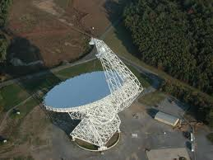
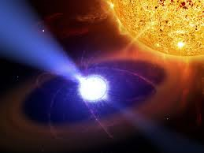
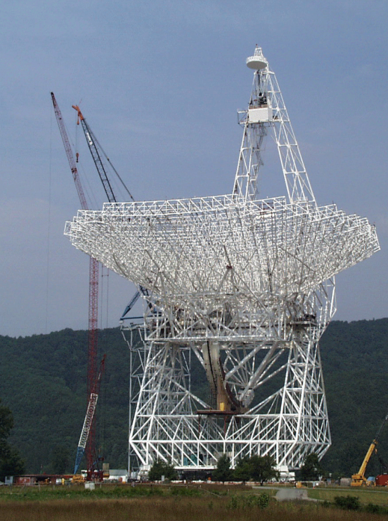
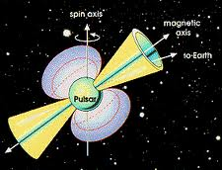
Original GBT Data

Slide 3
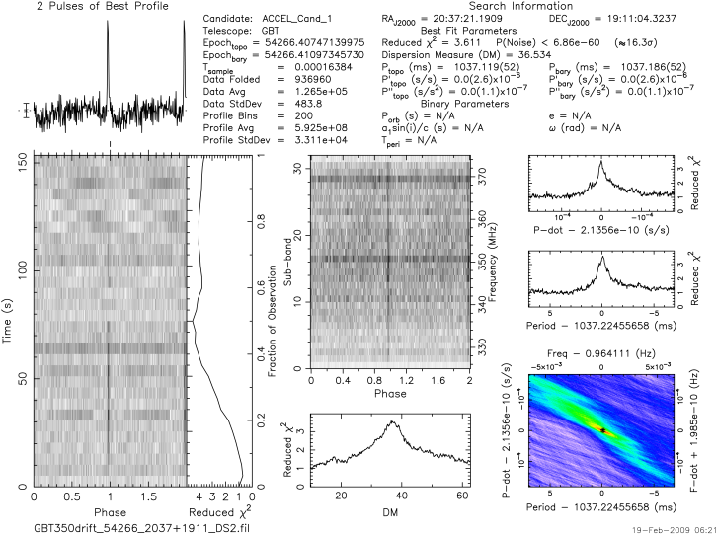
J2037+1911

Slide 4
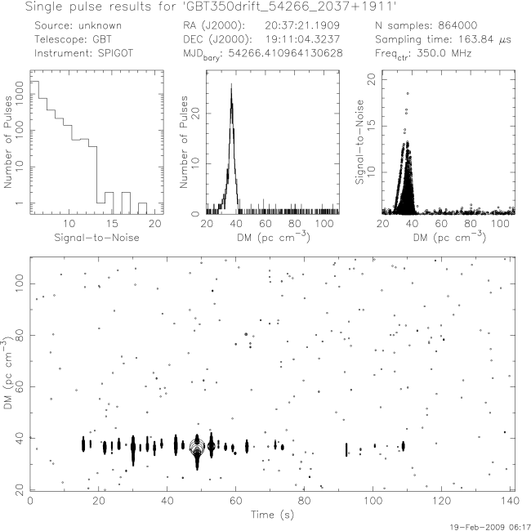
J2037+1911

Slide 5
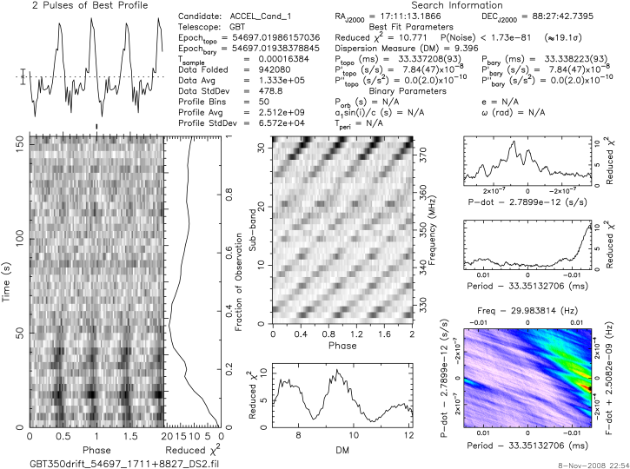
1711+8827

Slide 6
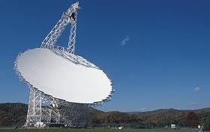
Recently Collected GBT Data

Slide 7
J2037+1942

Slide 8
1711+8827

Slide 9

Original Pulsar Data: J2037+1942
Recently Collected Pulsar Data: J2037+1942

Slide 10
Original Candidate Data:
1711+8827
Recently Collected Candidate Data:
1711+8827

Slide 11
Overall Observations
Known pulsar showed strong readings in both plots
Candidate assumed to be RFI
Period increases in both plots of original to collected.
Reduced χ² decreased slightly in the unknown plot readings
Reduced χ² increased dramatically in the known pulsar, J2037+1942

