Slide 1

Pulsars
Team Lyne

Slide 2
Members of Team Lyne
Tyler Farrell - Westosha Central High School, WI
Heather Frank - Fort Hill High School, MD
Annie B. Agee - Patrick Henry High School, VA
Emily Dick – Broadway High School, VA
Trent McDaniel – Langley High School, VA
Caitlin Ahrens - WVU (Student Mentor)
Ethel Perez – WVU (Student Mentor)

Slide 3
Our one week mission-To boldly go where no team of high school students has gone before.
  To sort through 15 data sets of Double Pulse Plots and Single Pulse Plots to identify pulsars.
  Observe our pulsar candidates with the Green Bank Telescope for an hour.
  Organize our data and present it to the group.

Slide 4
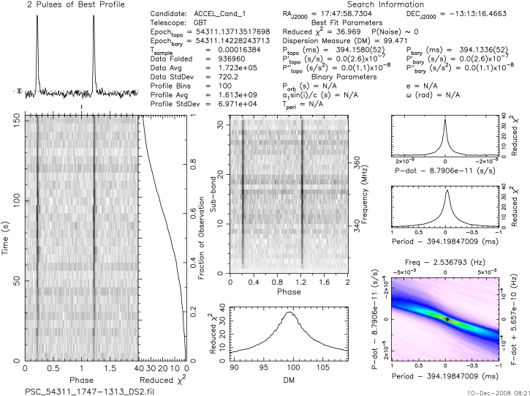
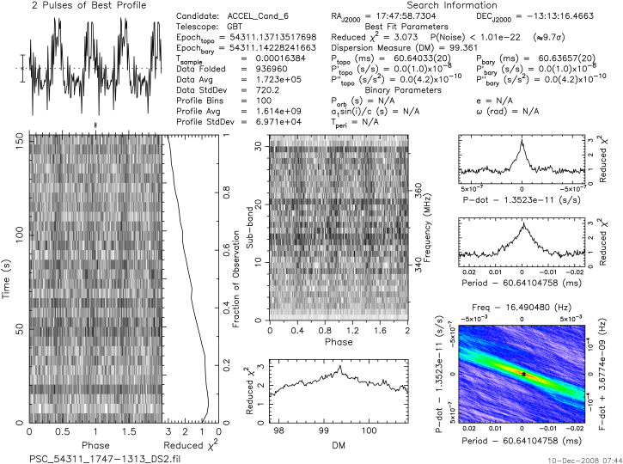
QUESTIONS WE HAD
Will we find new or already known pulsars?
How does interference affect the signal of pulsars?
Why don’t the Right Ascension, Declination, DMs, and periods match up ?

Slide 5
HOW
Our team split into two subgroups to sort through our assigned data sets.
We collaborated afterwards to prioritize what we wanted to view with our GBT time.
We found the best time for viewing our high-priority pulsars at the GBT with the program “Cartes du Ciel.”
We viewed our candidates at the Control Room.

Slide 6

Our Findings…
As of Thursday, we believed that we found-
  Two previously undiscovered pulsars,
  Four already discovered pulsars which we have identified,
  Many plots of RFI and noise.

Slide 7
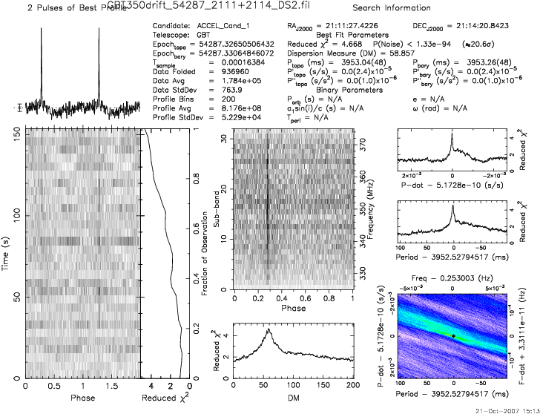
Pulsar Candidate 1
Not in catalog
Example number one
Double Pulse Plot

Slide 8
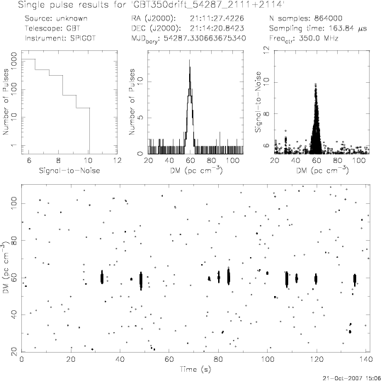
Pulsar Candidate 1
Not in catalog
Example number two
Single Pulse Plot

Slide 9
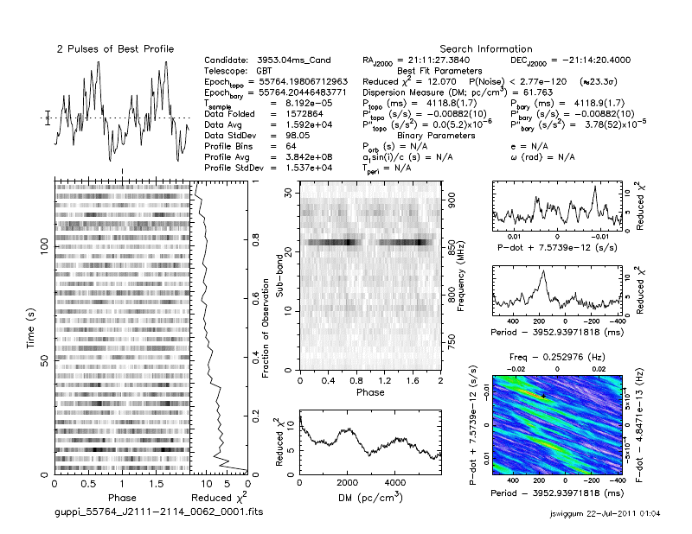
Pulsar Candidate 1 viewed with our GBT time
The wrong declination was used to look at this pulsar; on our list, the declination was supposed to be positive, but somewhere along the line, it was recorded as negative.

Slide 10
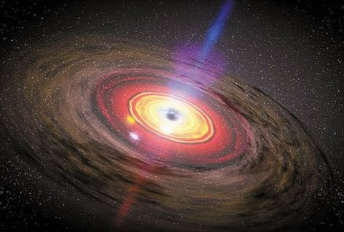
J2111+2114
The pulsar we found in one of our data sets has been recently discovered, and therefore not in the catalog.

Slide 11
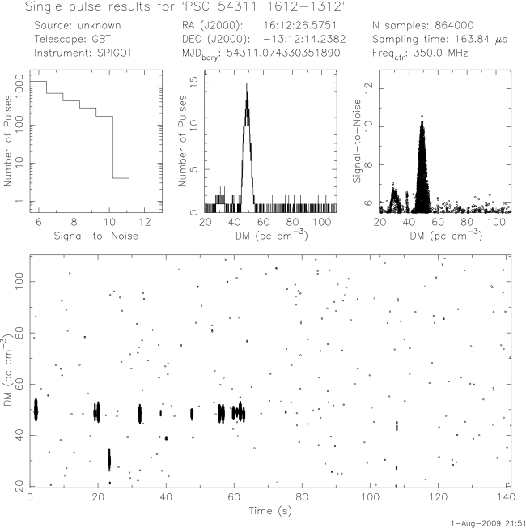
Pulsar Candidate 2
Found in catalog
Example number one
Single Pulse Plot

Slide 12
Pulsar Candidate 2 view with our GBT time
The beam was too small to find the pulsar, so we do not have GBT data from Friday.

Slide 13
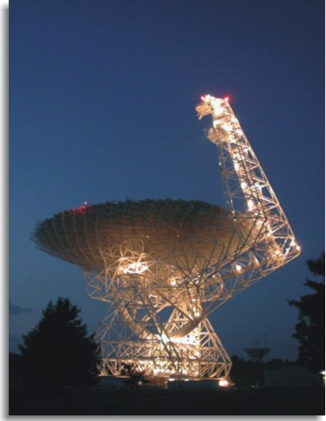
If we had more time…
Look at J2111+2114 with the GBT with the correct declination.
Look at J1742-1610, a known pulsar.
Research a few more known pulsars we found in our data set.

Slide 14
Questions that remain
What other information does the GBT collect?
Can we ever eliminate all interference from the plots?
How do you determine if a pulsar is in a binary system?
Will we ever discover what the inner core of a pulsar is composed of?

