Slide 1
Pulsar Data Search Evaluation
Wyatt Booth
Tiara Diaz
Spencer Shabshab
Katie Stroup
Crista Williams
Hiwot Abate
Notes:
Katie

Slide 2
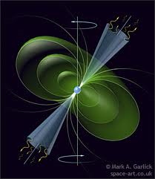
Mission Statement
For the past week, team Bell has been searching the sky for pulsars with the Green Bank Telescope. Our objective is to identify new pulsars, provide new data on known pulsars, and to identify sources of unwanted radio frequency interference.
Notes:
Katie

Slide 3
The Query
Our group has worked to answer the following questions: “What are the locations of pulsars relative to the earth,” and “Can these pulsars be utilized to draw conclusions or postulations about our universe?”
Notes:
Spencer

Slide 4
The Search
For five weeks, the immobilized GBT swept the sky, collecting over 130 terabytes (130,000 gigabytes) of data about radio signals from outer space.
Team Bell’s job is to review the data that the GBT has collected, and to identify any extraordinary signals while designating signals that may be pulsar “candidates.”
Notes:
Tiara

Slide 5
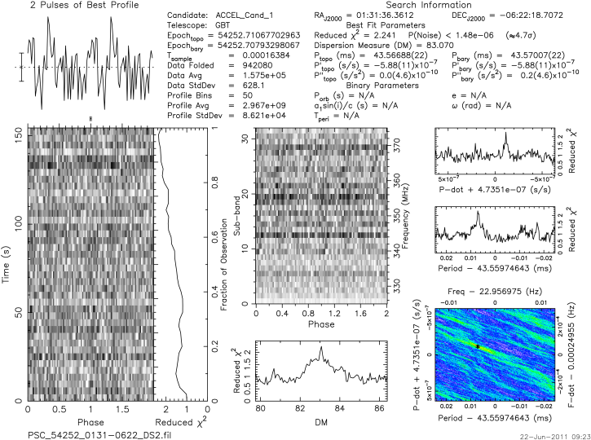
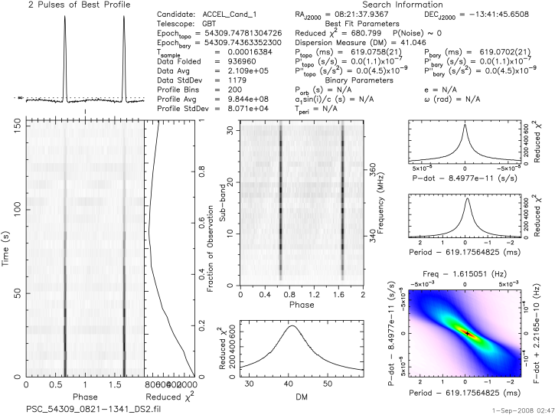
What We See:
Noise- no distinct signal
Pulsar Candidate
Notes:
Tiara

Slide 6
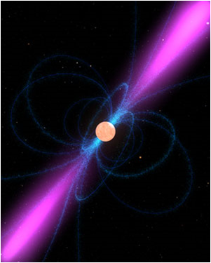
Artist’s rendition of a pulsar:
http://www.nasa.gov
Notes:
Hiwot

Slide 7
The Exotic Properties of a Pulsar
They possess an extremely high density; the density of an atomic nucleus!
They spin at an almost inconceivable speed- one known pulsar rotates around 716 times per second.
Their strong magnetic fields produce very strong beams of radio waves at its magnetic poles. The apparent “pulsation” that results from the rotation of the poles is how we identify a pulsar.
Notes:
Tiara

Slide 8
Data Analysis
Our group analyzed the data by looking at plots of the radio signals that the GBT has received and folded.
We search for evidence of a strong, periodic, broadband signal, which would indicate the possible existence of a pulsar at the pointing.
We also observed the DM readings of the signal, so as to ensure that any perceived signal is not emanating from the earth.
Notes:
Spencer

Slide 9
What We Found:
Analyzed data from 13 different pointings
We discovered 3 known pulsars
Identified 5 instances of radio frequency interference
Submitted 2 data sets as pulsar candidates.
Notes:
Wyatt

Slide 10
Our Time With the GBT:
In the hour that was graciously allotted to us with the GBT, we were unfortunately plagued with strong radio frequency interference that could not be compensated for. Our data was compromised. While our time didn’t produce the same success that we see in the more popular examples of the search for pulsars, the obstacles that we encountered are actually representative of some of the issues that astronomers deal with in their tireless search.
Notes:
Wyatt

Slide 11
Looking Back:
Our search was ultimately inconclusive, and our only regret is that we could not read the signal from our pointing through all of the interference.
We would be interested in knowing the source of the RFI, and we wish that we had the time to revisit our pointing, do a wider search, and take the opportunity to get a clearer look at our candidates.
Notes:
Crista

Slide 12
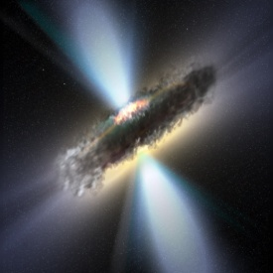

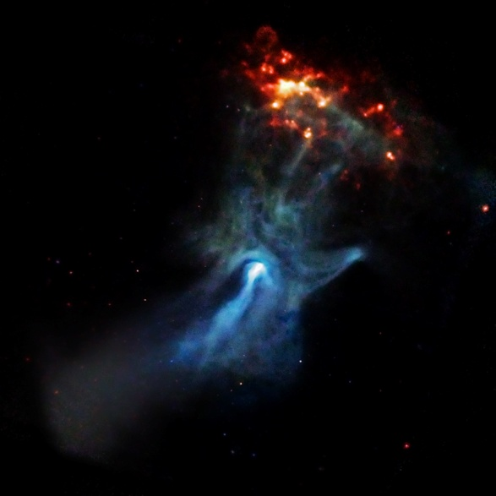




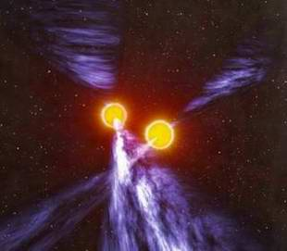




Also..Pulsars are not creatures from another dimension…
or Pokémon.
Notes:
Hiwot

