Slide 1
July 2011 GBT Observation
Team Parkes
Team Parkes
Janet Bree John
David Beth Debbie

Slide 2
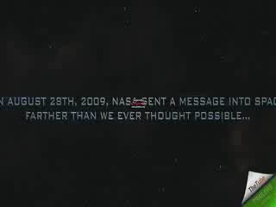

Slide 3
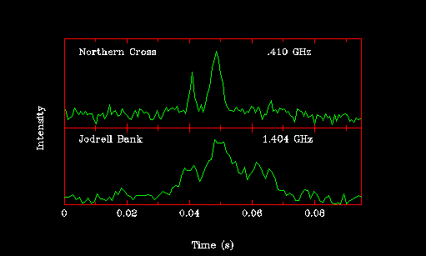


Slide 4
Purpose
Practice assessing pulsar plots
Discover new pulsar candidates
Refine knowledge of known pulsars

Slide 5
GBT Conditions
Summer 2007
350 MHz,50 MHz
35’ field of view
Objects drifting across field of view
Signal strength could change during scan
July 21, 2011
820 MHz, 200 MHz
12’ field of view
Object is tracked by GBT
Signal strength is constant during scan

Slide 6
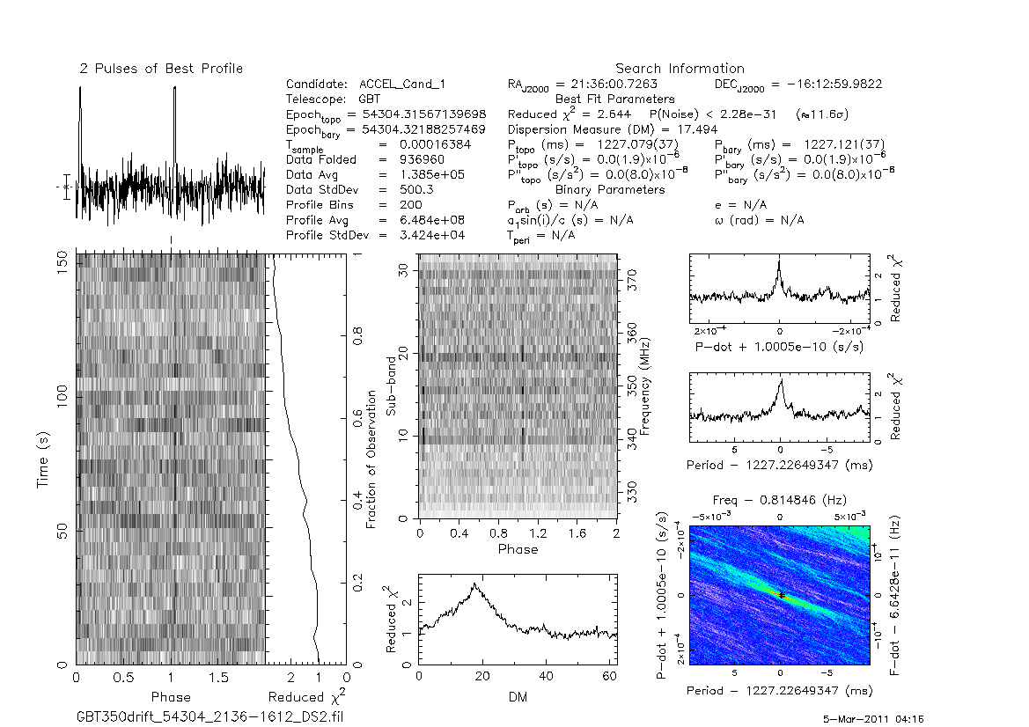
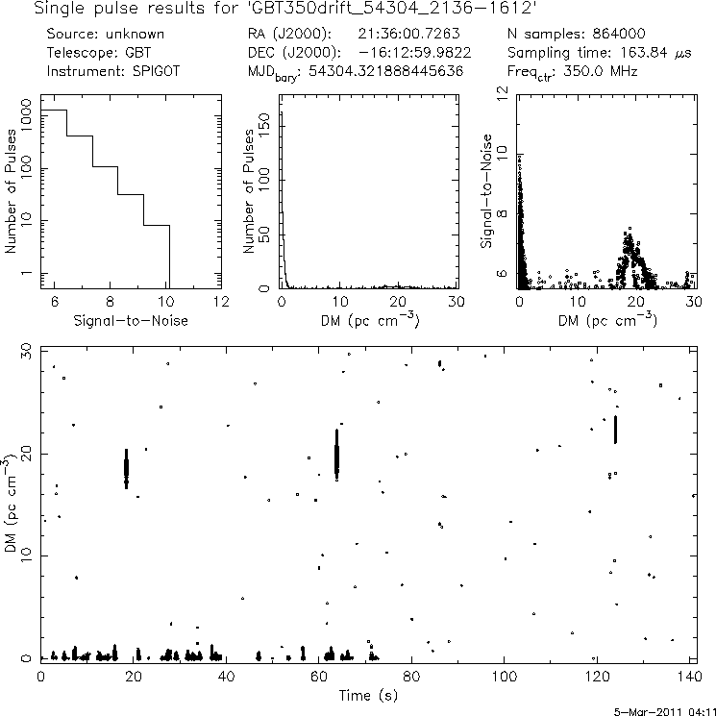
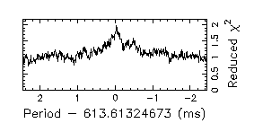
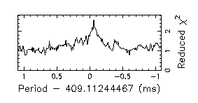
#1 Candidate 2136-1612

Slide 7
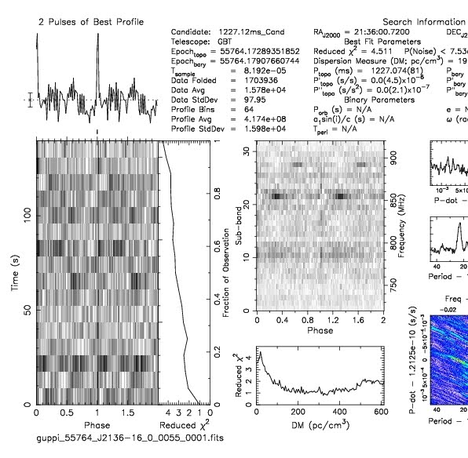
#1 Candidate 2136-1612 Results
July 21 GBT folding
Refolded at new pulsar period

Slide 8
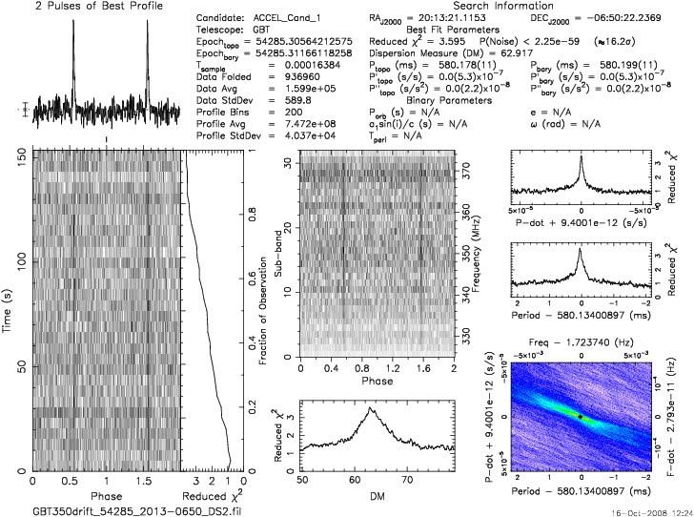
#2 Candidate 2013-0650
J206-087
  DM 32.4
  Period 0.580
Unknown
  DM 63
  Period 0.580
ATNF radius search
What is the maximum number of plots in one pointing?

Slide 9
#2 Candidate 2013-0650 Results
DM = 63.5
DM = 31.8

Slide 10
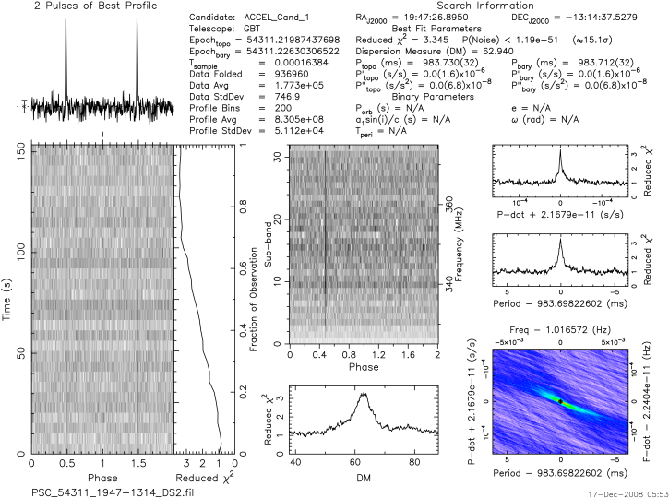
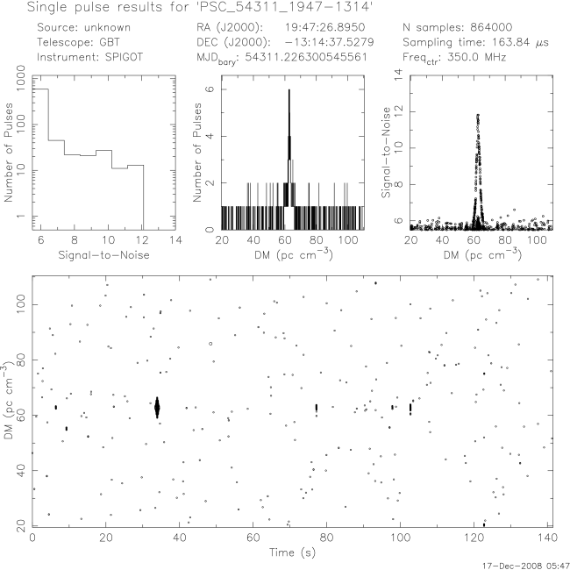
#3 Candidate 1947-1314
Known Pulsar
J1943-1237
Period differences

Slide 11
#3 Candidate 1947-1314 Results

Slide 12
Results Summary
2136-1612 we confirmed position at 820 MHz for a pulsar identified by a PSC student astronomer
2013-0650 identified by a PSC astronomer but listed in another catalog, not the ATNF
2013-0650 density flux
1947-1314 poor plot, RFI

Slide 13
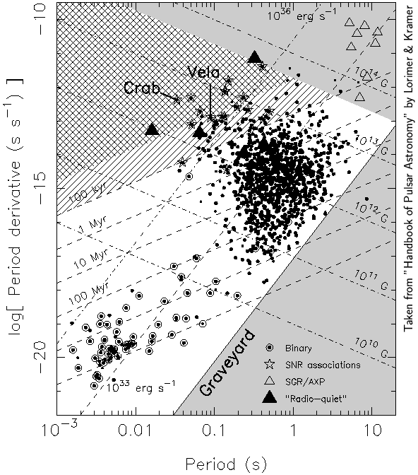
Graveyard Graph (P P dot Diagram)
Pulsar | Period (s) | Pdot residual (s/s)
2013-0650 | 0.5 | 2x10⁻¹⁰
2136-1612 | 0.4 | 5x10⁻¹³
2013-0650
2136-1612

Slide 14
Discussion/Conclusion
2013-0650 and 2136-1612 are young based on Graveyard Graph
2136-1612 can now be published with more accurate coordinates from 820 MHz.
2136-1612 results at conflicting periods and DM?
Computer analyses can’t be rushed

Slide 15
Future Work
Accuracy of Pdot calculations for Graveyard graph?
Density flux calculations
Rescan 1947-1314 with no RFI

Slide 16
Acknowledgements
NRAO
NSF
WVU
Sue Ann Heatherly
Sarah Scoles
Jeff Chaffins
Joe Swiggum
Peter Gentile
Duncan Lorimer
Maura McLaughlin

Slide 17
Please Stand
Sing to the tune of:
I’m a Little Teapot
I’m a little pulsar,
Fast and bright
Here is my axis,
Here is my light,
When my spin gets slowed I lose my life,
But neighbor stars can make me right.

