Slide 1

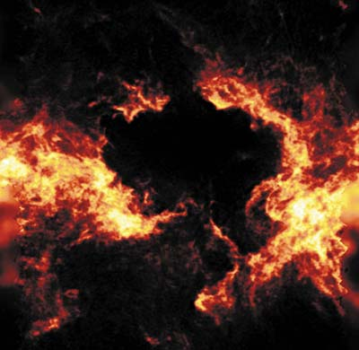


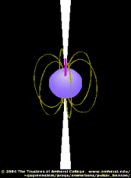
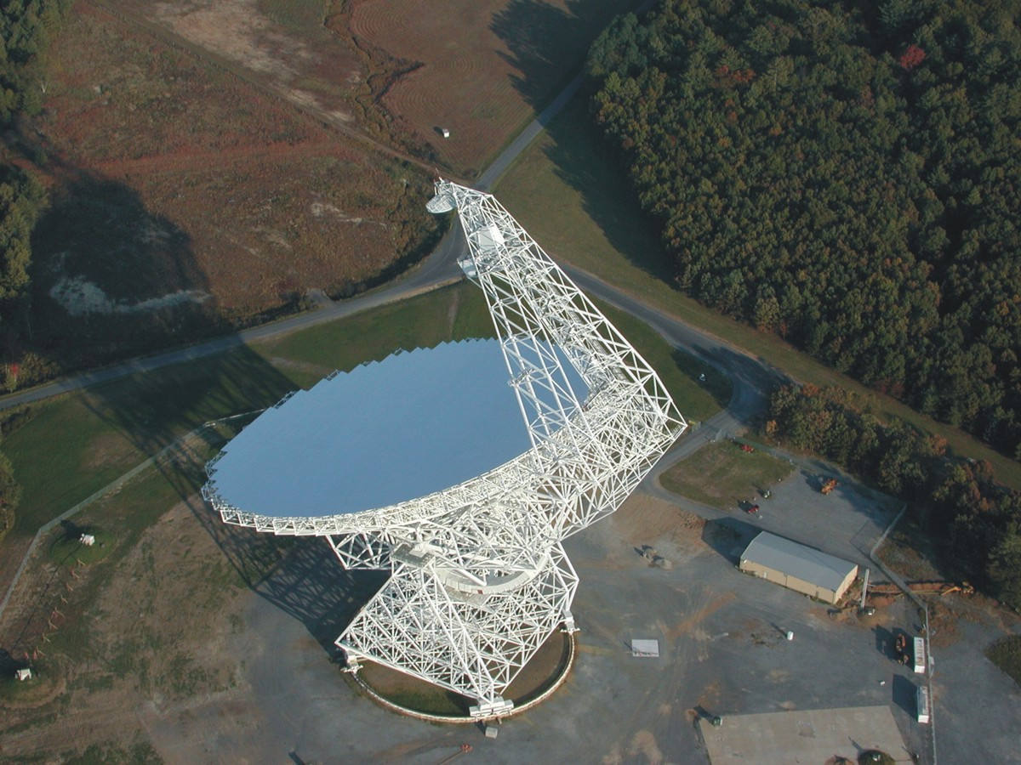
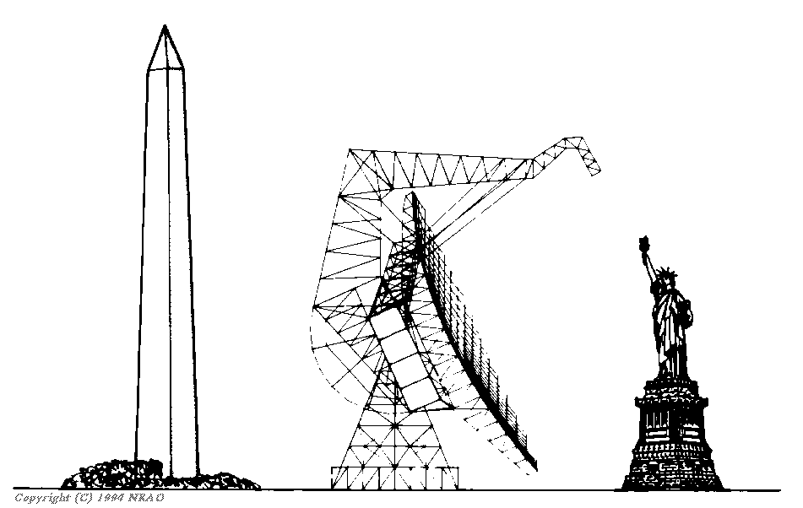
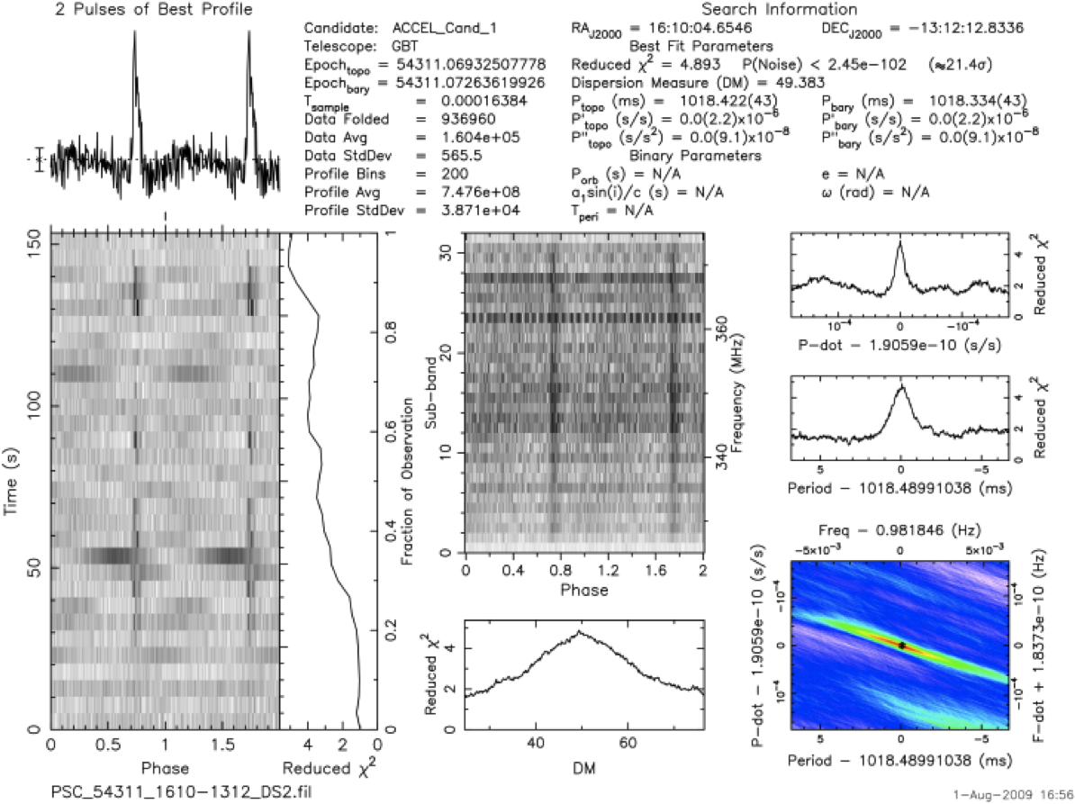
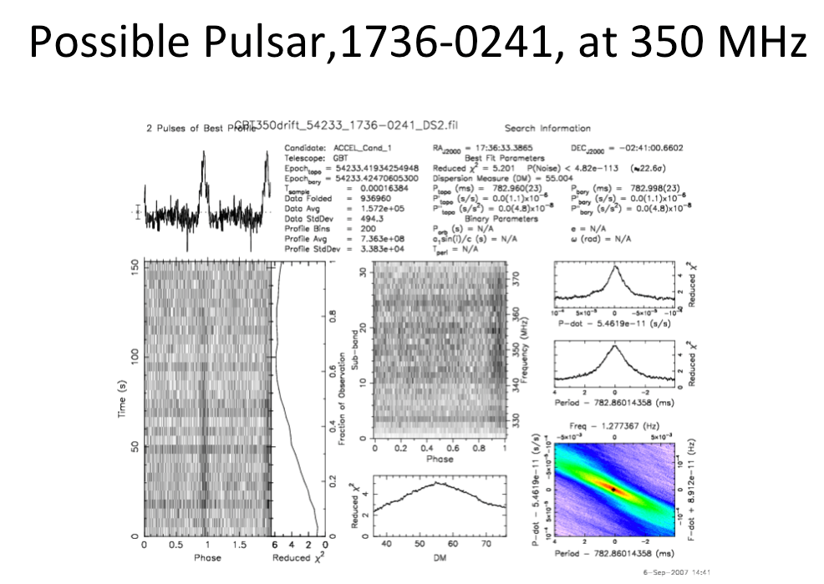
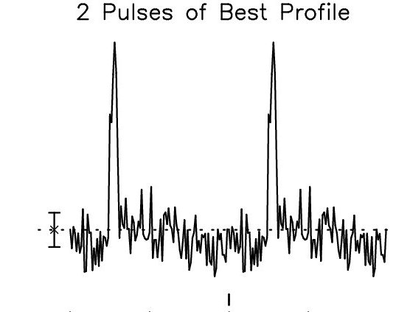
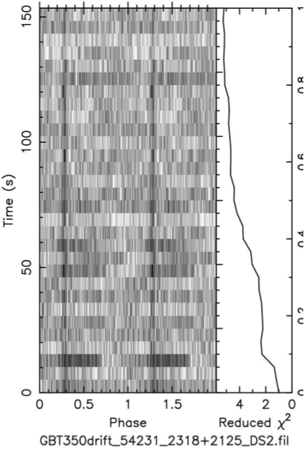
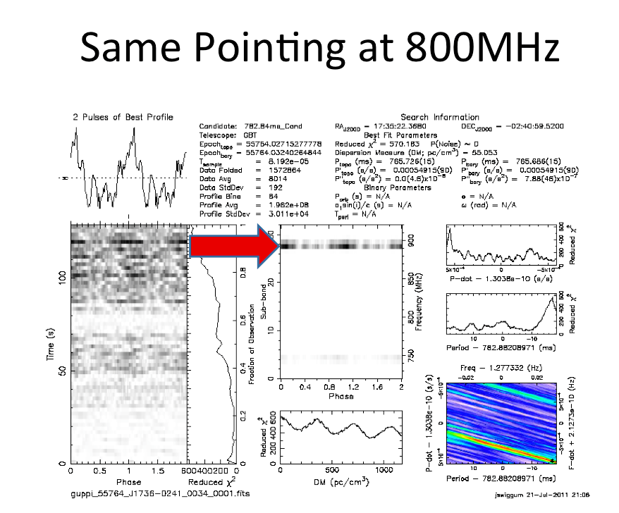
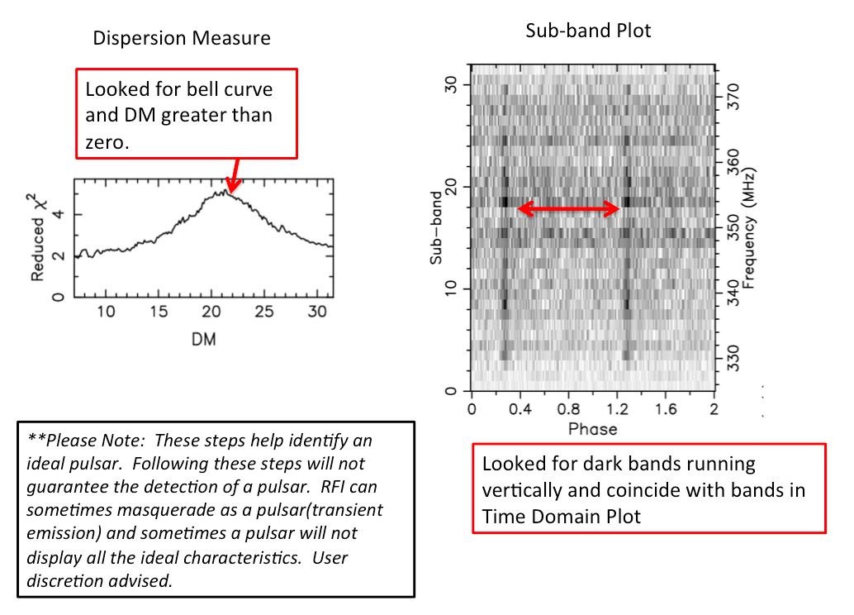
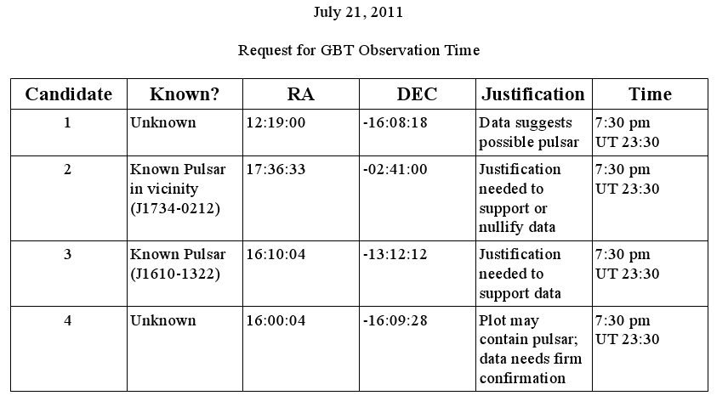
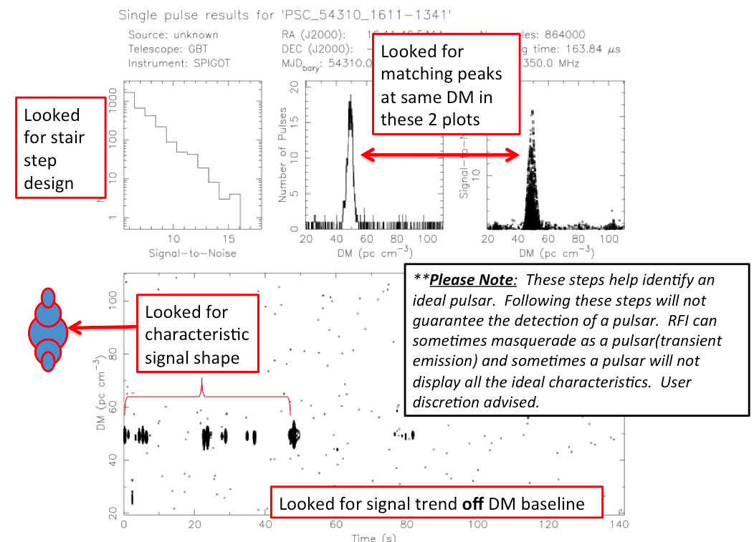
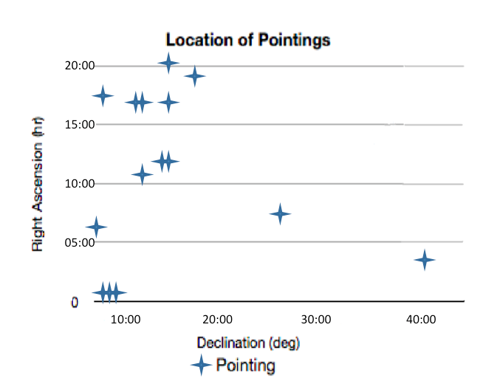

Team Jodrell
Mark Beal, Melinda Carpenter, Mauricia Casilac,
Joyce Corriere, Fred Hoffman, Jocelyn Virtudes
Abstract
Pulsars are highly magnetized, rotating neutron stars
that emit a beam of electromagnetic radiation. The radiation can only be observed when the beam of emission is pointing towards the Earth. This is called the lighthouse effect and gives rise to the pulsed nature that gives pulsars their name. Some reasons that scientists look for pulsars is to study physical phenomena that they can not study in labs, such as black holes and the effects of extreme electromagnetic and gravitational fields moving through space at high speeds.
Our goal in looking at the given data sets was to become more familiar with the GBT and pulsar detection. Also, we were given data that had not previously been seen, making identifying an unknown pulsar, possible. Through these exercises, we hope to become more adapt at identifying pulsars, noise, and RFI.
Our results were that the GBT data confirmed the known pulsar data, J1610-1322. The second plot analyzed was a possible pulsar candidate, 1219-1608 was not confirmed by 2nd GBT grid plot pointing. Our 3rd plot, 1736-0241, was located adjacent to a known pulsar, but could not be located during 2nd GBT grid plot pointing. Our 4th plot, 1202-1608, was not view during our allotted time, but will be up for review in the future as a possible pulsar.
.
Characteristics of a known pulsar given a prepfold plot
Fig. 1.— Left panel: A prepfold plot of the known pulsar 1610-1322at 350 MHz.
Figure 2- Right Panel-:A prefold plot of the known pulsar 160-1322 using the GBT at 820 MHz.
Features | Description
Wave Profile | the peak should be sharp and distinct
time series plot | there should be very distinct line from top to bottom
greater x² value | tells us that the signal is less likely to be noise
sub band | there should be distinct lines that go across wide range of frequency
Dispersion Measure | should have a distinct peak above zero and it should be within the projected DM range based on the website program
period | it should be greater than 1 millisecond and up to 8.5 seconds based on period range of known pulsars
Steps used to analyze data
Method
First we looked at data from the database. Each pointing has approximately 30 diagnostic plots which are composed of more or less 25 Prep fold plots and 5 single pulse plots.
We checked and analyzed diagnostic pulsar plots under each pointing using a scale of 1 to 3, with three being the most likely pulsar candidate. We also eliminated plots based on characteristics of obvious RFI or noise. The findings were further reaffirmed using the ATNF catalog to find out if they have been published or known already.
We then compiled a list of the best candidates for further observation on the GBT. Using CLEO, we assured that all of our potential plots would above the horizon during a one hour GBT observation allotment.
Looked for peaks well above the noise and wider than the peak width gauge.
Reduced Chi² needs to steadily increase and generally be higher greater than 3.
Looked for dark bands running vertically and coincide with peaks in Avg. Pulse Profile
Data
Using the database, the team analyzed a total of 510 pointings, three of which were pulsar candidates, and one known pulsar. Our candidates are summarized in the table below. The purpose of this poster is to verify and re-analyze the data based on the known pulsar plot characteristics.
Conclusion:
The GBT data confirmed the known pulsar data, J1610-1322.
The second plot analyzed was a possible pulsar candidate, 1219-1608 was not confirmed by 2nd GBT grid plot pointing.
Our 3rd plot, 1736-0241, was located adjacent to a known pulsar, but could not be located during 2nd GBT grid plot pointing.
Our 4th plot, 1202-1608, was not view during our allotted time, but will be up for review in the future as a possible pulsar.
At 800 MHz we found a definite narrow-band RFI signal in our second candidate. Some of our original plots at 350 MHz also, included well defined narrow band RFI, but most were deemed broadband RFI or noise.
We analyzed 15 pointings, each with about 34 plots. The following table displays our four best candidates.
.
Why Join the Pulsar Search Collaboratory?
Students have the chance to work side by side with real radio astronomers and engineers to understand physical phenomena that could not be studied in an actual lab. This program inspires students to reach for the stars and reach their full potential in science, engineering and technology.
Our data resulted in 75% noise, 23% RFI, and 2% Known Pulsar

