Slide 1

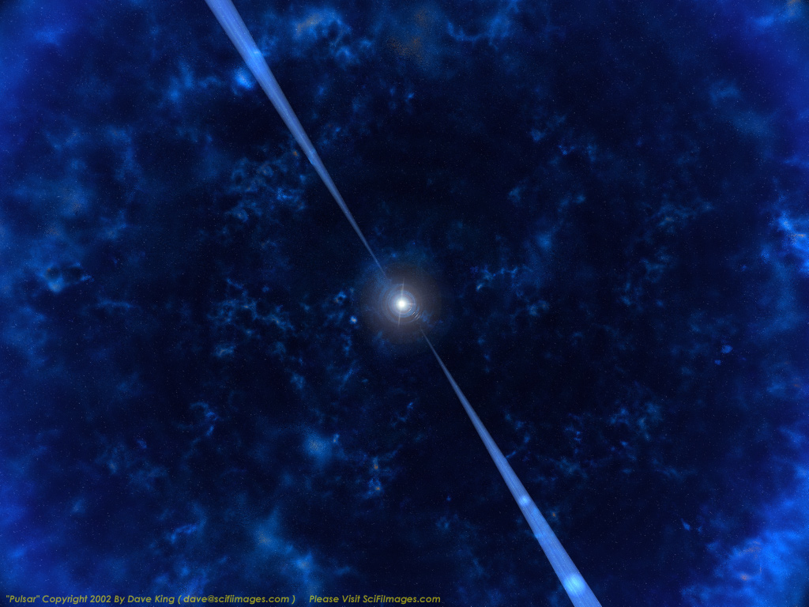
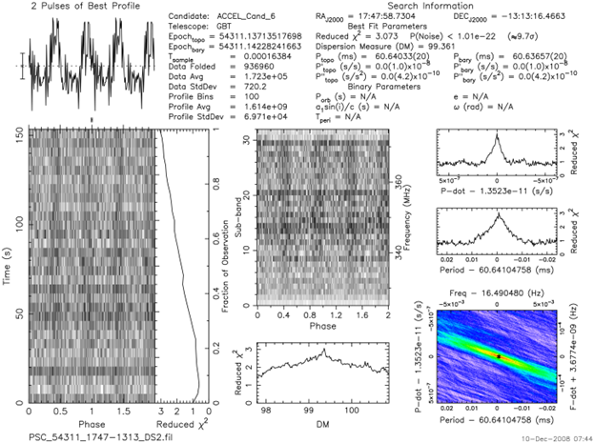
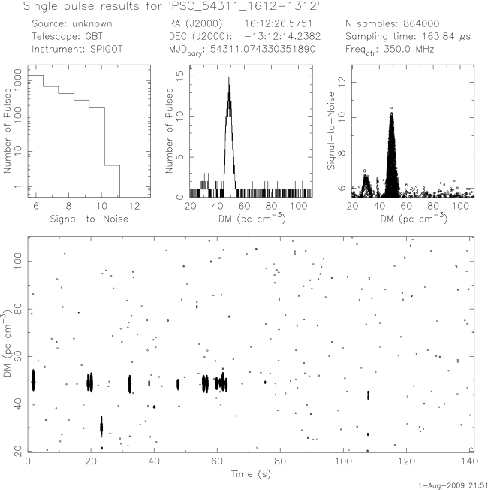
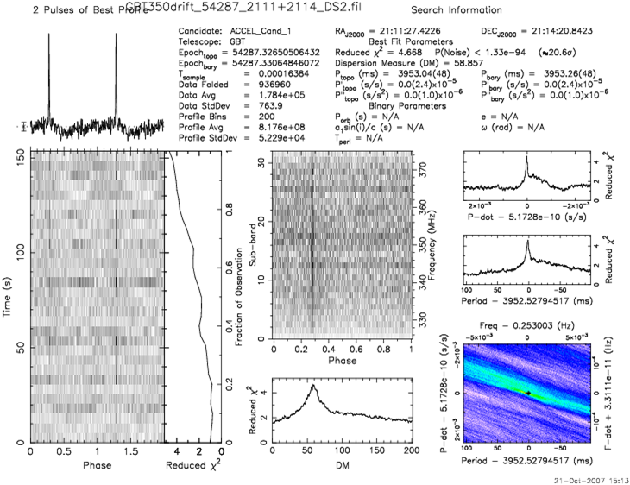
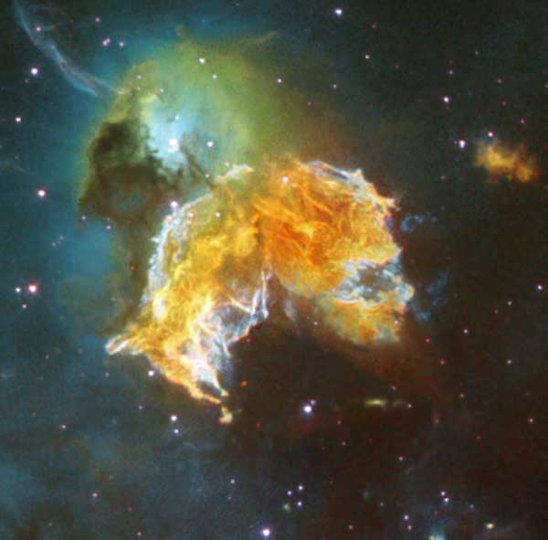
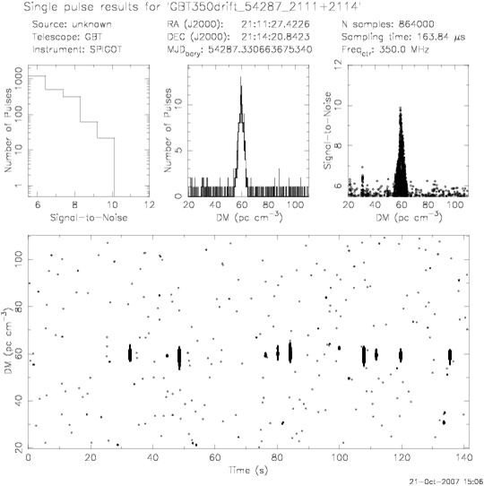
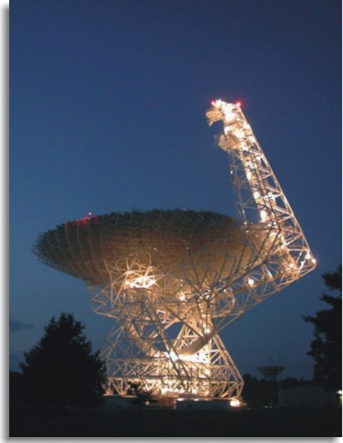
Team Lyne Conclusive Presentation
Pulsar Search Collaboratory
Heather Frank, Tyler Farrell, Annie B. Agee, Emily Dick, Trent McDaniel
Caitlin Ahrens & Ethel Perez
Our One Week Mission—
To boldly go where no high school student has gone before...
Our team sorted through 15 data sets of Double Pulse Plots and Single Pulse Plots to identify pulsars, both known and unknown.
We observed our pulsar candidates with the Green Bank Telescope for an hour on Friday, July 22 from 12:30 to 2:00 AM.
We organized our data and present it to the group and to keep a record of our accomplishments.
Team Lyne accomplished these goals by splitting the team in half to sort through the data sets which helped the process go more quickly.
Afterwards, we collaborated to prioritize which candidates we would observe with our GBT time.
Our Findings
What is a Pulsar?
A pulsar is born from a large star that burns through its Hydrogen, Helium, Carbon, and so on until it reaches Iron which will not go through the fusion process. The star then collapses and rebounds off of its iron core and a supernova is created. That gas expands indefinitely, but the dense core remains, creating a neutron star. In ideal conditions, this neutron star rotates rapidly with two oppositely placed beams of energy. This is a pulsar.
How is a pulsar found?
As the beams of energy rotate with the neutron star, radio telescopes on Earth can record these emissions. The neutron star rotates in a matter of milliseconds and the data recorded is folded over and over so that the high energy beam is readable through the radio interference created by galactic noise and RFI.
As of Thursday, we believed that we found-
  Two previously undiscovered pulsars,
  Four already discovered pulsars which we have identified,
  Many plots of RFI and noise.
  During our GBT observation time on Friday, we checked three of our candidates and had one recently discovered pulsar that was not in the catalogue, and two already known pulsars.
Pulsar Candidate Two J1610-1322
Found in catalogue.
Our team found strong evidence of a pulsar while sifting through our data sets. When we searched the coordinates in the catalogue, we found a pulsar with nearly identical coordinates and the same DM as on the plot. A known pulsar with such a strong signal went to number two on our priority list.
We searched for it during our GBT time on Friday, but the beam was too small to find the pulsar.
Below is the plot for this pulsar.
A known pulsar we did not get to observe with our GBT time.
Pulsars are not recorded as an optical image, of course, but this is an artist’s rendition of what it could look like.
Pulsar Candidate One J2111+2114
Not found in catalogue.
Our team found strong evidence of a pulsar in one of our data sets. When searched, the coordinates of the pulsar were not found in the catalogue of all known pulsars. This, of course, went to the top of our priority list.
When our GBT time came around, the wrong coordinates were entered in. The declination (the last four numbers of the pulsar) was entered as a negative number, which resulted in the data collection of Radio Frequency Interference.
We also found that J2111+2114 had been only recently discovered, and was therefore not present in the catalogue.
Below are the plots for this pulsar.
If we had more time...
Look at J2111+2114 with the GBT with the correct declination.
Look at J1742-1610, a known pulsar.
Research a few more known pulsars we found in our data set.
Double Pulse Plot for pulsar J2111+2114
Single Pulse Plot for J1610-1322 from our initial data set assignment.
Green Bank Telescope
Single Pulse Plot for Pulsar J2111+2114
Spicer, Alan. The Green Bank Telescope at Night. Photograph. Green Bank, WV. ASMT: Marine Communications, Computers, Networks. Alan Spicer Marine Telecom Blog, 06 May 2010. Web. 22 July 2011. <http://blog.marinetelecom.net/2010/05/06/the-national-radio-quiet-zone-nrqz-the-national-radio-astronomy-observatory-green-bank-west-virginia-the-green-bank-telescope/>.
An image of a supernova from the Hubble Space Telescope. Supernovas are a by-product of the creation of neutron stars.

