Slide 1

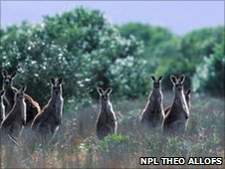
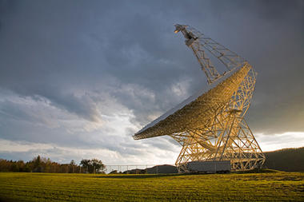
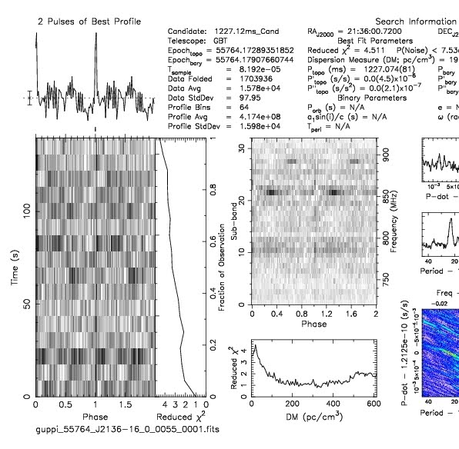
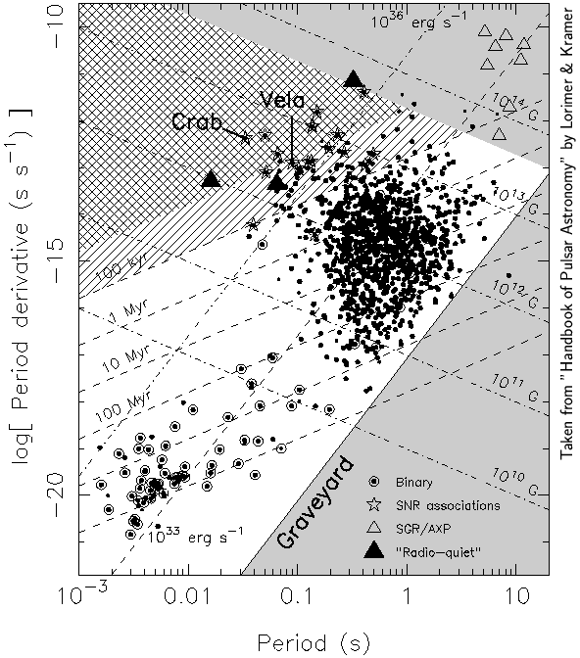
July 2011 GBT Observation
Team Parkes
Debra Chee, Janet Kahn, David Koritko, John Makous, Bree Ramey, Beth Spear
Introduction
Method
15 pointings from drift scans obtained by the GBT during the summer of 2007.
From these, we found 3 possible pulsar candidates.
We were given 1 hour of time on the GBT.
The Pulsar Search Collaboratory (PSC) is a program where high school students and teachers search radio wave data for pulsar signals from the Green Bank Telescope (GBT) located at the National Radio Astronomy Observatory (NRAO) in Green Bank, West Virginia. The Summer PSC Workshop is an intense six day program where students learn how to analyze radio frequency astronomical data, distinguishing potential new pulsar candidates from previously discovered pulsars and radio frequency interference. The summer program culminates with an opportunity to use the state-of-the-art GBT to locate and identify new pulsar candidates or refine measurements of known pulsars.
GBT Observations Conditions
Summer 2007
350 MHz,50 MHz
35’ field of view
Objects drifting across field of view
Signal strength could change during scan
July 21, 2011
820 MHz, 200 MHz
12’ field of view
Object is tracked by GBT
Signal strength is constant during scan
Green Bank Telescope
Purpose
Conclusion
Practice assessing pulsar plots
Discover new pulsar candidates
Refine knowledge of known pulsars
2013-0650 and 2136-1612 are young based on Graveyard Graph;
2136-1612 can now be published with more accurate coordinates from 820 MHz.;
2136-1612 results at conflicting periods and DM?
Computer analyses can’t be rushed
Results
#1 Candidate 2136-1612 Results
#3 Candidate 1947-1314 Results
#2 Candidate 2013-0650 Results
Future
Accuracy of Pdot calculations for Graveyard graph?
Density flux calculations
Rescan 1947-1314 with no RFI
2013-0650
2136-1612
Results Summary
2136-1612 we confirmed position at 820 MHz for a pulsar identified by a PSC student astronomer
2013-0650 identified by a PSC astronomer but listed in another catalog, not the ATNF
2013-0650 density flux
1947-1314 poor plot, RFI
Acknowledgements:
NRAO
NSF
WVU
Sue Ann Heatherly
Sarah Scoles
Jeff Chaffins
Joe Swiggum
Peter Gentile
Duncan Lorimer
Maura McLaughlin

