Slide 1

PULSARS!
By team Disney

Slide 2
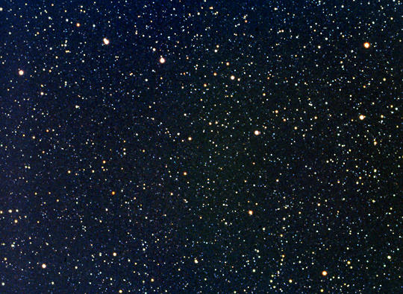
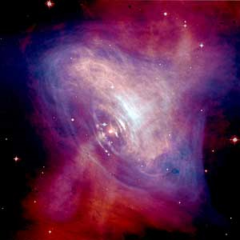
Searching for
PULSARS
Team Disney
Shauna Bare
Vanessa Crane
Crystal De Lara
Caroline Fresch
Haley James
Tamara Sims

Slide 3
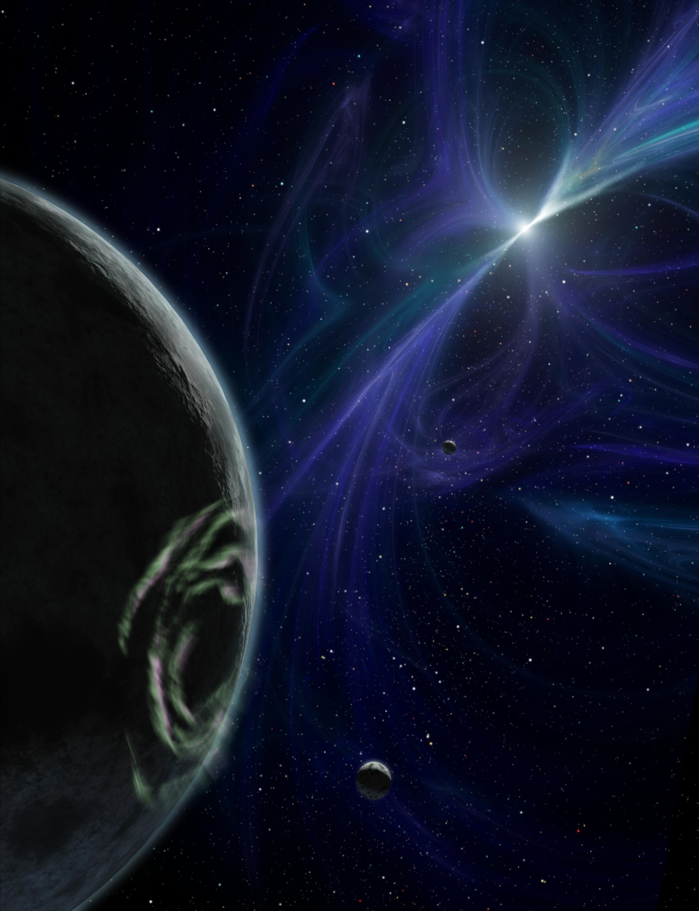
What is a pulsar?
“Pulsars are the collapsed cores of once massive stars that ended their lives as supernova explosions. Now existing as neutron stars, their rotation rates can reach incredible speeds, up to hundreds of times per second.”
-Geoff MCNamara, Clocks in the Sky: The Story of Pulsars

Slide 4
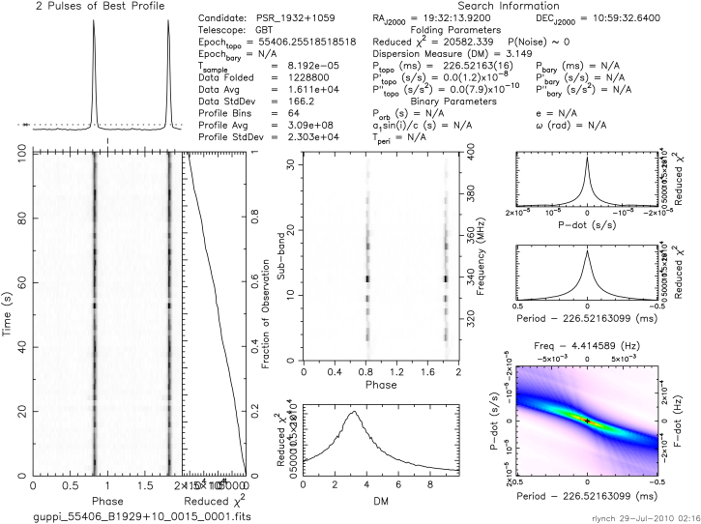
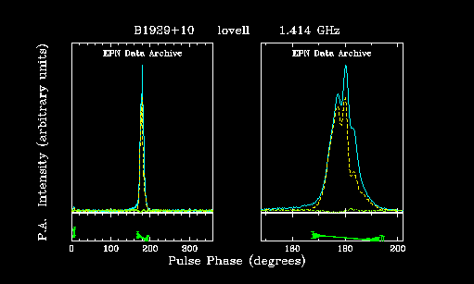
B1929+10
DM: 3.149
P: 0.22
1.16⁻¹⁵
Notes:
It has sharp peaks (profile)
it fades out, possibly due to gas and dust in space (time, frequency)
you see distinct lines with stronger points, and fades
it’s a pulsar
at different frequencies:
wider, more jagged

Slide 5
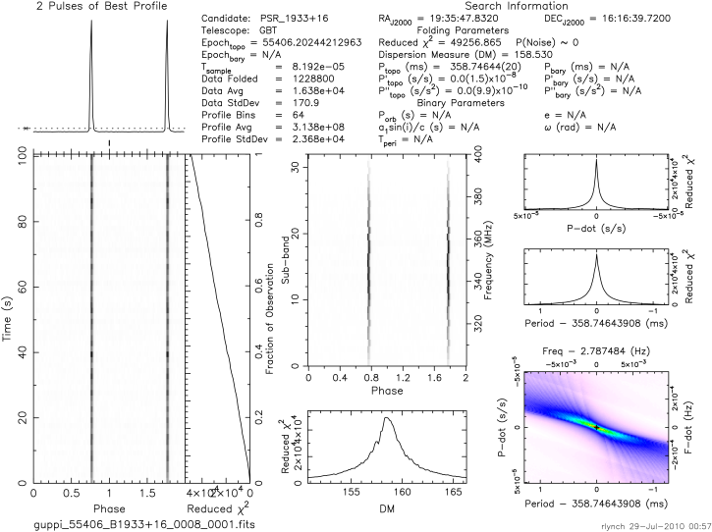
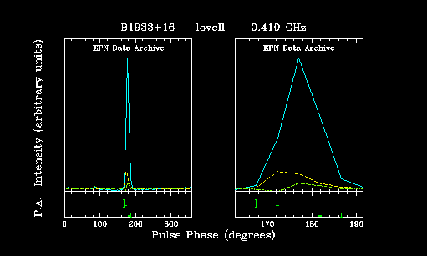
B1933+16
DM:158.5300
P: 0.358
6.00⁻¹⁵
Notes:
Sharp peaks.
Visible distinct lines
squiggly lines, unsure of what it is, possible interference
it’s a pulsar
differences in frequencies:
wider

Slide 6
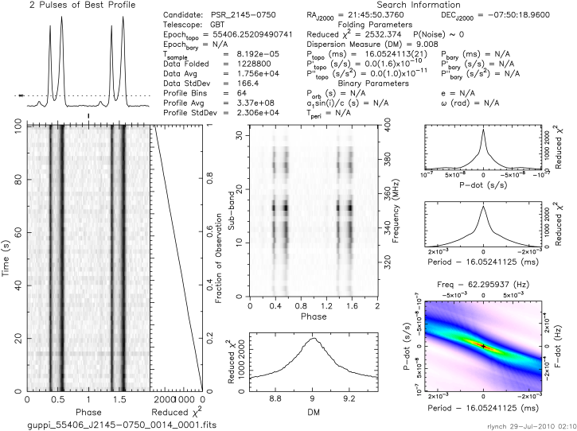
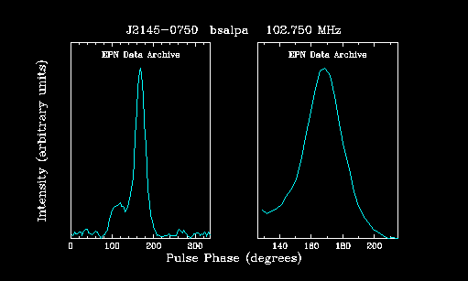
J2145-0750
Dm: 9.008
P: 0.016
3 X 10⁻²⁰
Notes:
Very high peaks
probability of noise 0
fading in and out due to gas and dust
it’s a pulsar
difference in frequencies:
more round
wider

Slide 7
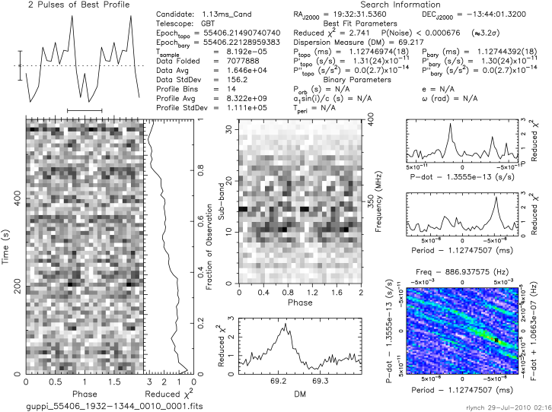
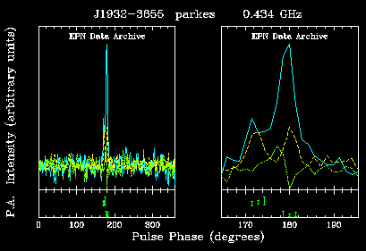
Not
a
Pulsar
Notes:
Lots of noise
no distinct lines
its not a pulsar
differences in frequencies:
noise
sharper peaks

Slide 8
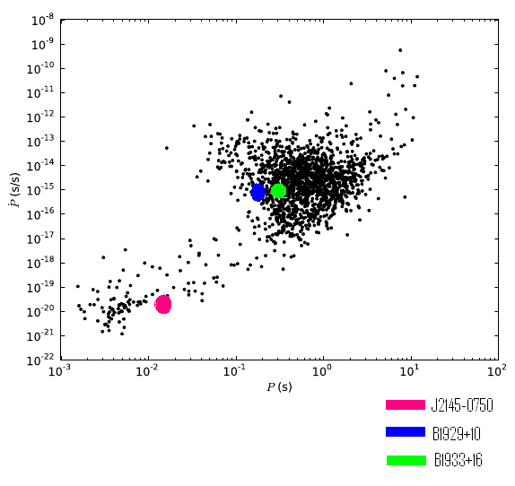
P P Dot Diagram

