Slide 1
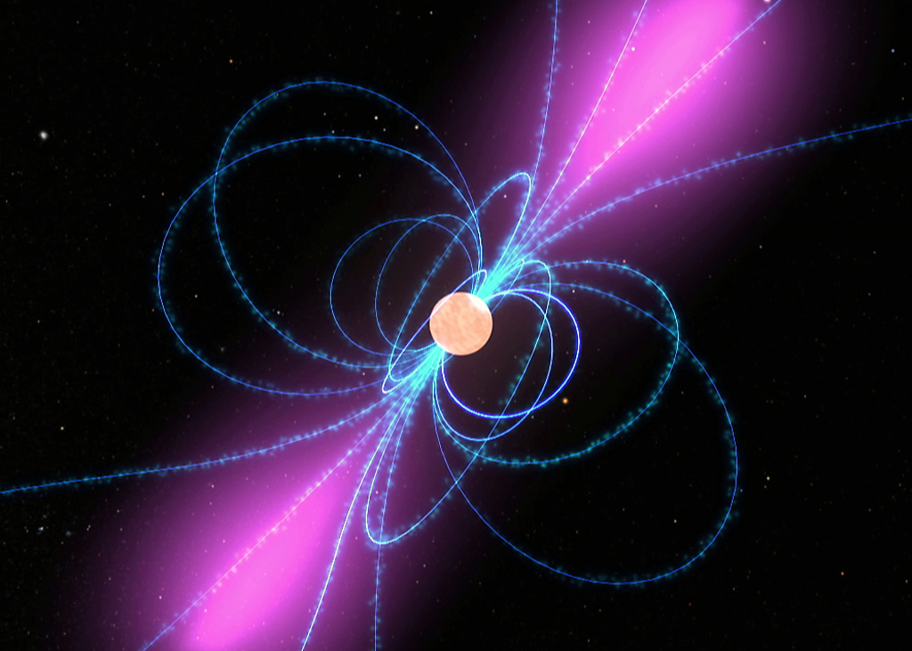
Team Hulse
James J.
Joshua M.
Daniel P.
Adam P.
James M.
Shane J.

Slide 2
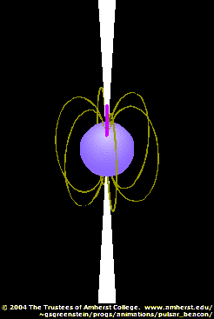
INTRODUCTION
  PULSAR
  MECHANISM
Prepfold plot/
Single-pulse plot
Pulse profile
Interstellar
medium
TOA
De-dispersion
And on-line folding
Ionized gas
Amplified
Telescope receives
radio waves
3)Data Acquisition by
monitor and control system
5) Change what data is recorded by
monitor and control software
2) Analog to Digital
conversion
4) First level data
processing software
6) Second level data analysis
software
Permission given by Ferdinand Camarote

Slide 3
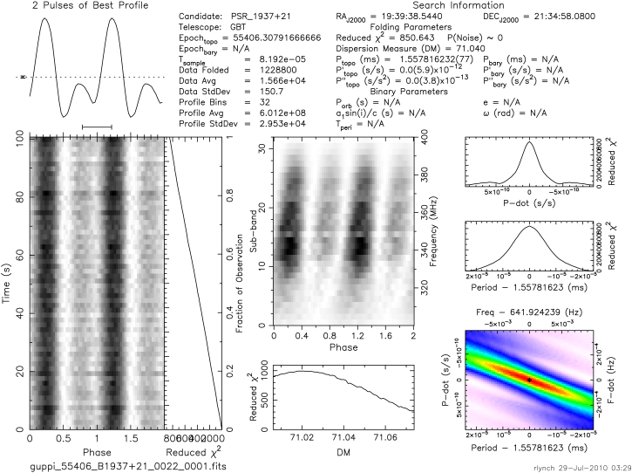
Test Candidate J1937+2134

Slide 4
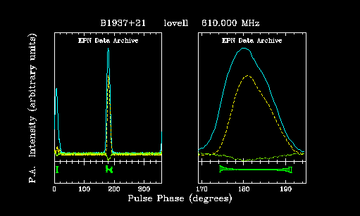
Test Candidate J1937+2134
This is the same pulsar, but from the European data archive. It was taken with the Arecibo telescope.

Slide 5
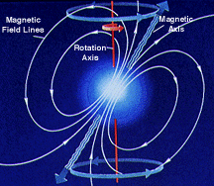
Double Pulses?
Test Candidate J1937+2134
The axis on this pulsar is tilted in a way that the rotation axis is pointed towards but slightly off to one side. So when it rotates we pick up the inter-pulse.

Slide 6
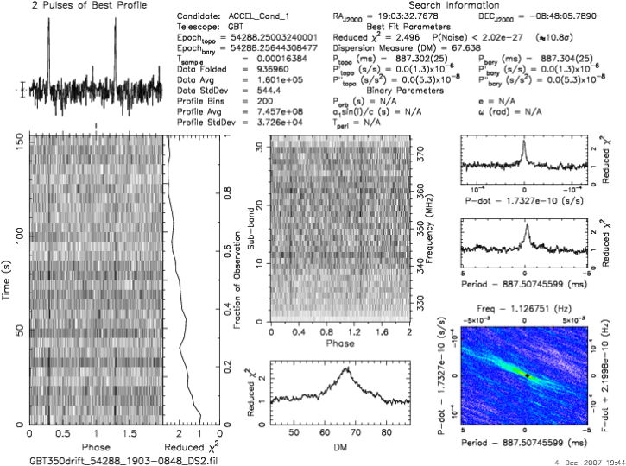
Our First Candidate 19:03-08:48
I believe this is a very good candidate because there is a very nice pulse and in the time vs. phase you can see a great signal and the DM peak has a clean peak.

Slide 7
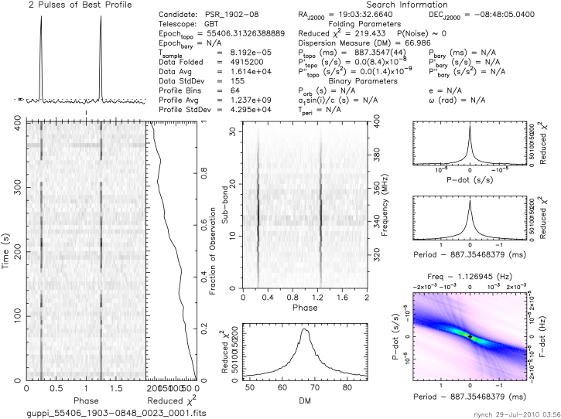
GBT Data 19:03-08:48
But this happens to be the same pulsar?

Slide 8
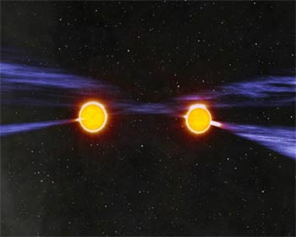
- Team Hulse -
Binary pulsar
By Shane Jay

Slide 9
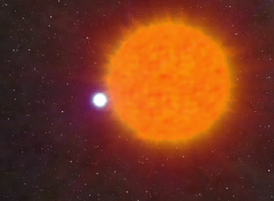
What is a binary pulsar?
http://www.atnf.csiro.au/research/pulsar/array/images/PulsarsCurrent320x256.mpg

Slide 10
A binary pulsar is a pulsar with a companion (another pulsar) orbiting around each other
Often it is a white dwarf or a neutron star
The companion of the pulsar is very difficult to discover
The easiest way to discover one is by using a radio telescope because pulsars emit impulses that are extremely regular and stable in the radio wave region
We find binary pulsars when the GBT picks up both signals and we can find a huge change in the period over time

Slide 11
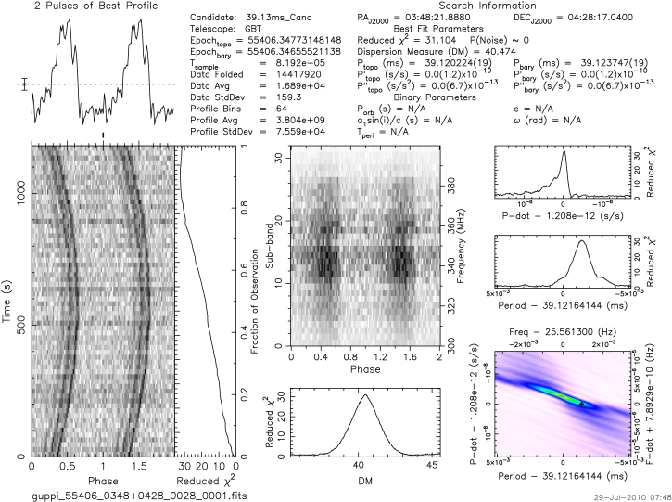
Binary Pulsar 03:48+0428

Slide 12
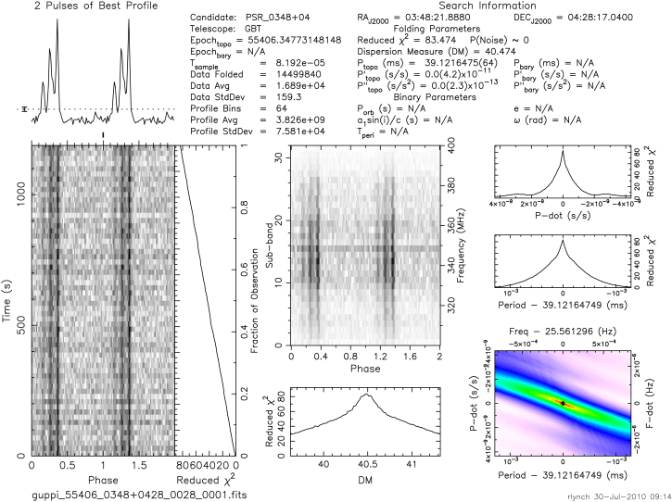
Binary Pulsar 03:48+04:28

Slide 13
How did we know it is a Binary Pulsar? ?
High X²
3
You can see 2 pulses. Small error bar.
We can tell it is a Binary Pulsar because the period changes very fast. From that we can notice that there are 2 pulsars.
3
3
3
Dark lines are vertical
Good peak for the DM

Slide 14
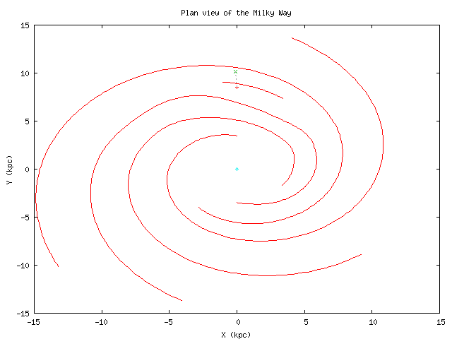
Where is it in our galaxy?
SUN
Binary pulsar

Slide 15
The Math
Period .039 s
Rate of change of the period 2.40453 x 10⁻¹⁹
Radius of magnetic field 18679.2 Km
Characteristic Age 2,577,822,280 years
Strength of magnetic field 3200645741.78 gauss

Slide 16
BINARY PULSAR FOUND BY RYAN LYNCH

Slide 17

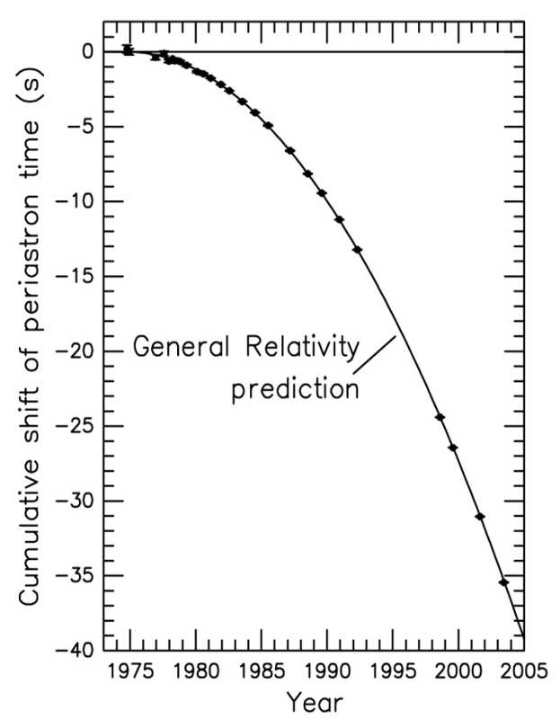
History of the First Binary Pulsar
The first Binary Pulsar was found by Russell Hulse.
He was born in November 28, 1950 in New York
He got a Noble Prize in physics in 1993.
The Binary Pulsar he found was PSR B1913+16

Slide 18
Pulsar Candidate Data: Noise

Slide 19
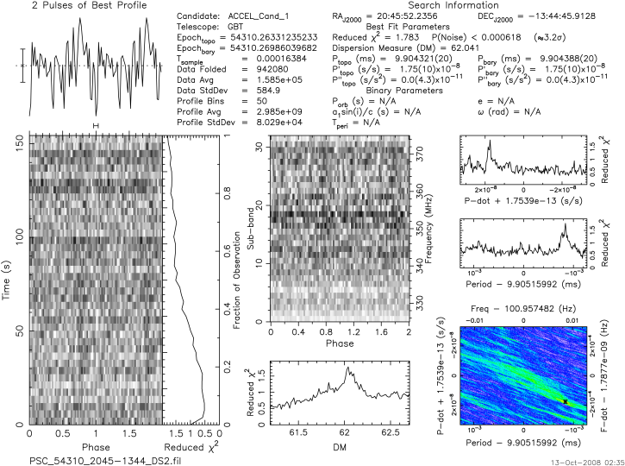
Candidate Test Data 2045-1344

Slide 20
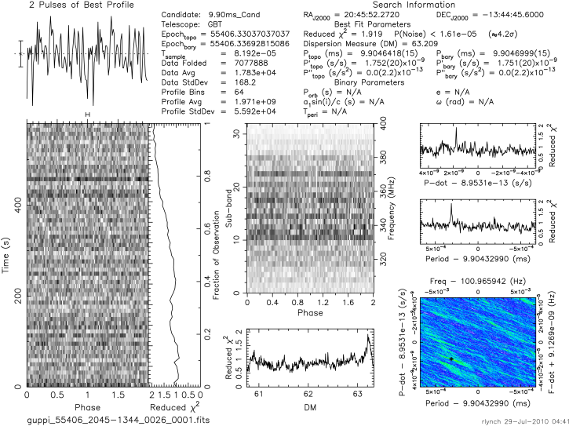
GBT Data 2045-1344

Slide 21
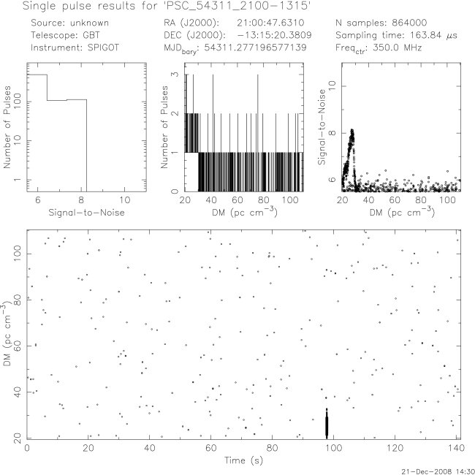
Candidate Test Data 2100-1315

Slide 22
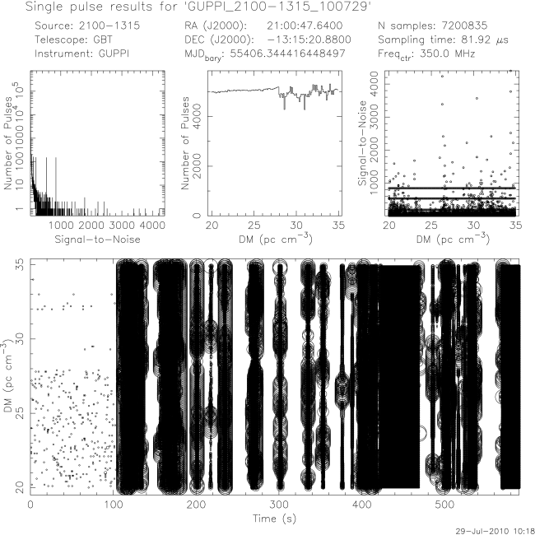
GBT Data 2100-1315

Slide 23
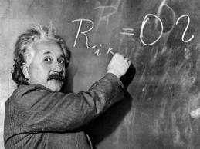
Mathematical Calculations
James is on his way to
becoming an astrophysicist.
http://www.calnewport.com/blog/?p=115

Slide 24
Formulas

Slide 25
James’ Pulsar for Tonight!

Slide 26
James’ Pulsar Found in Data

Slide 27
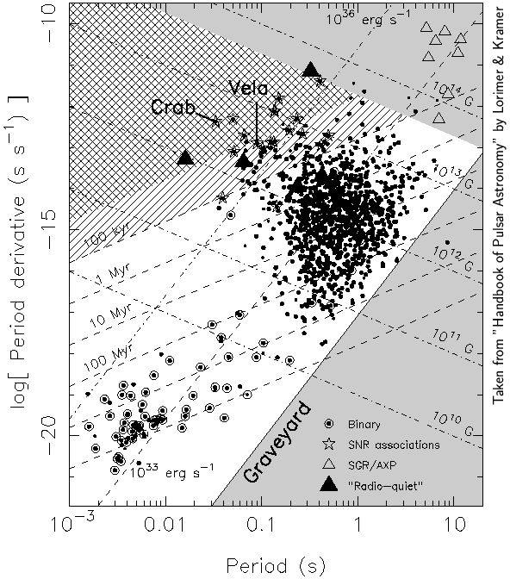
P P-dot Diagram

Slide 28
TEAM HULSE WOULD LIKE TO THANK THE FOLLOWING:
Sue Ann Heatherly
Dr. Rachel Rosen
Dr. Maura McLaughlin
Dr. Duncan Lorimer
Ryan Lynch
Joe
PSC Teachers & Student Mentors
NRAO Staff

