Slide 1

Team Taylor
Jesus, Jason, Eric, Carl, Franz, Austin, Joey, Greg, and Jennifer.

Slide 2
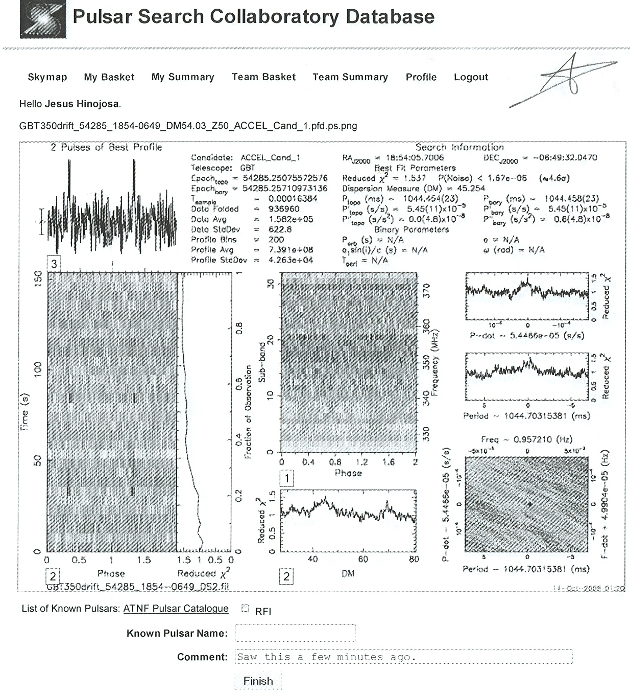

Slide 3
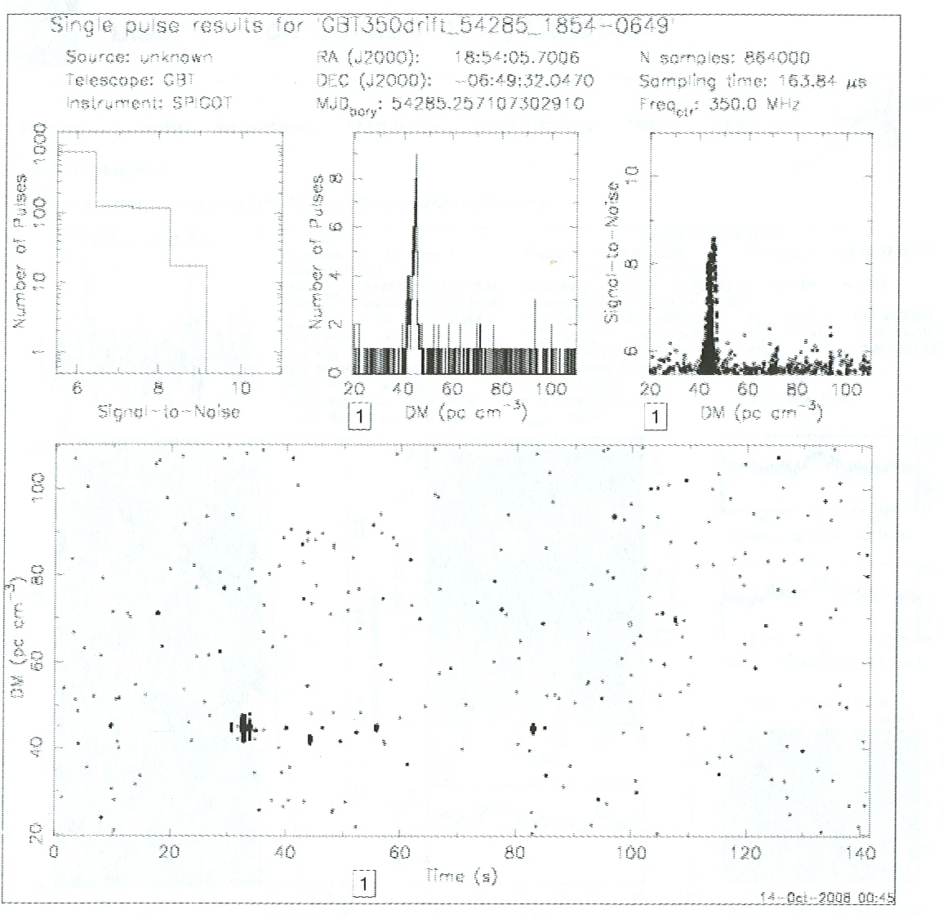

Slide 5
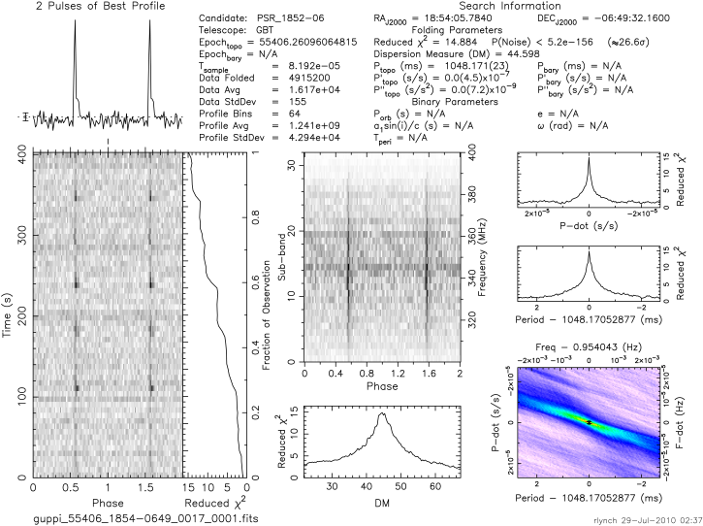

Slide 6
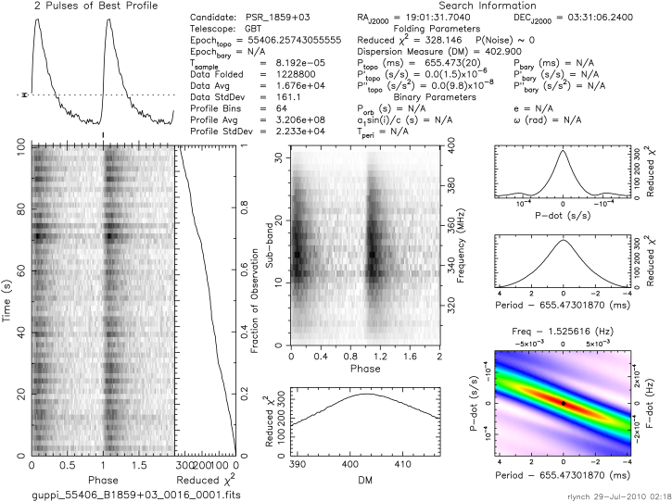
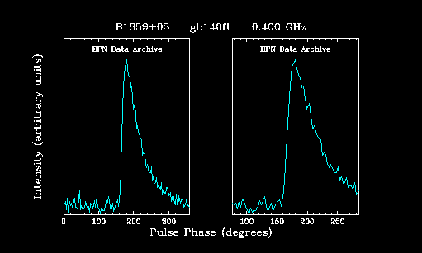
A known pulsar
pulse profile has exact characteristics as the one below
Pulsar distance from earth: 24090 light years
Galactic latitude: -0.5 degrees
Galactic longitude: 37.2 degrees
Epn source (one below) is at .4 GHz
Source on right is at 350 MHz
Maximum DM: 1037

Slide 7
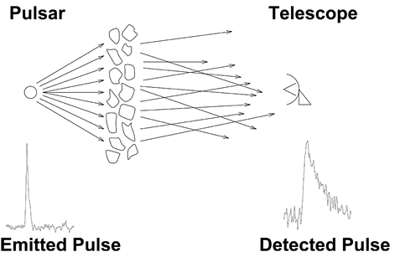
http://relativity.livingreviews.org/Articles/lrr-2008-8/fig_12.html
There is no way to fix or correct scattering.

Slide 8
Sources
EPN
ATNF pulsar catalog
http://relativity.livingreviews.org/Articles/lrr-2008-8/fig_12.html

Slide 9
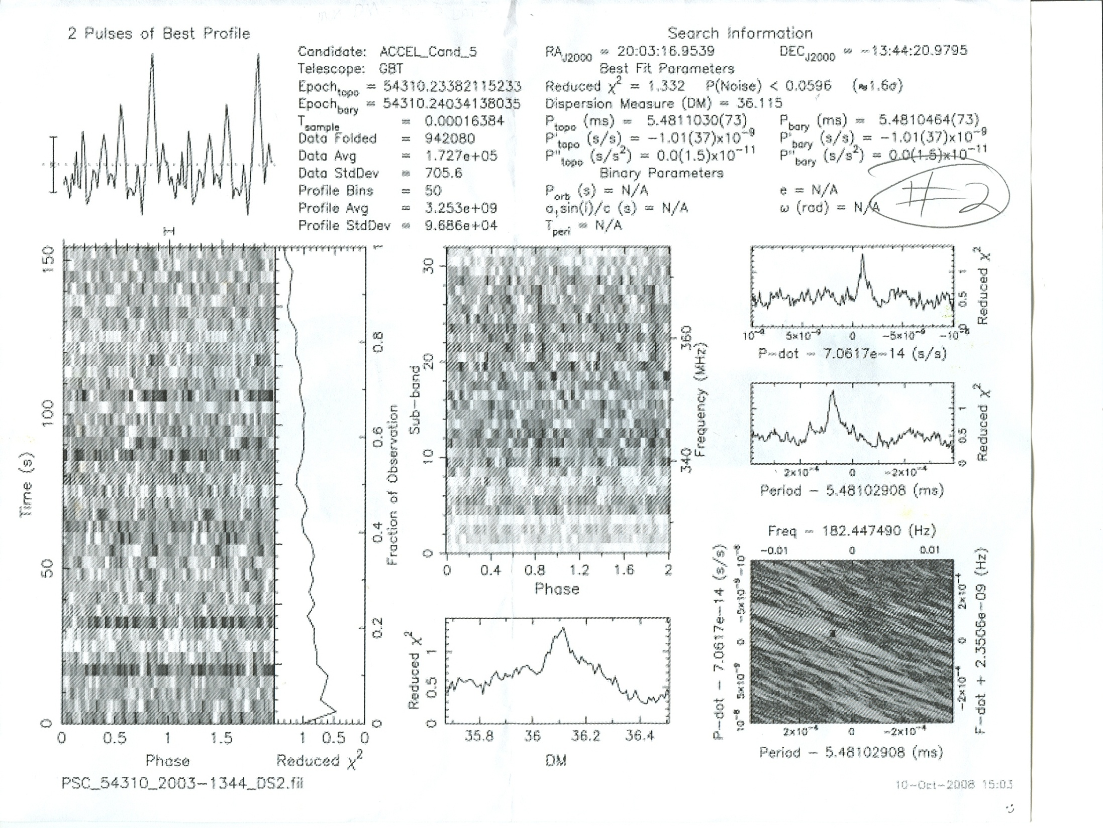
Franz

Slide 10
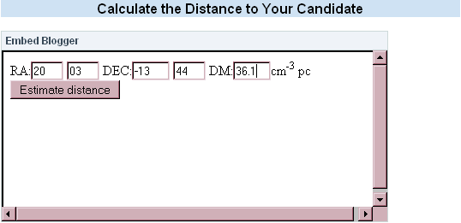
For Galactic longitude 28.3 degrees and latitude -22.0 degrees, and a dispersion measure of 36.1 cm⁻³ pc, the estimated distance to your source is 1.5 kpc. The maximum DM predicted by the model for this direction is 86.5 cm⁻³ pc.
http://sites.google.com/a/pulsarsearchcollaboratory.com/pulsar-search-collaboratory/

Slide 11
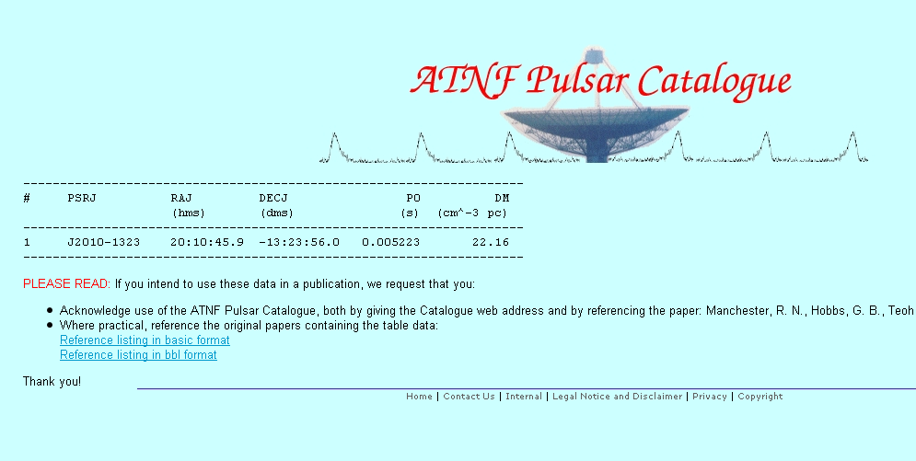
http://www.atnf.csiro.au/research/pulsar/psrcat/proc_form.php?table_top.x=58&table_top.y=36&JName=JName&RaJ=RaJ&DecJ=DecJ&P0=P0&DM=DM&startUserDefined=true&c1_val=&c2_val=&c3_val=&c4_val=&sort_attr=jname&sort_order=asc&condition=&pulsar_names=&ephemeris=short&coords_unit=raj%2Fdecj&radius=3&coords_1=20%3A03%3A00&coords_2=-13%3A44%3A00&style=Short+without+errors&no_value=*&fsize=3&x_axis=&x_scale=linear&y_axis=&y_scale=linear&state=query

Slide 12
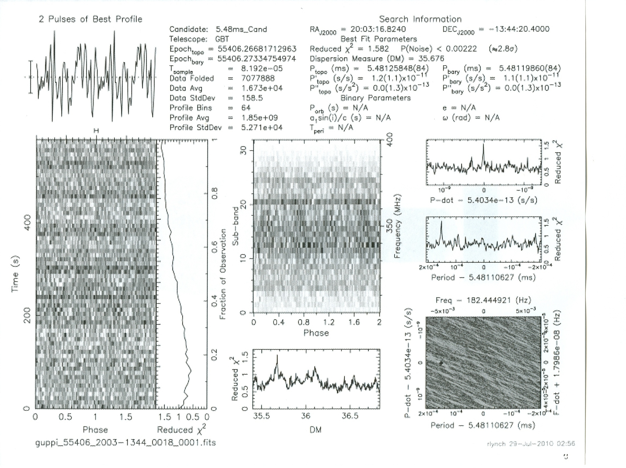

Slide 13
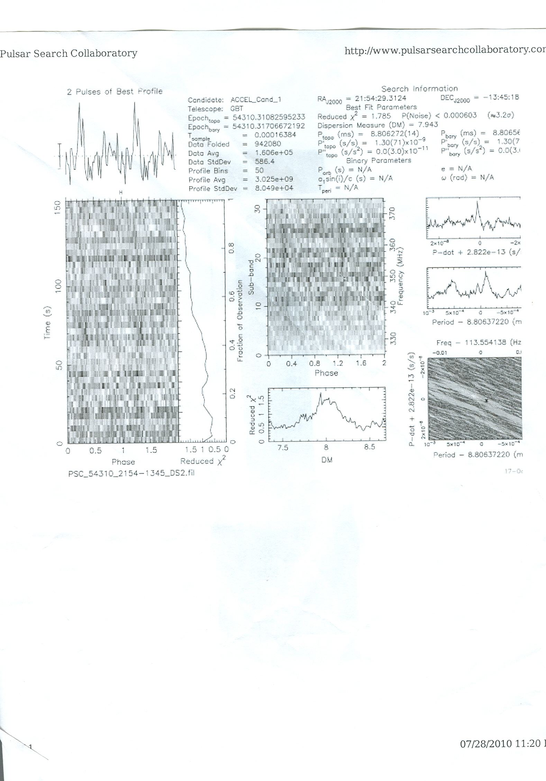
Initial Observation
DM: 7.943 pc cm⁻³
Maximum DM for region: 39.5 pc cm⁻³
Reduced Χ^{2:} 1.785
http://www.pulsarsearchcollaboratory.com/

Slide 14
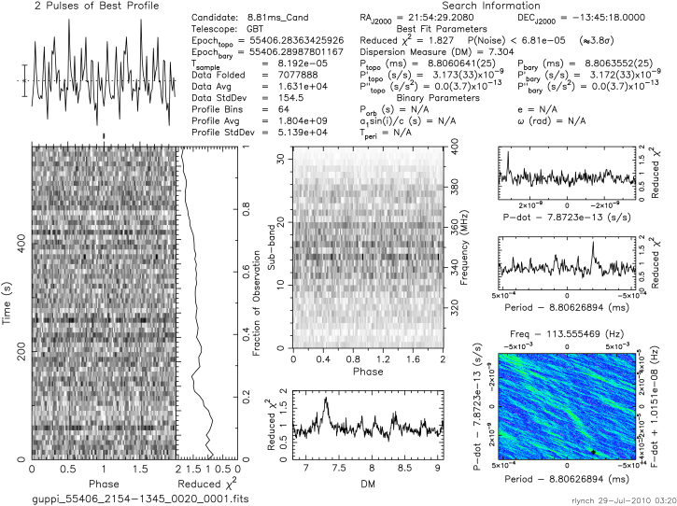
Follow-up Observation
P_{topo}(ms) ≈8.806
(consistent
with electrical interference)

Slide 15
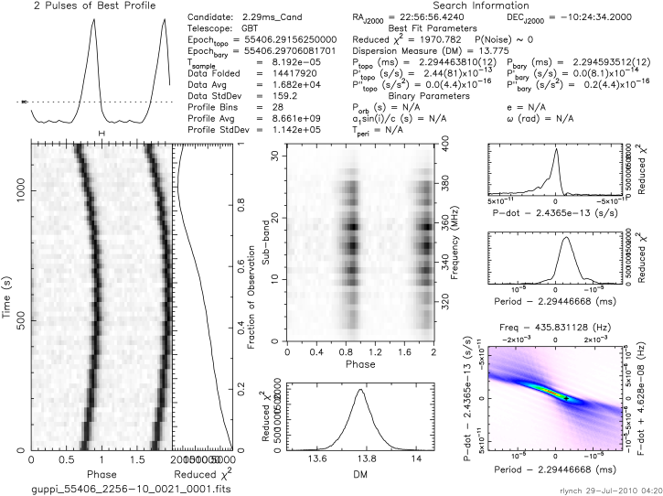
White Dwarf Companion
This pulsar is in orbit with a white dwarf.
It is about 0.6 kpc or 1900 light-years away.
As the pulsar moves away from Earth its pulse becomes delayed, but begins to arrive earlier as its orbit starts to bring it back towards Earth.
The white dwarf in orbit with this pulsar is extremely tiny even for a white dwarf.

Slide 16
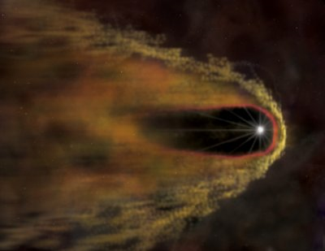
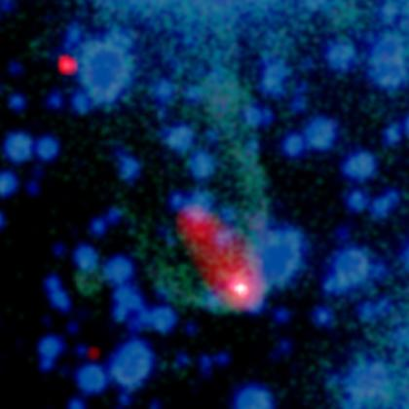
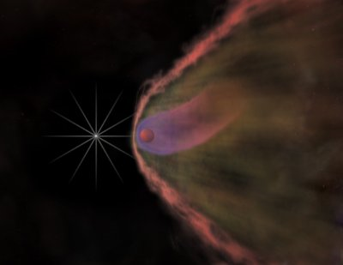
Black Widow Pulsar
It is believed that extreme conditions on the pulsar generate high-energy particle winds that blast the surface of the white dwarf, slowly evaporating it.
http://www.dailygalaxy.com/my_weblog/2010/04/image-of-the-day-the-black-widow-pulsar-.html
http://www.daviddarling.info/encyclopedia/B/Black_Widow_Pulsar.html
B. W. Stappers, et al., An x-ray nebula associated with the millisecond pulsar b1957 + 20 Science 299 : 1372–1374 (2003).
Credit: NASA/CXC/M.Weiss

Slide 17
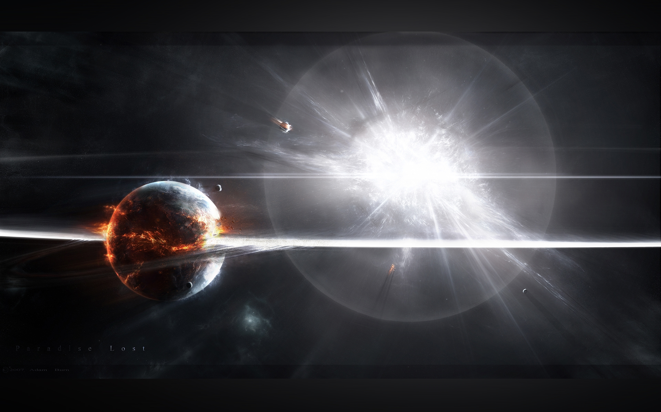
Supernova

