Slide 1

Team Hewish
Dustin, Dezmond, Dakota,
Michael, Austin

Slide 2
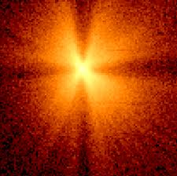
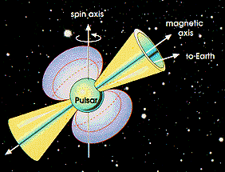
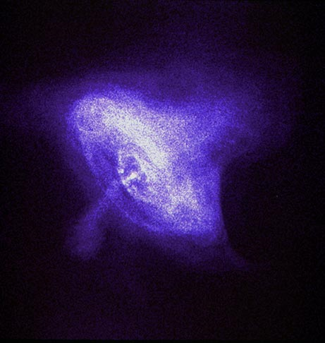
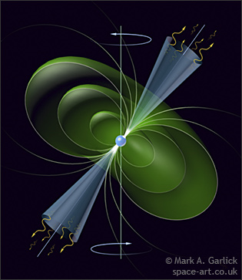
Pulsars
1
Pulsars are neutron stars that spin rapidly in space because of its magnetic field
Once a star leaves its main source it follows a certain path depending on its mass level
2
3

Slide 3
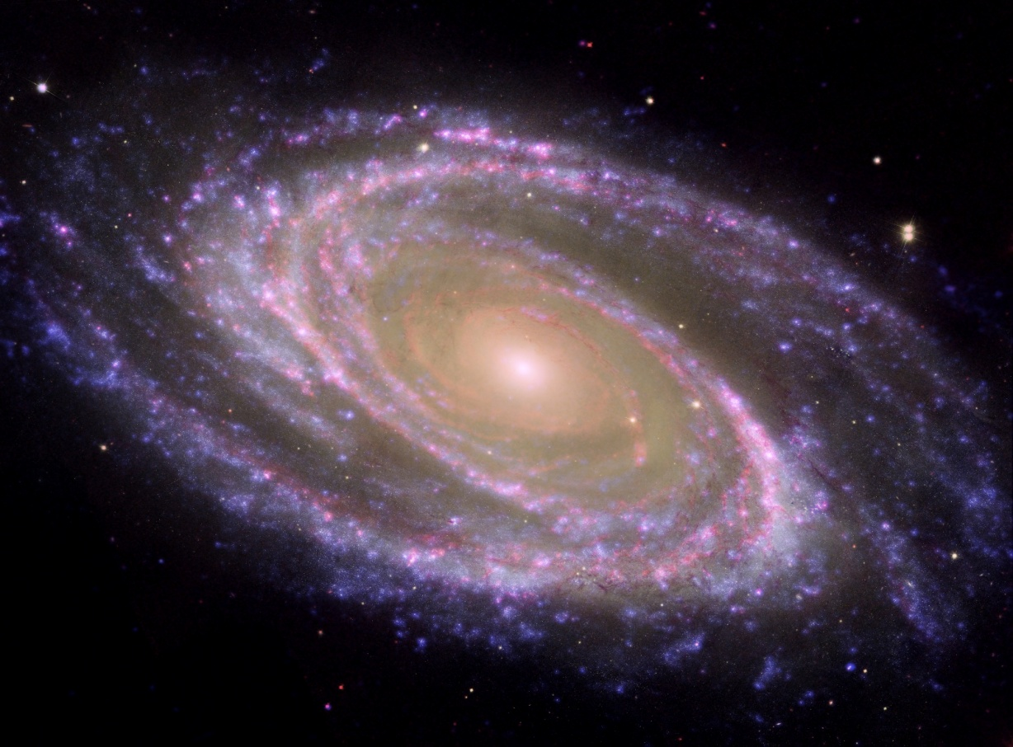
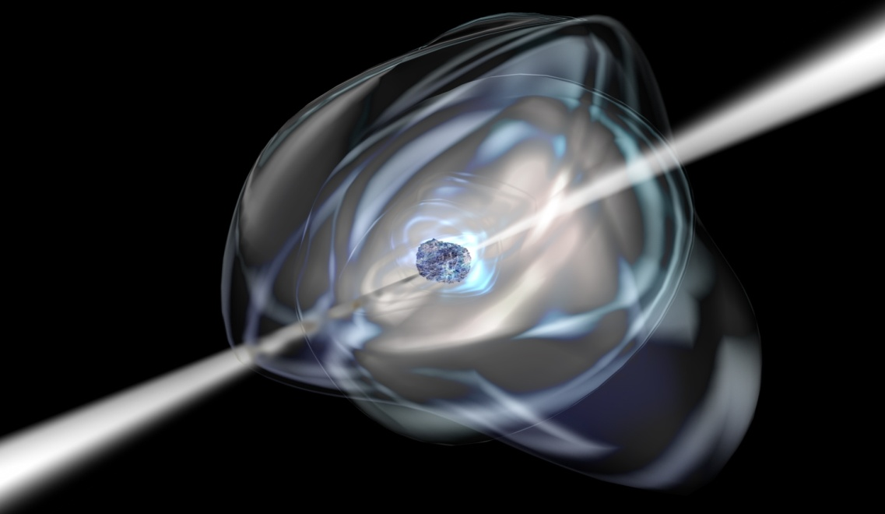
Questions
4
Does it make sense given what we know about the galaxy?
What interesting time/frequency structure do you see?
What structures are intrinsic to the pulsar and what might be extrinsic?
5

Slide 4
Formulas
1 kpc = 3260 light years
1 km= 0.62 miles
Pulsar age = 15.8 Myr * P * 10⁻¹⁵/P-dot
Radius of light cylinder R_{LC}= Pc/2π (c=3 x 10⁸ m/sec; speed of light)

Slide 5
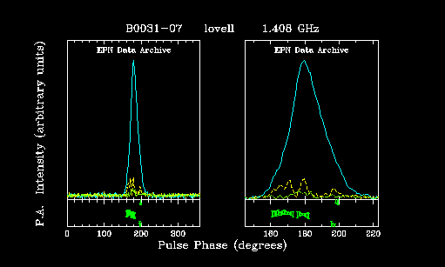
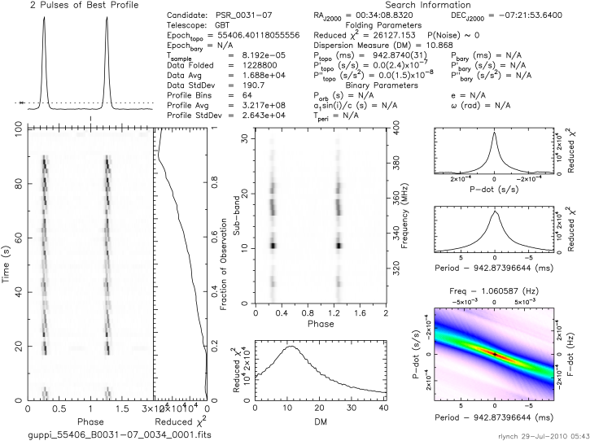
B0031-07
This pulsar was listed in both the European Pulsar Network and the ATNF. It is about 1304 light years away (0.4kpc). This was given to us by Rachel.
RA 00:34:08 Dec -07:21:53
l
These plots are from the European Pulsar Network from 1990 (1408 MHz).
The age of this pulsar is 36.5million years
The radius of the light cylinder is 29266 miles
P = 942.8 ms DM = 10.868 pc/cm³

Slide 6
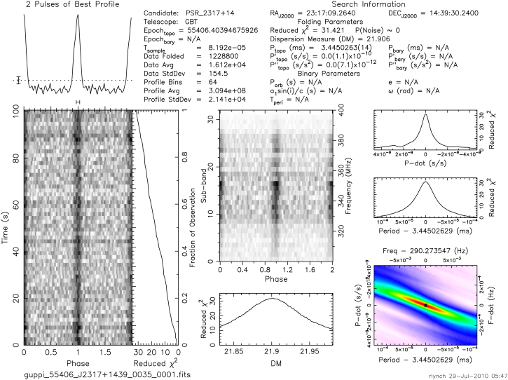
J2317+1439
This millisecond pulsar was given to us by Rachel.
Pulsar age is 1.42 billion years
The radius of the light cylinder is 9320 miles
P = 3.45 ms DM = 21.906 pc/cm³

Slide 7
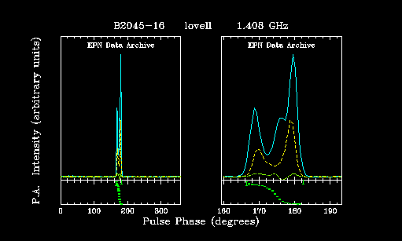
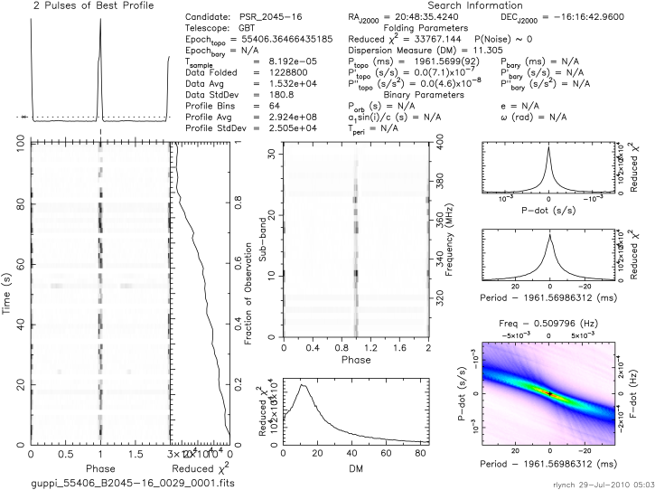
B2045-16
Rachel gave us this known pulsar listed in the ATNF catalog at approximately 1956 light years away (0.6 kpc).
RA 20:48:35 Dec -16:16:42
From European Pulsar Network - 1990 (1408 MHz)
Pulsar age is 2.83 million years
Light cylinder radius is 6089 miles
P = 1961.6 ms DM = 11.305 pc/cm³

Slide 8
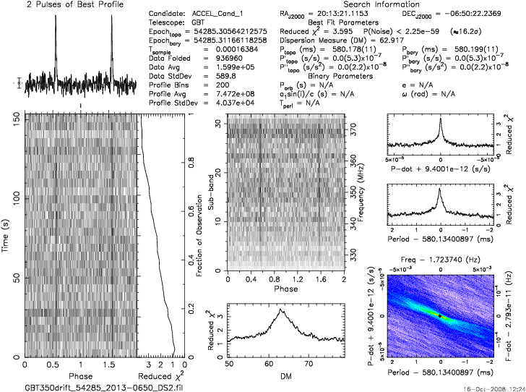
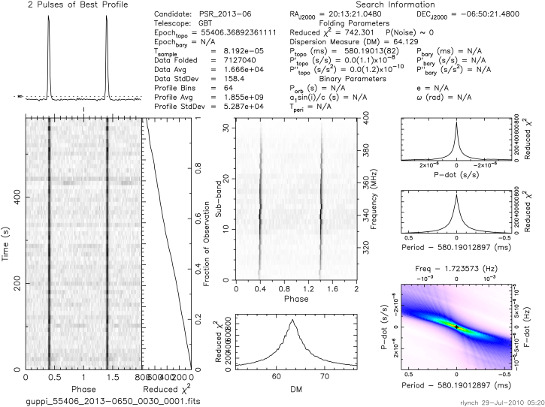
RA 20:13 DEC -06:50
Known pulsar discovered by an astronomer from 2008 GBT drift scan survey
Due to our longer observation on the GBT, our plot more clearly shows that this is a pulsar.
Light cylinder radius is 10,811 miles.
Estimated distance is 9784 LY (3.0 kpc).
P = 580.18 ms DM = 62.917 pc/cm³
P = 580.190 ms DM = 64.129 pc/cm³

Slide 9
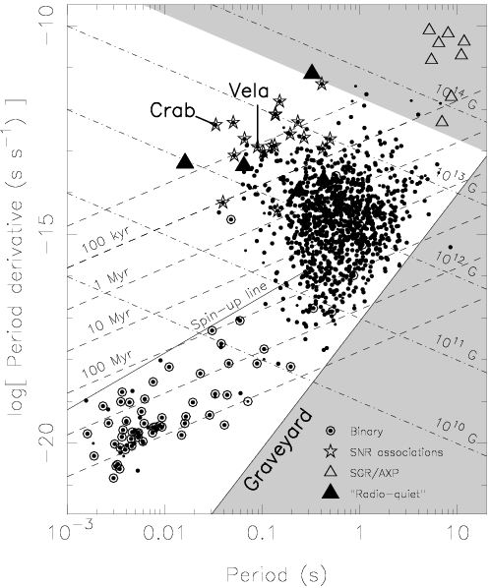
J2317+1439
B0031-07
B2045-16

Slide 10
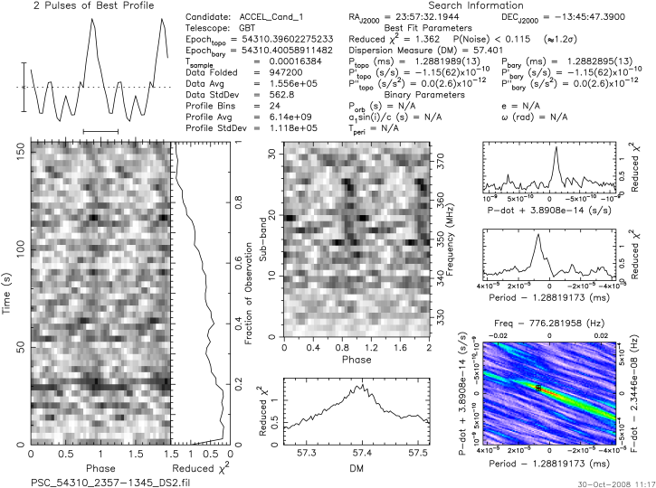
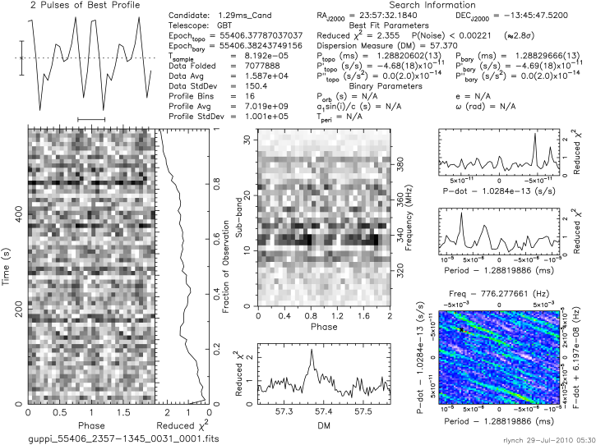
RA 23:57 DEC -13:45
Wondering about the period because it’s kind of low…
Candidate
GBT data taken on 07/27/10
P = 1.288 ms DM = 57.401 pc/cm³
P = 1.2882 ms DM = 57.370 pc/cm³
CONCLUSION: Not a pulsar; just noise!

Slide 11
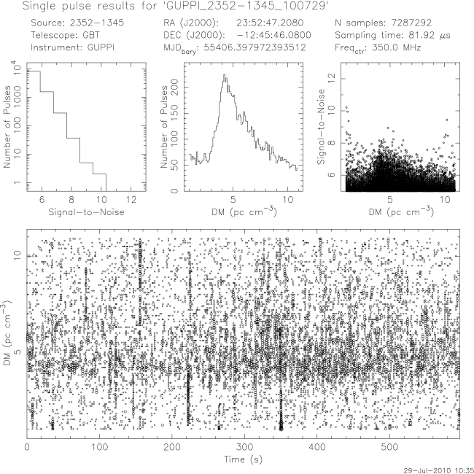
Intended Candidate
RA 23:52 Dec -13:45
Actual
2
This looks really promising!

Slide 12
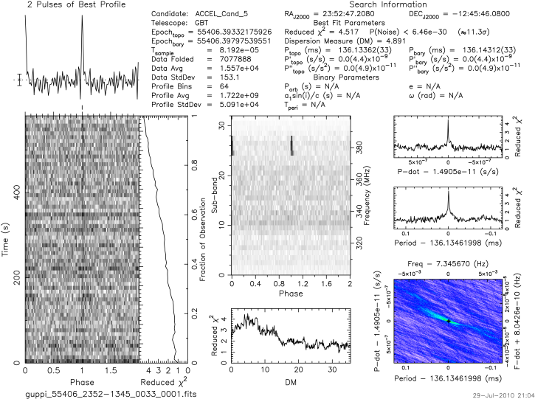

Slide 13
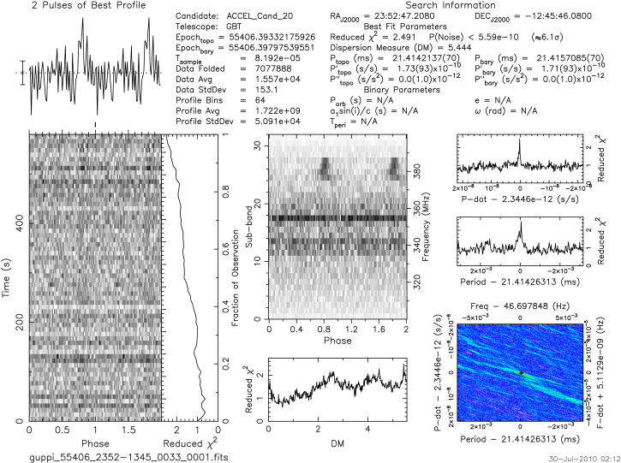

Slide 14
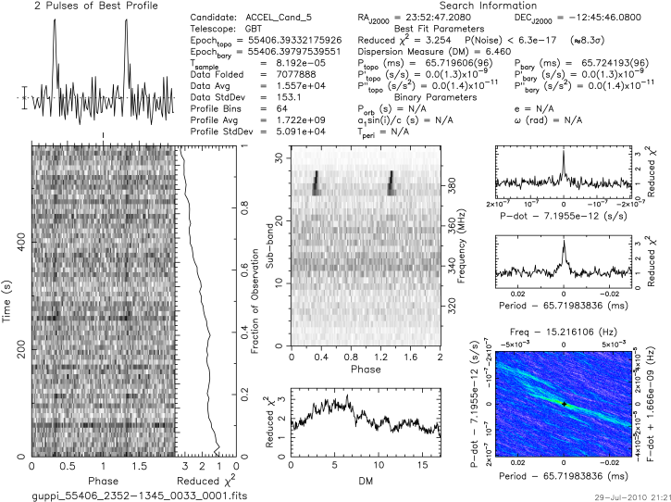
RFI

Slide 15
Conclusion
In conclusion we discovered that chart 14 is actually not a pulsar it’s RFI
Yes, because the galaxy is 100,000 light years wide and the Earth is 26,000 light-years away from the center of the Milky Way
The longer you observe the clearer the plot
Pulsars have consistent periods
Electrons accelerating around a magnetic field produce light (radio waves)
The further away the pulsar is the more the ISM it travel through and produces a higher DM

Slide 16
Images
astro.keele.ac.uk
cse.ssl.berkeley.edu
infosyncratic.nl
phys.ncku.edu.tw/~astrolab/mirrors/apod_e/ap050104.html
sciops.esa.int/index.php?project=integral&page=about_integral_science_compact

Slide 17
ACKNOWLEDGEMENTS
Thanks to . . .
Dr. Rachel Rosen
Sue Ann Heatherly
Ryan Lynch
Duncan Lorimer and Maura McLaughlin
Carolyn and Chelen

