Slide 1
Pulsars in Focus
An investigation into Pulsar Data collected by the Green Bank Telescope.
Team Bell
Anna, Kris, Cassie, Chandler, Ellen, Firas, Tessa, and Josh

Slide 2
Introduction
In this presentation, we will explore not only the data we collected during our 5:45 a.m. time slot at the Green Bank Telescope, but we will also compare and contrast findings of the Crab Pulsar from the American and European databases. The data we have collected consists of our potential candidates as well as two known pulsars.

Slide 3
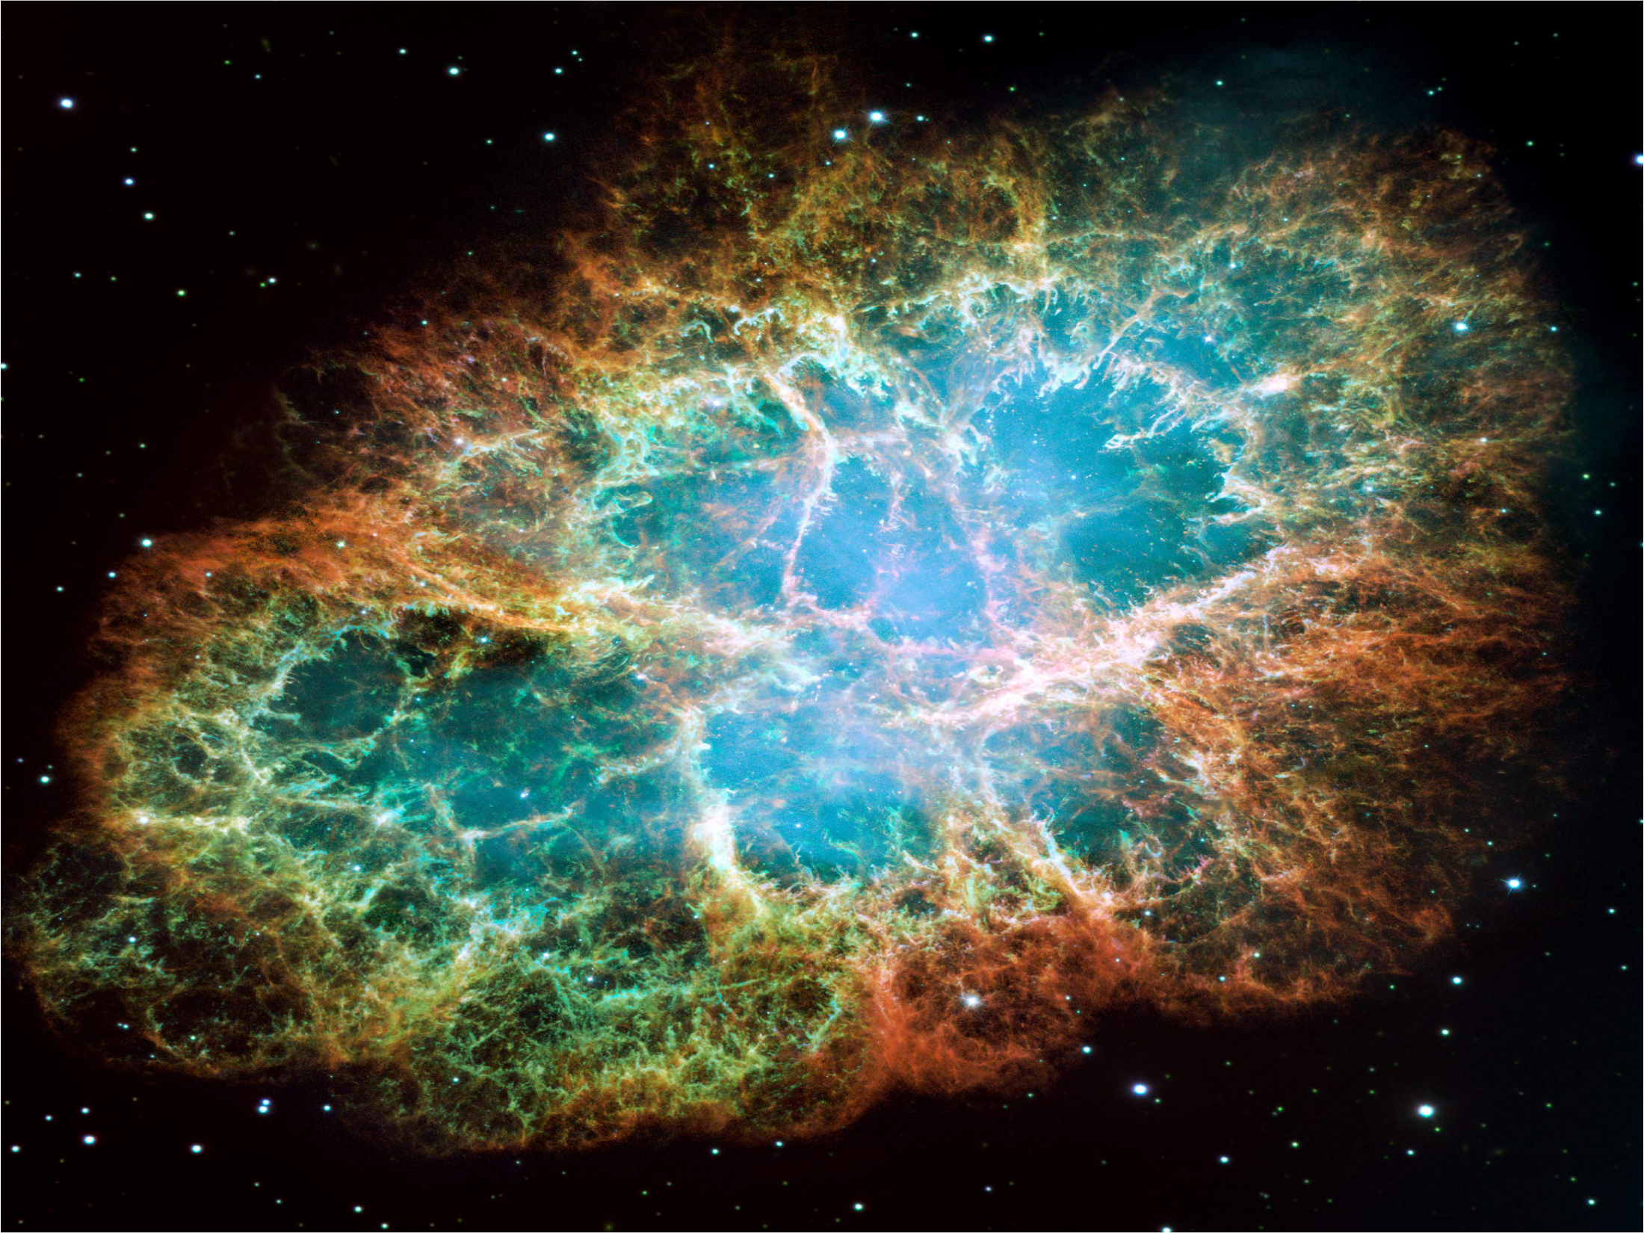

Crab Pulsar

Slide 4
Background Information
The crab pulsar is located within the Crab Nebula, which is located at RA: 5h 34m 40s and Dec: +22° 1' 10“.
The nebula is 6,000 light years away from Earth, or 1,900 parsecs, and is located in the Taurus constellation.
The Crab Pulsar is 956 yrs. old.
The pulsar is located at RA: 05h 34m 32s and Dec: +22° 0.0' 52 and is 5,545.4 light years or 1.9 kpc from Earth.

Slide 5
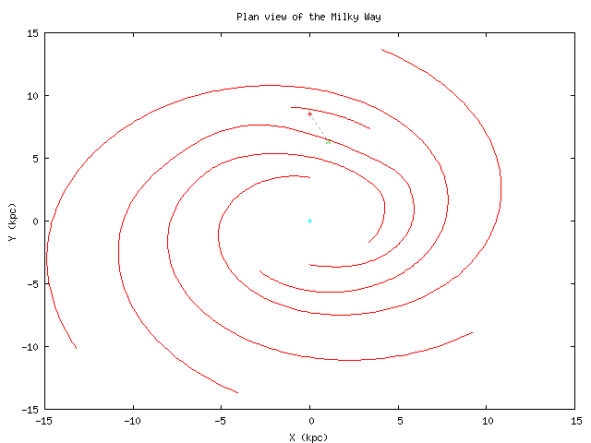
Location in our Galaxy
Here it is

Slide 6
History of Crab Nebula
July 5, 1054
Seen and Recorded by Chinese astronomers as a Guest Star
Depicted by Native Americans in Arizona.
Forgotten for six hundred years.
Later observed by John Bevis (1731) and Charles Messier (1738)
Named “Crab” by Lord-Rosse (1844) for structure.

Slide 7
The “Crab” Pulsar Fun FACTS!
Yes, science can be fun ☺
The Crab pulsar was officially discovered in 1968 by David H. Staelin and Edward C. Reifenstin III
The Pulsar is 25km in diameter
Rotates once every 33ms or 30 times a sec.
The pulsar is slowing down by 38 ns every day due to large amounts of energy being given out.
The approximate mass and luminosity could not be calculated.

Slide 8
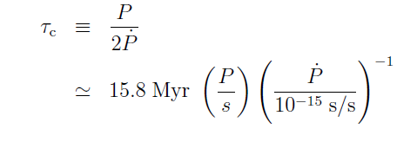

Formulas
Magnetic Field
AGE
Estimated Characteristic Age - 1.24e+03 Mega years according to the ATNF catalog.
Estimated Characteristic Magnetic Field – 3.78e+12 G according to the ATNF catalog.
*Our team attempted our own calculation to double check the catalog, but we love math to the extent that we decided to trust the astronomers ☺

Slide 9
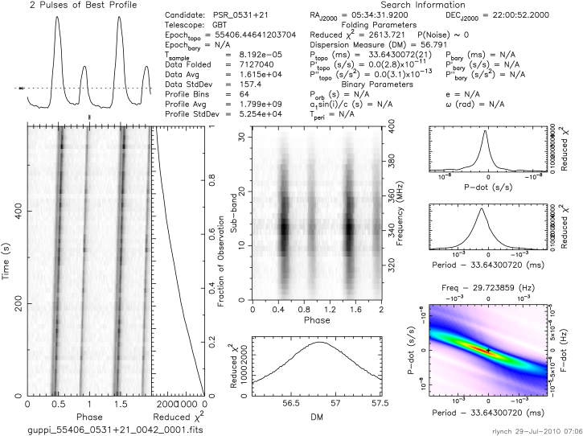
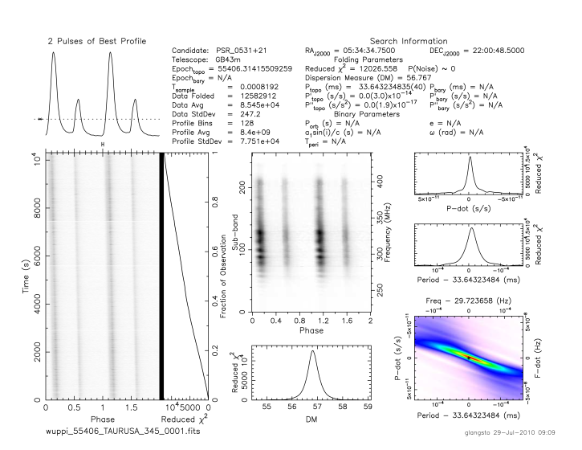
Comparing the GBT to the 43m
GBT plot
RA, DEC and DM are the same
Frequencies are the same
Pulses from the 43m are fainter
GBT pulses arrived later
GBT DM peaked later but is more precise due to the folding method
Time scale on GBT is by a factor of 100s while the factor on the 43m is 1000s.
43m looked at pulsar longer.
43m plot
Recorded by 43m
Recorded by GBT
Error that may have occurred includes:
Instrumental error:
  GBT slanted in time phase
  43m slanted in the sub-band
GBT pointed directly at the pulsar while the 43m missed it by a tiny bit-> may explain sub-band plot.
Probable explanations include:
Folding differences!

Slide 10

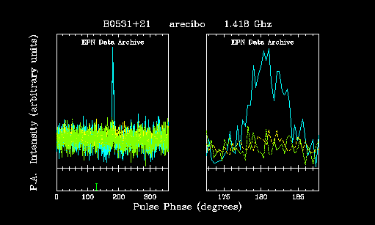
Comparing North America to Europe
Different countries use different systems to look at data. By comparing the same data from two different sources we can learn how to understand other countries systems.

Slide 11
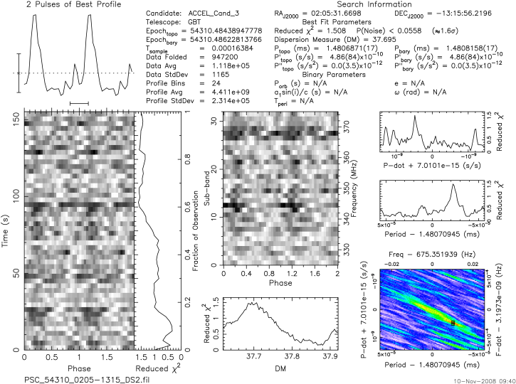
Comparing the “Crab” to a Candidate
Similarities
  Pulse Profile
  Noise level
  Dispersion Measures
Candidate J0205-1315
Crab Pulsar J0534-2200
Differences
  Time Series
  Sub-band Plot
  Period
  P-dot

Slide 12
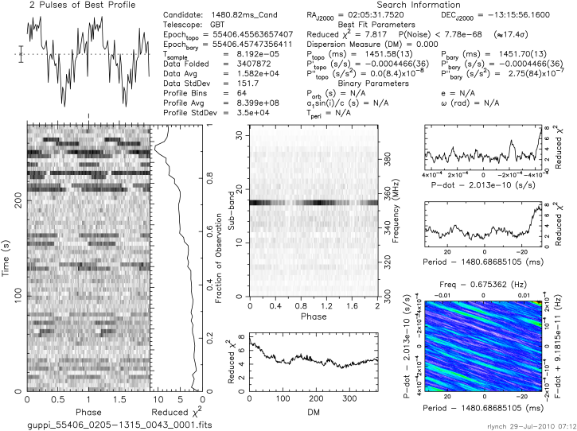
Pulsar to RFI
Crab
Nice peaks in Pulse Profile
Nice dark and distinct lines in Time Phase and Sub-Band plot
DM has a peak
The period and the P-dot are clear
RFI
No peaks in Pulse Profile
No lines in Time Phase or Sub-Band
DM peaks at zero
Period and P-dot are very unclear
We can use the plots that we gather from known pulsars to know if a candidate is a real pulsar or simply RFI.

Slide 13
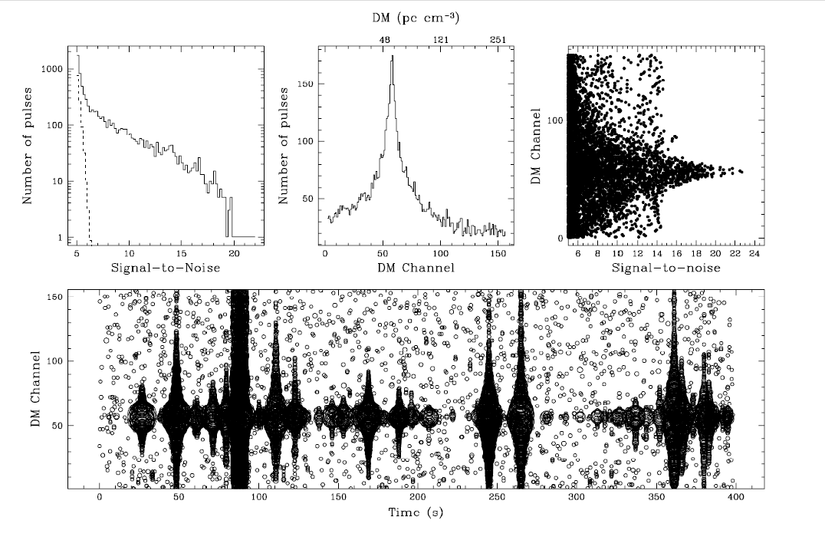
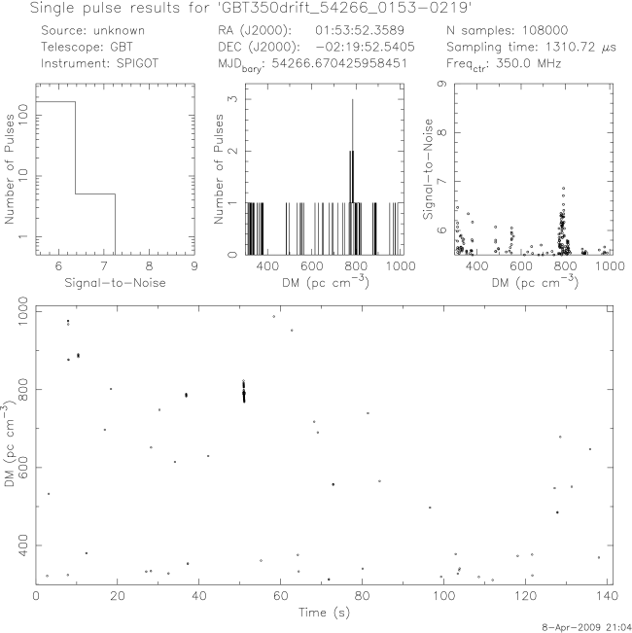
Comparing the “Crab” to a Single-Pulse Candidate
The signal-to-noise vs. # of pulses of the crab has a distinct downward slope while the other has a low signal to noise and very little slope.
DM is clear in both but extremely distinct in the Crab.
Time vs. DM is very clear in crab while just barely showing in candidate.

Slide 14
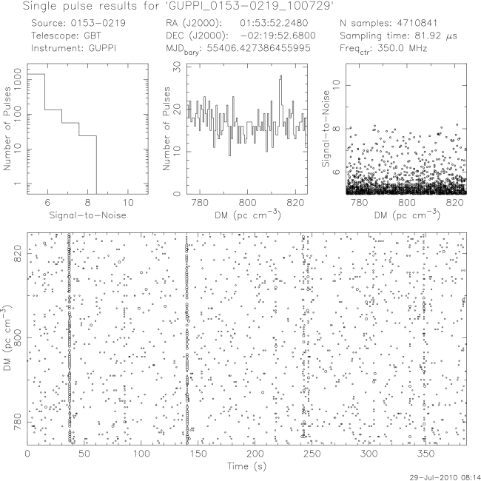
Pulsar to NOISE
Again, we can use the plots that we gather from known pulsars to know if a candidate is a real pulsar or simply RFI.
Obviously, this is not the pulsar we hoped for
The signal-to-noise vs. # of pulses plot looks good on the candidate, but the rest has no coherence to the Crab.
The time vs. DM plot does show distinct lines multiple times, but the DM is overly spaced over a variation of DMs.

Slide 15
Conclusion
We looked through all the possible data that fit our time slot but found no new pulsars. We found four known pulsars including the crab pulsar.
Having another session with the GBT would give us the chance to take a second look at some of our pointings that came back as RFI.

Slide 16
Special Thanks To…
Student Mentors
Teachers
  Especially Mot And Christine!
Scientists
  Rachel Rosen
  Ryan Lynch
  Sue Ann Heatherly
  Maura McLaughlin
  Duncan Lorimer
And Jocelyn Bell for starting it all!

