Slide 1
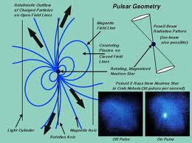
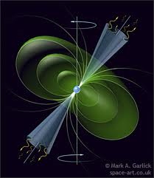
*Pulsar Research*
By: Team Lyne
Debra “Lil Debbie” Edwards
Grace “Watermelon” Shin
Hannah “Gosnell” Gosnell
Allyson “Birthday Girl” Meadows
Carlie “Killa” Kelley
Katy “Butterfly” Super
Vanessa “Kitty” Sandoval
Madelyn “Speed” Thomas
Keana “Mafia“ Robinson
Ferdinand “Double D”/”Fergilicious” Camarote

Slide 2
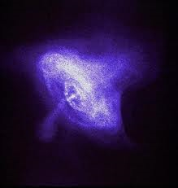
*Practice makes perfect!
B1642-03
RA:16:45
DEC: -03:17
DM: 35.665
We used a known pulsar to practice on.
You have to do a practice pulsar to make sure that the computers and equipment are all working correctly (calibration).
Our practice pulsar was a success!

Slide 3
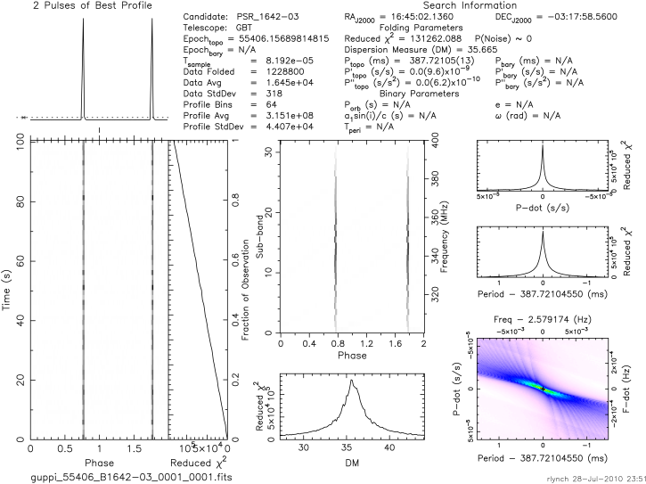

Slide 4
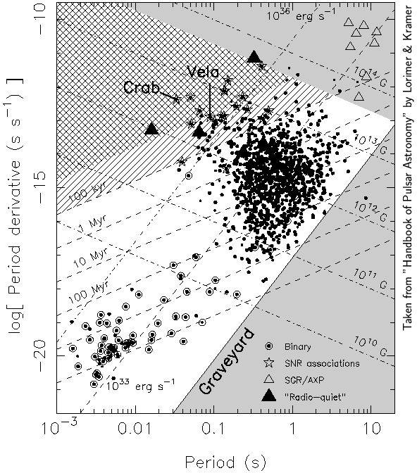
Period: 0.3876 s
log (P1): -14.75
European Pulsar Network Age: 3.45 million years
We calculated an age of 3.44 Myr

Slide 5
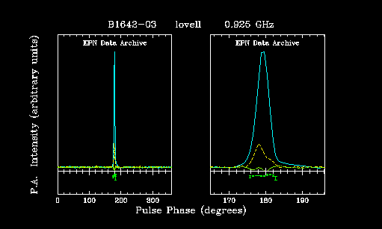
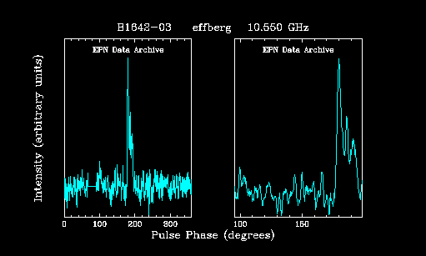
European Pulsar Network
  Above: 0.926 GHz
  Below: 10.550 GHz

Slide 6
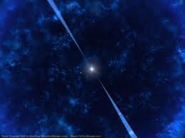
*Astronomical Discoveries!
RA: 17:42
DEC: -13:42
DM: 55.321
This pulsar was discovered by an astronomer in the drift scan database.
We chose this plot as a candidate because it is obviously a real pulsar.

Slide 7
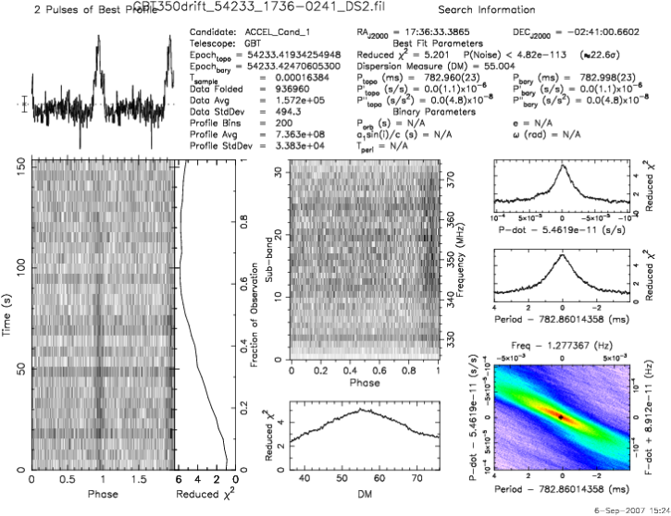

Slide 8
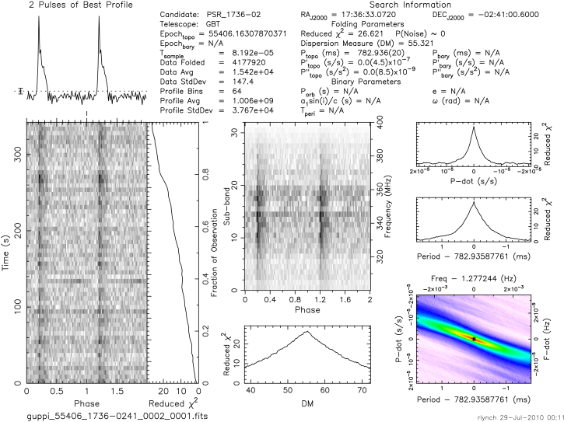

Slide 9
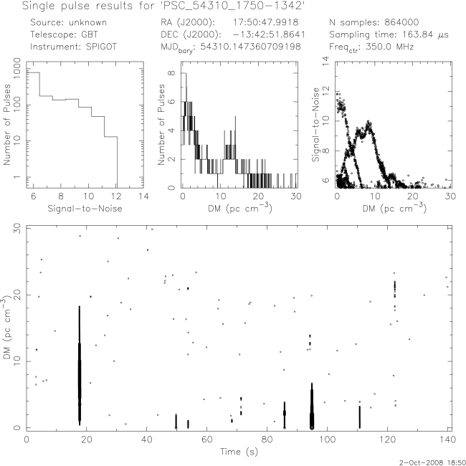
3
3
3

Slide 10
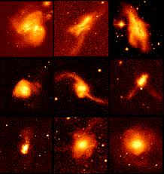
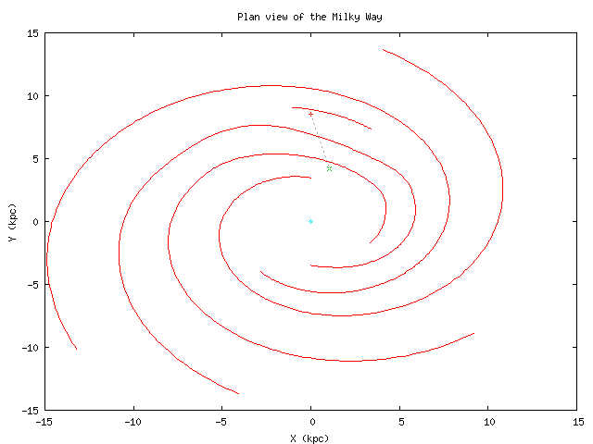
*Candidate #1
RA: 17:50
DEC: -13:42
DM maximum: 344
Galactic Longitude:13.6 degrees
Galactic Latitude: 7.0 degrees
Single pulse plot
4.5 kpc=14625 light years away
Possibly a rotating transient-characterized by bright radio bursts, periodically related, but occur infrequently, unlike the pulses of a normal pulsar.
Only appears at one time in the 140 second time period, but there is interference.
The signal tapers at the ends and is thicker in the middle. This is why we chose it as our candidate.

Slide 11
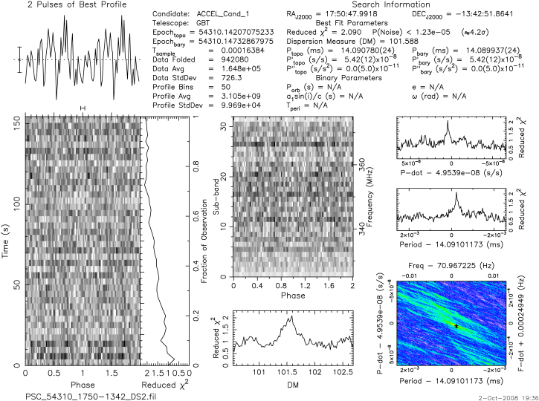
Our FFT plots for this RA and DEC are not very promising, but when we looked at the single pulse plot it resembled a RRAT.

Slide 12
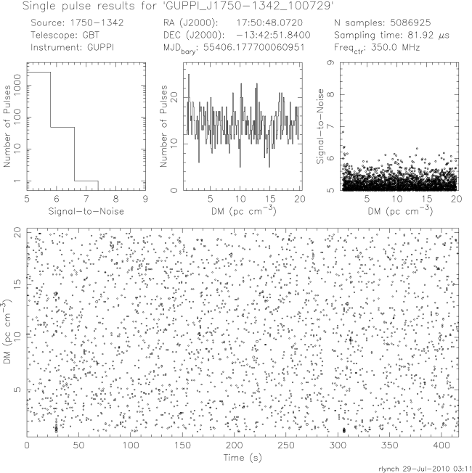
We observed this July 29. From our observations, this is not a pulsar, it is noise.
1
1
1

Slide 13
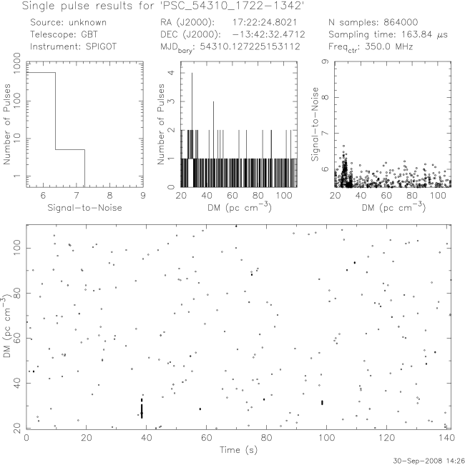
We thought that this single pulse plot would be a good candidate for a pulsar because of the two darker spots corresponding to each other. It also has fairly distinct peaks in the Number of Pulses and Signal-to Noise plots. At first glance, you might think this was RFI, but the lowest DM measure is actually 20. This candidate is about 3,912 light years away from us.
2
2
2
Candidate Pulsar 1722-1342

Slide 14
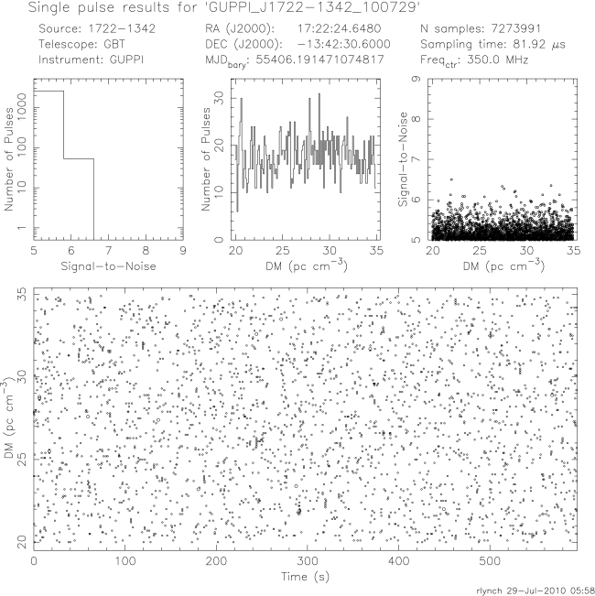
After our night at the GBT, this is what we discovered. We really didn’t find anything in this area. All of these plots point to the fact that this is most likely noise. We concluded that this candidate was not a pulsar.
1
1
1

Slide 15
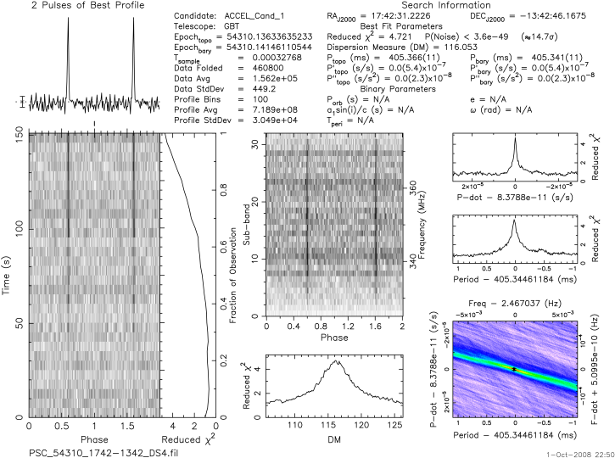
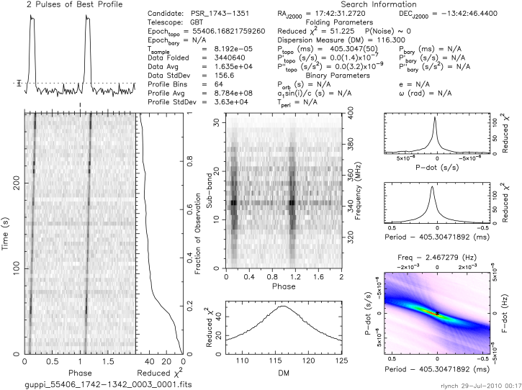
We found this in the database and looked it up in the ATNF Catalog. It looked like the perfect pulsar…
And it was!!
This pulsar is about 9,780 light years away. The DM, 116, and the latitude, 8, mean that it is near the galactic Plane. Within the galactic plane there is a lot of dust and gas, explaining why the DM is so high.
J1743-1351

Slide 16
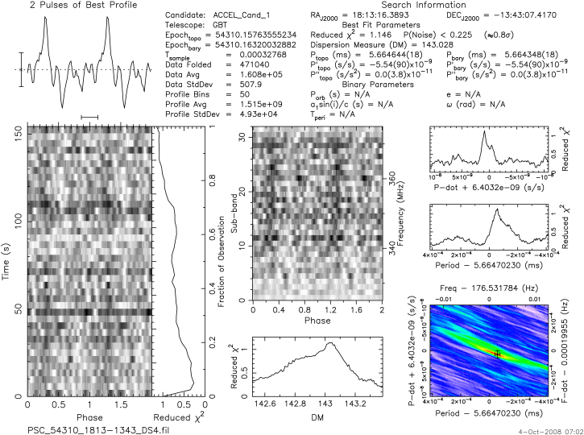
1813-1343
Time-Domain
2
Two blurry lines
that faded away towards the middle
and strengthened towards the top.
2
Sub-band
2
The ideal pulsar has a line that
stretches vertically across frequencies. Our
candidate has two vertical lines that run
across the middle frequencies.
2
This data was the original candidate we were to observe at the GBT.
July 28, 2010

Slide 17
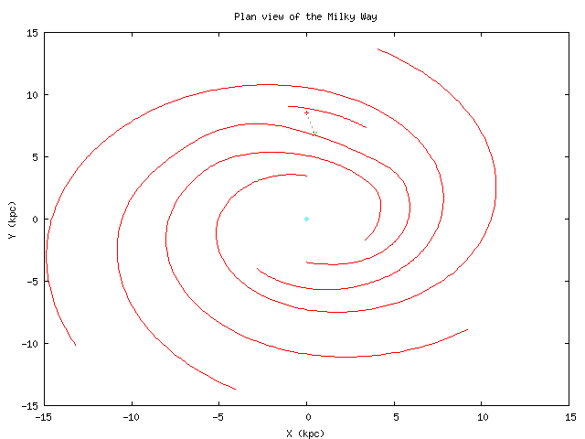
1813-1343
Distance
Galactic longitude is 16.4 degrees
Galactic latitude 2.1 degrees
Dispersion measure of 143.0 cm⁻³ pc
Estimated distance to your source is 9,454 light years
The maximum DM predicted by the model for this direction is 877.3 cm⁻³ pc

Slide 18
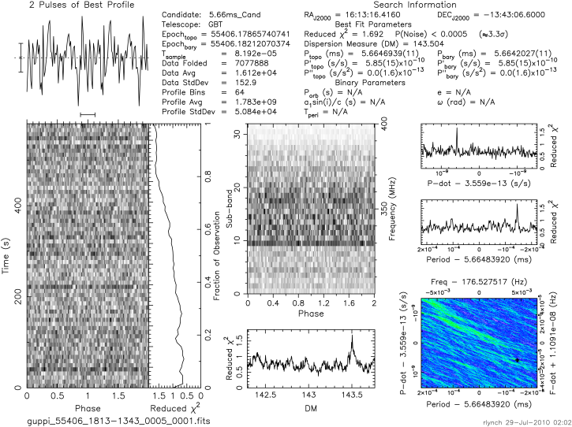
1613-1343
Pulse profile looks like noise
No distinct lines on the time- domain plot
no lines on the sub-band plot
DM is beyond the projected maximum value
Based on our observation this candidate is not a pulsar.
1
1
1
2
This is the candidate we accidentally looked up at the GBT.
July 29,2010

Slide 19
1613-1343
Distance
Galactic longitude 359.5 degrees
Galactic latitude 26.3 degrees,
Dispersion measure of 100.0 cm⁻³ pc,
Estimated distance to your source is 163,000 light years
The maximum DM predicted by the model for this direction is 71.8 cm⁻³ pc

Slide 20
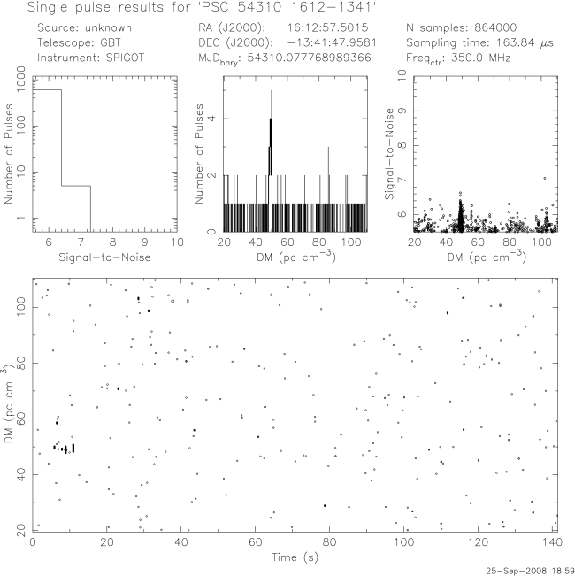
J1610-1322
The graph above is a known pulsar, J1610-1322.
September 25, 2008
3
3
3

Slide 21

Galactic longitude 359.4 degrees
Galactic latitude 26.5 degrees
Dispersion measure of 50.0 cm-3 pc,
Estimated distance to your source is 7,172 light years
Maximum DM predicted by the model for this direction is 71.1 cm-3 pc.

Slide 22
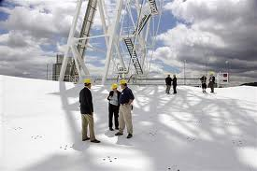
GBT TIME!
Our time on the GBT will be cherished for the rest of our lives. We are thankful that we got the chance to move a 17 million pound object (the largest moveable telescope EVER.). We have enjoyed our time at camp and would like to thank Sue Anne, Rachel, Ryan, Kevin, Duncan, Maura, the scientists, teachers, student mentors and everyone else who has made this place possible. You have made our incredible stay here fun. THANK YOU! Team Lyne will be returning to Green Bank March 6th 2014 to walk across the GBT ☺

