Slide 1
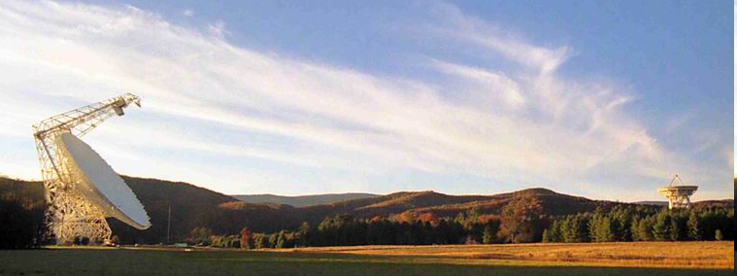
Calibration
Ron Maddalena
NRAO – Green Bank
November 2012

Slide 2
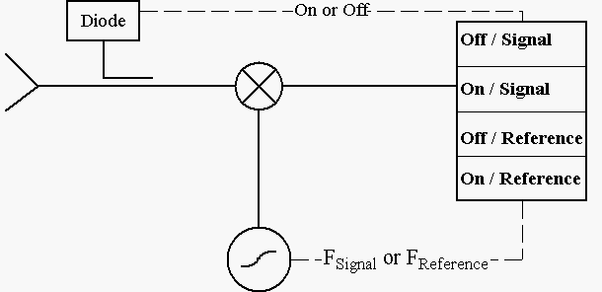
Receiver calibration sources allow us to convert the backend’s detected voltages to the intensity the signal had at the point in the system where the calibration signal is injected.

Slide 3
Reference observations
Difference a signal observation with a reference observation
Types of reference observations
  Frequency Switching
    In or Out-of-band
  Position Switching
  Beam Switching
    Move Subreflector
    Receiver beam-switch
  Dual-Beam Nodding
    Move telescope
    Move Subreflector

Slide 4
Position-Switched (On-Off) Observing

Slide 5
Typical Position-Switched Calibration Equation for a Point Source
A(Elev,t) = Air Mass
τ(ν,t) = Atmospheric Zenith Opacity
T_{cal} = Noise Diode Temperature
Area = Physical area of the telescope
η_{A} (ν,Elev) =Aperture efficiency (point sources)
T_{A} (ν) = Source Antenna Temperature
S(ν) = Source Flux Density
Sig(ν), Ref (ν) = Data taken on source and
on blank sky (in units backend counts)
On,Off = Data taken with the noise diode on and off
T_{sys} = System Temperature averaged over bandwidth

Slide 6
Position-Switched Calibration Equation
Sources of uncertainties
10-15% accuracy have been the ‘standard’
Usually, errors in T_{cal} dominate
Goal: To achieve 5% calibration accuracy without a significant observing overhead.

Slide 7
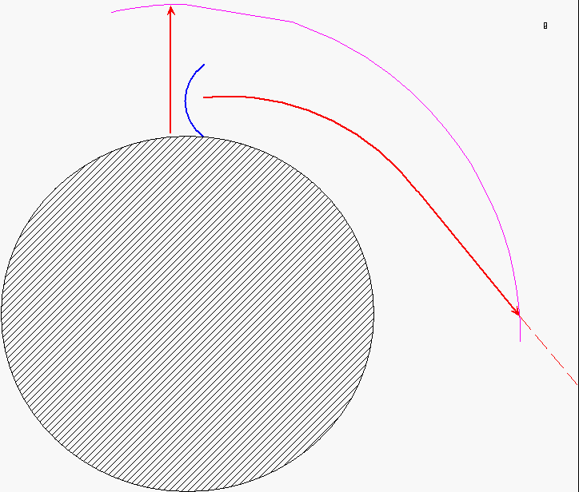
Air Mass Estimates
Depends upon density and index of refraction as a function of height
But, how can one get this information?

Slide 8
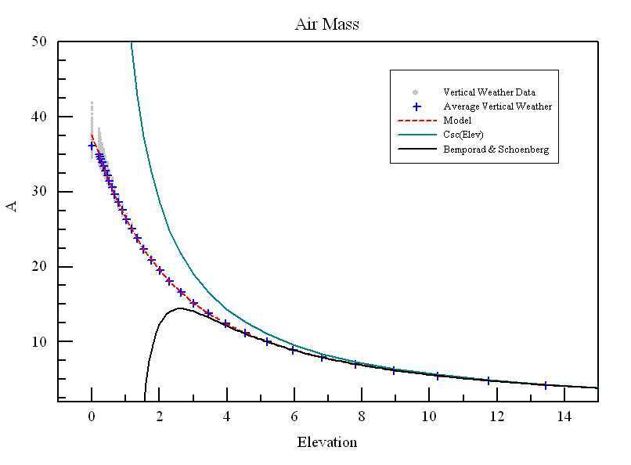
Air Mass Estimate
Air Mass traditionally modeled as 1/sin(Elev)
For 1% calibration accuracy, must use a better model below 15 deg.
Good to 1 deg
Use 1/sin(Elev) above 60 deg
Coefficients are site specific, at some low level

Slide 9
Typical Position-Switched Calibration Equation
A(Elev,t) = Air Mass
τ(ν,t) = Atmospheric Zenith Opacity
T_{cal} = Noise Diode Temperature
Area = Physical area of the telescope
η_{A} (ν,Elev) =Aperture efficiency (point sources)
T_{A} (ν) = Source Antenna Temperature
S(ν) = Source Flux Density
Sig(ν), Ref (ν) = Data taken on source and
on blank sky (in units backend counts)
On,Off = Data taken with the noise diode on and off
T_{sys} = System Temperature averaged over bandwidth

Slide 10
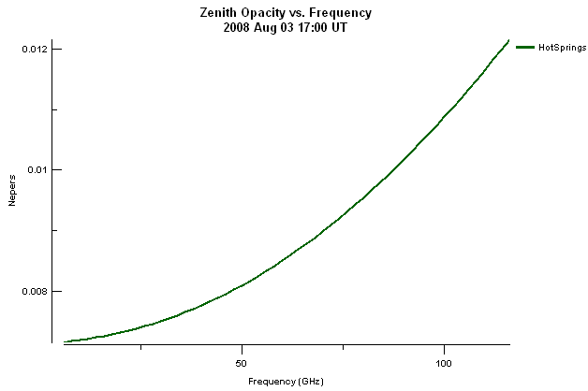
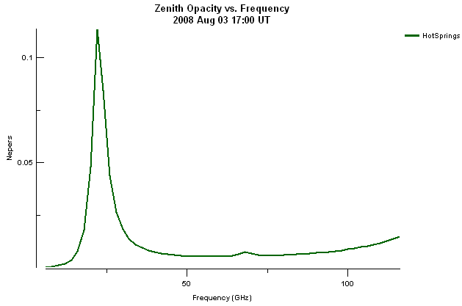
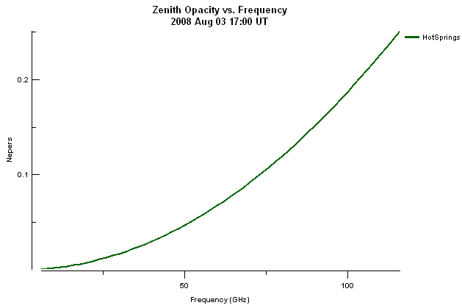
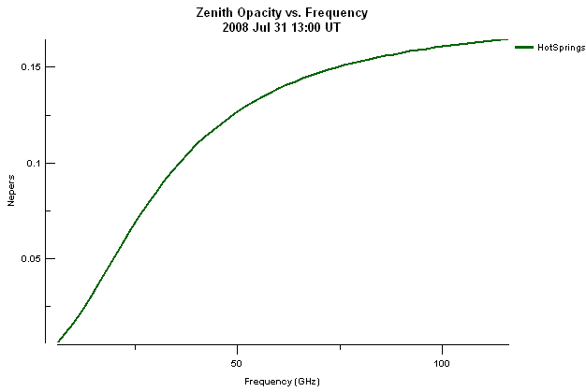
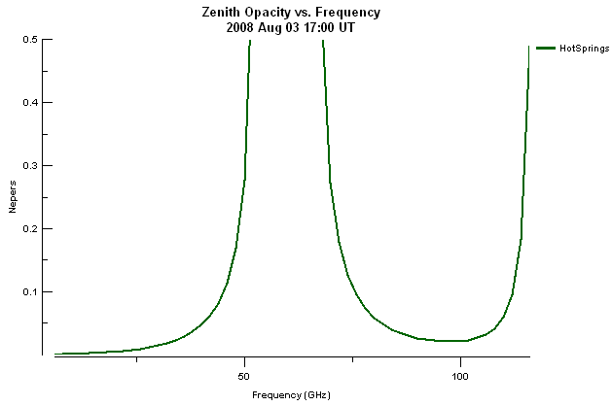
Opacities from the various components
Water Continuum
Dry Air Continuum
Water Line
Hydrosols
Oxygen Line

Slide 11
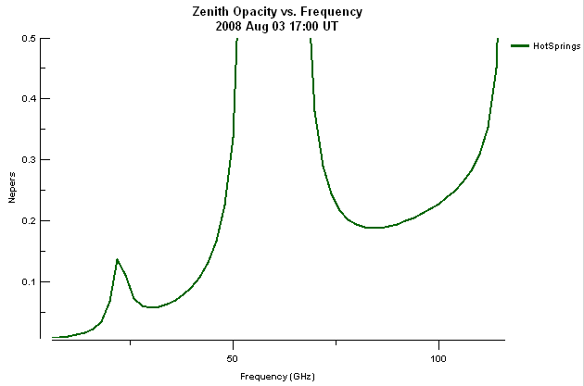
Opacities from the various components
gfs3_c27_1190268000.buf
Total Opacity

Slide 12
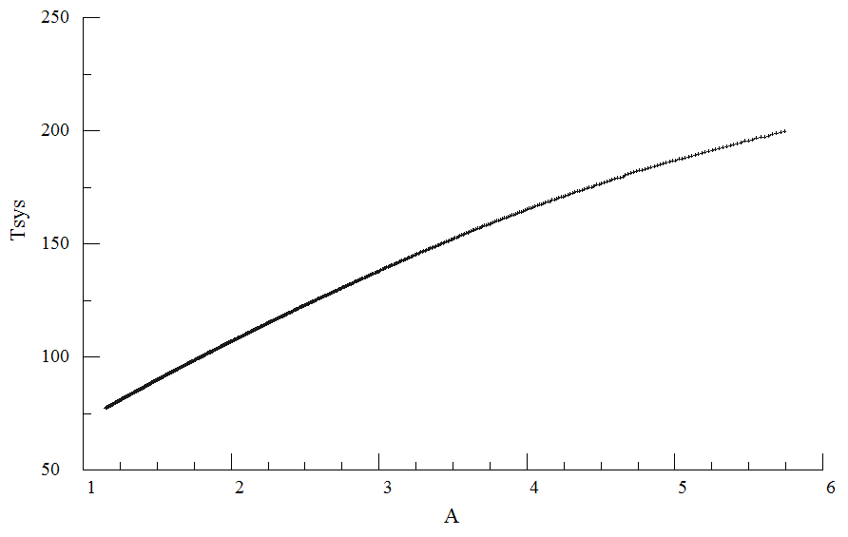
Determining Opacities
Slope ~ T_{ATM}τ

Slide 13
Typical Position-Switched Calibration Equation
A(Elev,t) = Air Mass
τ(ν,t) = Atmospheric Zenith Opacity
T_{cal} = Noise Diode Temperature
Area = Physical area of the telescope
η_{A} (ν,Elev) =Aperture efficiency (point sources)
T_{A} (ν) = Source Antenna Temperature
S(ν) = Source Flux Density
Sig(ν), Ref (ν) = Data taken on source and
on blank sky (in units backend counts)
On,Off = Data taken with the noise diode on and off
T_{sys} = System Temperature averaged over bandwidth

Slide 14
Determining T_{Cal} from hot-cold load measurements in the lab
Place black bodies (absorbers) of two known temperatures in front of the feed and record detected voltages.
    V_{Hot_Off} = g * T_{Hot}
    V_{Cold_Off} = g * T_{Cold}
    V_{Cold_On} = g * (T_{Cold} + T_{Cal})
g and T_{Cal} are unknown

Slide 15
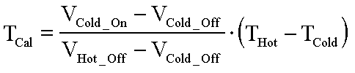
Determining T_{Cal} from hot-cold load measurements in the lab
Course frequency resolution
Uncertainties in load temperatures
Are the absorbers black bodies?
Detector linearities (300 & 75 K)
Lab T_{Cal} may be off by 10%
So… all good observers perform their own astronomical calibration observation

Slide 16
Noise Diode Estimates
Instead, we recommend an On-Off observation
  Use a point source with known flux -- polarization should be low or understood
  Use the same exact hardware, exact setup as your observation. (i.e., don’t use your continuum pointing data to calibrate your line observations.)
  Observations take ~5 minutes per observing run
  Staff take about 2 hrs to measure the complete band of a high-frequency, multi-beam receiver.
  Resolution sufficient: 1 MHz, sometimes better
  Accuracy of ~ 1%, mostly systematics.

Slide 17
Noise Diode Estimates
Remove Averaging, Solve for Tcal

Slide 18
Noise Diode Estimates

Slide 19
Typical Position-Switched Calibration Equation
A(Elev,t) = Air Mass
τ(ν,t) = Atmospheric Zenith Opacity
T_{cal} = Noise Diode Temperature
Area = Physical area of the telescope
η_{A} (ν,Elev) =Aperture efficiency (point sources)
T_{A} (ν) = Source Antenna Temperature
S(ν) = Source Flux Density
Sig(ν), Ref (ν) = Data taken on source and
on blank sky (in units backend counts)
On,Off = Data taken with the noise diode on and off
T_{sys} = System Temperature averaged over bandwidth

Slide 20
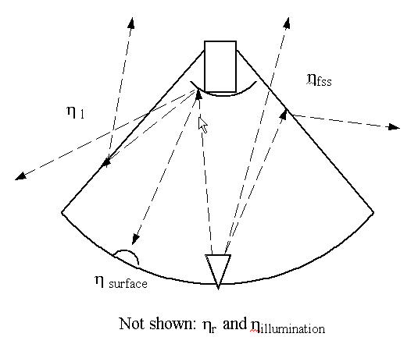
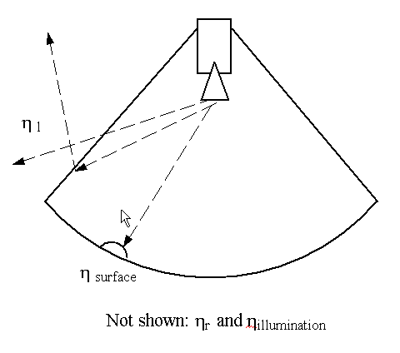
Telescope efficiencies – Part 1

Slide 21
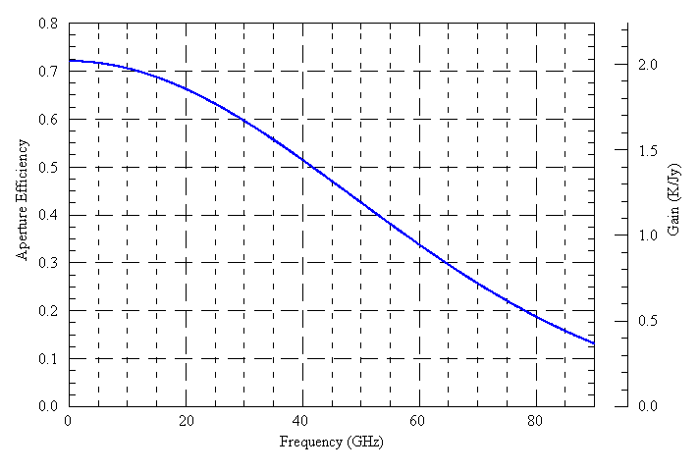
GBT Gain Curve
Ruze Equation – Surface errors

Slide 22
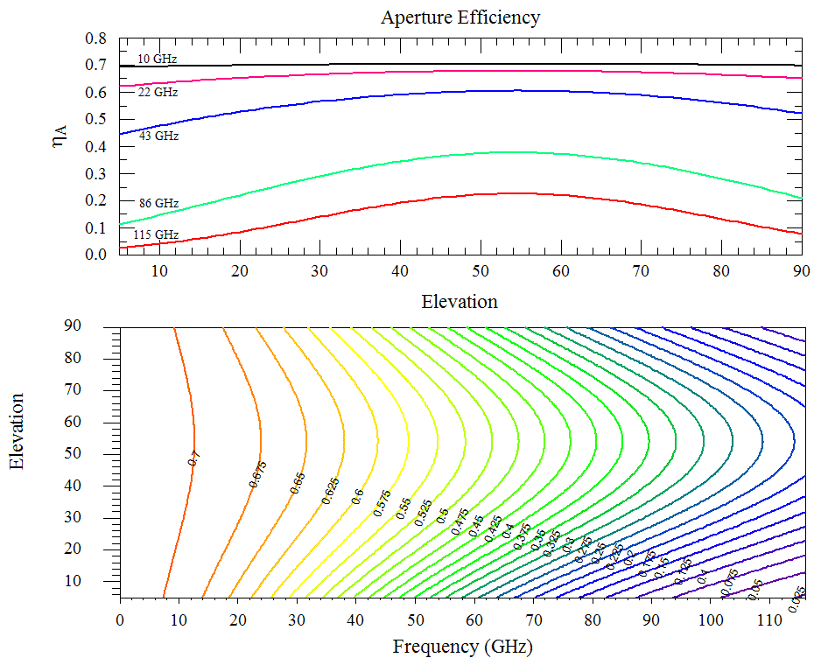
GBT Gain Curve

Slide 23
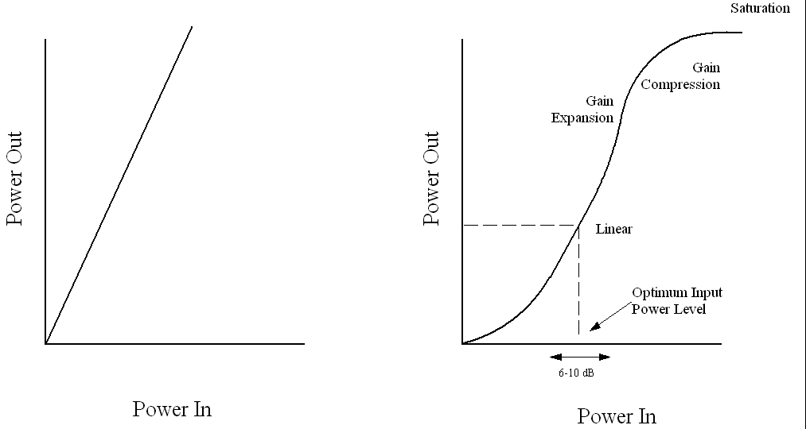
Non-linearity
If system is linear,
  P_{out} = B * P_{in}
  (Sig_{On}-Sig_{Off}) – (Ref_{On}-Ref_{Off} ) = 0
Model the response curve to 2nd order:
  P_{out} = B * P_{in} + C * P_{in}²
Our ‘On-Off’ observations of a calibrator provide:
  Four measured quantities: Ref_{off,} Ref_{on,} Sig_{off,} Sig_{on}
  T_{A} From catalog
  Four desired quantities: B, C, Tcal, Tsys
It’s easy to show that:
  C = [(Sig_{on}- Sig_{off} )-(Ref_{on}- Ref_{off})]/(2T_{A}T_{cal})
Thus:
  Can determine if system is sufficiently linear
  Can correct to 2nd order if it is not

Slide 24
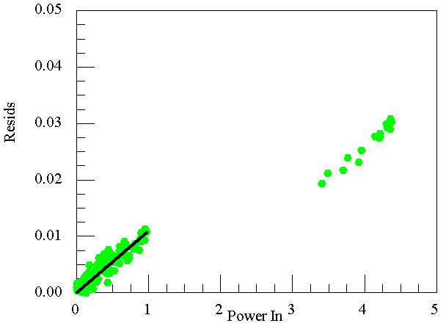
Non-linearity
(SigOn-SigOff) – (RefOn-RefOff )

Slide 25
Reference observations
Difference a signal observation with a reference observation
Types of reference observations
  Frequency Switching
    In or Out-of-band
  Position Switching
  Beam Switching
    Move Subreflector
    Receiver beam-switch
  Dual-Beam Nodding
    Move telescope
    Move Subreflector

Slide 26
Position switching
Move the telescope between a signal and reference position
  Overhead
  ½ time spent off source
Difference the two spectra
Assumes shape of gain/bandpass doesn’t change between the two observations.
For strong sources, must contend with dynamic range and linearity restrictions.

Slide 27
Frequency switching
Eliminates bandpass shape from components after the mixer
Leaves the derivative of the bandpass shape from components before the mixer.

Slide 28
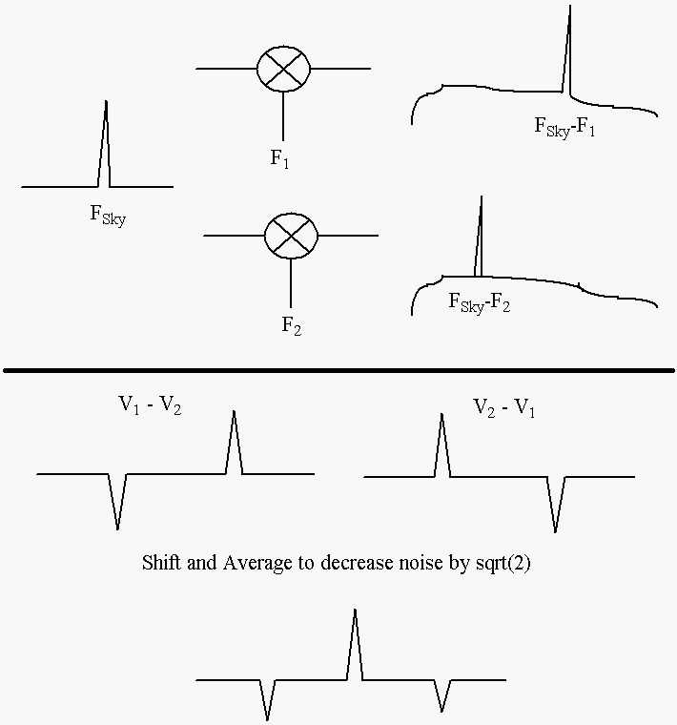
In-Band Frequency Switching

Slide 29
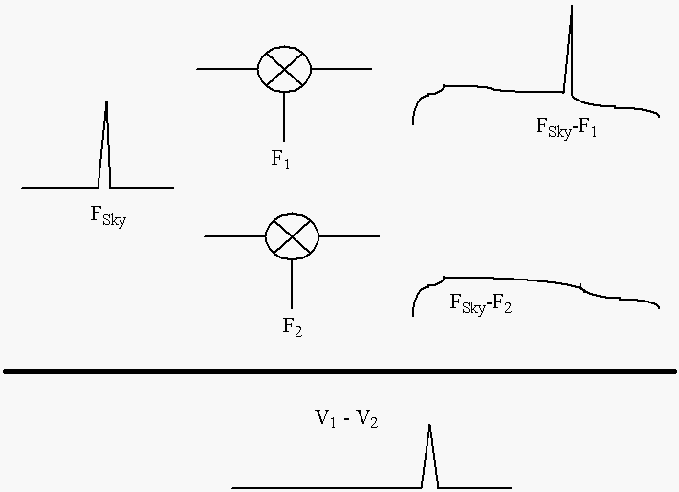
Out-Of-Band Frequency Switching

Slide 30
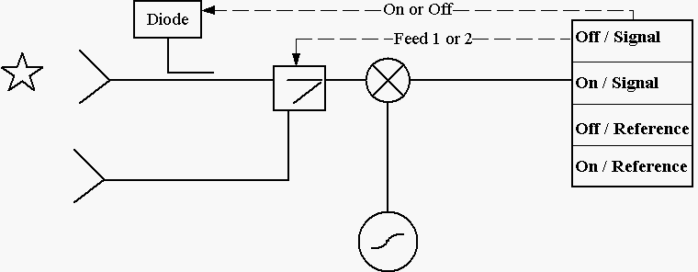
Beam switching – Internal switch
Difference spectra eliminates any contributions to the bandpass from after the switch
Residual will be the difference in bandpass shapes from all hardware in front of the switch.
Low overhead but ½ time spent off source

Slide 31
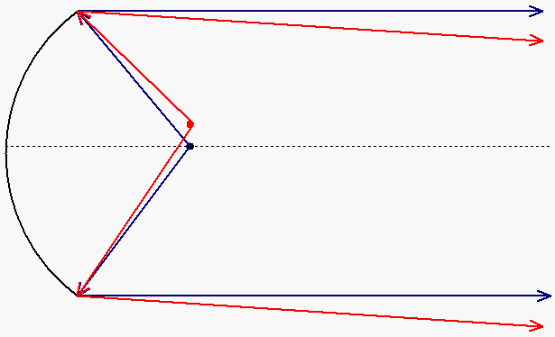
Atmosphere is in the near field
Common to all feeds in a multi-feed receiver

Slide 32
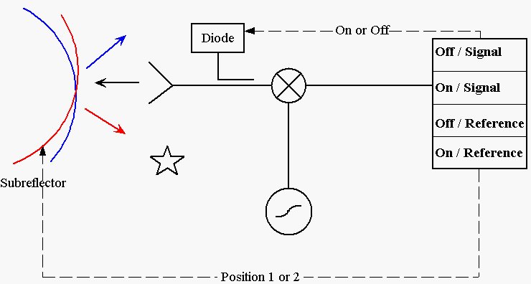
Beam Switching – Subreflector or tertiary mirror
Optical aberrations
Difference in spillover/ground pickup
Removes any ‘fast’ gain/bandpass changes
Low overhead. ½ time spent off source

Slide 33
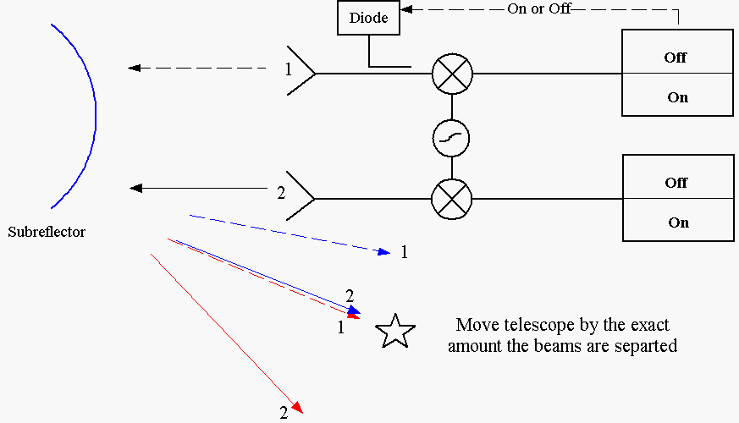
Nodding with dual-beam receivers - Telescope motion
Optical aberrations
Difference in spillover/ground pickup
Removes any ‘fast’ gain/bandpass changes
Overhead from moving the telescope. All the time is spent on source

Slide 34
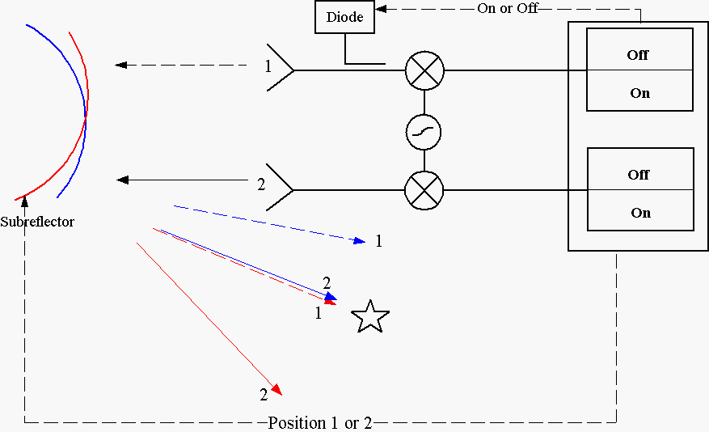
Nodding with dual-beam receivers - Subreflector or tertiary mirror
Optical aberrations
Difference in spillover/ground pickup
Removes any ‘fast’ gain/bandpass changes
Low overhead. All the time is spent on source

Slide 35
References
Rohlfs & Wilson, “Tools of Radio Astronomy”
Stanimrovis et al, “Single-Dish Radio Astronomy: Techniques and Practices”
Baars, 1973, IEEE Trans Antennas Propagat, Vol AP-21, no. 4, pp 461-474
Kutner & Ulich, 1981, Astronomica Journal, Vol 250,pp 341-348
Winkel, Kraus, & Bach, 2012, Astronomy & Astrophysics, vol. 540.

