Slide 1
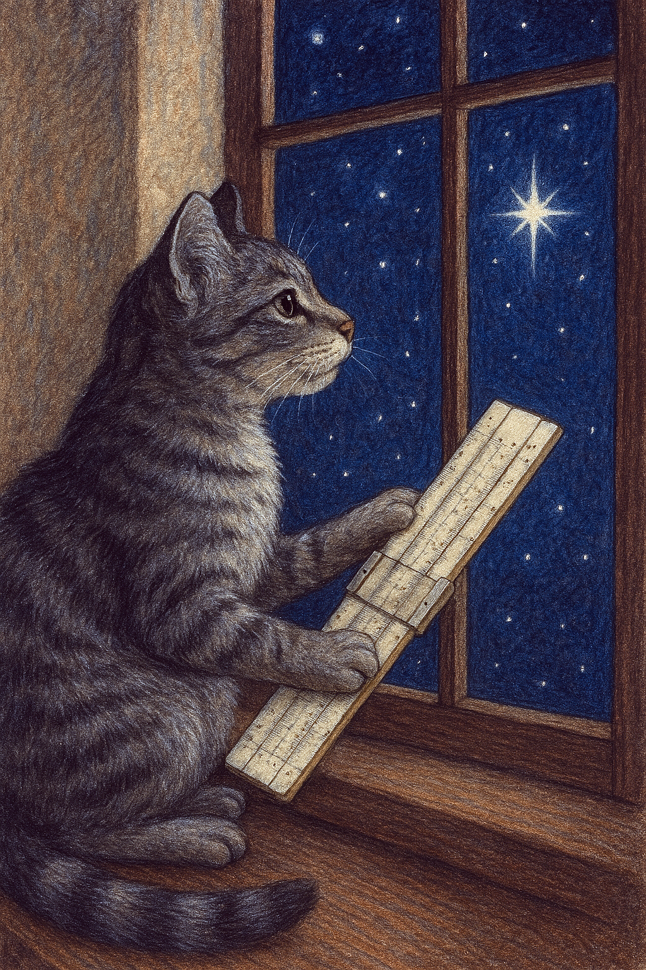

Topics in Calibration
Part I - Antenna Temperatures
Ron Maddalena
01 April 2026

Slide 2
J.W.M. Baars, “Measurements of Large Antenna with Cosmic Radio Sources”, IEEE Trans. Antennas Propogat., Vol. AP21, no. 4, pp 461-474, July 1973.
B. Winkel, A Kraus, & U Bach, “Unbiased Flux Calibration Methods for Spectral-Line Radio Observations”, A&A 540, 2012.
M.L. Kutner & B.L. Ulich, “Recommendations for Calibration Of Millimeter-Wavelength Spectral Line Data”, ApJ vol. 250, pp 341-348, Nov 1, 1981.
K. Rohlfs & T.L. Wilson, “Tools of Radio Astronomy”, 4th edition. §1.5, 4.2, 5.5, 6.3, 7.1, 7.2.
“Single Dish Radio Astronomy Techniques and Applications”, 2002.
  P.F. Goldsmith, “Radio Telescopes and Measurements at Radio Wavelengths”, §2.2, 4.2, 5, 6, Appendix.
  P.R. Jewell, “Millimeter Wave Calibration Techniques”, §1, 2, 3.
  R.J. Maddalena, “Reduction and Analysis Techniques”, §4

Slide 3
Outline
My approach
Spectral line calibration
GBTIDL’s ‘GETxxx’ routines
  Multiple sources of
    Systematic calibration errors
    Bad baseline
  Improper way to average integrations and scans
  How to save millions of $$ of telescope time every year
Two alternative algorithms
  Pluses: Baselines & Calibration
  Minuses: Higher Noise
Determining noise source intensities
  Astronomical observations significantly overestimate T_{ns}
  Hot-Cold load measurements give T_{ns} to better than 1%.

Slide 4
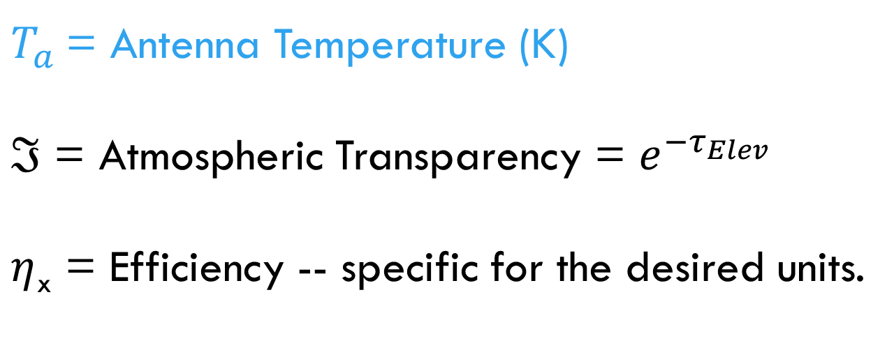
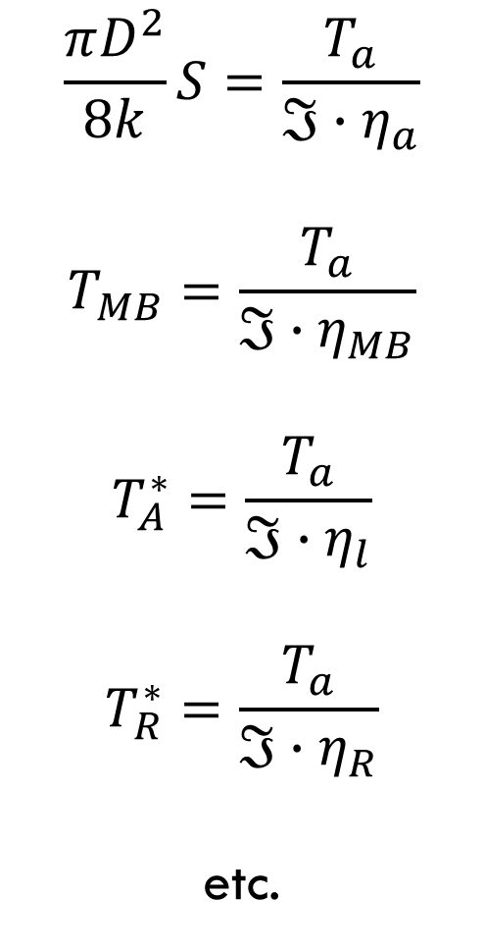
Scientific Relevant Units
$$\frac{πD^{2}}{8k}S=\frac{T_{a}}{{ℑ∙η}_{a}}$$
$$T_{MB}=\frac{T_{a}}{{ℑ∙η}_{MB}}$$
$$T_{A}^{∗}=\frac{T_{a}}{{ℑ∙η}_{l}}$$
$$T_{R}^{∗}=\frac{T_{a}}{{ℑ∙η}_{R}}$$
etc.
$T_{a}$= Antenna Temperature (K)
$ℑ$ = Atmospheric Transparency = $e^{−τ_{Elev}}$
$η$_{x} = Efficiency -- specific for the desired units.

Slide 5

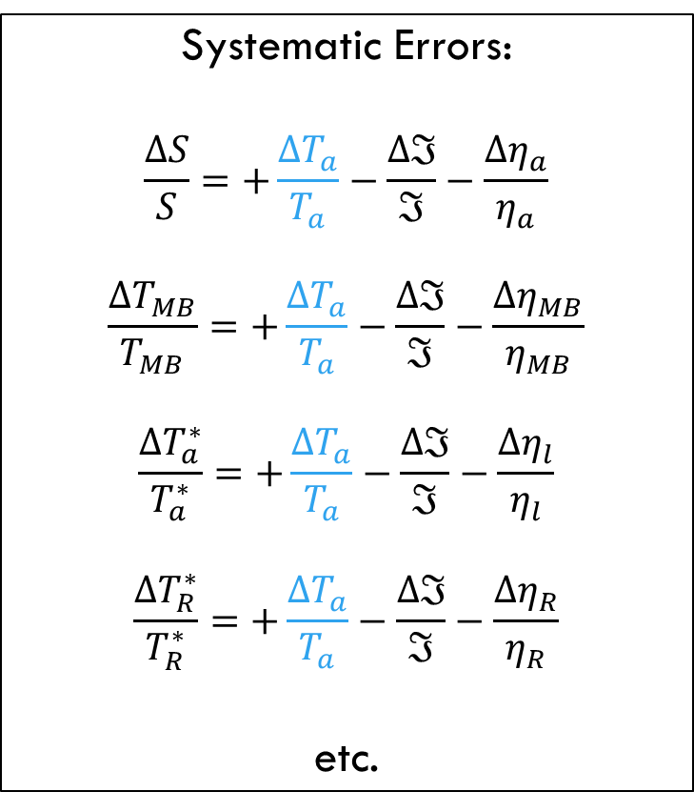
Using Fractional Errors
Simplifies the presentation
Δ : Systematic errors
σ : Random errors
Random Errors:
$${\left(\frac{σ_{S}}{S}\right)}^{2}={\left(\frac{σ_{T_{a}}}{T_{a}}\right)}^{2}+{\left(\frac{σ_{ℑ}}{ℑ}\right)}^{2}+{\left(\frac{σ_{η_{a}}}{η_{a}}\right)}^{2}$$
$${\left(\frac{σ_{T_{MB}}}{T_{MB}}\right)}^{2}={\left(\frac{σ_{T_{a}}}{T_{a}}\right)}^{2}+{\left(\frac{σ_{ℑ}}{ℑ}\right)}^{2}+{\left(\frac{σ_{η_{MB}}}{η_{MB}}\right)}^{2}$$
$${\left(\frac{σ_{T_{a}^{∗}}}{T_{a}^{∗}}\right)}^{2}={\left(\frac{σ_{T_{a}}}{T_{a}}\right)}^{2}+{\left(\frac{σ_{ℑ}}{ℑ}\right)}^{2}+{\left(\frac{σ_{η_{l}}}{η_{l}}\right)}^{2}$$
$${\left(\frac{σ_{T_{R}^{∗}}}{T_{R}^{∗}}\right)}^{2}={\left(\frac{σ_{T_{a}}}{T_{a}}\right)}^{2}+{\left(\frac{σ_{ℑ}}{ℑ}\right)}^{2}+{\left(\frac{σ_{η_{R}}}{η_{R}}\right)}^{2}$$
Systematic Errors:
$$\frac{ΔS}{S}=+\frac{{ΔT}_{a}}{T_{a}}−\frac{Δℑ}{ℑ}−\frac{{Δη}_{a}}{η_{a}}$$
$$\frac{ΔT_{MB}}{T_{MB}}=+\frac{{ΔT}_{a}}{T_{a}}−\frac{Δℑ}{ℑ}−\frac{{Δη}_{MB}}{η_{MB}}$$
$$\frac{ΔT_{a}^{∗}}{T_{a}^{∗}}=+\frac{{ΔT}_{a}}{T_{a}}−\frac{Δℑ}{ℑ}−\frac{{Δη}_{l}}{η_{l}}$$
$$\frac{ΔT_{R}^{∗}}{T_{R}^{∗}}=+\frac{{ΔT}_{a}}{T_{a}}−\frac{Δℑ}{ℑ}−\frac{{Δη}_{R}}{η_{R}}$$
etc.

Slide 6
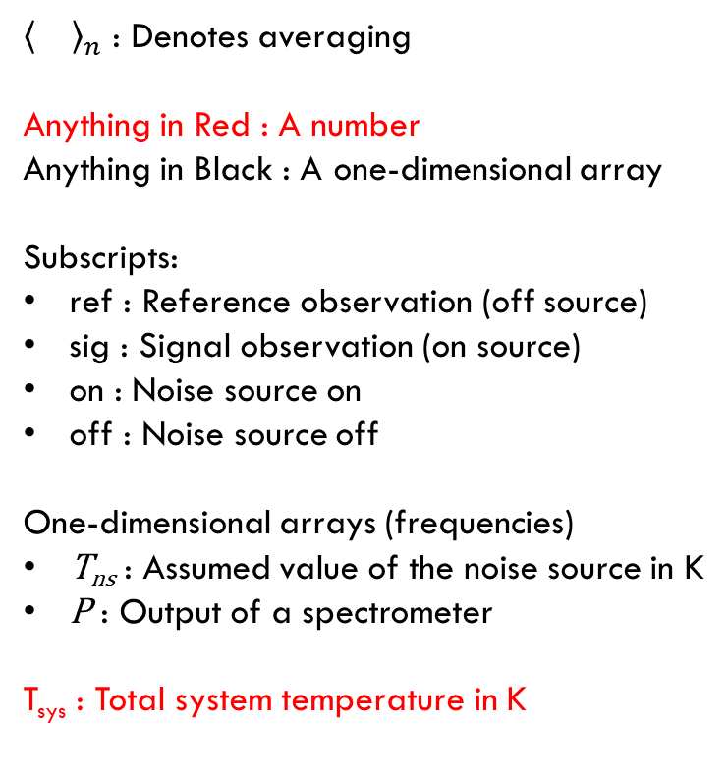


GBTIDL Spectral-Line Algorithm for determing T_{a} getps, getnod, getsigref, GETFS
${\left\langle \right\rangle }_{n}$ : Denotes averaging
Anything in Red : A number
Anything in Black : A one-dimensional array
Subscripts:
ref : Reference observation (off source)
sig : Signal observation (on source)
on : Noise source on
off : Noise source off
One-dimensional arrays (frequencies)
T_{ns} : Assumed value of the noise source in K
P : Output of a spectrometer
T_{sys} : Total system temperature in K
Basics:
$$T_{a}=\left(\frac{P_{sig}}{P_{ref}}−1\right)T_{sys,ref}$$
$$T_{sys,ref}={\left\langle \frac{P_{ref}{∙T}_{ns}}{P_{ref,on}−P_{ref,off}}\right\rangle }_{Bandwidth}$$
Simplified in order to show salient points:
$$T_{a}=\left(\frac{P_{sig,on}+P_{sig,off}}{P_{ref,on}+P_{ref,off}}−1\right)T_{sys,ref}$$
where
$$T_{sys,ref}={\left\langle \frac{P_{ref,on}+P_{ref,off}}{P_{ref,on}−P_{ref,off}} T_{ns}−\frac{T_{ns}}{2}\right\rangle }_{Bandwidth}$$

Slide 7




$$T_{a}=\left(\frac{P_{sig}}{P_{ref}}−1\right)T_{sys,ref}$$
Modelling
$P_{sig,off}=G_{sig}T_{sys,sig,off}=$ $G_{sig}\left({T_{a}+T}_{rcvr,sig}+T_{spill,sig}+T_{cmb}ℑ_{sig}+T_{atm}\left(1−ℑ_{sig}\right)\right)$
$P_{sig,on}={ G}_{sig}T_{sys,sig,on}=$ $G_{sig}\left(T_{sys,sig,off}+T_{ns}\right)$
$P_{ref,off}=G_{ref}T_{sys,ref,off}=$ $G_{ref}\left(T_{rcvr,ref}+T_{spill,ref}+T_{cmb}ℑ_{ref}+T_{atm}\left(1−ℑ_{ref}\right)\right)$
$P_{ref,on}=G_{ref}T_{sys,ref,on}=$ $G_{ref}\left(T_{sys,ref,off}+T_{ns}\right)$
Produces flat baselines and correctly calibrated $T_{a}$ only if:
$G_{sig}=G_{ref}$
$ℑ_{sig}=ℑ_{ref}$
$T_{spill,sig}=T_{spill,ref}$
$T_{rcvr,sig}=T_{rcvr,ref}$
$T_{sys,ref}$ : Constant with time
$T_{sys,ref}=T_{sys,sig}$
$T_{ns}$ : Constant with frequency and known to high accuracy
$\frac{ΔS}{S}= \frac{ΔT_{MB}}{T_{MB}}=$ $\frac{ΔT_{a}^{∗}}{T_{a}^{∗}}$ = $\frac{ΔT_{R}^{∗}}{T_{R}^{∗}}= \frac{ΔT_{ns}}{T_{ns}}$
$G_{sig}$ : Instrumental gain in units of Counts / K when observing your source
$G_{ref}$ : Instrumental gain in units of Counts / K when observing your reference position
$T_{a}$ : Antenna temperature (what we want)
$T_{rcvr}$ : Contribution of hardware
$T_{spill}$ : Contribution from spillover
$T_{cmb}$ : Contribution from the CMB
$T_{atm}\left(1−ℑ\right)$ : Contribution from the atmosphere
$T_{ns}$ : Contribution from Noise Source
B. Winkel, A Kraus, & U Bach, “Unbiased Flux Calibration Methods for Spectral-Line Radio Observations”, A&A 540, 2012.

Slide 8
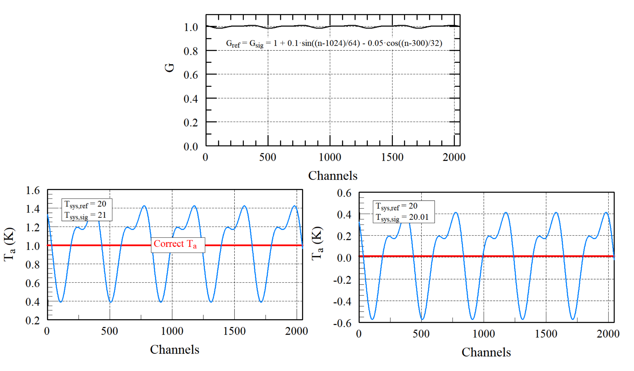

If all assumptions are satisfied except for a difference in Tsys
$$P_{sig}\left(i\right)=P_{ref}\left(i\right)+∆P$$
$$T_{a}\left(i\right)=\left(\frac{P_{sig}\left(i\right)}{P_{ref}\left(i\right)}−1\right)T_{sys,ref}$$
$$=\frac{∆P∙T_{sys,ref}}{P_{ref}\left(i\right)}$$

Slide 9

If all assumptions are satisfied except for a difference in G
$T_{a}=0$ ; $G_{sig}\left(i\right)=G_{ref}\left(i\right)+∆G$
$$T_{a}\left(i\right)=\left(\frac{G_{sig}\left(i\right)∙T_{Sys}(i)}{G_{ref}\left(i\right){∙T}_{Sys}(i)}−1\right)T_{sys,ref}$$
$$=\frac{∆G∙T_{sys,ref}}{G_{ref}\left(i\right)}$$
Over time G will also change shape with frequency.
$$G_{sig}\left(i\right)=G_{ref}\left(i\right)+∆G\left(i\right)$$
$$T_{a}\left(i\right)=\frac{∆G\left(i\right)∙T_{sys,ref}}{G_{ref}\left(i\right)}$$

Slide 10
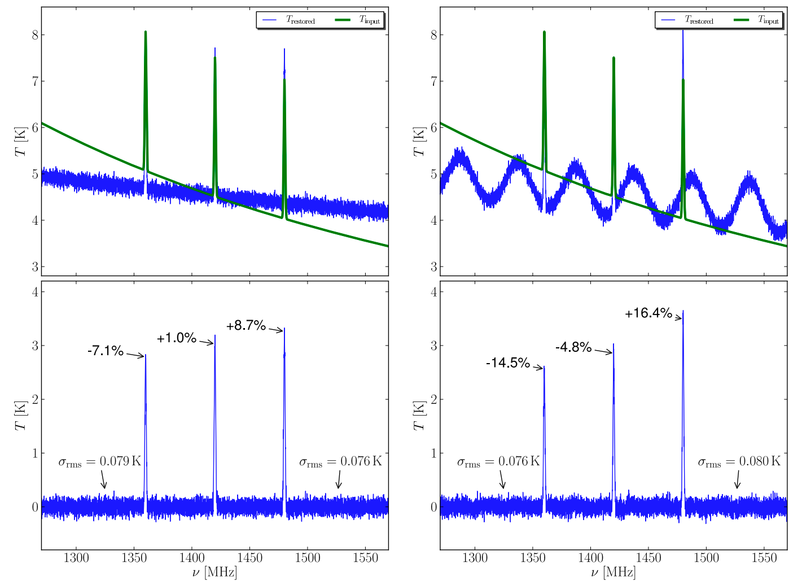

T_{sys} not constant Across The band
G & T_{sys} not constant Across the Band
Dinner in Elkins on me for the first person to find and fix the error in the ‘frequency-switched’ section of Winkel, Kraus, & Bach
Basics:
$$T_{a}=\left(\frac{P_{sig}}{P_{ref}}−1\right)T_{sys,ref}$$
$$T_{sys,ref}={\left\langle \frac{P_{ref}{∙T}_{ns}}{P_{ref,on}−P_{ref,off}}\right\rangle }_{Bandwidth}$$
B. Winkel, A Kraus, & U Bach, “Unbiased Flux Calibration Methods for Spectral-Line Radio Observations”, A&A 540, 2012.

Slide 11
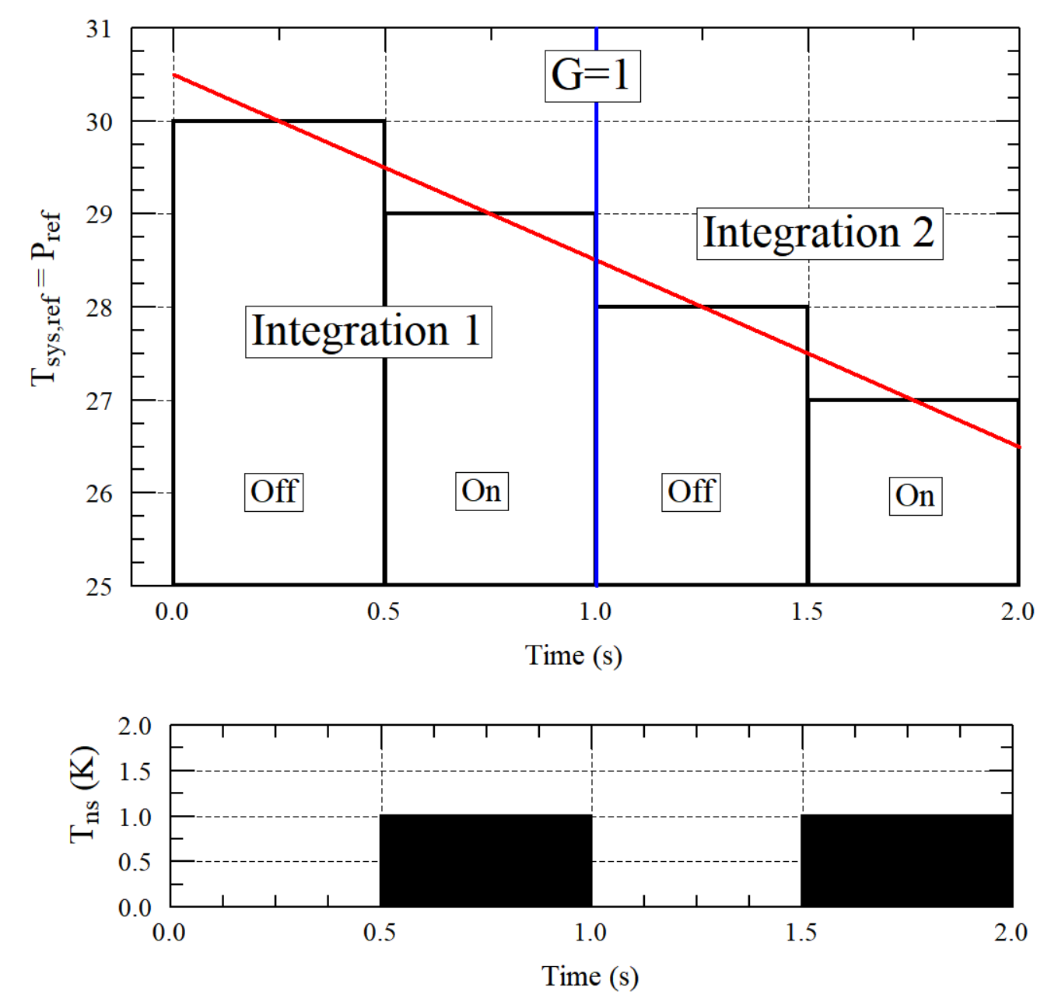
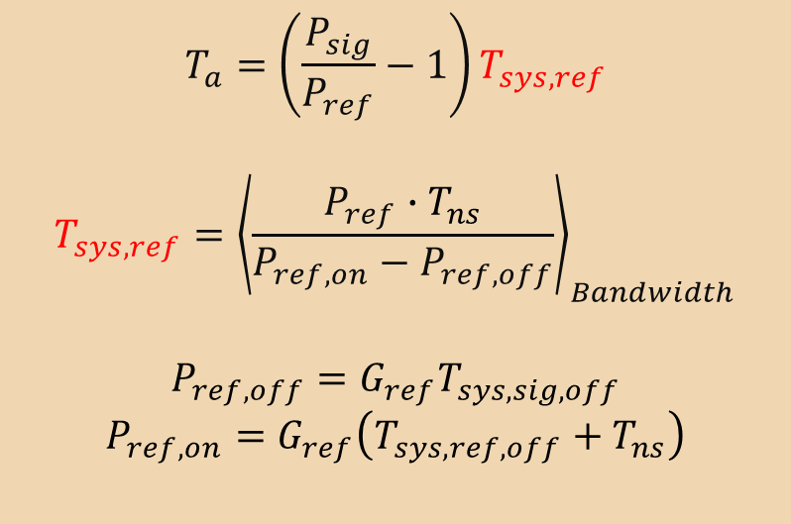

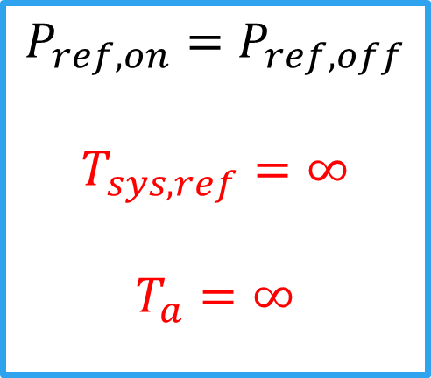
$$T_{a}=\left(\frac{P_{sig}}{P_{ref}}−1\right)T_{sys,ref}$$
$$T_{sys,ref}={\left\langle \frac{P_{ref}{∙T}_{ns}}{P_{ref,on}−P_{ref,off}}\right\rangle }_{Bandwidth}$$
$$P_{ref,off}=G_{ref}T_{sys,sig,off}$$
$$P_{ref,on}=G_{ref}\left(T_{sys,ref,off}+T_{ns}\right)$$
Instead of:
$$\frac{P_{ref,off}}{P_{ref,on}−P_{ref,off}}$$
Use:
$$\frac{P_{ref,off}}{P_{ref,on}−P_{ref,off}−\frac{P_{ref}\left(n\right)−P_{ref}(1)}{2n}}$$
Otherwise, for small $∆T_{sys}$:
$$\frac{{∆T}_{a}}{T_{a}}\sim \frac{∆T_{sys}}{2n∙T_{ns}}$$
$$P_{ref,on}=P_{ref,off}$$
$$T_{sys,ref}=∞$$
$$T_{a}=∞$$

Slide 12
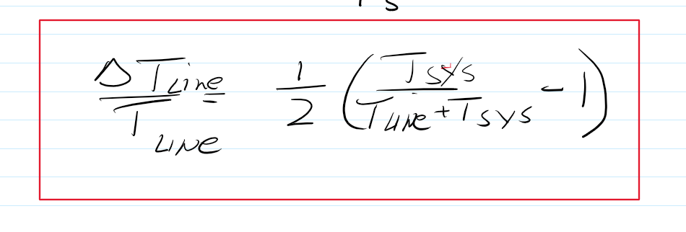
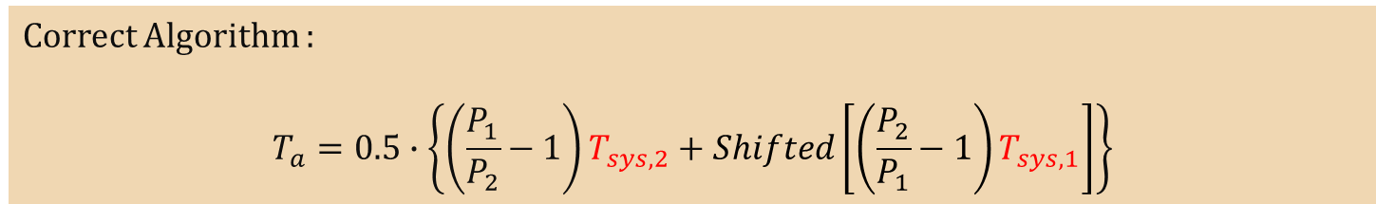
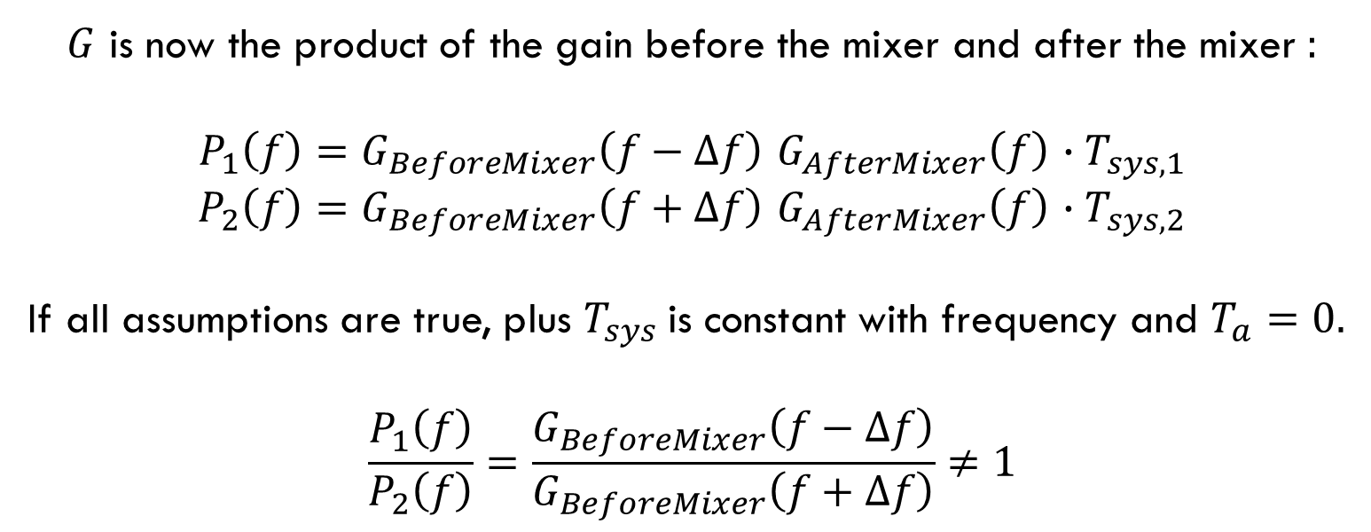
In-Band Frequency Switching
$$T_{a}=0.5∙\left\{\left(\frac{P_{1}}{P_{2}}−1\right)T_{sys,2}−Shifted\left[\left(\frac{P_{1}}{P_{2}}−1\right)T_{sys,2}\right]\right\}$$
Correct Algorithm :
$$T_{a}=0.5∙\left\{\left(\frac{P_{1}}{P_{2}}−1\right)T_{sys,2}+Shifted\left[\left(\frac{P_{2}}{P_{1}}−1\right)T_{sys,1}\right]\right\}$$
$G$ is now the product of the gain before the mixer and after the mixer :
$P_{1}\left(f\right)=G_{BeforeMixer}\left(f−∆f\right)$ $G_{AfterMixer}\left(f\right)$ ${∙T}_{sys,1}$
$P_{2}\left(f\right)=G_{BeforeMixer}\left(f+∆f\right)$ $G_{AfterMixer}\left(f\right)$ ${∙T}_{sys,2}$
If all assumptions are true, plus $T_{sys}$is constant with frequency and $T_{a}=0.$
$$\frac{P_{1}\left(f\right)}{P_{2}\left(f\right)}=\frac{G_{BeforeMixer}\left(f−∆f\right)}{G_{BeforeMixer}\left(f+∆f\right)}≠1$$

Slide 13
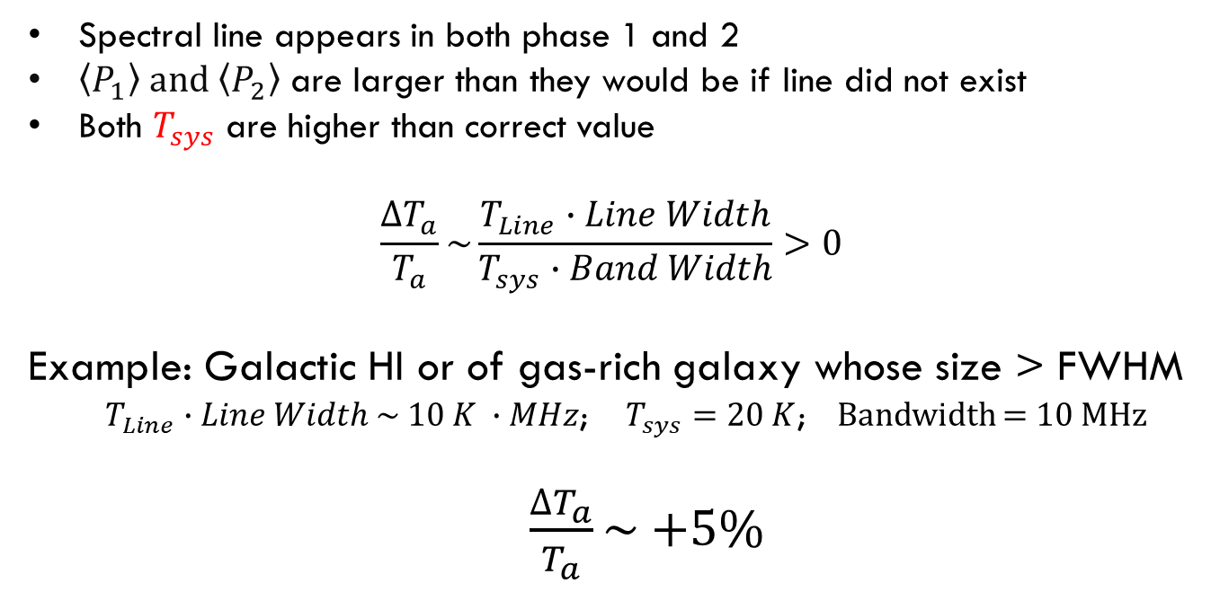

In-Band Frequency Switching
$$T_{sys,1}={\left\langle \frac{P_{1}{∙T}_{ns}}{P_{1,on}−P_{1,off}}\right\rangle }_{}T_{sys,2}={\left\langle \frac{P_{2}{∙T}_{ns}}{P_{2,on}−P_{2,off}}\right\rangle }_{}$$
Spectral line appears in both phase 1 and 2
$\left\langle P_{1}\right\rangle \text{and} \left\langle P_{2}\right\rangle$ are larger than they would be if line did not exist
Both $T_{sys}$ are higher than correct value
$$\frac{∆T_{a}}{T_{a}}\sim \frac{T_{Line}∙Line Width}{T_{sys}∙Band Width}>0$$
Example: Galactic HI or of gas-rich galaxy whose size > FWHM
$T_{Line}∙Line Width \sim 10 K ∙MHz$; $T_{sys}=20 K$; Bandwidth = 10 MHz
$\frac{∆T_{a}}{T_{a}}\sim$ +5%
GBTIDL does not have the ability for users to specify what channels are to be ignored when calculating $T_{sys}$.

Slide 14
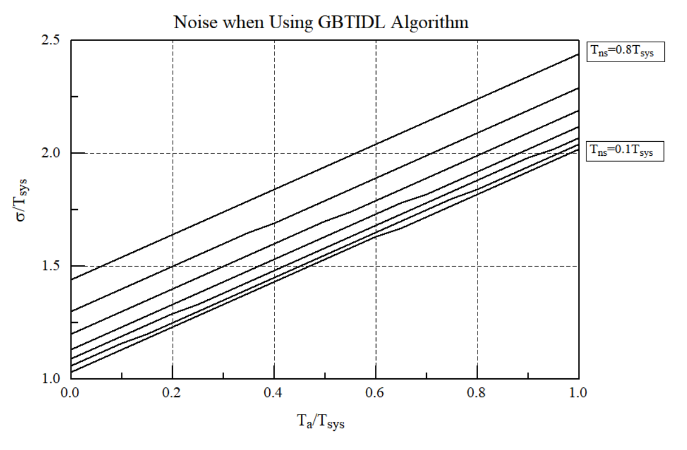
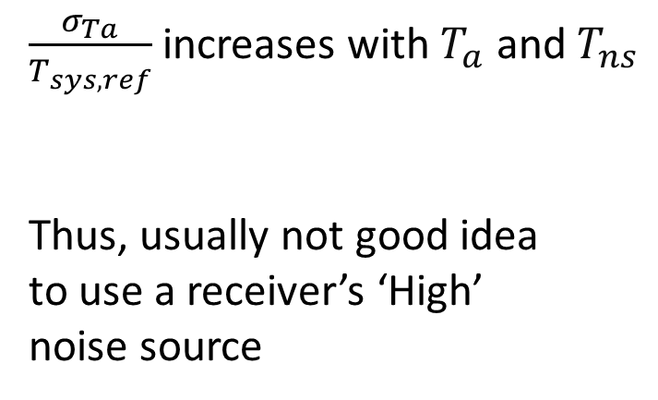
$\frac{σ_{Ta}}{T_{sys,ref}}$ increases with $T_{a}$ and $T_{ns}$
Thus, usually not good idea
to use a receiver’s ‘High’
noise source

Slide 15
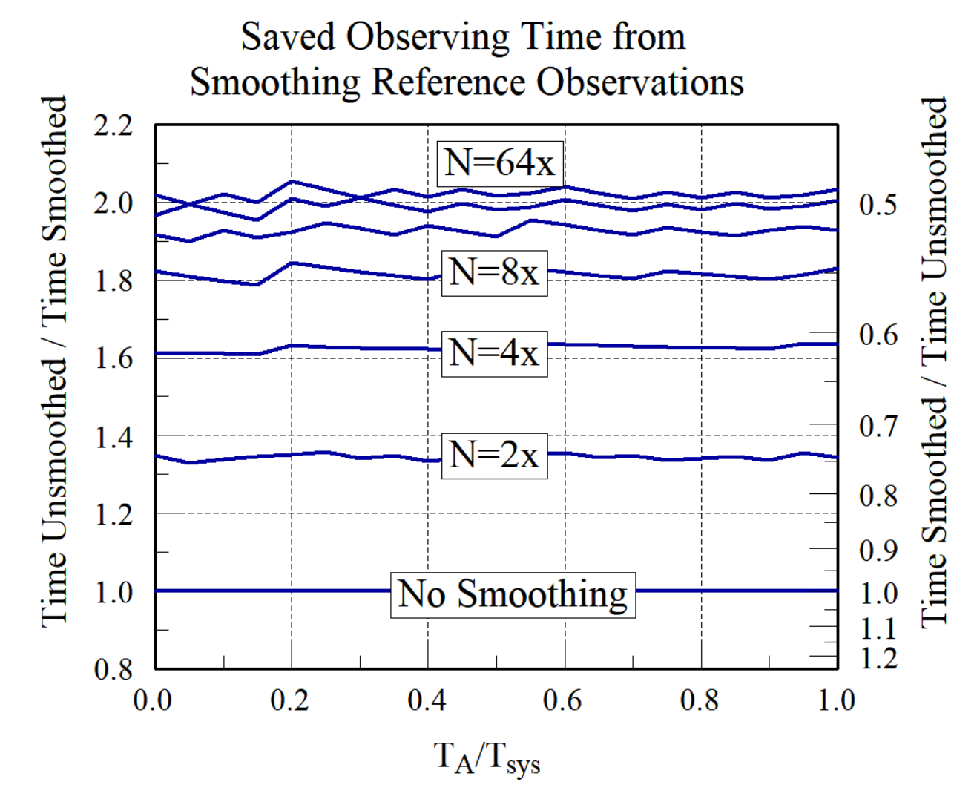
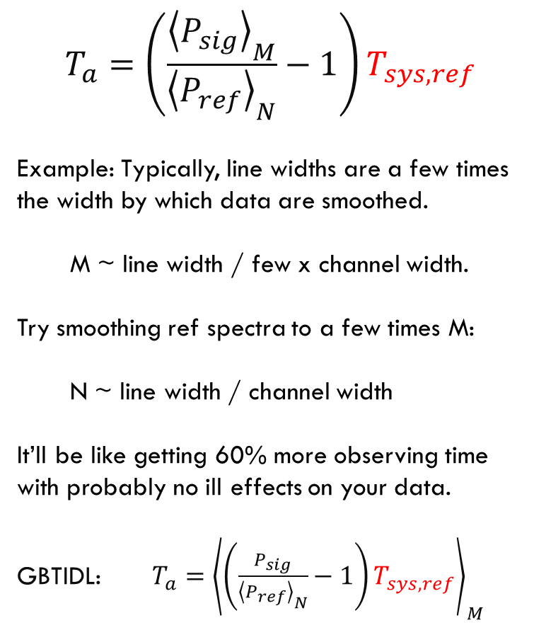
$$T_{a}=\left(\frac{{\left\langle P_{sig}\right\rangle }_{M}}{{\left\langle P_{ref}\right\rangle }_{N}}−1\right)T_{sys,ref}$$
Example: Typically, line widths are a few times the width by which data are smoothed.
M ~ line width / few x channel width.
Try smoothing ref spectra to a few times M:
N ~ line width / channel width
It’ll be like getting 60% more observing time with probably no ill effects on your data.
GBTIDL: $T_{a}={\left\langle \left(\frac{P_{sig}}{{\left\langle P_{ref}\right\rangle }_{N}}−1\right)T_{sys,ref}\right\rangle }_{M}$

Slide 16
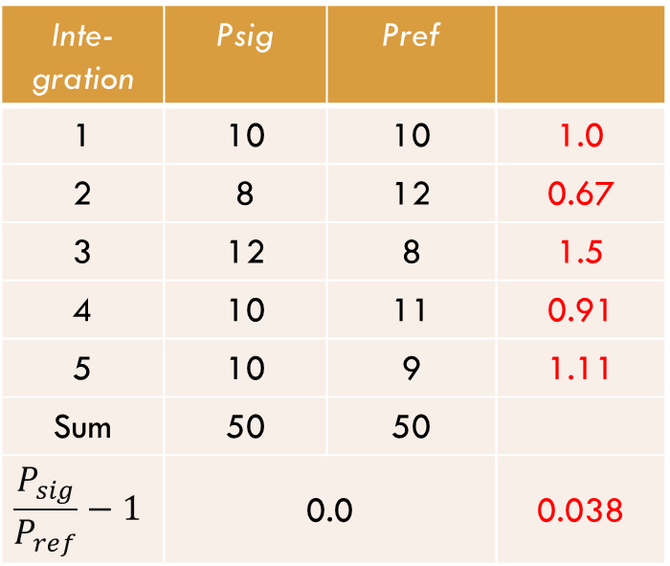
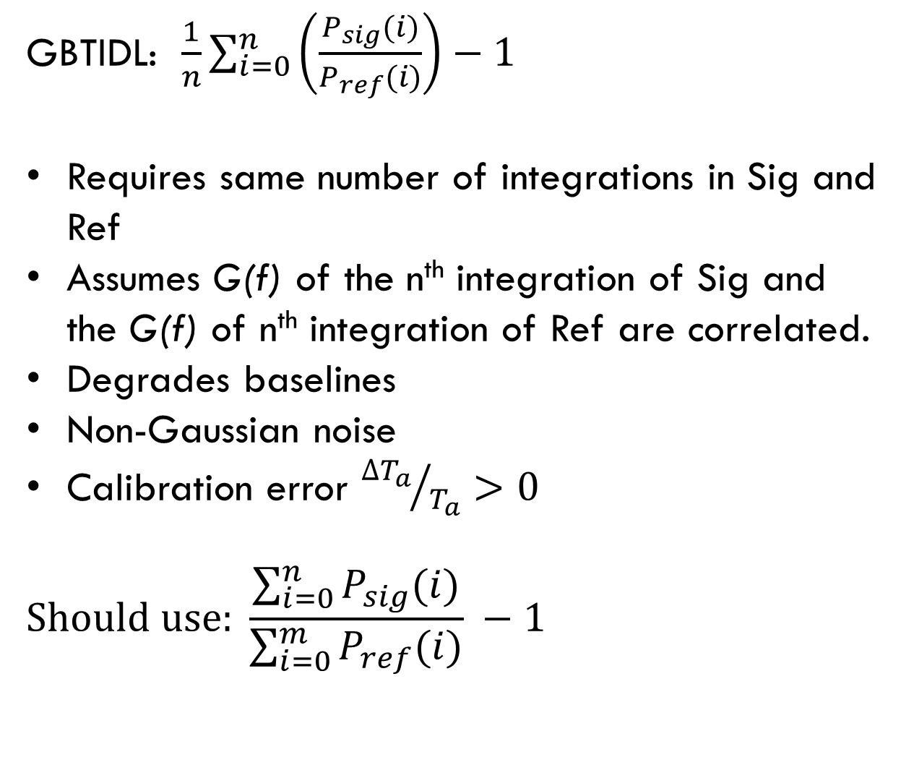

Averaging Integrations and Scans
Averaging Scans:
GBTIDL: $\frac{1}{n_{Total}}\sum_{s}{\sum_{i}{\left(\frac{P_{sig}(i)}{P_{ref}(i)}\right)}−1 }$
UniPOPS: $\frac{1}{n_{scans}}\sum_{s}{\frac{\sum_{i}{P_{sig}(i)}}{\sum_{i}{P_{ref}(i)}} −1 }$
Recommended: $\frac{\sum_{sig}{\sum_{i}{P_{sig}(i)}}}{\sum_{ref}{\sum_{i}{P_{ref}(i)}}} −1$
Weighted averages : $w=1/{σ^{2}}\sim {t_{effective}}/{T_{sys}^{2}}$
GBTIDL: $\frac{1}{n}\sum_{i=0}^{n}{\left(\frac{P_{sig}(i)}{P_{ref}(i)}\right)}−1$
Requires same number of integrations in Sig and Ref
Assumes G(f) of the n^{th} integration of Sig and the G(f) of n^{th} integration of Ref are correlated.
Degrades baselines
Non-Gaussian noise
Calibration error ${∆T_{a}}/{T_{a}}>0$
$$Should use: \frac{\sum_{i=0}^{n}{P_{sig}(i)}}{\sum_{i=0}^{m}{P_{ref}(i)}} −1$$
Inte-gration | Psig | Pref
1 | 10 | 10 | 1.0
2 | 8 | 12 | 0.67
3 | 12 | 8 | 1.5
4 | 10 | 11 | 0.91
5 | 10 | 9 | 1.11
Sum | 50 | 50
$$\frac{P_{sig}}{P_{ref}}−1$$ | 0.0 |  | 0.038

Slide 17
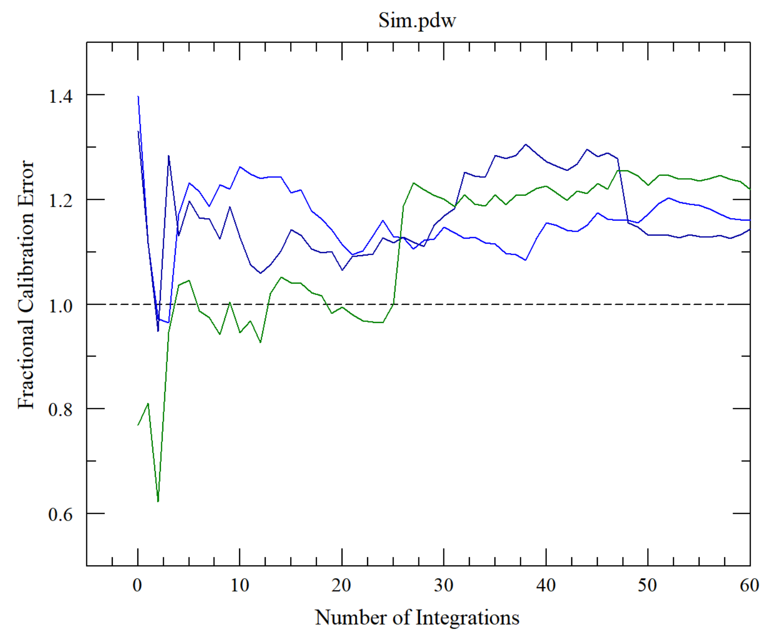
Calibration error when using GBTIDL’s averaging algorithm

Slide 18
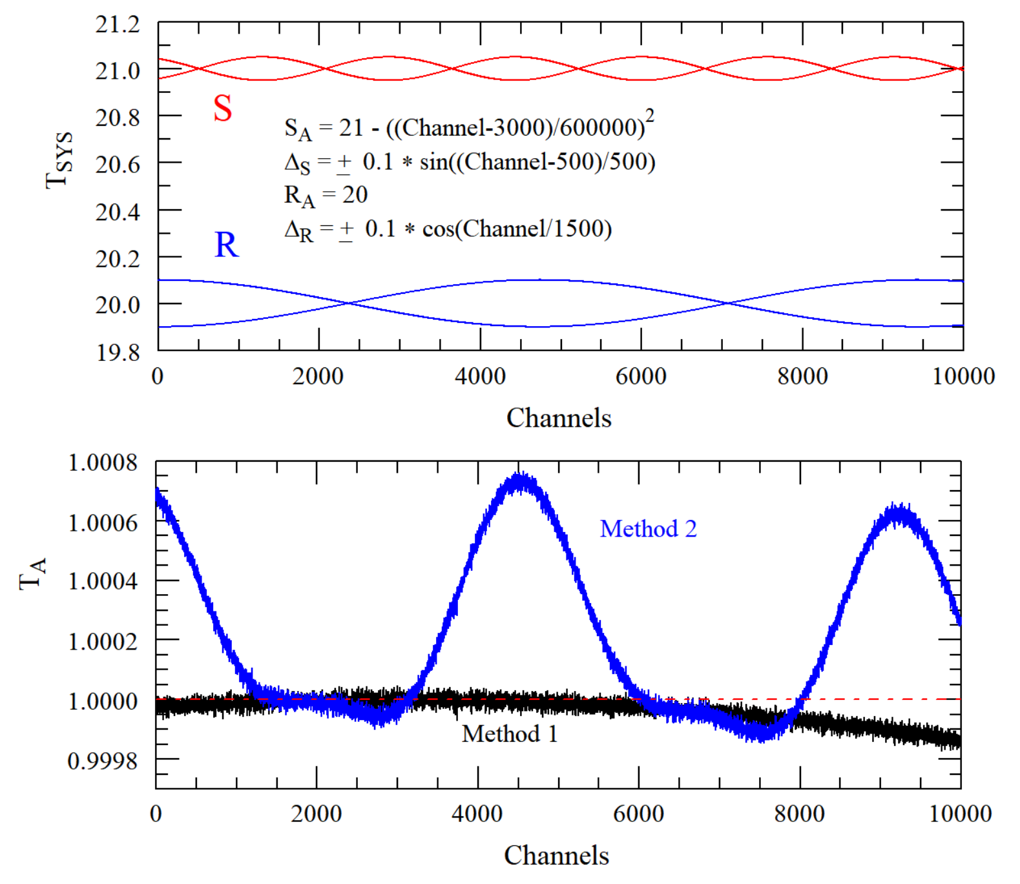
Baselines produced by GBTIDL’s Averaging Algorithm

Slide 19
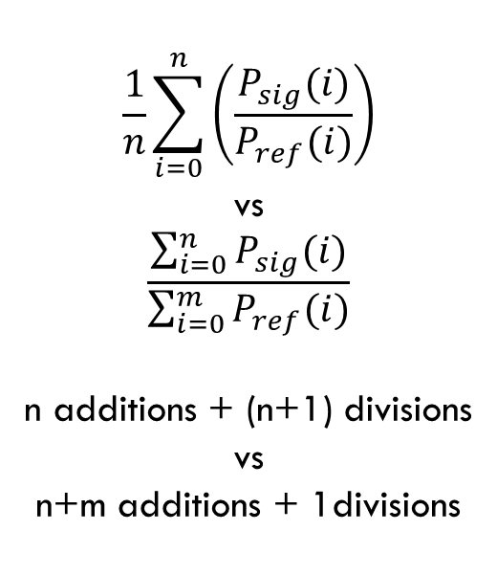
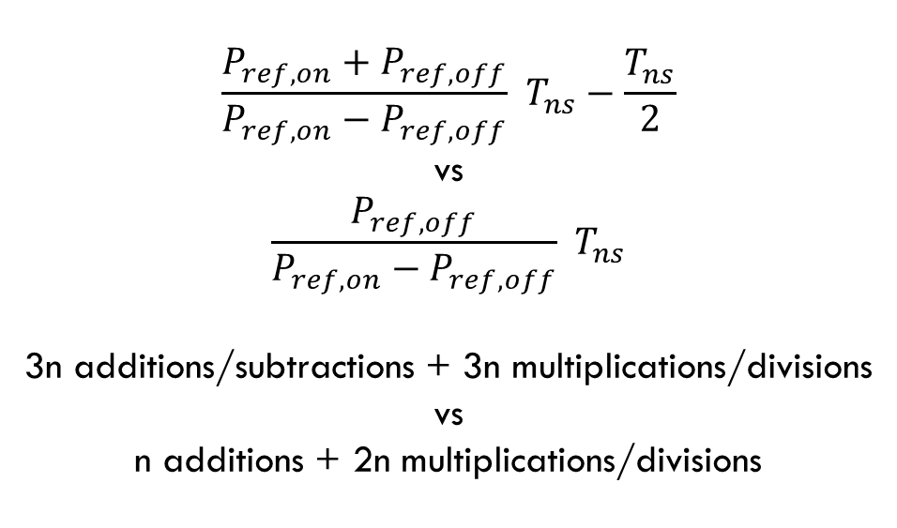
Wasted CPU Cycles
$$\frac{P_{ref,on}+P_{ref,off}}{P_{ref,on}−P_{ref,off}} T_{ns}−\frac{T_{ns}}{2}$$
vs
$$\frac{P_{ref,off}}{P_{ref,on}−P_{ref,off}} T_{ns}$$
3n additions/subtractions + 3n multiplications/divisions
vs
n additions + 2n multiplications/divisions
$$\frac{1}{n}\sum_{i=0}^{n}{\left(\frac{P_{sig}(i)}{P_{ref}(i)}\right)}$$
vs
$$\frac{\sum_{i=0}^{n}{P_{sig}(i)}}{\sum_{i=0}^{m}{P_{ref}(i)}}$$
n additions + (n+1) divisions
vs
n+m additions + 1divisions

Slide 20
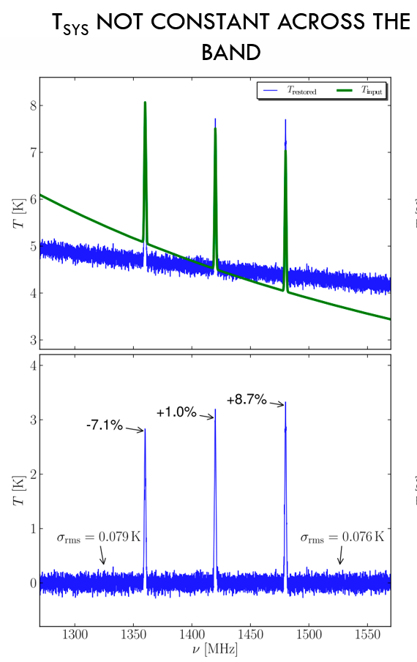
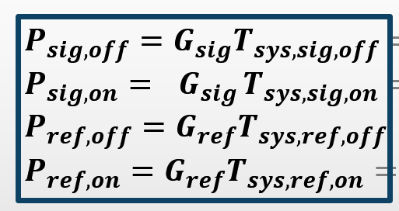


Alternative Algorithm #1
GBTIDL: $T_{a}=\left(\frac{P_{sig,on}+P_{sig,off}}{P_{ref,on}+P_{ref,off}}−1\right){\left\langle \frac{P_{ref,on}+P_{ref,off}}{P_{ref,on}−P_{ref,off}} T_{ns}−\frac{T_{ns}}{2}\right\rangle }_{Bandwidth}$
$$T_{a}=\left(\frac{\left(P_{sig,on}+P_{sig,off}\right)−\left(P_{ref,on}+P_{ref,off}\right)}{P_{ref,on}−P_{ref,off}}\right)∙\frac{T_{ns}}{2}$$
$$=\frac{P_{sig}−P_{ref}}{P_{ref,on}−P_{ref,off}}∙T_{ns}$$
Requires:
$G_{sig}=G_{ref}$
$ℑ_{sig}=ℑ_{ref}$
$T_{spill,sig}=T_{spill,ref}$
$T_{rcvr,sig}=T_{rcvr,ref}$
$T_{sys,ref}$ : Constant with time
$T_{sys,ref}=T_{sys,sig}$
$T_{ns}$ : Constant with frequency and known to high accuracy

Slide 21
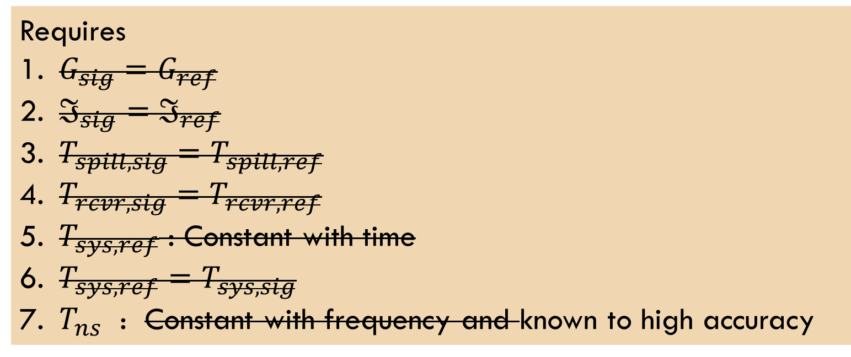
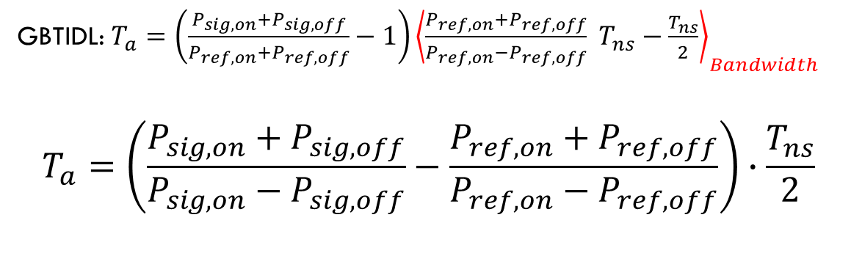
Alternative Algorithm #2
GBTIDL: $T_{a}=\left(\frac{P_{sig,on}+P_{sig,off}}{P_{ref,on}+P_{ref,off}}−1\right){\left\langle \frac{P_{ref,on}+P_{ref,off}}{P_{ref,on}−P_{ref,off}} T_{ns}−\frac{T_{ns}}{2}\right\rangle }_{Bandwidth}$
$$T_{a}=\left(\frac{P_{sig,on}+P_{sig,off}}{P_{sig,on}−P_{sig,off}}−\frac{P_{ref,on}+P_{ref,off}}{P_{ref,on}−P_{ref,off}}\right)∙\frac{T_{ns}}{2}$$
Requires
$G_{sig}=G_{ref}$
$ℑ_{sig}=ℑ_{ref}$
$T_{spill,sig}=T_{spill,ref}$
$T_{rcvr,sig}=T_{rcvr,ref}$
$T_{sys,ref}$ : Constant with time
$T_{sys,ref}=T_{sys,sig}$
$T_{ns}$ : Constant with frequency and known to high accuracy

Slide 22
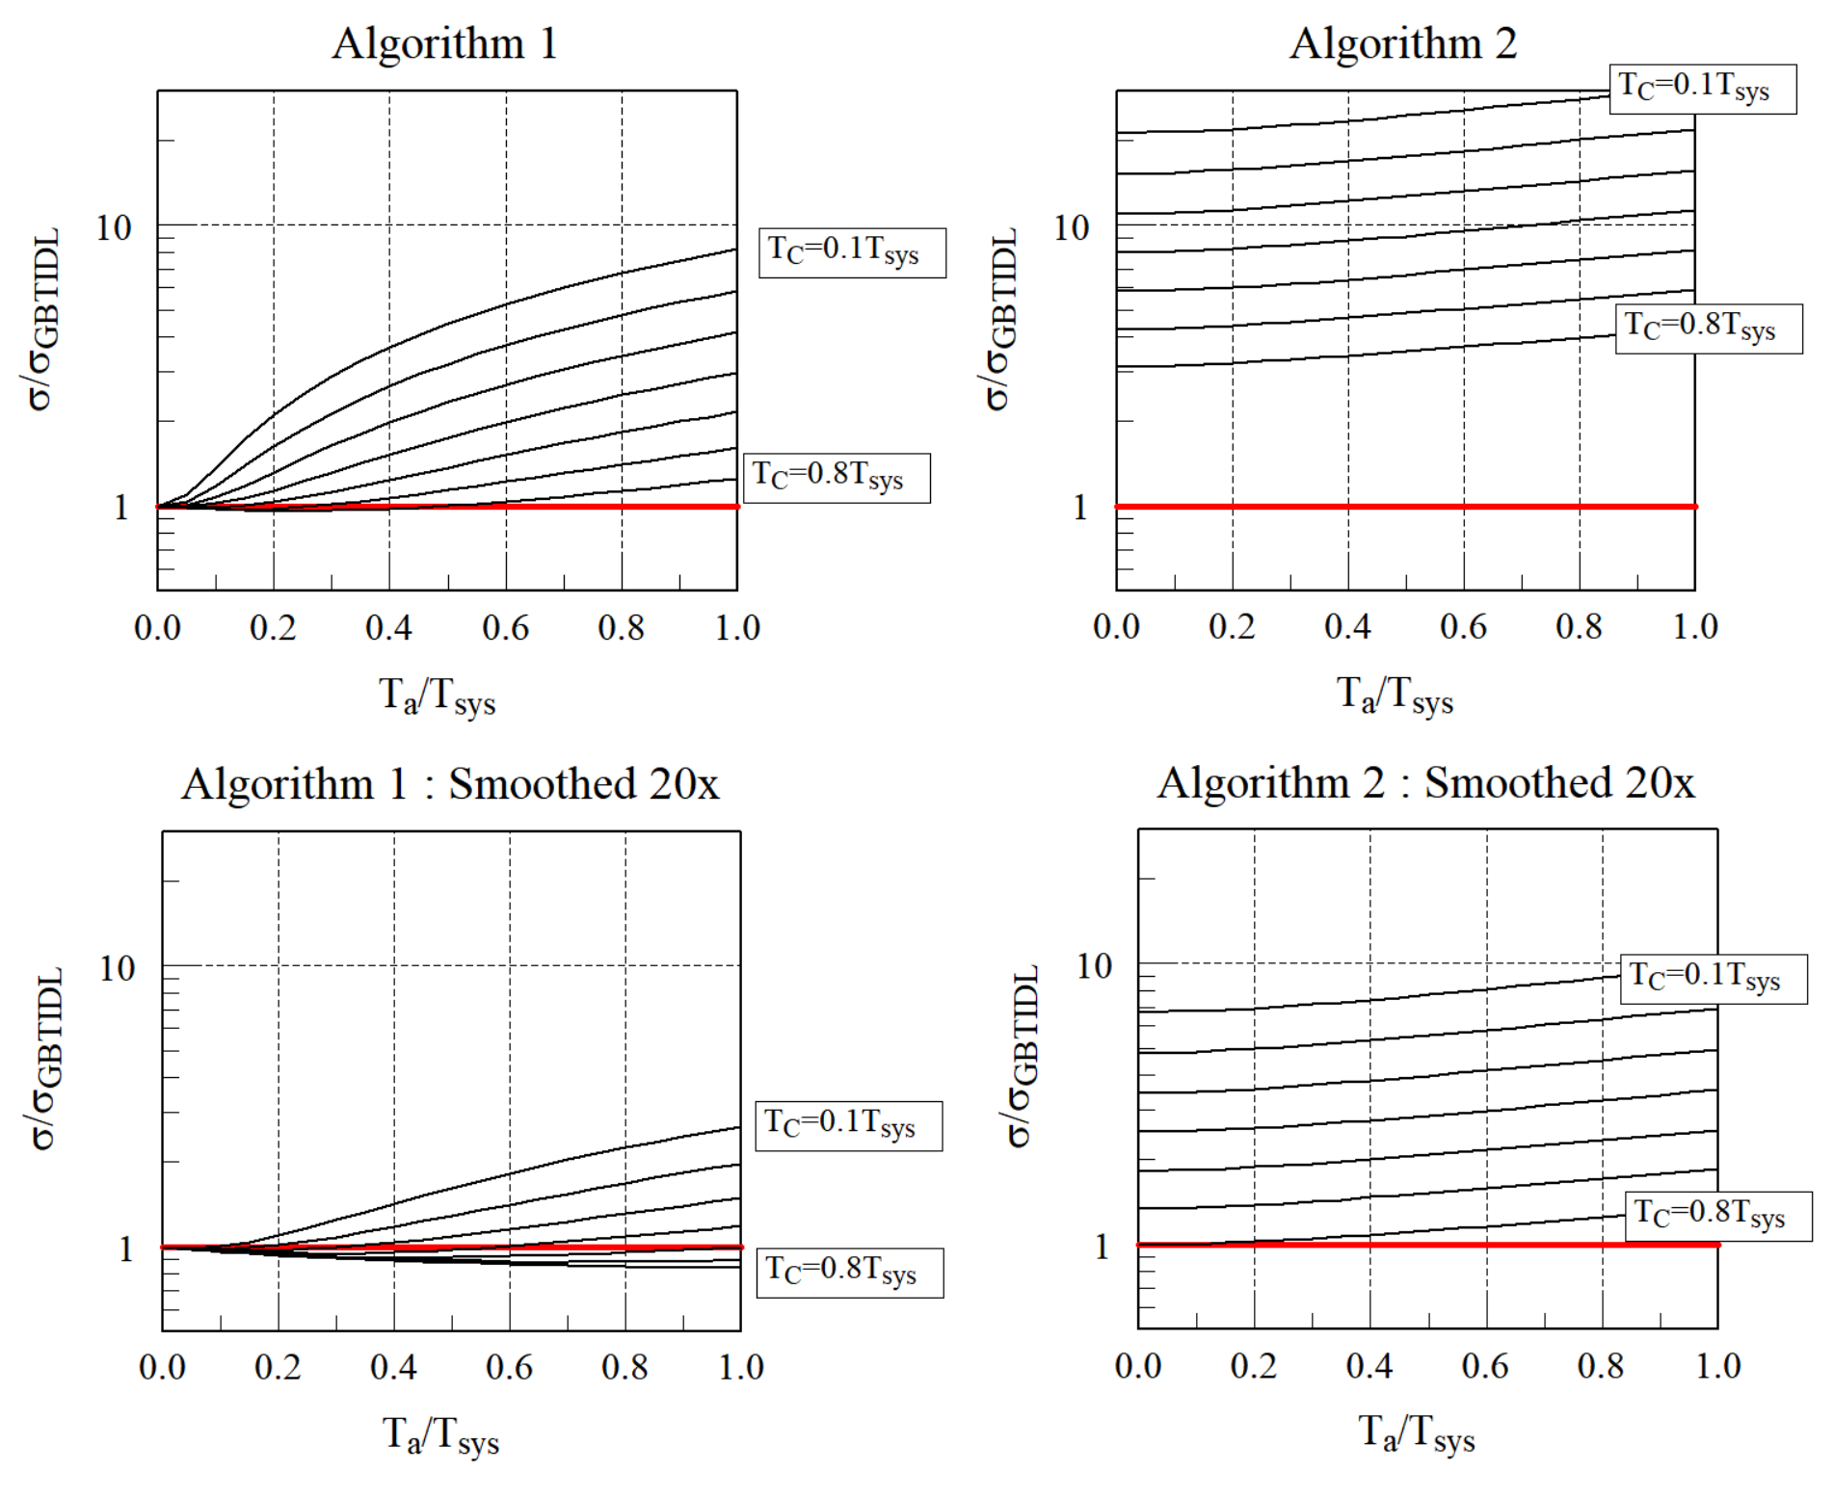
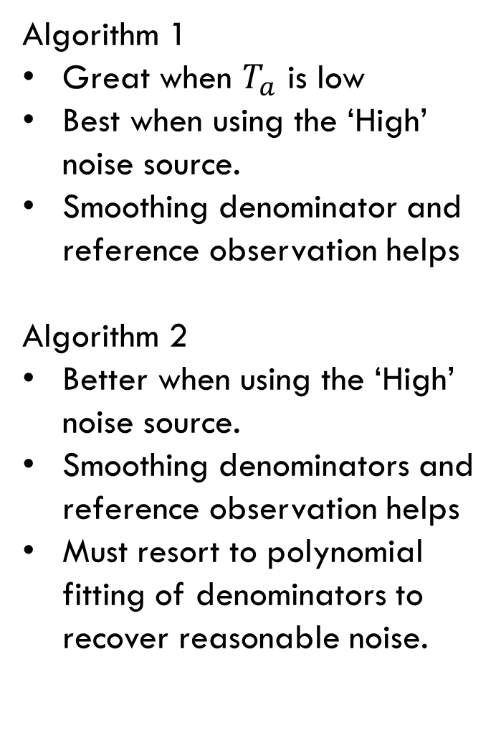
Noise of algorithms 1 and 2 compared to that generated by the GBTIDL algorithm
Algorithm 1
Great when $T_{a}$ is low
Best when using the ‘High’
noise source.
Smoothing denominator and
reference observation helps
Algorithm 2
Better when using the ‘High’
noise source.
Smoothing denominators and
reference observation helps
Must resort to polynomial
fitting of denominators to
recover reasonable noise.

Slide 23
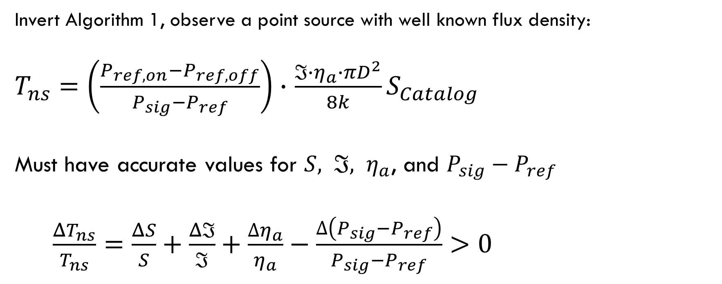
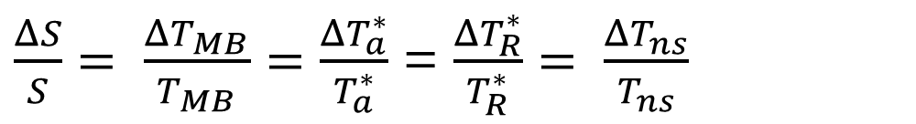
What About T_{ns} ?
Astronomical Observations
$\frac{ΔS}{S}= \frac{ΔT_{MB}}{T_{MB}}=$ $\frac{ΔT_{a}^{∗}}{T_{a}^{∗}}$ = $\frac{ΔT_{R}^{∗}}{T_{R}^{∗}}= \frac{ΔT_{ns}}{T_{ns}}$
Invert Algorithm 1, observe a point source with well known flux density:
$T_{ns}=\left(\frac{P_{ref,on}−P_{ref,off}}{P_{sig}−P_{ref}}\right)∙$ $\frac{{ℑ∙η}_{a}∙πD^{2}}{8k}S_{Catalog}$
Must have accurate values for ${S, ℑ, η}_{a}$, and $P_{sig}−P_{ref}$
$\frac{ΔT_{ns}}{T_{ns}}=\frac{ΔS}{S}+\frac{Δℑ}{ℑ}+\frac{{∆η}_{a}}{η_{a}}−\frac{∆\left(P_{sig}−P_{ref}\right)}{P_{sig}−P_{ref}}>0$

Slide 24
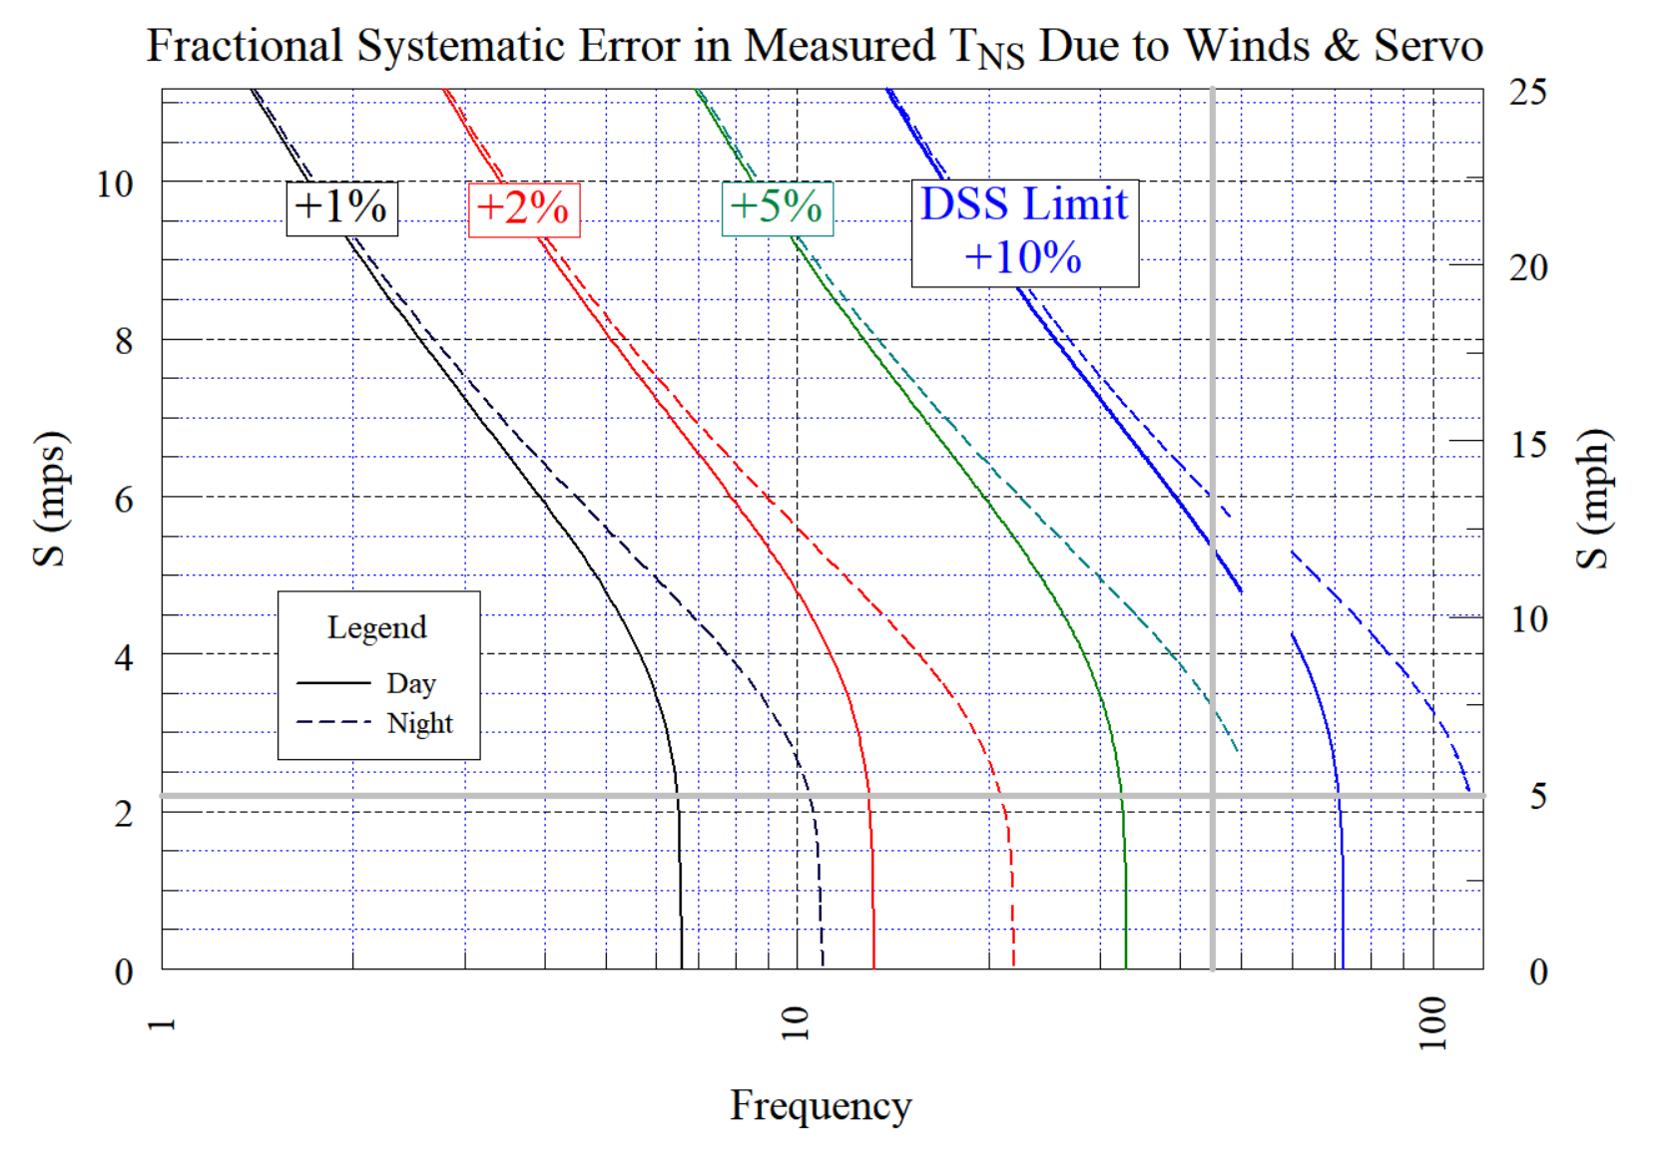

Slide 25
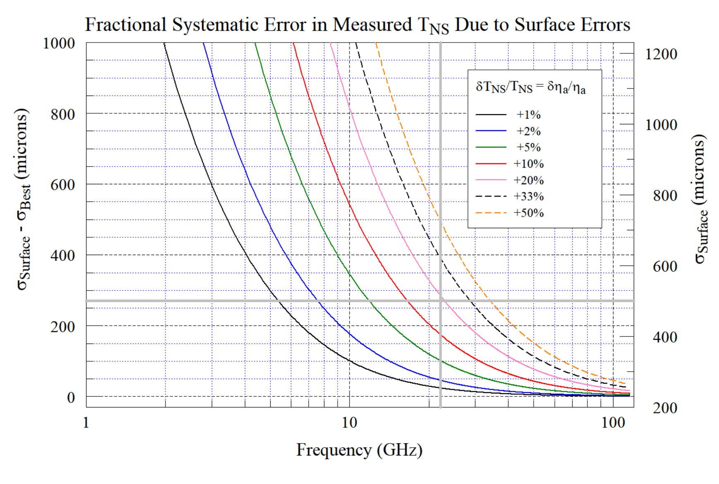

Slide 26
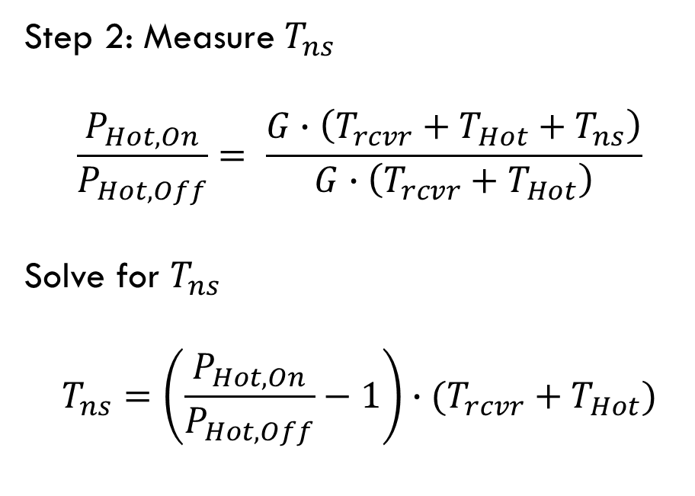
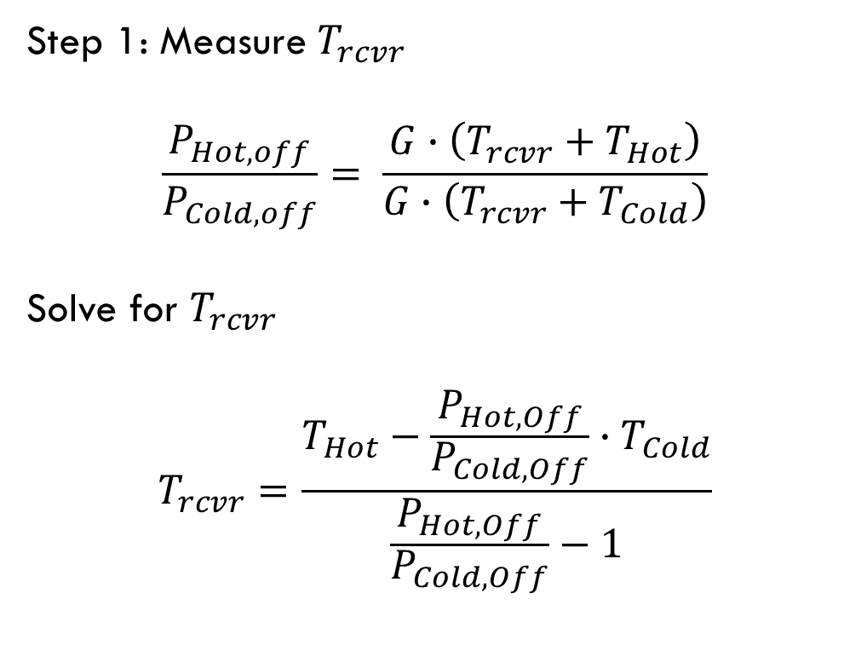
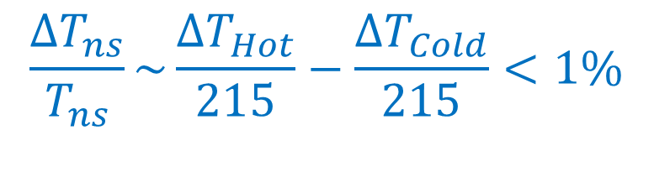

What About T_{ns} ?
Hot-Cold Load Measurements are far superior
Step 1: Measure $T_{rcvr}$
$$\frac{P_{Hot,off}}{P_{Cold,off}}= \frac{G∙\left(T_{rcvr}+T_{Hot}\right)}{G∙\left(T_{rcvr}+T_{Cold}\right)}$$
Solve for $T_{rcvr}$
$$T_{rcvr}=\frac{T_{Hot}−\frac{P_{Hot,Off}}{P_{Cold,Off}}∙T_{Cold}}{\frac{P_{Hot,Off}}{P_{Cold,Off}}−1}$$
Step 2: Measure $T_{ns}$
$$\frac{P_{Hot,On}}{P_{Hot,Off}}= \frac{G∙\left(T_{rcvr}+T_{Hot}+T_{ns}\right)}{G∙\left(T_{rcvr}+T_{Hot}\right)}$$
Solve for $T_{ns}$
$$T_{ns}=\left(\frac{P_{Hot,On}}{P_{Hot,Off}}−1\right)∙(T_{rcvr}+T_{Hot})$$
$$\frac{∆T_{ns}}{T_{ns}}\sim \frac{{∆T}_{Hot}}{215}−\frac{{∆T}_{Cold}}{215}<1\%$$
$$∆T_{rcvr}\sim 0.5{∆T}_{Hot}−1.5{∆T}_{Cold}\sim 0.5K$$

Slide 27

Summary
GBTIDL’s ‘GETxxx’ routines
  Best noise
  Bad calibration and baselines
  Showed a better way to average integrations & scans
Alternative algorithms
  Much better baselines & calibration
  Worse noise
Proper smoothing can save giga $$ / year
T_{ns}
  Astronomical measurements will overestimate T_{ns} by many %
  Hot-Cold-Load measurements give T_{ns} to better than 1%

Slide 28

Preview

