Slide 1
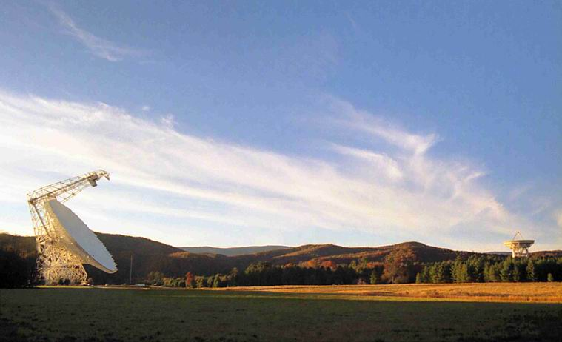
Single-Dish Radio Telescopes
Dr. Ron Maddalena
National Radio Astronomy Observatory
Green Bank, WV

Slide 2
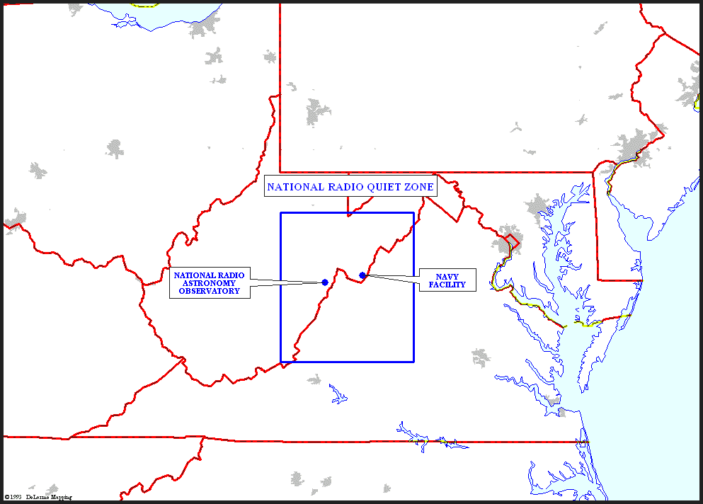
National Radio Quiet Zone

Slide 3
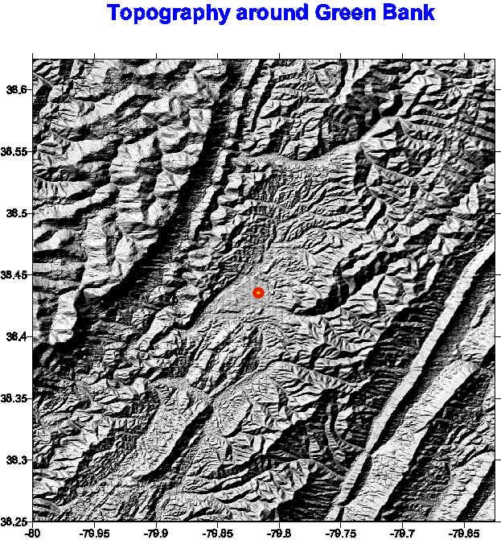
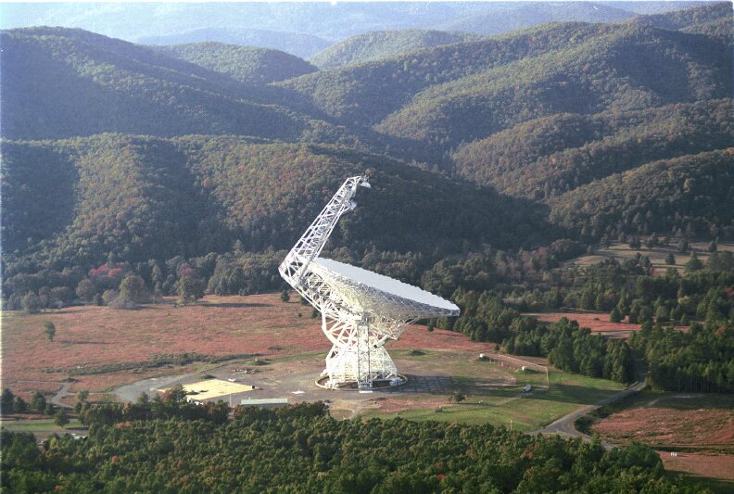
National Radio Quiet Zone

Slide 4
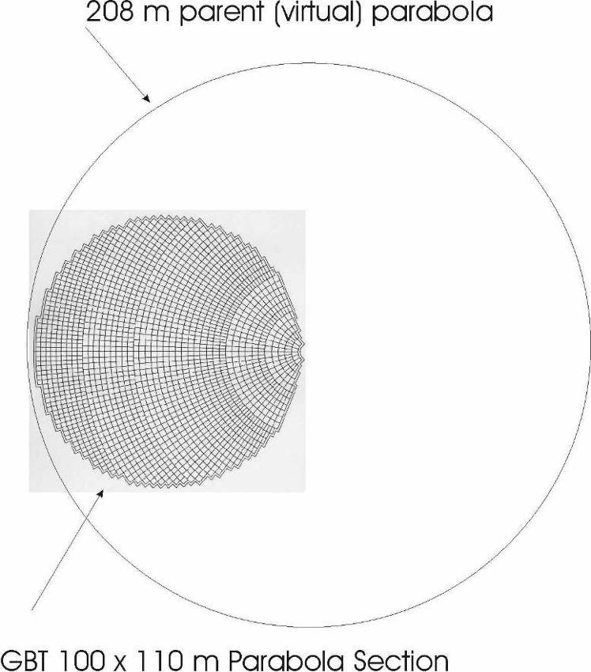
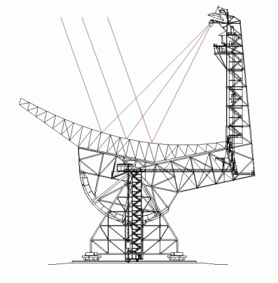
GBT Telescope Optics
110 m x 100 m of a 208 m parent paraboloid
Effective diameter: 100 m
Off axis - Clear/Unblocked Aperture

Slide 5
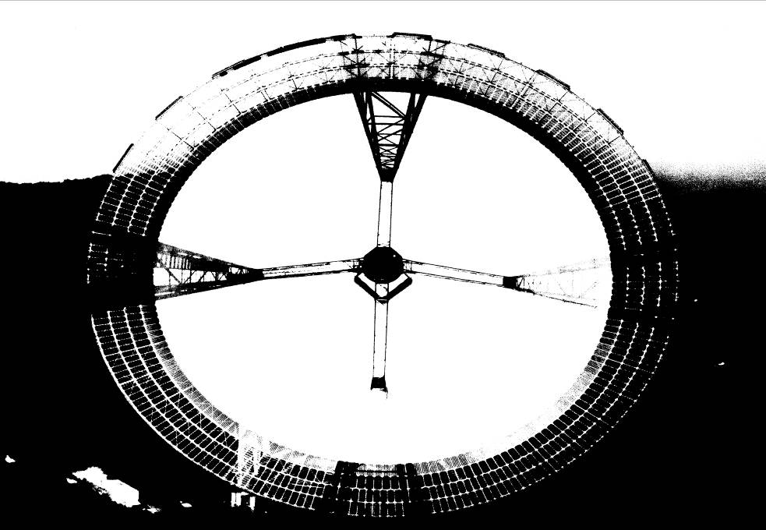
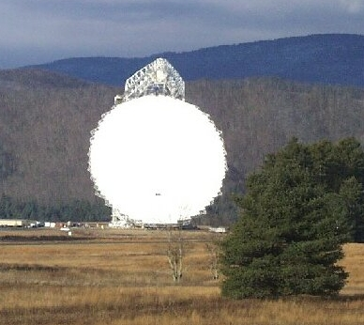
Telescope Optics
High Dynamic Range
High Fidelity Images

Slide 6
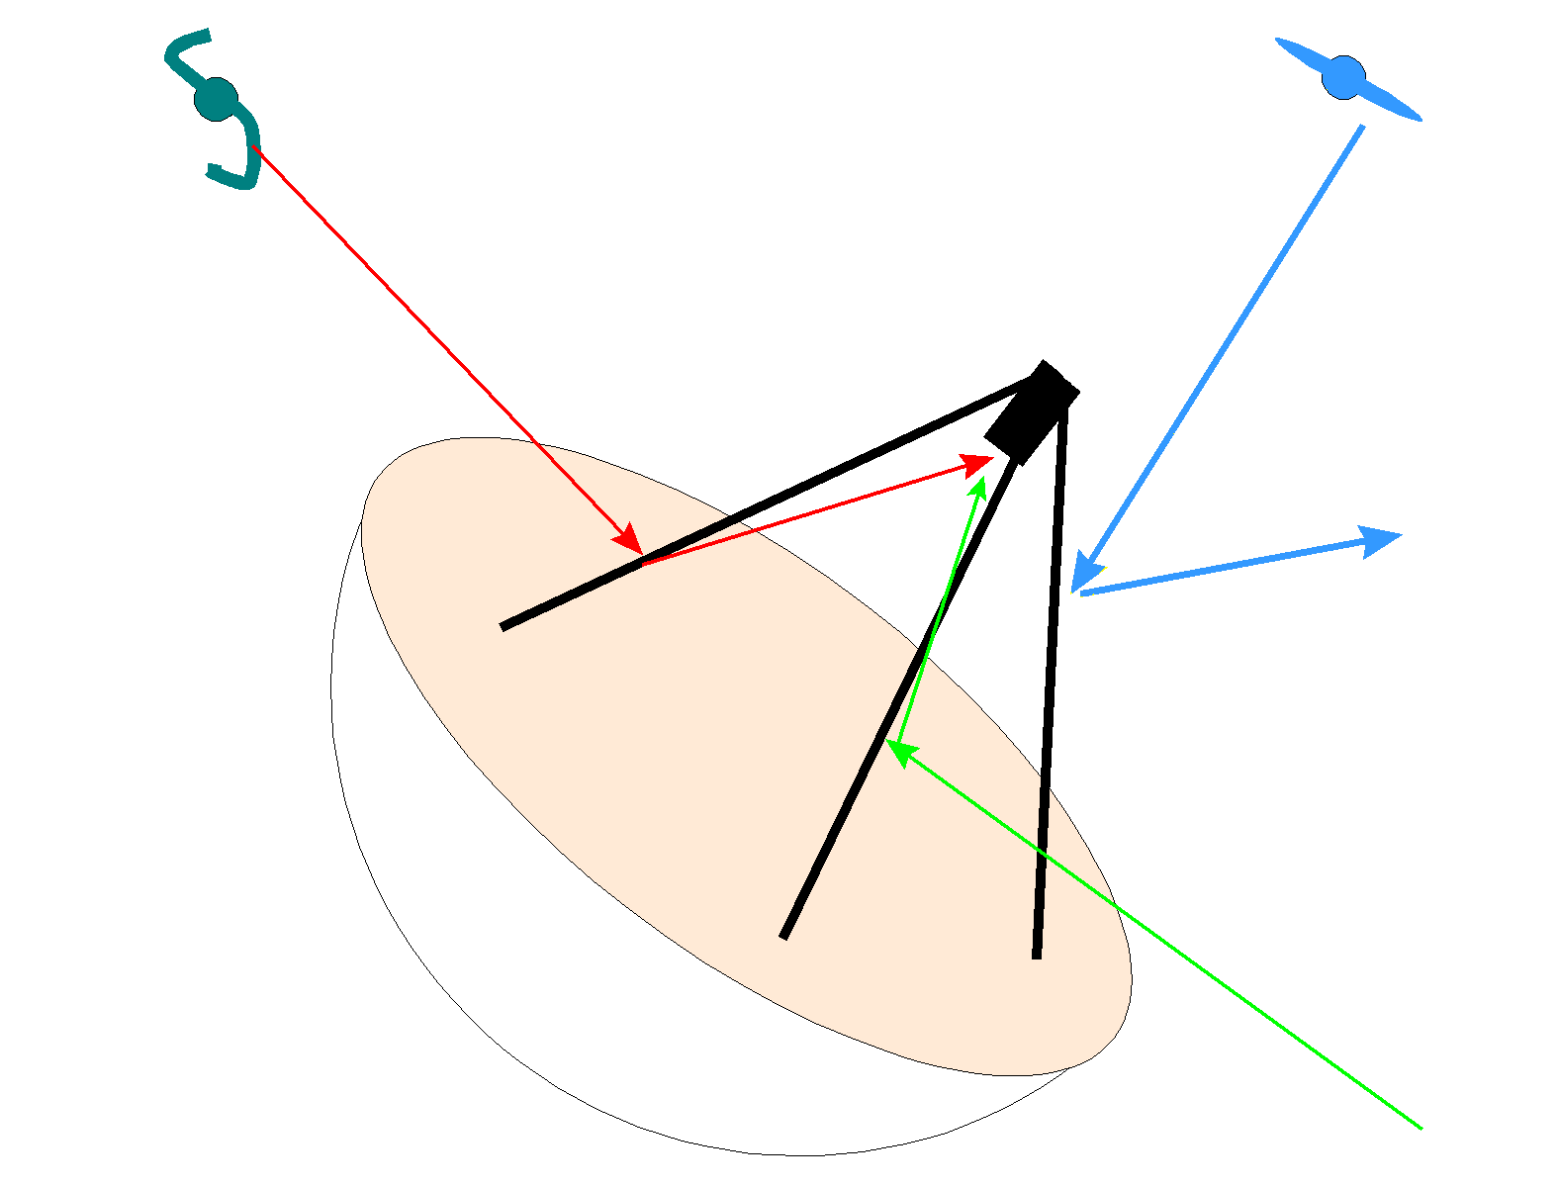
Telescope Optics

Slide 7
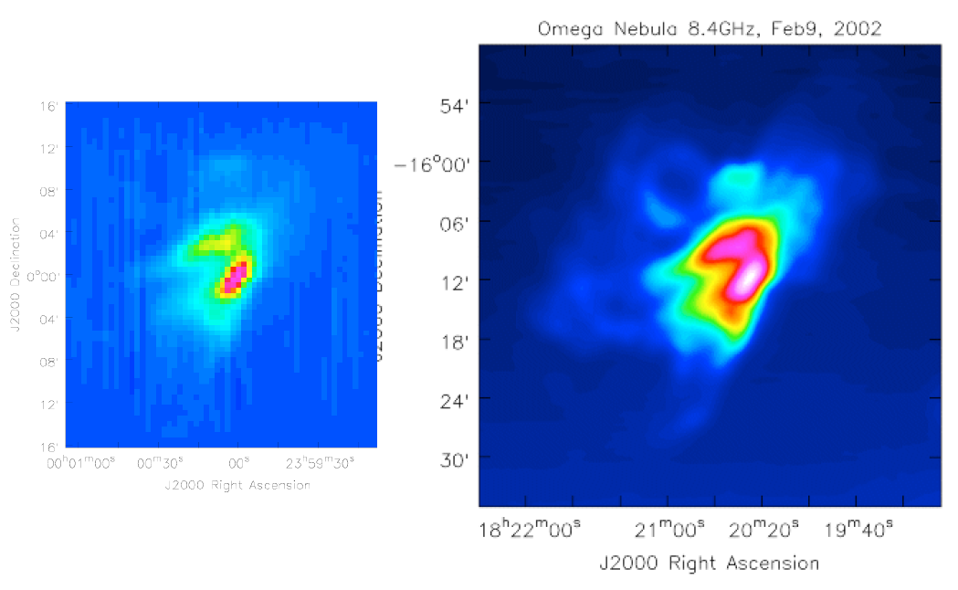
Telescope Optics

Slide 8
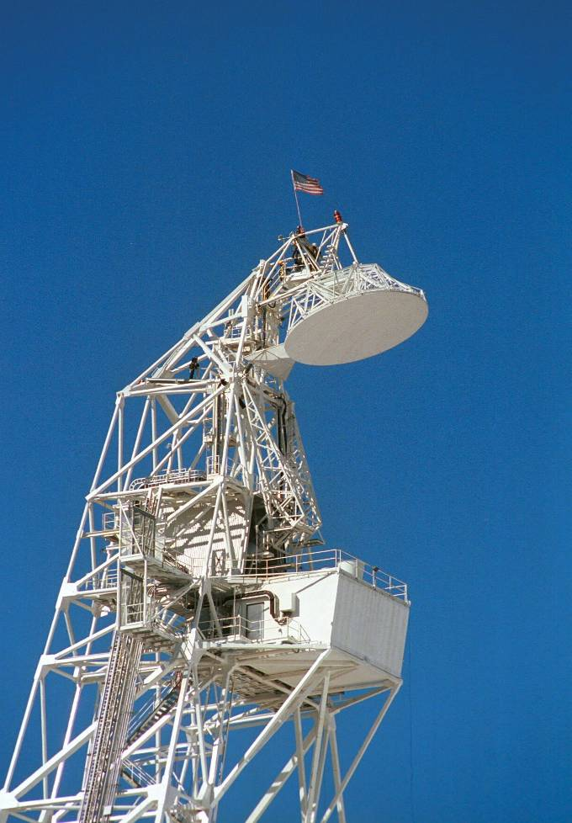
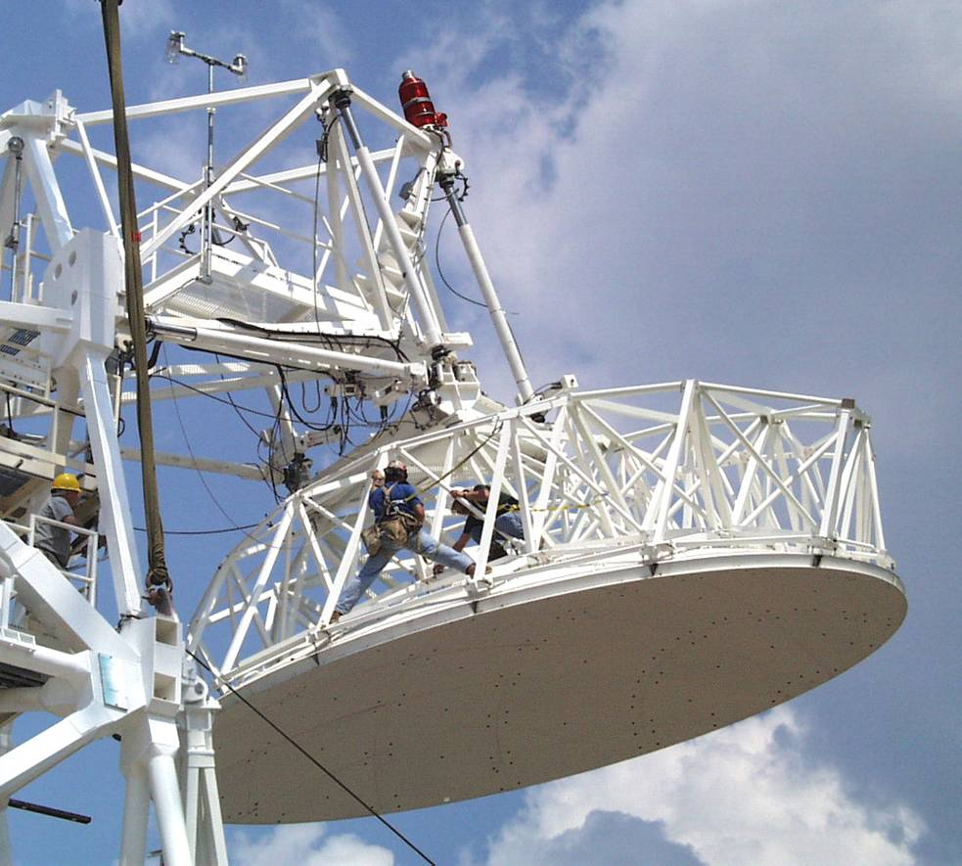
Telescope Optics
Prime Focus: Retractable boom
Gregorian Focus: 8-m subreflector - 6-degrees of freedom

Slide 9
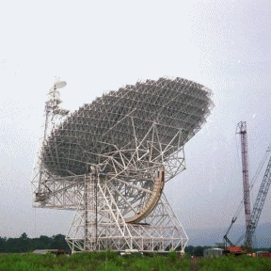
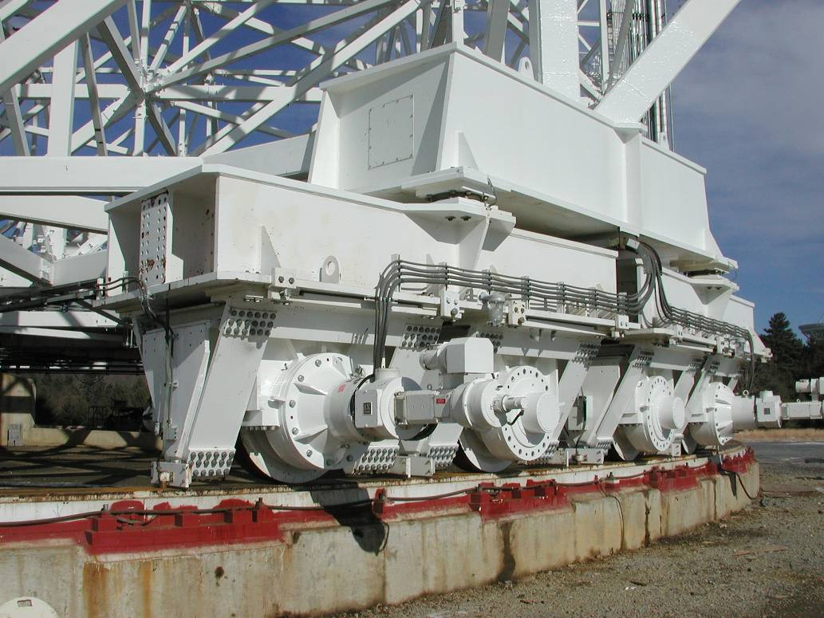
Telescope Structure
Fully Steerable
Elevation Limit: 5º
Can observe 85% of the entire Celestial Sphere
Slew Rates: Azimuth - 40º/min; Elevation - 20º/min

Slide 10
Telescope Structure
Blind Pointing:
(1 point/focus)
Offset Pointing:
(90 min)
Continuous Tracking:
(30 min)

Slide 11
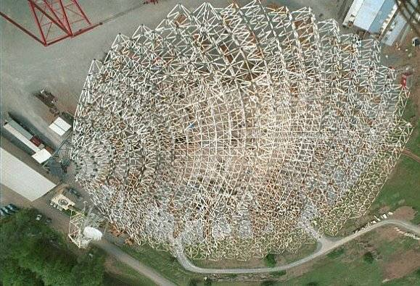
Telescope Structure

Slide 12
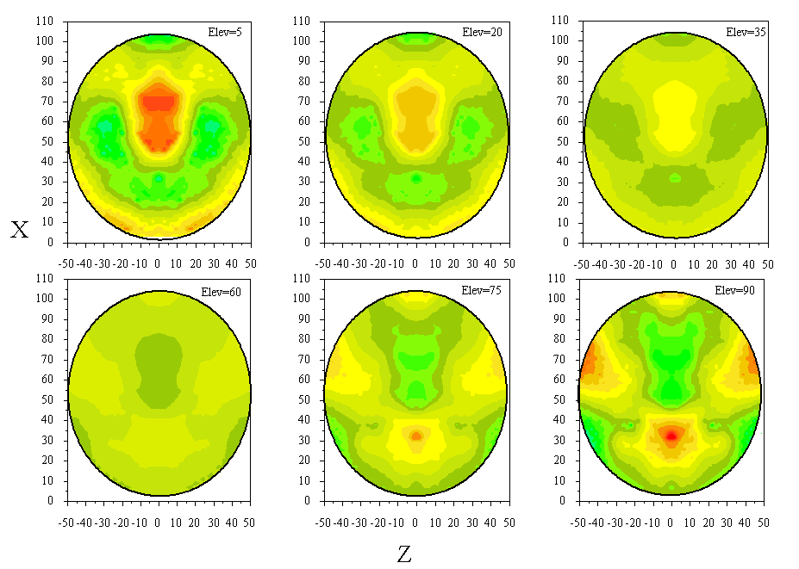
Active Surface
Surface Deformations from Finite Element Model

Slide 13
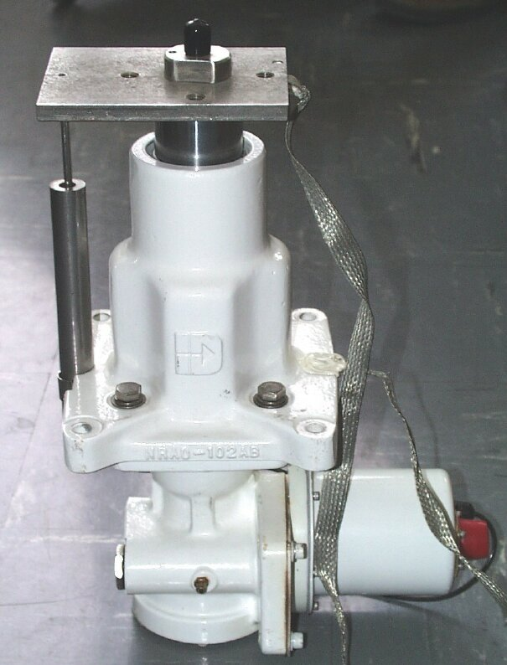
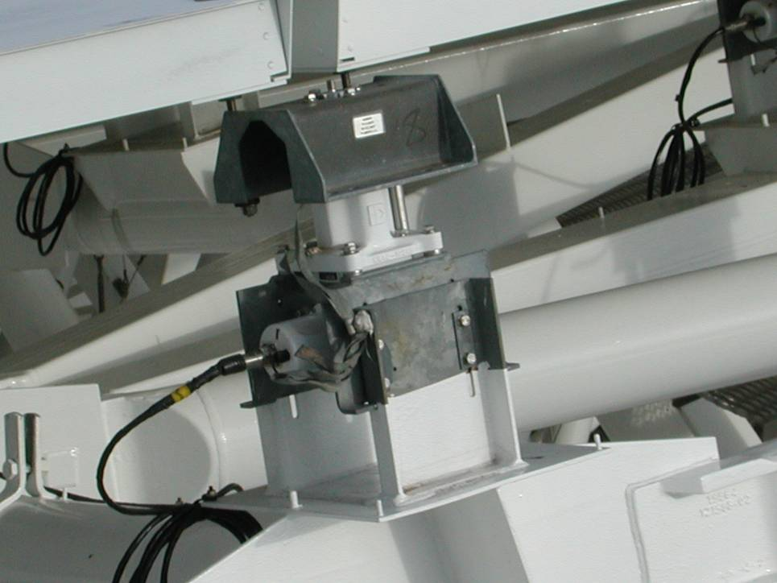
Active Surface

Slide 14
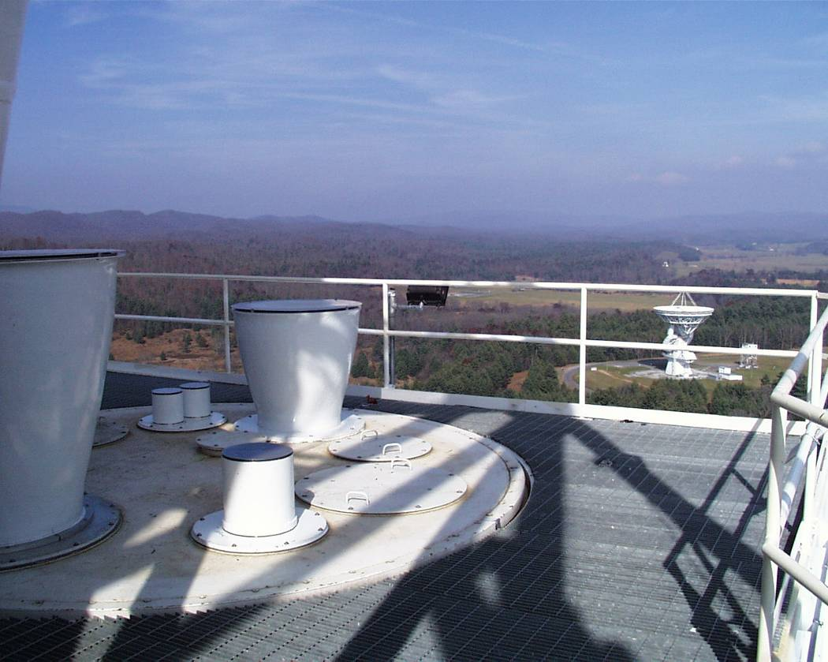
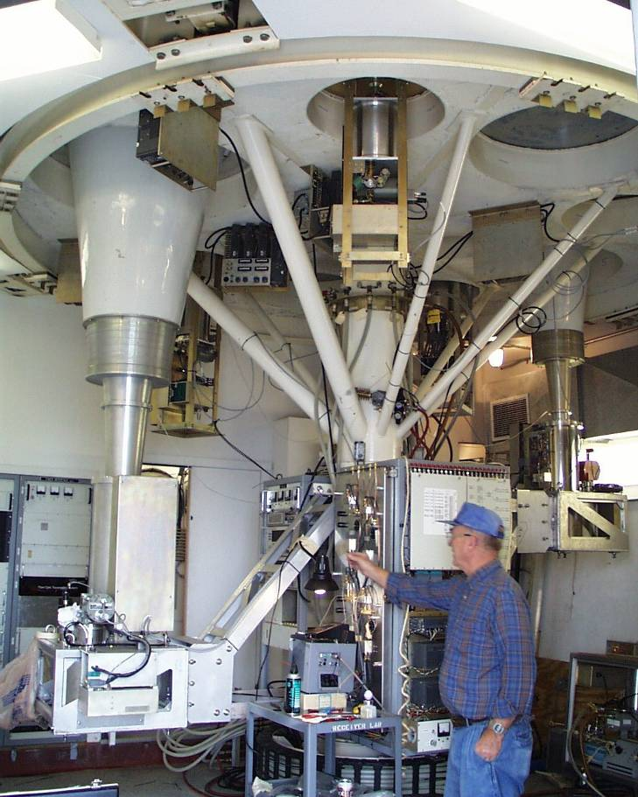
Telescope Optics
Rotating Turret with 8 receiver bays

Slide 15
Receivers
Receiver | Operating Range | Status
Prime Focus 1 | 0.29—0.92 GHz | Commissioned
Prime Focus 2 | 0.910—1.23 GHz | Commissioned
L Band | 1.15—1.73 GHz | Commissioned
S Band | 1.73—2.60 GHz | Commissioned
C Band | 3.95—5.85 GHz | Being Upgraded
X Band | 8.2—10.0 GHz | Commissioned
Ku Band | 12.4—15.4 GHz | Commissioned
K Band 7-pixel | 18—26.5 GHz | Commissioned
Ka Band | 26—40 GHz | Commissioned
Q Band | 40—50 GHz | Commissioned
W Band | 68—92 GHz | Commissioned
Penn Array | 86—94 GHz | Being Upgraded

Slide 16
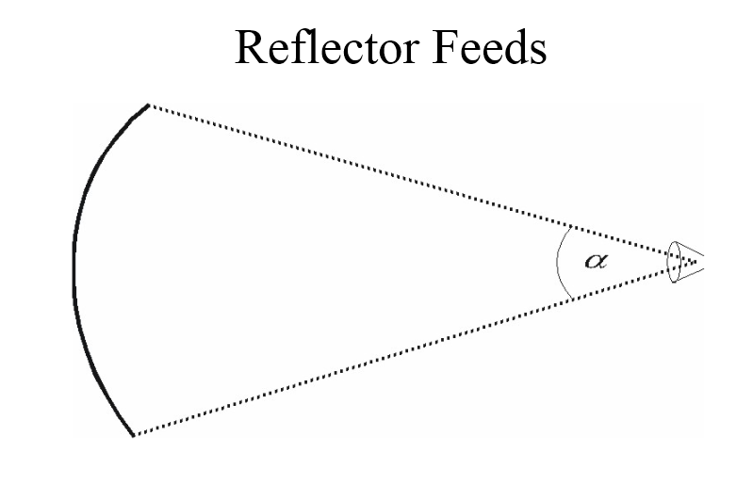

Slide 17
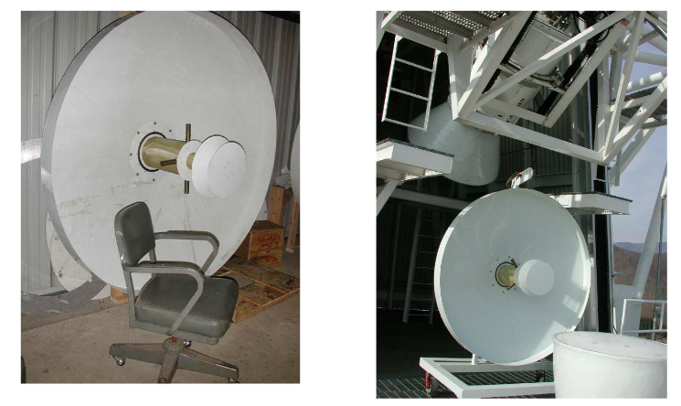

Slide 19
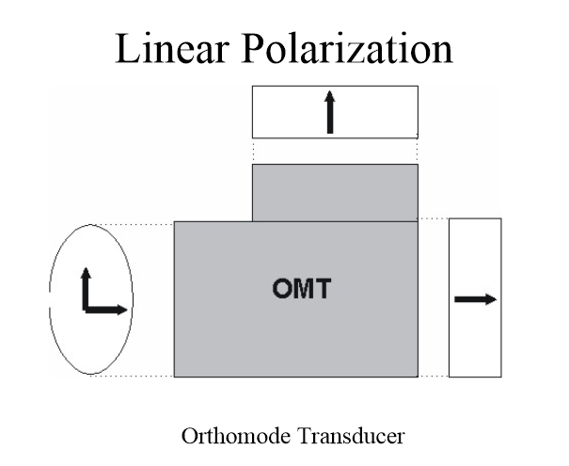

Slide 22
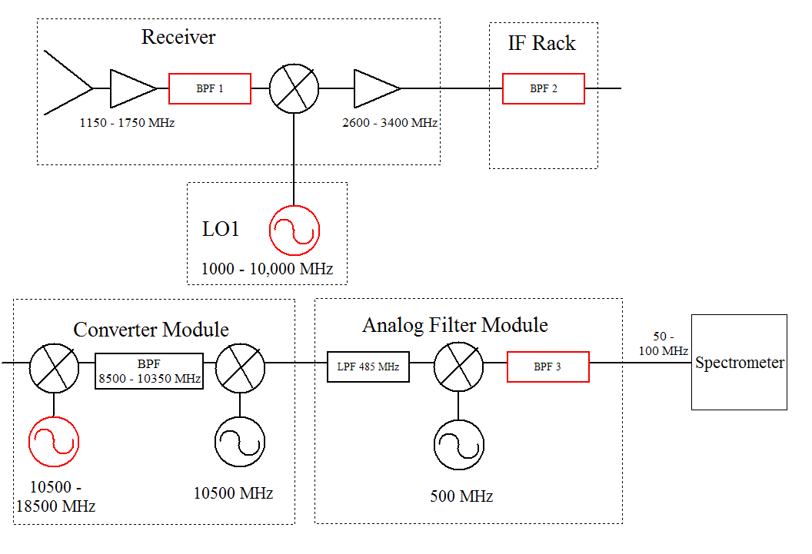

Slide 23
Typical Components
Amplifiers
Splitters
Mixers
Couplers
Attenuators
Filters
Power Detectors
Synthesizers
Switches
Multipliers

Slide 24
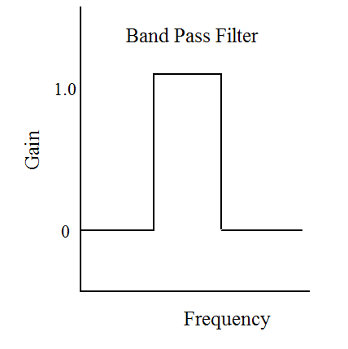
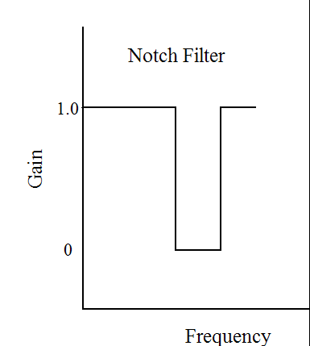
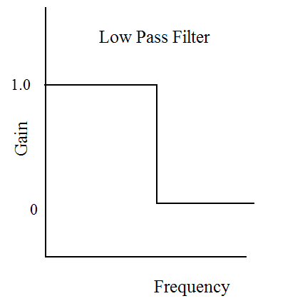
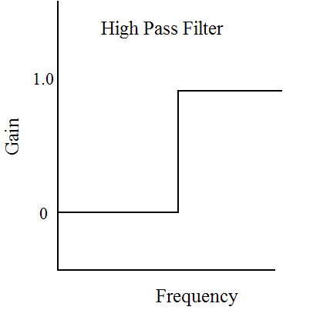
Types of Filters
Edges are smoother than illustrated

Slide 25
Types of Mixers
f
f_{IF}
n and m are positive or negative integers, usually 1 or -1
Up Conversion : f_{IF} > f
Down Conversion : f_{IF} < f
Lower Side Band : f_{LO} > f
- Sense of frequency flips
Upper Side Band : f_{LO} < f
f_{LO}
f_{IF} = n*f_{LO} + m*f

Slide 26
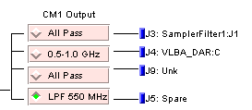
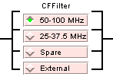
Example Switches

Slide 27
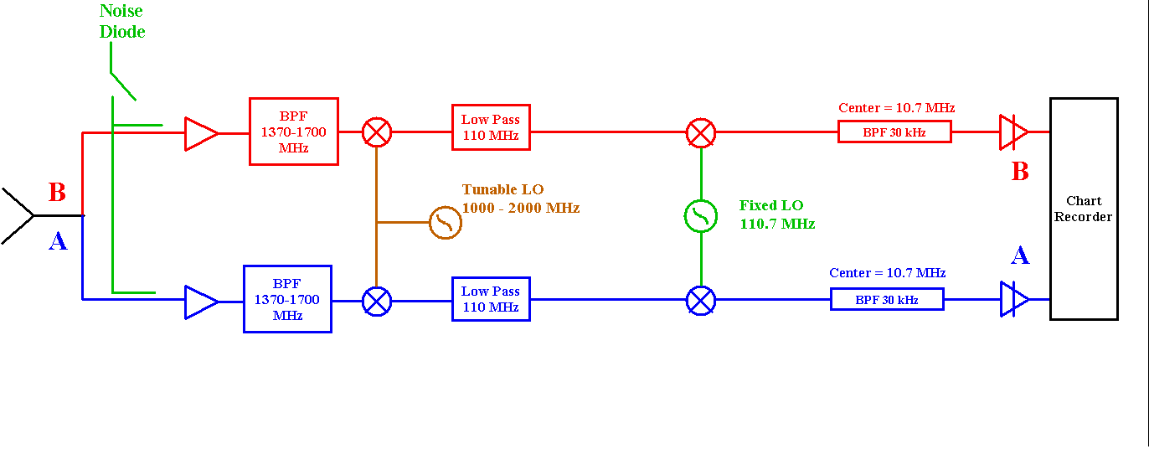
40-Ft System

Slide 28
Quiz 1: Determine values for the first LO for the 40-ft when…
Observing HI at 1420.41 MHz
Observing OH at 1665.6 MHz

Slide 30
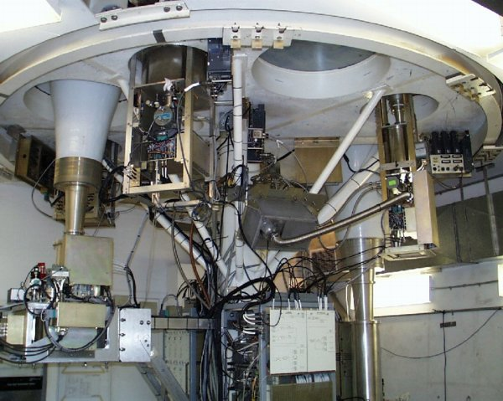
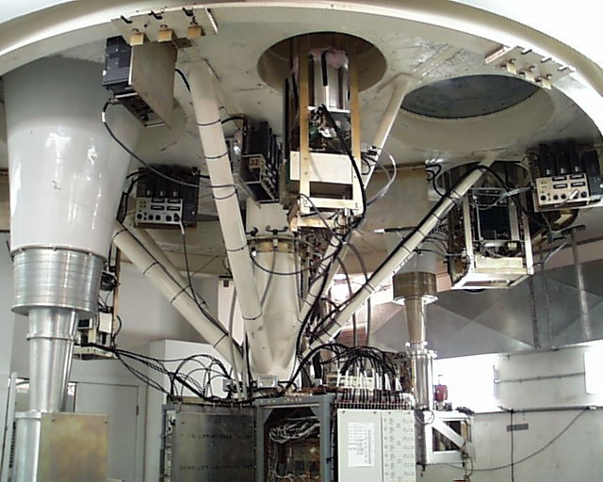
Receiver Room

Slide 31
Typical Receiver

Slide 32
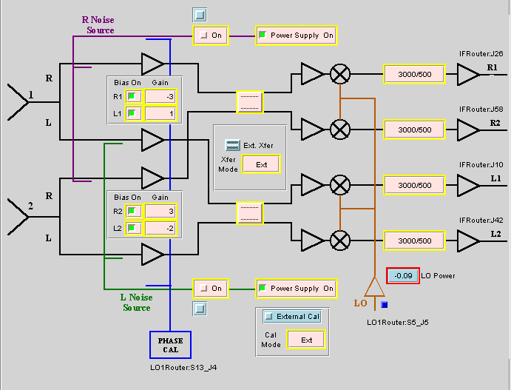
Multi-beam Receiver

Slide 33
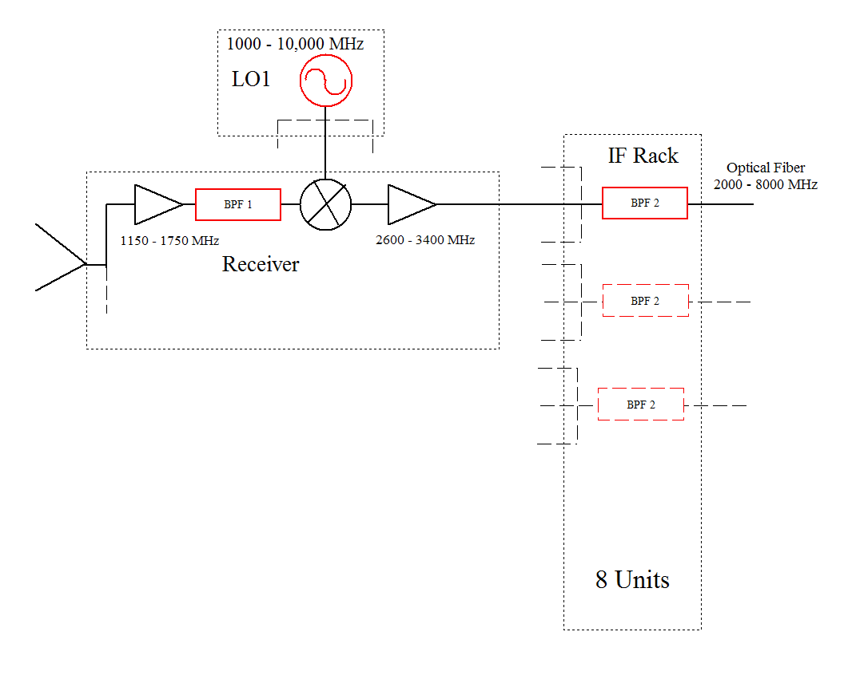

Slide 34
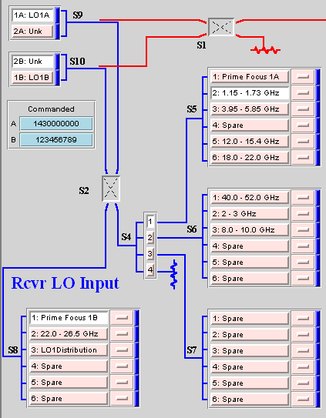
Local Oscillator and Switching Matrix

Slide 36
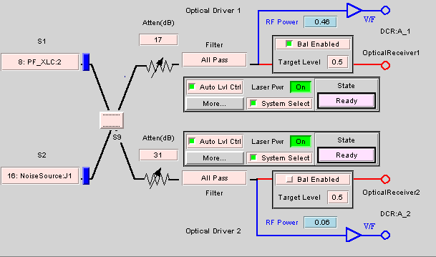
IF Rack – Input switching Matrix, IF Filters, Power Balancing Attenuators, and Drivers for 8 Optical Fibers

Slide 37
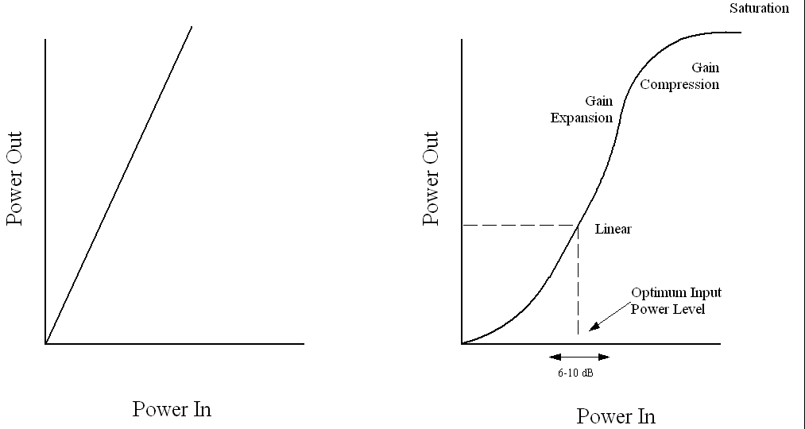
Power Balancing/Leveling and Non-Linearity

Slide 39
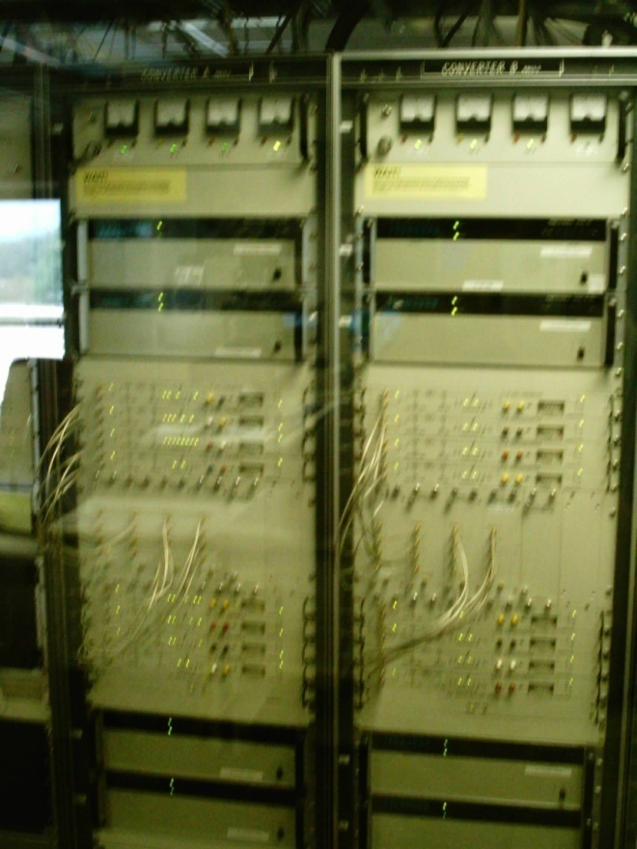
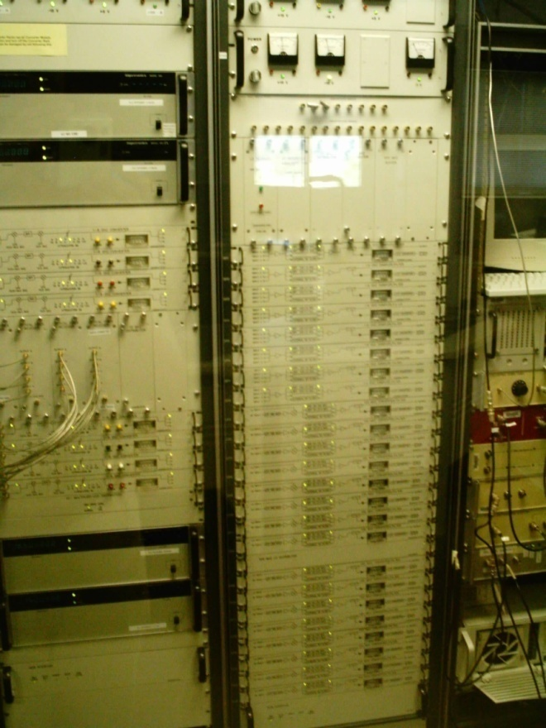
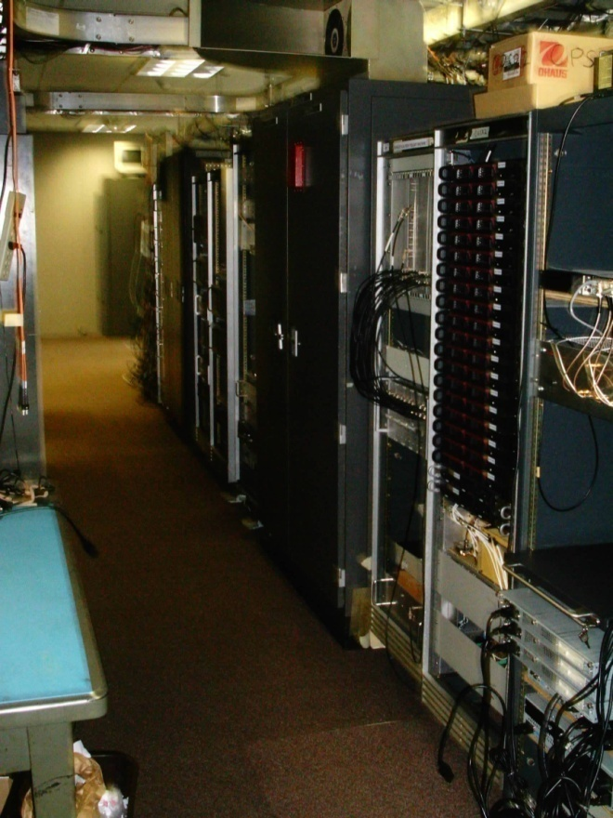
Converter and Analog Filter Racks, Spectrometer

Slide 40
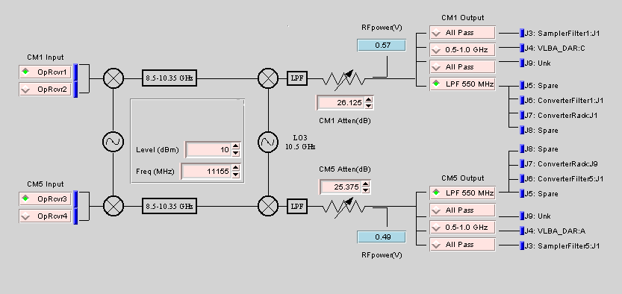
Converter Rack – Receivers for Optical Fibers, LO2 and LO3, Power Balancing Attenuators, Output Switches to Backends and AFR

Slide 41
Analog Filter Rack
For 12.5 and 50 MHz Slow-Speed Spectrometer Samplers : LO4 and Filters
For 200 and 800 MHz High-Speed Spectrometer Samplers : Input Switches and Filters.

Slide 42
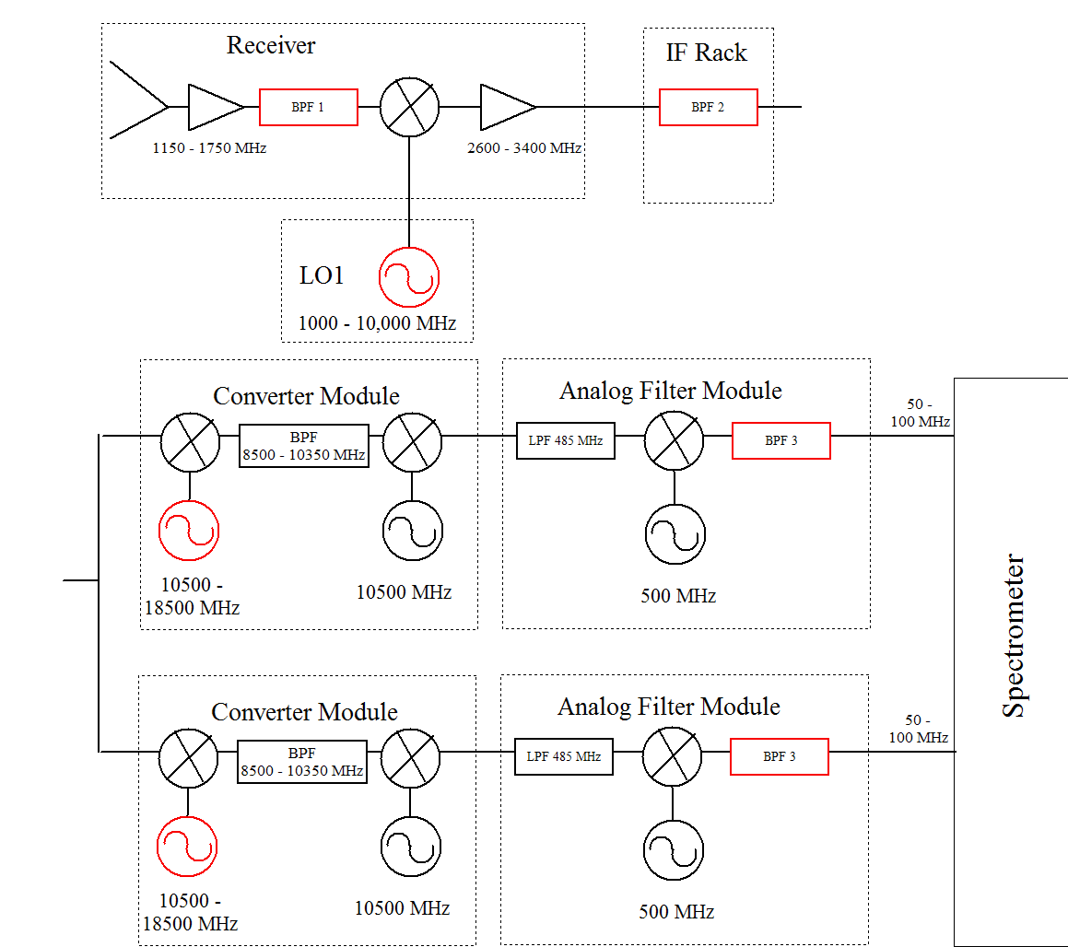
Quiz 2: Determine values for red components

Slide 43
Quiz 2: Determine values for red components
Goal : Observe simultaneously 1420 MHz and 1665 MHz with the 50 MHz wide (75 MHz center frequency) mode of the Spectrometer
Parameters:
BPF1 can be: 1100–1800, 1600-1750, 1300-1450, or 1100-1450 MHz
All mixers are LSB. Hint: first two mixers up convert, the last two down convert.
BPF2 can be : 2990-3010, 2960-3040, 2840-3160, 2360-3640, 5960-6040, 5840-6160, or 5360-6640 MHz
BPF3 can be : 50-100 or 25-37.5 MHz
See block diagram for other parameters
Hint: Work from the receiver down the chain until you get stuck, then from Spectrometer up. Try 1420 MHz first, then add in 1665 MHz.
Record values for LO1 and both LO2’s; settings for BPF1, 2, and 3; and values for all Intermediate Frequencies.

Slide 44
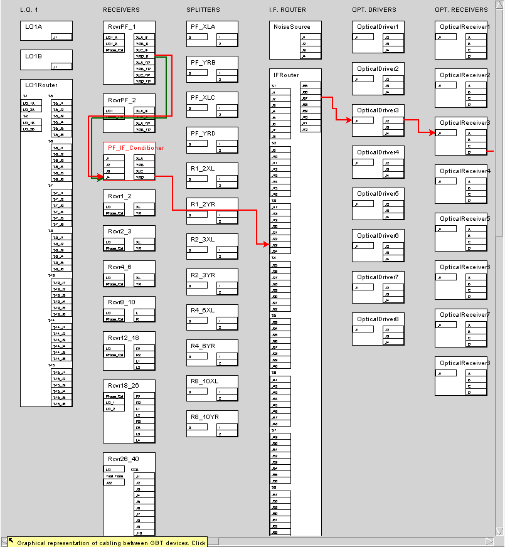

Slide 45
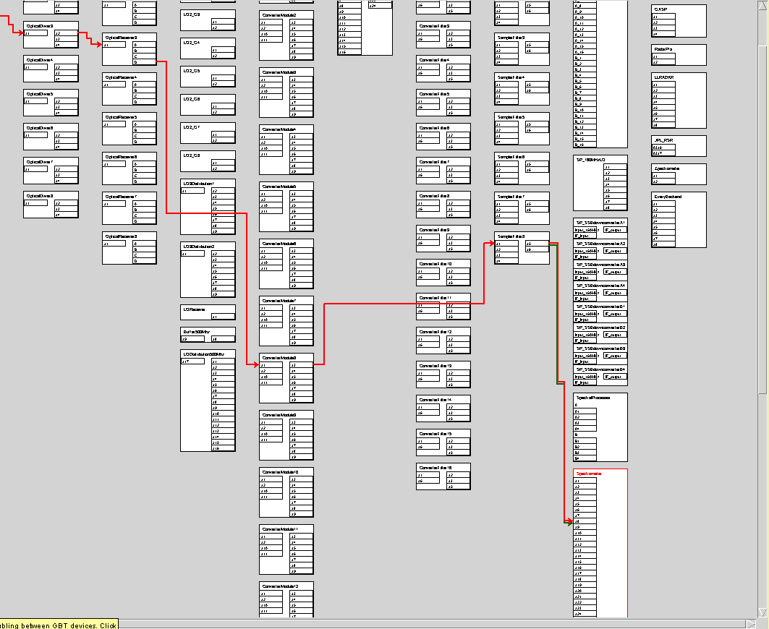

Slide 46
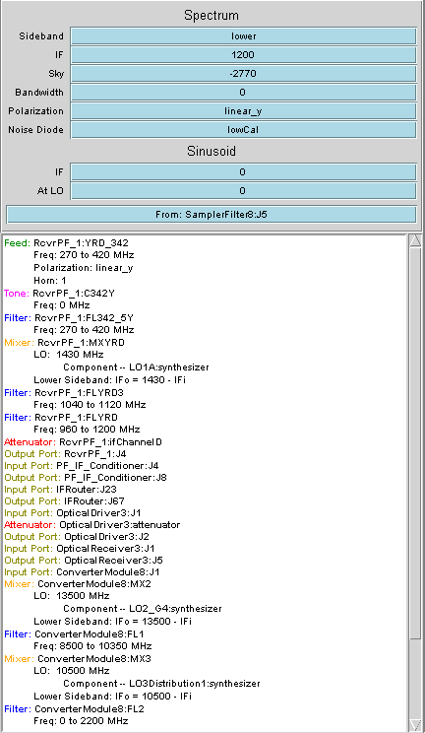
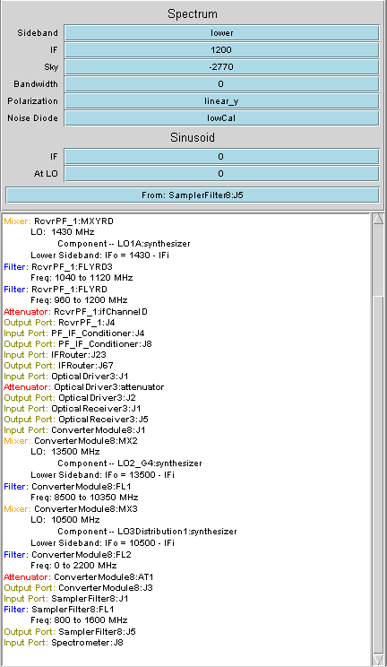

Slide 47
GBT – Astrid does all the hard work for you…..
configLine = """
receiver = "Rcvr1_2"
beam = “B1"
obstype = "Spectroscopy"
backend = "Spectrometer"
nwin = 2
restfreq = 1420.4058, 1665.0
deltafreq = 0, 0
bandwidth = 12.5
swmode = "tp"
swtype = "none"
swper = 1.0
swfreq = 0.0, 0.0
tint = 30
vlow = 0
vhigh = 0
vframe = "lsrk"
vdef = "Radio"
noisecal = "lo"
pol = "Linear"
nchan = "low"
spect.levels = 3
"""

Slide 48
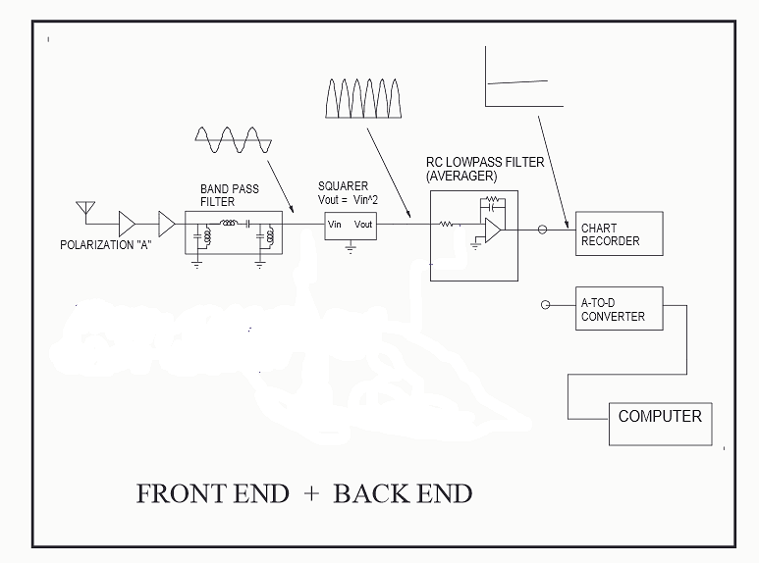

Slide 49
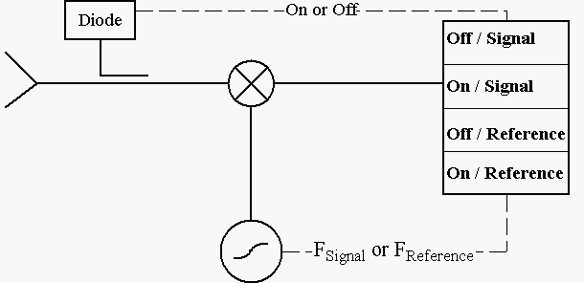
Model Receiver

Slide 50
Continuum - Point Sources On-Off Observing
Observe blank sky for 10 sec
Move telescope to object & observe for 10 sec
Move to blank sky & observe for 10 sec
Fire noise diode & observe for 10 sec
Observe blank sky for 10 sec

Slide 51
Continuum - Point Sources On-Off Observing

Slide 52
Continuum - Point Sources On-Off Observing
Known:
Equivalent temperature of noise diode or calibrator (T_{cal}) = 3 K
Bandwidth (Δν) = 10 MHz
Gain = 2 K / Jy
Desired:
Antenna temperature of the source (T_{A})
Flux density (S) of the source.
System Temperature(T_{s}) when OFF the source
Accuracy of antenna temperature (σ _{TA})

Slide 53
