Slide 1
Tracing The Signal
Ron Maddalena
July 2011

Slide 2
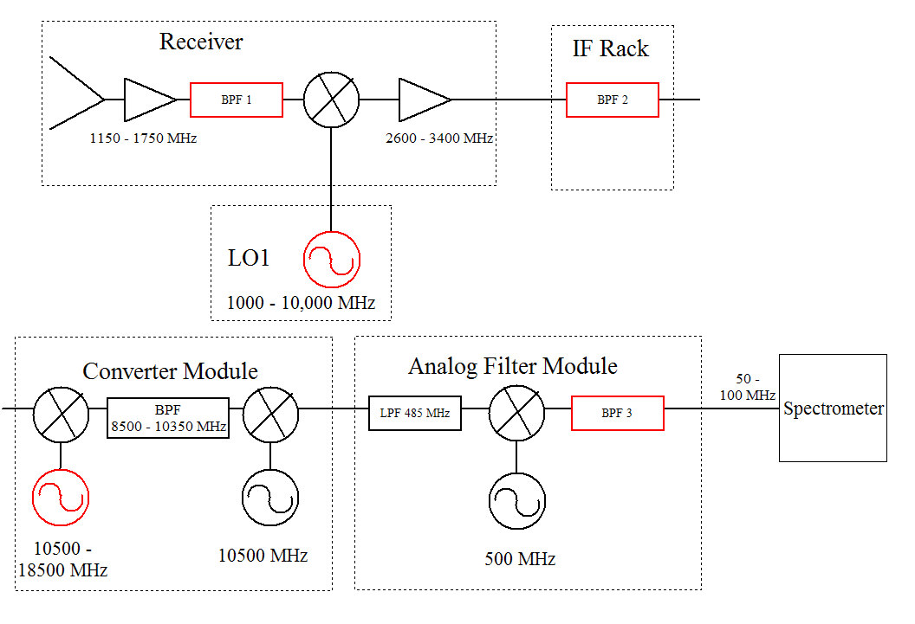

Slide 3











Typical Components
Amplifiers
Splitters
Mixers
Couplers
Attenuators
Filters
Power Detectors
Synthesizers
Switches
Multipliers

Slide 4
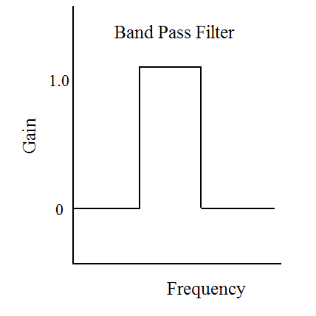
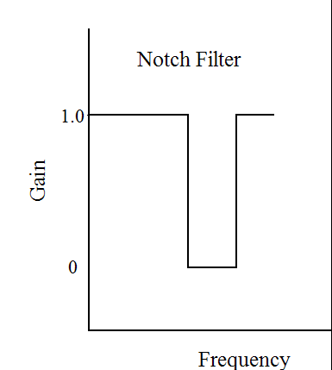
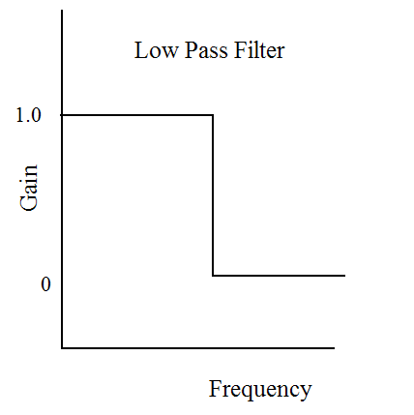
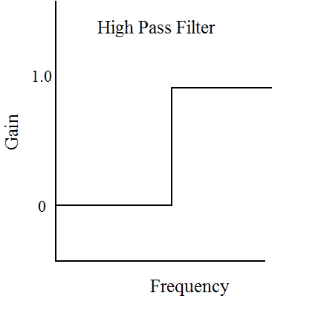
Types of Filters
Edges are smoother than illustrated

Slide 5
Types of Mixers
f
f_{IF}
n and m are positive or negative
integers, usually 1 or -1
Up Conversion : f_{IF} > f
Down Conversion : f_{IF} < f
Lower Side Band : f_{LO} > f
  - Sense of frequency flips
Upper Side Band : f_{LO} < f
f_{LO}
f_{IF} = n*f_{LO} + m*f

Slide 6

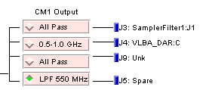

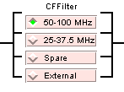
Example Switches

Slide 7
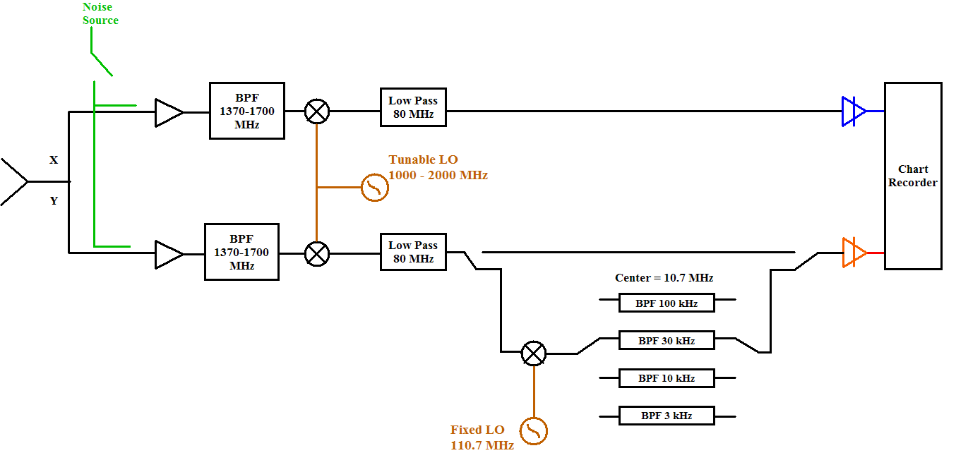
40-Ft System

Slide 8
Quiz 1: Determine values for the first LO for the 40-ft when…
Observing HI at 1420.41 MHz with a 30 kHz bandwidth
Observing OH at 1665.6 MHz with a 10 kHz bandwidth

Slide 10
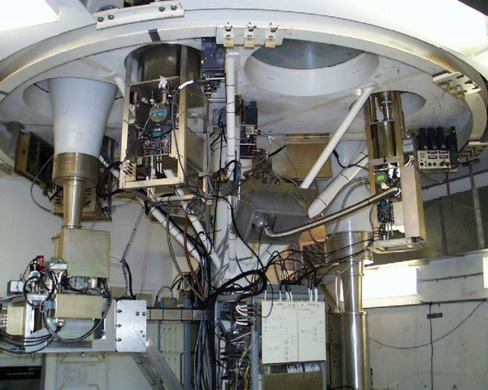
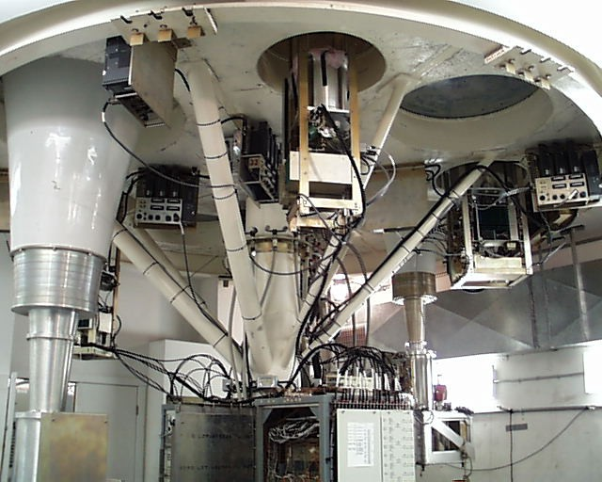
Receiver Room

Slide 11
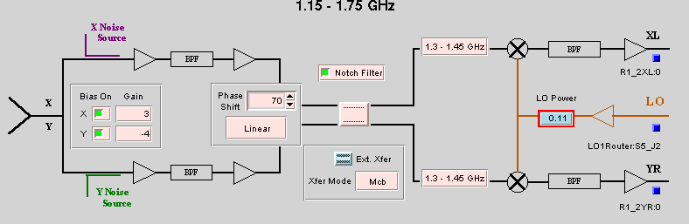
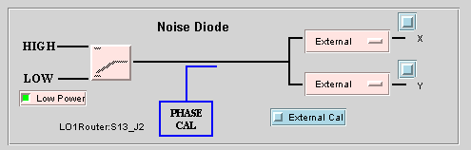
Typical Receiver

Slide 12
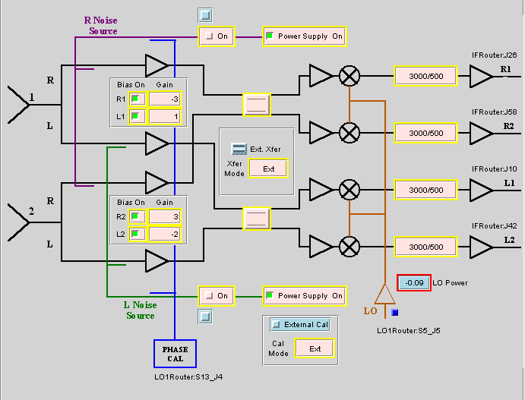
Multi-beam Receiver

Slide 13
Receiver Room

Slide 14
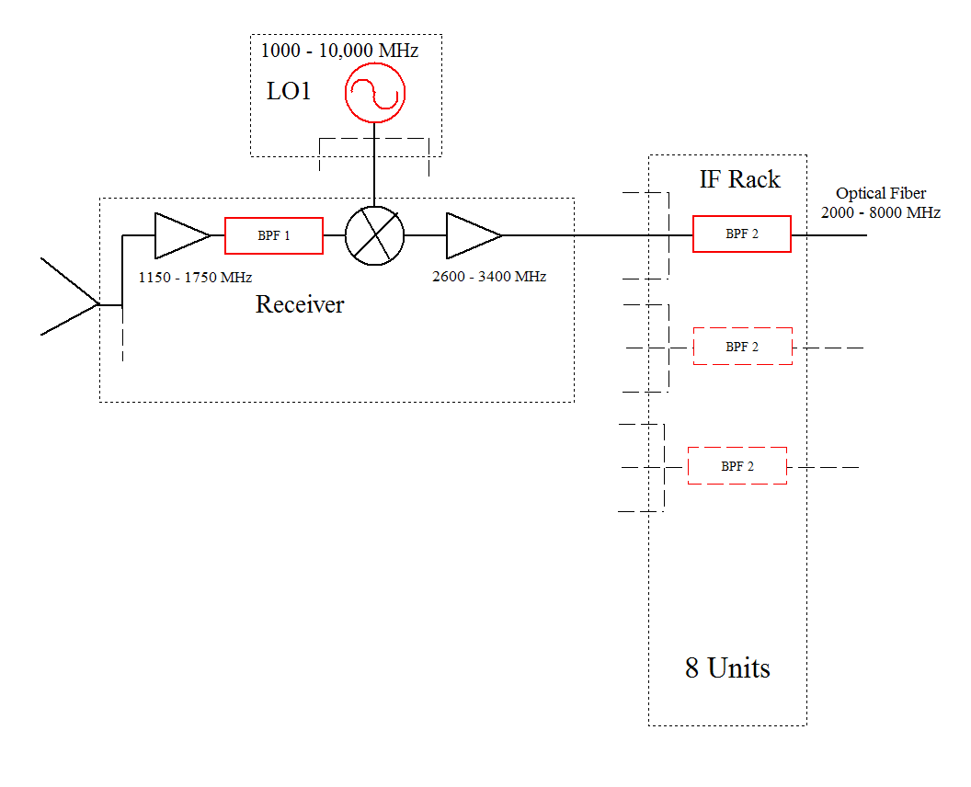

Slide 15
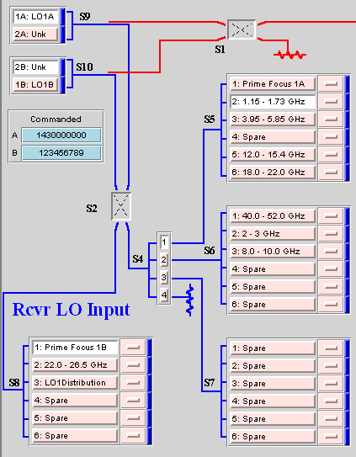
Local Oscillator and Switching Matrix

Slide 16
Typical Receiver

Slide 17
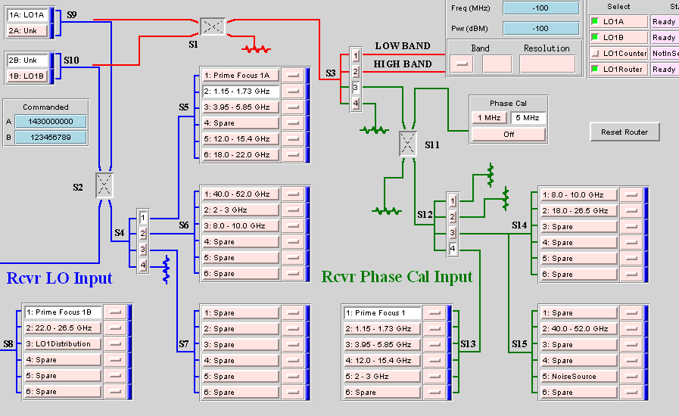

Slide 19
Receiver Room

Slide 20
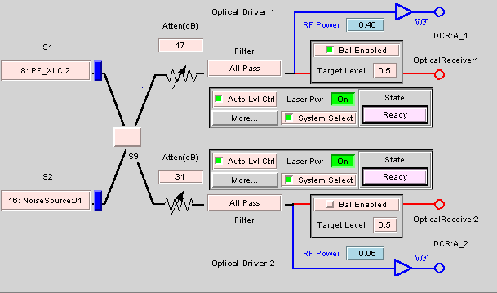
IF Rack – Input switching Matrix, IF Filters, Power Balancing Attenuators, and Drivers for 8 Optical Fibers

Slide 21
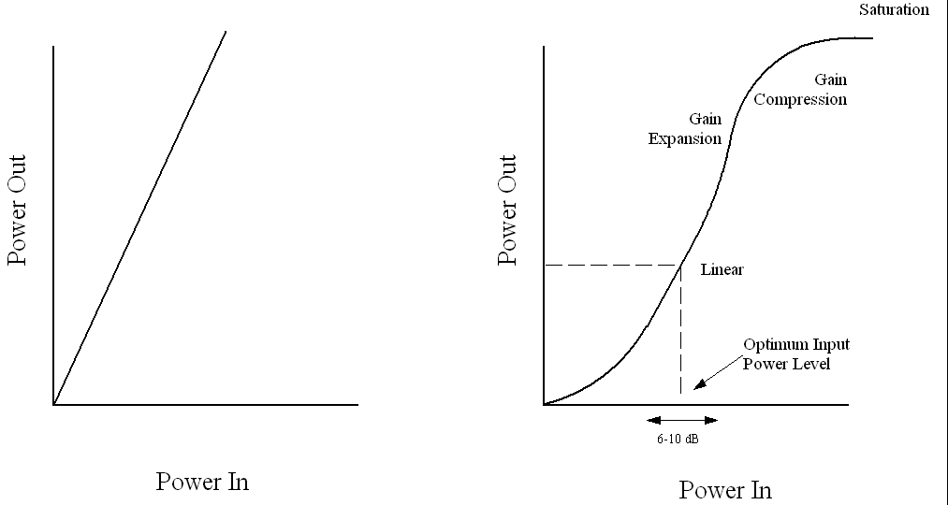
Power Balancing/Leveling and Non-Linearity

Slide 24
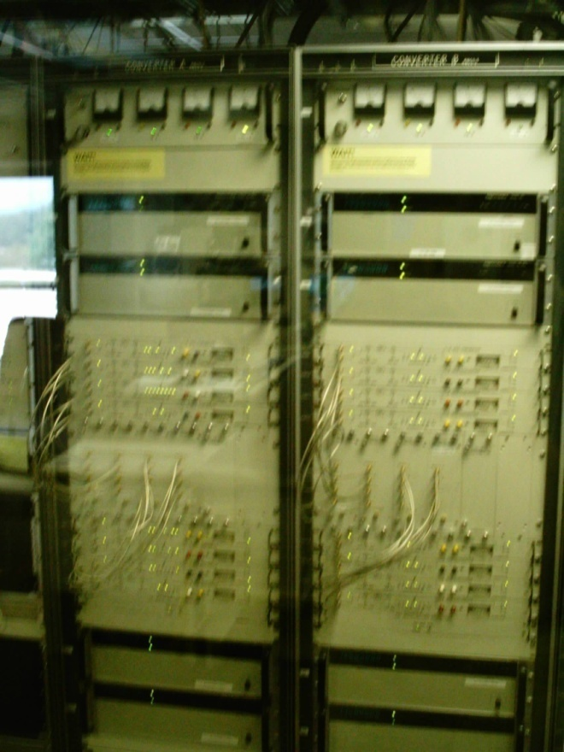
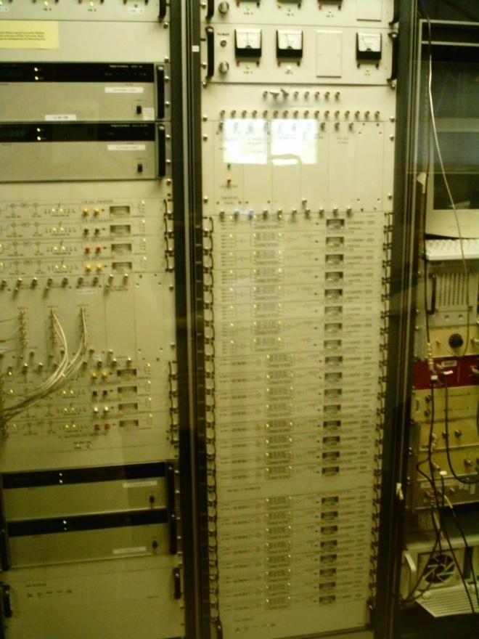
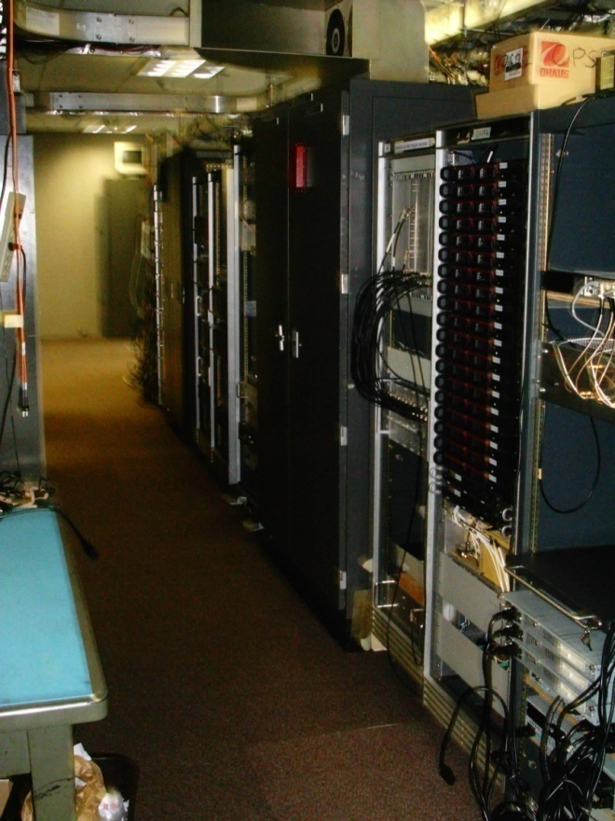
Converter and Analog Filter Racks, Spectrometer

Slide 25
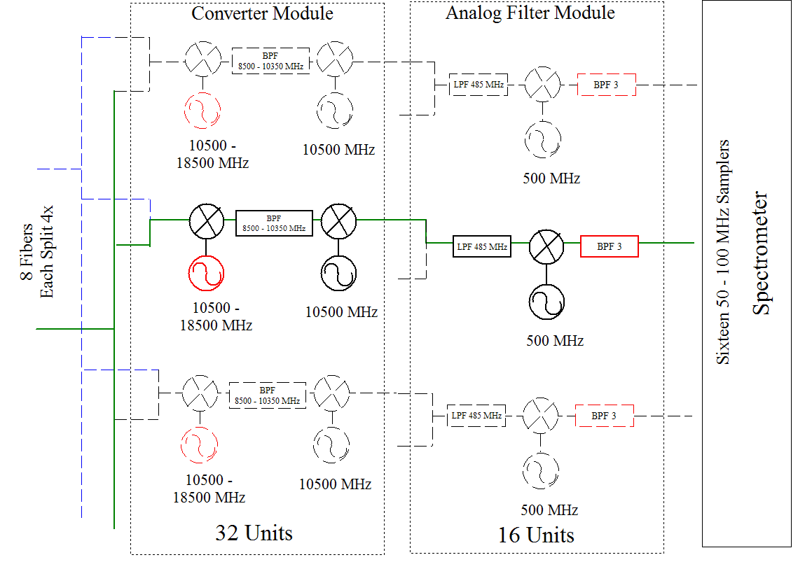

Slide 26
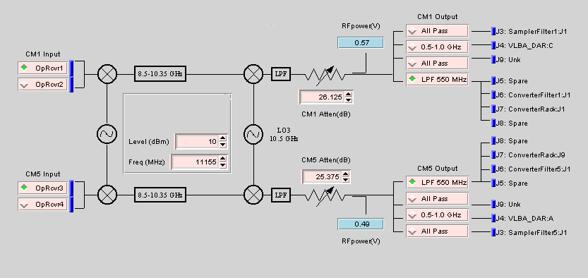
Converter Rack – Receivers for Optical Fibers, LO2 and LO3, Power Balancing Attenuators, Output Switches to Backends and AFR

Slide 28
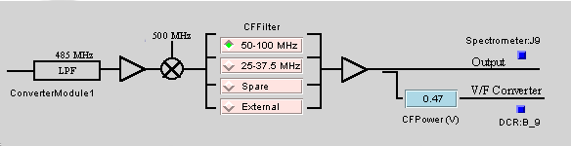
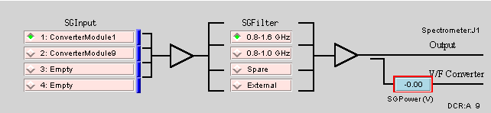
Analog Filter Rack
For 12.5 and 50 MHz Slow-Speed Spectrometer Samplers : LO4 and Filters
For 200 and 800 MHz High-Speed Spectrometer Samplers : Input Switches and Filters.

Slide 29
Quiz 2: Determine values for red components

Slide 30
Quiz 2: Determine values for red components
Goal : Observe 1420 MHz with the 50 MHz mode of the Spectrometer
Parameters:
  BPF1 can be: 1100–1800, 1600-1750, 1300-1450, or 1100-1450 MHz
  All mixers are Lower Side Band. Hint: first two mixers up convert, the last two down convert.
  BPF2 can be : 2990-3010, 2960-3040, 2840-3160, 2360-3640, 5960-6040, 5840-6160, or 5360-6640 MHz
  BPF3 can be : 50-100 or 25-37.5 MHz
  See block diagram for other parameters
Hint: Work from the receiver down the chain until you get stuck, then from Spectrometer up
Record values for LO1 and LO2; settings for BPF1, 2, and 3; and values for all Intermediate Frequencies.

Slide 31
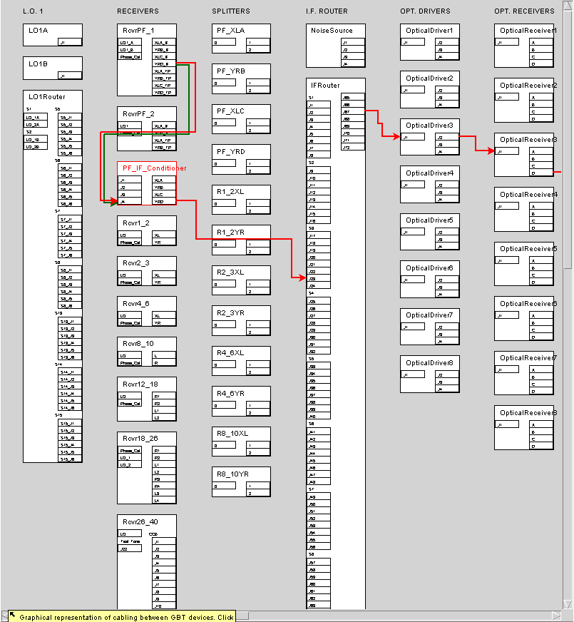

Slide 32
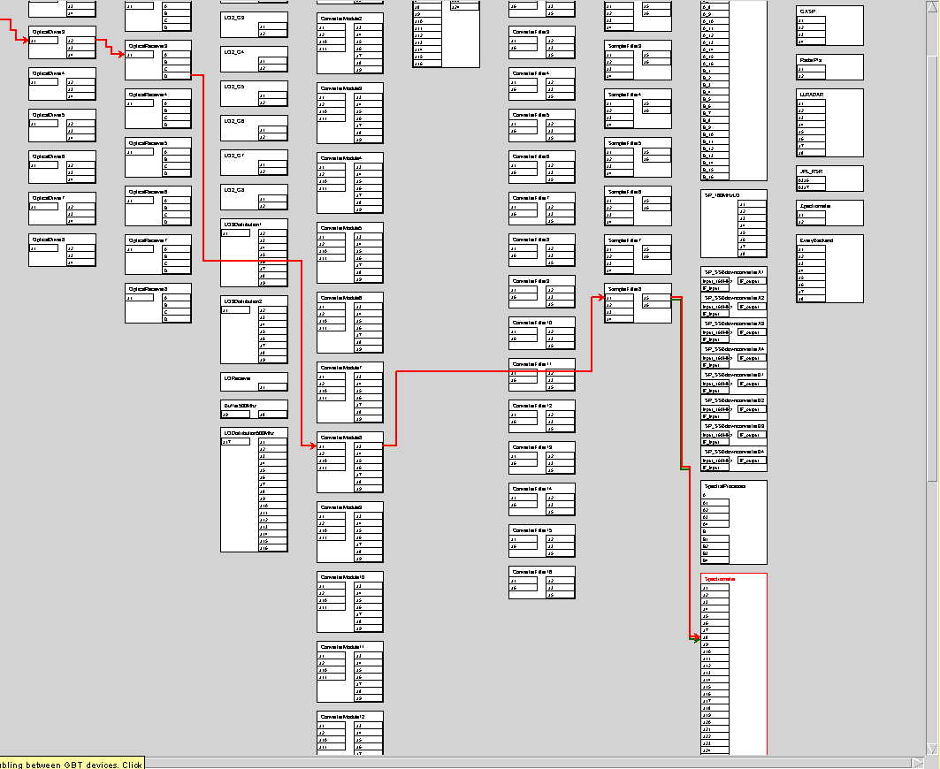

Slide 33
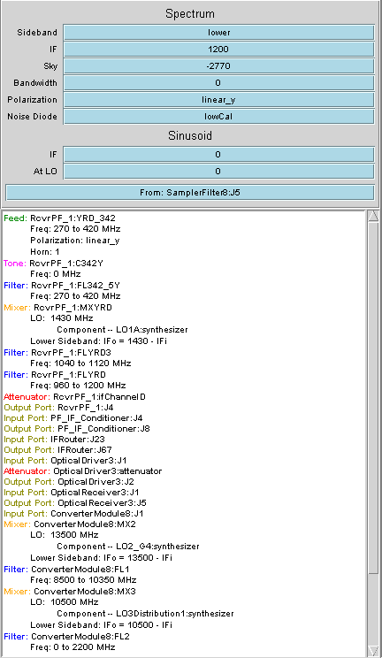
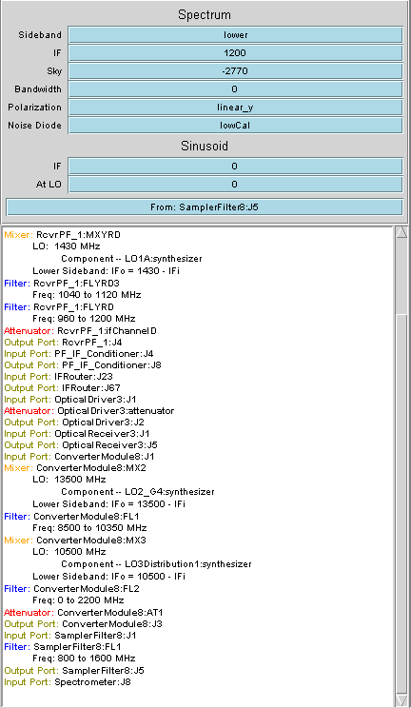

Slide 34
GBT – Astrid program does all the hard work for you…..
configLine = """
receiver = "Rcvr1_2"
beam = “B1"
obstype = "Spectroscopy"
backend = "Spectrometer"
nwin = 1
restfreq = 1420.4058
deltafreq = 0
bandwidth = 12.5
swmode = "tp"
swtype = "none"
swper = 1.0
swfreq = 0.0, 0.0
tint = 30
vlow = 0
vhigh = 0
vframe = "lsrk"
vdef = "Radio"
noisecal = "lo"
pol = "Linear"
nchan = "low"
spect.levels = 3
"""

Slide 35
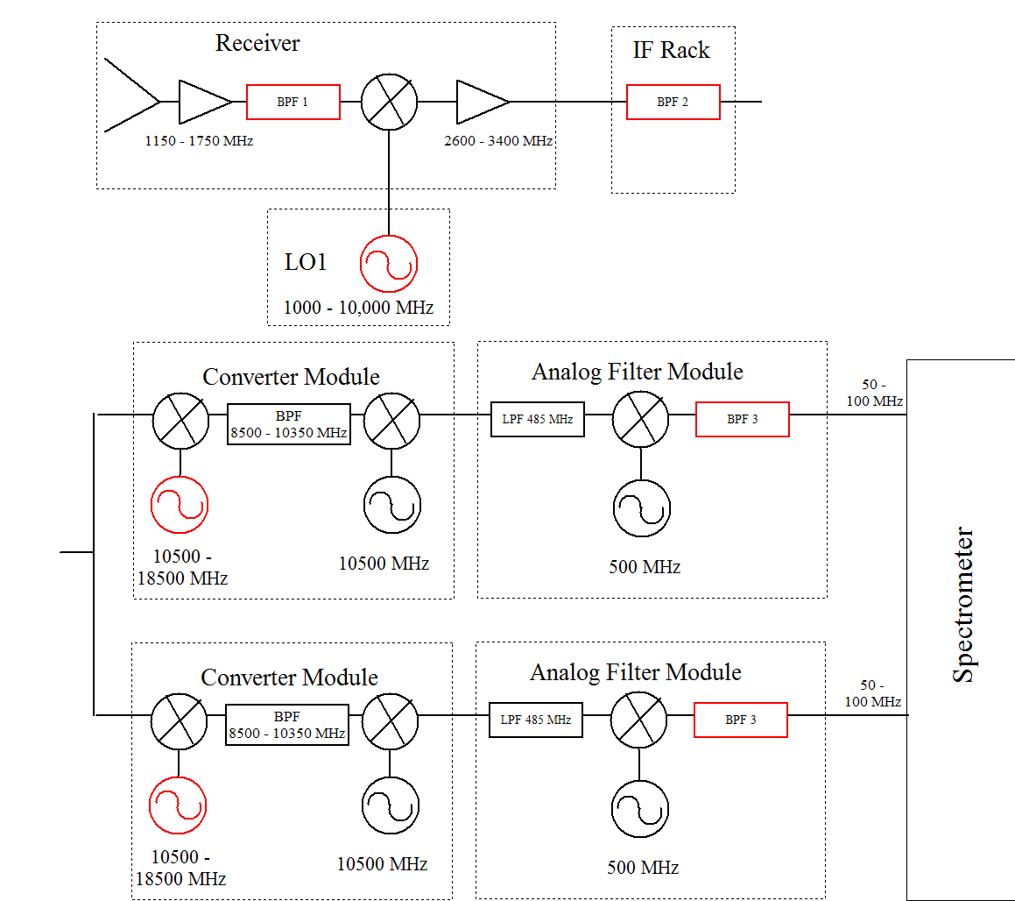
Quiz 3: Determine values for red components

Slide 36
Quiz 3: Determine values for red components
Goal : Observe simultaneously 1420 MHz and 1665 MHz with the 50 MHz mode of the Spectrometer
Parameters:
  BPF1 can be: 1100–1800, 1600-1750, 1300-1450, or 1100-1450 MHz
  All mixers are LSB. Hint: first two mixers up convert, the last two down convert.
  BPF2 can be : 2990-3010, 2960-3040, 2840-3160, 2360-3640, 5960-6040, 5840-6160, or 5360-6640 MHz
  BPF3 can be : 50-100 or 25-37.5 MHz
  See block diagram for other parameters
Hint: Work from the receiver down the chain until you get stuck, then from Spectrometer up. Start with the results from Quiz 1.
Record values for LO1 and both LO2’s; settings for BPF1, 2, and 3; and values for all Intermediate Frequencies.

