Slide 1
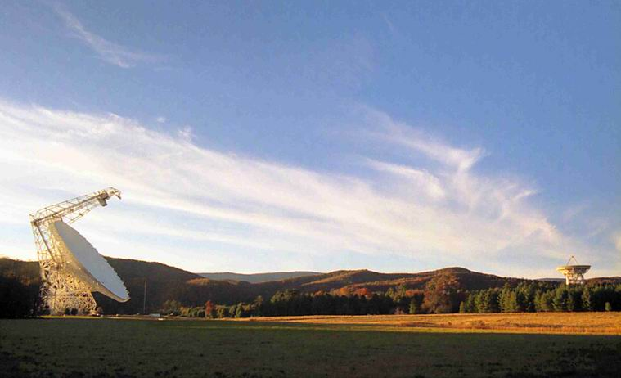
The Quest for Extraterrestrial Signals
Ron Maddalena
National Radio Astronomy Observatory
Green Bank, WV
© Associated Universities, Inc; April/2016

Slide 2
Preliminary thoughts
How certain are you that other solar systems are common?
How certain are you that other Earth-like planets are common?
How certain are you that extraterrestrial life is common?
How certain are you that extraterrestrial intelligent life is common?
How certain are you that it is common for intelligent life to try to communicate its existence to other worlds?
How certain are you that intelligent life would colonize?

Slide 3
Extraterrestrial Life Debate – Not New
Philosophy/Cosmology/World-View inspired:
Atomist (Epicurus) – 5th century BC
Lucretius – 1st century AD
Giordano Bruno (heretic) – 16th century
Kepler (Moon) – 16th century
Voltaire (Micromegas -- aliens) – 18th century
Thomas Paine (Common Sense) – 1776
Scientists:
Sir John Herschel (Moon & Sun) – 19th century
Percival Lowell (Mars) – 1894/95
Marconi (Detects radio waves from Mars) -- 1920

Slide 4
Opinions on The Search for Extraterrestrial Intelligence
It is not science research
It is science research but not very worthwhile
It is worthwhile
It is an imperative area of research
Cost and risk versus possible payoff

Slide 5
Searching for Extraterrestrial Signals is a Lot Like Searching for Unicorns
If one can estimate there’s a high likelihood there’s one Unicorn per square mile, then the search would have low costs
If one can estimate Unicorns are extremely rare, no more than one per 10,000 square miles, what must one do to definitively determine that not even one Unicorns exists?

Slide 6
The Drake Equation
N = the number of civilizations in our galaxy for which communication might be possible
R* = The rate of formation of stars suitable for the development of intelligent life.
f_{p} = The fraction of those stars with planetary systems
n_{e} = The number of planets, per solar system, with an environment suitable for life.
f_{l} = The fraction of suitable planets on which life actually appears.
f_{i} = The fraction of life bearing planets on which intelligent life emerges.
f_{c} = The fraction of civilizations that develop a technology that releases detectable signs of their existence into space
L = The length of time such civilizations release detectable signals into space.
Quoted from: http://www.seti.org/drakeequation

Slide 7
The Drake Equation
N = the number of civilizations in our galaxy for which communication might be possible
R* = The rate of formation of stars suitable for the development of intelligent life. About 7 / year
f_{p} = The fraction of those stars with planetary systems
n_{e} = The number of planets, per solar system, with an environment suitable for life.
f_{l} = The fraction of suitable planets on which life actually appears.
f_{i} = The fraction of life bearing planets on which intelligent life emerges.
f_{c} = The fraction of civilizations that develop a technology that releases detectable signs of their existence into space
L = The length of time such civilizations release detectable signals into space.
Quoted from: http://www.seti.org/drakeequation

Slide 8
The Drake Equation
N = the number of civilizations in our galaxy for which communication might be possible
R* = The rate of formation of stars suitable for the development of intelligent life. About 7 / year
f_{p} = The fraction of those stars with planetary systems. About 1
n_{e} = The number of planets, per solar system, with an environment suitable for life.
f_{l} = The fraction of suitable planets on which life actually appears.
f_{i} = The fraction of life bearing planets on which intelligent life emerges.
f_{c} = The fraction of civilizations that develop a technology that releases detectable signs of their existence into space
L = The length of time such civilizations release detectable signals into space.
Quoted from: http://www.seti.org/drakeequation

Slide 9
Optimistic Values
N = the number of civilizations in our galaxy for which communication might be possible
R* = The rate of formation of stars suitable for the development of intelligent life. About 7 / year
f_{p} = The fraction of those stars with planetary systems. About 1
n_{e} = The number of planets, per solar system, with an environment suitable for life. About 0.2
f_{l} = The fraction of suitable planets on which life actually appears.
f_{i} = The fraction of life bearing planets on which intelligent life emerges.
f_{c} = The fraction of civilizations that develop a technology that releases detectable signs of their existence into space
L = The length of time such civilizations release detectable signals into space.
Quoted from: http://www.seti.org/drakeequation

Slide 10
Optimistic Values
N = the number of civilizations in our galaxy for which communication might be possible
R* = The rate of formation of stars suitable for the development of intelligent life. About 7 / year
f_{p} = The fraction of those stars with planetary systems. About 1
n_{e} = The number of planets, per solar system, with an environment suitable for life. About 0.2
f_{l} = The fraction of suitable planets on which life actually appears. 0.1 ????
f_{i} = The fraction of life bearing planets on which intelligent life emerges.
f_{c} = The fraction of civilizations that develop a technology that releases detectable signs of their existence into space
L = The length of time such civilizations release detectable signals into space.
Quoted from: http://www.seti.org/drakeequation

Slide 11
Optimistic Values
N = the number of civilizations in our galaxy for which communication might be possible
R* = The rate of formation of stars suitable for the development of intelligent life. About 7 / year
f_{p} = The fraction of those stars with planetary systems. About 1
n_{e} = The number of planets, per solar system, with an environment suitable for life. About 0.2
f_{l} = The fraction of suitable planets on which life actually appears. 0.1 ????
f_{i} = The fraction of life bearing planets on which intelligent life emerges. 1 ???
f_{c} = The fraction of civilizations that develop a technology that releases detectable signs of their existence into space
L = The length of time such civilizations release detectable signals into space.
Quoted from: http://www.seti.org/drakeequation

Slide 12
Optimistic Values
N = the number of civilizations in our galaxy for which communication might be possible
R* = The rate of formation of stars suitable for the development of intelligent life. About 7 / year
f_{p} = The fraction of those stars with planetary systems. About 1
n_{e} = The number of planets, per solar system, with an environment suitable for life. About 0.2
f_{l} = The fraction of suitable planets on which life actually appears. 0.1 ????
f_{i} = The fraction of life bearing planets on which intelligent life emerges. 1 ????
f_{c} = The fraction of civilizations that develop a technology that releases detectable signs of their existence into space. 0.2 ????
L = The length of time such civilizations release detectable signals into space.
Quoted from: http://www.seti.org/drakeequation

Slide 13
Optimistic Values
N = the number of civilizations in our galaxy for which communication might be possible
R* = The rate of formation of stars suitable for the development of intelligent life. About 7 / year
f_{p} = The fraction of those stars with planetary systems. About 1
n_{e} = The number of planets, per solar system, with an environment suitable for life. About 0.2
f_{l} = The fraction of suitable planets on which life actually appears. 0.1 ????
f_{i} = The fraction of life bearing planets on which intelligent life emerges. 1 ????
f_{c} = The fraction of civilizations that develop a technology that releases detectable signs of their existence into space. 0.2 ????
L = The length of time such civilizations release detectable signals into space. 1,000,000,000 years ???????????????
Quoted from: http://www.seti.org/drakeequation

Slide 14
Optimistic Values
N = the number of civilizations in our galaxy for which communication might be possible = 28,000,000 – mean separation 30 lyrs (about 10 pc)
R* = The rate of formation of stars suitable for the development of intelligent life. About 7 / year
f_{p} = The fraction of those stars with planetary systems. About 1
n_{e} = The number of planets, per solar system, with an environment suitable for life. About 0.2
f_{l} = The fraction of suitable planets on which life actually appears. 0.1 ????
f_{i} = The fraction of life bearing planets on which intelligent life emerges. 1 ????
f_{c} = The fraction of civilizations that develop a technology that releases detectable signs of their existence into space. 0.2 ????
L = The length of time such civilizations release detectable signals into space. 1,000,000,000 years ???????????????
Quoted from: http://www.seti.org/drakeequation

Slide 15
We have an actual, singular amazing observation. A critical piece of scientific data.
There has never been a detection of an ET
Fermi Paradox
Some civilizations will develop interstellar travel.
the Milky Way galaxy would be covered in about a million years even with slow interstellar speeds
The Milky Way is 10 billion years old.
Some term in the Drake Equation acts as a barrier to the formation of intelligent life
And/or L is relatively short

Slide 16
Rare Earth Hypothesis (Pessimistic)
N*=Number of stars in the Milky Way: 10¹¹ – 5x 10¹¹
n_{e}=Number of planets in the habitable zone
f_{g} = fraction in the galactic habitable zone
f_{p} = fraction of stars with planets
f_{pm} = fraction of planets that are rocky
f_{i} = fraction of planets that can develop microbial life
f_{c} = fraction of planets that develop complex life
f_{l} = fraction of a planet’s lifetime that can support life
f_{m} = fraction of planets with a large moon
f_{p} = fraction of planetary systems with a Jovian moon
f_{me} = fraction of planets with a low number of extinction events

Slide 17
Rare Earth Hypothesis
Other considerations
Right kind of galaxy
Right kind of star
Stable orbit
Something must stop the typical planetary migrations that would destroy rocky planets in the habitable zone
Fast rotating planet – requires a collision with another planet-sized object
Magnetic field
Low but not zero intrinsic nuclear radiation
Plate tectonics and a tilted axis to promote evolution

Slide 18
How did life get started? Complex life? Intelligent life?
Chemist/Biologist have some ideas on how to get the chemistry of life started
Known chemistry reaction rates cannot produce the complexity of life in less then 1 million years
Panspermia
Comets, etc. seeded the Earth with the complex molecules known to form and exist in interstellar space which jump started the chemistry.
And then there’s Mars.
Chemist/Biologist also have some ideas on why it is inevitable that eventually complex life forms would develop.

Slide 19
What are SETI searches like?
Optical – encoded messages on collimated light beams
Infrared – the signature of Dyson spheres (Soviet Union/Russians)
Radio (US)
1-5 GHz
High time resolution
High frequency resolution
Pointed observations toward particular stars
Commensal/Piggy-back experiments

Slide 20
But, if you don’t do the experiment, you won’t know the answer. And, what would be the consequences if the answer turns out to be: yes?? What protocols should scientist follow if a detection is made?

Slide 21
Final thoughts
How certain are you that other solar systems are common?
How certain are you that other Earth-like planets are common?
How certain are you that extraterrestrial life is common?
How certain are you that extraterrestrial intelligent life is common?
How certain are you that it is common for intelligent life to try to communicate its existence to other worlds?
How certain are you that intelligent life would colonize?

Slide 22
Final Opinions on The Search for Extraterrestrial Intelligence
It is not science research
It is science research but not very worthwhile
It is worthwhile
It is an imperative area of research

