Slide 1
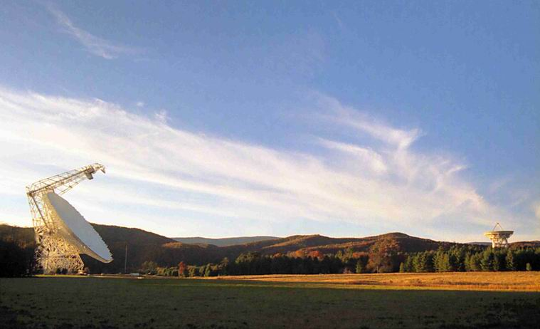


Fundamentals of the GBT and
Single-Dish Radio Telescopes
Dr. Ron Maddalena
National Radio Astronomy Observatory
Green Bank, WV
March 2016
©Associated Universities, Inc., 2016

Slide 2
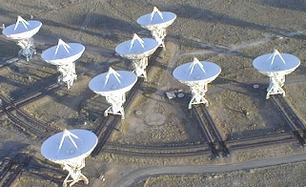
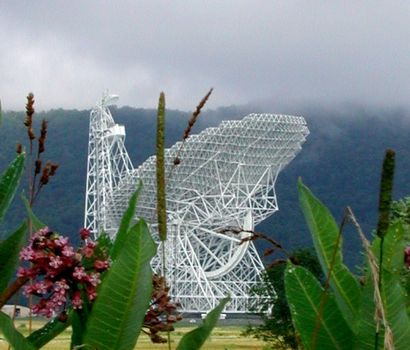

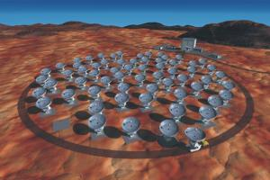
National Radio Astronomy Observatory
National Laboratory
Founded in 1954
Funded by the National Science Foundation

Slide 3
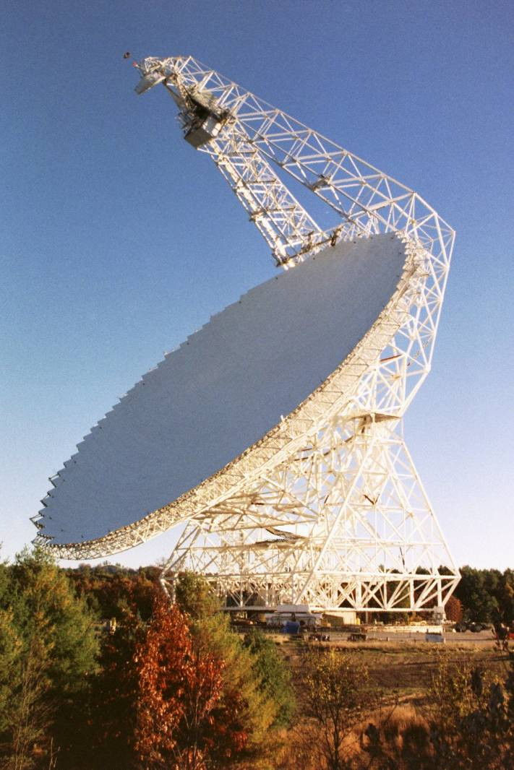
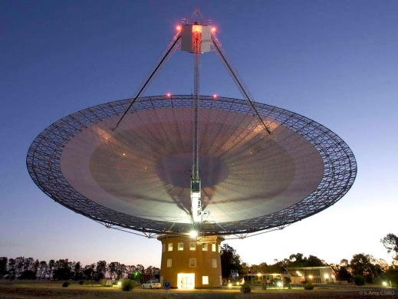
Telescope Structure and Optics

Slide 4
Telescope Structure and Optics

Slide 5
Telescope Structure and Optics
Large 100-m Diameter:
  High Sensitivity
  High Angular Resolution – wavelength / Diameter

Slide 6
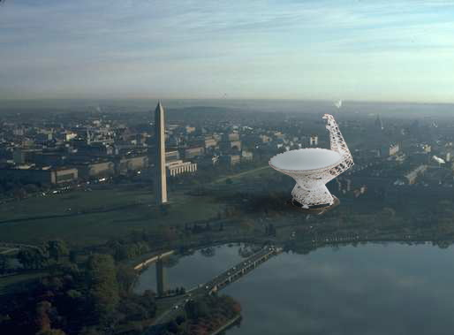

Slide 7
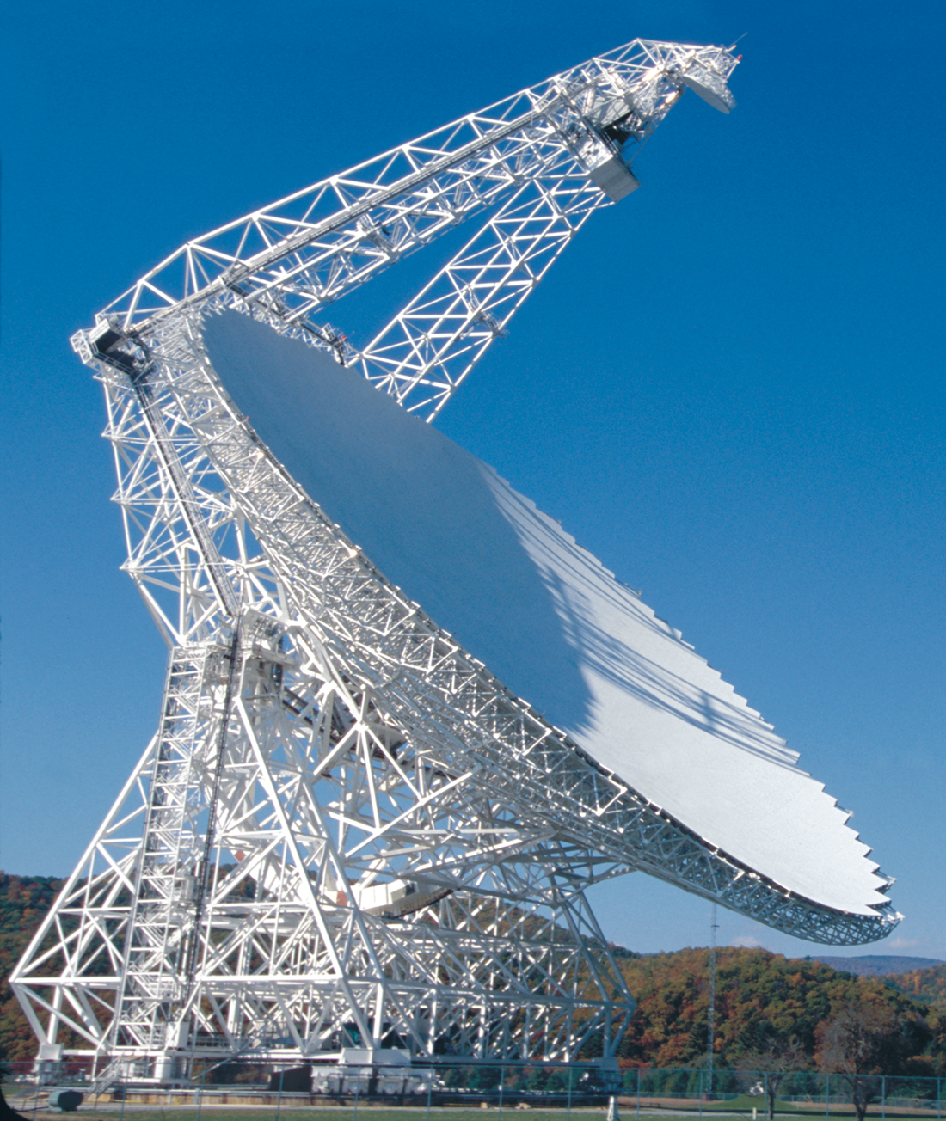
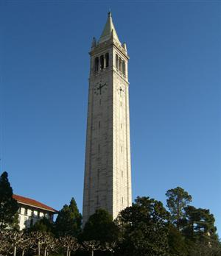

Slide 8


Slide 9
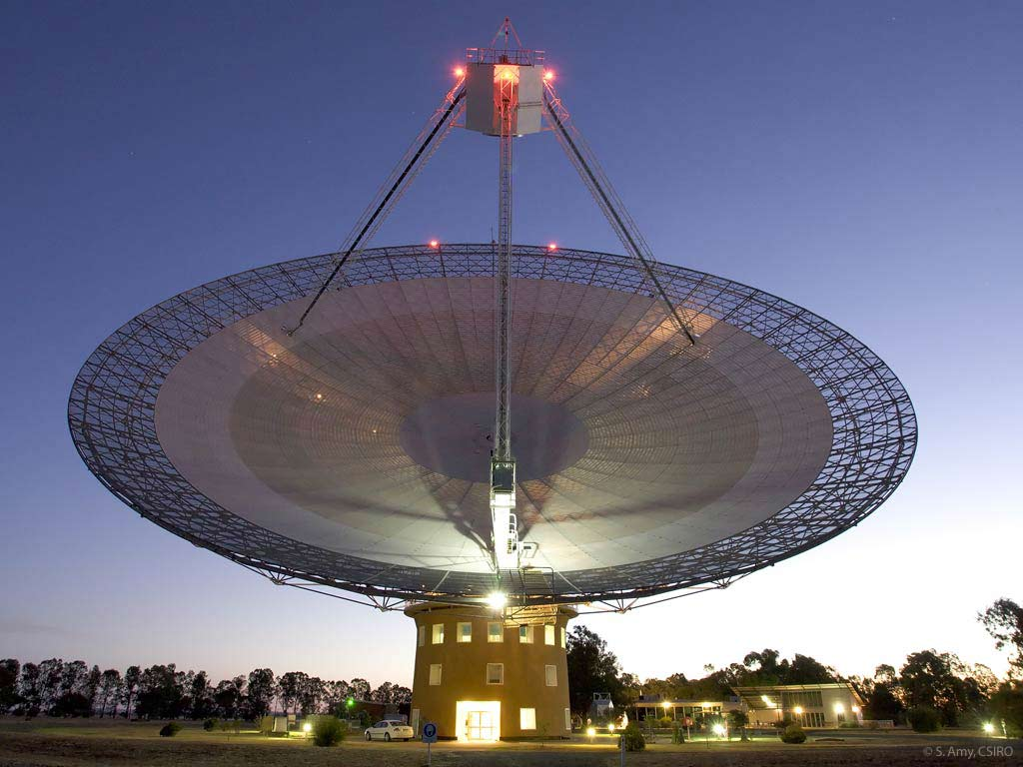
Telescope Structure and Optics

Slide 10
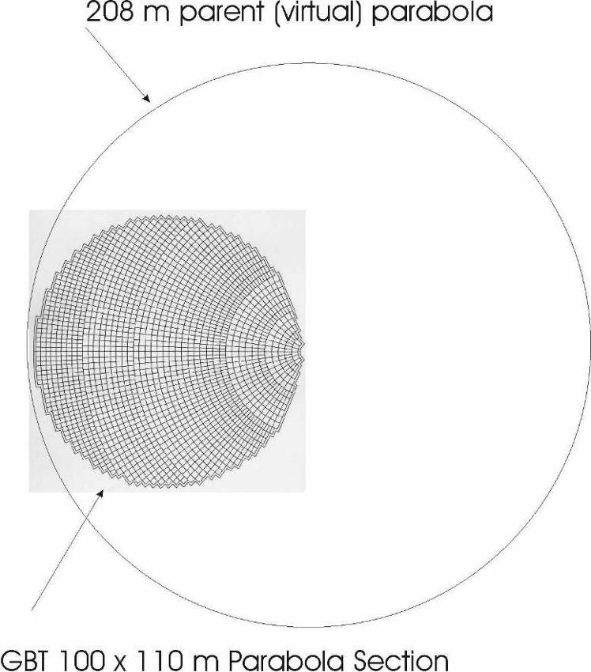
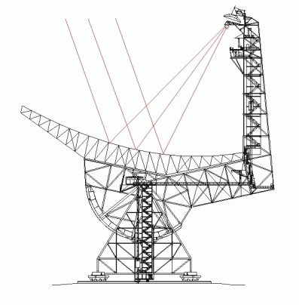
GBT Telescope Optics
110 m x 100 m of a 208 m parent paraboloid
  Effective diameter: 100 m
  Off axis - Clear/Unblocked Aperture

Slide 11
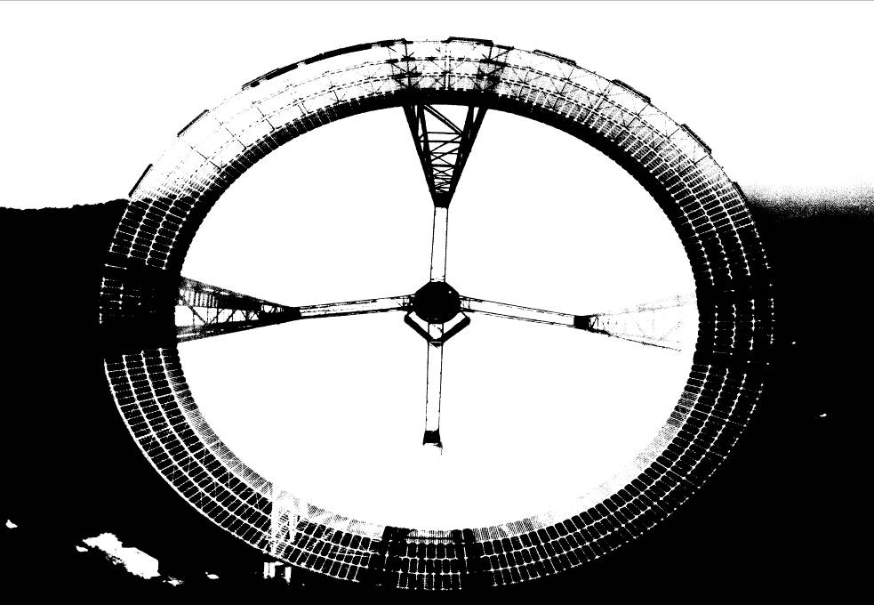
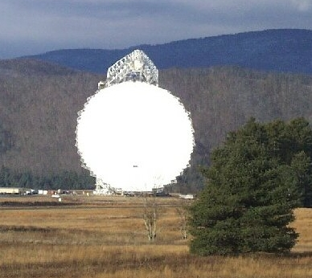
Telescope Optics
High Dynamic Range
High Fidelity Images

Slide 12
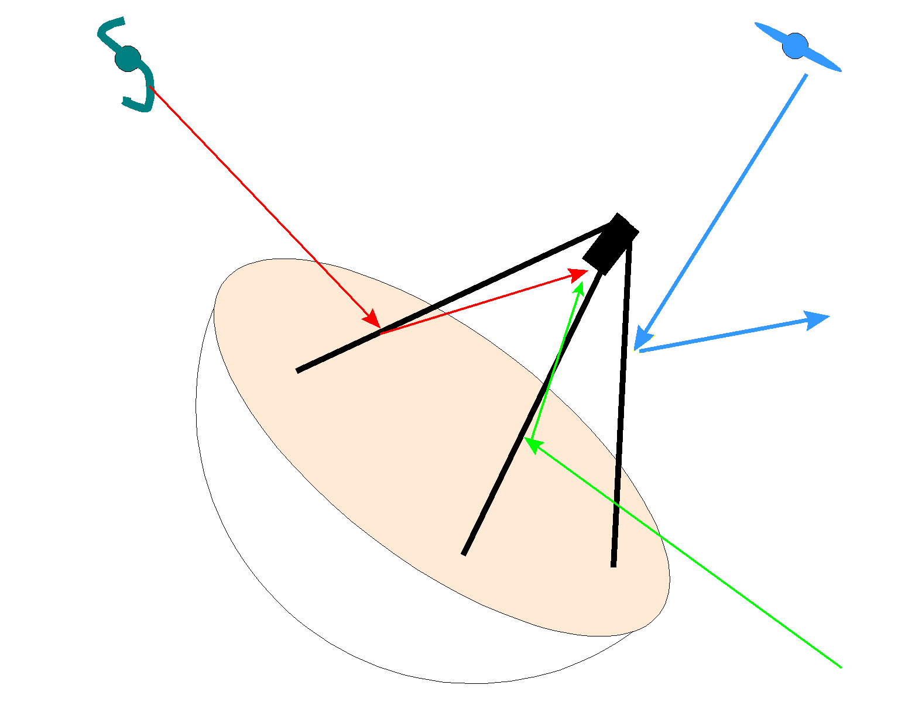
Telescope Optics
Stray Radiation
Blockage
Spillover

Slide 13
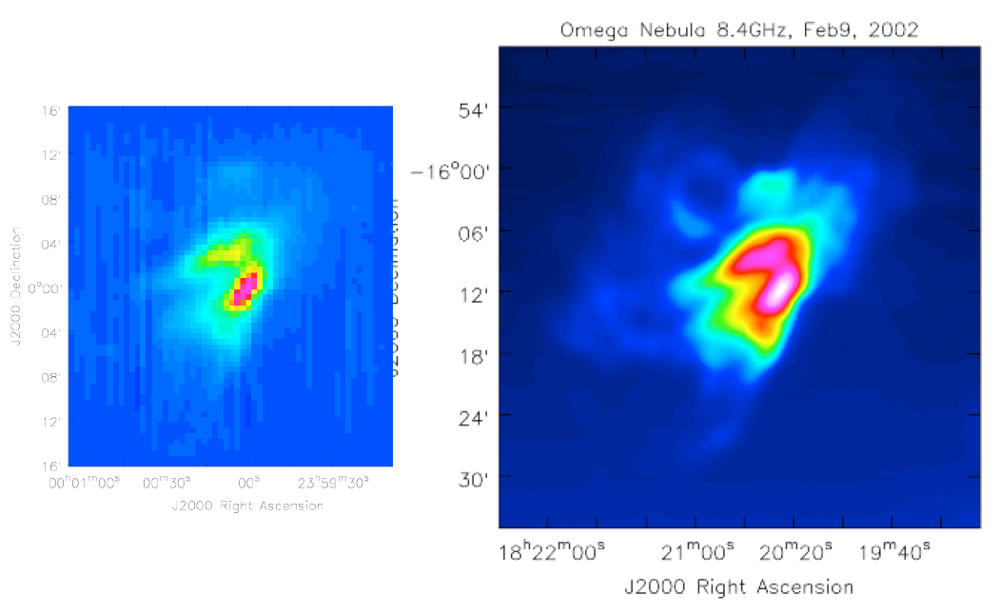
Telescope Optics

Slide 15
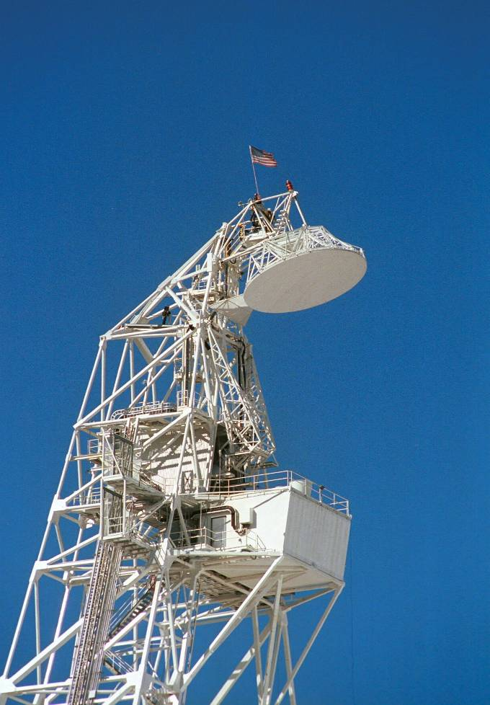
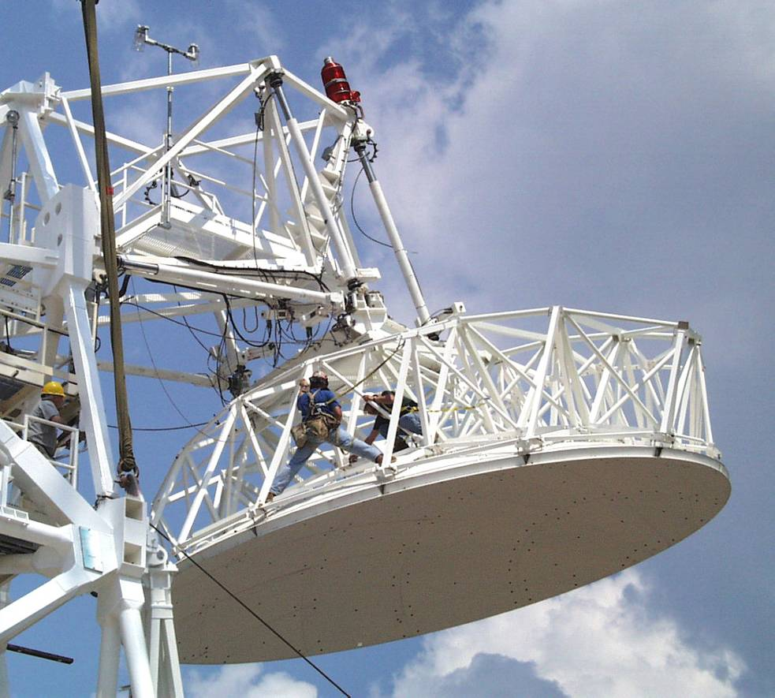
Telescope Optics
Prime Focus: Retractable boom
Gregorian Focus: 8-m subreflector - 6-degrees of freedom

Slide 16
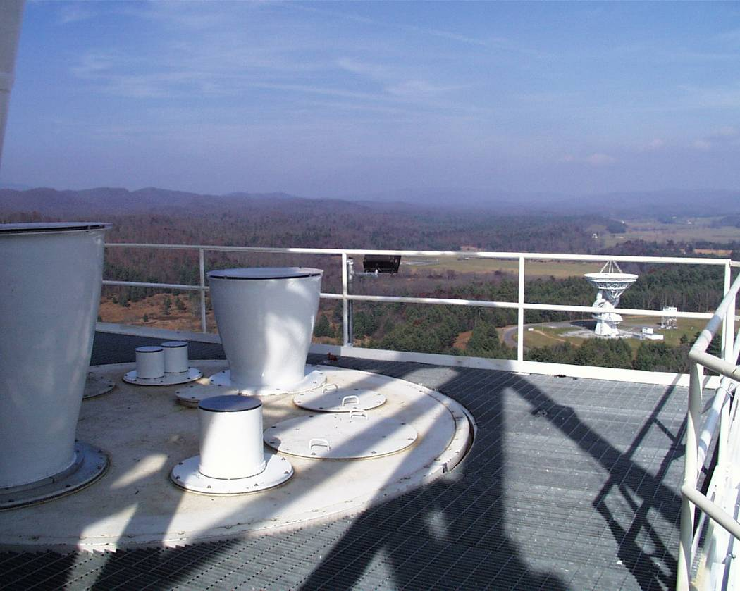
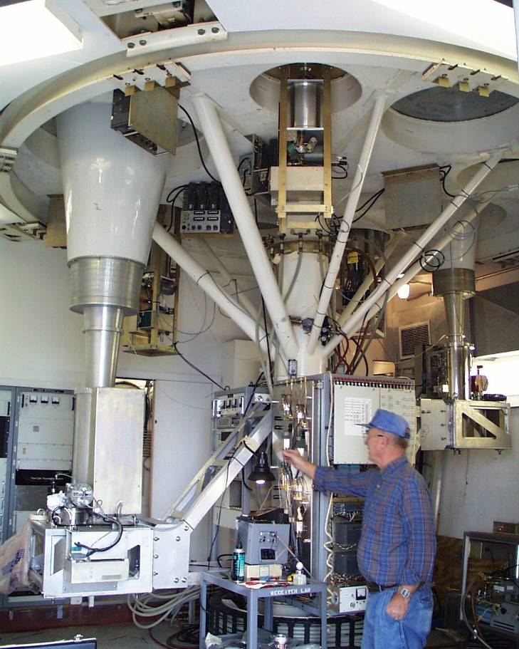
Telescope Optics
Rotating Turret with 8 receiver bays

Slide 17
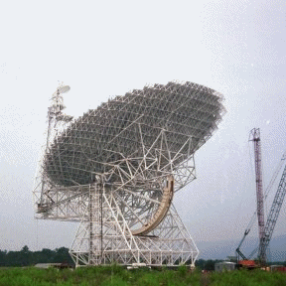
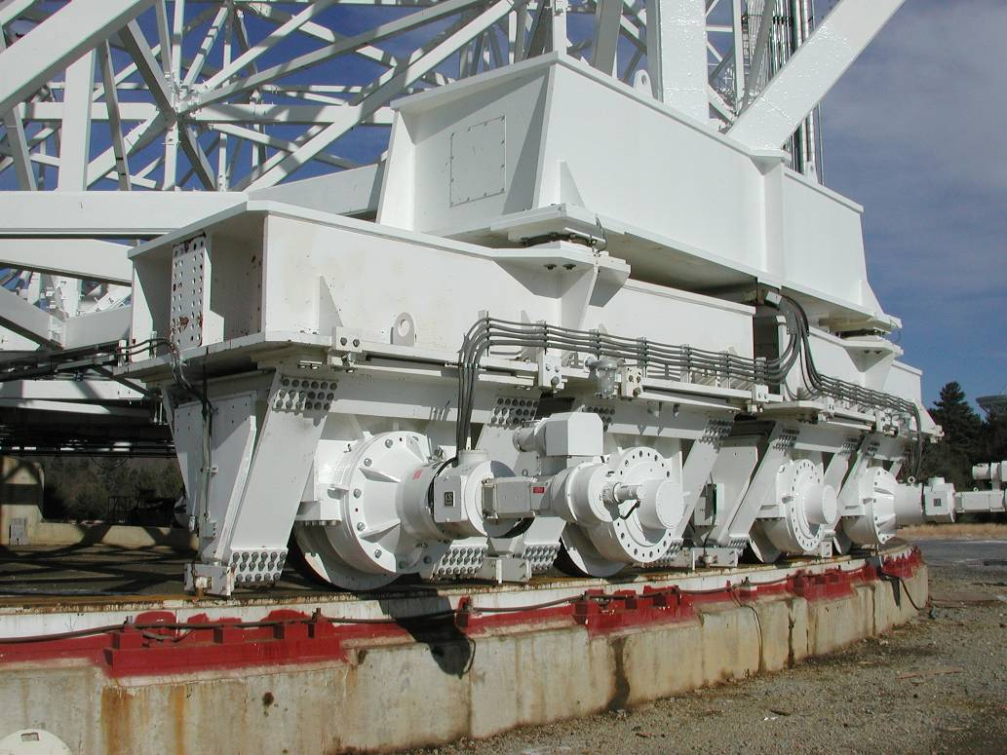
Telescope Structure
Fully Steerable
  Elevation Limit: 5°
  Can observe 85% of the entire Celestial Sphere
Slew Rates: Azimuth - 40°/min; Elevation - 20°/min

Slide 18
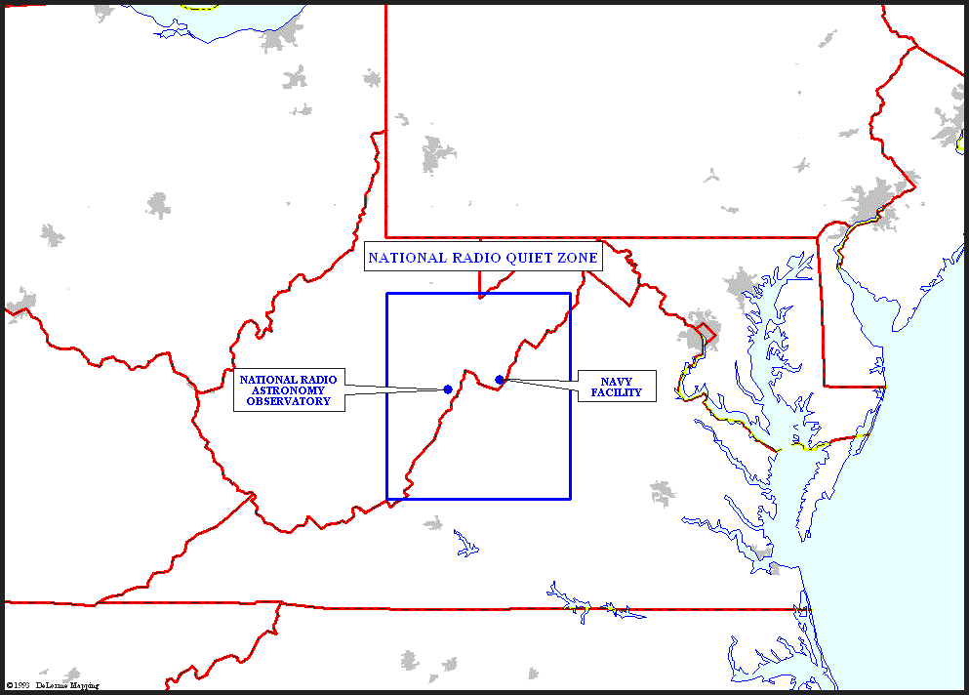
National Radio Quiet Zone

Slide 19


Slide 20
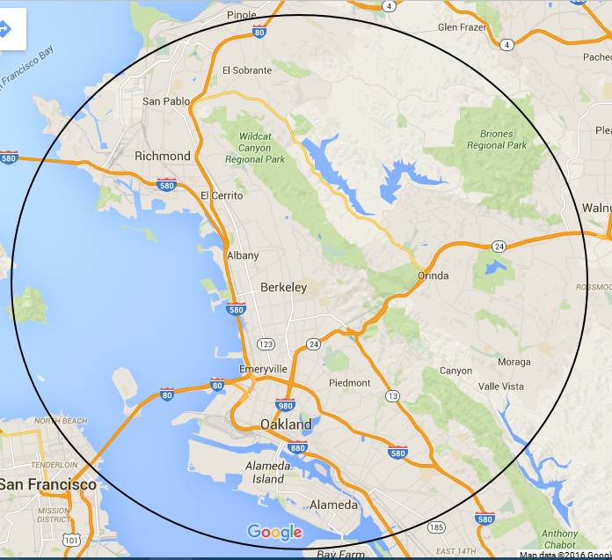

Slide 21
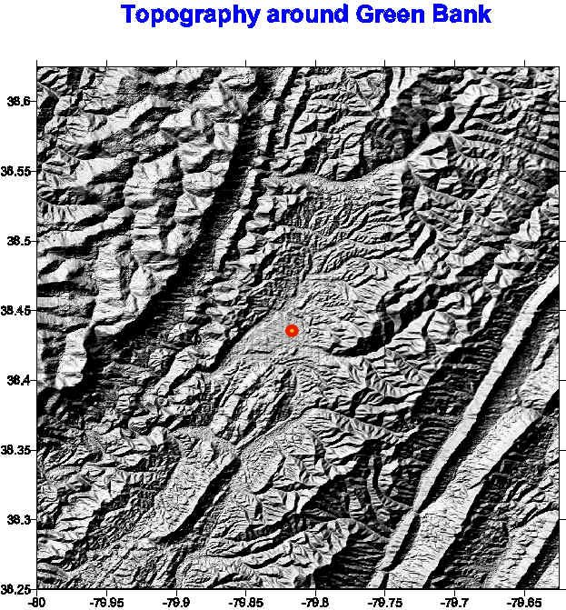
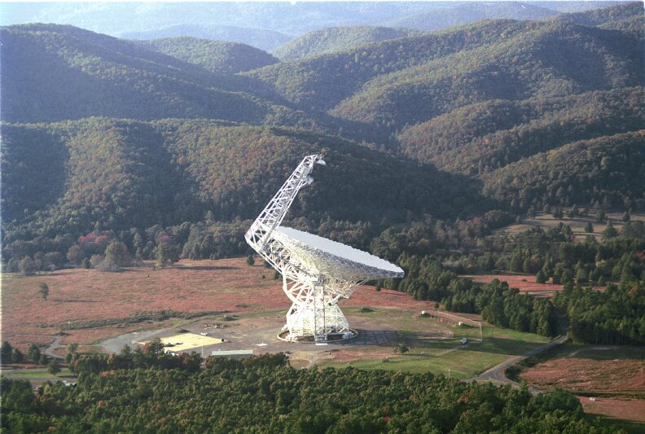
National Radio Quiet Zone

Slide 23
Atmosphere
Index of Refraction
  Weather (i.e., time) and frequency dependent
  Real Part: Bends the light path
  Imaginary part: Opacity
    http://www.gb.nrao.edu/~rmaddale/Weather/
Winds
  Wind-induced pointing errors
  Safety

Slide 24
The Influence of the Atmosphere and Weather at cm- and mm-wavelengths
Opacity
  Calibration
  System performance – Tsys
  Observing techniques
  Hardware design
Refraction
  Pointing
  Air Mass
    Calibration
    Interferometer & VLB phase errors
  Aperture phase errors
Cloud Cover
  Continuum performance
  Calibration
Winds
  Pointing
  Safety
Telescope Scheduling
  Proportion of proposals that should be accepted
  Telescope productivity

Slide 25
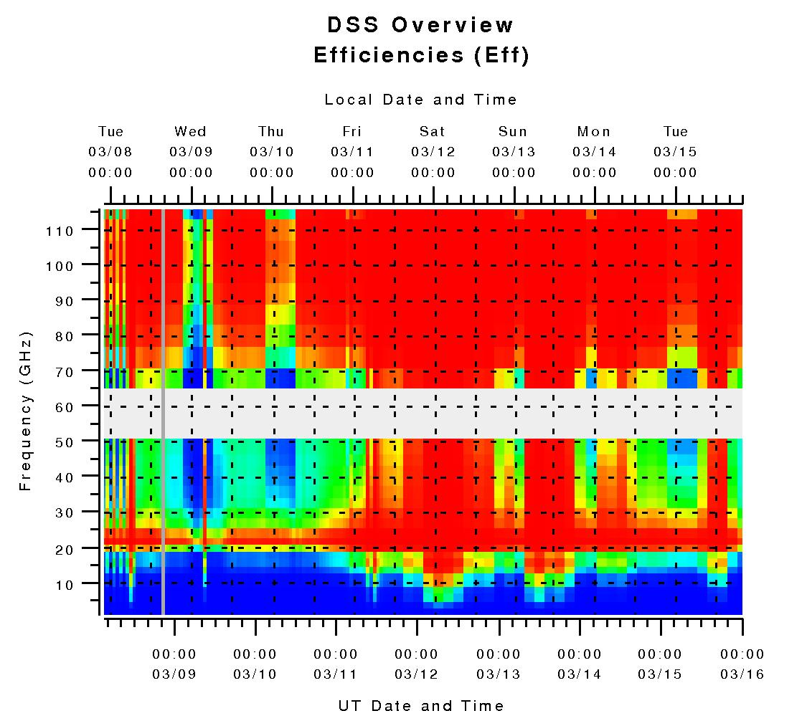
Weather Forecasts for Radio Astronomy

Slide 26
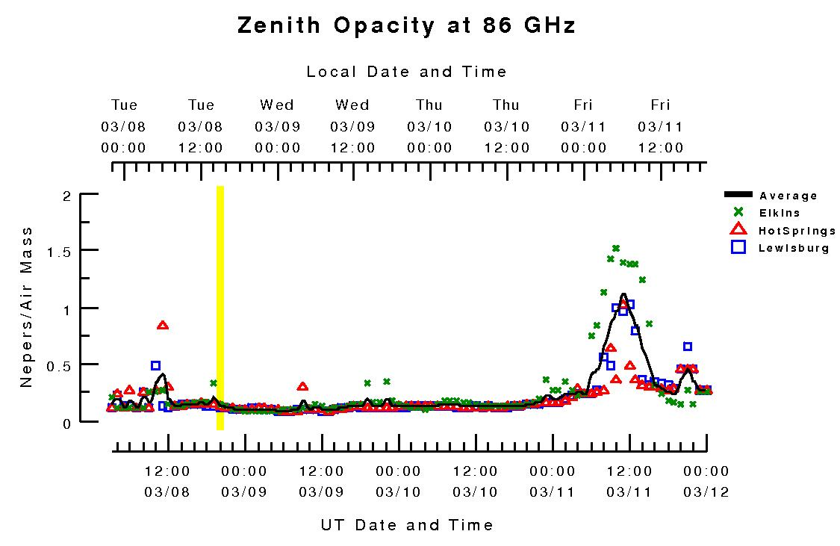
Weather Forecasts for Radio Astronomy

Slide 28
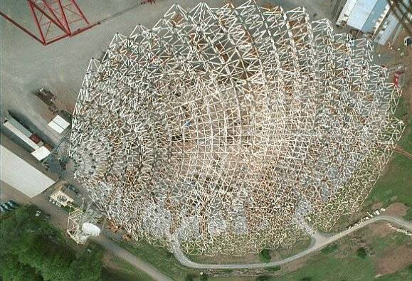
Telescope Structure

Slide 29
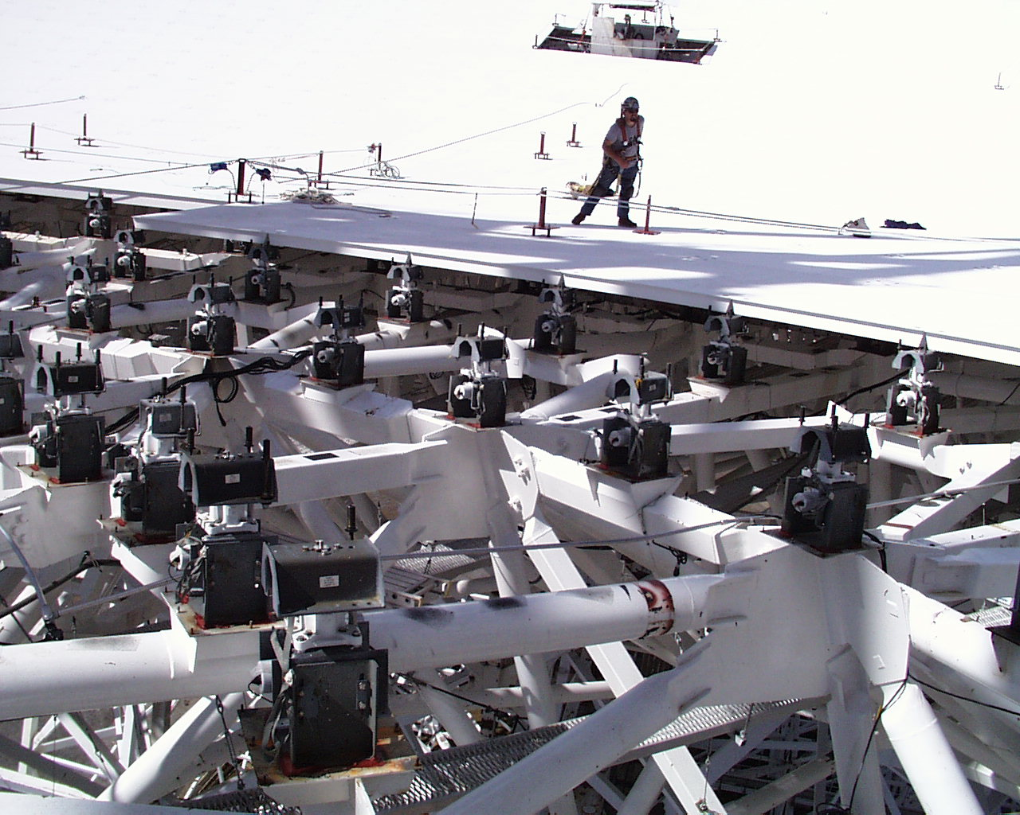
GBT active surface system
Surface has 2004 panels
  average panel rms: 68 µm
2209 precision actuators

Slide 30
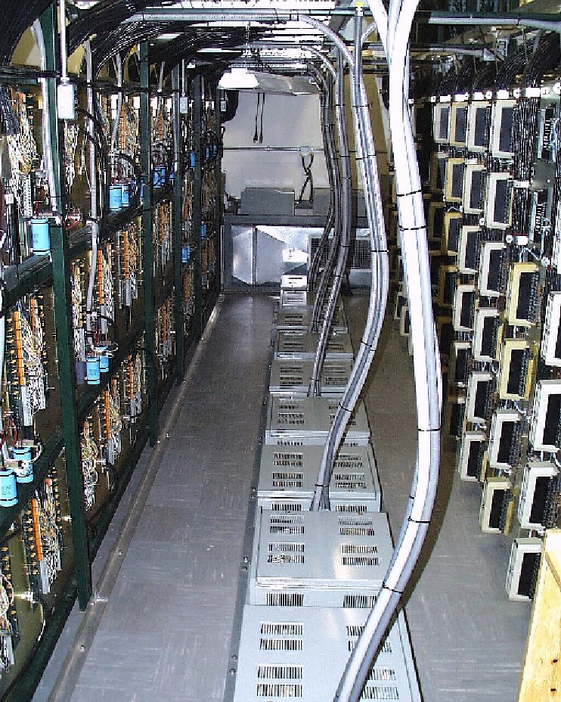
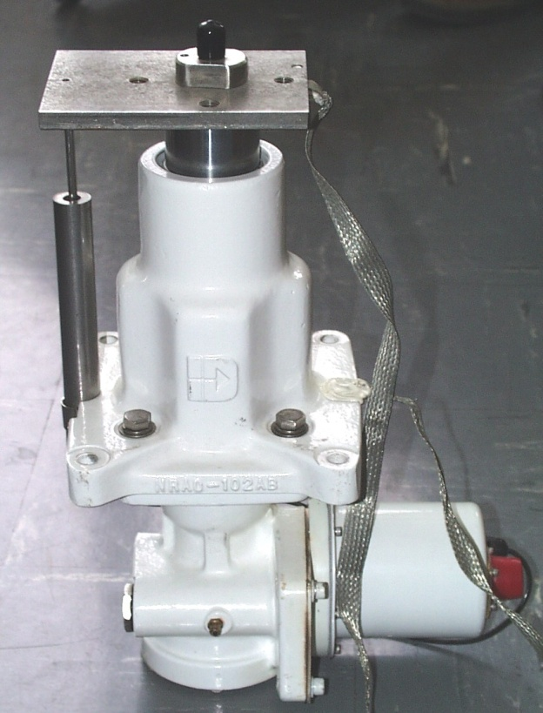
Surface Panel Actuators
One of 2209 actuators.
Actuators are located under each set of surface panel corners
Actuator Control Room
26,508 control and supply wires terminated in this room

Slide 31
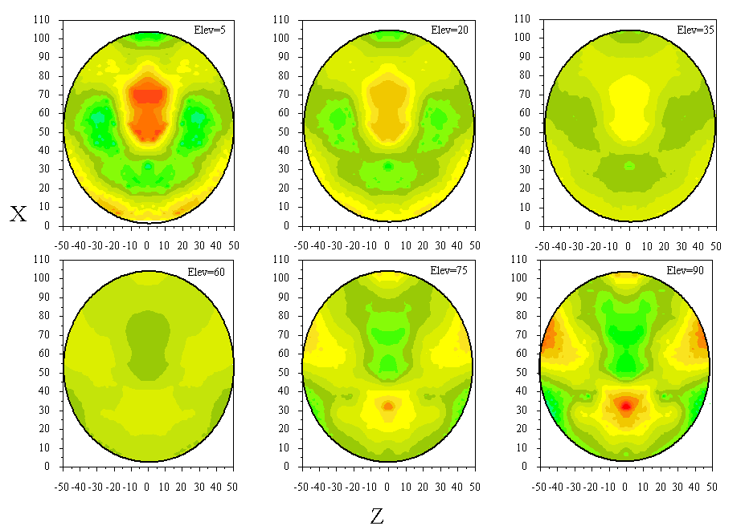
Finite Element Model Predictions

Slide 32
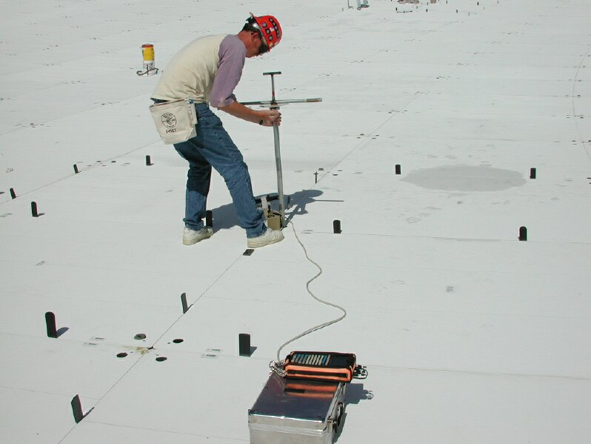
Mechanical adjustment of the panels

Slide 33
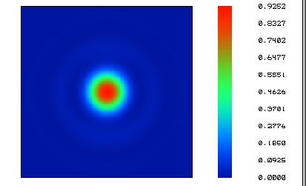
Image quality and efficiency

Slide 34
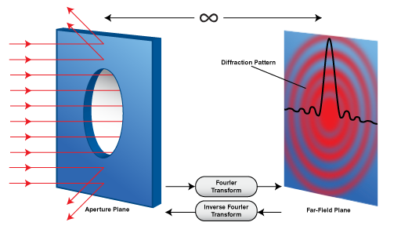
Image quality, efficiency, resolution

Slide 35
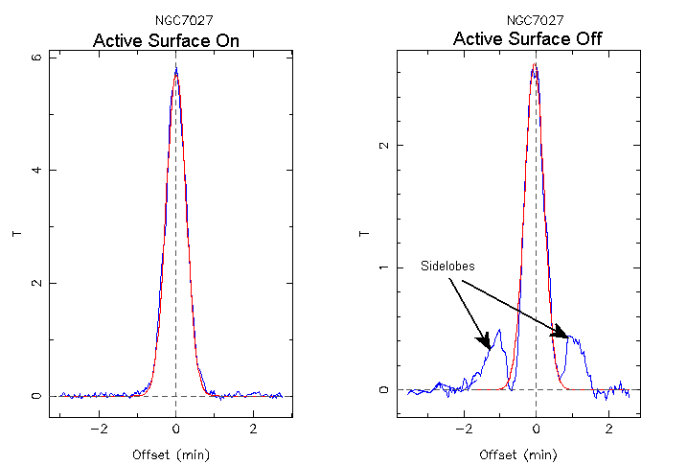
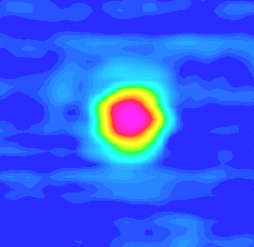
Image quality and efficiency

Slide 36
Holography
Notes:
If you now image the aperture plane to be this circular aperture here, then the technique of holography makes use of the fact that the far field beam pattern is simply the fourier transform of the aperture plane pattern. For a gaussian illuminated aperture plane with no wavefront errors, the beam pattern is a perfect diffraction pattern. If you measure the beam pattern, perform the inverse fourier transform, then the resulting phase in the aperture plane gives you the wavefront, and hence surface error.

Slide 37
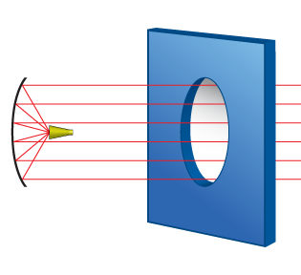
Holography
Notes:
If you now image the aperture plane to be this circular aperture here, then the technique of holography makes use of the fact that the far field beam pattern is simply the fourier transform of the aperture plane pattern. For a gaussian illuminated aperture plane with no wavefront errors, the beam pattern is a perfect diffraction pattern. If you measure the beam pattern, perform the inverse fourier transform, then the resulting phase in the aperture plane gives you the wavefront, and hence surface error.

Slide 38
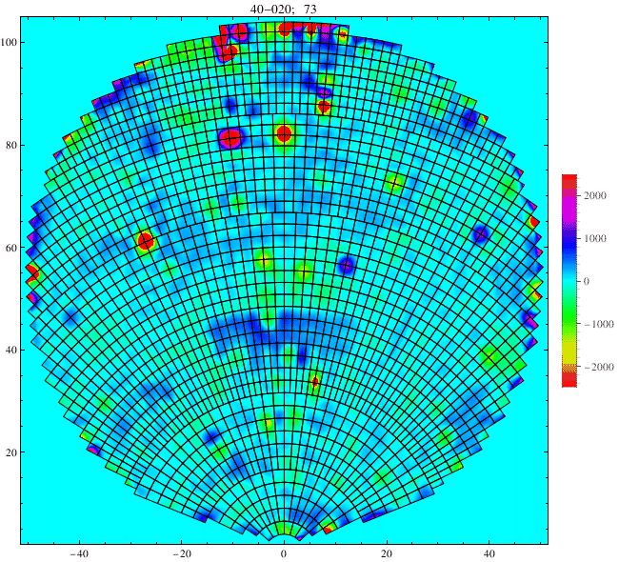
Surface accuracy (rms) = 240 µm

Slide 39
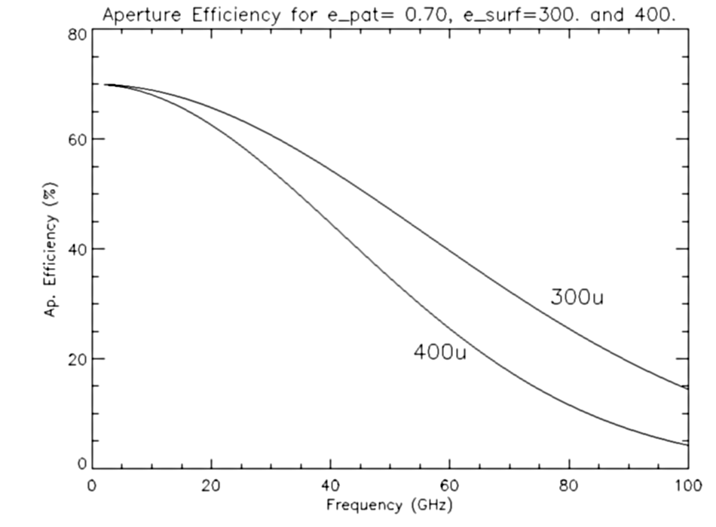
Aperture Efficiency
σ = rms surface error

Slide 40
Telescope Structure
Blind Pointing:
(1 point/focus)
Offset Pointing:
(90 min)
Continuous Tracking:
(30 min)

Slide 41
Optics
Primary Focus
Subreflector / Gregorian Secondary Focus
Focus tracking model
  Residuals measured and removed by observer.
  Tactics: frequency-dependent
Diffraction (Airy) pattern (Beam & Sidelobes) & surface errors
  Optical efficiency: not 100%
    Users must determine and correct for efficiency
    Source-size, frequency and elevation dependent
  Auto OOF Holography
  Stray radiation
Subreflector nodding

Slide 42
Receiver Focal Plane & Receiver Feeds
Converts EM wave in free space to an electrical wave in a waveguide or cable.
Mustang (Bolometer)
Reciprocity
Illumination (feed taper 10- to 14 dB)
  Stray Radiation
    Spillover
  Efficiency
Array receivers

Slide 43
Receivers
Receiver | Operating Range | Status
Prime Focus 1 | 0.29—0.92 GHz | Commissioned
Prime Focus 2 | 0.910—1.23 GHz | Commissioned
L Band | 1.15—1.73 GHz | Commissioned
S Band | 1.73—2.60 GHz | Commissioned
C Band | 4—8.0 GHz | Recently upgraded
X Band | 8—12.0 GHz | Commissioned
Ku Band | 12—15 GHz | Commissioned
K Band Array | 18—27 GHz | Commissioned
Ka Band | 26—40 GHz | Commissioned
Q Band | 40—50 GHz | Commissioned
W Band | 68—92 GHz | Commissioned
Mustang Bolometer | 86—94 GHz | Being upgraded
ARGUS | 80—115 GHz | Being commissioned

Slide 44
Receiver
Band Names (Horrible jargon)
  P- (0.3 GHz), L-, S-, C-, X-, Ku-, K-, Ka-, Q-, W-band (100 GHz).
Parts of typical ‘coherent’ GBT receiver (not Mustang)
  Calibration chopper (W-band)
  Feed(s)
  Polarizer
  Noise coupler (all but W-band) and noise source
  Cryogenic amplifier
  Other amps, attenuators, & filters (depends upon receiver)
  Polarization Hybrid ( < 8 GHz) or switches
  Mixers and Local Oscillator
  Splitters

Slide 45
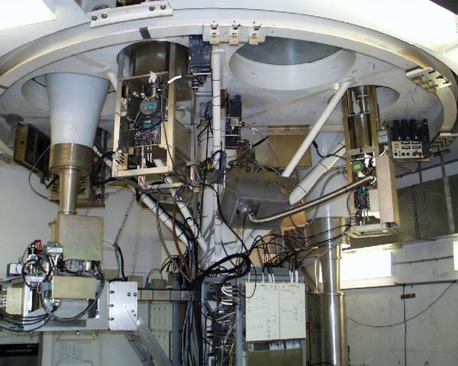
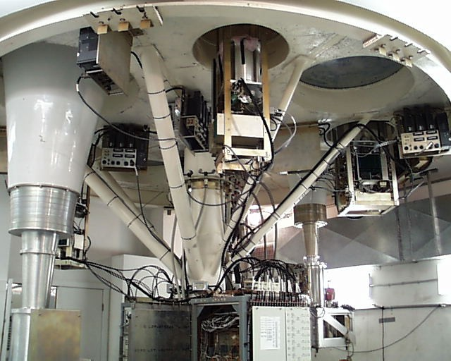
Receiver Room

Slide 46
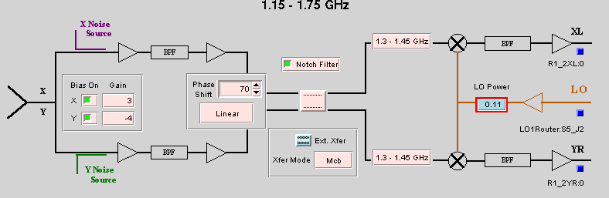
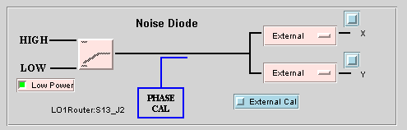
Typical Receiver

Slide 47
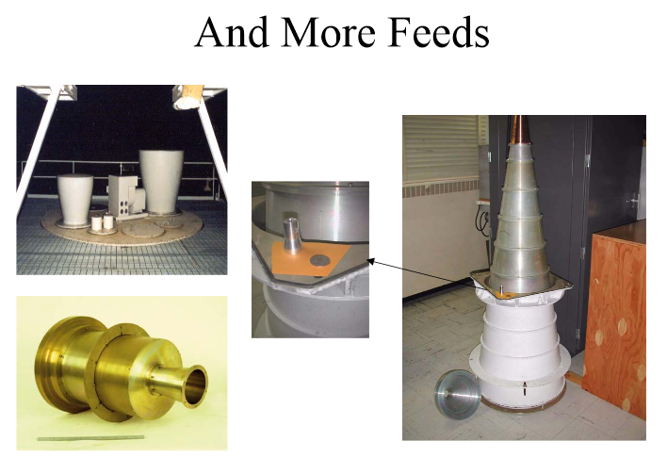
Receiver Feeds

Slide 48
Typical Receiver

Slide 49











Typical Components
Amplifiers
Splitters
Mixers
Couplers
Attenuators
Filters
Power Detectors
Synthesizers
Switches
Multipliers

Slide 50
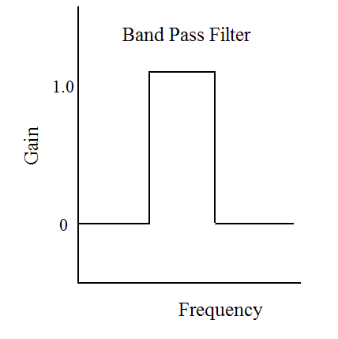
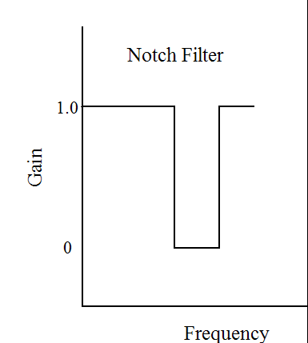
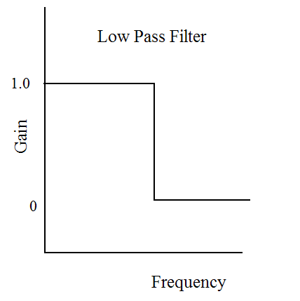
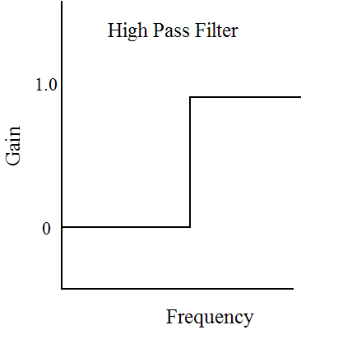
Types of Filters
Edges are smoother than illustrated

Slide 51
Types of Mixers
f
f_{IF}
n and m are positive or negative
integers, usually 1 or -1
Up Conversion : f_{IF} > f
Down Conversion : f_{IF} < f
Lower Side Band : f_{LO} > f
  - Sense of frequency flips
Upper Side Band : f_{LO} < f
f_{LO}
f_{IF} = n*f_{LO} + m*f

Slide 52

40-Ft System
Determine values for the first LO for the 40-ft when Observing HI at 1420 MHz

Slide 53


Slide 54


Slide 55


Slide 56
GBT – Astrid program does all the hard work for you…..
configLine = """
receiver = "Rcvr1_2"
beam = “B1"
obstype = "Spectroscopy"
backend = "Spectrometer"
nwin = 1
restfreq = 1420.4058
deltafreq = 0
bandwidth = 12.5
swmode = "tp"
swtype = "none"
swper = 1.0
swfreq = 0.0, 0.0
tint = 30
vlow = 0
vhigh = 0
vframe = "lsrk"
vdef = "Radio"
noisecal = "lo"
pol = "Linear"
nchan = "low"
spect.levels = 3
"""

Slide 57

Power Balancing/Leveling and Non-Linearity

Slide 58



Spectral-line observations
Raw Data
Reduced
Data – High
Quality
Reduced
Data –
Problematic

Slide 59
Reference observations
Difference a signal observation with a reference observation
Types of reference observations
  Frequency Switching
    In or Out-of-band
  Position Switching
  Beam Switching
    Move Subreflector
    Receiver beam-switch
  Dual-Beam Nodding
    Move telescope
    Move Subreflector

Slide 60

Model Receiver

Slide 61

Out-Of-Band Frequency Switching

Slide 62
On-Off Observing

Slide 63

Nodding with dual-beam receivers - Telescope motion
Optical aberrations
Difference in spillover/ground pickup
Removes any ‘fast’ gain/bandpass changes
Overhead from moving the telescope. All the time is spent on source

Slide 64

Nodding with dual-beam receivers - Subreflector motion
Optical aberrations
Difference in spillover/ground pickup
Removes any ‘fast’ gain/bandpass changes
Low overhead. All the time is spent on source

Slide 65

Intrinsic Power P (Watts)
Distance R (meters)
Aperture A (sq.m.)
Flux = Power Received/Area
Flux Density (S) = Power Received/Area/bandwidth
Bandwidth (BW)
A “Jansky” is a unit of flux density
Notes:
Power P Isotropic radiator; in general power may be directive.

Slide 66
System Temperature
Radiometer Equation

Slide 67
40-Ft System

Slide 68
System Temperature

Slide 70
System Temperature

Slide 71
On-Off Observing
Observe blank sky for 10 sec
Move telescope to object & observe for 10 sec
Move to blank sky & observe for 10 sec
Fire noise diode & observe for 10 sec
Observe blank sky for 10 sec

Slide 72

Continuum - Point Sources
On-Off Observing
T_{NoiseDiode}=3K
Off Source
Diode On
On Source
Off Source

Slide 73
Source Antenna Temperature

Slide 74
Continuum - Point Sources
On-Off Observing
On Source
Off Source
Diode On
T_{A}=6K
T_{NoiseDiode}=3K
Off Source
T_{SYS}=20K

Slide 75
Converting T_{A} to Scientifically Useful Values

