Slide 1
The Effects of the Atmosphere and Weather on Radio Astronomy Observations
Ronald J Maddalena
July 2011

Slide 2
The Influence of the Atmosphere and Weather at cm- and mm-wavelengths
Opacity
Calibration
System performance – Tsys
Observing techniques
Hardware design
Refraction
Pointing
Air Mass
Calibration
Interferometer & VLB phase errors
Aperture phase errors
Cloud Cover
Continuum performance
Calibration
Winds
Pointing
Safety
Telescope Scheduling
Proportion of proposals that should be accepted
Telescope productivity

Slide 3
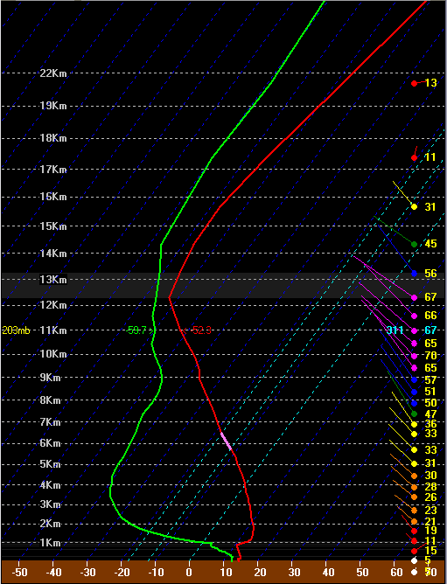
Structure of the Lower Atmosphere

Slide 4
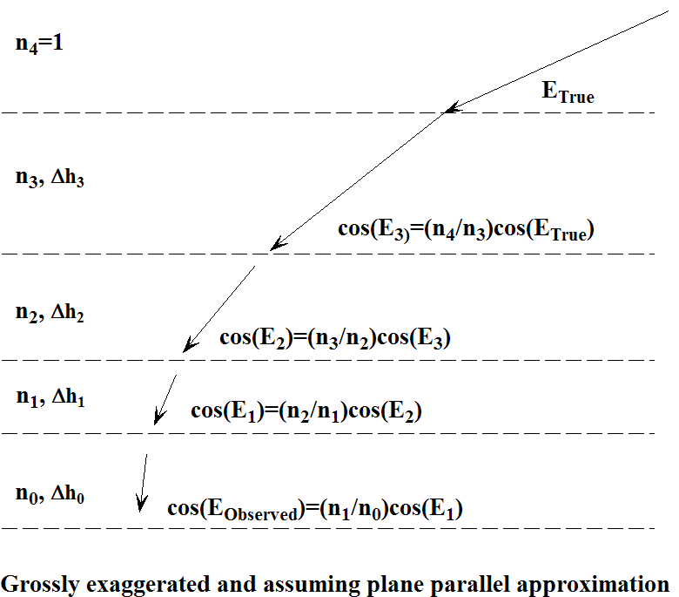
Refraction

Slide 5
Refraction
Index of Refraction is weather dependent:
Froome & Essen, 1969
http://cires.colorado.edu/~voemel/vp.html
Guide to Meteorological Instruments and Methods of Observation (CIMO Guide) (WMO, 2008)

Slide 6
Refraction
For plane-parallel approximation:
n0 • Cos(Elev_{Obs})=Cos(Elev_{True})
R = Elev_{Obs} – Elev_{True} = (n₀-1) • Cot(Elev_{Obs})
Good to above 30° only
For spherical Earth:
a = Earth radius; h = distance above sea level of atmospheric layer,
n(h) = index of refraction at height h; n₀ = ground-level index of refraction
See, for example, Smart, “Spherical Astronomy”

Slide 7
Refraction
Important for good pointing when combining:
large aperture telescopes
at high frequencies
at low elevations
(i.e., the GBT)
Every observatory handles refraction differently.
Offset pointing helps eliminates refraction errors
Since n(h) isn’t usually known, most (all?) observatories use some simplifying model. Example:
Updated from: Maddalena, GBT memo 112, 1994.

Slide 8
Relative Air Mass
Ratio of column density along line of sight to column density toward zenith
Rohlfs & Wilson, “Tools of Radio Astronomy”

Slide 9
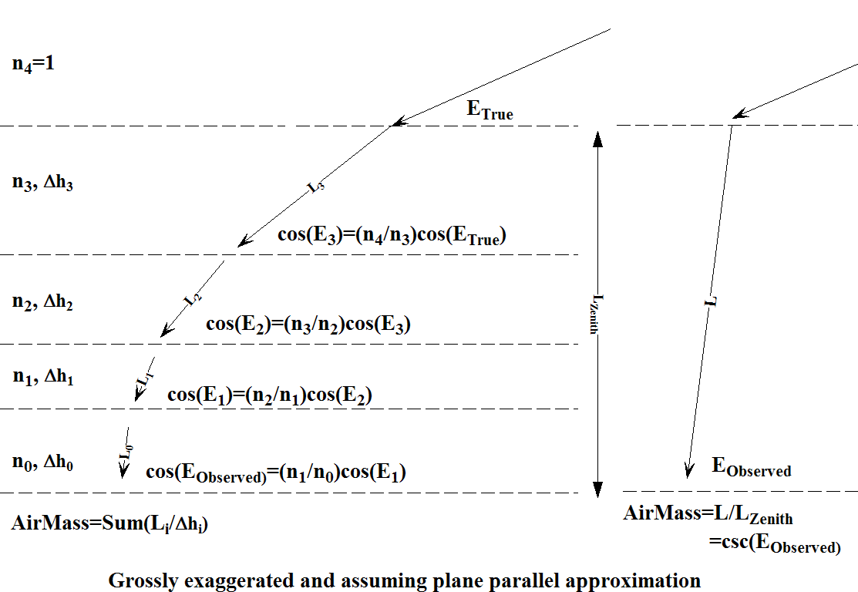
Relative Air Mass

Slide 10
Exercise 1: Air Mass and Refraction for Elev=6°
H (km) ΔH (km) n Elev_{Obs} L_{los} (km) AirMass
---------------------------------------------------------------------------------------------------------
Above Atmosphere 0 6 0 0
34.8 12.00 1.0000019
17.3 17.55 1.0000341
11.7 5.557 1.0000764
8.5 3.260 1.0001105
6.0 2.465 1.0001442
4.2 1.778 1.0001745
2.9 1.308 1.0002056
2.0 0.956 1.0002374
1.4 0.565 1.0002771
1.1 0.315 1.0002872
0.8 0.251 1.0003108
-------------------------------------------------------------------------------------------------------
Formulae:
Elev_{Obs} = ArcCos[ Cos(Elev_{Obs}^{Previous}) • n / n^{previous} ]
L_{los} = ΔH / sin(Elev_{Obs})
AirMass = AirMass^{Previous} + L_{los} / Δ H

Slide 11
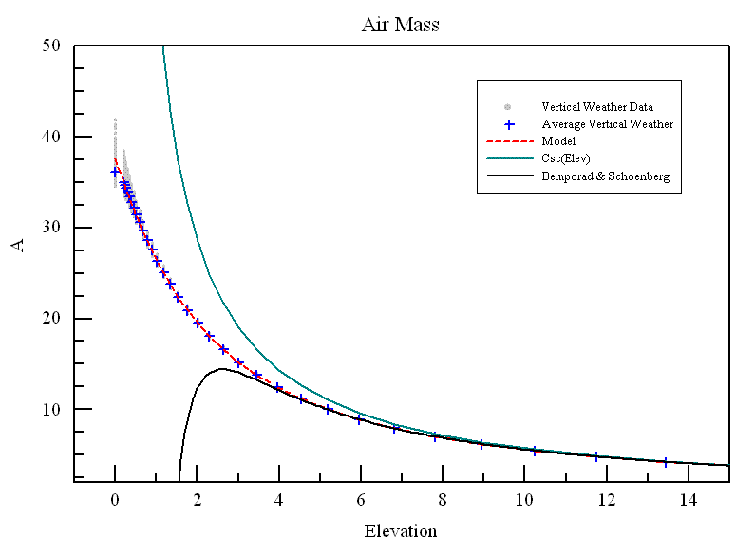
Relative Air Mass
Not significantly weather dependent
csc(Elev_{Obs}) breaks down when Elev < 15°
Use instead:
Maddalena & Johnson, 2006

Slide 12
Atmospheric Opacity (τ)
Hits observations twice:
Attenuates the source
Adds to received power (T_{sys})
Signal-to-noise ∝ T_{A}/T_{sys}
Important for calibration:
Some simplifications:
Optically Thick (τ >> 1): Last term in T_{sys} becomes T_{Atm}
Optically Thin (τ << 1): Last term becomes T_{Atm} • τ • AirMass
Sometimes written as:

Slide 13
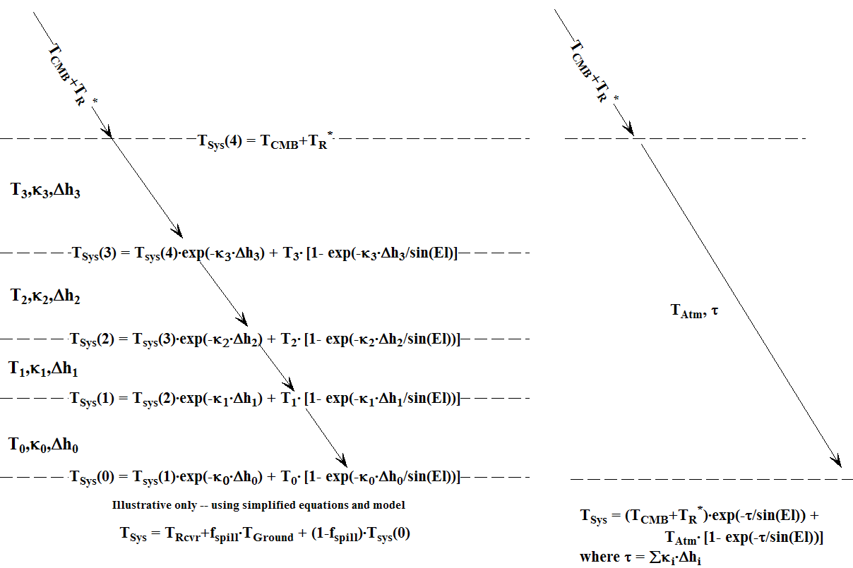
Radiative Transfer Through any Atmosphere

Slide 14
Exercise 2: τ, T_{sys} , T_{Atm} and Attenuation for Observation at the Zenith with No Spillover for a 10K Source
H(km) ΔH (km) κ(Nepers/km) T_{Layer}(K) τ ∑τ Attenuation T_{A} (K) T_{sys} (K)
--------------------------------------------------------------------------------------------------------------------------------------------
Above Atmosphere 0 0 0 1.0 10 12.7
34.8 12.00 1.0189e-07 222.34
17.3 17.55 1.6119e-05 203.99
11.7 5.557 1.0405e-04 225.49
8.5 3.260 4.0313e-04 250.79
6.0 2.465 5.4708e-04 265.69
4.2 1.778 8.9588e-04 275.99
2.9 1.308 1.8908e-03 282.59
2.0 0.956 4.0906e-03 287.89
1.4 0.565 8.2437e-03 287.79
1.1 0.315 0.0121247 288.69
0.8 0.251 0.0169950 288.59
--------------------------------------------------------------------------------------------------------------------------------------------
T_{Atm} = (T_{sys} - T_{A} - T_{CMB} • exp(- ∑τ)) / (1 - exp(- ∑τ)) = ____________
Total T_{sys} = T_{sys} + T_{rcvr} = ____________
Formulae:
τ = κ • ΔH
Attenuation = exp(-τ )
T_{A} = T_{A}^{Previous} • Attenuation
T_{sys} = Tsys^{Previous} • Attenuation + T_{Layer} • (1 - Attenuation)
Use: T_{rcvr} = 15 K, T_{CMB} = 2.7 K

Slide 15
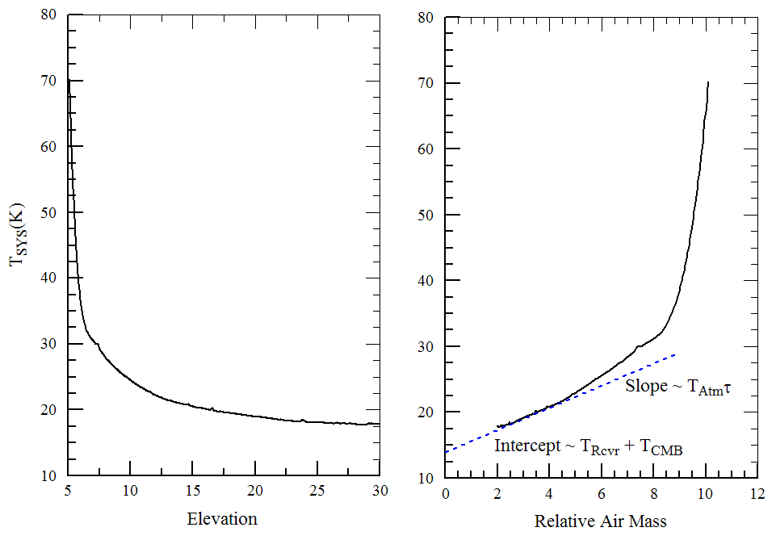
Tippings to Determine τ
Requires knowing T_{Atm} and f_{Spillover} and good calibration
ΔT_{cal}/T_{cal} = ΔT_{Sysl}/T_{Sys} = Δ τ/τ

Slide 16
Definition of T_{Atm}
The slope in a tipping curve really isn’t related to the opacity!!
Try instead:
; Calculates an estimate to Tatm from ground air temperature and frequencies.
; Only appropriate for freqs < 50 GHz. The rms uncertainty in my model is 3.5 K
; Maddalena & Johnson (2005, BAAS, Vol. 37, p.1438).
;
; freqs : list of frequencies in MHz
; TempK : ground temperature in K
;
function quickTatm, freqs, TempK
f = freqs/1000.
A = 259.691860 - 1.66599001*f + 0.226962192*f^2 - 0.0100909636*f^3 + 0.00018402955*f^4 - 0.00000119516*f^5
B = 0.42557717 + 0.03393248*f + 0.000257983*f^2 - 0.0000653903*f^3 + 0.00000157104*f^4 - 0.00000001182*f^5
return, A + B*(TempK-273.15)
end

Slide 17
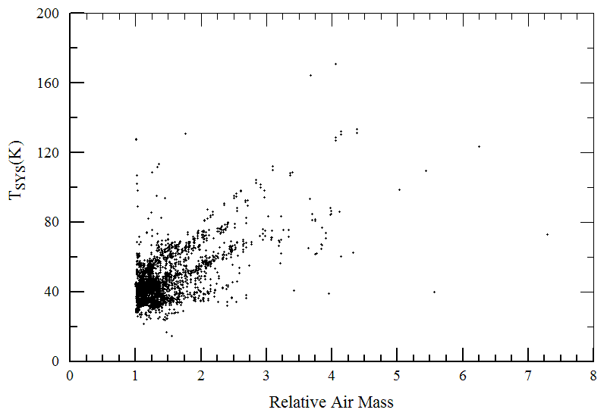
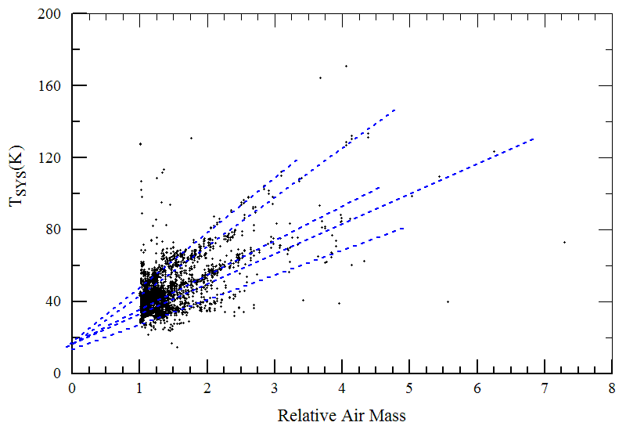
Quick, Simple, and Accurate τ

Slide 18
Quick, Simple, and Accurate τ
Invert T_{sys} equation to solve for attenuation
At low frequencies and low Air Mass:
Every single observation tells you its opacity !!
Just need to use your ensemble of observations to determine T_{Rcvr}

Slide 19
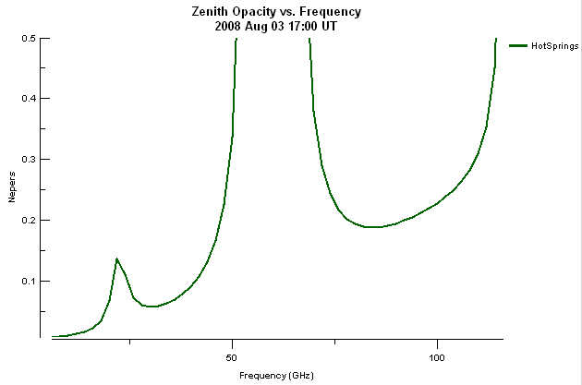
Opacity vs Frequency
gfs3_c27_1190268000.buf
Total Opacity

Slide 20
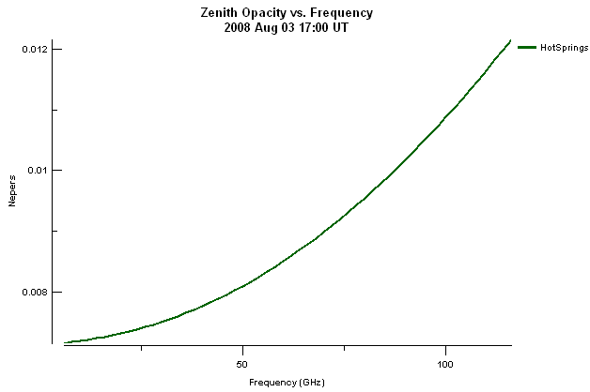
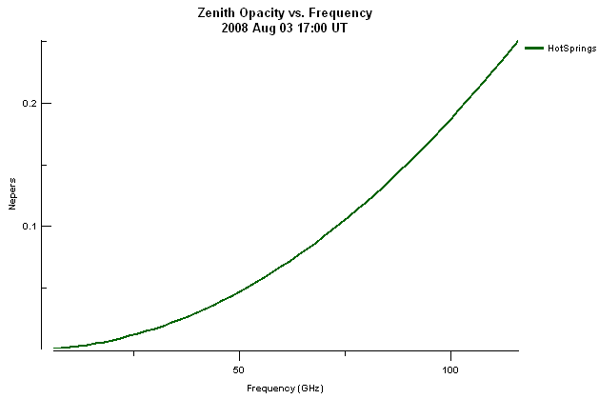
Opacities from Various Atmosphere Components
Water Continuum
Dry Air Continuum

Slide 21
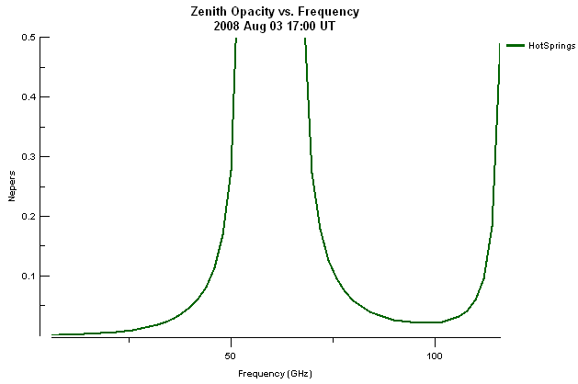
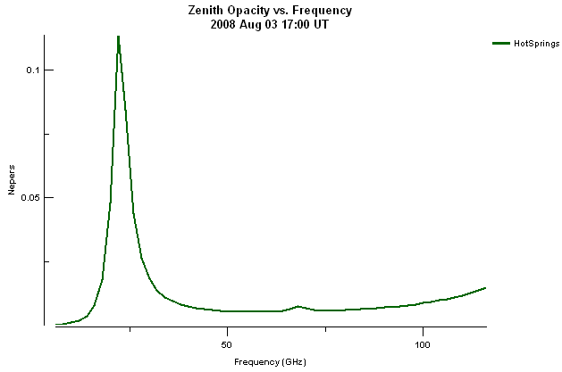
Opacities from Various Atmosphere Components
Water Line
Oxygen Line

Slide 22
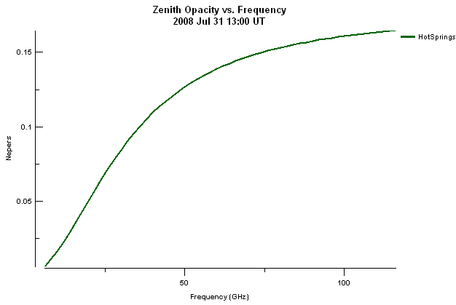
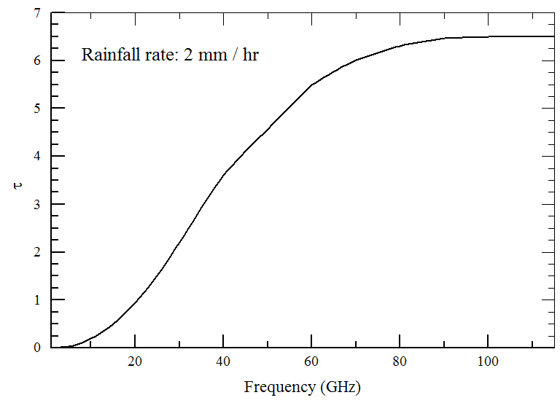
Opacities from Various Atmosphere Components
Rain
Hydrosols

Slide 23
Precipitable Water Vapor (PWV) vs Opacity
Precipitable Water Vapor in mm
Graphs suggest that
τ ~ A + B • PWV(mm)
Where A and B are frequency dependent.
See Marvil (2010) EVLA Memo 143 for values of A and B for 1-50 GHz
But, estimates can be in error if there are hydrosols or rain present.

Slide 24
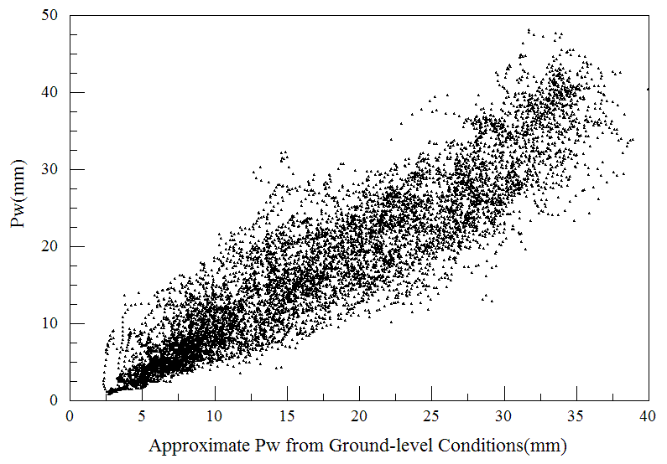
Precipitable Water Vapor from Ground-Level Conditions
PWV_{H2O} (mm) ~ Scale Height (km) • 216.7(mBar) • P_{H20} / T_{Ground} (K)
Where Scale Height ~ 2.2 km
Butler (1998), “MMA Memo 237”
But, it’s a very rough value only and more useful for site statistics and not really suitable for calibration

Slide 25
Affects of Winds
Force = Air Density • Wind Speed²
Hooke’s Law: Force ∝ Displacement ∝ Δθ
Telescope Beams are Gaussian
Condon & Balser (2011), DSS memo 5

Slide 26
Weather Forecasting for Radio Astronomy
The standard products of the National Weather Service (other than winds, cloud cover, precipitation, and somewhat PWV) do not serve radio astronomy directly.
But, the NWS products be reprocessed to generate forecast values that are more useful for radio astronomy.

Slide 27
Vertical profiles
Atmospheric pressure, temperature, and humidity as a function of height above a site (and much more).
Derived from Geostationary Operational Environmental Satellite (GOES) soundings and, now less often, balloon soundings
Generated by the National Weather Service, an agency of the NOAA.
Bufkit, a great vertical profile viewer
http://www.wbuf.noaa.gov/bufkit/bufkit.html

Slide 28
Vertical Profiles
65 layers from ground level to 30 km
Stratospheric (Tropapause ~10 km)
Layers finely spaced (~40 m) at the lower heights, wider spacing in the stratosphere
Available for major towns (Elkins, Hot Springs, Lewisburg)
Three flavors of forecasts:
1 hr and 12 km resolution, 12 hr range, 1 hr updates
1 hr and 12 km resolution, 84 hr range, 6 hr updates
3 hr and 35 km resolution, 120 hr range, 12 hr updates

Slide 29
Bufkit files available for “Standard Stations”

Slide 30
Basics of Atmospheric Modeling
Liebe, 1985, “Radio Science”, Vol 20, p. 1069.
Maddalena (http://www.gb.nrao.edu/~rmaddale/Weather)

Slide 31
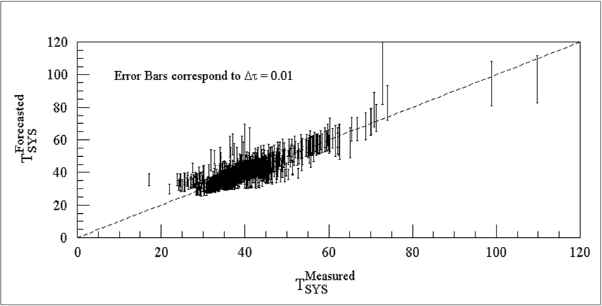
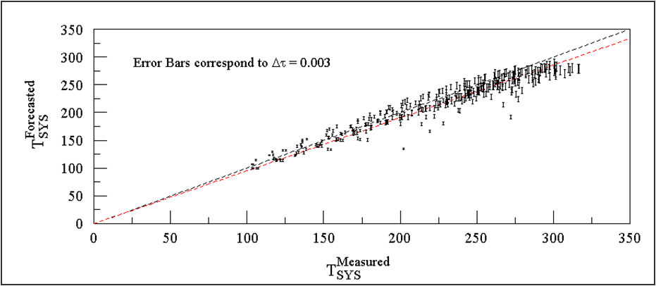
The Accuracy of Radio-Astronomy Forecasts is High
22 GHz
41-45 GHz

Slide 32
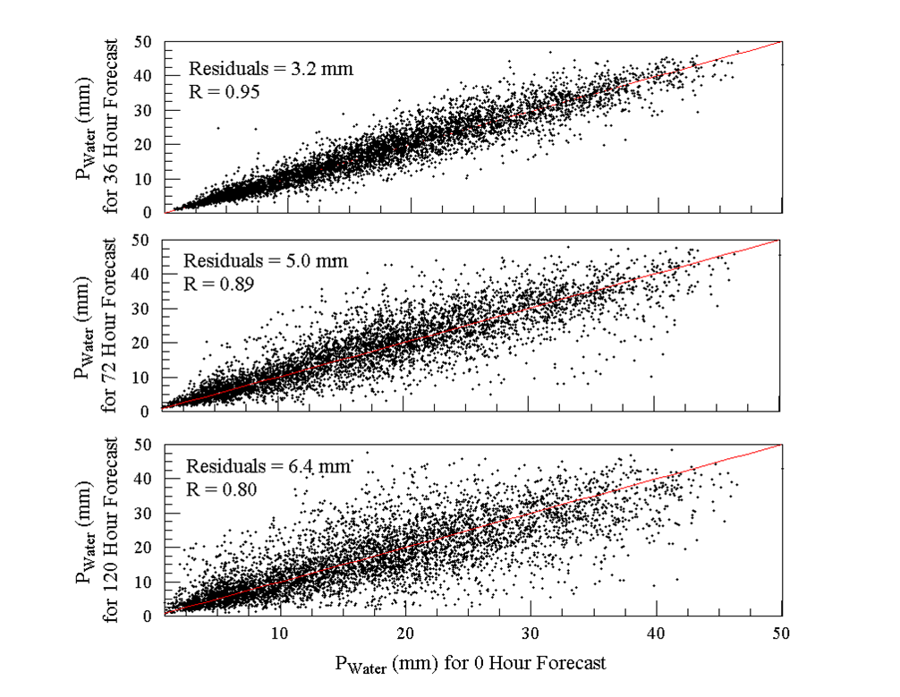
The Reliability of Radio-Astronomy Forecasts is High
Correlation Between Forecasts
Hr R rms (mm)
-----------------------------------------------------
6 0.985 1.76
12 0.978 2.11
18 0.972 2.41
24 0.968 2.58
30 0.960 2.91
36 0.952 3.15
42 0.942 3.46
48 0.932 3.73
54 0.922 4.03
60 0.910 4.35
66 0.898 4.64
72 0.885 4.95
78 0.875 5.19

Slide 33
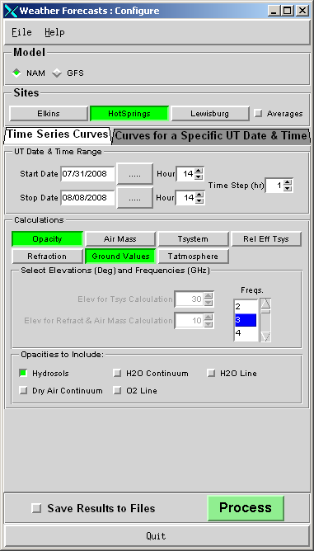
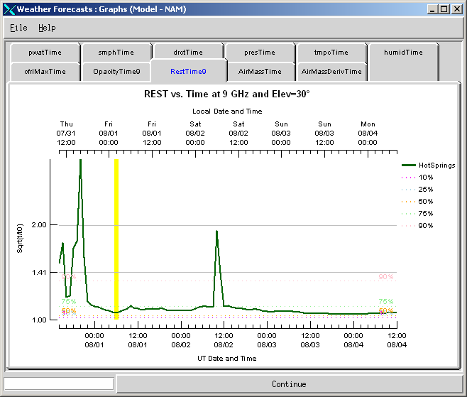
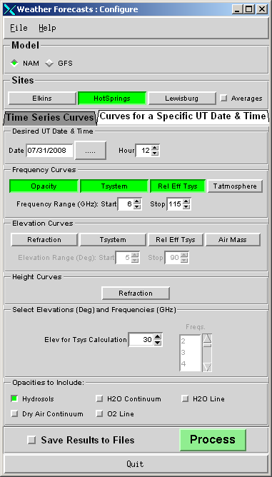
User Software: cleo forecasts

Slide 34
Web Page Summaries
http://www.gb.nrao.edu/~rmaddale/Weather
3.5 and 7 day forecasts.
Provides:
Ground weather conditions
Opacity and T_{Atm} as a function of time and frequency
T_{sys} and RESTs as functions of time, frequency, and elevation
Refraction, differential refraction, comparison to other refraction models
Weather.com forecasts
NWS alerts
Short summary of the modeling and list of references
Overview (Pizza) Plots

Slide 35
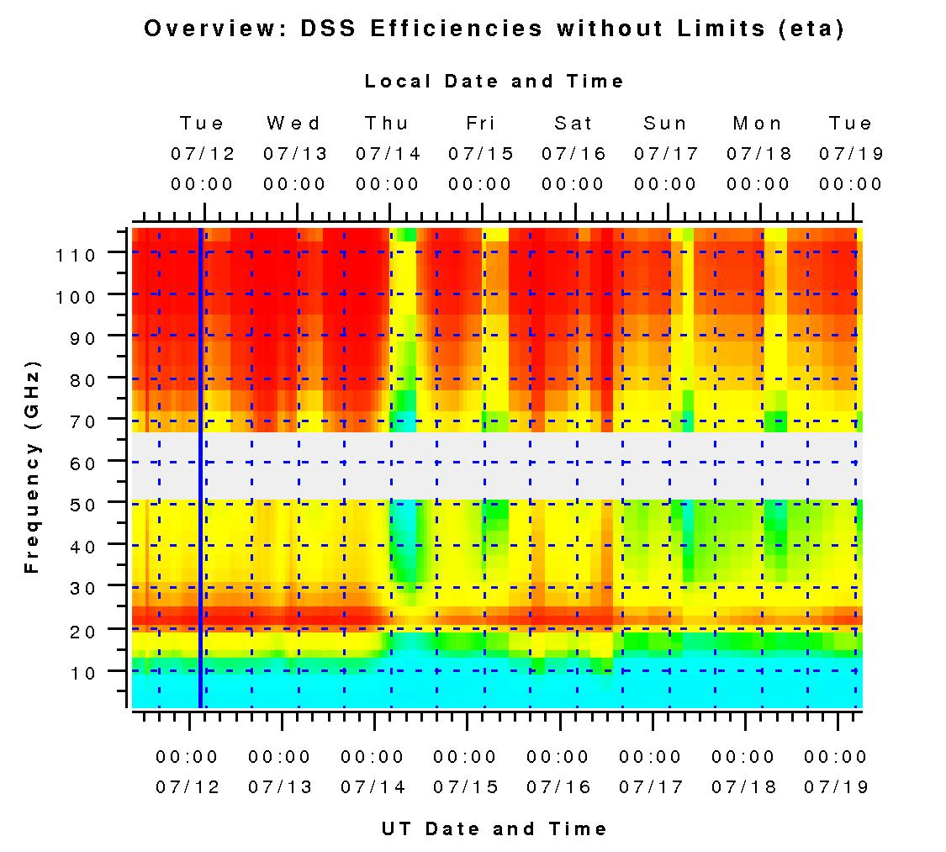
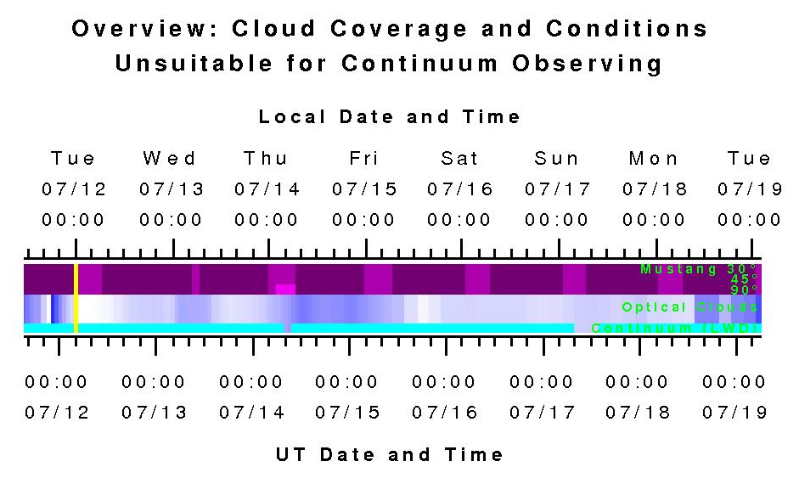
Overview (Pizza) Plots and GBT Scheduling

Slide 36
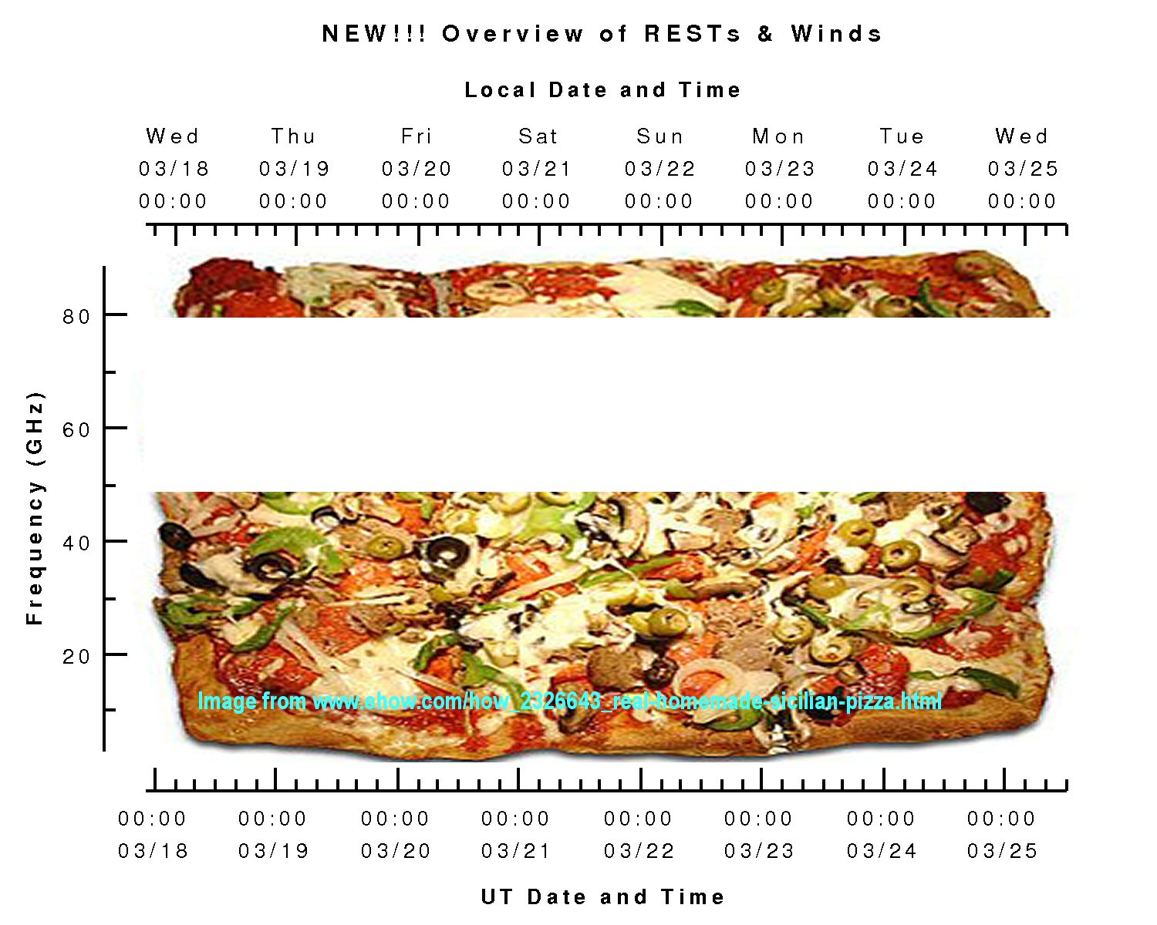
Pizza Plots and GBT Scheduling

Slide 37
GBT Dynamic Scheduling
Uses cm- and mm-wave weather forecasts to determine the optimum way to schedule projects for the next 2 days
Additional factors:
Project ranking
Availability of hardware
Observer blackouts dates/times
Allows for multiple observers on a project
Proposal pressure vs frequency and LST range
Observers are provided with emails when they are scheduled.
If remotely observing, observers use VNC to conduct their experiment.
Before one can remotely observe, one must first observe locally so that we can ensure remote observing will be fruitful.
For more details, see:
http://science.nrao.edu/gbt/scheduling/dynamic.shtml
Condon & Balser (2011), DSS memo 4
Condon & Balser (2011), DSS memo 5

Slide 38
DSS Project Weather ‘Scoring’
Product of three measures of observing efficiency:
η_{Surface} : Loss in observing efficiency due to degradation of surface (<1 during the ‘day’, =1 at night)
η_{Tracking} : Loss in observing efficiency due to winds (outlined above) plus servo system errors.

Slide 39
The Influence of the Atmosphere and Weather at cm- and mm-wavelengths
Opacity
Calibration
System performance – Tsys
Observing techniques
Hardware design
Refraction
Pointing
Air Mass
Calibration
Interferometer & VLB phase errors
Aperture phase errors
Cloud Cover
Continuum performance
Calibration
Winds
Pointing
Safety
Telescope Scheduling
Proportion of proposals that should be accepted
Telescope productivity

