Slide 1
Ultra Wideband Feeds
Steven White

Slide 2
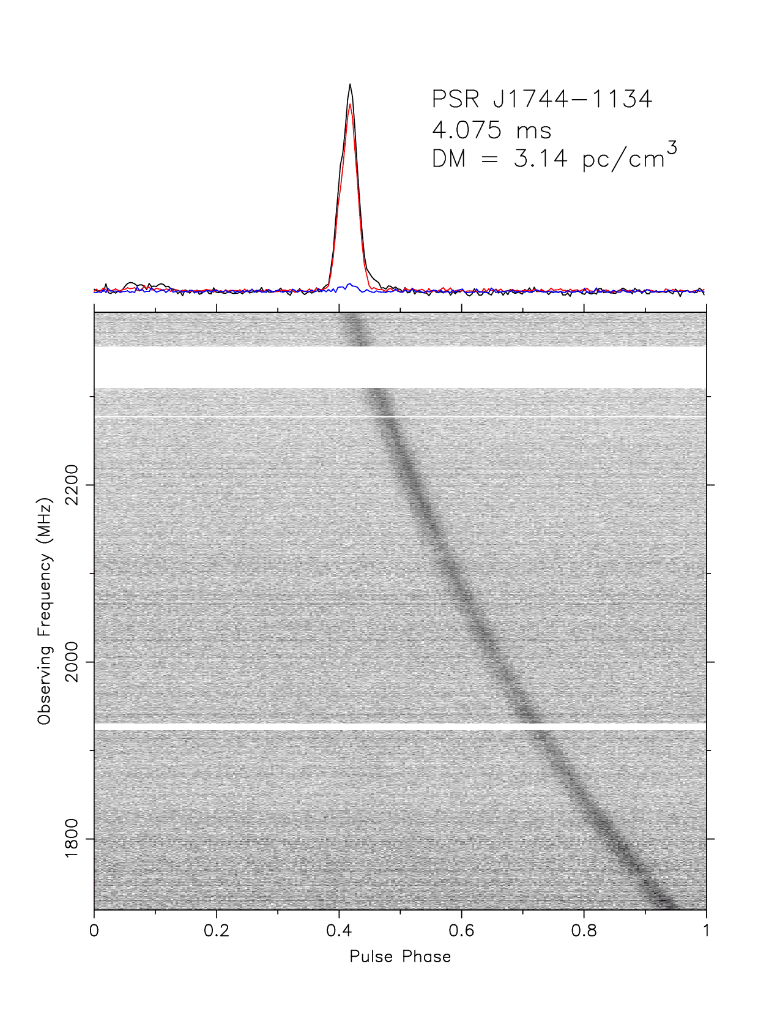
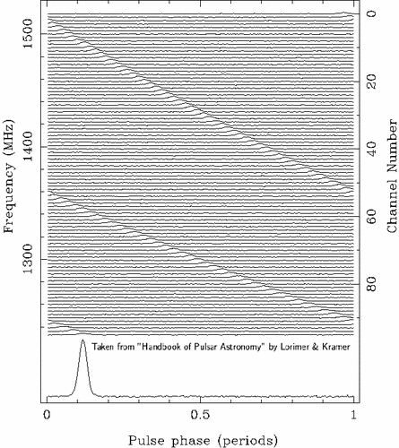
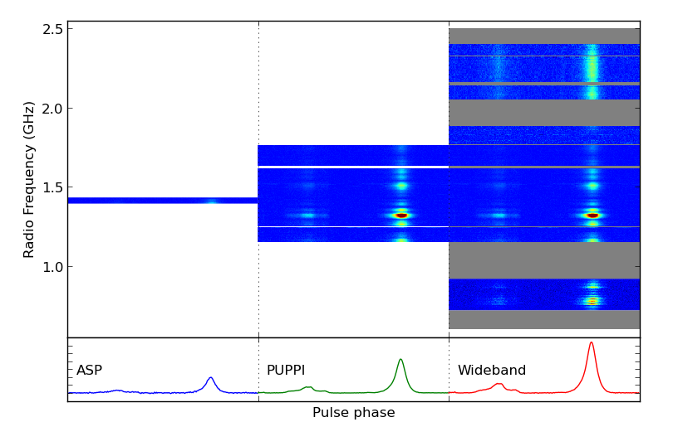
Wide bandwidth for Pulsar Timing
Improved dispersion measurement improves timing.

Slide 3
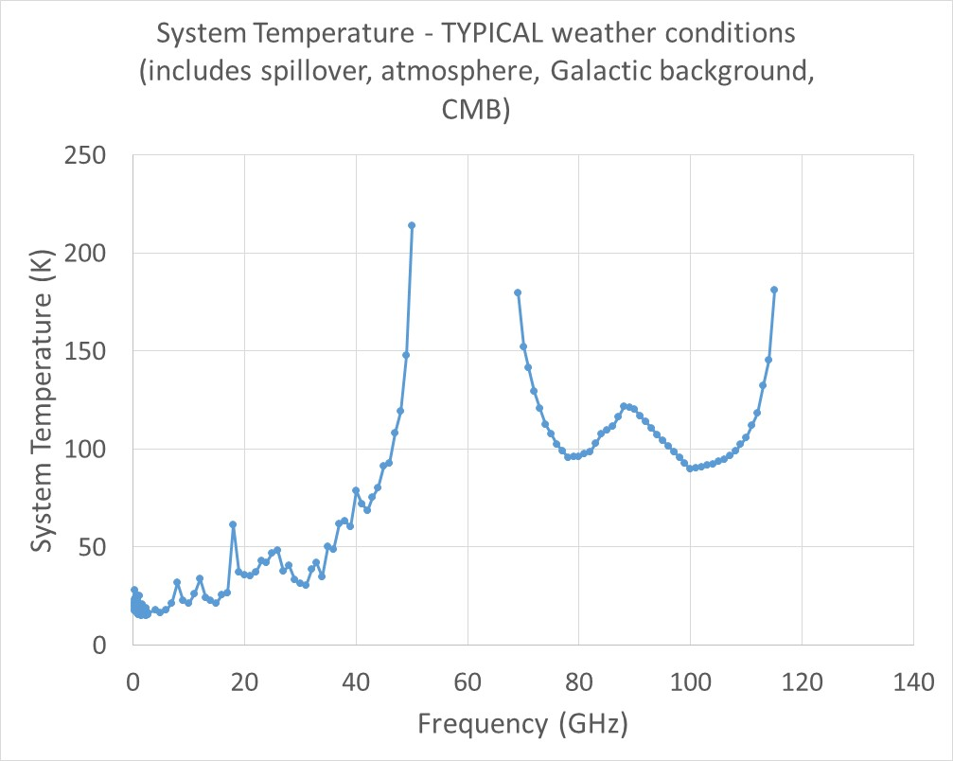
The GBT
Majority of the Pulsar Flux below 4 GHz (C band receiver)

Slide 4
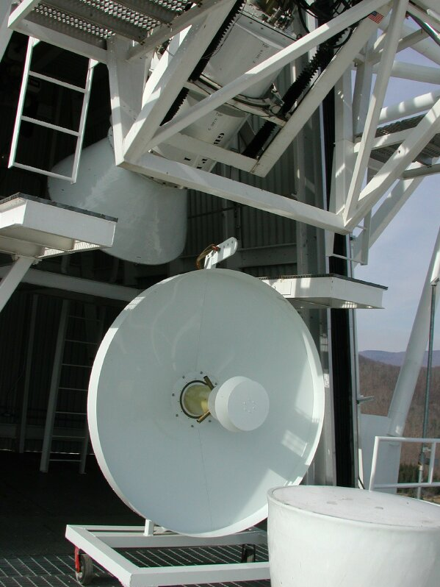
Prime Focus Feed
800 MHz Corrugated Feed
Cross Dipole 290-395 MHz Feed
Notes:
One of the GBT prime focus feeds, using crossed dipoles and reflectors to narrow the beam and increase the bandwidth. This feed operates over the 290-395 MHz frequency range. At right, the feed sits on the GBT receiver room, ready to be installed on the prime focus boom (background).

Slide 5
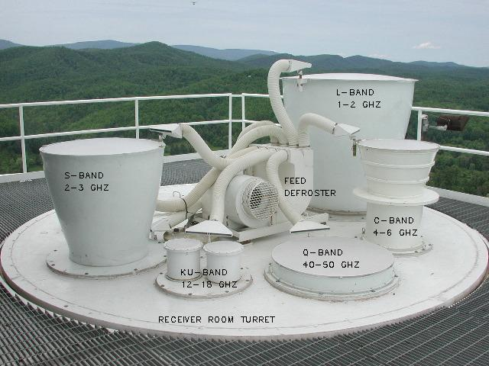
Gregorian Feeds
Notes:
At upper left is the GBT Gregorian feed turret, with feeds visible which operate at 1.5 GHz, 2.3 GHz, and twin feeds which operate at 13 GHz. At lower right is a hybrid mode prime focus feed designed for high efficiency and low spillover, draw back is limited bandwidth. The photo at upper right shows a large Cassegrain feedhorn (right) and a smaller prime focus feed (on the floor), and a GBT Gregorian feedhorn that operates near 95GHz (close-up at center).

Slide 6
Corrugated Horns
Analytical Expressions are closed form.
Symmetrical Beam
Defined Edge Taper
Good Impedance Match

Slide 7
Waveguide Modes

Slide 8
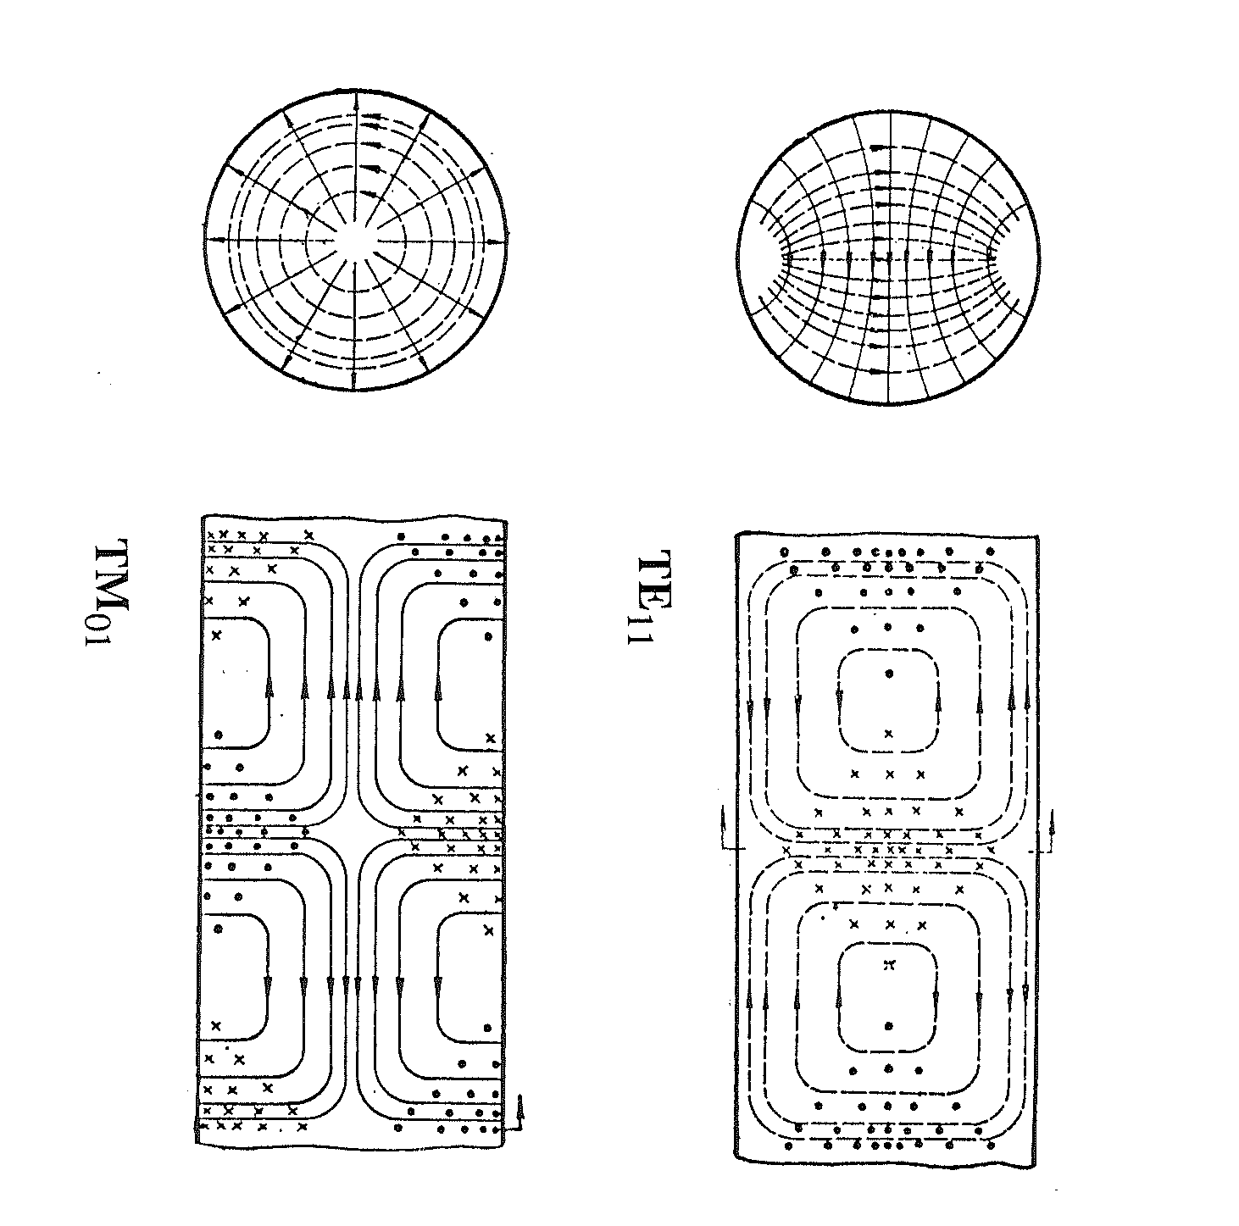
Corrugated Feed Horn
Design and Measurement of Conical Corrugated Feed Horns for the BIMA Array, Xiaolei Zhang, 1991, Memo 17

Slide 9
Prime Focus Receivers
Receiver Frequency T_{receiver} T_{sys}
[GHz] [K] [K]
PF1.2 0.385 - 0.520 22 43 K
PF1.4 0.680 - 0.920 21 29 K
PF2 0.910 - 1.230 10 17 K
L 1-2 6 20
S 2-3 8-12 22
C 4-6 5 18
Notes:
Feed design limits the bandwidth of prime focus receivers. Corrugated horns are not practical at this frequency. Notice the increased system temperature at lower frequencies compared to the receiver (amplifier) temperatures.

Slide 10
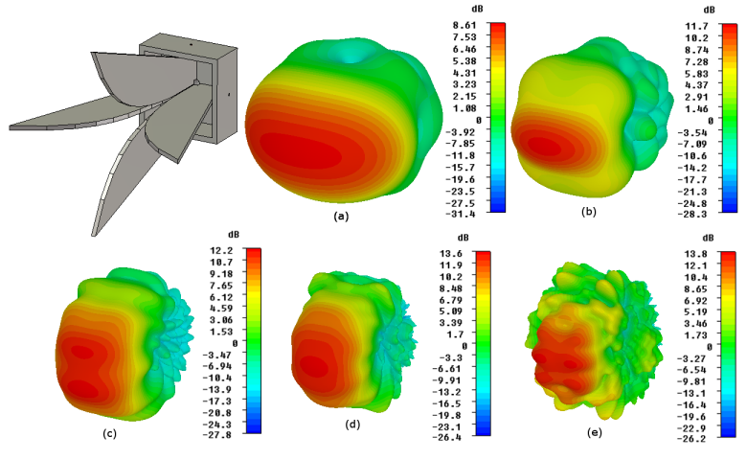
Ahmed Akgiray Thesis
No closed form equations, must use 3-D modeling software for designs.
Open Boundary Quad Ridge Feed Horn (Vivaldi)

Slide 11
CSIRO Design

Slide 12
GBT Prime Focus CST 3D Model
Equivalent f/D = 0.7
Aperture:  800 mm
$$θo=39$$
z^{n}
Horn Profile
WG: 130 mm
Height: 800 mm +
Sinusoidal and Spline Curve Quad Ridges
306,000,000 Mesh Cells (Long Solver Times ~hrs)

Slide 13
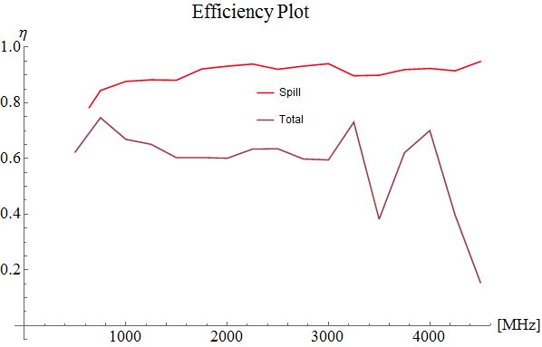
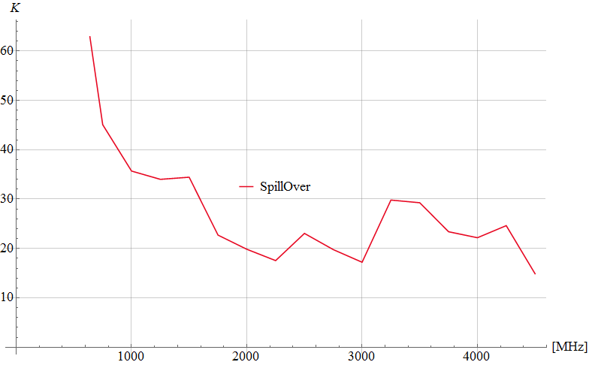
GBO Wideband Feed Results
Noise Temperature
Zenith: with Tgnd = 290  K

Slide 14
Additional Challenges
Efficiency comparison with Physical Optics (GRASP)
Improve spillover at lower frequencies
Waveguide Window
Large Atmospheric Force
Transparent to 4 GHz
Vacuum Seal
SPIE 2017: NRC Herzberg Astronomy and Astrophysics, Victoria, BC, Canada
Composite laminate construction, with layers of quartz glass fiber. TenCate EX-1515 with quartz is chosen for its low-loss and low outgassing properties?
Low Noise Amplifier
Difficult to match noise parameters over large bandwidth
Differential Design (CSIRO)?

Slide 15
RFI Mitigation
Wide Band feeds for pulsar timing -> interference problems
Implement real time RFI excision algorithms.
Total bandwidth ~ 4 GHz, require 8 GHz sampling rates (coming soon?)
Require > 12 bits for RFI excision
High speed FGA to process data rates.
High speed data links 10Gb/s already exist.
Require ~ 80 dB of shielding in front end box.
Two channels heat dissipation a concern, but manageable
Water cooling implemented for PAF

Slide 16
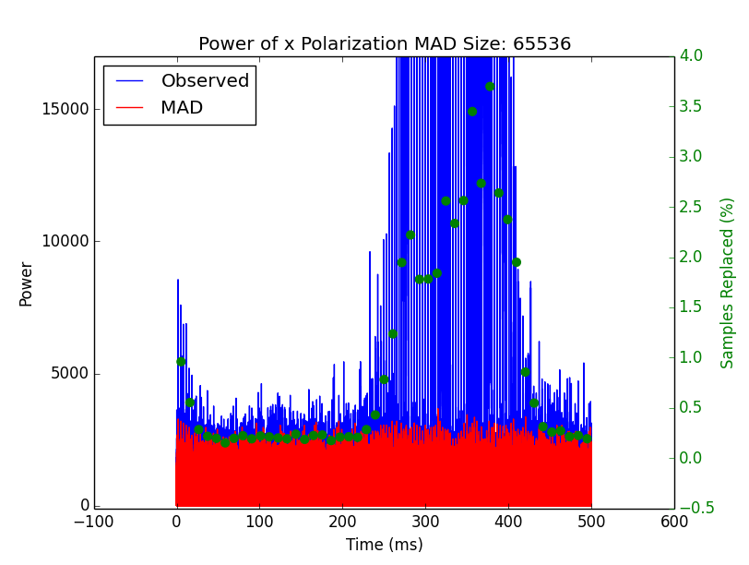
Results – Bedford Radar Time Domain

