Slide 1

Green Bank Instrumentation circa 2030
Dan Werthimer and 800 CASPER Collaborators
http://casper.berkeley.edu

Slide 2
Upcoming Nobel Prizes with Radio Instrumentation
Gravitational Wave Detection (pulsar timing)
(eg: this morning’s LIGO announcement)
Black Hole Physics (Event Horizon Telescope…)
How did the First Stars and Galaxies Form ? (EOR)
What causes FRB’s ?
Measure baryon density of universe using FRB’s
B mode polarization CMB
Discover ET

Slide 3
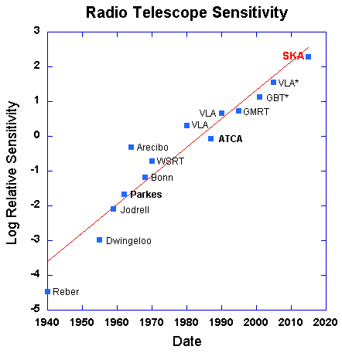
Radio Telescope Sensitivity doubles every 3.6 years

Slide 4
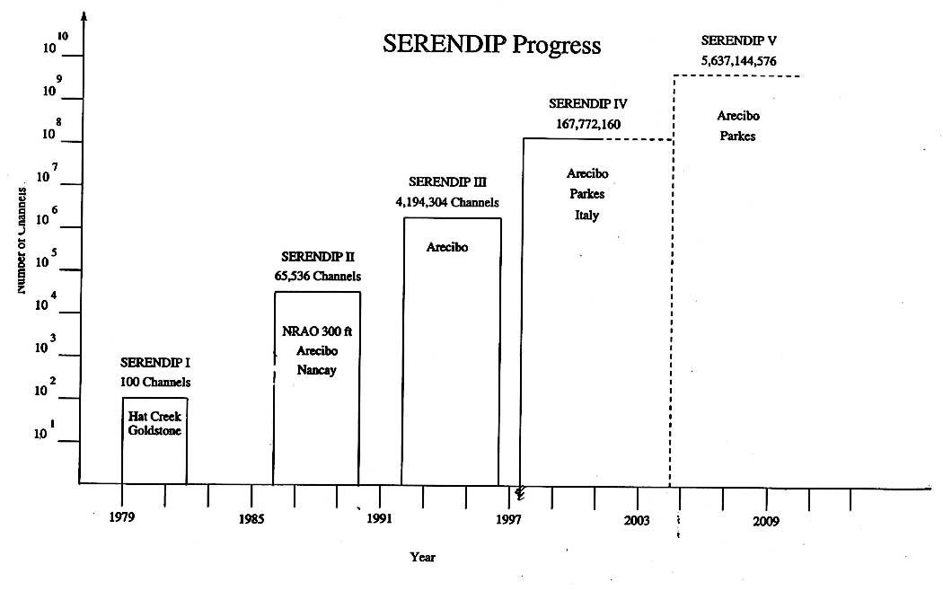
Moores Law – Instruments using FPGA’s:
2X per year (1,000,000 over 20 years)
Notes:
41.jpg

Slide 5
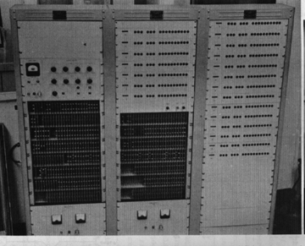
1960 – First Radio Astronomy Digital Correlator
21 lags 300kHz clock discrete transistors
$19,000
Sandy Weinreb

Slide 6
Correlator processing power
10⁷
SKA
EVLA
10⁹
10⁶
.
ALMA
LOFAR
GFlops
10⁵
SMA
10⁴
EVN/WSRT
10³
VLA
10⁶
10²
DXB
DAS
DLB
DCB
10
1
10³
70
75
80
85
90
95
2000
05
10
2015
source: Arnold van Ardenne

Slide 7
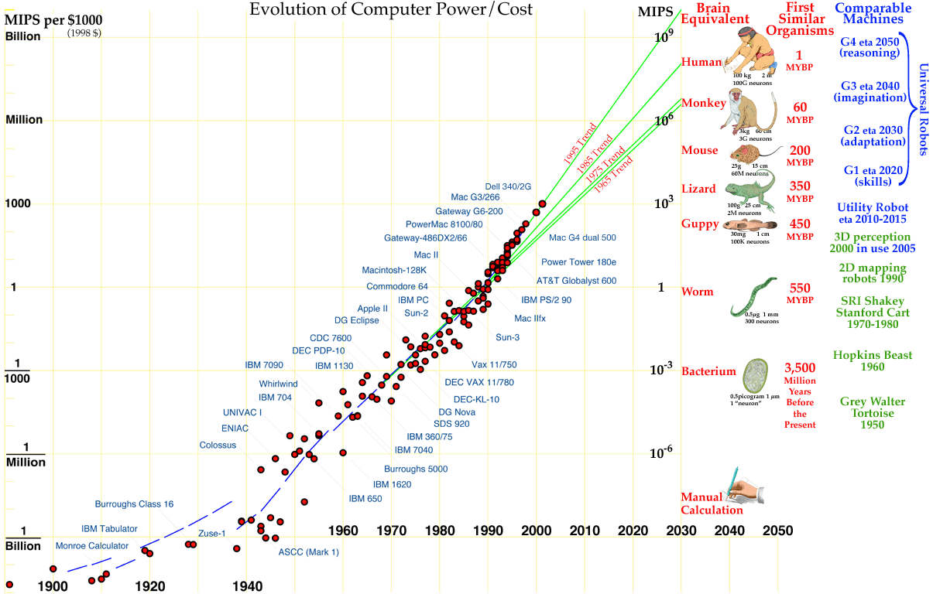
We’re on the cusp of technological maturity: “ancestor” simulations of 10³⁵ ops or 0.1c galactic exploration

Slide 8
CASPER Philosophy and Religion
Design Observatories with Plan for Exponential Growth in Digital Processing
Digital Backend should be replaced every 5 years (keep software, toss old - buy new hardware)
DSP Part of Operating Costs, not construction costs

Slide 9
expect (plan for)
100 GHz bandwidth
1000 to 1M antenna arrays
1000 to 1M beams (commensal experiments)
6:1 or 20:1 ? Feeds and receivers
phased array feeds with low Tsys ?
Observatory removes RFI (part of instrument)

Slide 10
GBO Receivers circa 2025
0.6 to 4 GHz 6:1 22K single beam
4 to 24 GHz 6:1 22K single beam
20 to 120 GHz 6:1 single beam
0.6 to 2 GHz Phased Array Feed 20K 1,000 beams
75 – 115 GHz 800 beam horn array (ultra-argus)

Slide 11
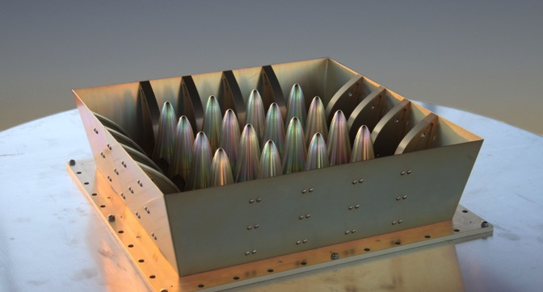
“Rocket” PAF
Next generation PAF
  “rocket” elements; “edge” elements
Superb matching with LNA
  Key to improved performance
  Noise Temp due to uncooled LNAs
4x5 prototype constructed
  tested as aperture array
  ~15K better than equivalent ASKAP tests
  Tested on Parkes
    Measurements affected by RFI
Design better suited to cooling
  → CryoPAF funding proposal
    Full 94 dual-pol array + ASKAP back-end
    Expected Tsys <20K !?

Slide 12
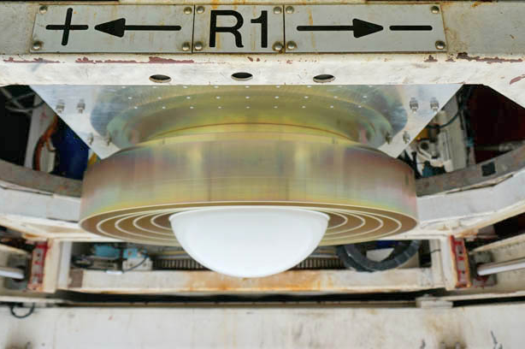
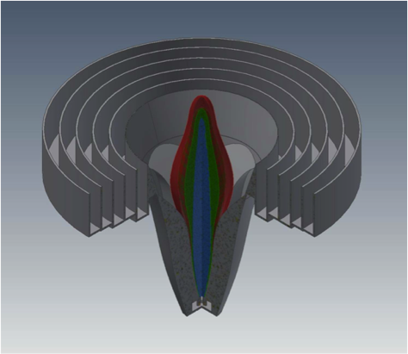
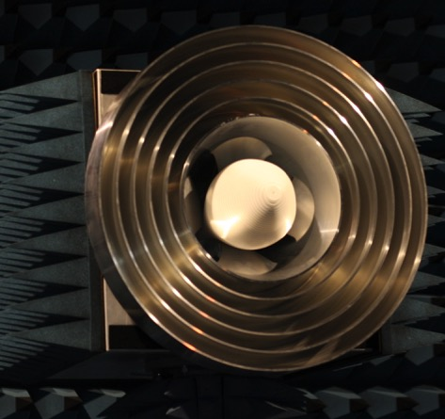
Parkes UltaWideBand system
Quadridge structure with dielectric spear
0.7—4.0 GHz, Tsys ~22K, SEFD ~35 Jy
First light Aug 2017, commission late 2017
Sampler/digitiser and timing (Back-end)
  4 Gsps (2 GHz bands)
Ethernet switch and GPU cluster
  Installed 2016 & used PAF@Parkes
  Software - collaborators
RFI mitigation built-in – reference antenna
Notes:
Noise below 1 GHz and above 3.5 GHz due to mis-matched LNA which will be replaced. New LNAs did not cool and used LNAs designed for 1-3.5 GHz for ATCA.

Slide 13
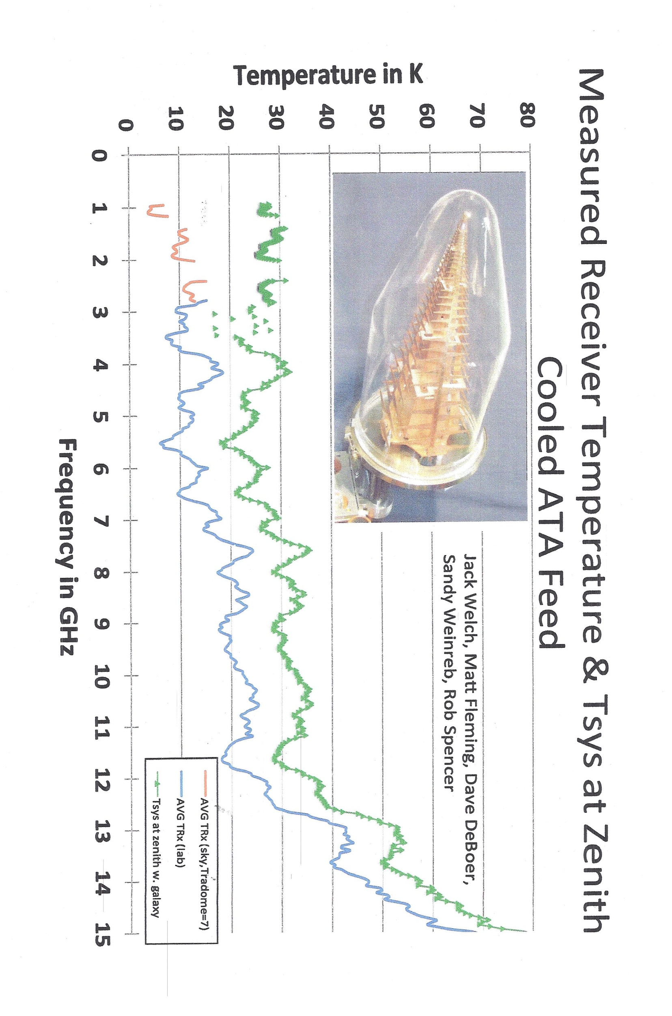

Slide 14
Instrument Architectures
Scalable
Upgradeable
Flexible
General and Multi-Purpose
Fault Tolerant

Slide 15
Simultaneous Digital Backends
Piggyback, Commensal, Sky Surveys
Signal Splitter
Pulsar Spectrometer
Baseband Data Recorder
Galactic Spectrometer
Extra Galactic Spectrometer
SETI Spectrometer
Analog Power Splitters
or
Digital Data Splitter

Slide 16
CASPER General Purpose Architechture
Dynamic Allocation of Resources, need not be FPGA based

Slide 17
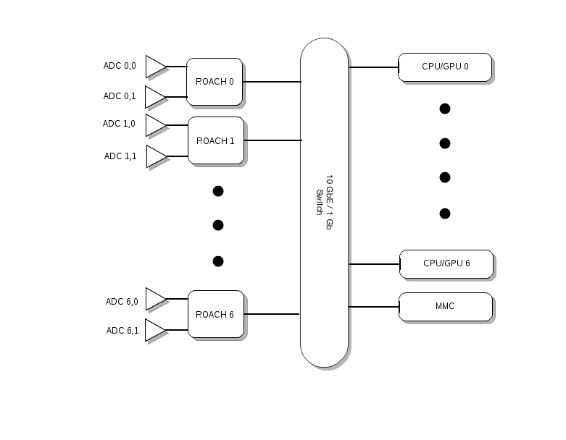
VEGAS/DIBAS Multi-beam Spectrometer + Pulsar Timing/Searching John Ford, Dan Werthimer, David MacMahon, Richard Prestage

Slide 18
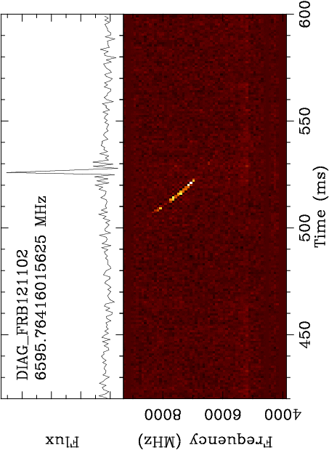
FRB121102 (repeater)
Highest Frequency detection (4 – 9 GHz) widest bandwidth (5.4 GHz)

Slide 19
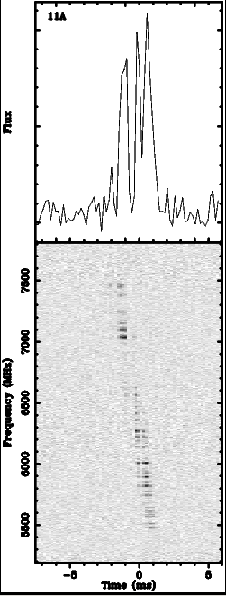
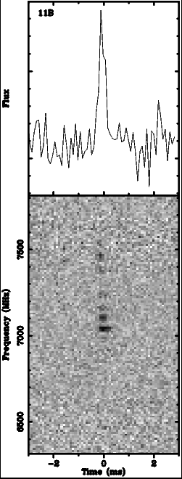
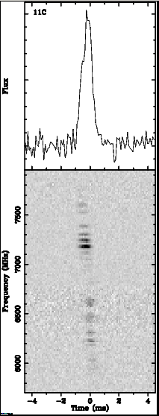
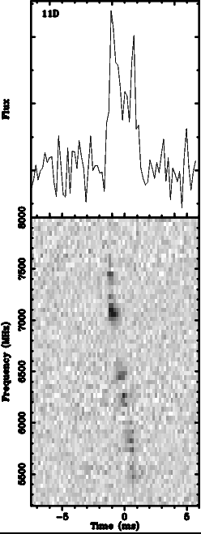
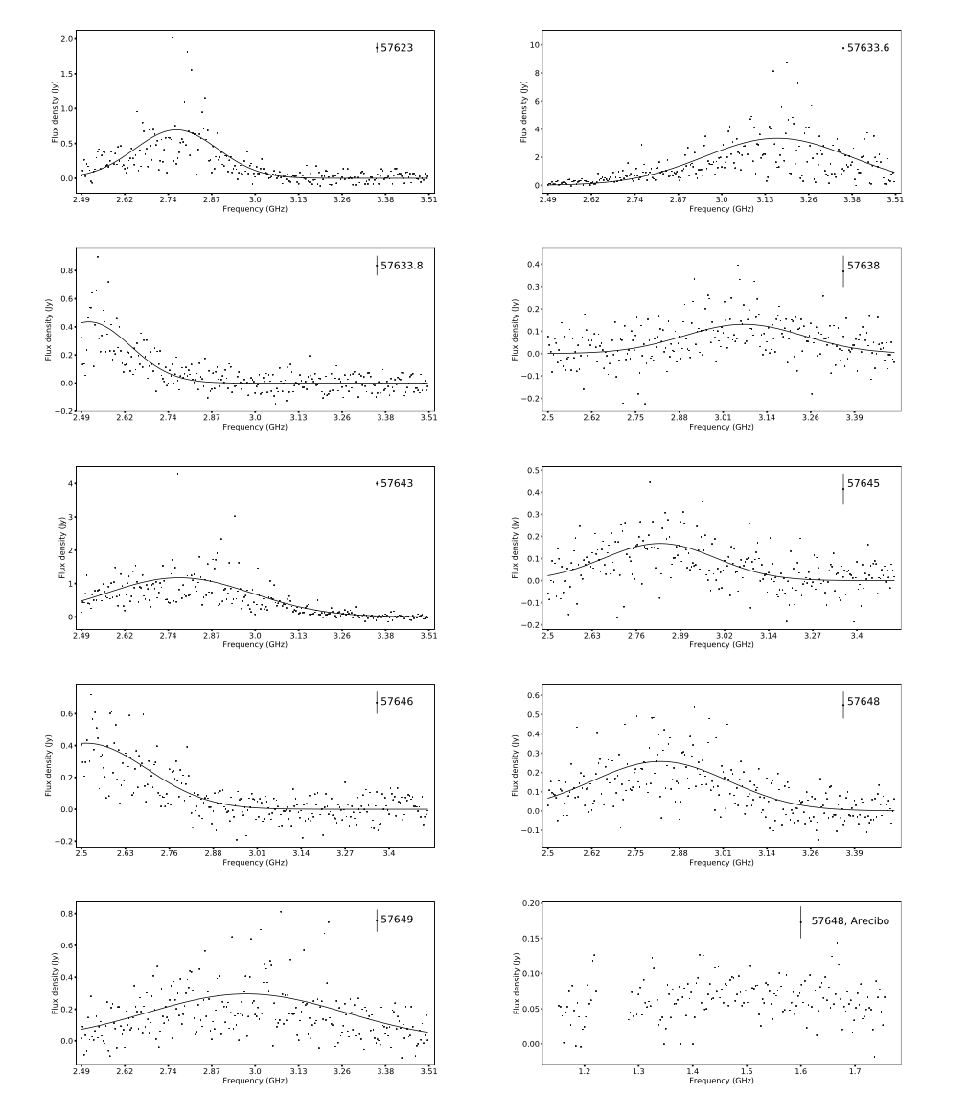
Coherently dedispersed pulses
Law et al. 2017

Slide 20
Fast ADC’s
15 Gsps 4 bit Adsantec
26 Gsps 3.5 bit Analog Devices
55 Gsps 8 bit Fujitsu
80 Gsps 8 bit Berkeley
160 Gsps 8 bit Keysight
240 Gsps 8 bit Teledyne Lecroy

Slide 21
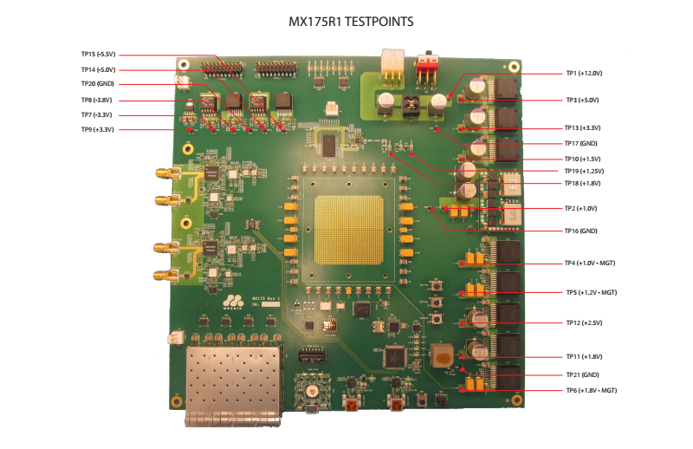
Dual 26 Gsps 3.5 bit ADC and FPGA

Slide 22
Board Interconnect - Upgradable
Problem: Backplanes are short lived
(S100, Multibus, VME, ISA, EISA, PCI, PCIx, PCIe, PCIe2.0, compactPCI, compactPCIe, ATCA…)
Solution: Use 10, 40 or 100 Gbit/sec Ethernet
Ethernet since 1973 – likely to stay around !

Slide 23
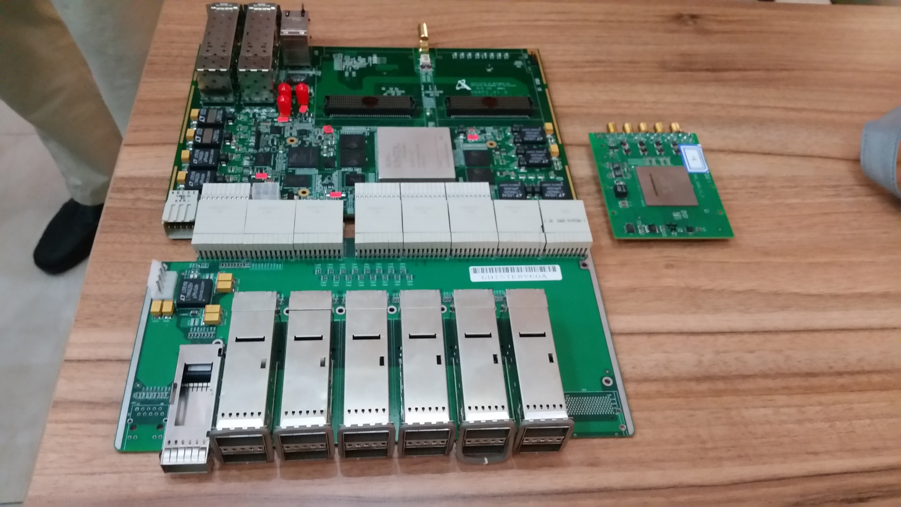

Slide 24
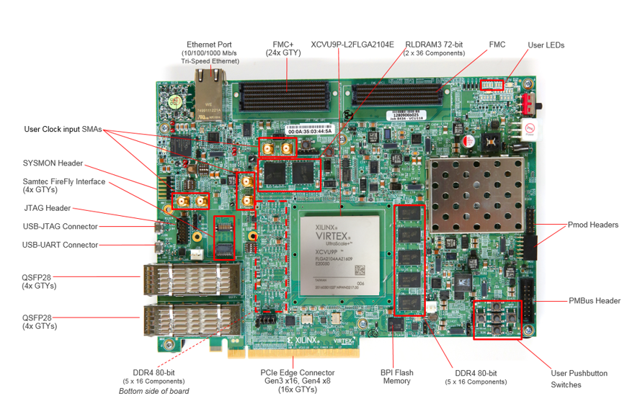
VCU118 5x100Gbit Ethernet ports

Slide 25
Casper Commandments
Thou Shalt Share thy Knowledge
Thou Shalt Help thy Neighbor Casperite
Thou Shalt Covet thy Ethernet to Connect Everything
Switches are Free

Slide 26
CASPER Real-time Signal Processing Instrumentation
Rapid development
Open-source, collaborative
Reusable, platform-independent gateware
Modular, upgradeable hardware
Industry standard ethernet communication
Use switches to interconnect FPGA/GPU/CPU
Low Cost
Notes:
26

Slide 27
Tutorials
Introduction to Simulink and Roach (blink an LED)
Using 10 Gbit Ethernet
Spectrometer (400MHz, 2k channels)
Correlator (4 input, 400MHz, 1k channels)
Heterogeneous Computing ADC→ROACH→CPU/GPU
Intro to embedding Verilog/VHDL in Simulink
Yellow Block Creation

Slide 28
Annual CASPER Workshops
morning: talks
afternoon: lab training, tutorials, working groups,
get help designing an instrument….

