Slide 1
Welcome to Green Bank Observatory

Slide 2
The Green Bank Observatory
World class facility for STEM research and education
Primary instrument: Green Bank Telescope (GBT)
  100-m diameter aperture
  Frequency range: 0.1 – 116 GHz
  Fully steerable (85% sky coverage)
  Flexible, easy to use, with rapid response time
  Dynamic scheduling system matches observing goals and weather
Numerous other instruments and telescope on site
World class STEM education facility and programs

Slide 3
The Green Bank Observatory
Located with two radio quiet zones
  NRQZ: 13,000 sq miles, FCC/NTIA protection
  WVRAZ: 10 mile radius protection around site
Site: 2,600 acres, 48 buildings, 8 telescopes
  32 dwellings, dormitory, small hotel
  Café/cafeteria
  3 classrooms, 2 auditoriums
Electronics lab/staff for maintenance & development
Fully staffed machine shop on site

Slide 4
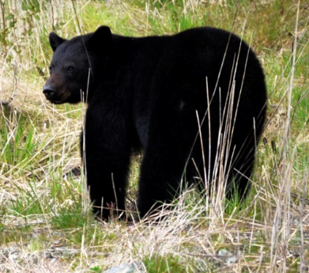
Basic Info/Site Safety
Please turn off all wireless devices while on site
No digital equipment or personal vehicles past parking lot
  Non-digital (disposable) cameras are available for sale in the gift shop
  You are welcome to walk or bike the site as you please
We are a remote, natural area, home to many types of wildlife
  You will commonly see deer, bear, snakes, etc.
  Wildlife are most active at dusk and dawn
  Mother bear(s) and cubs live downsite
  Do not approach wildlife. (Do not panic). Just walk away

Slide 5


You are in the Radio Quiet Zone.
Please turn off all wireless devices!
THANKS!

