Slide 1
Transformative Science for the Next Decade with the Green Bank Observatory, October 16-18 2017
Instrumentation – Phased Array Feeds (PAF)
Bill Shillue

Slide 2
Outline
Some information and results of the Focal L-Band Array for GBT (FLAG) cryogenic PAF
Comparison of FLAG to other L-band receivers and other PAFs
Snapshot and summary of other radio astronomy PAF
Discussion

Slide 3
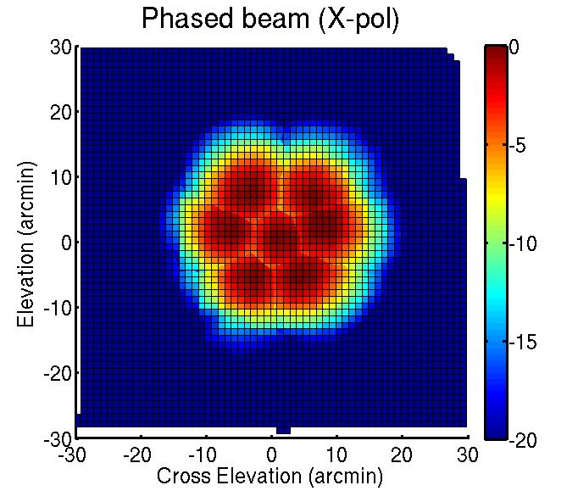
Phased Array Concept
Focal plane
Complex weighted sum from multiple dipole/channels to form a beam
Repeat to form multiple beams
Arrange beams to fully sample extended Field of View

Slide 4
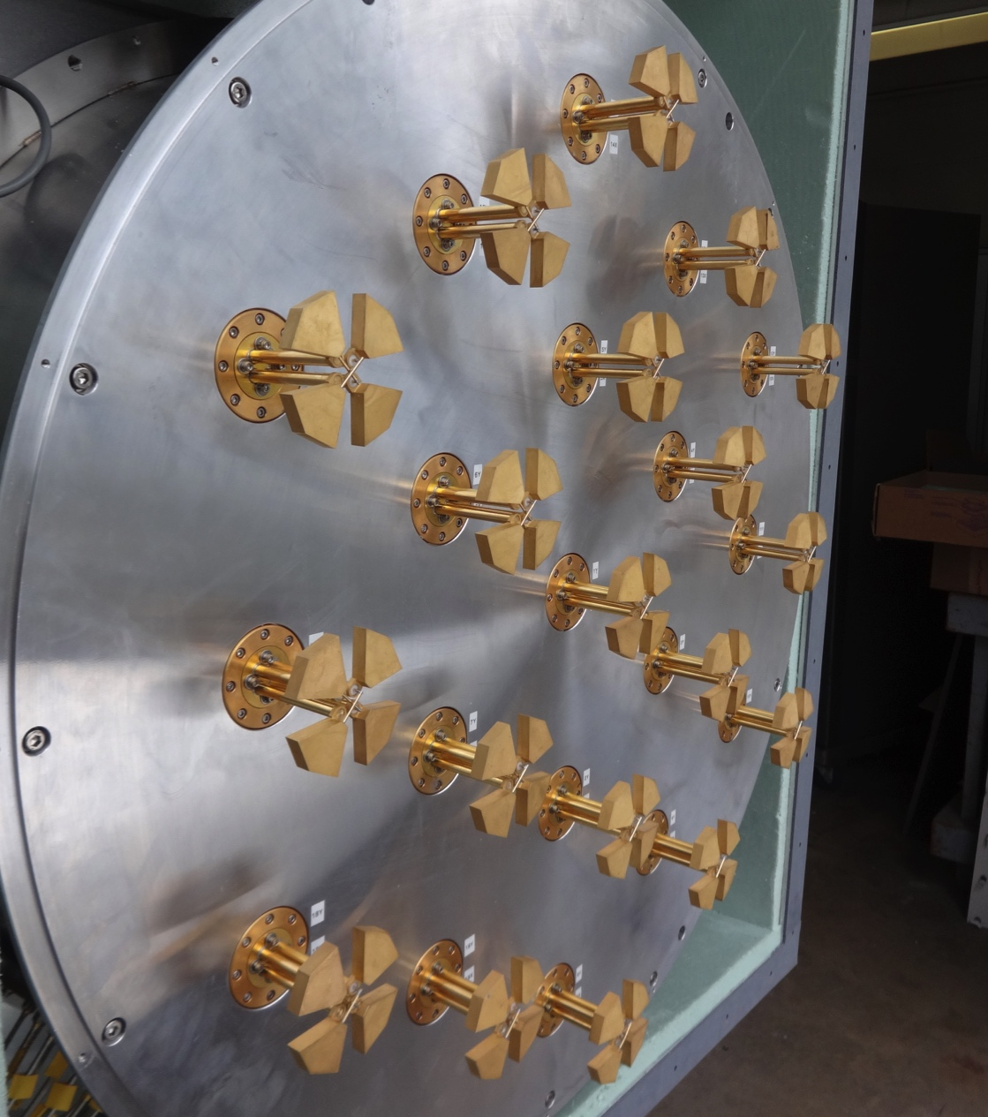
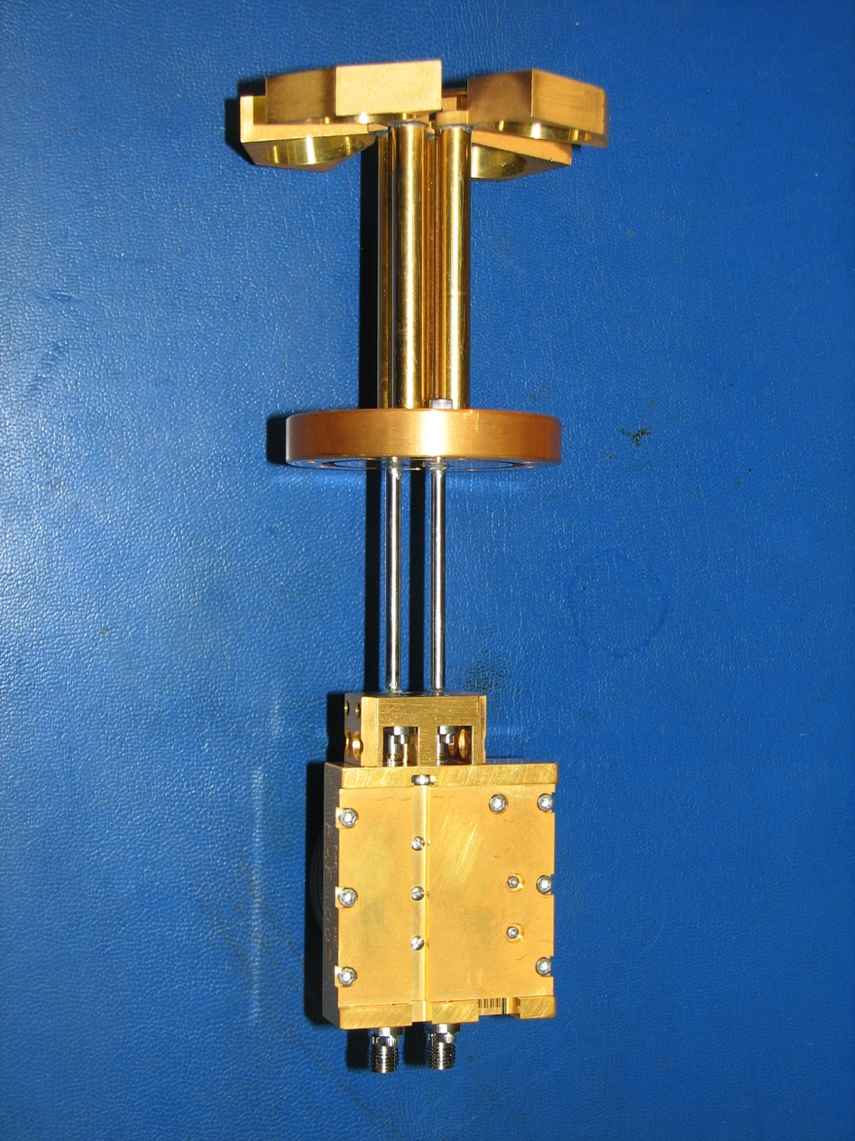
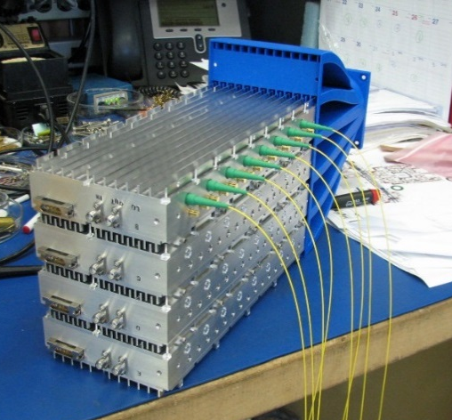
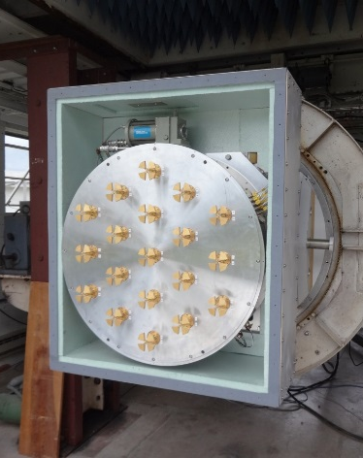
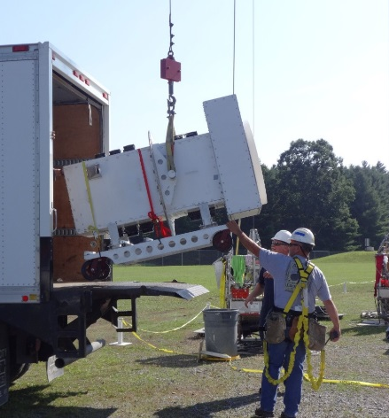
Focal L-Band Array for GBT (FLAG)
New Instrumentation
Custom crossed dipole design, low-loss
Cryogenic transition, low-noise SiGe LNA
Cryogenic dewar 0.74m diameter
Packaged receiver
Integrated multichannel downconverter, digitizer, and optical transmitter assembly

Slide 5
FLAG “Beamformer” Backend
WVU/BYU/NRAO Collaboration funded by NSF ATI gramt
High performance digital backend
Beamformer/Correlator/Spectometer
40-channels, 150 MHz processed bandwidth
Real-time beamforming, transient survey capability

Slide 6
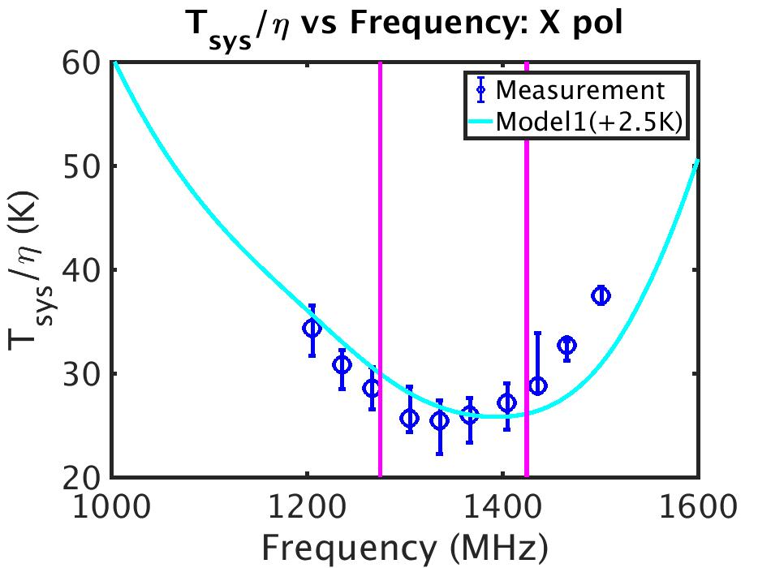
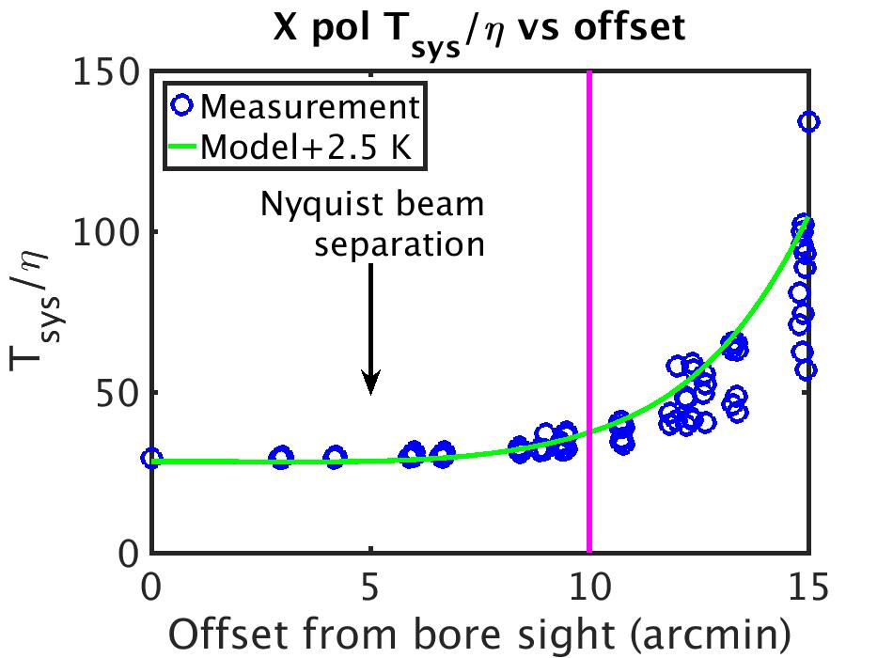
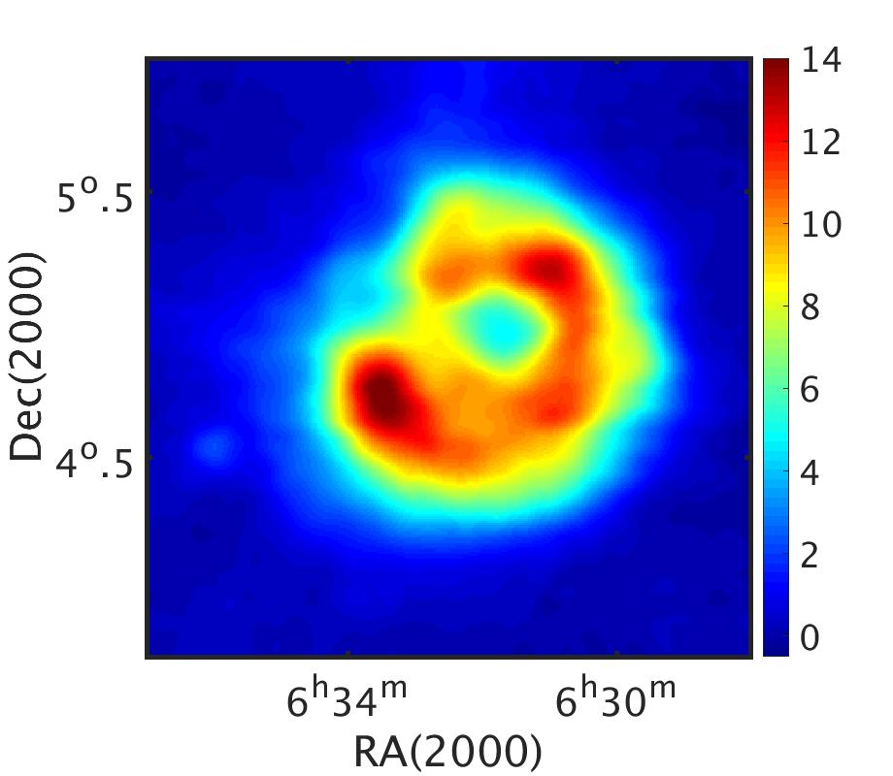
Focal L-Band Array for GBT (FLAG)
The best median T_{sys}/η for X polarization is 25.4 K at 1.336 GHz
The half power beam width of 10 arcmin at 1336 MHz is marked by the vertical line
Survey speed increase 7x compared to GBT L-band
FLAG image of Rosette nebula (Roshi)

Slide 7
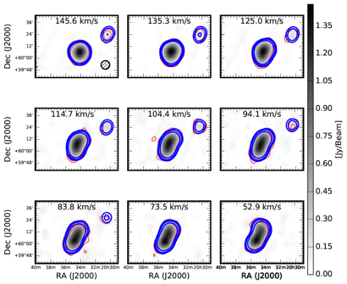
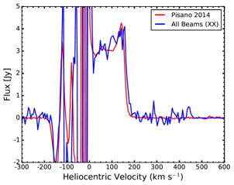
NGC 6946 map (Pisano)
Channel maps with single pixel (red) overlay of FLAG data from all 7 beams in X-polarization
Integrated spectrum from FLAG and single pixel

Slide 8
FLAG Efficiency T_{sys}/η
Name | Institute | Location | Frequency | T_{sys}/η | Technical
FLAG | GBO/NRO/WVU/BYU | Green Bank, WV | 1.2-1.6 GHz | 25 | 19 elements, dual-pol, 7 beams
PHAD | DRAO | Penticton, Canada | 1-2 GHz | N/A | 180 Vivaldi elements, dual-pol
APERTIF | ASTRON | Westerbork, Netherlands | 1-1.75 GHz | 93 | 121 Vivaldi elments, dual-pol, 37 beams
AO40 | Cornell | Arecibo | 1.28-1.68 GHz | ~50 | dual-pol dipole, 40 beams ?
FAST | NAOC | China | 1.05-1.45 GHz | N/A | ~200 dipole elements
ASKAP | CSIRO | Western Australia | 0.7-1.8 GHz | 60 on Parkes, 80 on ASKAP | 188 checkerboard elements, dual-pol, 36 beams
PHAROS | JBO | Manchester, UK | 4-8 GHz | N/A | 144 elements, 24 active, 4-beams, dual-pol

Slide 9
FLAG Survey Speed
Compared to other L-band instruments
For narrow band science
For broadband survey (i.e pulsar search)
Name | MHz BW | Survey Speed m^4K^-2 deg^2 MHz
FLAG | 150 | 2.30E+06
GBT | 400 | 0.90e+06
Parkes | 300 | 1.80E+06
Arecibo | 300 | 4.50E+06
Effelsberg | 300 | 1.60E+06
Parkes w PAF | 700 | 2.10E+06

Slide 10
Other PAFs

Slide 11
UMass Millimeter Wave Phased Array 70-95 GHz, 64 element (PHAMAS)
  Tested on GBT in 2015, combination of small beam size ~2 arc-sec and telescope sway from feed arm and wind led to difficulty with sky calibration beamforming
  Erickson, N. R., et al. "A 64 Element, 70–95 GHz Focal Plane Phased Array." 2015 IEEE AP-S/URSI Symposium
  Bardin, JC., et al. "A 70–95 GHz SiGe downconverter IC for large-N focal plane arrays." 2014 IEEE MTT-S Symposium
Cornell 19-element dual-polarization L-band Phased Array for Arecibo
  Tested in 2014 on Arecibo, beamformed system temperature estimated ~36K, with Tsys/h ~51K
  G. Cortes-Medellin et al, “A Fully Cryogenic Phased Array Camera for Radio Astronomy,” IEEE Trans AP-S, June, 2015
  Much larger concept has been proposed

Slide 12
ASKAP
36 x 12m synthesis array
PAF 188 elements, xxx beams
700-1800 MHz, 300 MHz instantaneous
Formidable DSP
In use for Science
Tsys/eta ~ 80K
arXiv:1509.00544v1
Bright FRB detection
arXiv:1705.07581v2

Slide 13
ASKAP PAF for MPIfR
Tsys/eta ~60K

Slide 14
APERTIF
Transforms WSRT into 21-cm survey facility
1130-1750 MHz, instantaneous BW=300 MHz
12 x 25m reflectors, Tsys/eta = 93 K
121 elements, 37 beams x 2 polarizations
FOV = 8 sq degrees

Slide 15
NRC S-Band CryoPAF
Cryo-PAF 2.8-5.18 GHz
0.48-m cryostat
140 Vivaldi elements, 96 LNAs
18 or 36 beams
Trcvr (goal) = 11K
In development

Slide 16
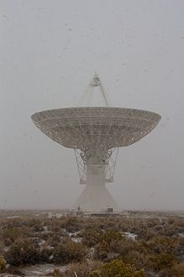
JPL Concept for L-band PAF
Uncooled array 2m x 2m
200 dual-polarized elements, 100 beams
Field-of-View approx. 3.5 sq degrees
Caltech 40m telescope, Owens Valley
1.28-1.53 GHz
Goal, T_{LNA} = 15K, Tsys of 25K or Tsys/eta of 42K
Requires LNA development, based on Schleeh result Schleeh, Joel, Niklas Wadefalk, Per-Åke Nilsson, and Jan Grahn. "10 K room temperature LNA for SKA band 1." 2016 MTT-S symposium
Fast Radio Burst machine

Slide 17
FAST PAF
1-1.5 GHz
Hexagonal cavity backed dipole array
217 elements, 109 beams
Developmental stage, moving slowly

Slide 18
Discussion
Warm vs cold PAF?
  Cold better performance per beam
  Warm can be larger format for mechanical and cost reasons but also higher DSP cost
  Cold wins > 10 GHz, debate exists 1- 10 GHz, warm wins < 1 GHz?
Use on synthesis arrays
  Hard to retrofit i.e. ALMA, EVLA due to cryo, data transmission and DSP
  For new general purpose array, (like NGVLA) PAF has special needs (DSP, receiver footprint) that are not merited by the limited science case
Single Dish
  PAF could replace single pixel if receiver and DSP cost is worth the gain in survey speed for wide FoV science
  But best cryoPAF performance must be demonstrated first over typical single pixel bandwidth
PAF vs Focal Plane Array
  PAF can have some advantages over focal plane arrays, but FPA has significantly lower DSP cost
  Adopt PAF where FPA is irritating, either due to size or due to the inconvenience of non-overlapping beams on sky
Notes:
R DSP cost

Slide 19
Conclusion
The GBT FLAG PAF has unprecedented sensitivity, and improved survey speed compared to L-band single pixel
FLAG Beamformer backend enables HI and pulsar science
CSIRO and Westerbork now working on or interested in cryoPAFs
Future PAF for single dish with strong survey science case

Slide 20
END

Slide 21
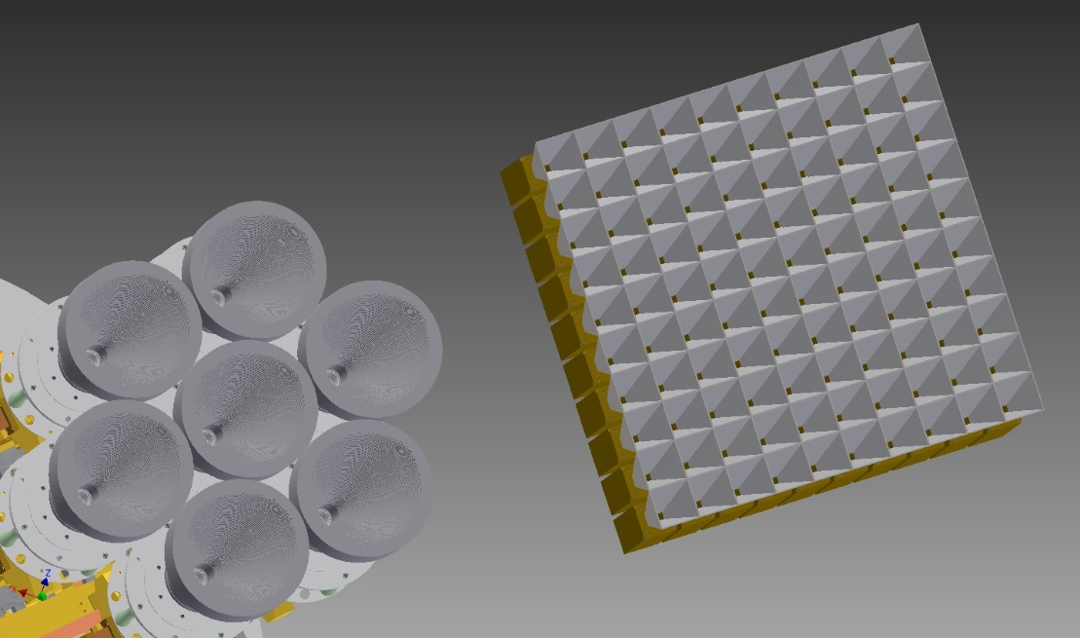
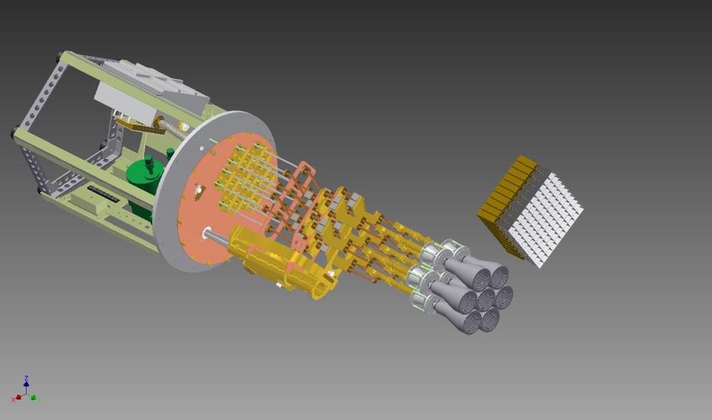
K-PAF for GBT
22.24-25.43 GHz, cryogenic
256 pyramidal feedhorns, 225 beams
400 MHZ instantaneous bandwidth
Tsys/eta ~ 80K
DSP based on CHIME system
CONCEPT only!

