Slide 1

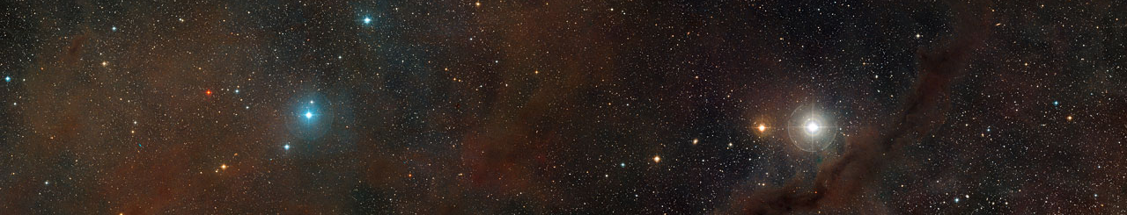
Filaments and Dense Cores in Taurus
Probed using the 100m GBT
Youngmin Seo
Jet Propulsion Laboratory, California Institute of Technology
Collaborators: Paul F. Goldsmith, Yancy L. Shirley, Derek Ward-Thompson,
Jason M. Kirk, David Frayer, Rachel Friesen, Jeong-Eun Lee, Sara Church,
Glen Langston, Joe Masters, Robert W. Garwood
© 2017. All rights reserved.

Slide 2
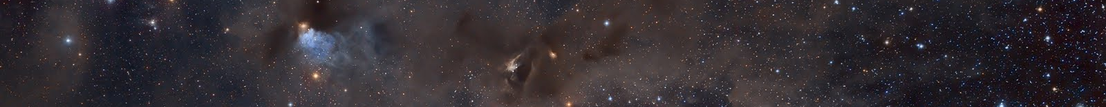
I. INTRODUCTION
Star formation in Molecular Clouds
Taurus
Serpens
Orion
IRDCs
Etc.
Formation of Filaments & Dense Cores
Collapse of Molecular Cloud
L1544
L183
L694
L63
Bok Globules
Etc.
Formation of Star
Gravitational Collapse of Dense Cores
A complete view of star formation processes from a molecular cloud to protostars is required.

Slide 3
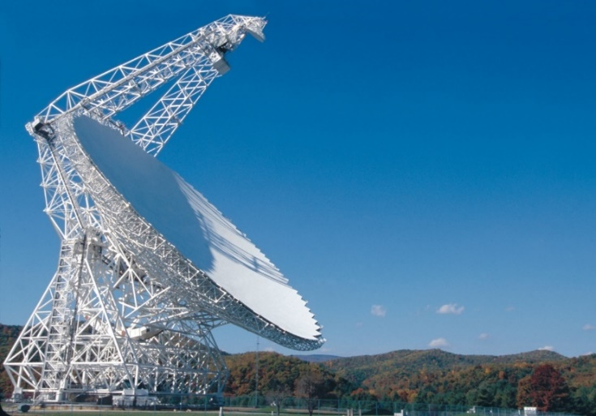
II. OBSERVATIONS
1. Probing Filaments and Dense Cores using KFPA
GBT KFPA (2012A, 2013A)
Dense Structure Survey in NH₃, CCS, HC₇N
Observation time: 90 hours
Median rms: 0.1 K
Lowest rms: 0.058 K
2. Probing Collapse & Fragmentation of Dense Cores
using Argus
GBT Argus (2016B, 2017B)
Collapse & Fragmentation Survey in HCN & HCO⁺ for infall survey, and N₂H⁺ & NH₂D
for fragmentation survey
Observation time: 10 hours out of 70 hours
Median rms: 0.15 K
Lowest rms: 0.08 K

Slide 4
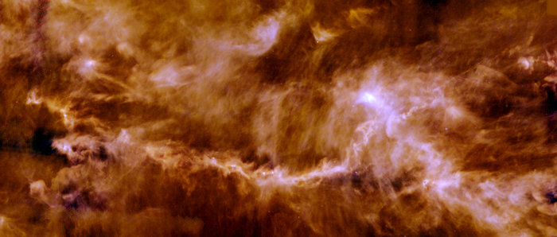
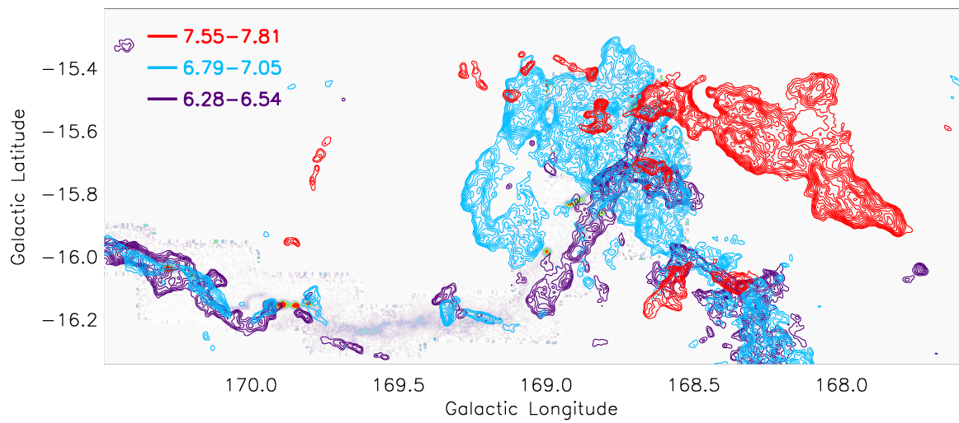
III. DENSE STRUCTURES
Anatomy of L1495-B218 Filaments in Taurus
[Palmeirim et al. 2013]
500 µm dust continuum
Filaments
Hub
50% of protostars
are at the hub
[Goldsmith et al. 2008]
¹³CO 1-0

Slide 5
III. DENSE STRUCTURES
Anatomy of L1495-B218 Filaments in Taurus
Converging or shear flow
[Goldsmith et al. 2008,
Narayanan et al. 2008]

Slide 6
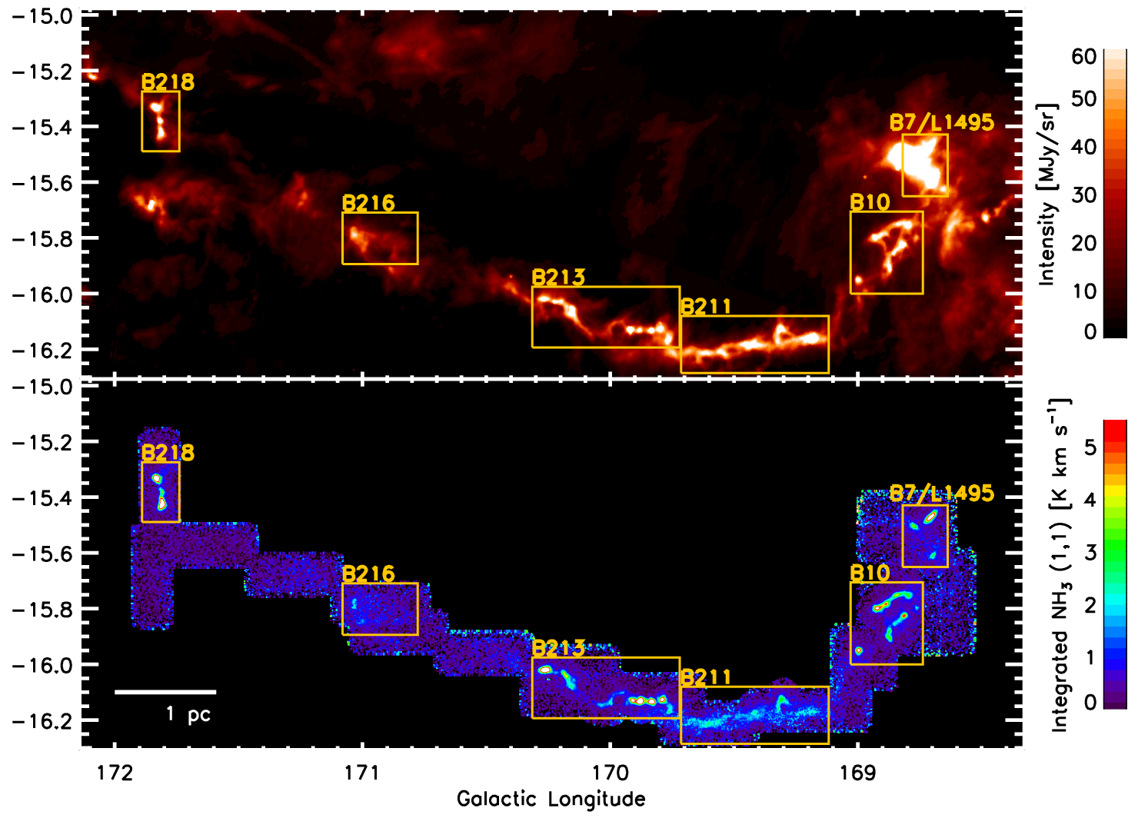
III. DENSE STRUCTURES
Probing Filaments & Dense Cores KFPA: NH₃, CCS, HC₇N
500 µm dust continuum
500 um dust continuum
Hub
50% of protostars
are at the hub
Galactic latitude
Regions with Class I/II
GBT KFPA NH₃ (1,1)
Showing intermediate
& high density gas
[Seo et al. 2015]

Slide 7
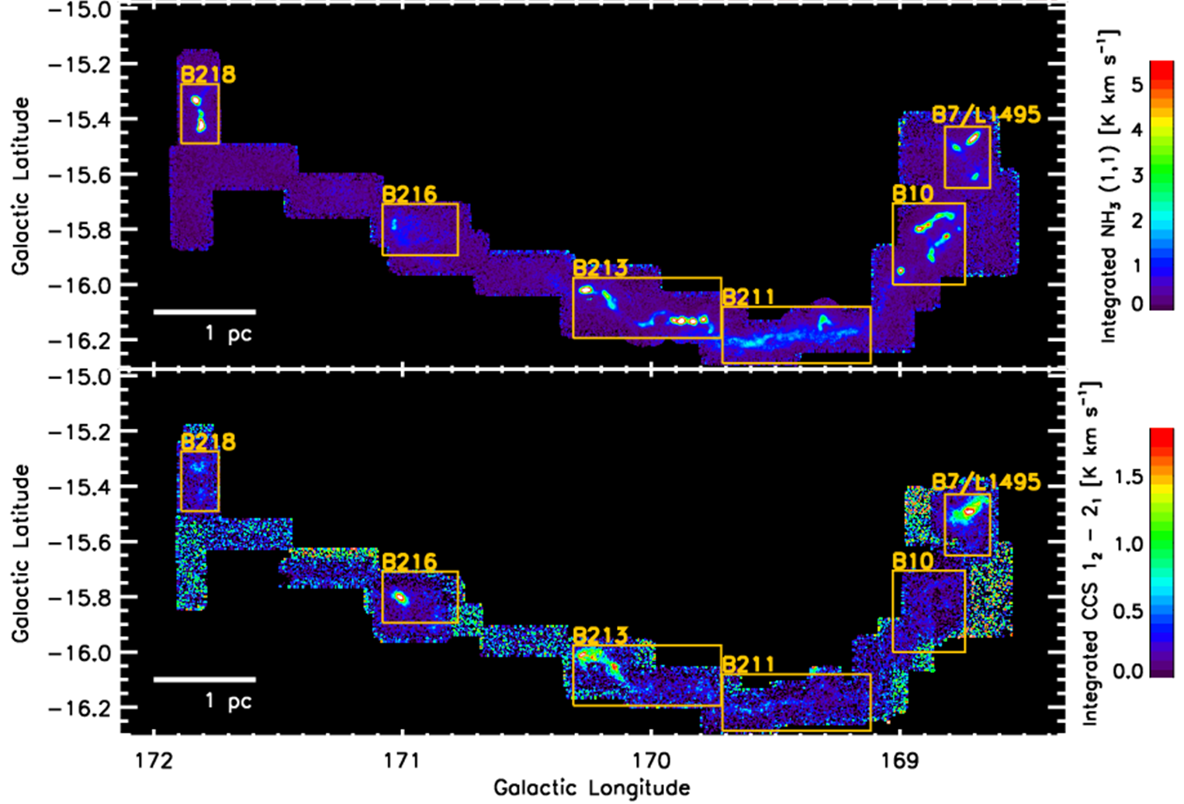
III. DENSE STRUCTURES
Probing Filaments & Dense Cores KFPA: NH₃, CCS, HC₇N
GBT KFPA NH₃ (1,1)
Showing intermediate
& high density gas
Regions with Class I/II
GBT KFPA CCS 2₁ - 1₀
Showing chemically
young gas
[Seo et al. 2015]

Slide 8
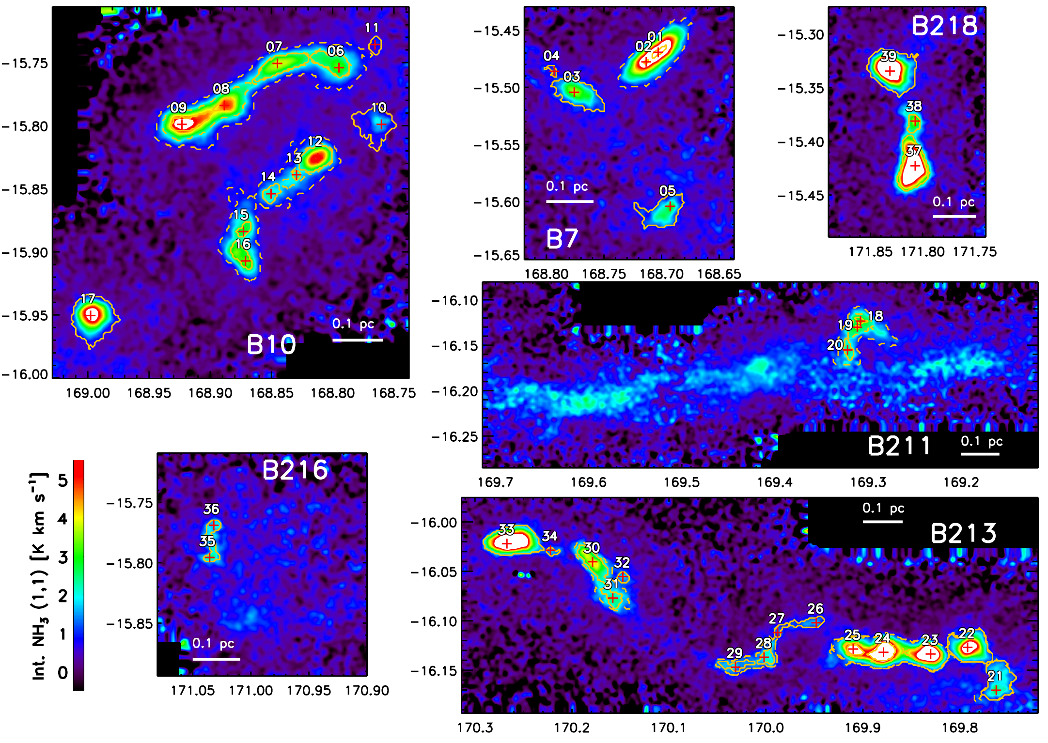
III. DENSE STRUCTURES
Dense Cores Identification
Identifying NH₃ structures using a dendrogram algorithm
[Seo et al. 2015]
39 leaves & 16 branches

Slide 9
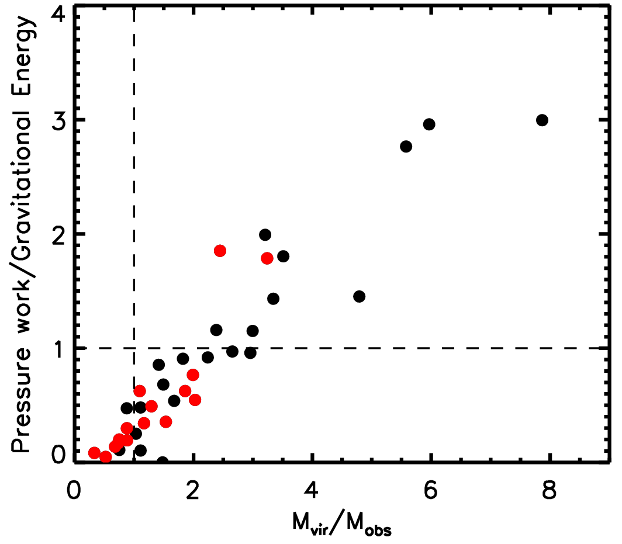
III. DENSE STRUCTURES
Physical Properties of Dense Cores
Dense cores in evolved regions
Only 9 out of 39 leaves are
gravitationally bound
7 out of 9 gravitationally bound
leaves are active
growth by
large scale
converging CO flow
Pressure-confined
Gravitationally unstable
Pressure confined structures:
No gravitational fragmentation
Pressure-confined structure → gravitationally bound structure → Star formation

Slide 10
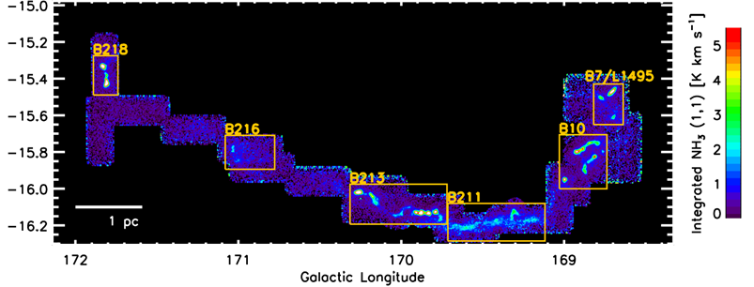
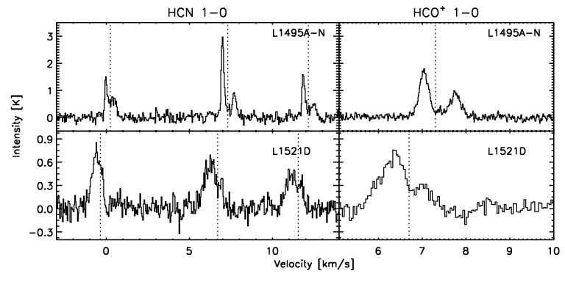
IV. COLLAPSE & FRAGMENTATION
1521D
L1495A-N
12m ARO
Infall speed:
0.8 km/s
Infall speed:
0.1 km/s
[Seo et al. in prep]

Slide 11
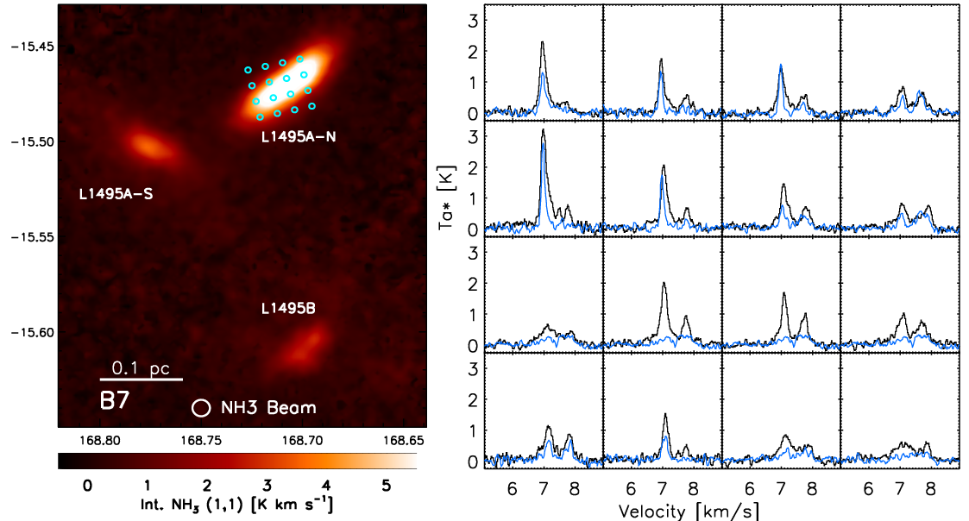
IV. COLLAPSE & FRAGMENTATION
Probing Filaments & Dense Cores using Argus
GBT Argus, HCN 1-0 and HCO⁺ 1-0
Blue: HCN, Black: HCO+
Infall:
0.9 km/s
Hub
[Seo et al. in prep]
Highly asymmetric infall motion in L1495A-N from Argus mapping
Unusually strong infall motion in L1495A-N
Infall:
0.1 km/s

Slide 12
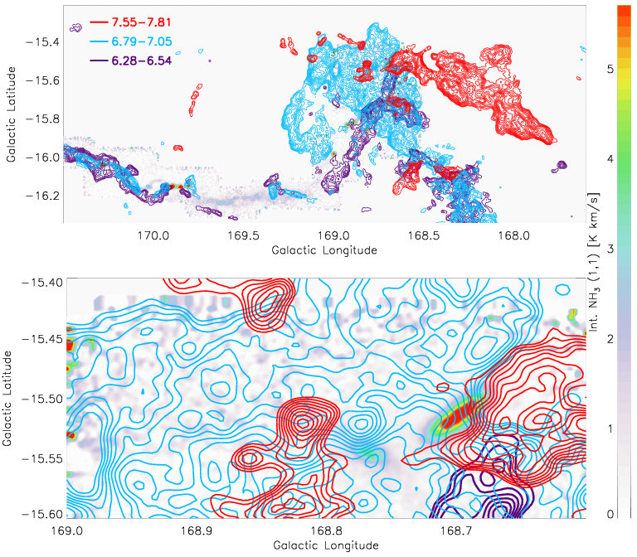
IV. COLLAPSE & FRAGMENTATION
Probing Filaments & Dense Cores using Argus
- Peak infall motion: >Mach 4
¹³CO 1-0
- The collapse predicted by
similarity solutions: Mach 3.3
[Larson 1969, Penston 1969]
- Similar to shock-induced
collapse [Gong & Ostriker 2009]
- L1495A-N may form and collapse
by colliding flow.
- Collapse time expected to be
significantly short (<0.5 Myr)

Slide 13
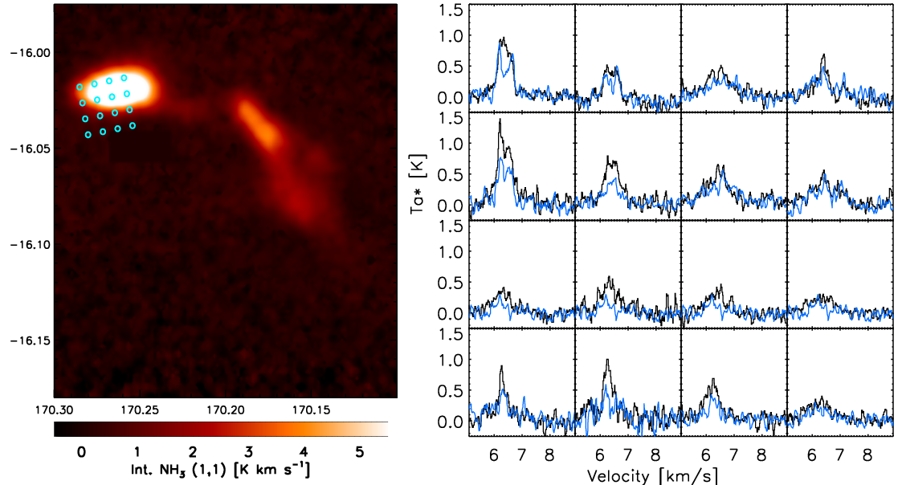
IV. COLLAPSE & FRAGMENTATION
Probing Filaments & Dense Cores using Argus
GBT Argus, HCN 1-0 and HCO⁺ 1-0
Blue: HCN, Black: HCO+
Filament
Infall:
0.05 km/s
Infall:
0.09 km/s
L1521D
Infall:
0.04 km/s
[Seo et al. in prep]
L1521D is slowly collapsing at half the sound speed.

Slide 14
V. DISCUSSION & CONCLUSIONS
Two Modes of Star Formation
Overall: Pressure-confined structure → gravitationally bound structure → Star formation
In detail: two modes, Fast and Slow
[Seo et al. in prep]
At the hub(L1495A-N)
Within filament(L1521D)
Fast star formation
by converging large-scale flows
Stellar group/cluster formation
Slow star formation
by quasi-static gravitational collapse
Isolated star formation

Slide 15
VI. FUTURE
Star Formation & Argus+
Getting a complete view of star formation processes in molecular clouds
General star formation processes within a molecular cloud (Large maps)
+
Individual star formation (High spatial and spectral resolution)
Connecting dynamics of a molecular cloud and individual star formation
Comparison of star formation processes between molecular clouds
(Argus+ Gould Belt survey, IRDC survey)
Footprint of
Argus+

Slide 16
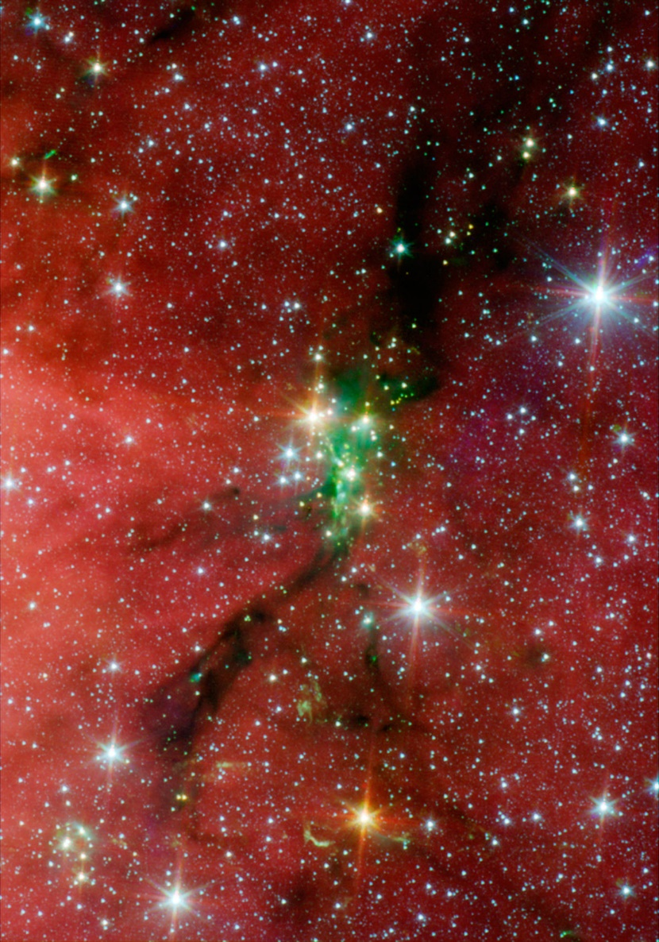
VI. FUTURE
Star Formation & Argus+
Getting a complete view of star formation processes in molecular clouds
Serpens South (~440pc)
Footprint of
Argus+
Connecting dynamics of a molecular cloud and individual star formation
Comparison of star formation processes between molecular clouds
(Argus+ Gould Belt survey, IRDC survey)

Slide 17
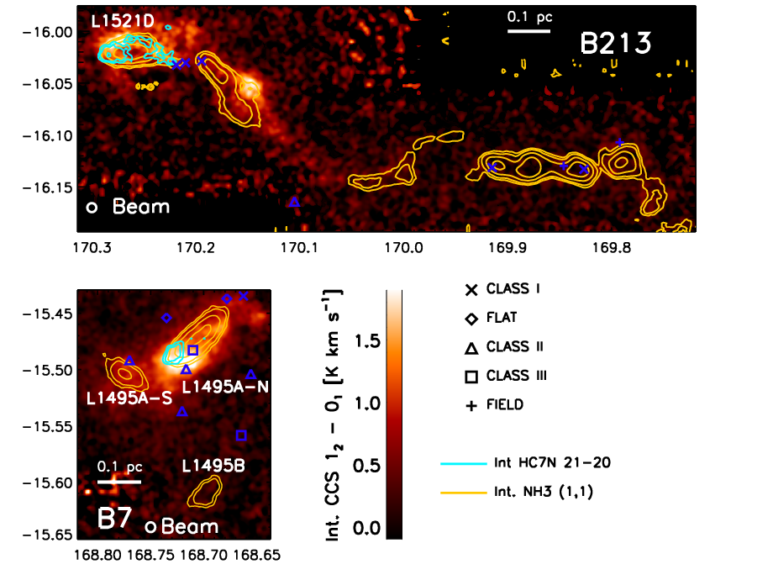
III. DENSE STRUCTURES
[Seo et al. in prep]
CCS and HC₇N detected in evolved dense cores (L1495A-N, L1521D)
→ CCS and HC₇N might trace newly accreted gas in this region.

