Slide 1
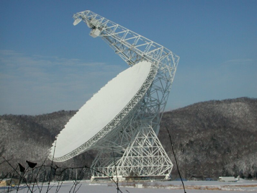
Galaxy Formation and Evolution: Where we are and where we are going.
D.J. Pisano (WVU)
djpisano@mail.wvu.edu

Slide 2
The Big Questions
How does the gas content of galaxies evolve over cosmic time and in different environments?
How does gas flow into and out of galaxies?
How is matter distributed in the universe and how does it evolve?

Slide 3
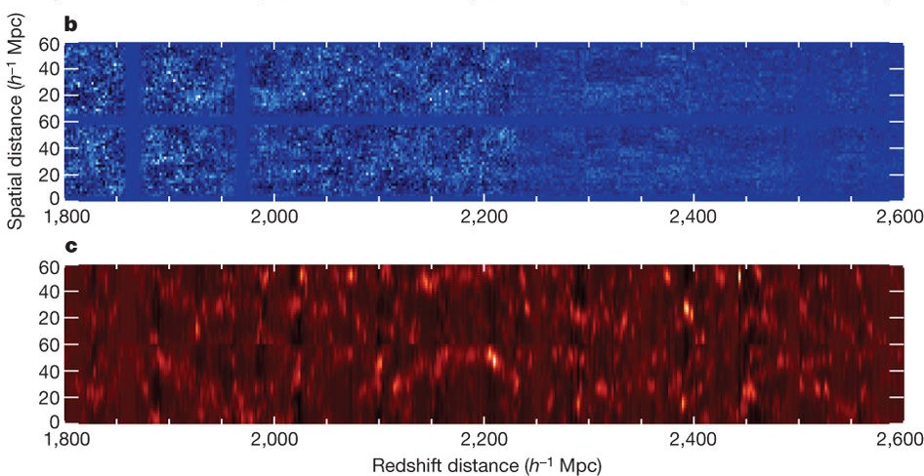
HI at high redshift
Ω_{HI} ≈ (5.5±1.5)x10⁻⁴ from cross-correlating GBT HI observations with optical DEEP2 data (Chang et al. 2010, Masui et al. 2013, Switzer et al. 2013).
Data can also be used to constrain dark energy.

Slide 4
HI at high redshift
Can use gravitational lenses to detect HI from single galaxies out to z ≈1 with current radio telescopes (Hunt et al. 2016, Deane et al. 2015)

Slide 5
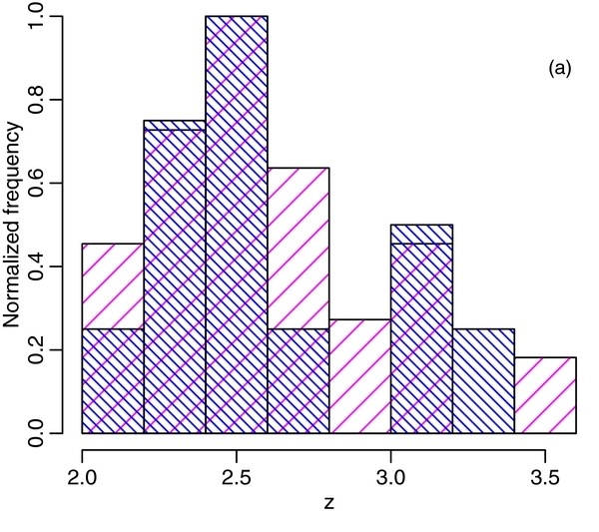
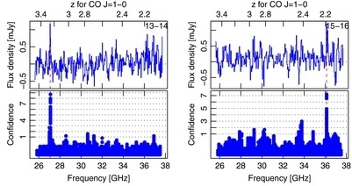
High redshift CO searches
GBT Ka-band Zpectrometer and other receivers (as well as VLA, ALMA, etc.) used to detect high-z CO from star-forming galaxies (e.g. Harris et al. 2012)

Slide 6
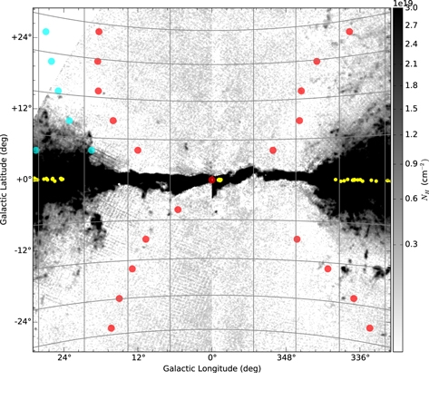
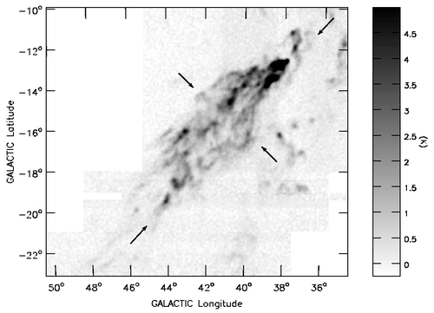
Diffuse HI around the Milky Way
Can see HI clouds removed from region of Galactic Center wind (left; Lockman & McClure-Griffiths 2016).
See HVCs interacting with surrounding medium as they fall onto the Galactic Disk (right; Lockman et al. 2008).

Slide 7
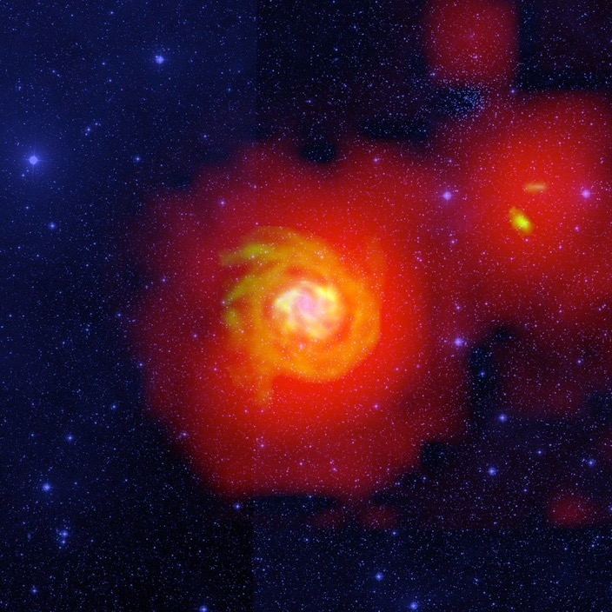
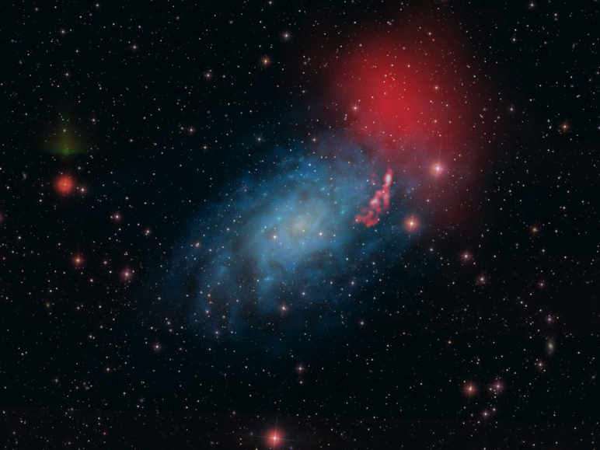
N_{HI} ~ 10¹⁸ cm⁻² around nearby galaxies
de Blok et al. 2014
Pisano (2014)
Boomsma et al. (2008)

Slide 8
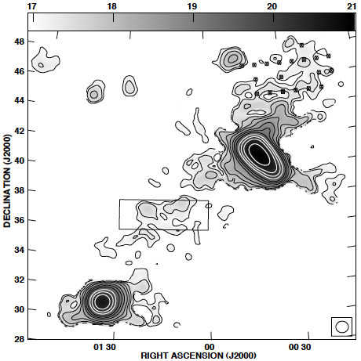
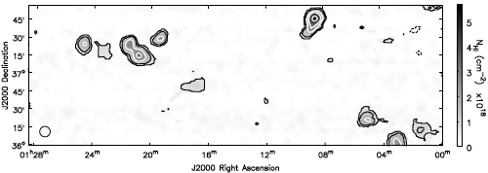
N_{HI} ~ 10¹⁷ cm⁻² around M31...
Despite its initial appearance in BT04, even at N_{HI} ~10¹⁷ cm⁻², this gas is clumpy with M_{HI} = 0.4-4x10⁵ M.
Braun & Thilker 2004
Wolfe et al 2016

Slide 9
Covering fractions for M31
Howk et al. 2017
GBT observations appear inconsistent with COS-Halos results.
Due to differences in sample galaxies?
GBT observations down to N_{HI} ~ 4x10¹⁷cm⁻² towards random sightlines reveal no HI emission.
f_{c} < 0.051 is consistent with simulations.

Slide 10
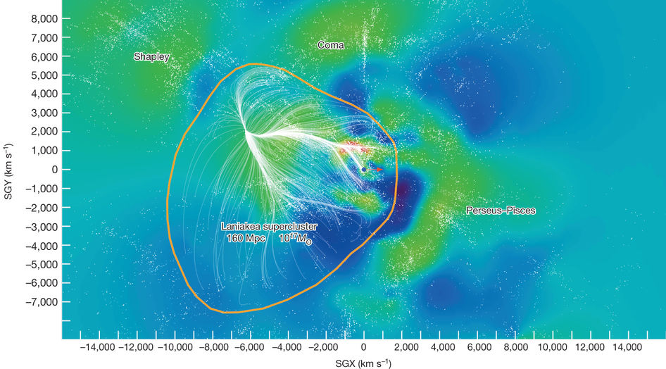
Large Scale Mass distributions
Using TFR and other direct distance measurements we can map out peculiar velocity field and the distribution of mass in the local universe (Tully et al. 2012)

Slide 11
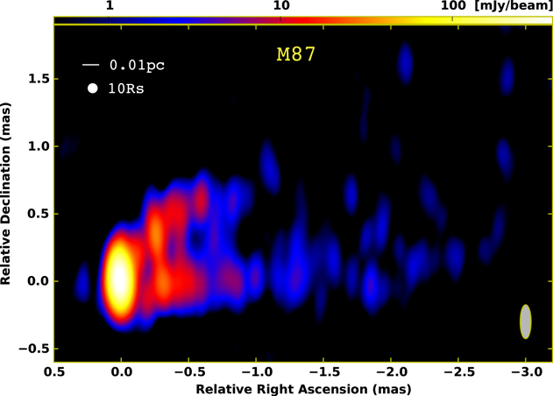
Studying SMBHs
Hada et al. (2016) used VLBA+GBT at 86 GHz to image within 10 R_{s} of M87 SMBH

Slide 12
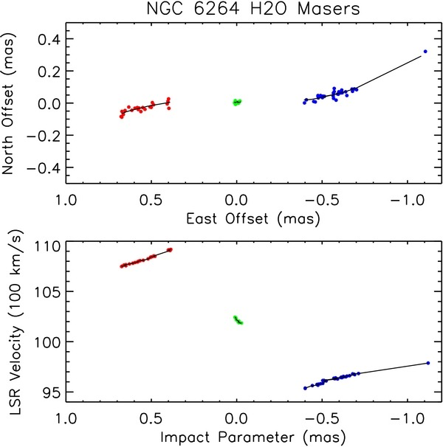
H₂O Maser Measurements
Kuo et al. (2013) used GBT+VLBA observations of H₂O masers to measure M_{BH} in NGC 6264 = (3.09±0.42)x10⁷ M⊙.
Got direct distance measurement of 144±19 Mpc.

Slide 13
Other Recent Science
HI absorption
HI in dwarf galaxies, compact groups, etc.
Measuring possible variations in fundamental constants
Looking for radio continuum from dark matter annihilation.
And more…

Slide 14
What’s coming in the next 10 years?
CHIME and other instruments will do HI intensity mapping at high redshifts.
MeerKAT, ASKAP, APERTIF will be conducting wide-area and deep surveys of local and distant HI (e.g WALLABY, MHONGOOSE, LADUMA, & DINGO, plus CHILES with VLA).
FAST will bring unprecedented resolution and sensitivity to HI studies.

Slide 15
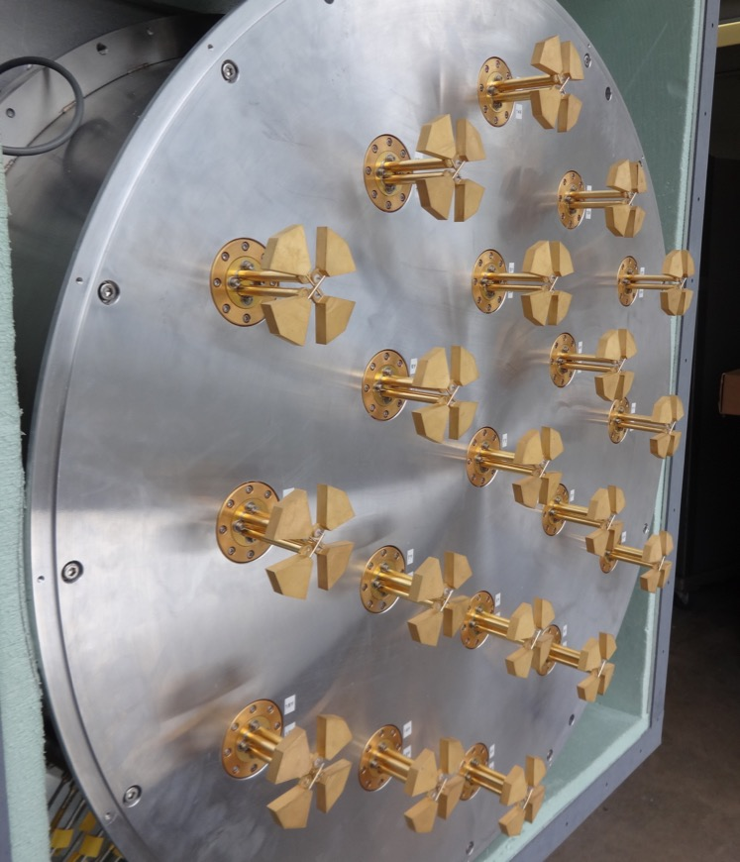
Role of GBT in the next decade
With wide-bandwidth arrays at low and high frequencies, we can map low surface brightness HI and CO (accretion & intensity mapping).
Radio quiet zone + sensitivity will help with HI emission & absorption studies at high-z.
Frequency & sky coverage still unique. Extremely frequency agile as well.

Slide 16
Two exciting future science projects… (that are not just more of the same…)

Slide 17
Evolution of HI & H₂
Neither the evolution of Ω_{HI} nor Ω_{H2} are well-constrained. And neither can explain evolution of SFR vs. time. (Popping et al. 2015).
Need more data vs. redshift for both.

Slide 18
CO intensity mapping
Large area, wide-bandwidth maps between 20-50 GHz and 70+ GHz can provide statistical detection of CO (Carilli 2011, Breysse et al. 2014, Li et al. 2016).
Can be used to infer Ω_{H2} compare with Ω_{HI} to constrain evolution of gas in galaxies.

Slide 19
Cosmic Magnetism
Rotation Measure synthesis to probe B-field in Galactic Halo & IGM.
Use lower frequency bolometer with ability to measure magnetic field at ≲𝛍G level of IGM.
Looking at diffuse emission over larger scales, so GBT has a role to play.

Slide 20
The Future
The GBT outfitted with array receivers has an important role to play in the study of the growth of structures in the universe.
The GBT’s sensitivity is important for VLBI experiments.
In the SKA+FAST era, GBT occupies a unique niche with its sensitivity, sky coverage, and frequency coverage that complements new facilities.
In an era of tight budgets, it is easier (less risky) and cheaper to improve instrumentation on existing telescopes than to build big facilities from scratch.

