Slide 1
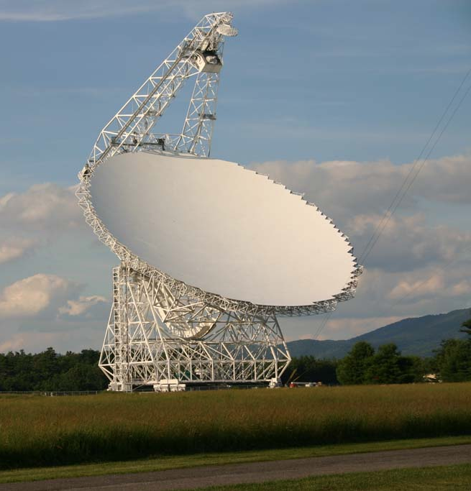
Quantifying the Relationship between Dense Gas and Star Formation in Nearby Galaxies
Amanda Kepley
Assistant Scientist
North American ALMA Science Center
National Radio Astronomy Observatory
Notes:
PRETTY THIS LIST UP.

Slide 2
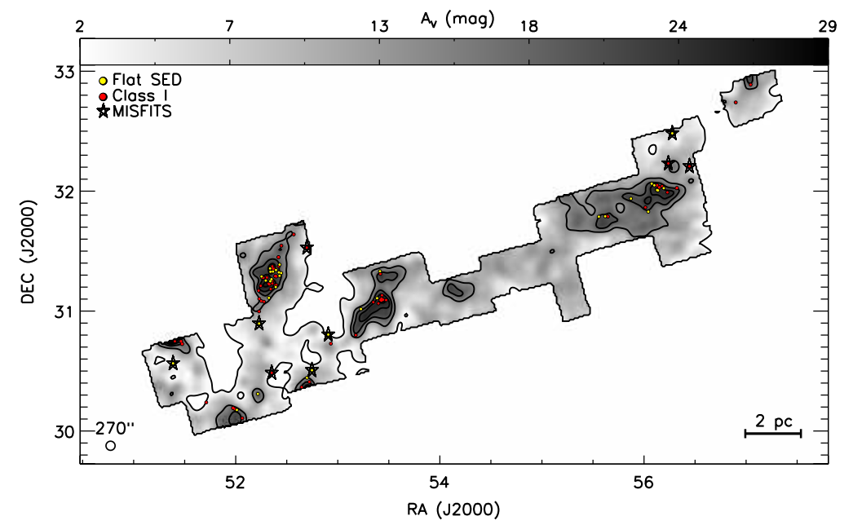
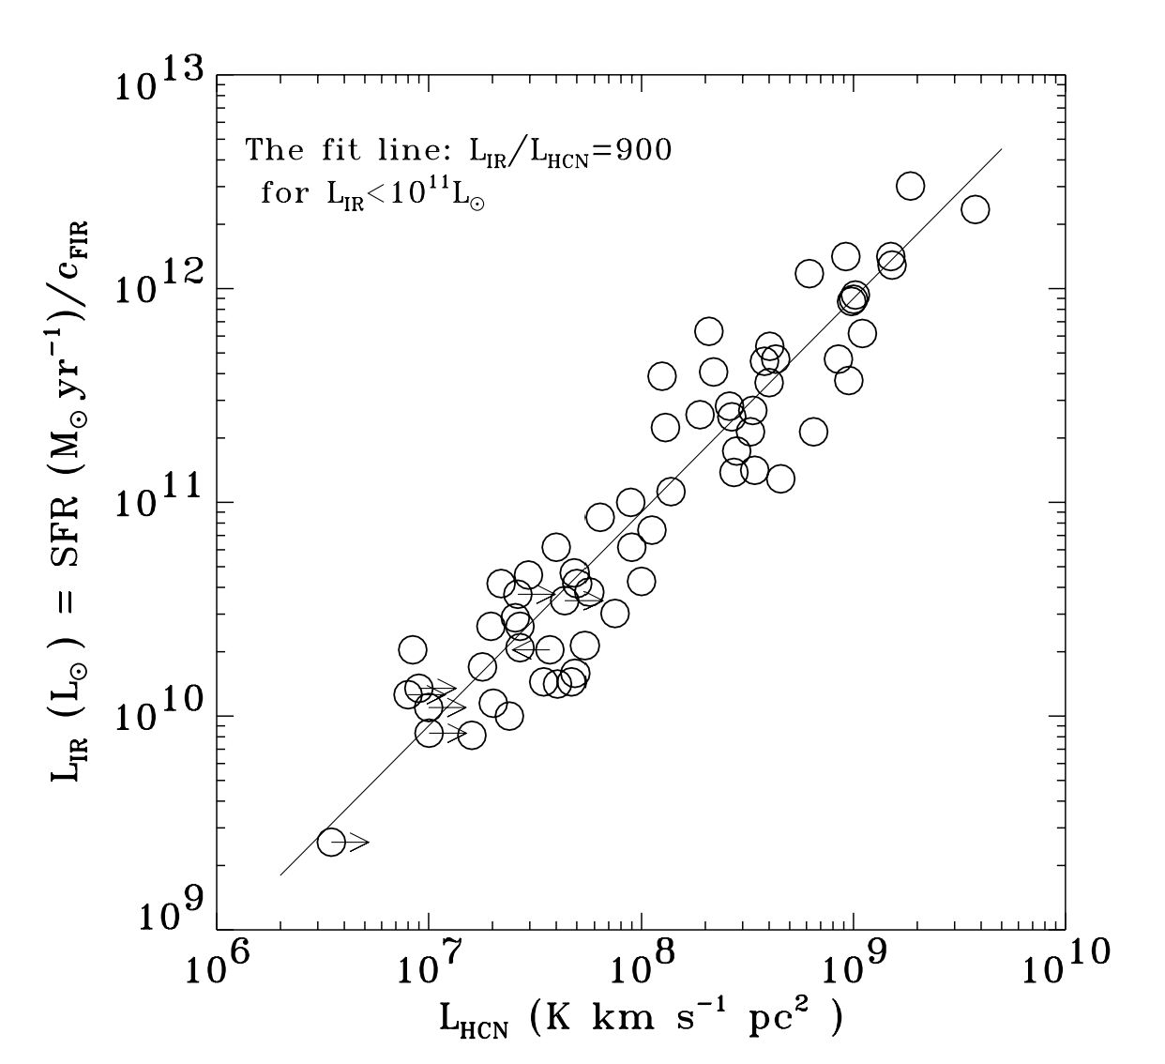
Star formation correlates most strongly with dense molecular gas.
Resolved measurements
in the Milky Way
Heiderman+ 2010
Integrated measurements
in nearby galaxies
IR Luminosity
≈ SFR
Dense Gas (as traced by HCN)
Gao & Solomon (2004)
Notes:
Our most detailed knowledge about this relationship comes from the Milky Way.
The Milky Way only represents a narrow range of physical conditions present in galaxies.

Slide 3
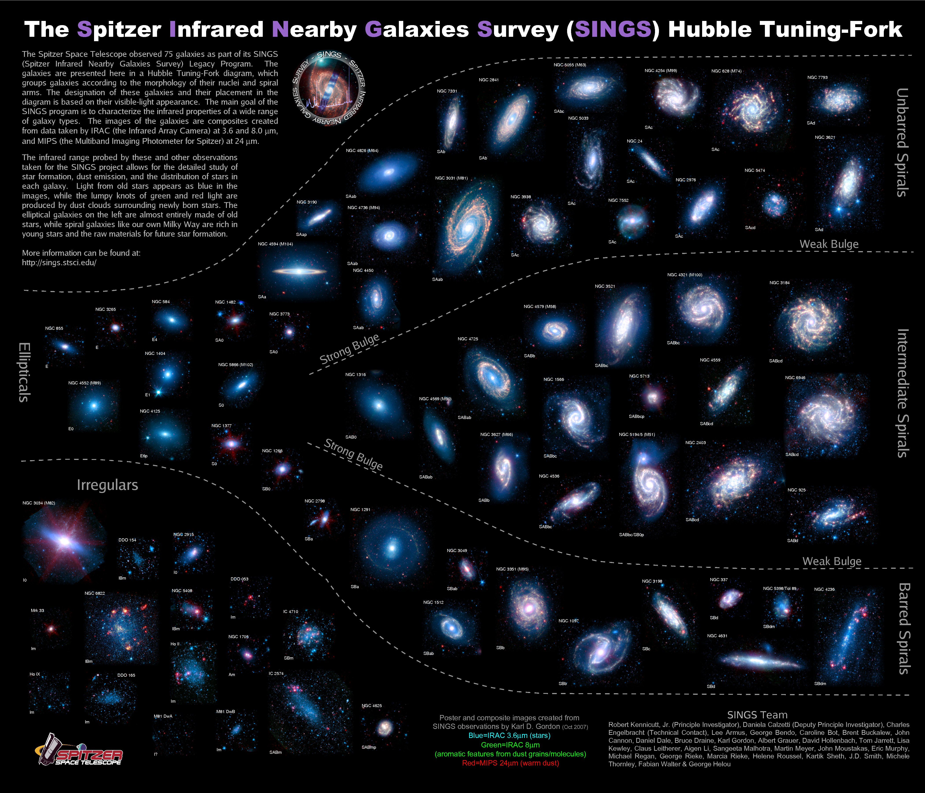
Mapping dense gas in nearby galaxies probes a wider range of physical conditions.
Notes:
The Milky Way only represents a narrow range of physical conditions present in galaxies.

Slide 4
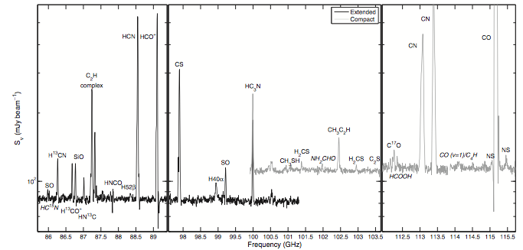
Mapping dense gas tracers in nearby galaxies is difficult because these lines are faint.
10-30 times fainter than CO!
Meier+ 2015

Slide 5
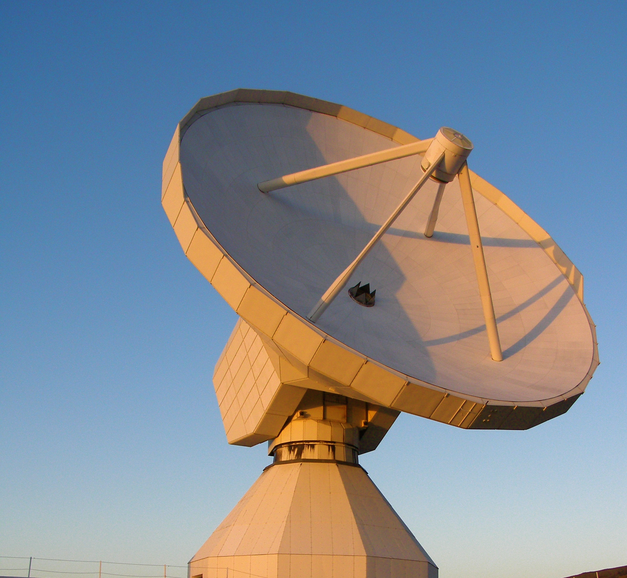
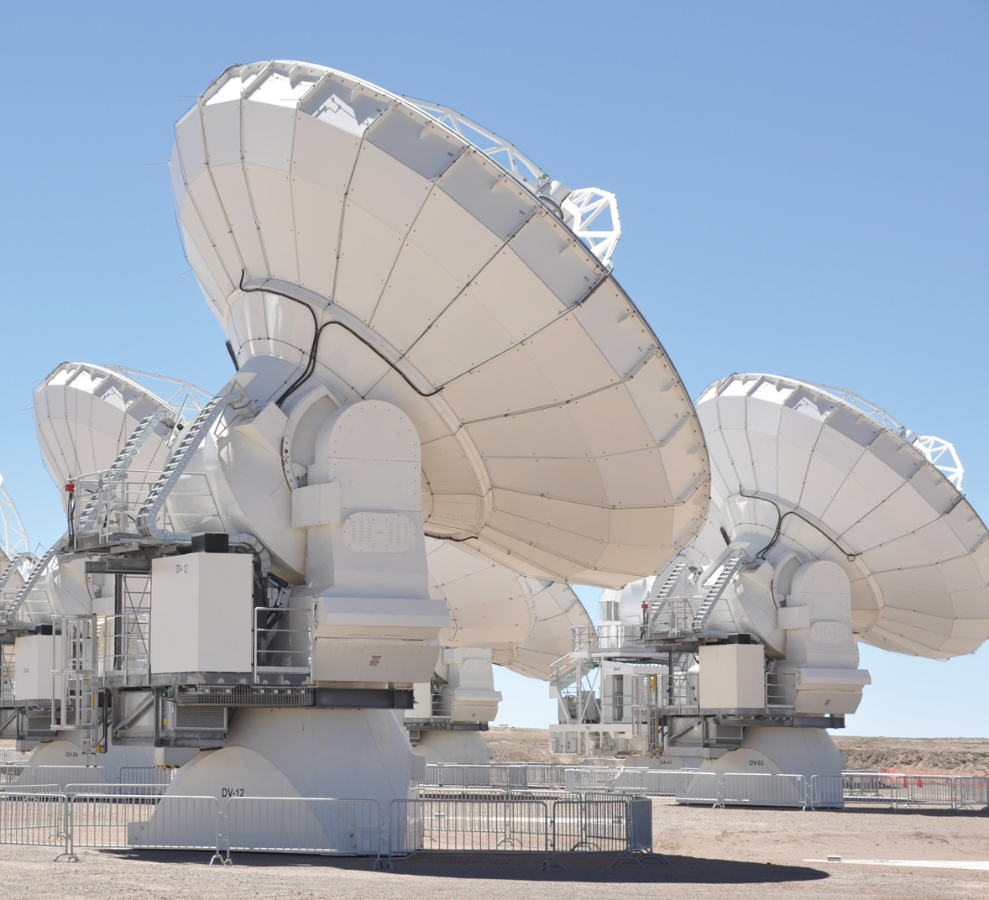
Sensitivity of latest generation of telescopes is opening up new frontiers in dense gas studies.
IRAM 30m+EMIR
EMIR Multi-line Probe of the ISM Regulating Galaxy Evolution
(EMPIRE)
PI: Frank Bigiel
Co-Is include A. Kepley
IRAM Large Program ~2015-2017, ~440 hr
Disks of nine galaxies mapped in HCN, HCO+, CS, ¹³CO, C¹⁸O
Spatial resolution ~1.5kpc (at 10Mpc)
Observations are complete. Papers are coming out.
ALMA
ALMA Dense Gas Observations of Galaxies
PI: Adam Leroy
Co-Is include A. Kepley
All data taken
Inner 3 kpc of 4 nearby galaxies with a range of SFE and nuclear starburst behavior
Resolution ~ 200pc
Paper submitted (Gallagher+). See A. Bolatto’s talk.

Slide 6
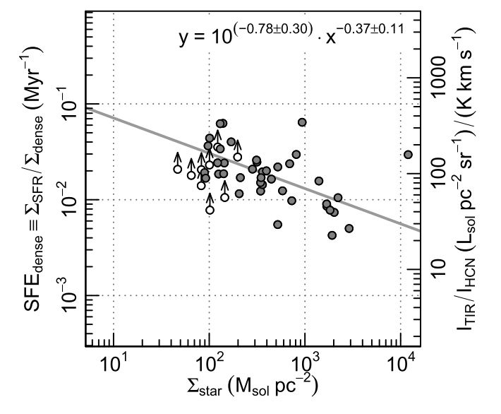
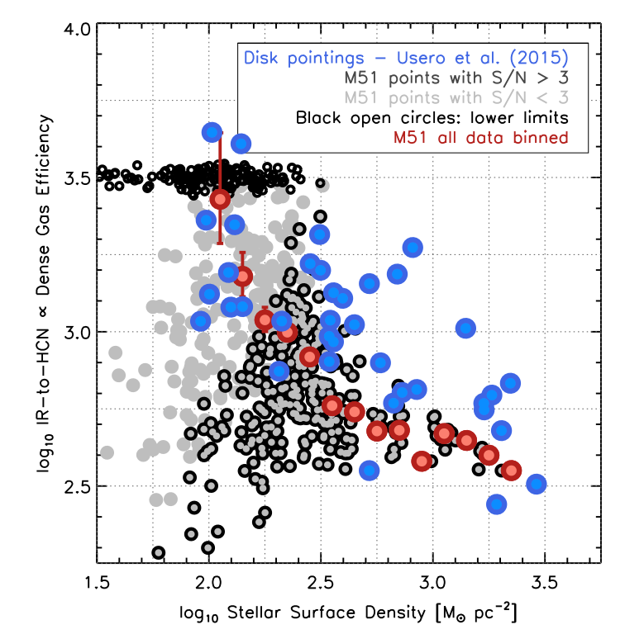
These types of studies are already starting to see trends with physical conditions within galaxies.
Individual pointings in many galaxies
Deep observations of M51
Dense Gas Star formation Efficiency
(Ratio of SFR to Dense Gas)
Dense Gas Star formation Efficiency
(Ratio of SFR to Dense Gas)
Stellar Surface Density
Stellar Surface Density
Usero+ 2015
Bigiel+ 2016
Radius
Radius

Slide 7
The GBT has the potential to make major contributions to this field.
GBT has a collecting area 20% larger than ALMA and 4x that of the next largest single dish (LMT).
~10arcsec beam means you can distinguish 30 Doradus sized regions at the distance of M82.
Deep, moderately high resolution maps of nearby galaxies

Slide 8
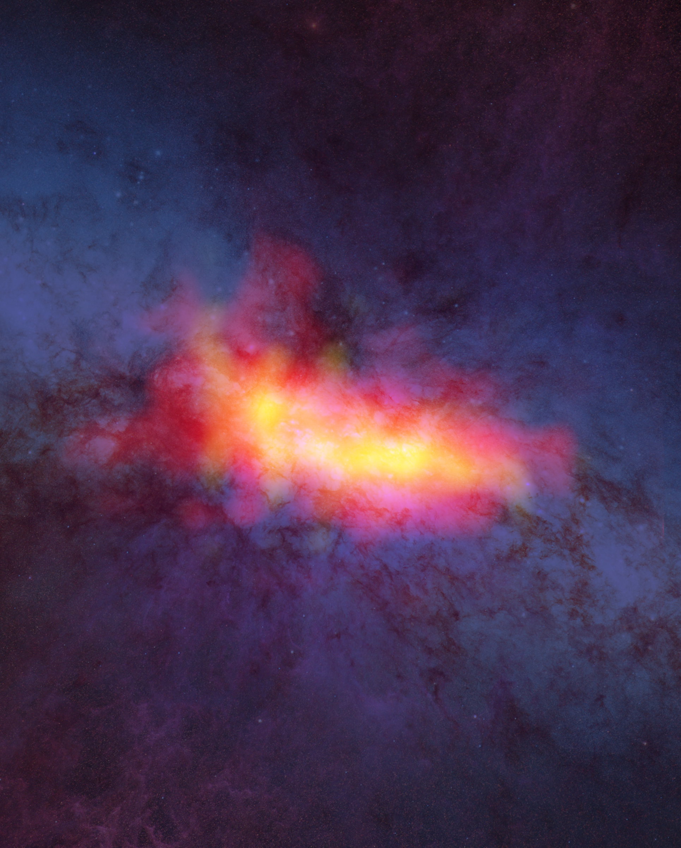
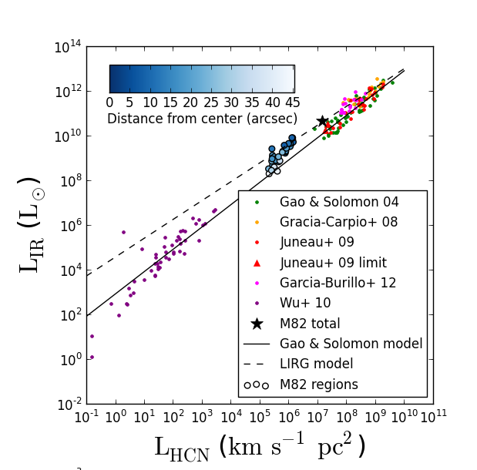
The GBT has demonstrated that it can do deep observations of dense molecular gas tracers.
HCN
HCO+
Deepest map to date!
Only 16 hours with the GBT!
Kepley + 2014

Slide 9
The GBT has demonstrated that it can do deep observations of dense molecular gas tracers.
Kepley et al, in prep (to be submitted by 10/31)
Notes:
IC 10
-- Local Group galaxy
--¼ solar metallicity. Intermediate between LMC and SMC.

Slide 10
Argus significantly increases the mapping speed of the GBT at 4mm.
Major limitation of previous, effectively single pixel receiver was its slow mapping speed.
Argus is 16 pixel focal plane array built by Stanford (PI Sarah Church), Caltech, JPL, U. Maryland, U. Miami, and NRAO.
16 pixels means that you can map galaxies in the order of 5-10 hours instead of >50 hours.

Slide 11
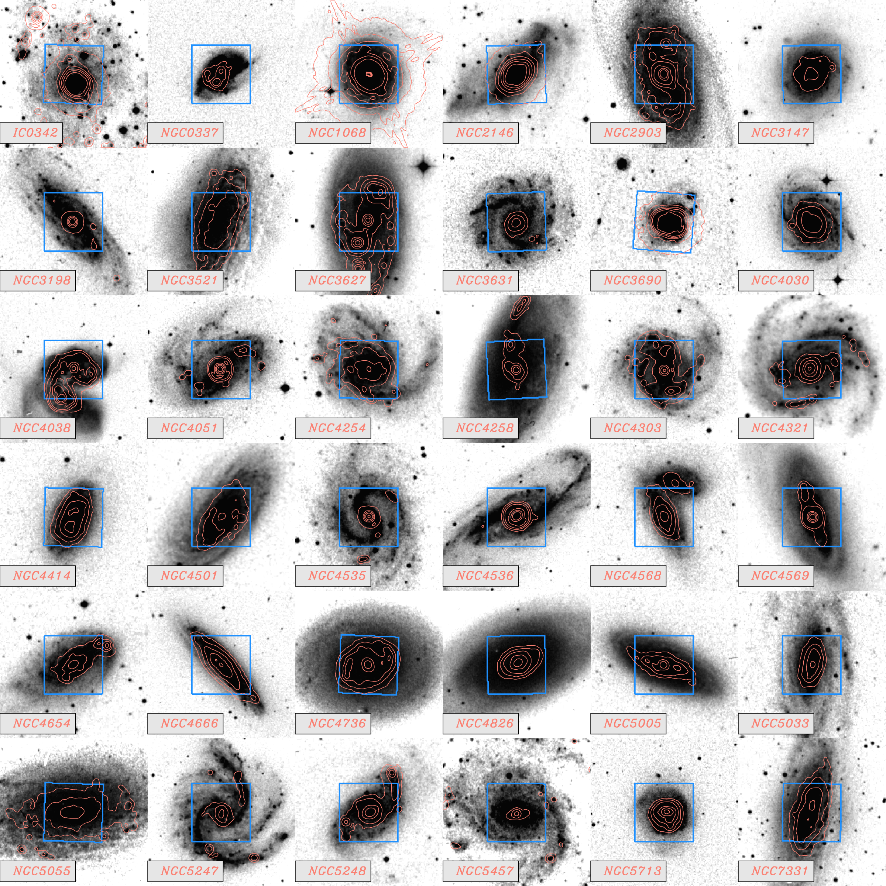

DEGAS* will quantify the relationship between dense gas and star formation in a large sample.
FULL PROPOSAL ACCEPTED!
~500HR OVER 3 YEARS (GULP)
A. Kepley (PI)
A. Leroy
S. Church
K. Cleary
D. Frayer
E. Rosolowsky
A. Harris
A. Bolatto
F. Bigiel
M. Gallagher
J. Gunderson
A. Hughes
M. J. Jimenez
S. Kessler
C. Lee
J. Li
J. Meyer
K. Sandstrom
A. Schruba
M. Sieth
E. Schinnener
A. Usero
2’ by 2’ maps of 4 dense molecular gas tracers in 36 nearby galaxies spanning a wide range of galaxy properties with ~750pc resolution.
Supported by NSF AST
Grant to co-Is.
* Dense Extragalactic GBT+Argus Survey
Notes:
(

Slide 12
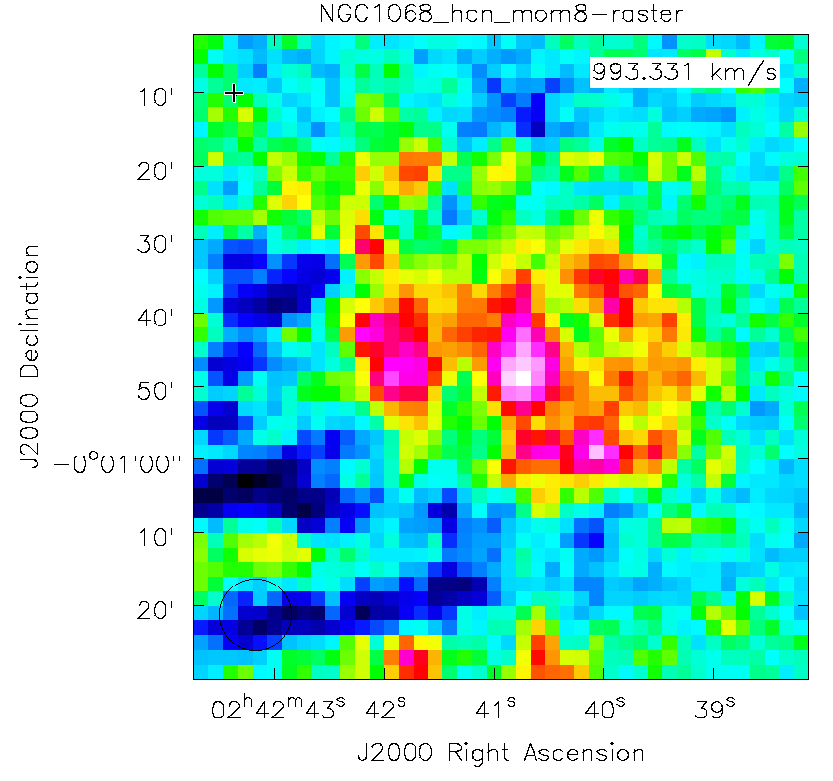
Observations started Spring 2017 and will go through 2020.
Preliminary
Data during 17A season limited by poor weather.
On sky for 9.25h tonight and 8h tomorrow!
Preliminary results will be shown in GBT special session at the AAS on January 11 at 10:00 a.m.

Slide 13
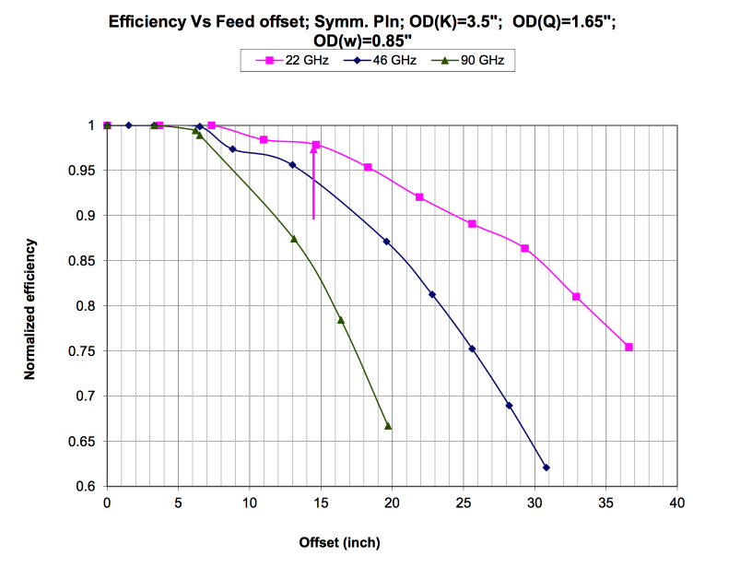
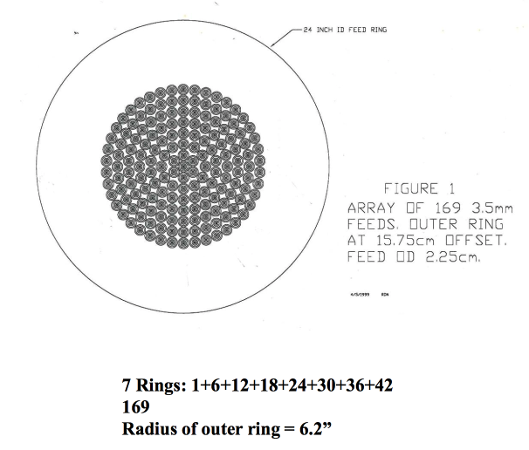
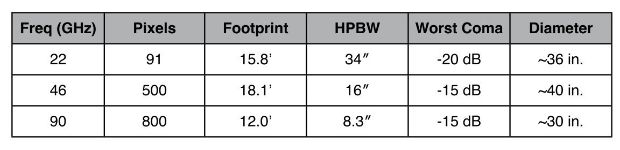
The focal plane of the GBT can accommodate even larger arrays.
13x
500x
50x
GBT memos 198 & 199 (Norrod and Srikanth) and 295 (Lockman). See also talk by S. Church.

Slide 14
Large arrays would enable mapping of entire disks of large samples of nearby galaxies.
Figure courtesy Adam Leroy
Notes:
~100 to a few hundred depending on what you need.

Slide 15
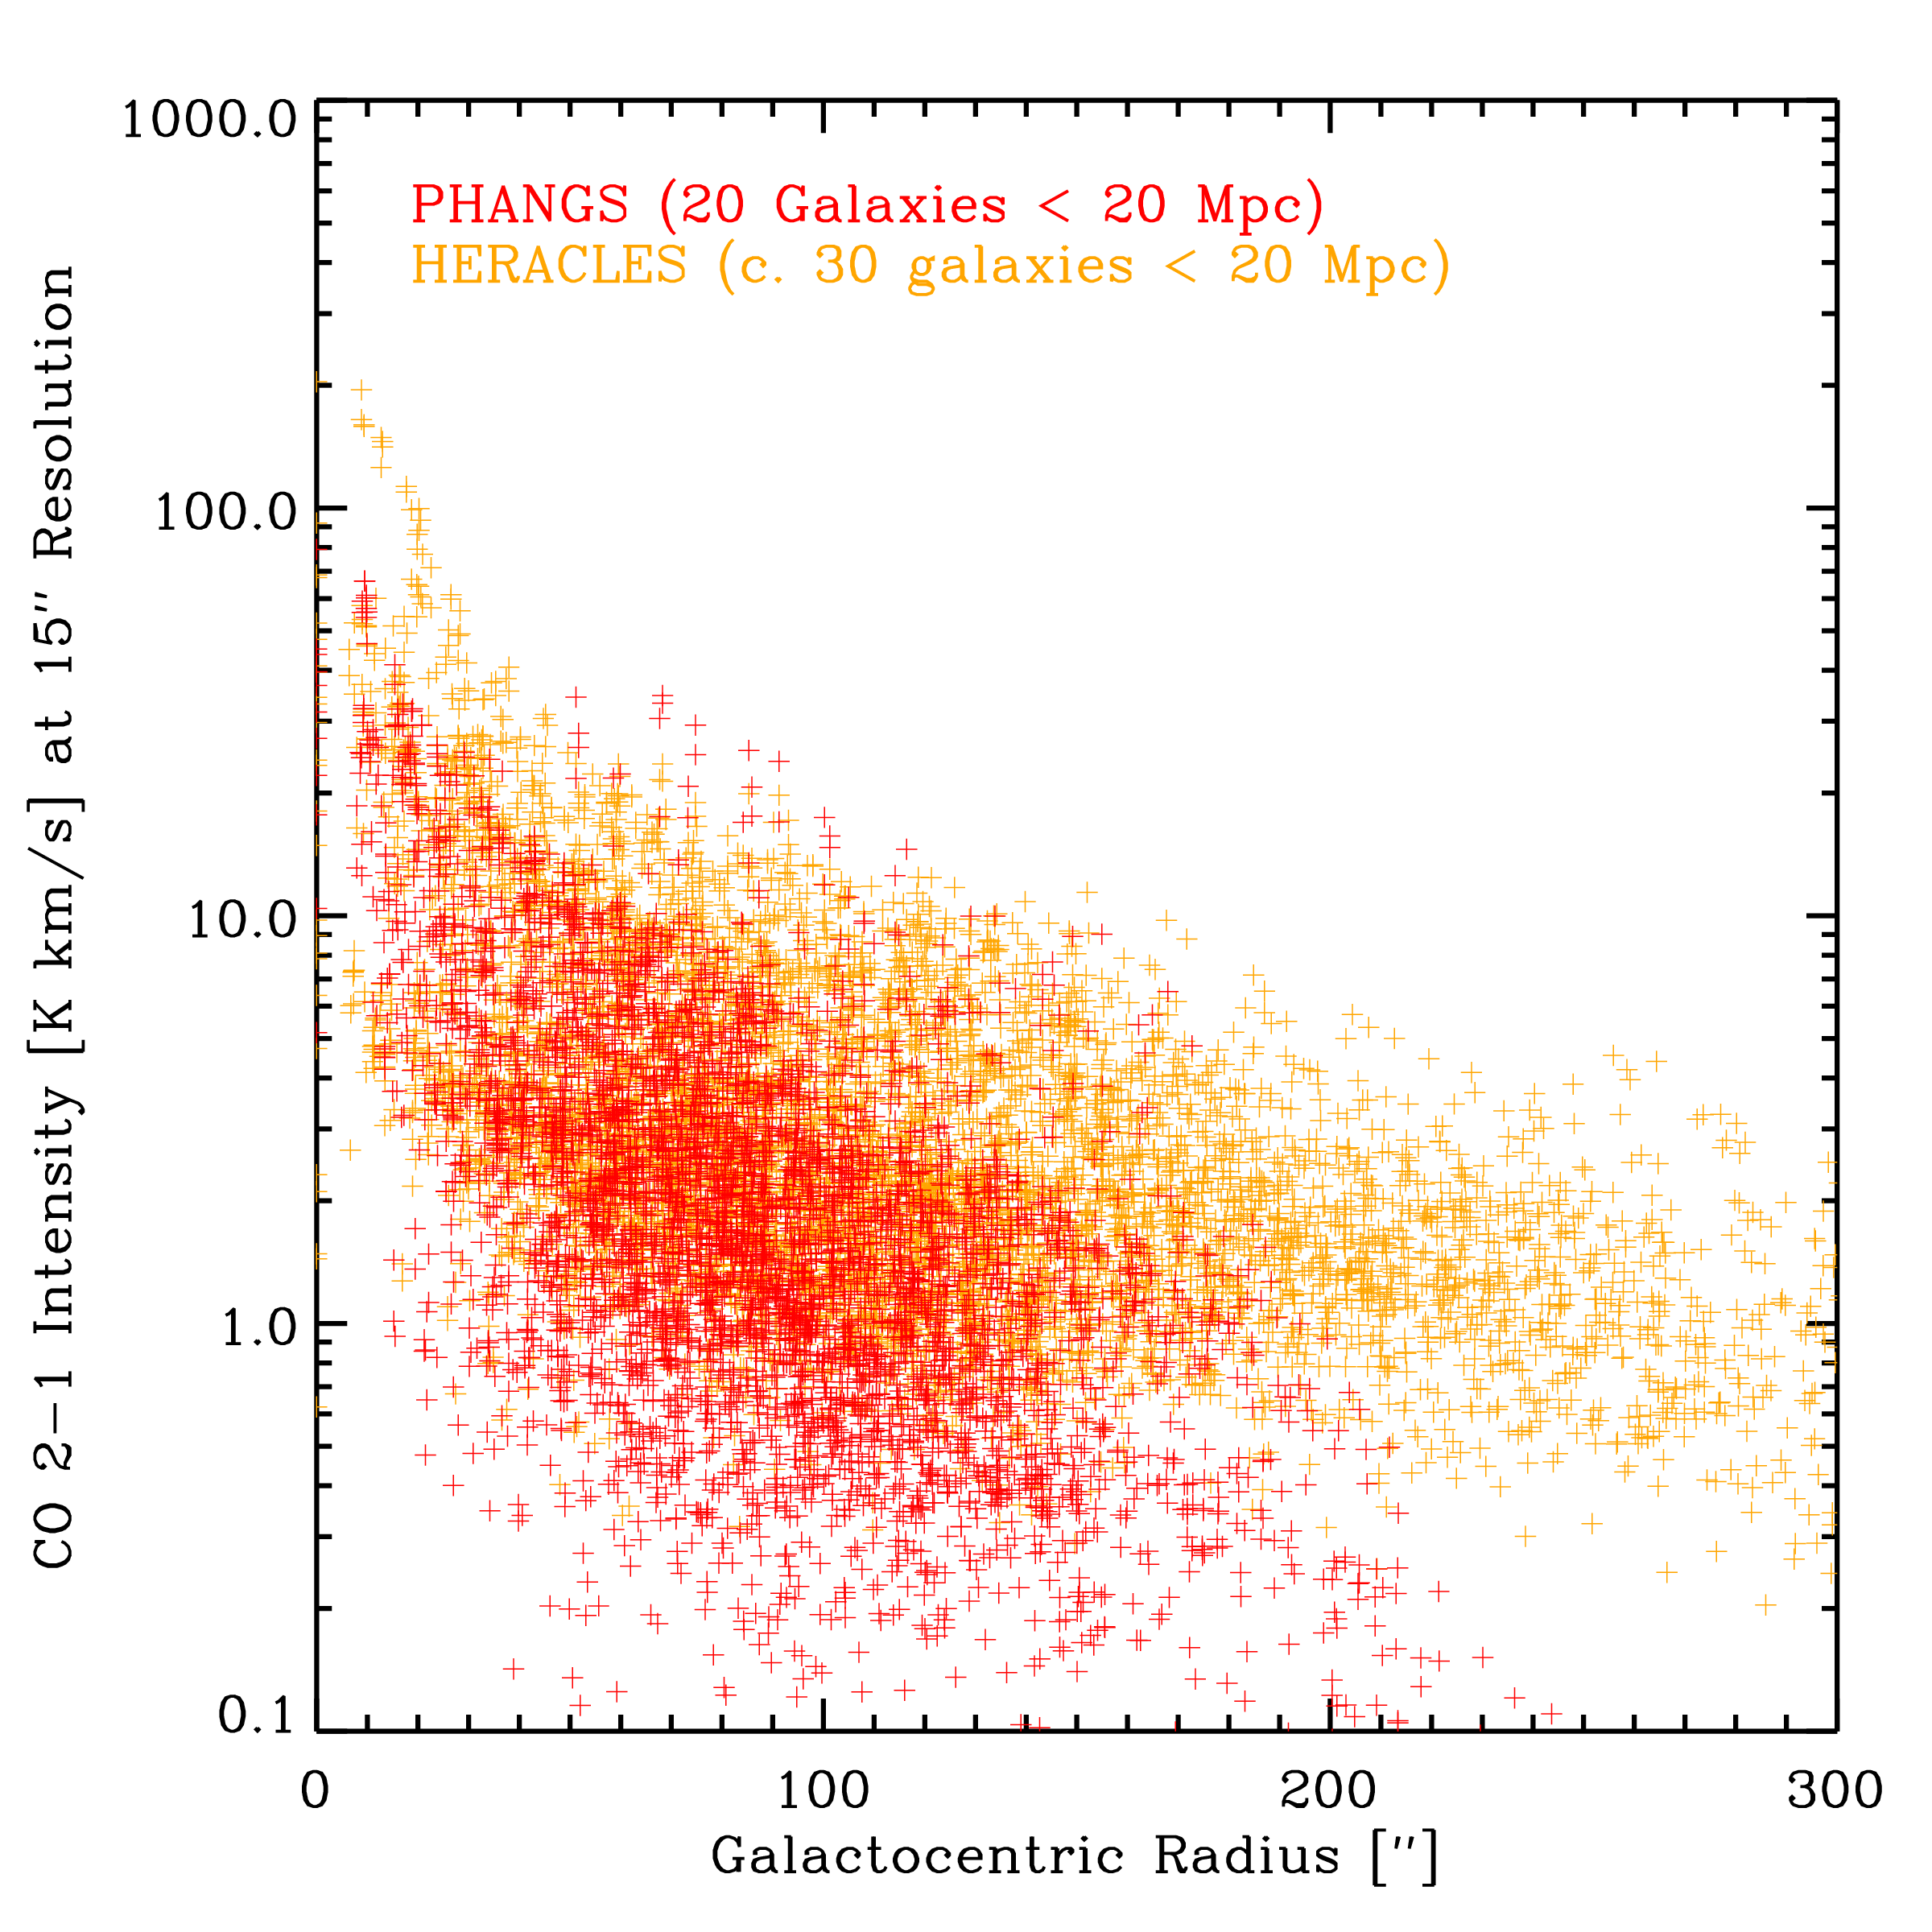
Sensitivities would need to be on the order of ~0.1 mK per 25km/s.
Line widths ~25km/s
HCN/CO ratio ~0.01 (disk) to 0.1 (center)
0.1 mK to 1mK per 25km/s
Stacking could enable deeper detections.
5’
Figure courtesy Adam Leroy

Slide 16
Re-cap
Quantifying the relationship between dense gas and star formation under a wide range of physical conditions is a key step towards understanding star formation.
Mapping dense gas in nearby galaxies allows us to probe a wide range of physical conditions with good spatial resolution.
The GBT has the sensitivity and resolution at 4mm to be extremely competitive with other instruments operating at this frequency.
Multi-pixel receivers like Argus significantly increase the mapping speed of the GBT.
DEGAS will use the combination of GBT+Argus to do the largest resolved survey of dense gas in nearby galaxies to date.
Even larger 4mm arrays are possible enabling us to map dense gas across the entire disks of ~100 of nearby galaxies.

