Slide 1
Large bolometer arrays on radio telescopes.
Simon Dicker

Slide 2
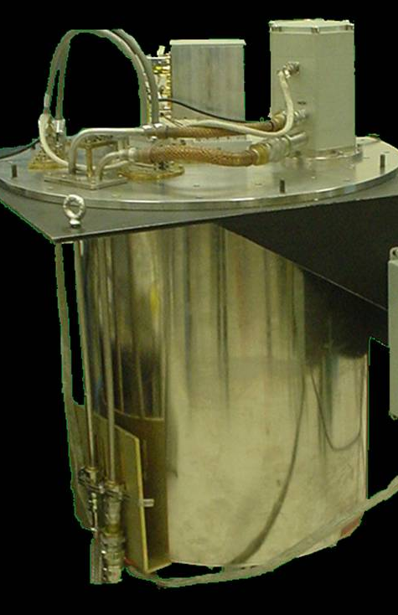
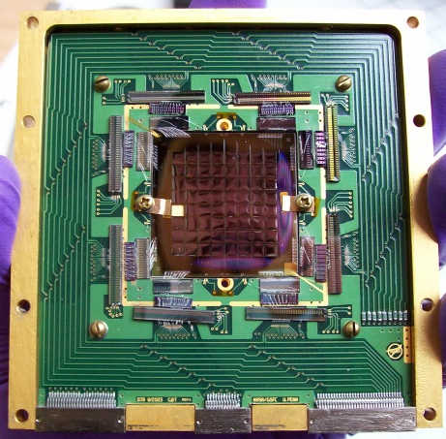
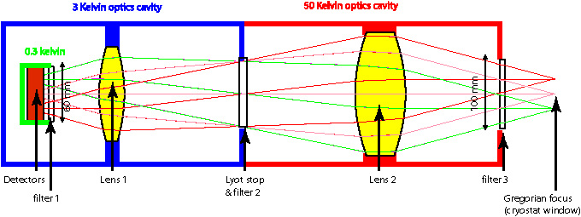
MUSTANG
MUSTANG
  64 absorber coupled TES bolometers
  45” field of view
  Cold reimaging optics
  Bare pixels (0.7 f*lambda)
  Time Domain multiplexed readout
  300mK cryogenics running off a PT405
On GBT 2006
Replaced by
MUSTANG2

Slide 3
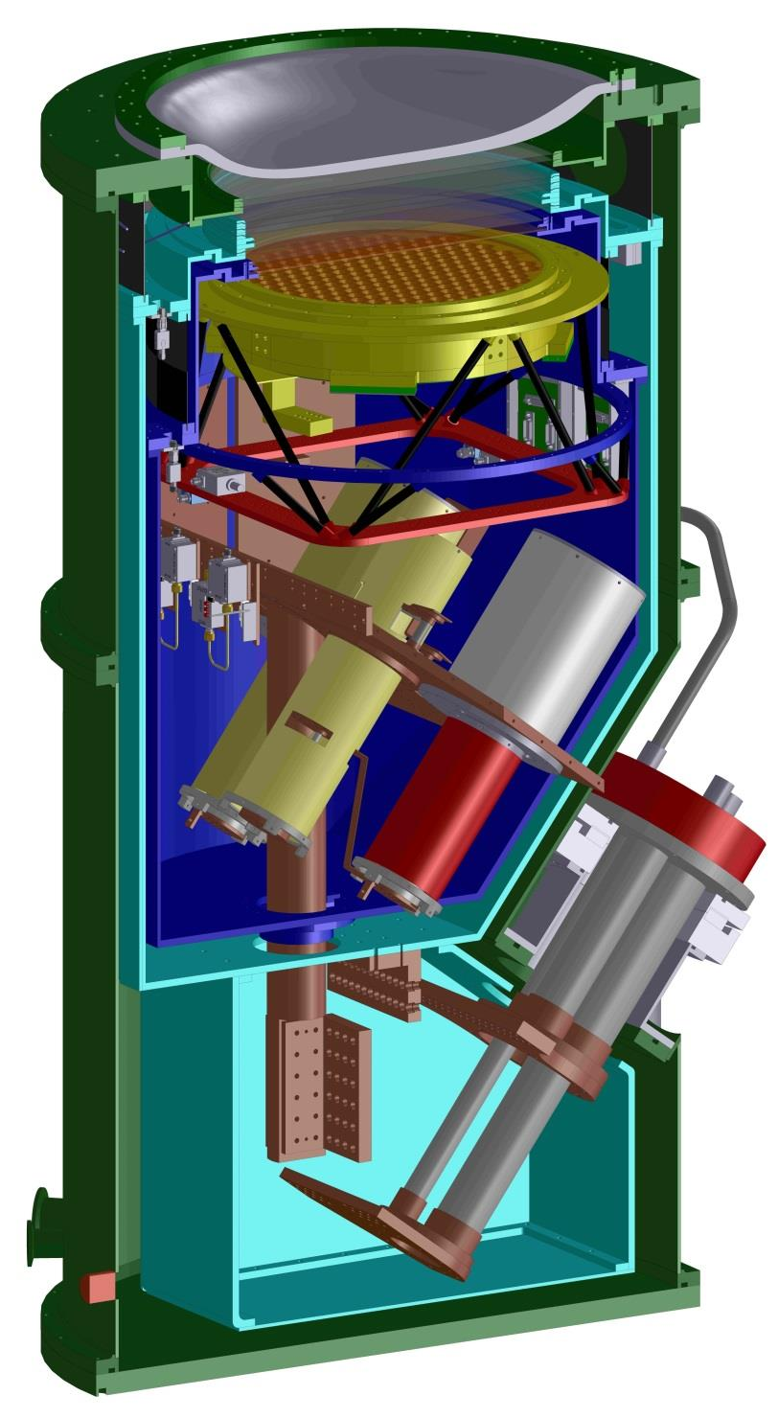
MUSTANG 2
20 inches
AR coated UHMWPE window (large)
Filter Stack (a lot of optical power to block)
Feedhorn array (300mK) 4.2’ fov, f1.94 feeds.
uMux readout
Helium-4 sorption refrigerators
(angled for better thermal stability with elevation – requires turret rotator)
Helium-3 sorption refrigerator (300mK)
Future arrays may have to be colder
PT 410 pulse tube from cryomech
(1W cooling at 4.2K; 30W at 40K)
Pushes limits of GBT compressors
Installed on GBT 2014

Slide 4
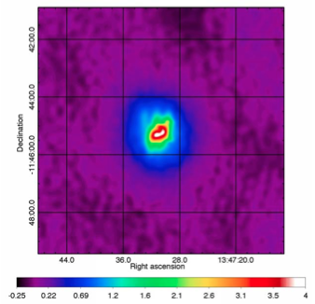
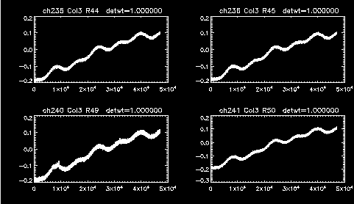
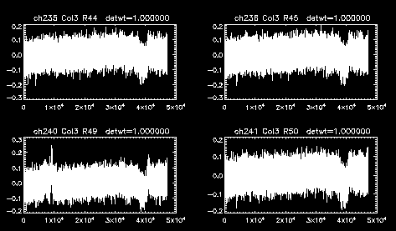
Large arrays on large telescopes
Large telescopes can see the details others cannot.
Large field-of-views very powerful at removing atmospheric foregrounds.
This comes at the expense of loosing structure larger than the array.
Currently we do not make full use of the GBT’s field of view.
Large arrays are easy to build with bolometers
With background limited detectors very high mapping speeds possible – with 80,000 detectors =>
Few µK /beam/second
PLANK Beam (143 GHz)
ACT beam (145GHz)
MUSTANG 2 Beam
MUSTANG 1 fov
MUSTANG 2 fov
0.85 Strehl limit at 90GHz
Real M2 timestreams simple common mode subtraction

Slide 5
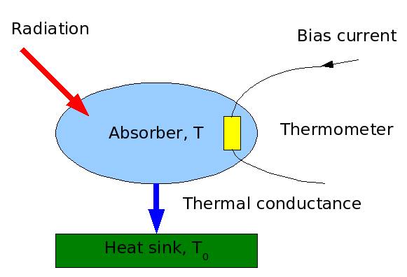
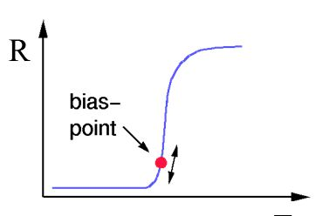
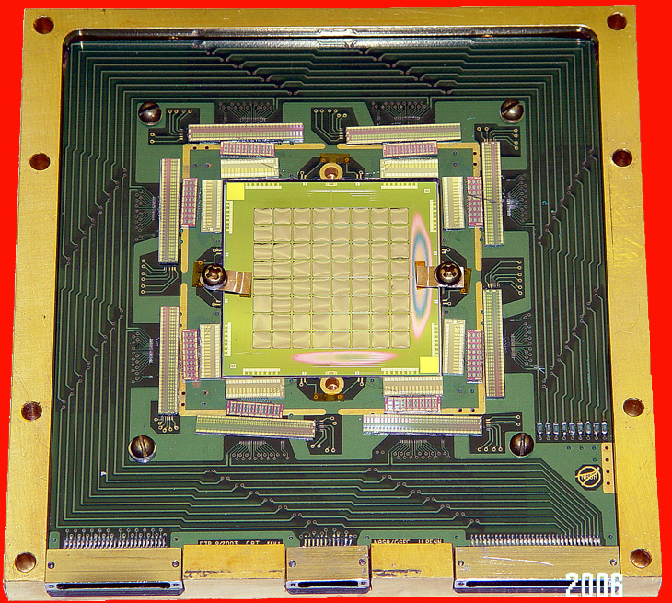
Bolometers
Simple operation – absorb the power, measure the temperature
Absorbs all wavelengths, need filters to define band
Use Heat sinks from 4K to 100mK
Originally used NTD thermometers
Currently nearly all mm and submm bolometers use Transition Edge Sensors (TES)
  Can be made in large quantities
  Electrothermal feedback => fast time constants
TES sensors = voltage biased superconductor
Bi covered 1µm thick absorbing membrane
10µm thick legs
TES sensor
3.3mm
Silicon frame
MUSTANG bolometers (original design)

Slide 6
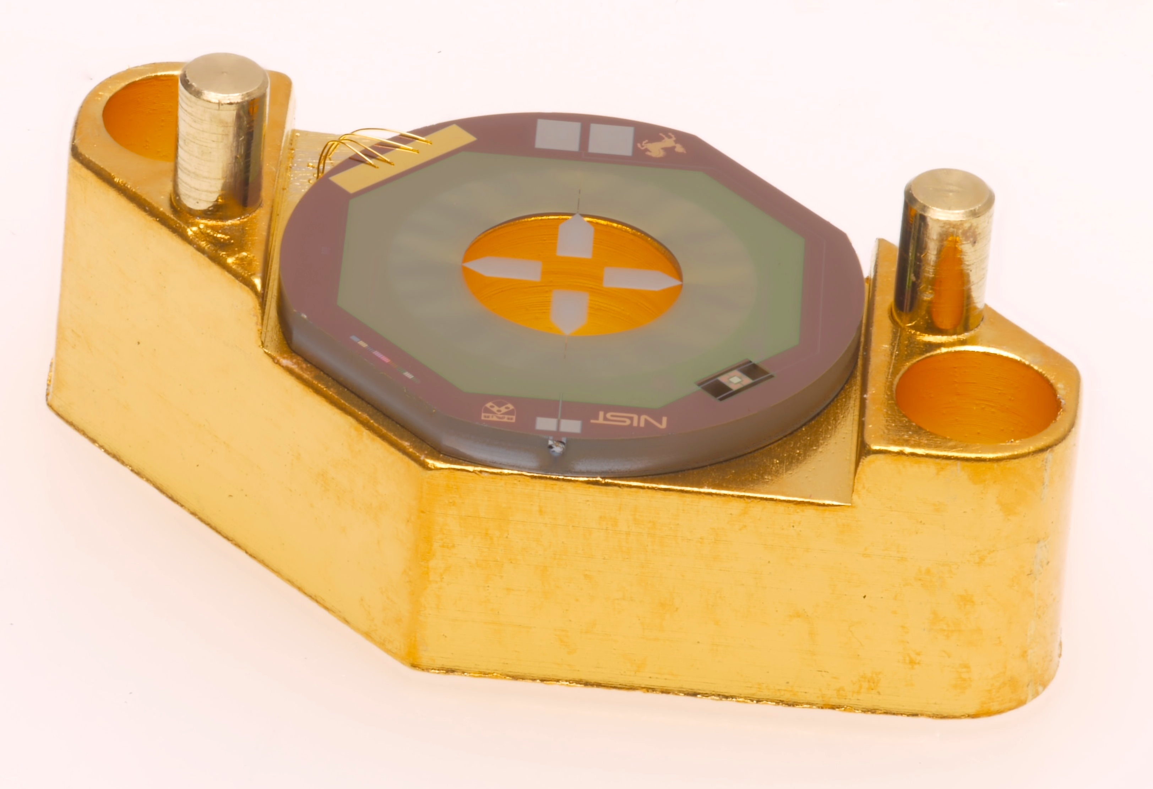
Bolometers – MUSTANG vs MUSTANG2
3.3mm
7 mm
MUSTANG (similar to ACT)
Large membranes => extra noise
  Susceptible to vibrations (V. high Q)
  Significant internal thermal barriers
Easily damaged (95% yield)
Half f*lambda spacing makes noise targets harder to meet
MUSTANG2 (similar to ACTpol)
Fits behind feedhorn.
Planar OMT couples radiation to much smaller TES island via microstrip.
Individual pixels allows us to pick and chose bolometers
Much more robust design.

Slide 7
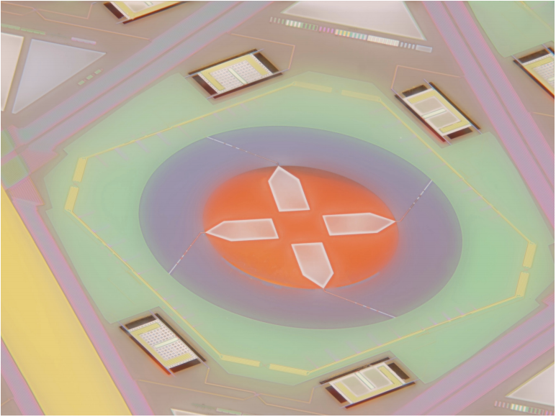
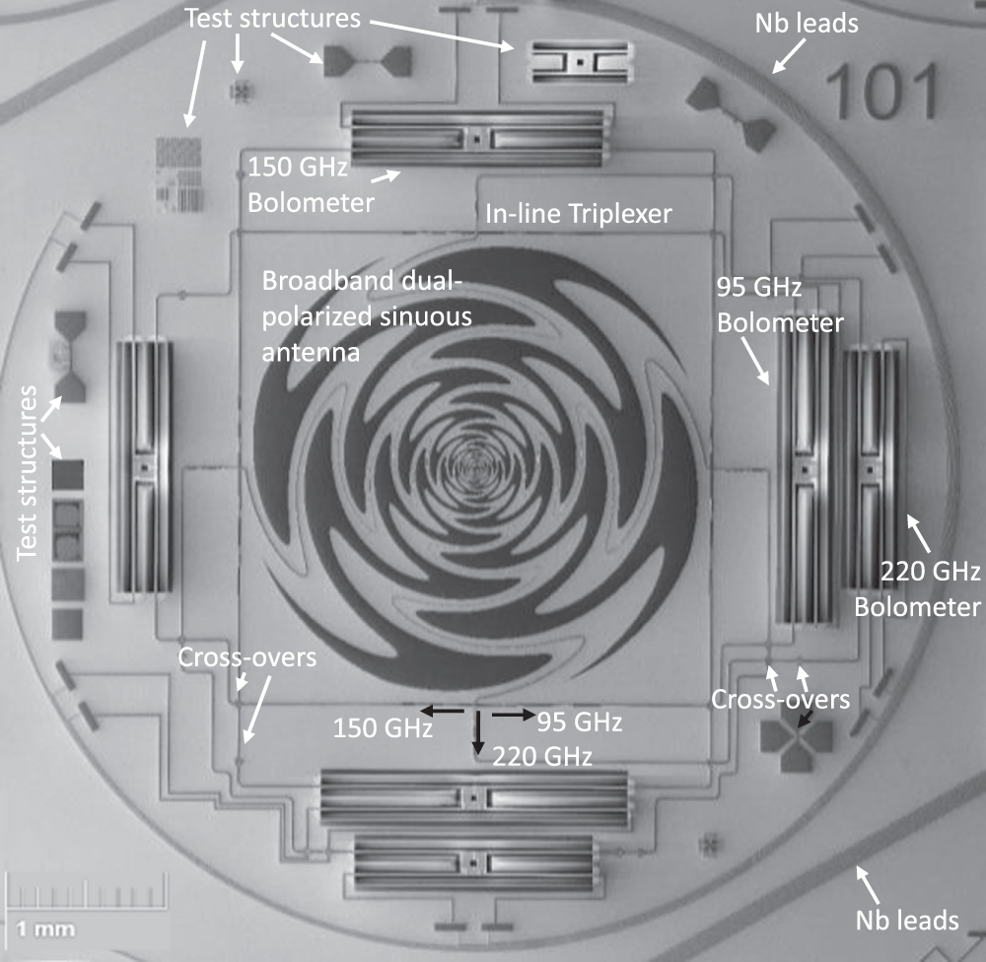
Bolometers – latest.
150 GHz Ex
150 GHz Ey
90 GHz Ey
90 GHz Ex
Photo – Advanced ACT
Photo – SPT collaboration
Same microstrip to small bolometer islands
OMT or Planar antenna & lenslets
Multiple bands/polarizations using microstrip filters.
Lots of work being done (by others)
Heat pumps on bolometer legs. (can run off warmer baths)
Hot electron bolometers
Deployments
ACT / SPT : ~3000
Advanced ACT / SPT 3G : ~10 000
Simons’ Observatory : 80 000
CMB stage 4 : 250 000 bolometers
Cost per detector/readout is dropping (less $1/pixel inc readout)

Slide 8
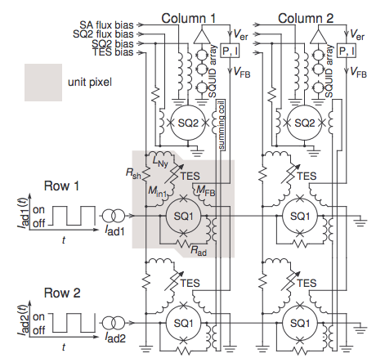
Multiplexing Readout
3 common Types:
Time domain
Frequency domain
uMux
Read out one row at a time at kHz rate.
Num wires ~sqrt detectors
  1 pair wires / row
  1 pair wires /col
  Extra wires for detector bias
~1000 detectors /readout
Feedback to keep SQUID amplifiers on sensitive part of their curves.
Used by MUSTANG and ACT
2 by 2 mux layout

Slide 9
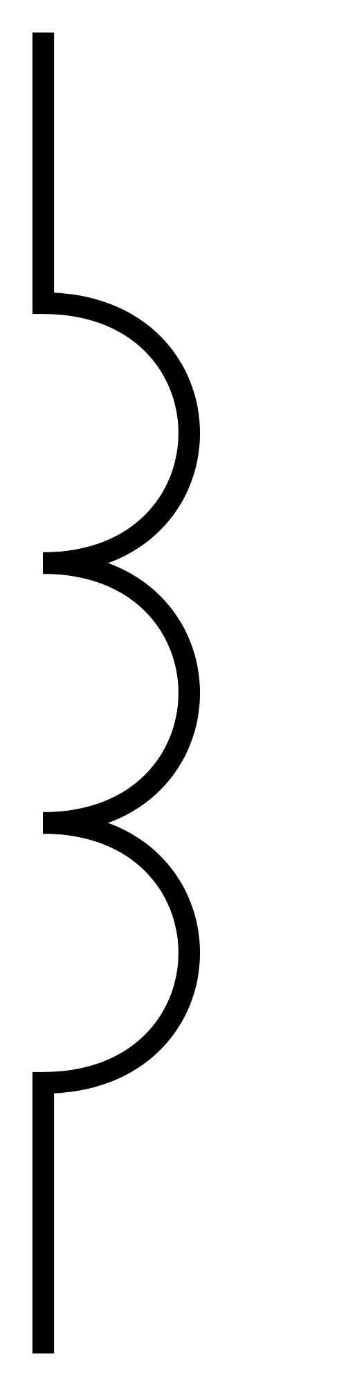
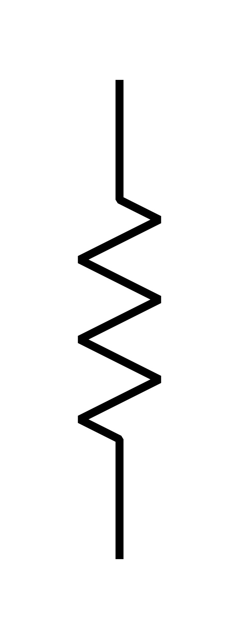
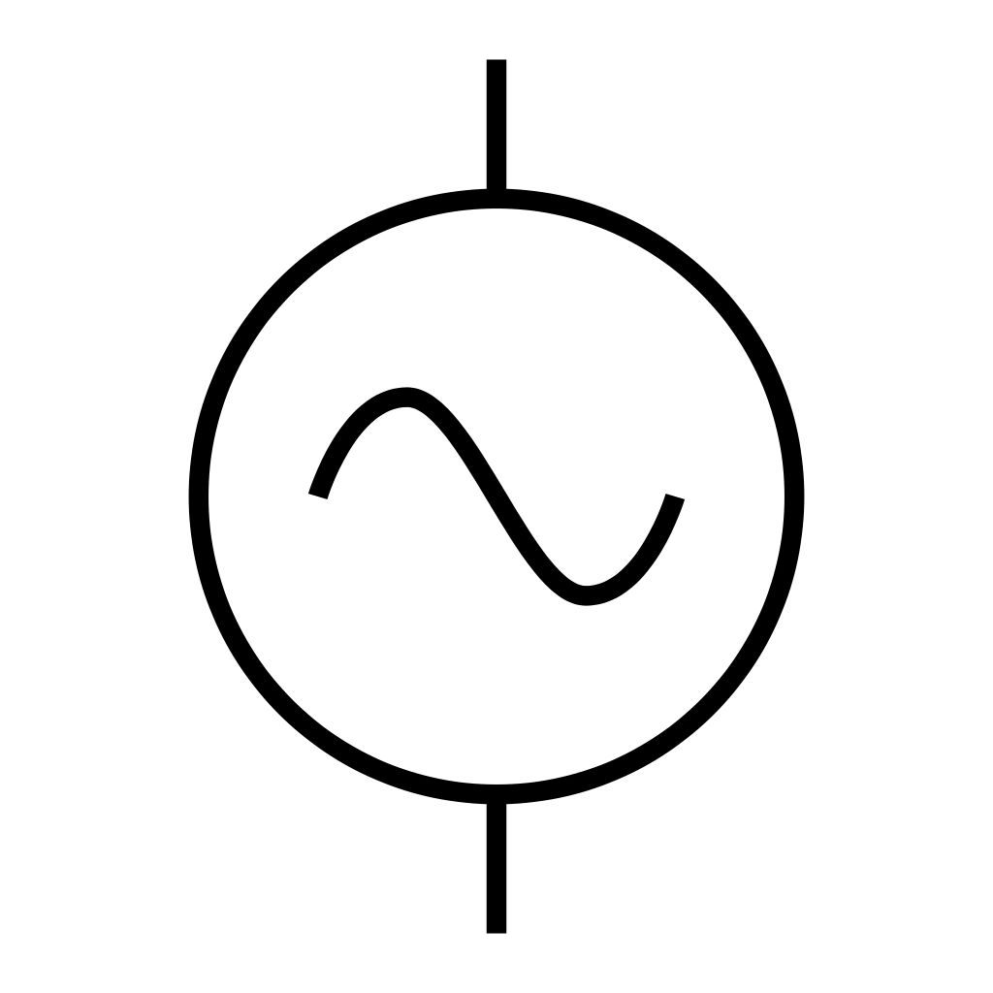
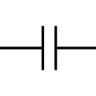
Multiplexing Readout
3 common Types:
Time domain
Frequency domain (SPT)
uMux (NIST)
Each Bolometer bias has different filter in MHz range.
Room temperature electronics generate tone for each resonator
Currently 68 bolometers / 4 wires
No Fundamental limit on number of detectors
In practice stray capacitance/inductance limits number of detectors that can be multiplexed.
Used by SPT/POLARBEAR
Working on 128 bolometers for Simons Observatory
Shunt resistor
TES bolometers
A
250 mK
4 K
300 K

Slide 10
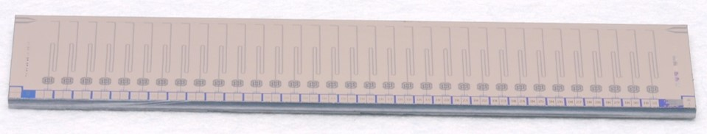
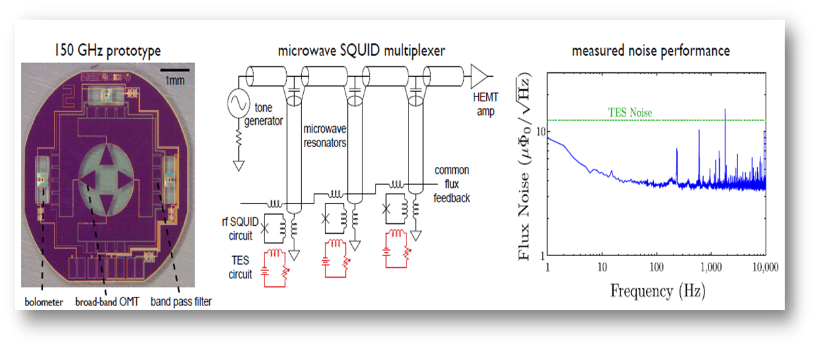
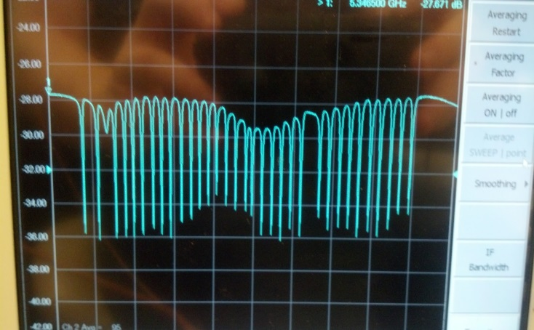
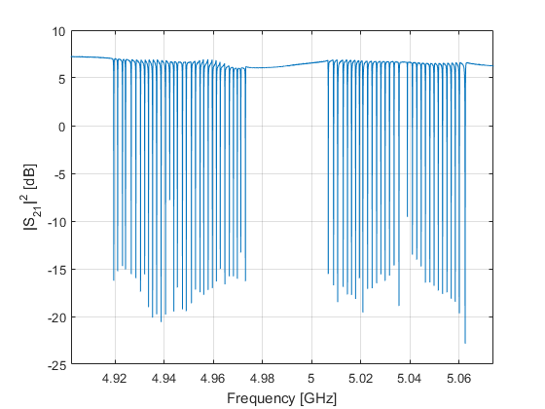
Multiplexing Readout
3 common Types:
Time domain
Frequency domain (SPT)
uMux (NIST)
Each bolometer coupled to microwave resonator with a slightly different frequency.
Measure phase changes using a comb of frequencies (4-8GHz) => readout with single pair of coax
Also need flux ramp and detector bias wires (one per array).
MUSTANG 2 : 64 channels/coax pair
MUSTANG 2 w. new mux chips – 256 channels/coax pair (512MHz bandwidth)
Simons’ Observatory 2000 channels/coax pair
MUSTANG2 style 32 resonator chip
MUSTANG2 6GHz spacing
New 1.8GHz spacing

Slide 11
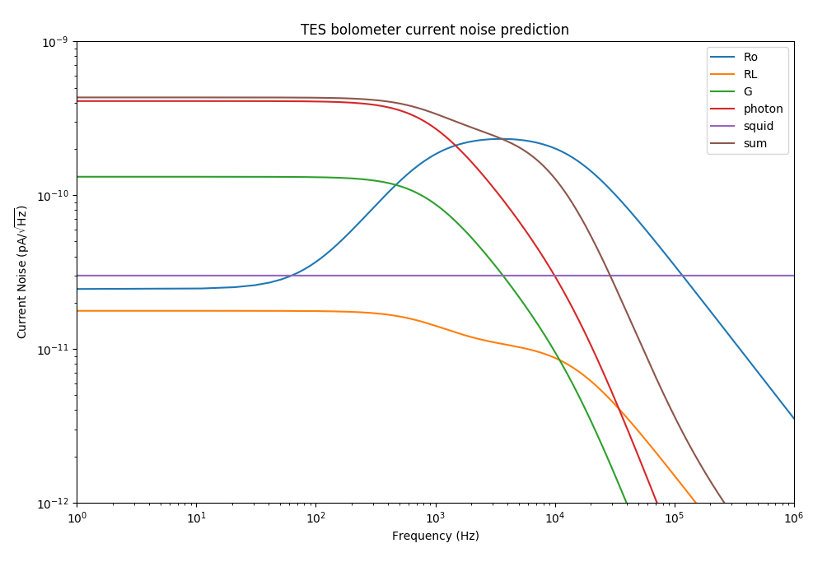
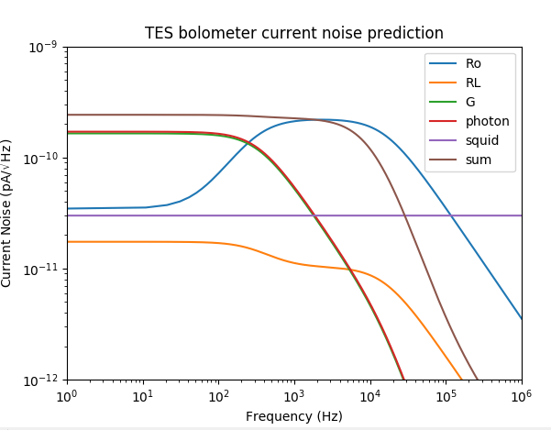
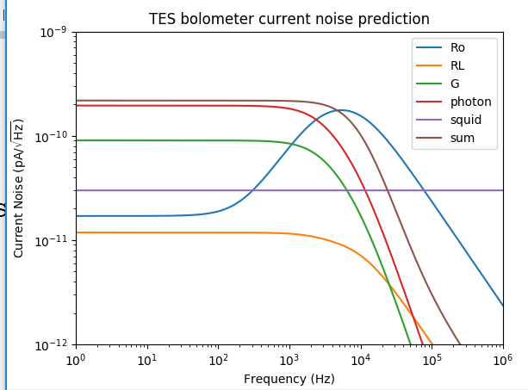
Bolometer design & cooling
Ideal bolometer has noise dominated by atmosphere (easier at GBT than in space). (right)
As band is divided up loading decreases. (bottom)
Loading also decreases at lower frequencies and splitting polarizations.
At some point you need a lower base temperature – most CMB experiments have moved onto 100mK cryogenic systems. (bottom right)
Can we get 100mK on the GBT?
GBT Signal band
30GHz band, dual pol, Tc=450mK
2GHz band, single pol, Tc=450mK
2GHz band, single pol, Tc=200mK
(software to produce the plots from Hannes Humbuyr - NIST)

Slide 12
Possible ideas
K-band MUSTANG2
  Replace the array, & filters. Rest of hardware stays the same.
  Can swap arrays for summer/winter.
R=few “spectrometer” array
  Splitting the bands would give you a spectral index map as well as intensity with no noise penalty.
  Current backend could readout 1024 bolometers.
  Band variation could be an issue.
Polarization
  Calibration angle could be tricky – how well do we need to know this?
Use the full field of view (~10’ would require ~24” window)
  Would have to “overflow” the 24” turret slot

