Slide 1
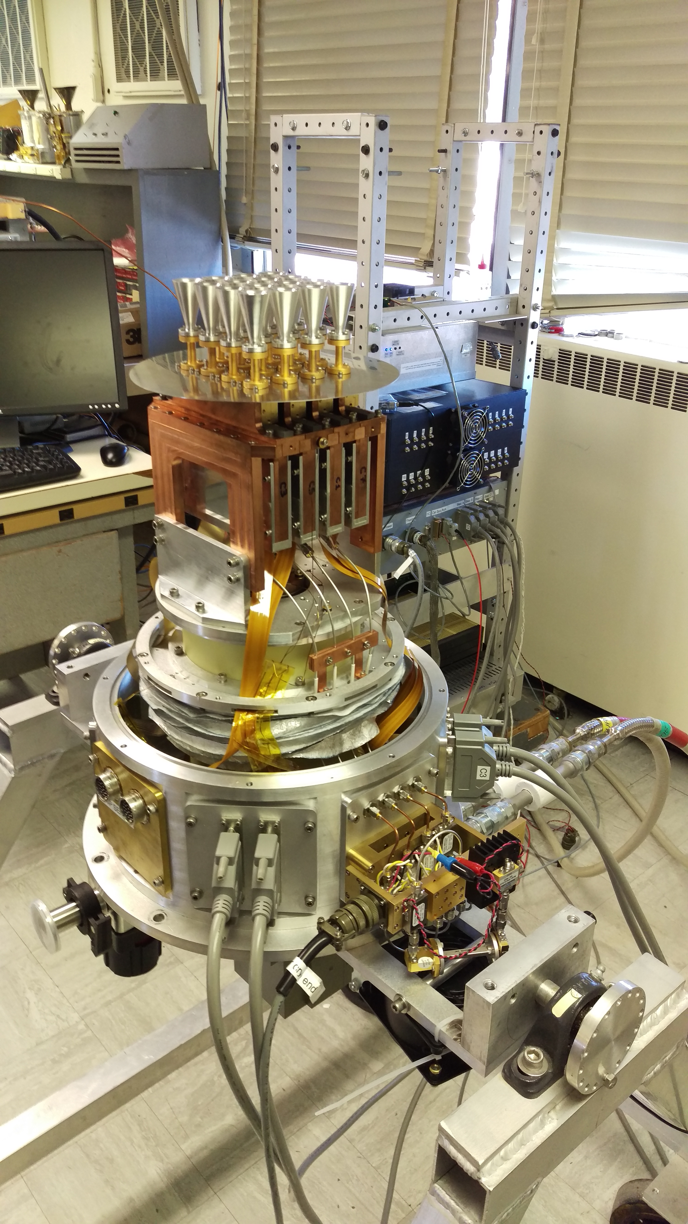
Large-Format Conventional Feed Arrays on the GBT
Sarah Church¹, Kieran Cleary²
¹Stanford University
²California Institute of Technology

Slide 2

16-element, 76-115.3 GHz
Uses InP low noise HEMT amplifier MMIC chips (Northrop Grumman)
Designed to be highly scalable
Commissioned at GBT in 2016
Uses the VEGAS spectrometer

Slide 3
The Argus Instrument Team
Stanford
  Sarah Church (PI)
  Dongwoo Chung (grad student)
Caltech
  Kieran Cleary
  Tony Readhead
JPL
  Todd Gaier
  Lorene Samoska
  Pekka Kangaslahti
  Rohit Gawande
  Paul Goldsmith
U. Maryland
  Andy Harris
U. Miami
  Josh Gundersen
GBO
  David Frayer
Former Team Members
  Matt Sieth (Stanford)
  Kiruthika Devaraj (Stanford)
  Judy Lau (Stanford)
  Rodrigo Reeves (Caltech)

Slide 4
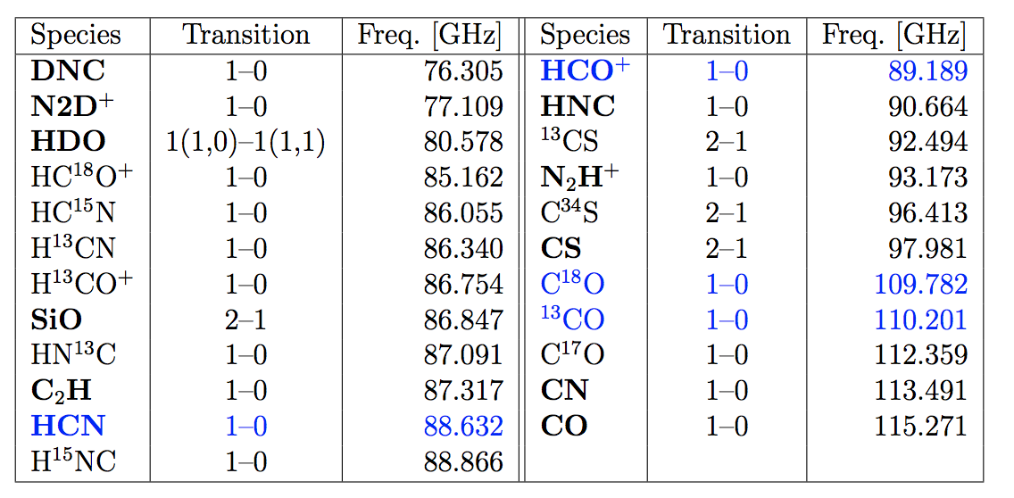
Line Coverage
Notes:
The 3mm atmospheric window and important astronomical spectral line transitions. The atmospheric transmission in percent for Green Bank is given by the blue curve for an elevation of 90 and the red curve at 30. The solid black curve systematically decreasing with frequency represents the aperture efficiency of the GBT assuming the current surface performance of 240μm rms. Important astronomical lines are labeled. Argus array will cover frequency range from 85–116 GHz which includes the important dense gas tracers of HCN, HCO+, HNC, and N2H+ at around 90GHz as well as the brightCO lines at 110–115 GHz.

Slide 5
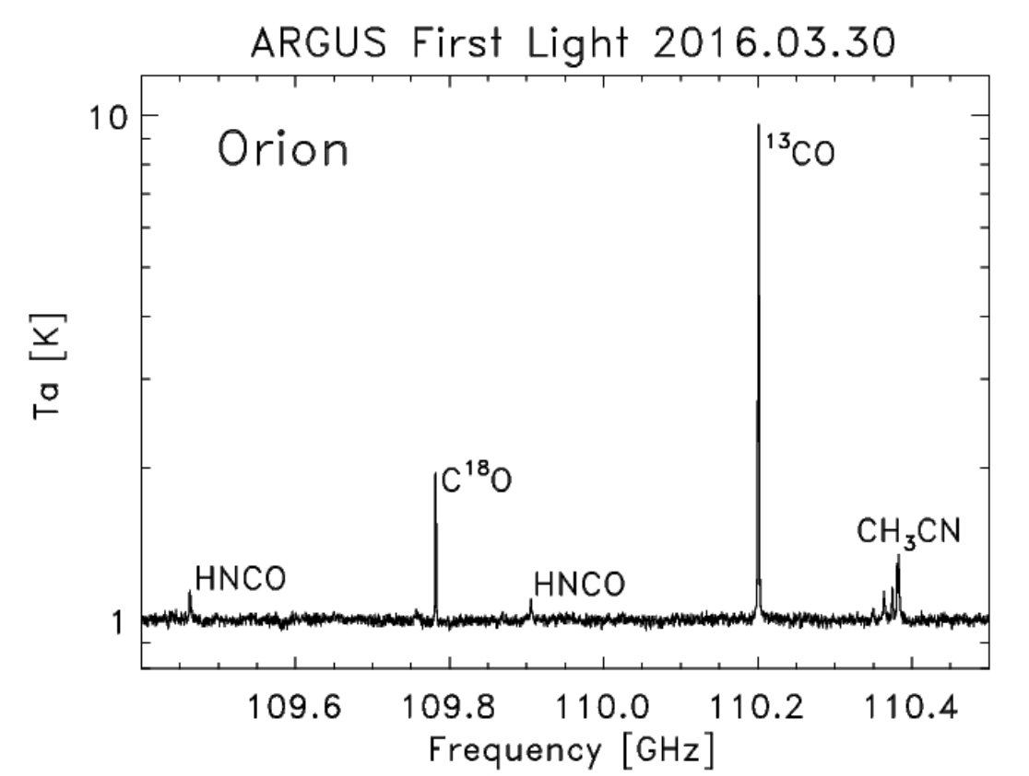
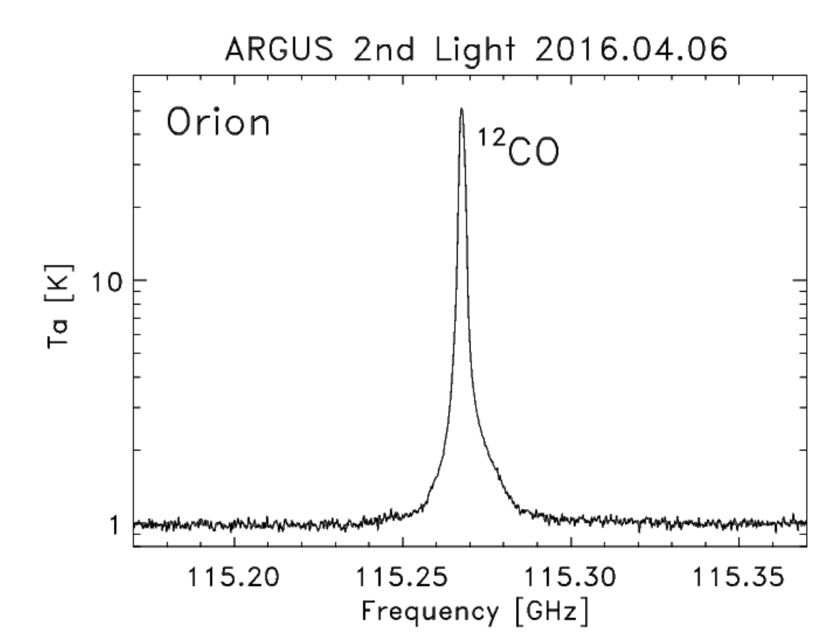
First light spectra Spring 2016
DR21 in 13CO
40 minutes Opacity = 0.42
-- D. Frayer
First GBT spectrum above 100 GHz

Slide 6
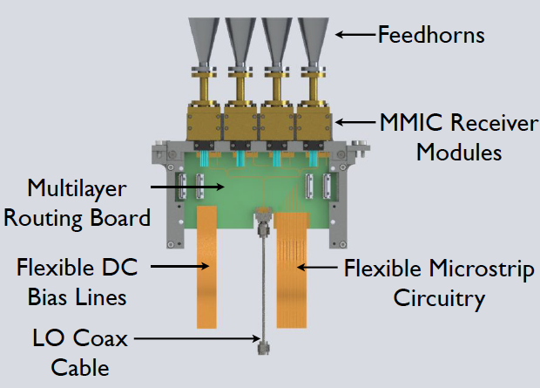
Argus is a prototype, designed from the beginning to be scalable to a larger instrument

Slide 7
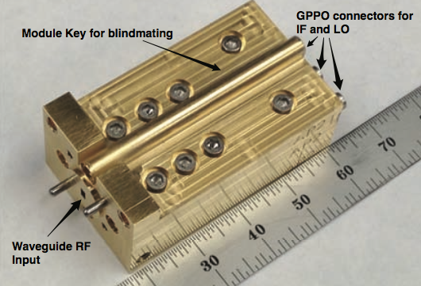
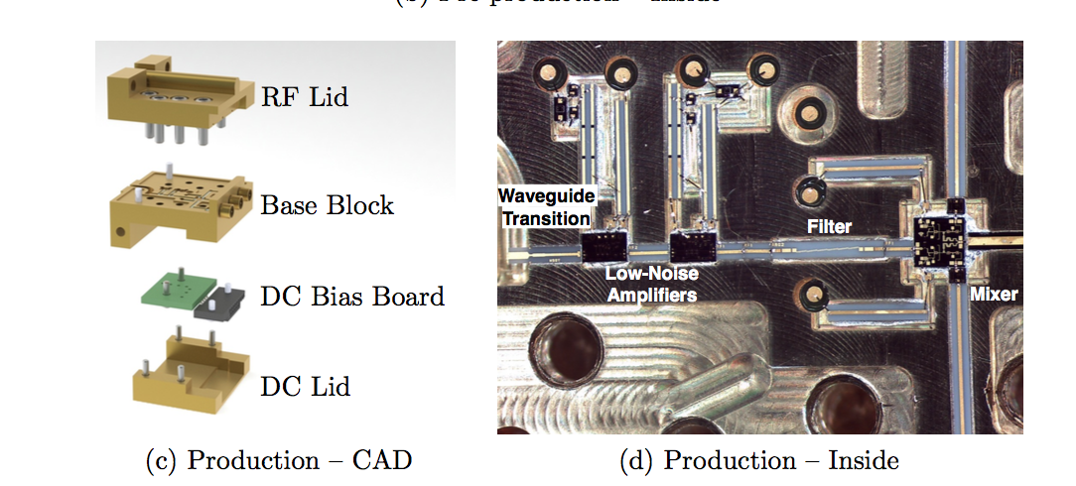
Argus LNA Modules
I
Q
Shottky IQ Mixer
LO

Slide 8

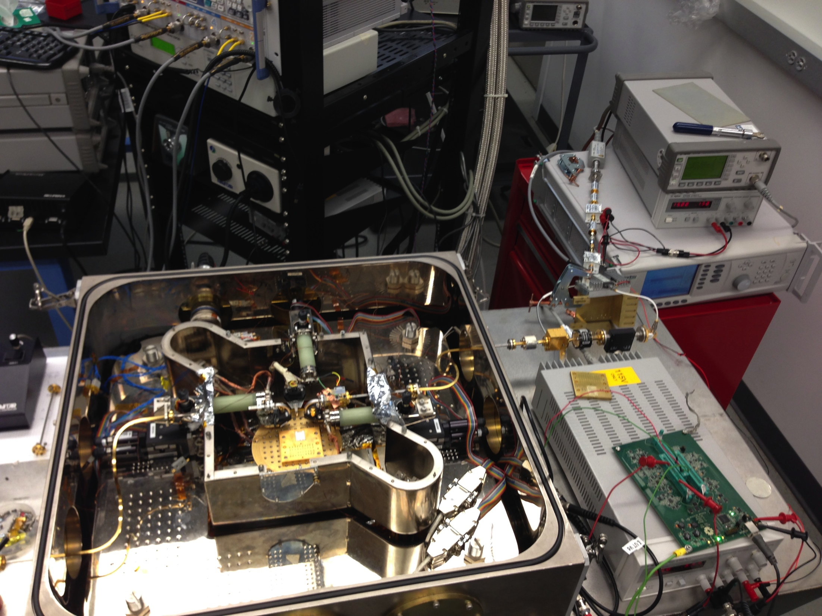
Caltech Cryogenic Probe Test Station
CRAL – CAHILL RADIO ASTRONOMY LAB
Rapid characterization of MMIC LNAs cryogenically using wafer probes
WR-10 service loop
Probe
positioner
shield
WR-10 service loop

Slide 9
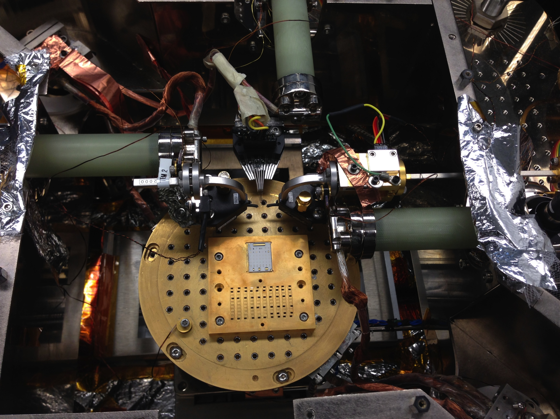
Caltech Cryogenic Probe Test Station
CRAL – CAHILL RADIO ASTRONOMY LAB
Isolator &
RF amplifier
G10
DC probe
Heated
termination
Wafer probes
Calibration substrate
Chip carrier
Thermal strapping

Slide 10
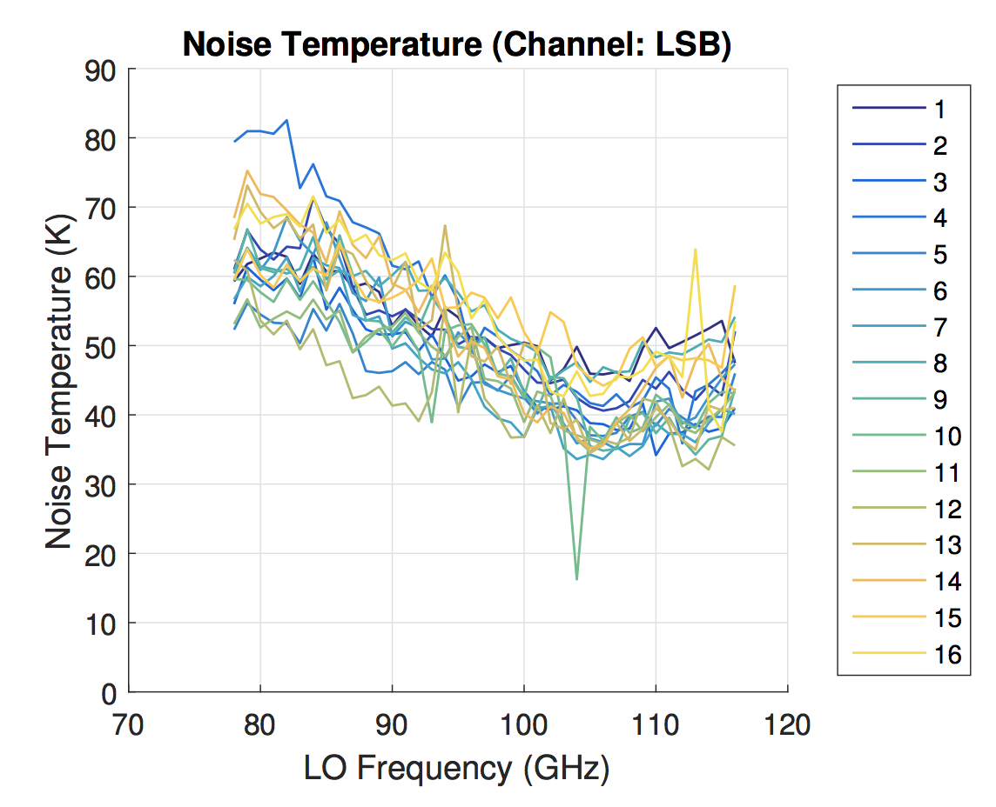
Argus receiver temperature (lab)
Argus LNA

Slide 11
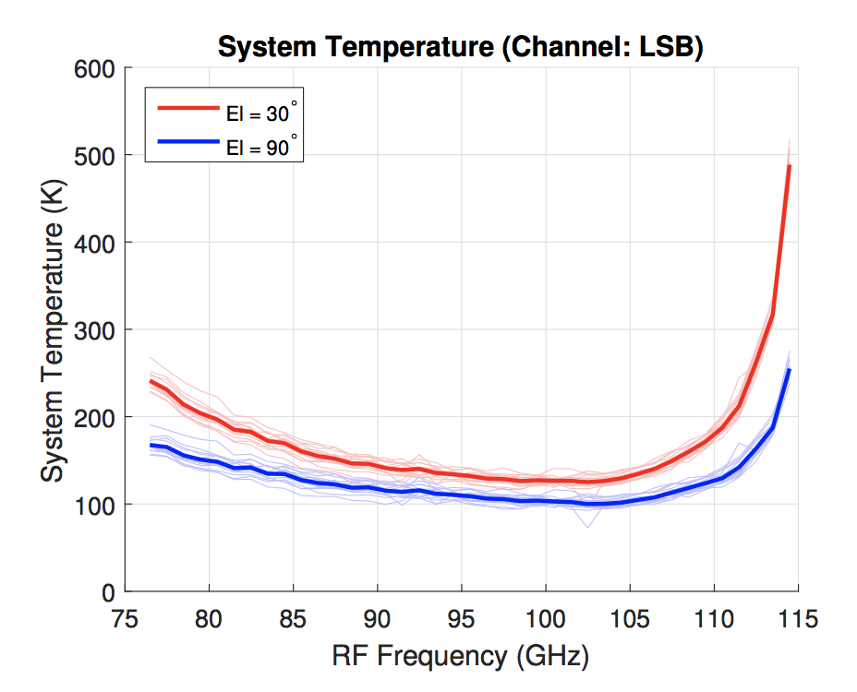
Performance on the GBT

Slide 12
Beyond Argus
Argus is a successful demonstration of a scalable design
Next generation array
  144 pixel design scaling Argus technology
  Better LNAs for flat performance across the full 75-115.3 GHz band
Longer term
  A backend with wider instantaneous performance (Argus has 10 GHz bandwidth c.f. 1.5 GHz for VEGAS)
  Further miniaturization of receiver modules for closer packing => 800 pixels

Slide 13
CRAL – CAHILL RADIO ASTRONOMY LAB
Newer LNAs have more uniform performance across the band

Slide 14
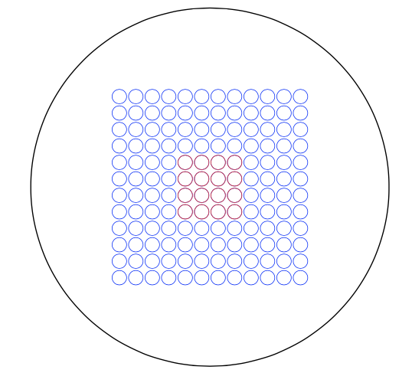
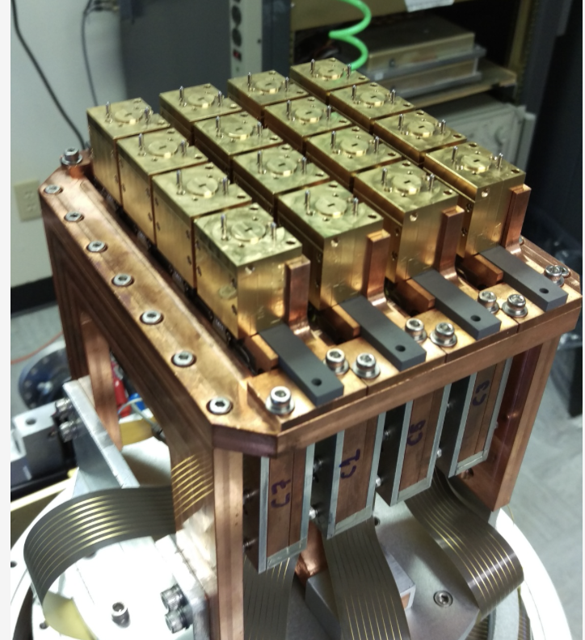
Argus +
Existing array technology would scale to 144 pixels without the need for additional R&D
24” turret
6 arcmin
12”

Slide 15
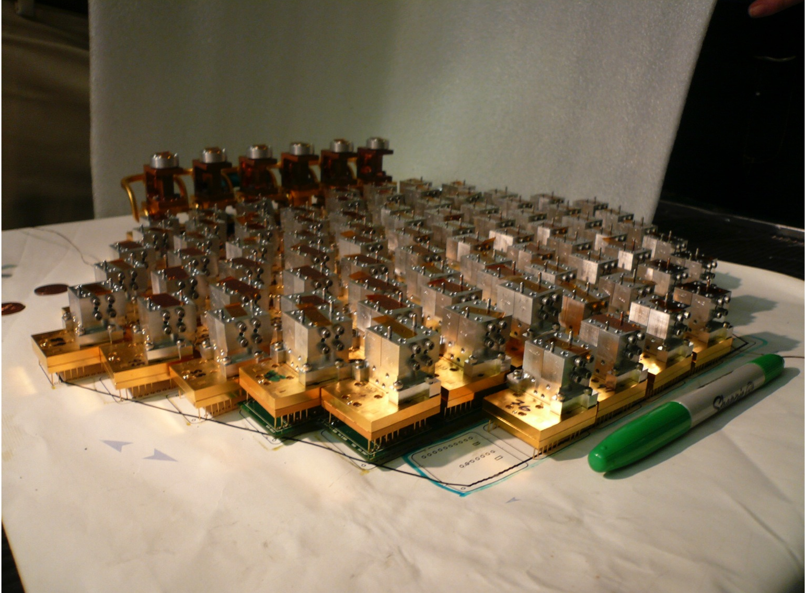
Focal Plane Arrays
CRAL – CAHILL RADIO ASTRONOMY LAB
Q/U Imaging ExperimenT (QUIET)
91 elements at 100 GHz (19 elements at 40 GHz)
83-103 GHz
100 nm amplifiers

Slide 16
Wider Band Spectrometer would Allow Simultaneous Observations of Multiple Lines
12CO
HCN
HCO+
13CO
C18O
Promising broad-band technologies are becoming available

Slide 17
Beyond Argus +? 800 pixels?
Closer packing
New design for LO distribution

Slide 18
Alternate LO distribution scheme
GEOSTAR – JPL mission
144 elements at 180 GHz
Earth-sensing, room-temperature,
0.5 GHz bandwidth
35nm amplifiers
LO distribution through waveguide manifold
LNAs + IQ mixers

Slide 19

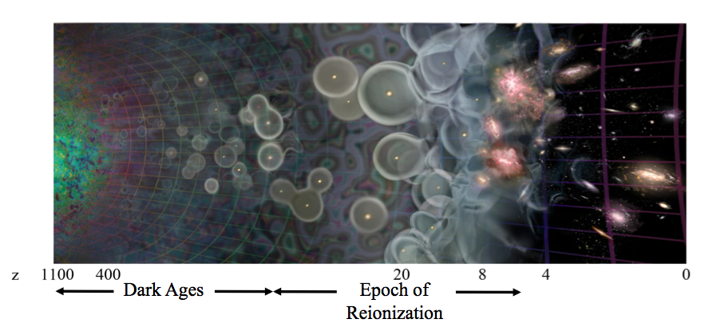
Ka Band Focal Plane Array
CRAL – CAHILL RADIO ASTRONOMY LAB
Loeb, A., “The Dark Ages of the Universe”, Scientific American, Vol 295, 2006
CO-Mapping Array Pathfinder (COMAP)
19 elements at 30 GHz
26-34 GHz
35nm amplifiers

