Slide 1
Gas and Star Formation in Galaxies:
Why we need a large single-dish and how the GBT should be retooled as an exciting new observatory
Alberto Bolatto
University of Maryland

Slide 2
Are Single-Dishes Necessary?
Interferometers excel at: point source sensitivity, high resolution
They are terrible at: surface brightness sensitivity, field of view
Precisely where a SD can excel!
Moreover, interferometers are extremely complicated and cumbersome: new instrumentation and rapid response pose extremely hard cost and logistical challenges
YES!

Slide 3
Role of a Single Dish
Mapping Speed
Multipixel receivers and bolometers cover large areas quickly with good surface brightness sensitivity
Required for Milky Way GMCs, nearby galaxies, circum-galactic medium, galaxy clusters, large-area blind surveys
SD multipixel backends are inexpensive, large bandwidths are simpler
Spatial Dynamic Range (context)
SD like the GBT can capture scales from 0.1-100s of pc, essential to understand the star formation process and ISM structure
Required for resolving substructure while covering entire galaxies, galaxy clusters, etc
Exploration
New/visiting instruments, rapid response, speculative projects, wide-area surveys

Slide 4
But Why Are These Capabilities Interesting?

Slide 5
Gas and Star Formation in Galaxies I
Madau & Dickinson (2014)
Most stars formed by z~1
Galaxies underwent a burst of growth at z~1-3: z~2 galaxies look very different from today’s
The volume density of SFR has decayed an order of magnitude since its peak
How did this process work?
How did galaxies acquire the properties we see today?

Slide 6
Gas and Star Formation in Galaxies II
Lilly et al. (2013)
Withaker et al. (2012)
Most galaxies populate a tight main sequence in the SFR-M* plane
The “growth spurt” moves this sequence
This points to self-regulated secular evolution
What causes the evolution of the main-sequence?

Slide 7
Gas and Star Formation in Galaxies III
Star formation happens in dense molecular gas
Gas consumption timescales for the molecular reservoir, 𝛕_{dep}=M(H₂)/SFR, are short (<<𝛕_{Hubble}), requiring HI→H₂ and accretion
How does the regulation work?
CO
HI
kinematics
stars
SFR
Images from HERACLES (Leroy+ 2008), THINGS (Walter+ 2008), SINGS (Kennicutt+ 2003)

Slide 8
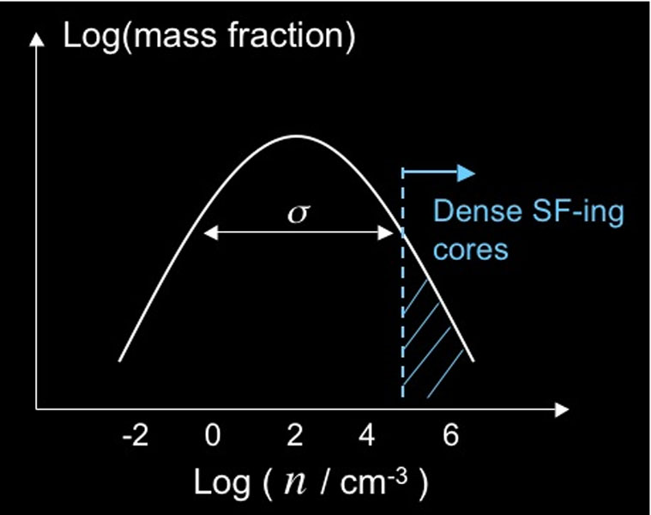
How Does Self-Regulation Work? I
There are several processes involved: each may have its own bottleneck
Ultimately stars form in dense collapsing cores
Prevailing idea is that creation of dense cores that can collapse is a very important regulation step
Turbulent clouds form these cores with an efficiency that depends on mean density, virial parameter, and turbulence properties (e.g. Mach number)
e.g., Padoan & Nordlum (2002), Krumholz+ (2005, 2012, 2014), Hennebelle & Chabrier (2008), Federrath & Klessen (2012, 2013)

Slide 9
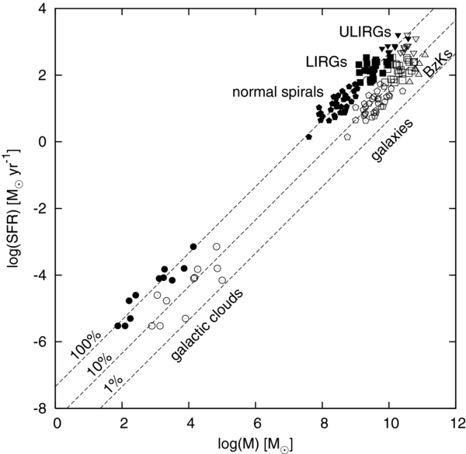
How Does Self-Regulation Work? II
This may give rise to SFR efficiencies observed over many different scales
But is that how it works?
Understanding the mechanisms requires multi-scale observations of molecular clouds and galaxies, to see how density, boundedness, and turbulence changes in response to feedback from star formation
Lada et al. (2012)

Slide 10
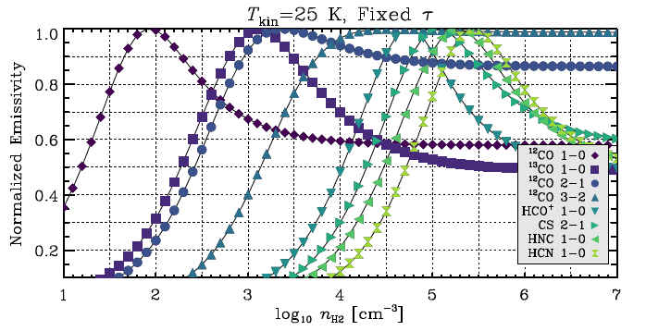
The Probes I
Leroy et al. (2017)
Gaining this information is impossible from just ¹²CO
We need multi-transition probes of the physical conditions in the dense gas phase

Slide 11
The Probes II
Meier et al. (2015)
Why have not we been doing more of this? It’s incredibly hard!
¹²CO is extremely bright. The next bright lines are ✕10-30 fainter
Beyond those, there is a rich set of spectroscopic diagnostics that are ✕100-200 fainter

Slide 12
The Probes III
HCN, HCO⁺, CS and other high-dipole molecules for density
¹³CO, C¹⁸O, C¹⁷O for density and column density
H¹³CN, HC¹⁵N, H¹³CO+ isotopic ratios
H40a, H52b radio recombination
HNC, HNCO, SiO shocks
CN for photodissociation
Deuterated molecules at 80 GHz ice evaporation, temperature
These are all weak lines, so multiplexing is important
Meier et al. (2015)

Slide 13
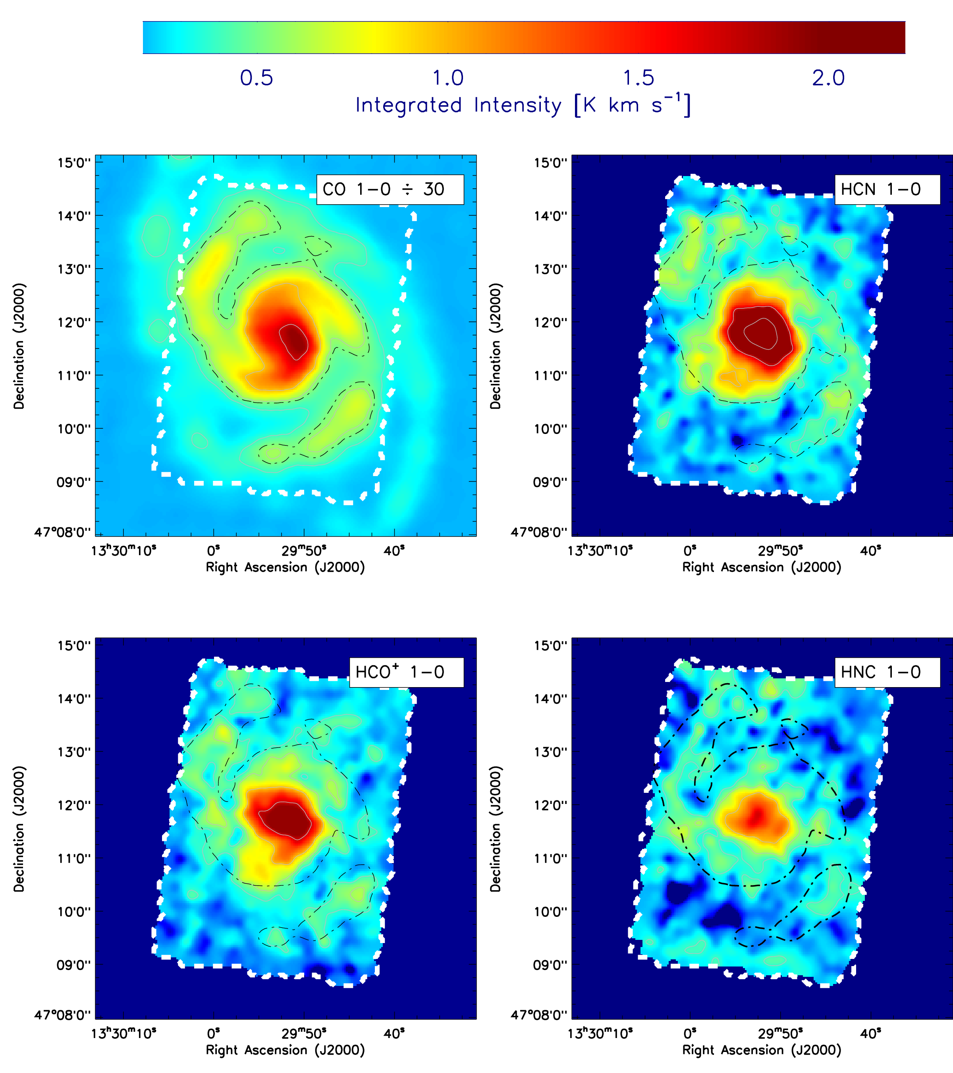
New Observations
Surveys like EMPIRE at the IRAM 30m (Bigiel et al. 2016) and DEGAS at the GBT (Kepley et al, see next talk) are starting to acquire these important data
Note that this is still very hard for the 30m
Bigiel et al. (2016); maps of M51 for CO, HCN, HCO+, HNC

Slide 14
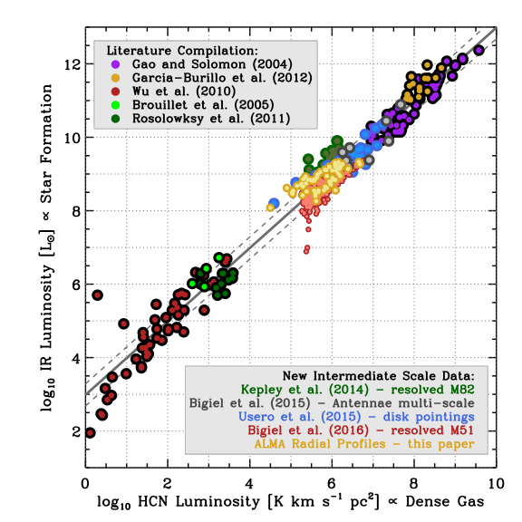
What Are We Learning?
The plot shows a compilation of external galaxy and Milky Way cloud points
It is a linear Kennicutt-Schmidt relation for dense gas: for dense gas local clouds and galaxies fall on the same relation
Of course, anything looks good on a luminosity-luminosity plot, but they hide an awful lot of physics
New surveys:
Disk pointings
M51 pixels
M82 regions
Antenna pointings
ALMA disk profiles
Gallagher, Leroy et al. (submitted)

Slide 15
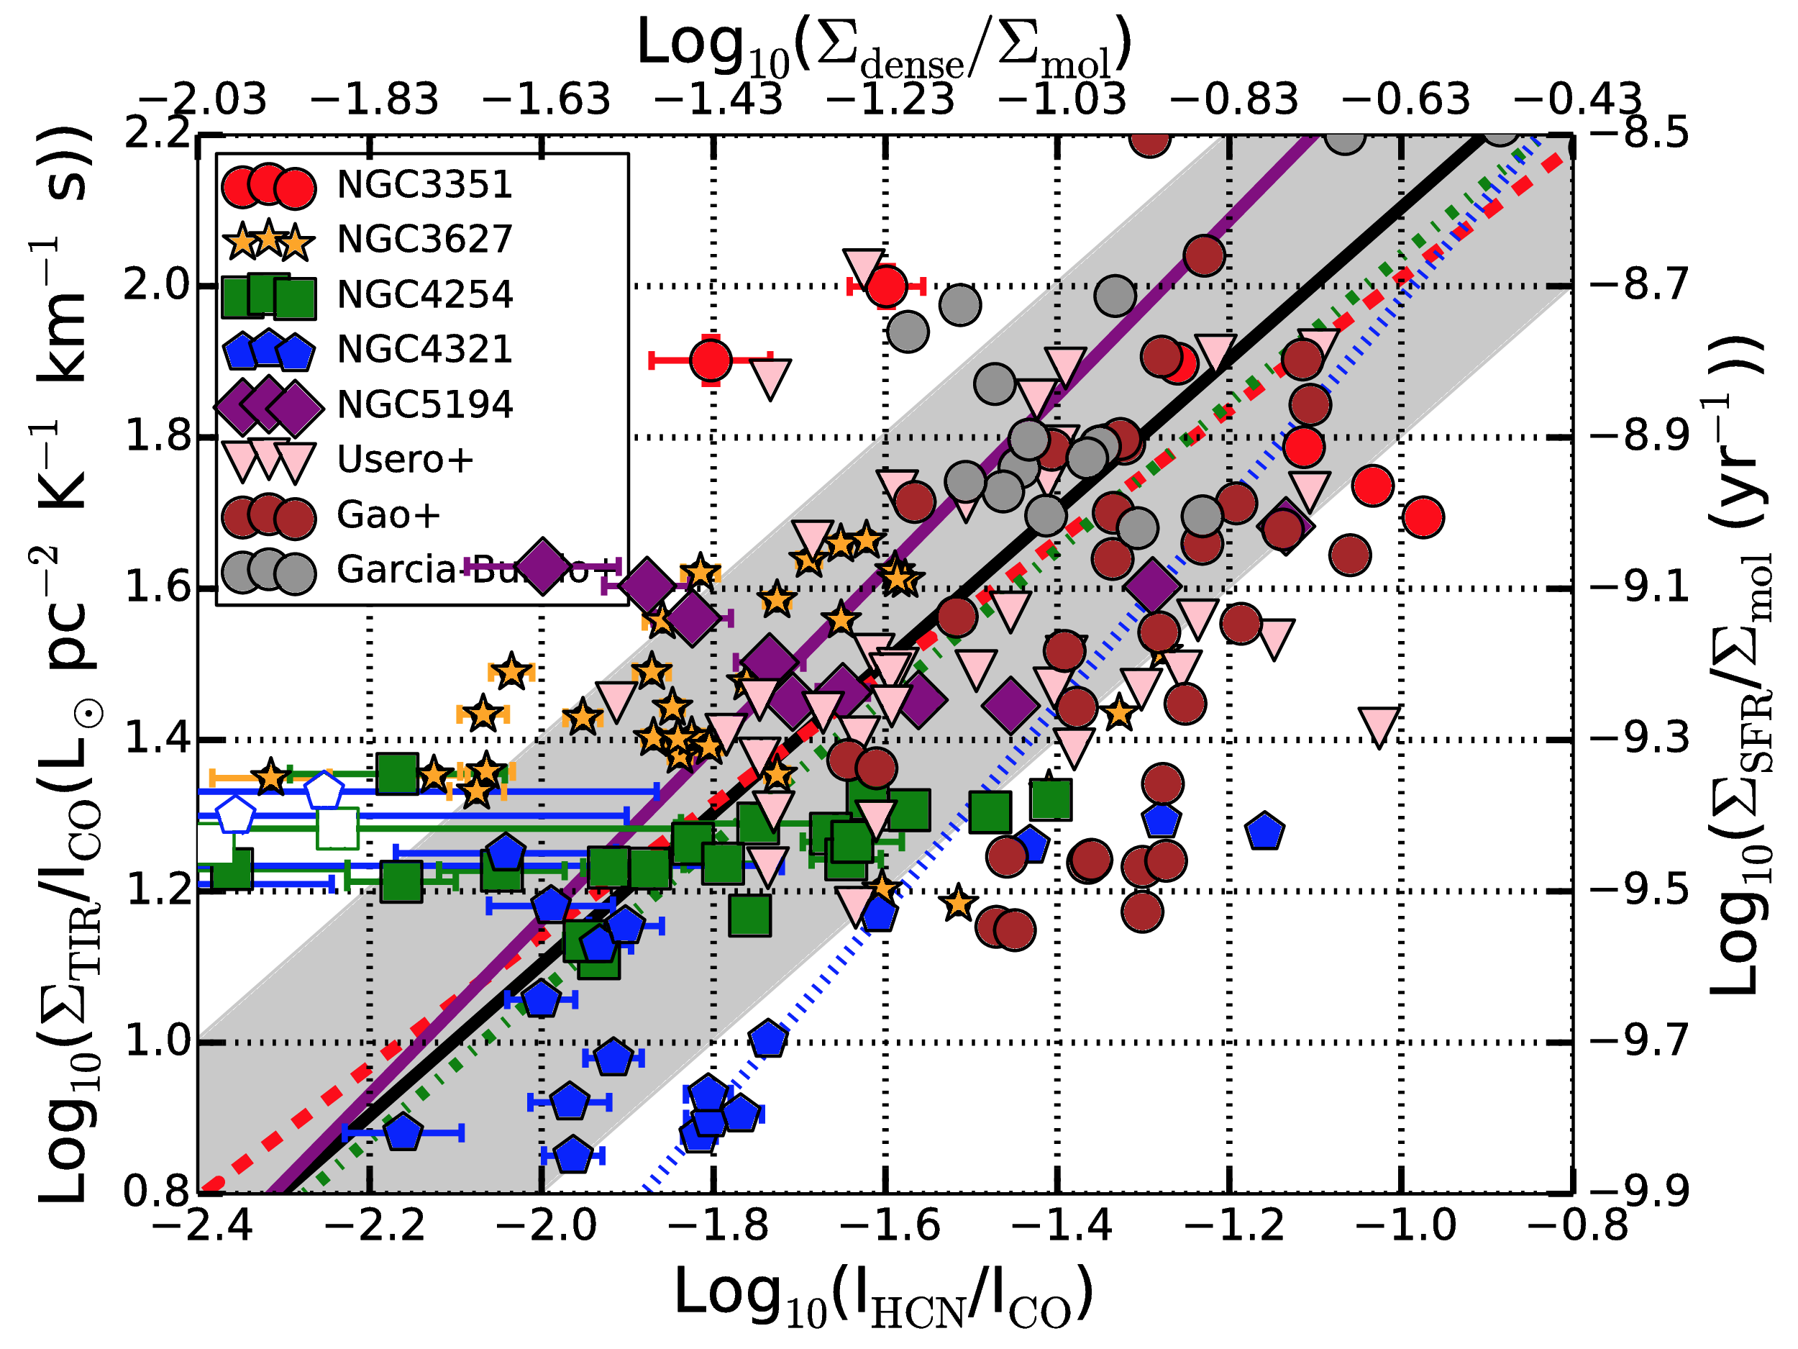
SF Efficiency and Dense Gas Fraction
Gallagher, Leroy et al. (submitted)
Is the efficiency of star formation constant in dense gas?
There is a relation, but with a large amount of scatter
Where is that coming from?
Apparent SFR per H₂
Each point: galaxy, ring in a galaxy, or 1-2 kpc beam in a galaxy
Apparent Dense Gas Fraction

Slide 16
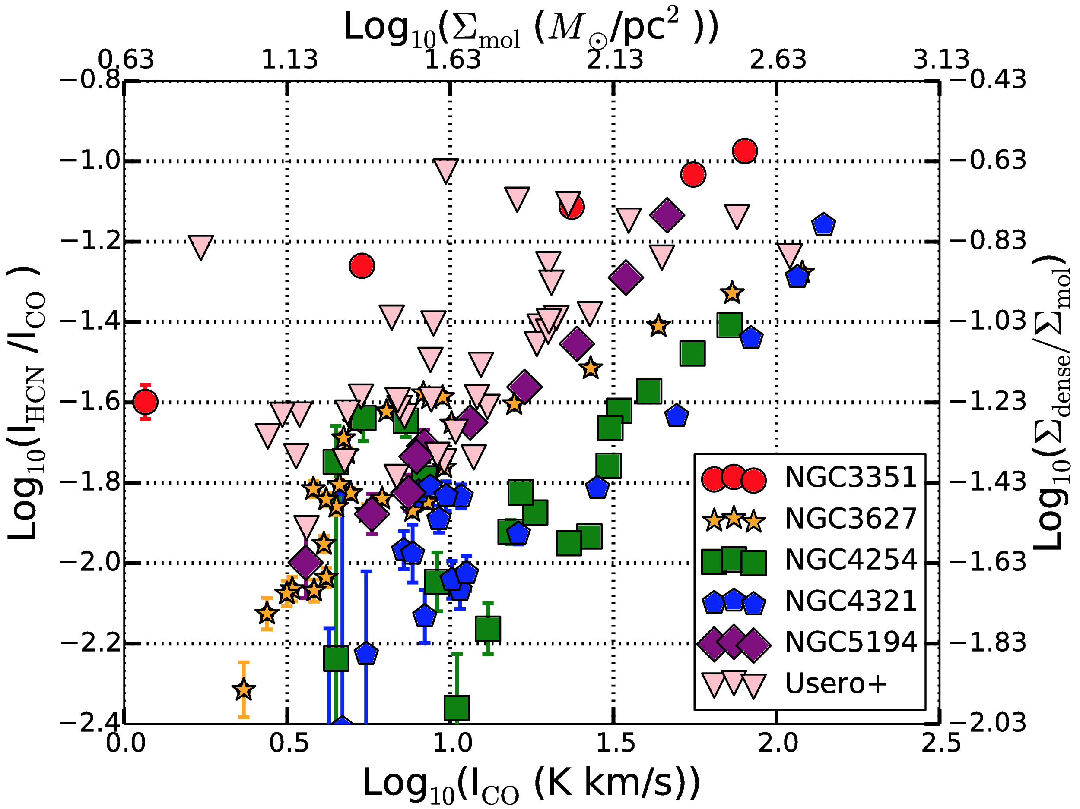
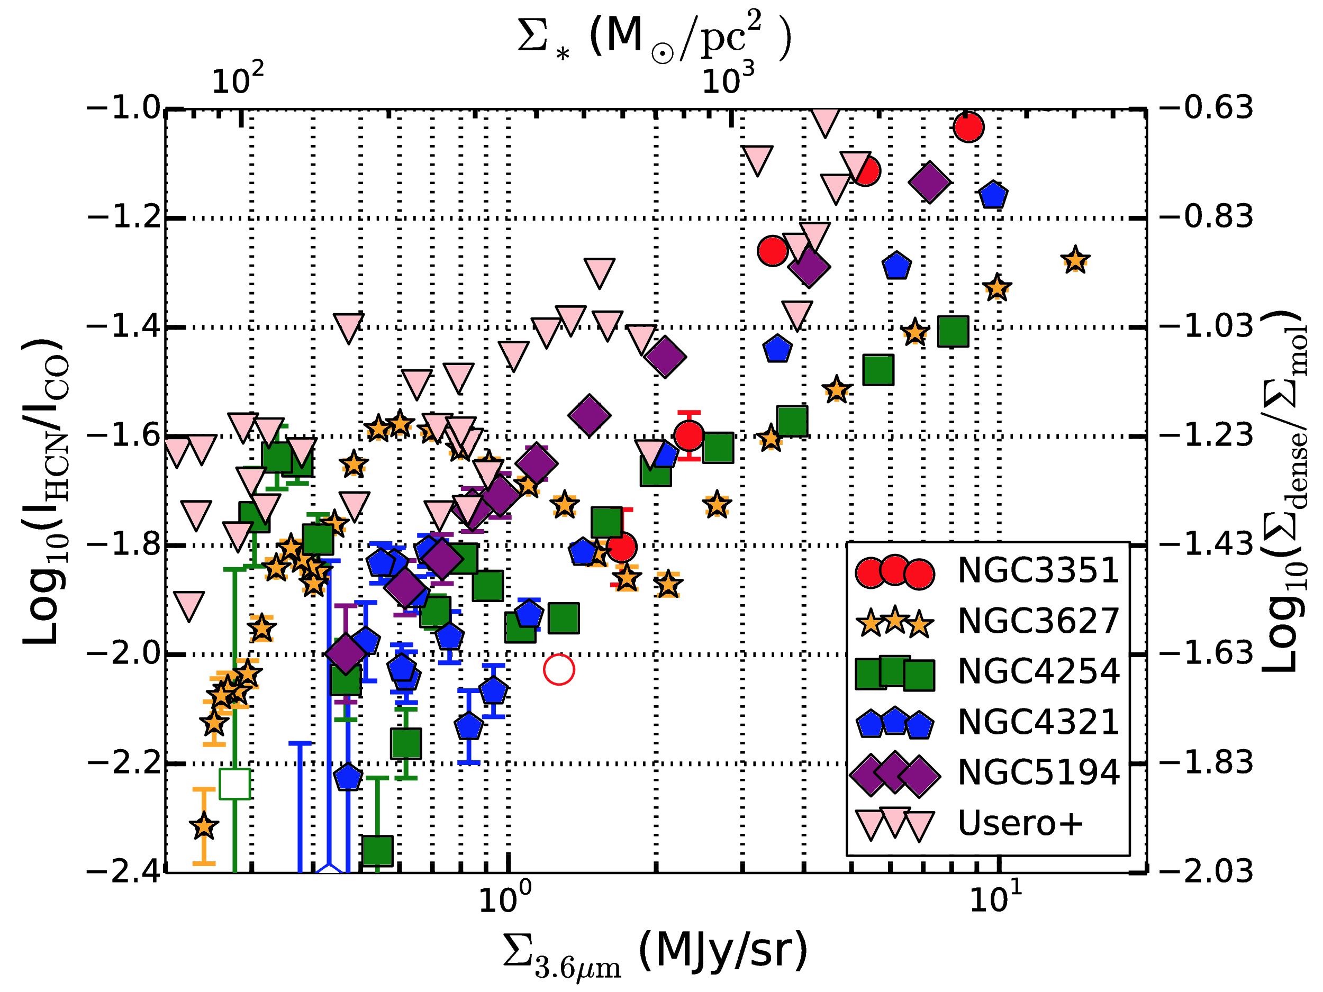
Why Does the Gas Become Dense?
Gallagher, Leroy et al. (submitted)
Dense Gas Fraction
Gas Surface Density
Stellar Surface Density
One important question is what determines how much dense gas a galaxy has
More gas-rich regions have higher dense gas fractions
Regions with higher stellar surface density also have higher dense gas fractions

Slide 17
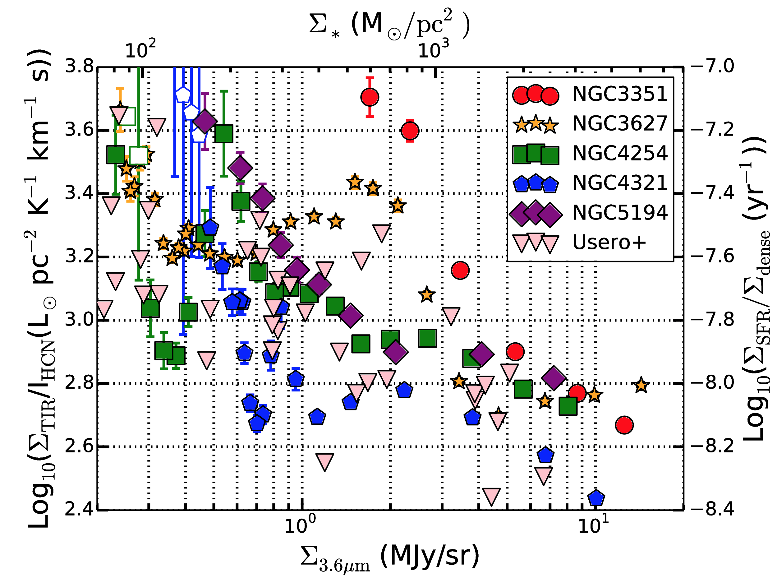
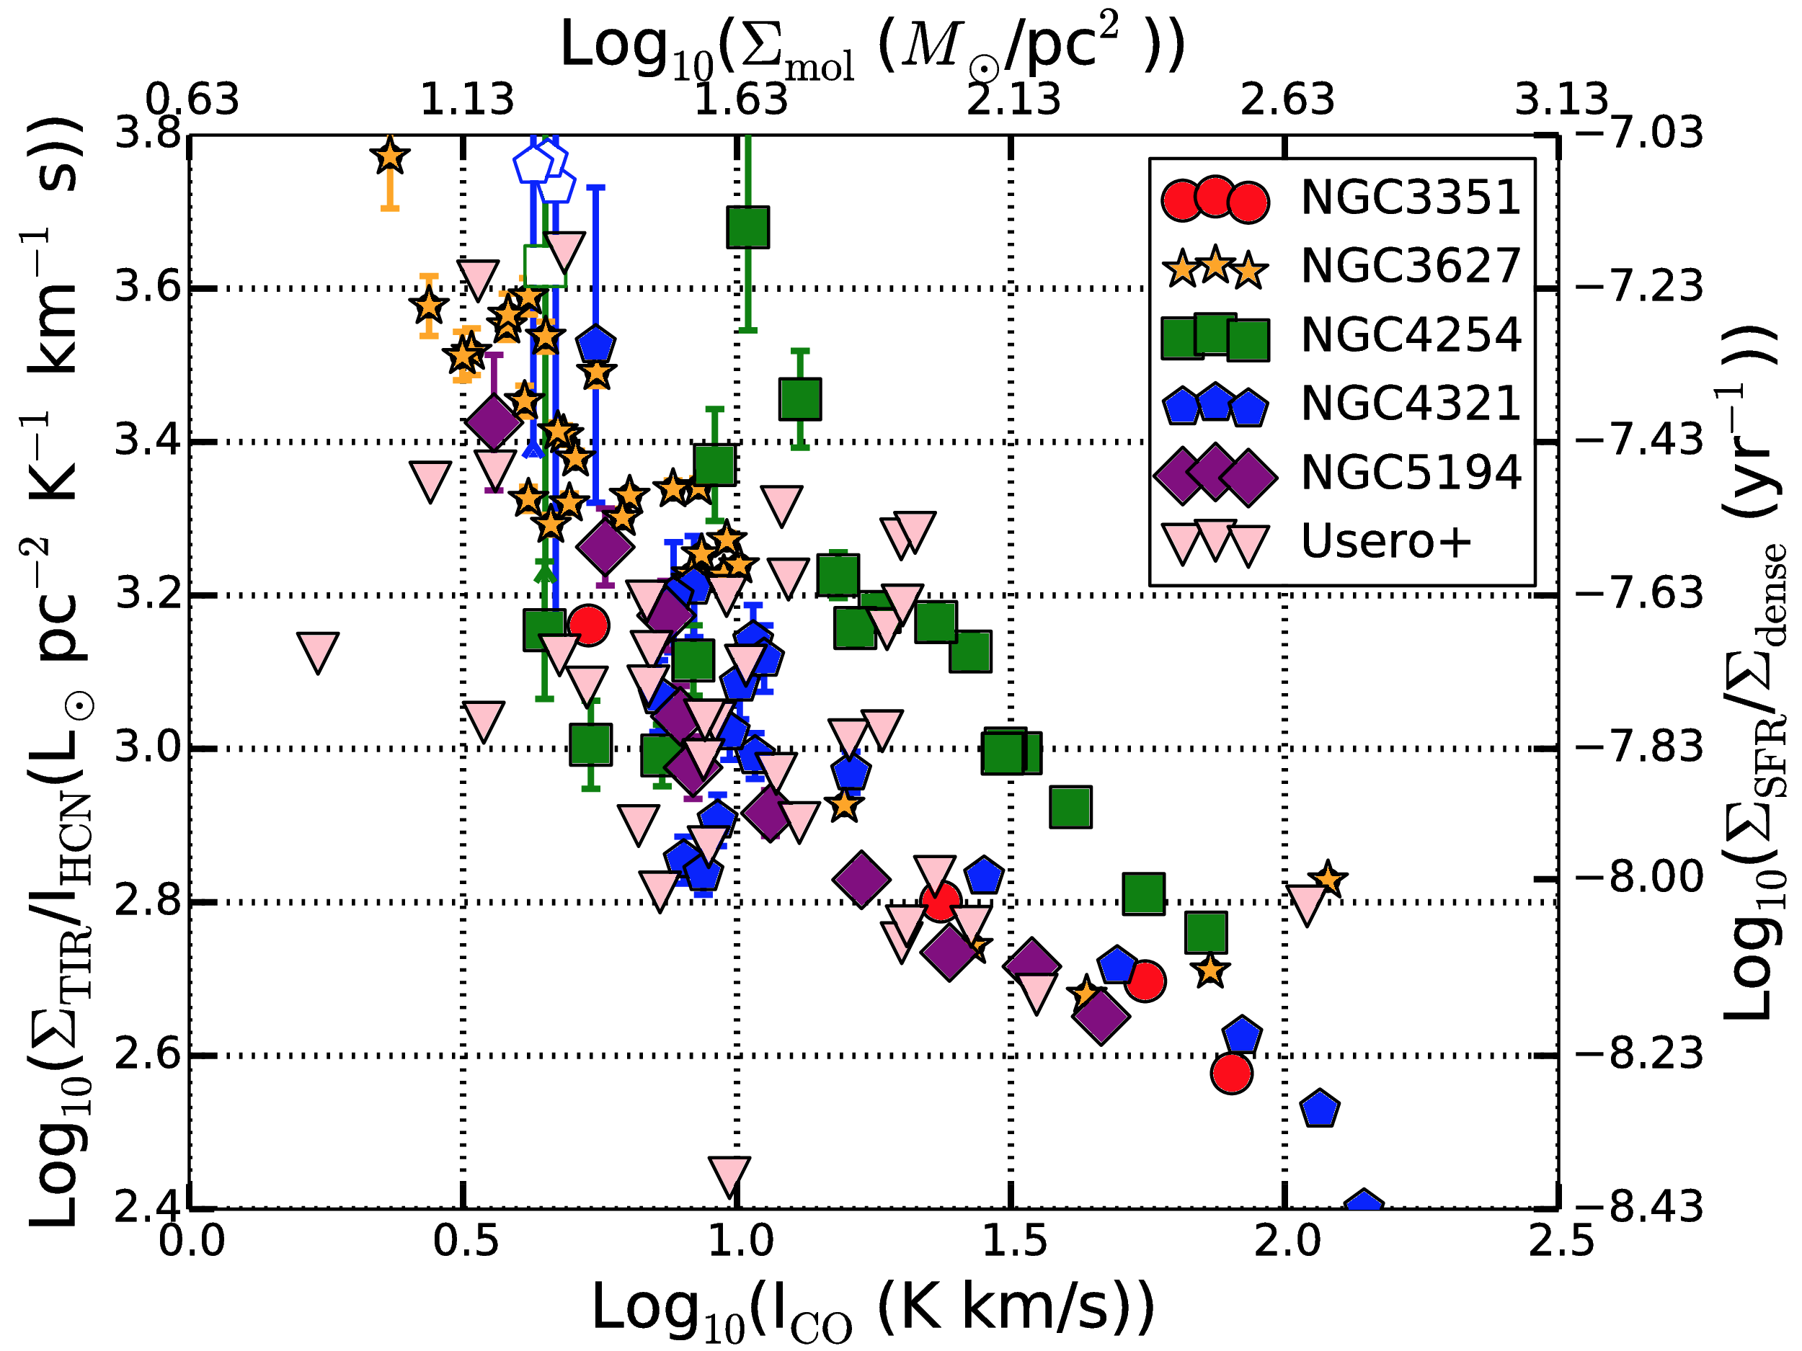
Not All Dense Gas Forms Stars Equally
Gallagher, Leroy et al. (submitted)
Apparent SFR per dense gas
Gas Surface Density
Stellar Surface Density
Not all dense gas is equally efficient at forming stars
Dense gas efficiency drops at higher surface densities of gas or stars
These are the typical conditions in the centers

Slide 18
Summary
We do not understand how galaxies self-regulate
We have some scaling relations
We strongly suspect that stellar feedback plays the dominant role
To answer this question we need observations that yield information on the state of the gas
We are beginning to gather some of it, and it shows interesting trends
But we are painfully limited in our ability to map large areas with good surface brightness sensitivity and resolution
This is the niche for a large single-dish equipped with large-format array receivers with good bandwidth per pixel
Note that there are many transitions spread over the 3-4 mm band
This requires good bandwidth per pixel: the “one line at a time” approach is not good enough

