Slide 1
You are an alien from another world. You have alien eyes. What do you notice about your vision?
Put on your cosmic visors.
Your job is to visit planet RGB and report back to your commander.
You have arrived.
Your commander will ask you to report what you see. Wait for instructions.
Click the mouse to look out of the window of your space ship.
Notes:
You are the commander! Make sure all your little aliens put on their filter visors before you begin. You can read this slide to them. Ask for comments about their vision, and accept all answers. Then continue reading.

Slide 2
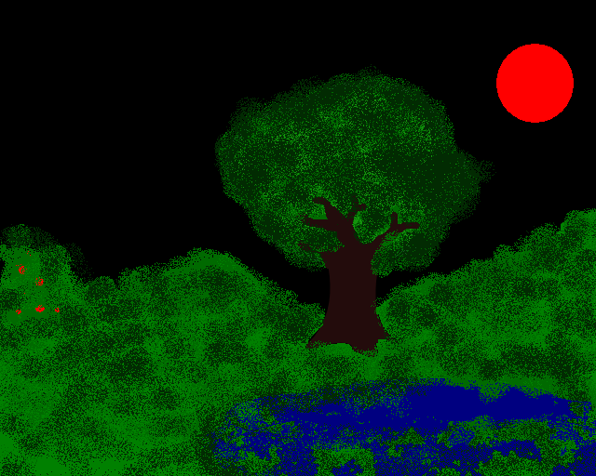
Notes:
Ask first for the blue aliens to describe what they see. Then the red aliens, and finally the green.
As the Commander you can say: “ Hmm, it appears as through we have some disagreement about the characteristics of this planet. But Wait! They are sending us a message…

Slide 3
Ok Alien. Now you have received this message from Planet RGB. Can you decode it?
Notes:
Get responses from the red aliens, the blue aliens and the green aliens. You can say: Once again we learn different things though different eyes. Red aliens, you see the numbers 4,3,2,1. Blue Aliens are receiving a nice “ Hi”. And green aliens are picking up “help”. It seems as if your eyes are all very useful! You can let your aliens trade filters with each other now. “Your cosmic visors are filters. They let only one color or wavelength of light through. Are they useful in noticing different messages?”

Slide 4
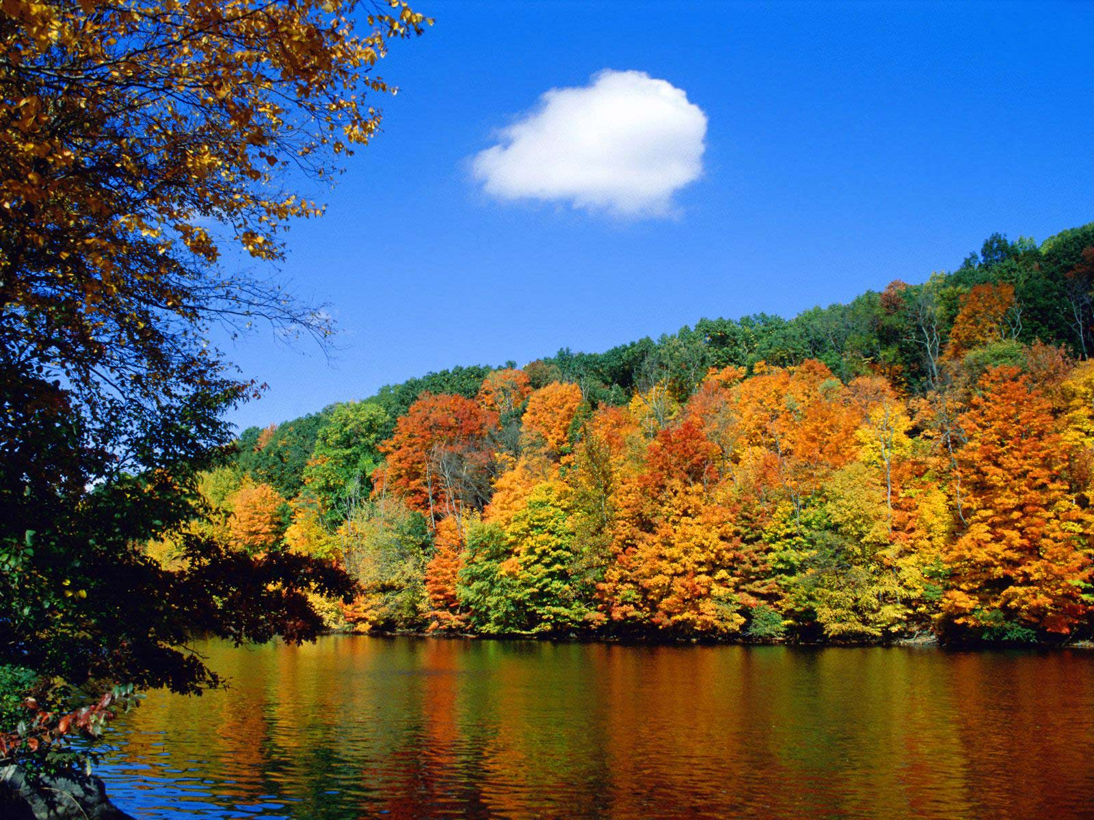
Here’s a more realistic view of a planet. Describe this through the different filters.
Notes:
Notice the white cloud is can be seen through all filters. White light is a mixture of all the colors of the rainbow, including red, green and blue!

Slide 5
Astronomers use filters too, and for the same reasons. If you isolate just one color of light, you can learn what parts of your object – your starfield, nebula or galaxy – is glowing in only that color. That helps you discover what causes the object to shine.

Slide 6
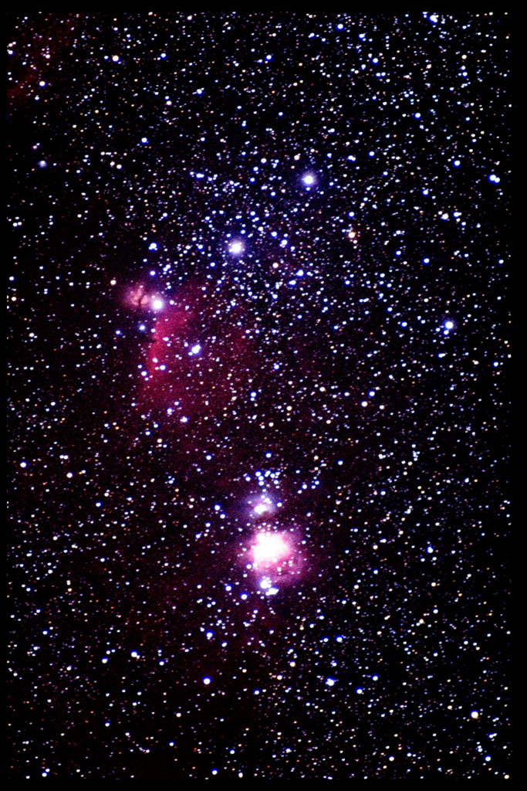
This is Orion’s Belt.
It is a combination of 3 pictures: one taken through a red filter, one through a green filter, and one through a blue filter.
Check it out with your filters.
Image Credit: T. Credner & S. Kohle, AlltheSky.com
Notes:
Note to self: I would put a better RGB in this space.

Slide 7
Representational Images
Astronomers don’t just combine images taken through red, green and blue filters. They use narrow-band filters too. And, they combine images from very different telescopes like x-ray telescopes and radio telescopes!
Notes:
For each image, read what each color represents, and then check it out with the filters.

Slide 8
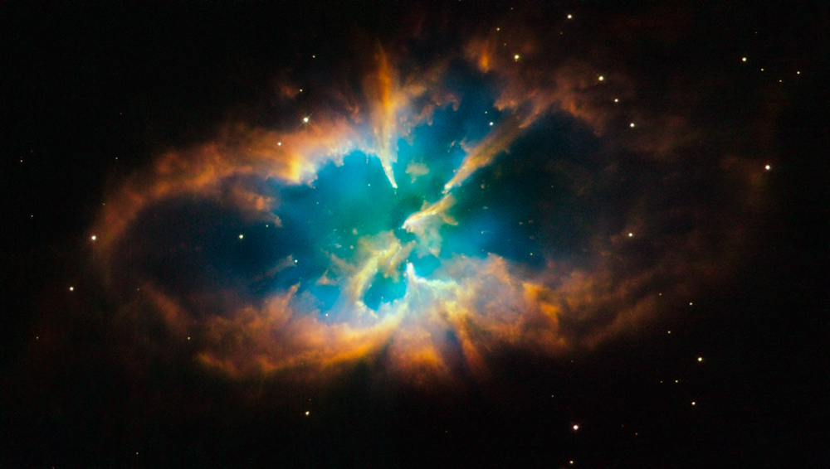
NGC 2818, Planetary Nebula
Image Credit: Hubble Space Telescope. Narrow band filters for nitrogen, hydrogen and oxygen were used and then combined into this representational color image (nitrogen = red, hydrogen = green and oxygen = blue). Telescopes: Hubble Space Telescope

Slide 9
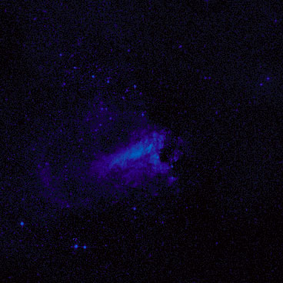
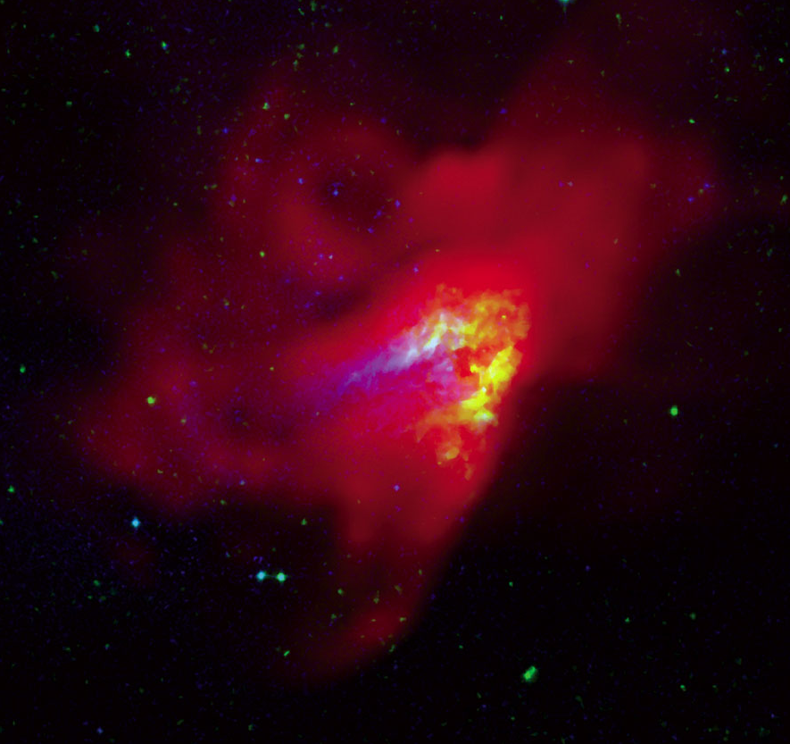
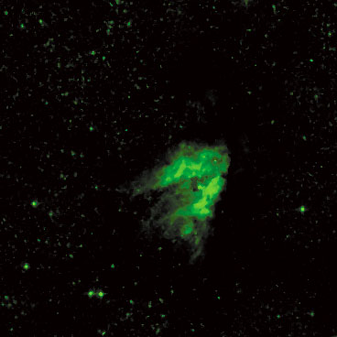
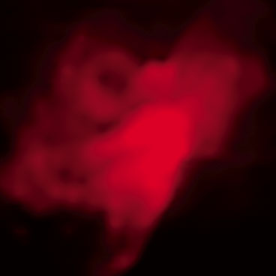
Blue = visible light
M 17, Omega Nebula
Green = infrared energy
Red= radio waves
Image Credit: NRAO/AUI
Telescopes: Palomar 48 inch, 2MASS, NRAO Green Bank Telescope.
Notes:
The infrared energy is emitted by dust clouds warmed by new stars in the nebula. The visible light and radio waves are produced when these stars ionize the gas around them.

Slide 10
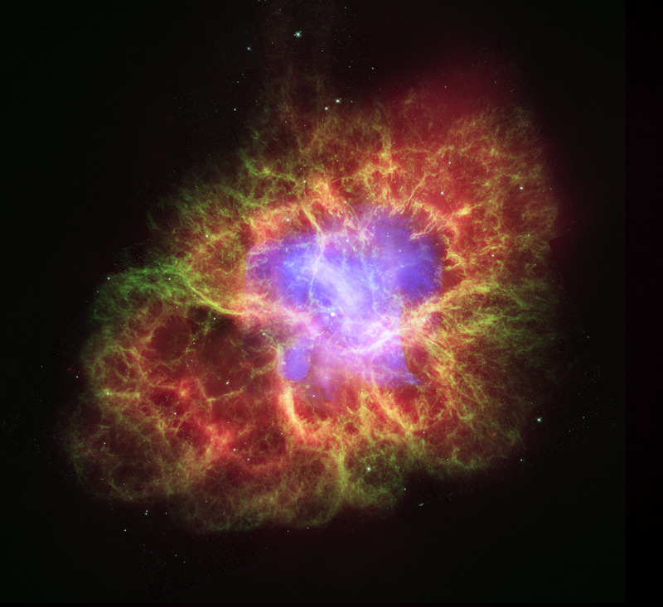
M 44, Crab Nebula
Image Credit: NASA, ESA and J. Hester . X-rays =light blue, visible light = green & dark blue, infrared energy = red. Telescopes: Chandra X-Ray Observatory, Hubble Space Telescope, Spitzer Space Telescope.

Slide 11
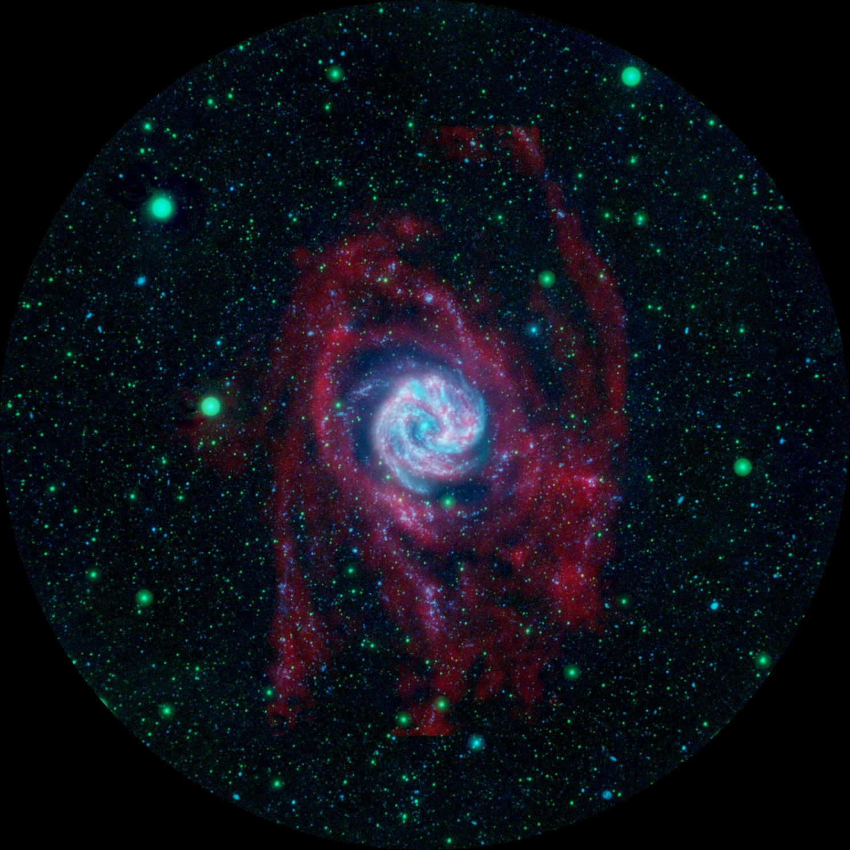
The Southern Pinwheel Galaxy
Image Credit: NASA/NRAO/MPIA
Far-ultraviolet light = blue, near-ultraviolet light = green and radio waves = red.
Telescopes:
GALEX (Galaxy Evolution Explorer), Very Large Array

