Slide 1
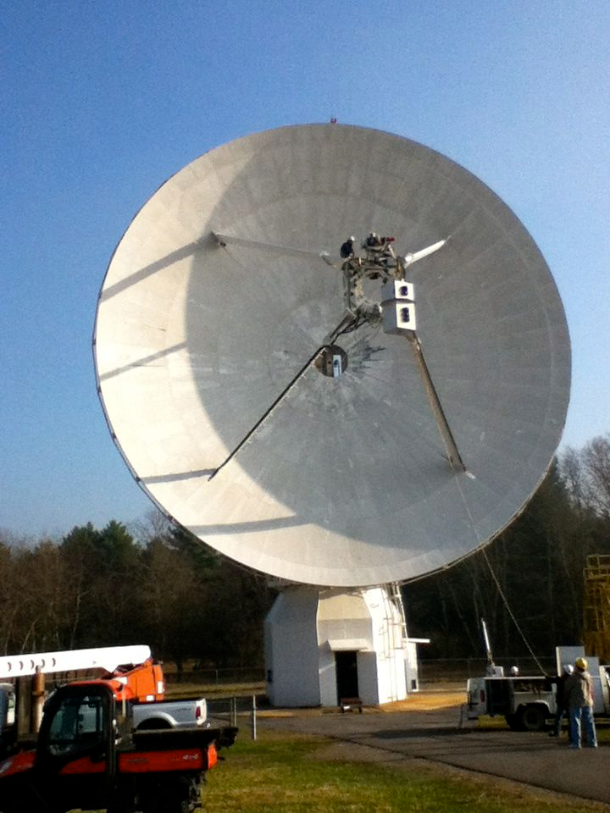
Using a Radio Telescope
Installing the receiver on the 20 Meter Telescope
Notes:
The Skynet 20 Meter Telescope at the NRAO in Green Bank, WV. It is called the 20 Meter Telescope because the dish is 20 meters across.

Slide 2
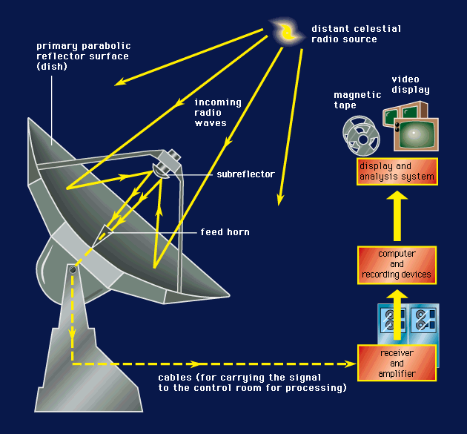
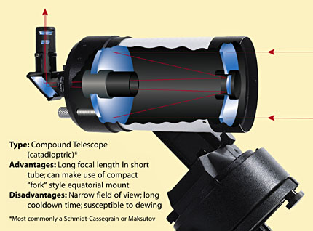
Radio Telescope
Optical Telescope
Notes:
Like an optical telescope, radio telescopes also have parabolic mirrors, but they’re not shiny enough to reflect visible light well. The receiver is at the focal point. We can’t see radio waves and so must put an electronic detector at the focal point. This is where things get different. A radio telescope detector is like a CCD with only one pixel! So to make an image you have to move the whole telescope and map the sky.

Slide 3
Weird things about radio telescopes:
FOV and angular resolution is the same for a radio telescope – one pixel camera. For the 20 Meter = 0.7 degrees
Exposure Time = Integration time, but a radio telescope must move or map to make an image.
Sky patterns: Daisy, Map, On-Off, Track
Two Spectral Modes: Low /High resolution

Slide 4
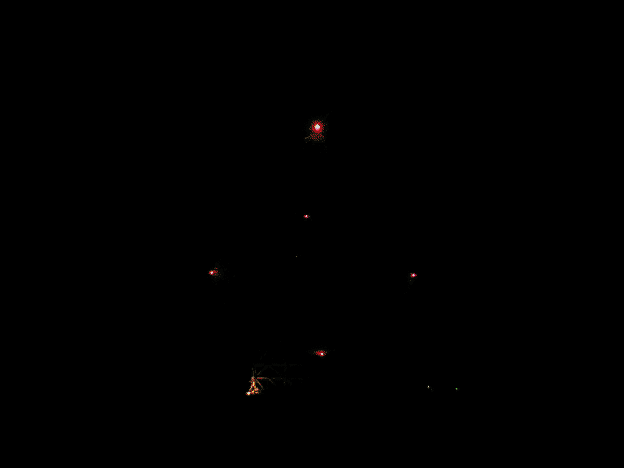
Robert C. Byrd Green Bank Telescope
2000 dedication.
100 x 110m, novel offset design.
Most versatile telescope: 100 MHz-100 GHz.
Notes:
This little movie shows a radio telescope doing several tracking observations, and then a mapping observation. Watch the whole telescope “wiggle back and forth” at the end of the video.

Slide 5
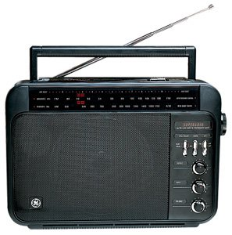
Low Resolution/High resolution?
Notes:
Just like an FM radio has a band that goes from 88 MHz to 108 MHz, the 20 Meter receiver has a band too. It goes from 1300 MHz to 1800 MHz!. You can tune the 20 meter telescope to specific frequencies to pick up signals from different elements or molecules. That’s High resolution observing. But you can also detect ALL of the signals across the whole band. Imagine picking up all of the stations on your FM radio at once. You could point your antenna around and more easily determine the total power from radio stations as a function of LOCATION.

Slide 6
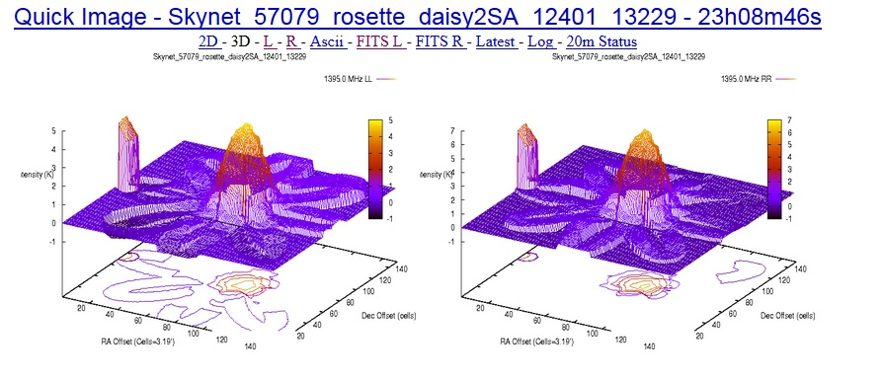
Data Products
currently not integrated with Skynet, but are archived at the NRAO
Notes:
20 Meter Data are not stored on the Skynet computers just yet, and you can’t use Afterglow. But you can access the data on an NRAO website. This website also has much helpful advice! https://www.gb.nrao.edu/20m You get lots of data products: 2D graphs, Ascii Data, and Fits files that you can open with free programs like Astroimage processor, FITSVIEW, or DS9

Slide 7
Observing Modes with the 20 Meter Telescope
Notes:
Just how are radio waves created in celestial objects?

Slide 8
Low Resolution
EG 1: Mapping nebulae

Slide 9

Nebulae are clouds of hot ionized gas.
Electron accelerates as it passes near a proton.
radio waves are released
Notes:
Electron is green. Proton is red. Situation where the gas is hot enough to ionize. The protons does not capture the electron to form an atom. But when the electron whizzes by its path is bent because it is attracted to the proton. That’s an acceleration. Radio waves are released.

Slide 10
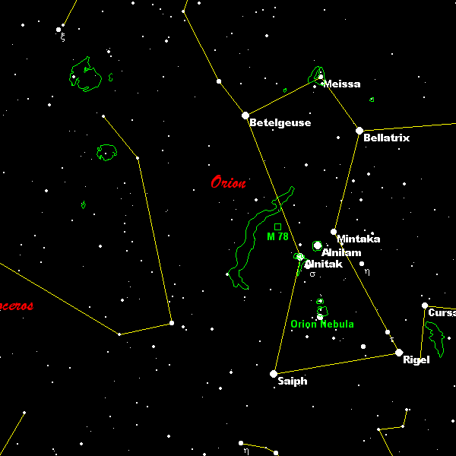
Notes:
Orion constellation – from a planetarium program. This slide shows objects that emit visible light: stars mostly, and also some nebulae.
For a free and excellent planetarium program try Cartes du Ciel: http://www.stargazing.net/astropc/index.html.

Slide 11
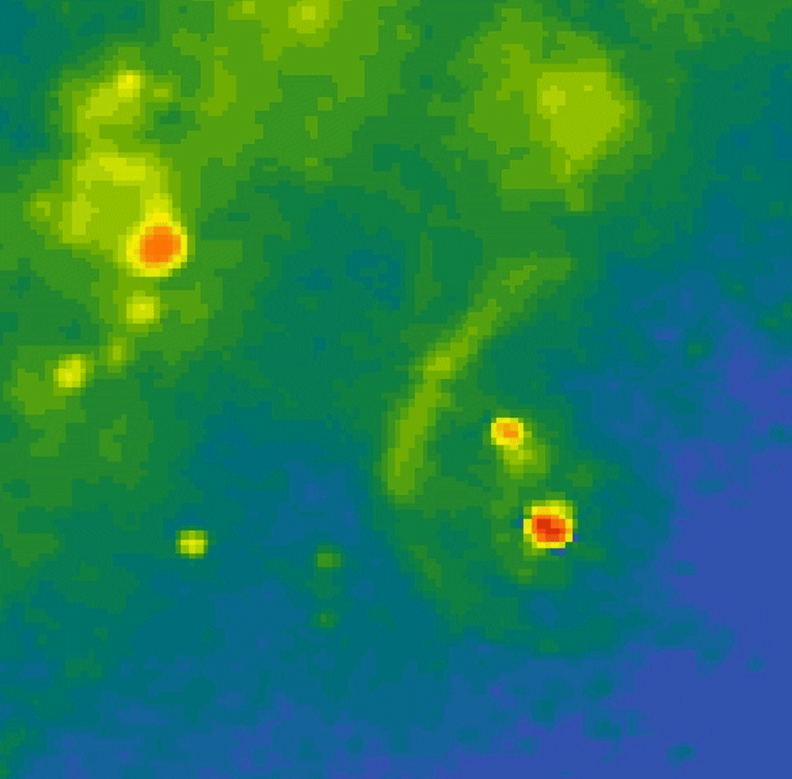
Notes:
Radio Map from the 43 Meter Telescope in Green Bank, WV Note the radio signals ( red strongest, blue weakest) are coming from the Nebulae.

Slide 12
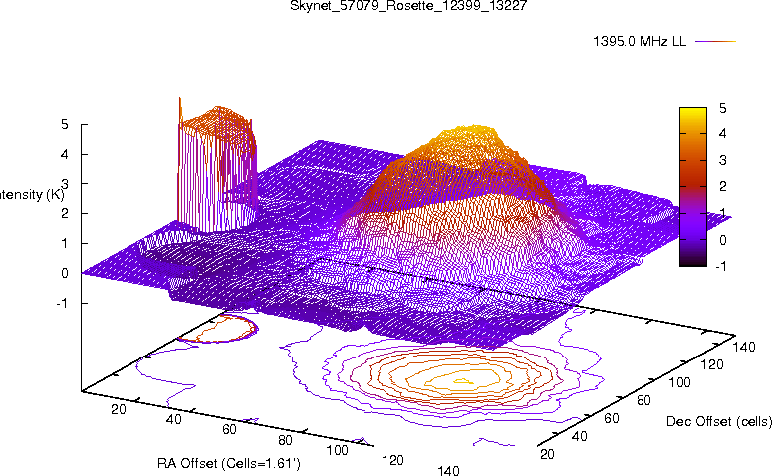
Rosette Nebula
Daisy scan Radius: 120 arc seconds
12 petals
0.2 s integration time
Total duration 180 seconds
Notes:
Here’s a quick look Daisy scan of the Rosette Nebula taken with the 20 Meter. Kinda messy, but quick!

Slide 13
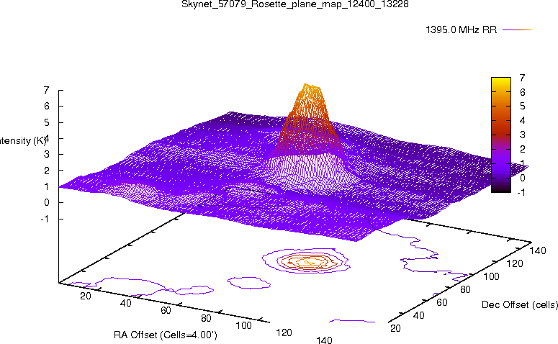
A 12 degree “Map” of the Rosette Nebula Area
Showing more detail.

Slide 14
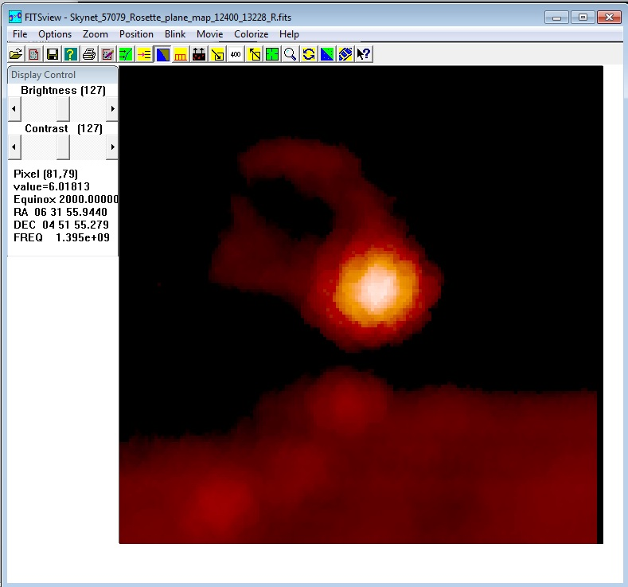
Raster map: 12 degrees
https://www.nrao.edu/software/fitsview/
Notes:
Downloaded the Fits file from the 12 degree map and displayed it with FITSVIEW. You can see lots more detail

Slide 15
Notes:
Compare the 20 Meter Telescope data to this portion of the 43 Meter Telescope map. Not bad!

Slide 16
Low resolution
EG 2:
detecting supernova remnants,
detecting galaxies and quasars (with blackholes at their centers!)

Slide 17
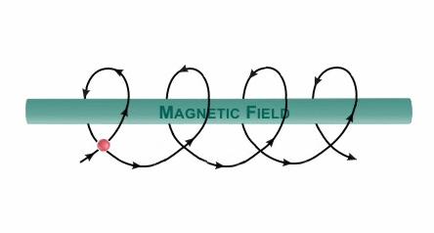
Electrons accelerate around magnetic field lines
Notes:
Since circular motion represents acceleration (i.e., a change in velocity), the electrons radiate photons of a characteristic energy, corresponding to the radius of the circle.

Slide 18
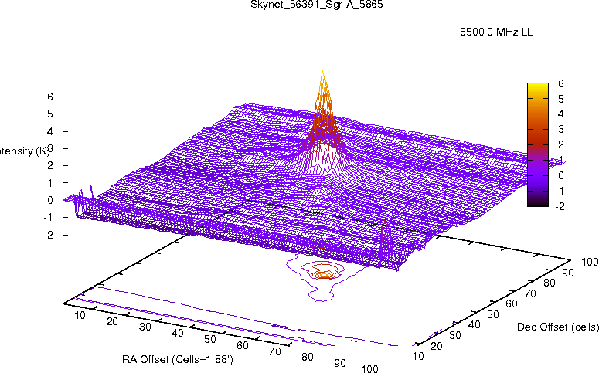
Notes:
The Center of the Milky Way Galaxy, Sagittarius A.

Slide 19
Notes:
The FITS file from the same data as the previous slide, displayed with FITSVIEW.

Slide 20
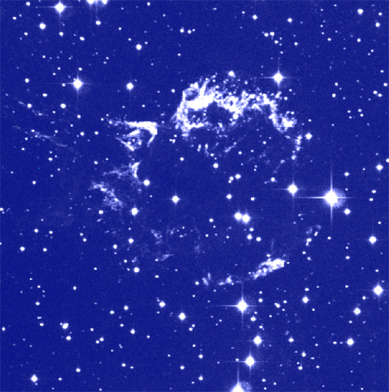
Notes:
Cas A SNR – optical photo
(from Chandra web site http://chandra.harvard.edu/pub.html)

Slide 21
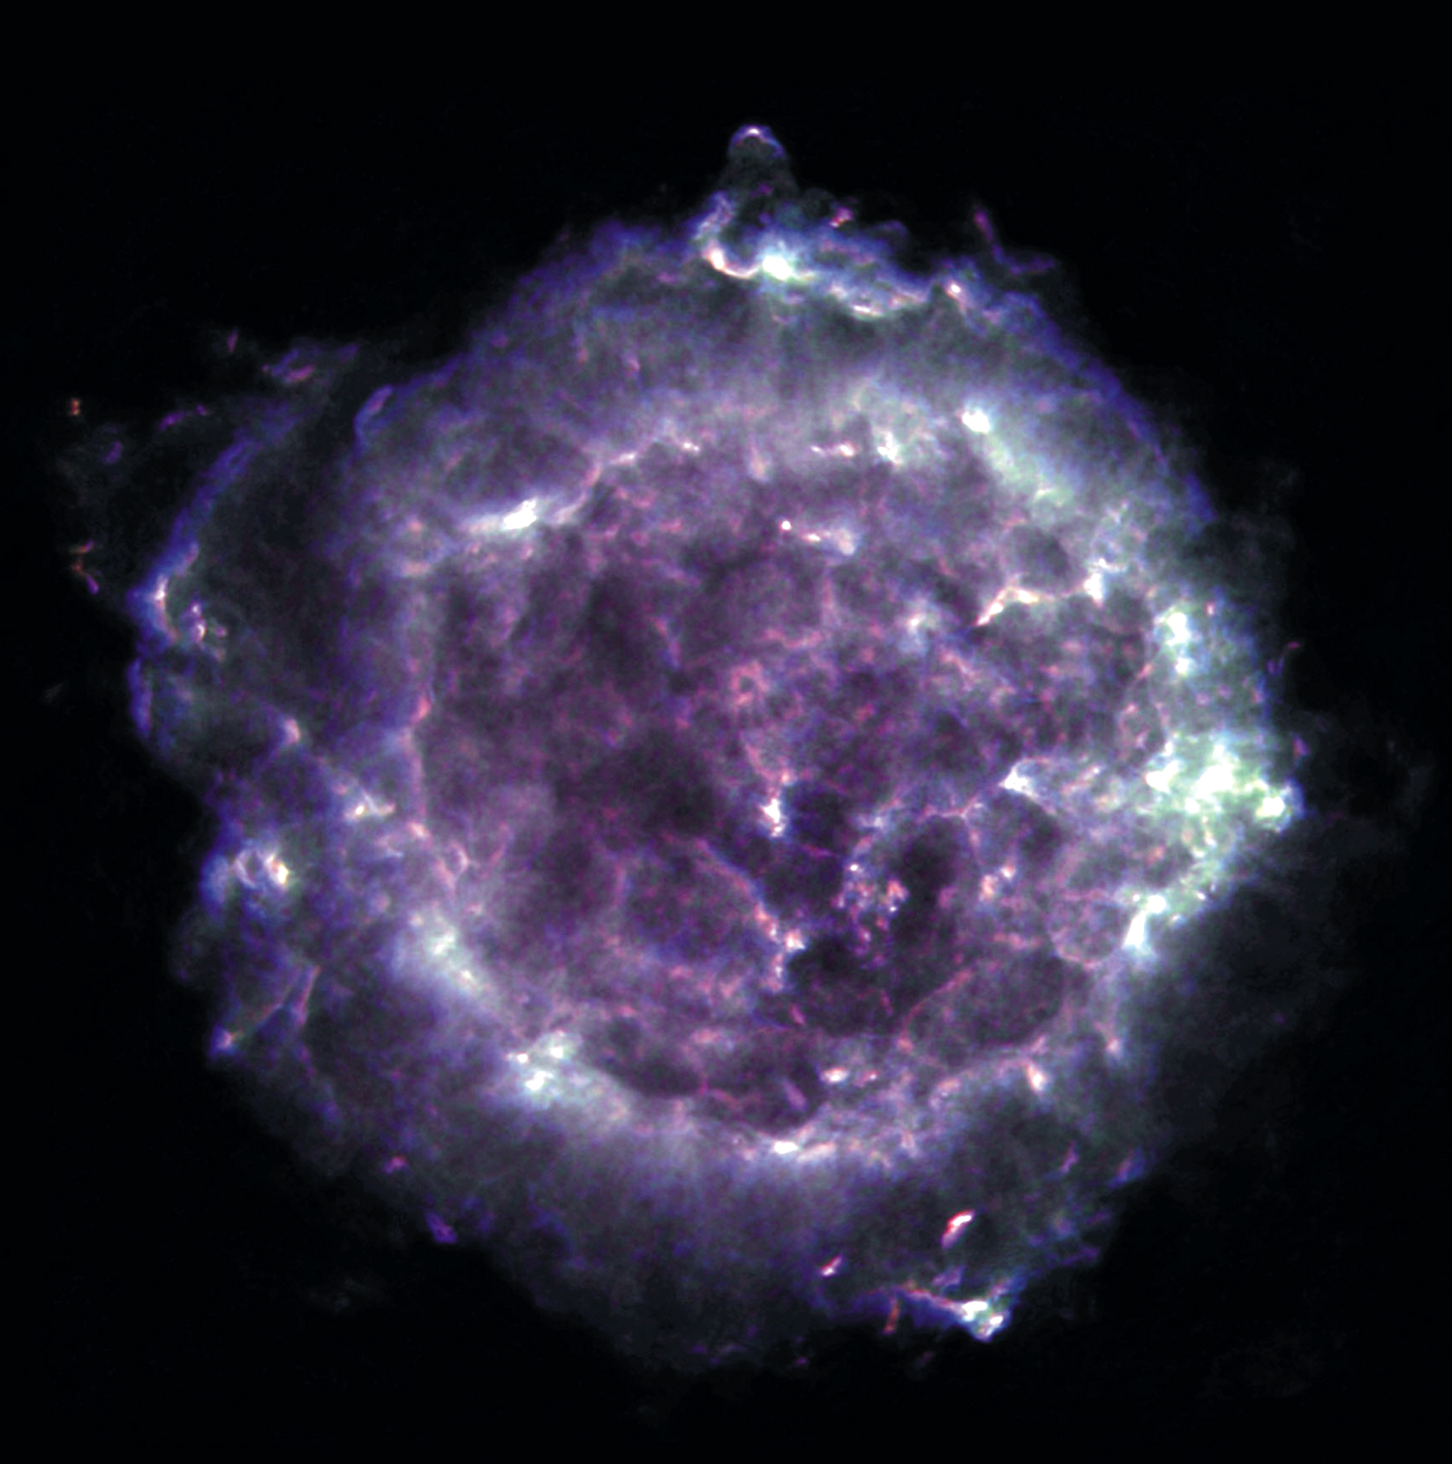
Notes:
Cas A in the Radio. Next to the sun, the “brightest” radio source in the sky. This is a supernova remnant and could have a neutron star at its center.

Slide 22
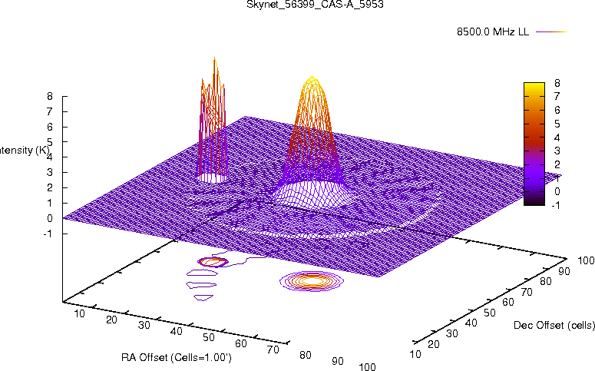
Notes:
Daisy Scan with lots of petals of Cas A.

Slide 23
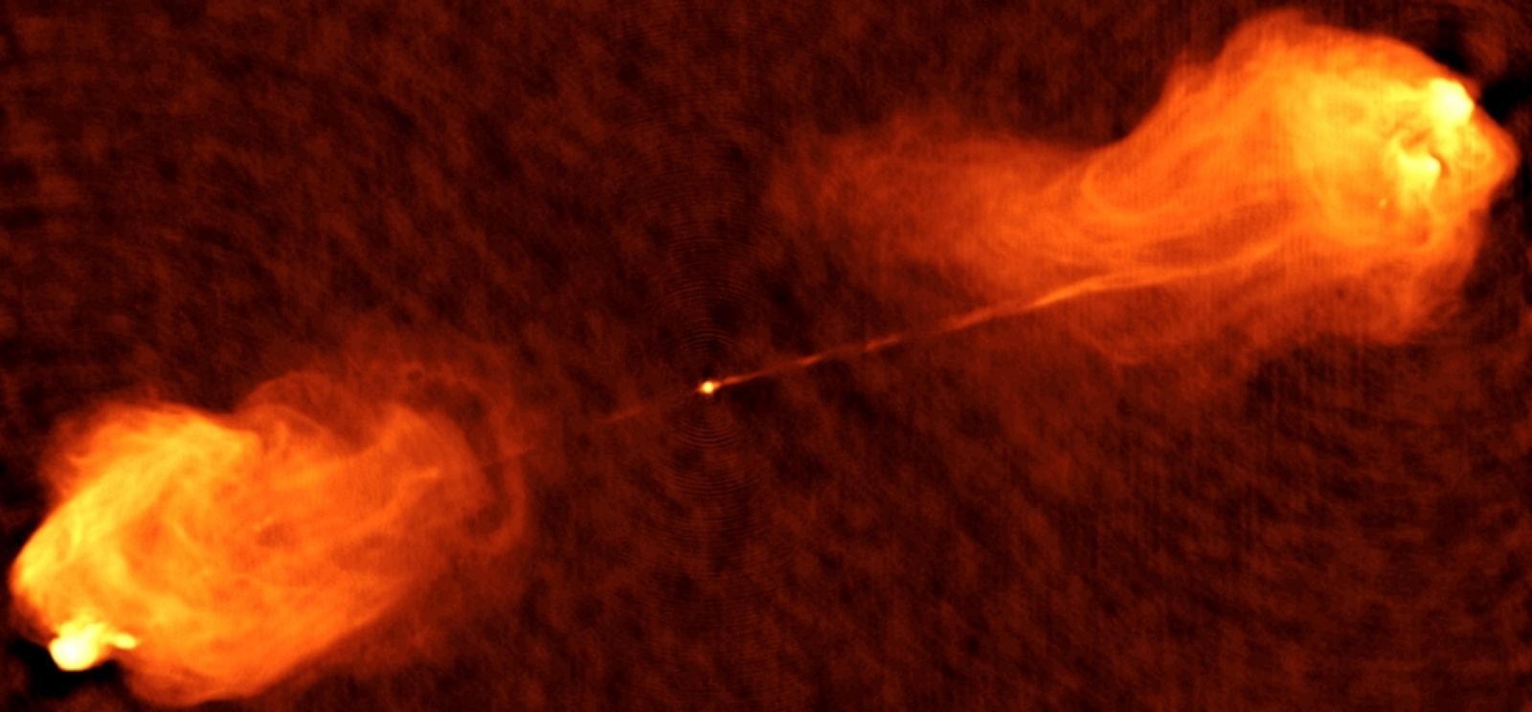
Cygnus A
VLA Telescope (30 km diameter)
Notes:
Cygnus A – a radio galaxy ~ 600 million light years from here! The detail in this image can NOT be achieved with the 20 Meter telescope. This was made by a telescope that is effectively 30 kilometers across!

Slide 24
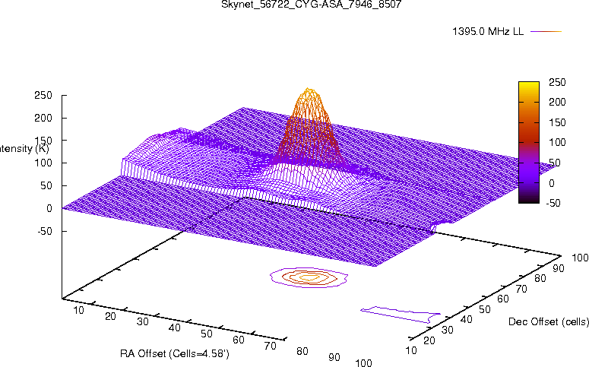
Cygnus A
20 Meter Telescope
Notes:
Map of Cygnus A region made with the 20 meter. The big bump is Cygnus A.

Slide 25
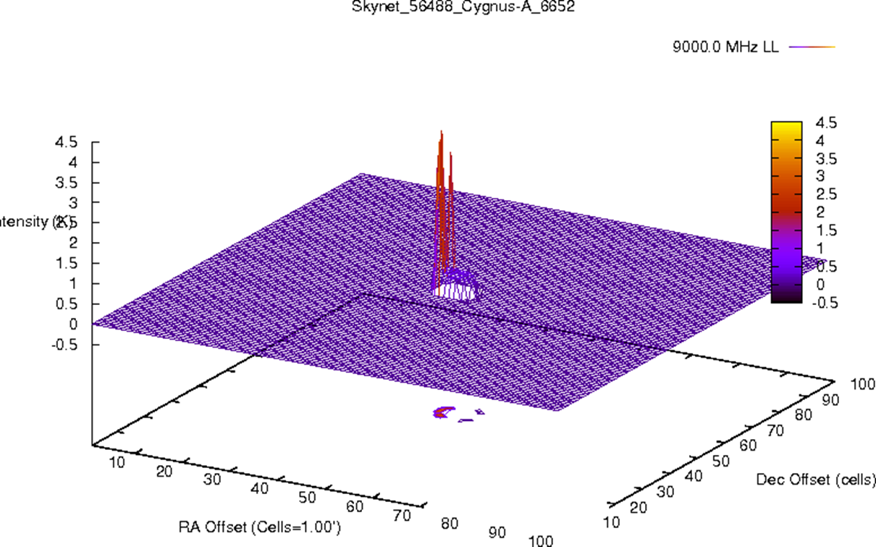

Slide 26

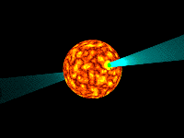
Low resolution
0329+54
EG 3: Known pulsars
Vela
0531+21
Notes:
Diagram of a pulsar. A pulsar is a stellar remnant – a neutron star. A pulsar has the mass of the Sun, but is as small as Milwaukee! We detect a narrow beam of radio waves each time the pulsar spins toward us.

Slide 27
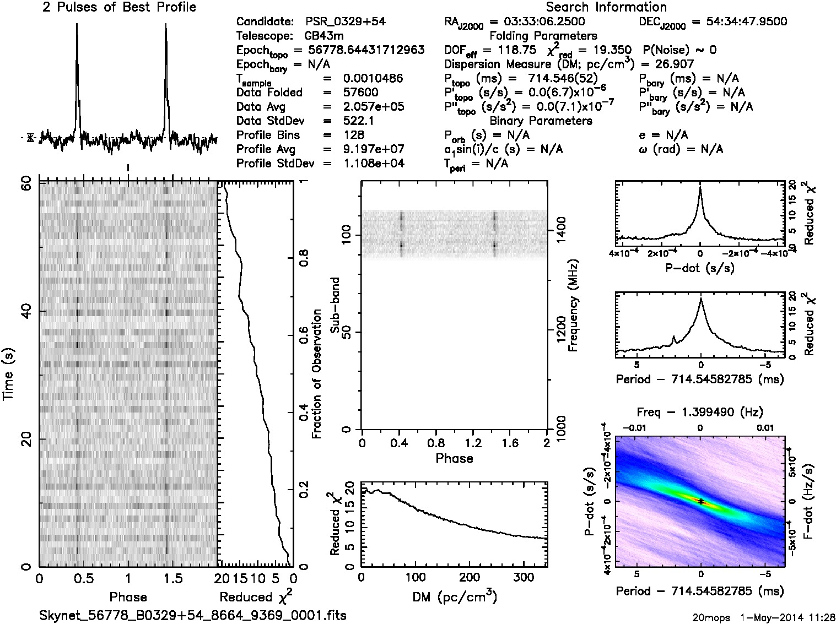
Notes:
This is the data that is returned when you observe a known pulsar with the 20 Meter. More on this topic as a forum discussion?

Slide 28
High Resolution
  Looking for atomic and molecular transitions (spectral lines)
  Atomic Hydrogen and Hydroxyl can be observed with the 20 Meter.
Notes:
You could do the spectrum tubes and diffraction gratings activity here.

Slide 29
Gas Spectra
Neon
Sodium
434 nm
486 nm
656 nm
Hydrogen
Notes:
Bottom one is hydrogen. Lines are produced as electrons jump from higher energy levels to lower ones. Energy released in the form of specific wavelengths or colors of light.

Slide 30
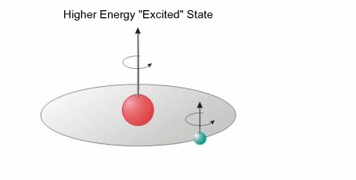
Electron accelerates to a lower energy state
Notes:
We also get radio spectral lines from hydrogen. This is called a spin flip transition. The atom has less energy after the electron flips – the energy equivalent to a 21 cm radio wave, with a frequency of 1420.41 MHz

Slide 31
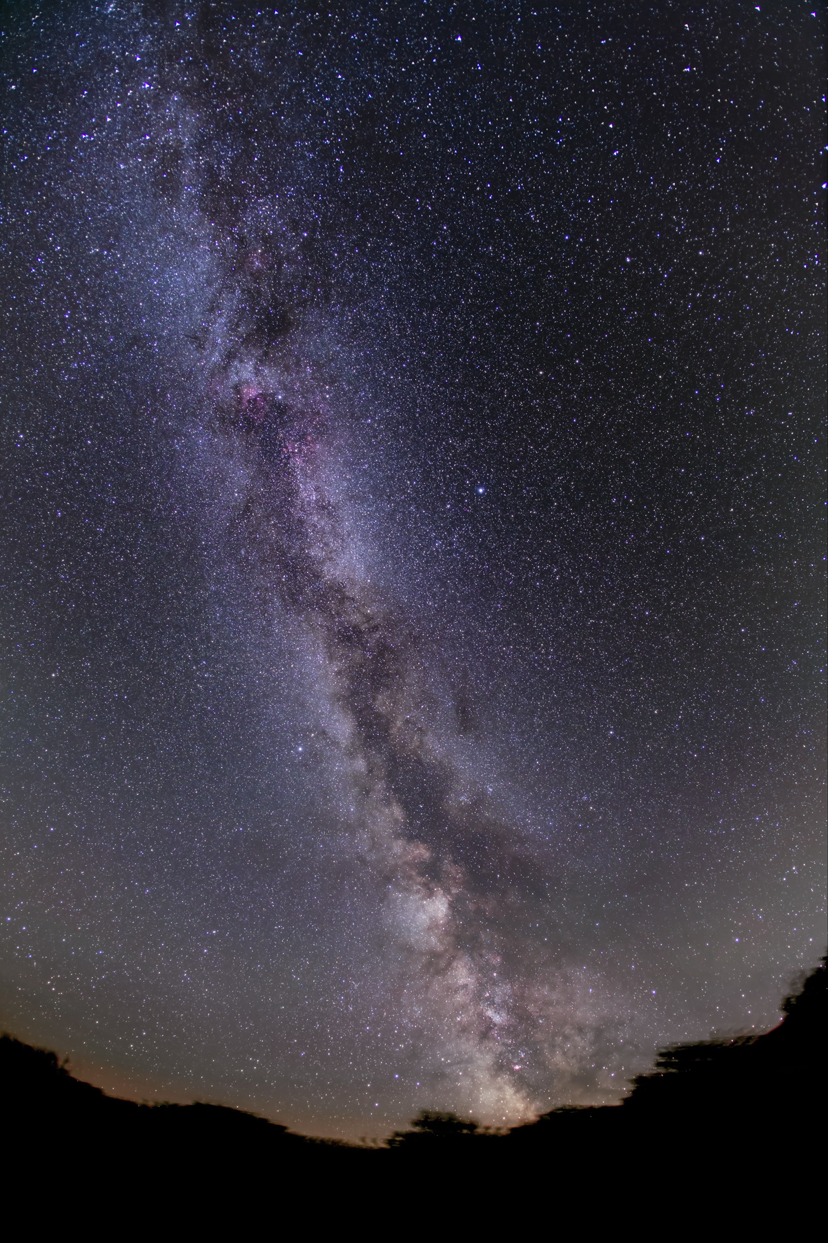
Notes:
Where will you look for atomic hydrogen signals? Perhaps the plane of the Milky Way?

Slide 32
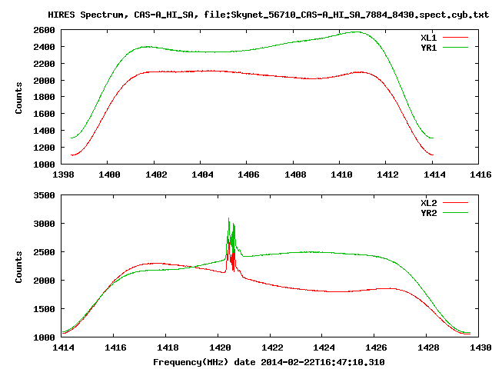
Notes:
20 Meter Quick Look Data. To zoom in on these spectral lines, import the ascii data into excel.

