Slide 1
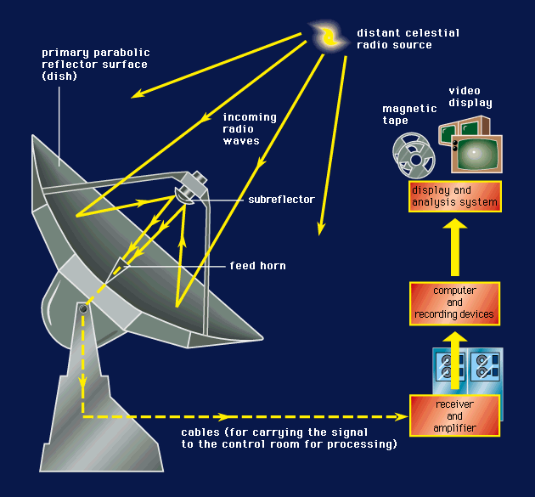
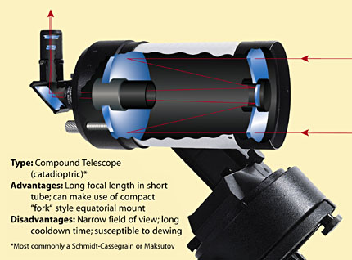
Radio Telescope
Optical Telescope
Notes:
Radio telescopes also have parabolic mirrors, but they’re not shiny enough to reflect visible light well. The receiver is at the focal point. We can’t see radio waves and so must put an electronic detector at the focal point.

Slide 2
Weird things about radio telescopes:
FOV and angular resolution is the same for a radio telescope – One pixel camera. For the 20 Meter = .7 degrees
Exposure Time = Integration time, but radio telescope must move or map to make an image.
Sky patterns: Daisy, Map, On-Off, Track
Low Spectral /High Spectral resolution

Slide 3
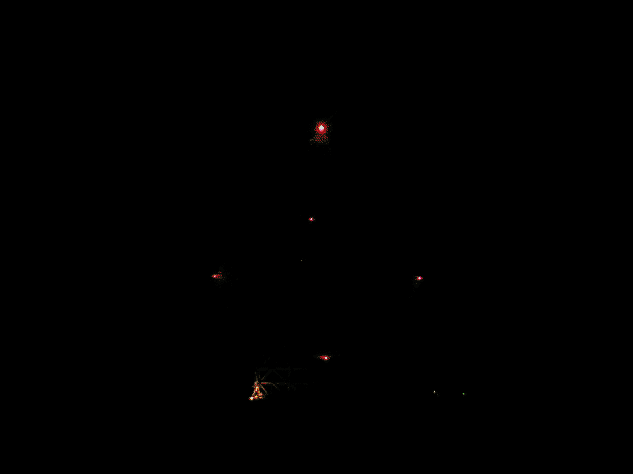
Robert C. Byrd Green Bank Telescope
2000 dedication.
100 x 110m, novel offset design.
Most versatile telescope: 100 MHz-100 GHz.

Slide 4
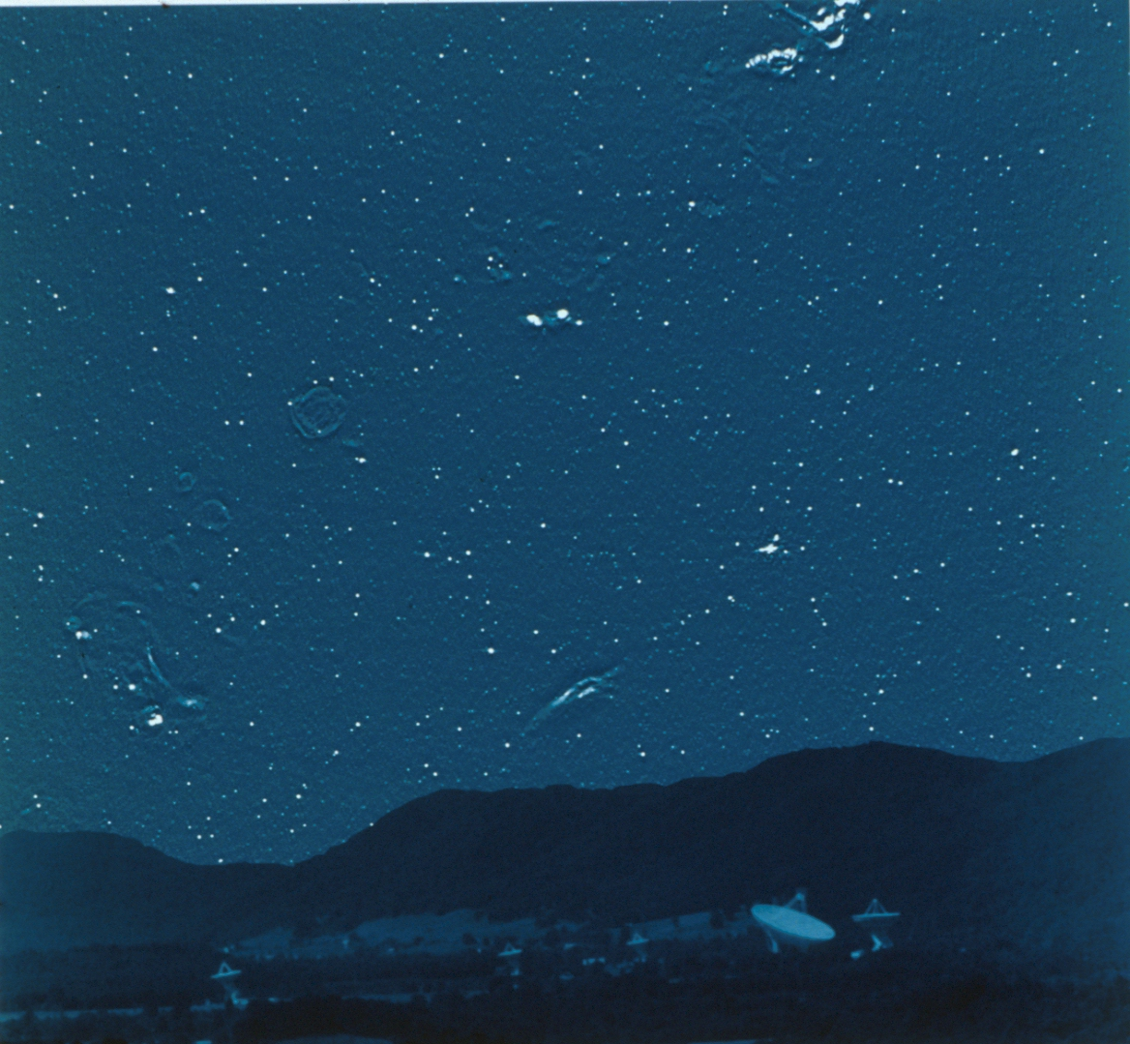
The
Radio
Sky
Notes:
This view of the radio sky. If your eyes ( which would be about 200 feet across!!) could see radio waves instead of light this is what the sky would look like Does it look similar to the night sky shown in the previous slide? You can see some large objects and many “point sources” which look like stars. What are these objects?

Slide 5
Observing Modes with the 20 Meter Telescope
Notes:
Just how are radio waves created in celestial objects?

Slide 6
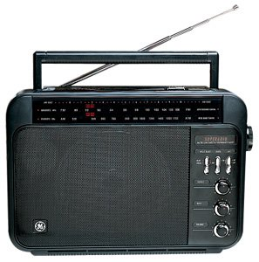
Low Resolution/High resolution?

Slide 7
Low Resolution
EG 1: Mapping nebulae

Slide 8

Electron accelerates as it passes near a proton.
radio waves are released
Notes:
Electron is green. Proton is red. Situation where the gas is hot enough to ionize. The protons does not capture the electron to form an atom. But when the electron whizzes by its path is bent because it is attracted to the proton. That’s an acceleration. EM waves must be released.

Slide 9
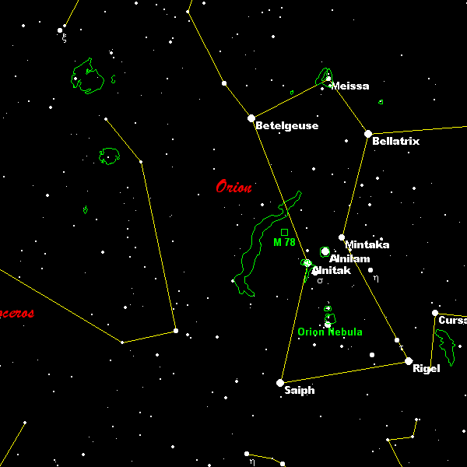
Notes:
Orion constellation – from a planetarium program. This slide shows objects that emit visible light: stars mostly, and also some nebulae.
For a free and excellent planetarium program try Cartes du Ciel: http://www.stargazing.net/astropc/index.html.

Slide 10
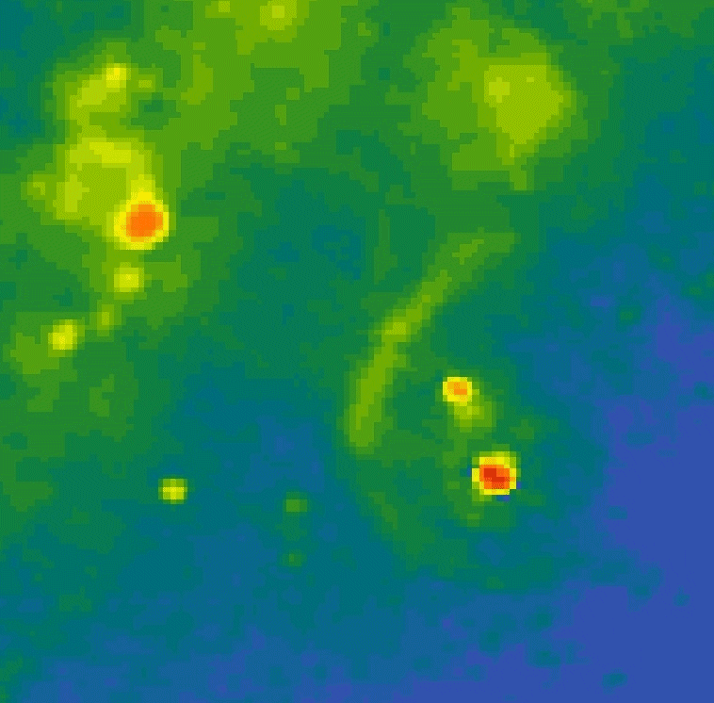
Notes:
This is the RADIO image of the same region, and to the same SCALE. You don’t see the stars here, but where the gas is. The stronger the radio waves, the redder the color. Nebulae emit radio waves because the gas is ionized and there are free electrons and free protons. The emission mechanism is called “free-free” emission because the protons and electrons remain unbound before and after a close encounter.

Slide 11
Low resolution
EG 2: mapping the Milky Way, detecting galaxies with blackholes

Slide 12
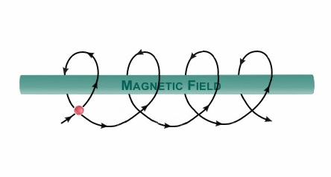
Electrons accelerate around magnetic field lines
Notes:
Since circular motion represents acceleration (i.e., a change in velocity), the electrons radiate photons of a characteristic energy, corresponding to the radius of the circle.
The following slides show examples of objects that emit radio waves this way

Slide 13
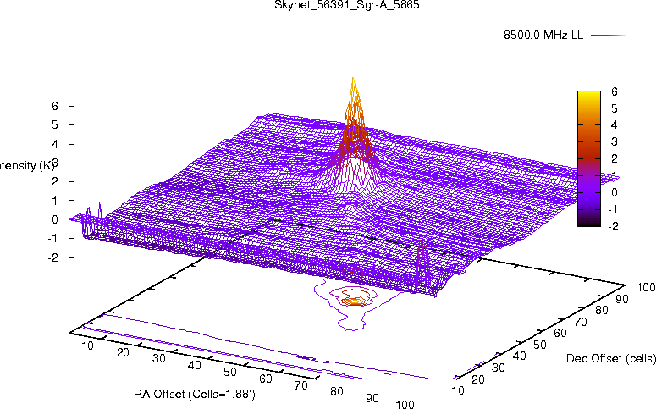

Slide 15
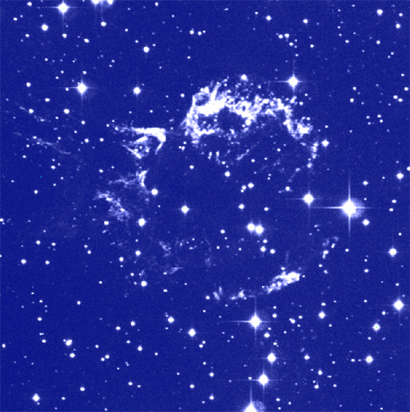
Notes:
Cas A SNR – optical photo
(from Chandra web site http://chandra.harvard.edu/pub.html)

Slide 16
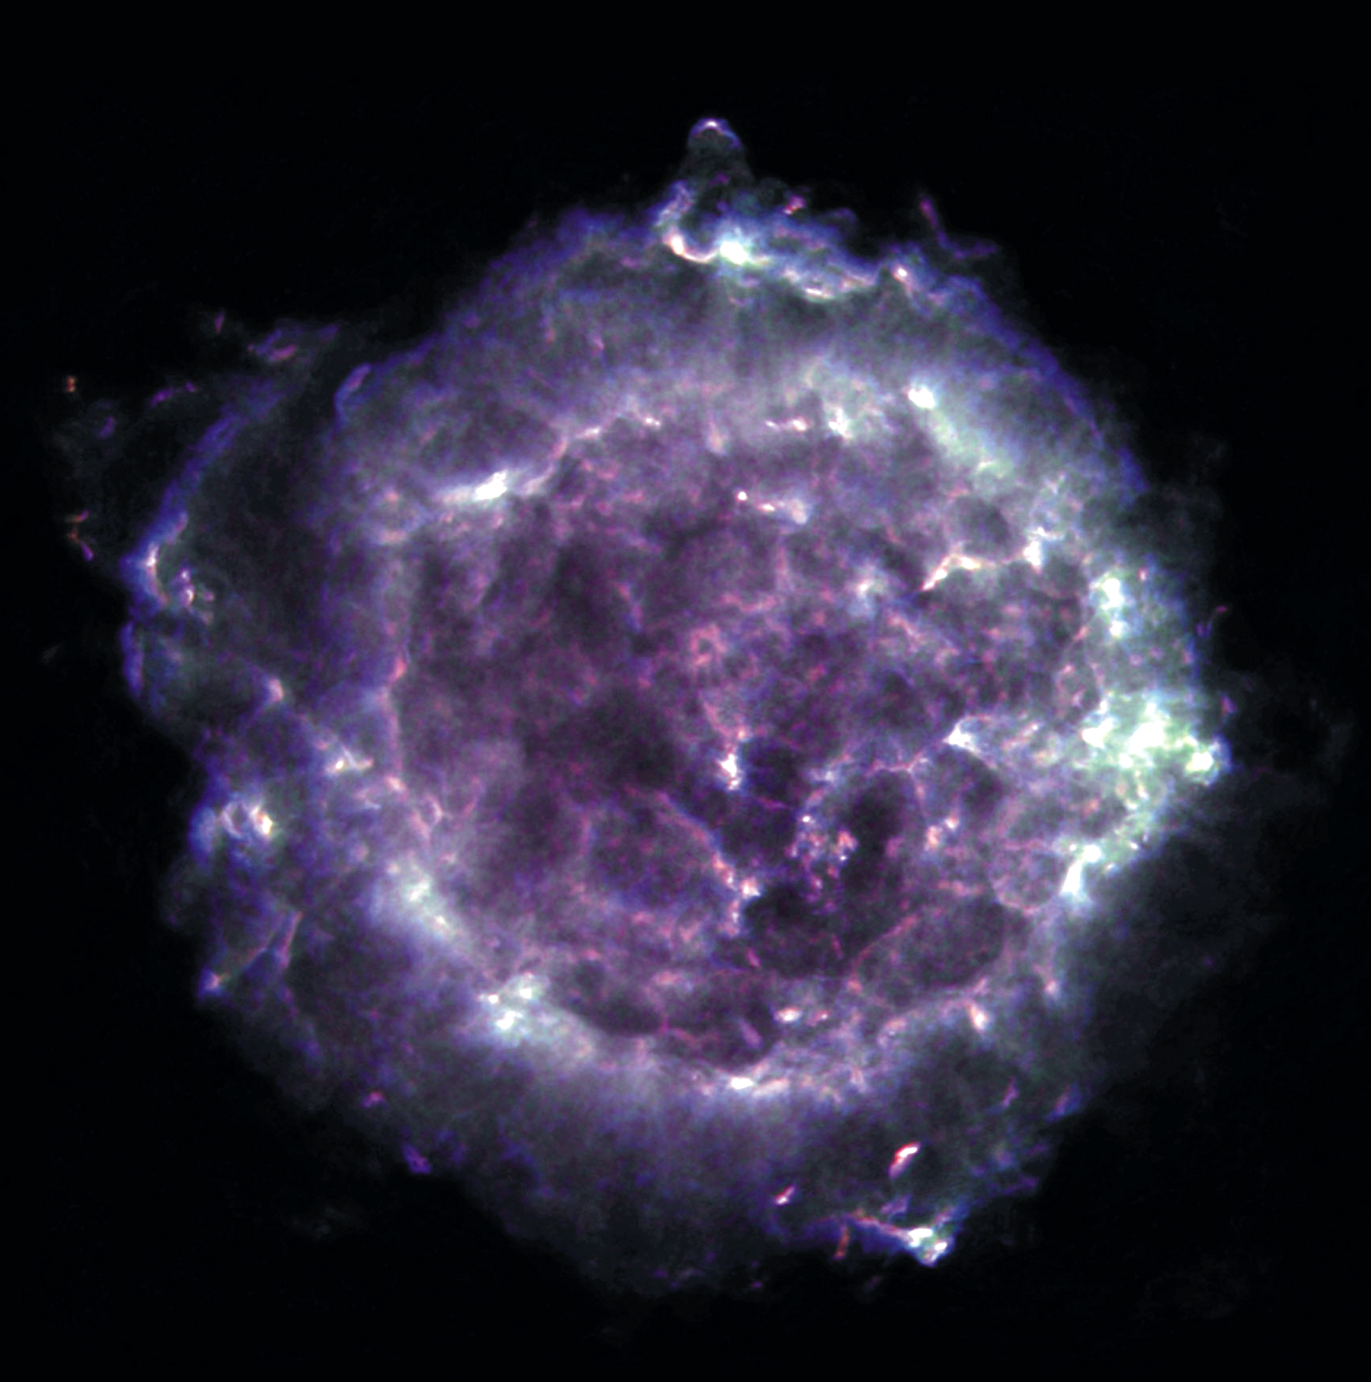
Notes:
Cas A in the Radio. Next to the sun, the “brightest” radio source in the sky. This is a supernova remnant and could have a neutron star at its center.

Slide 17
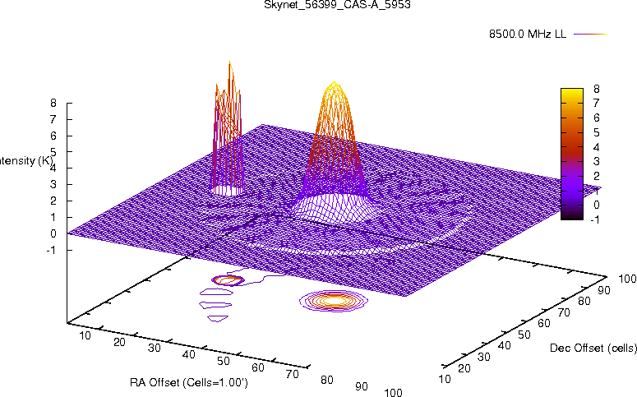

Slide 18
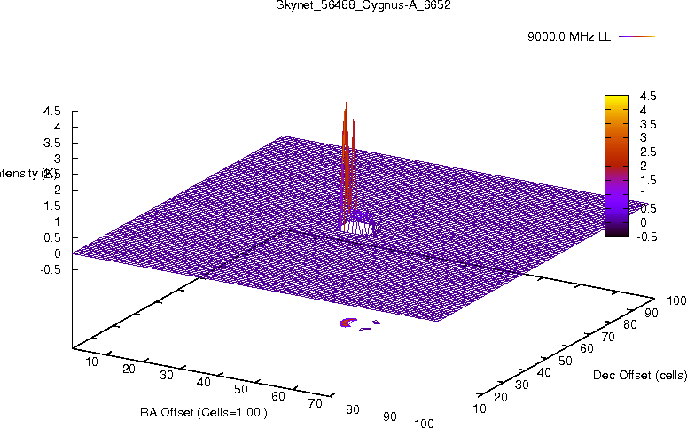

Slide 19

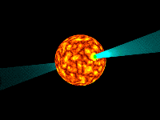
Low resolution
0329+54
EG 3: Known pulsars
Vela
0531+21
Notes:
Diagram of a pulsar. A pulsar is a stellar remnant – a neutron star. A pulsar has the mass of the Sun, but is as small as Milwaukee! We detect a narrow beam of radio waves each time the pulsar spins toward us.

Slide 20
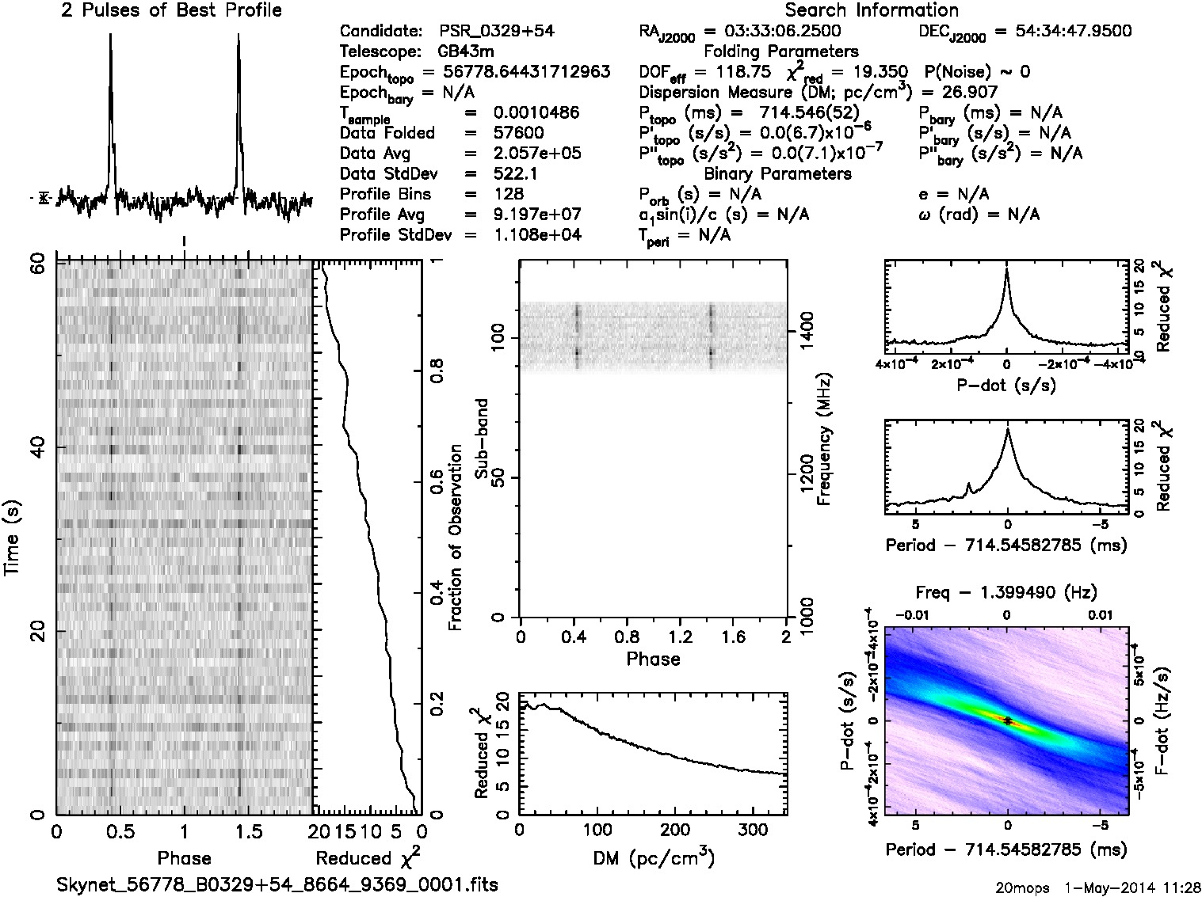

Slide 21
High Resolution
  Looking for Hydrogen-Atomic and molecular transitions (spectral lines)
Notes:
You could do the spectrum tubes and diffraction gratings activity here.

Slide 22
Gas Spectra
Neon
Sodium
434 nm
486 nm
656 nm
Hydrogen
Notes:
Bottom one is hydrogen. Lines are produced as electrons jump from higher energy levels to lower ones. Energy released in the form of specific wavelengths or colors of light.

Slide 23
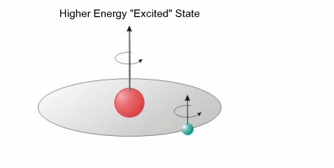
Electron accelerates to a lower energy state
Notes:
We also get radio spectral lines from hydrogen. This is called a spin flip transition. The atom has less energy after the electron flips – the energy equivalent to a 21 cm radio wave!

Slide 24
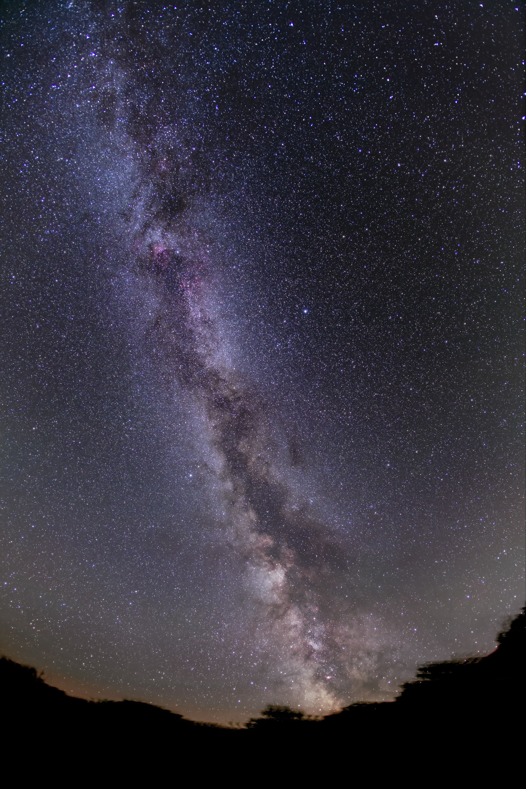
Notes:
NGC 628 – spiral galaxy, optical image

Slide 25
