Slide 1
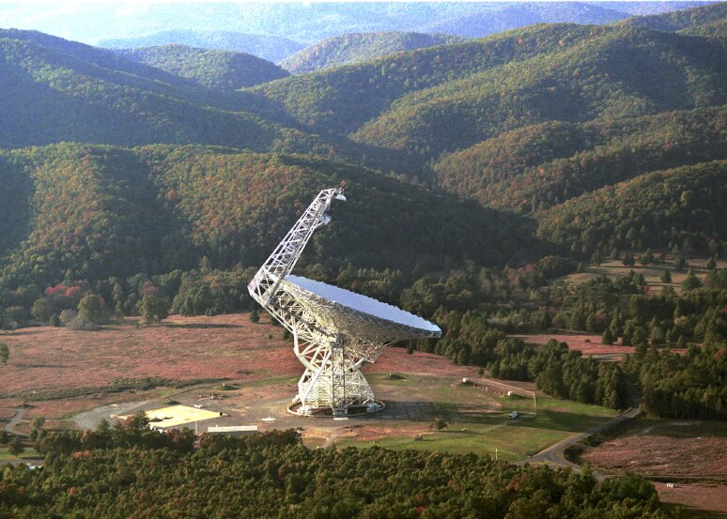
Radio Astronomy and the NRAO
Sue Ann Heatherly
National Radio Astronomy Observatory

Slide 2
What is the
National Radio Astronomy Observatory?
Mission:
to develop and operate state-of-the-art instruments for use by scientists at universities and institutes in the U.S. and around the world.
  Four Telescope Facilities
  Central Development Laboratory
  Headquarters

Slide 3
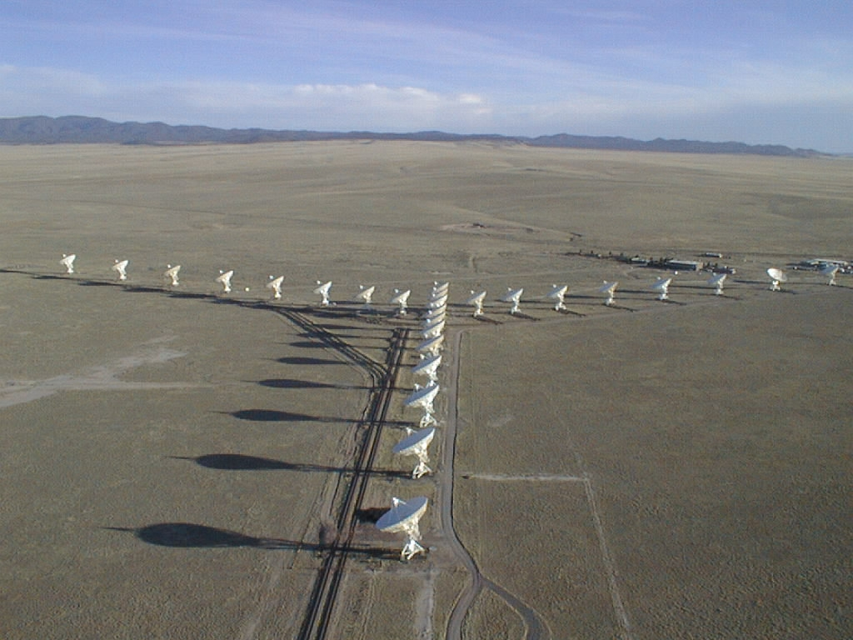
The Very Large Array (VLA)
1980 dedication. Upgraded 2012.
Twenty-seven 25-m antennas in reconfigurable array outside of Socorro, NM.
Has produced more published science than any other telescope on the face of the Earth!

Slide 4
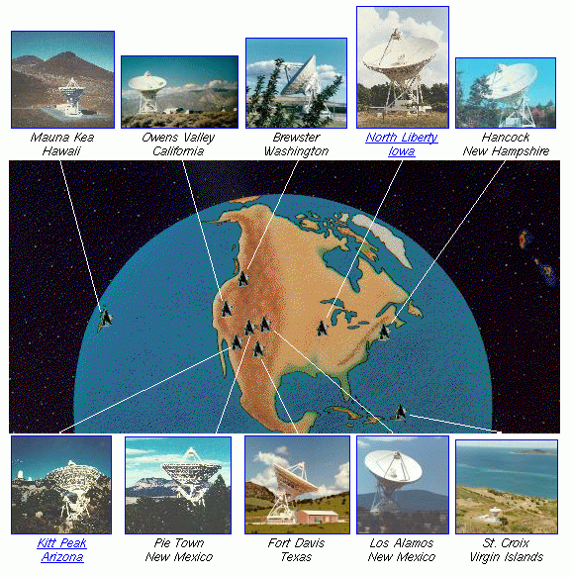
Very Long Baseline Array (VLBA)
1993 dedication.
Operated from Socorro.
Ten 25-m antennas spread across US, Canada, P.R.
Highest resolution imager in astronomy.

Slide 5
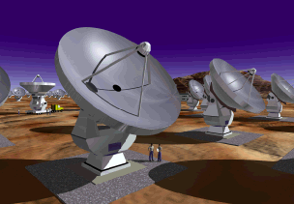
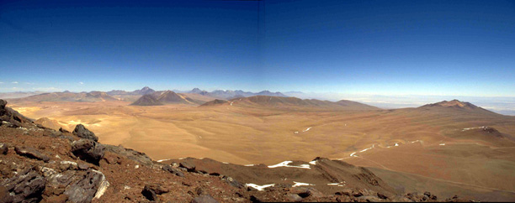
Atacama Large Millimeter Array
64 12-meter diameter dishes for millimeter and sub-millimeter-wave imaging.
Presently under construction in Chile. Early Science underway

Slide 6
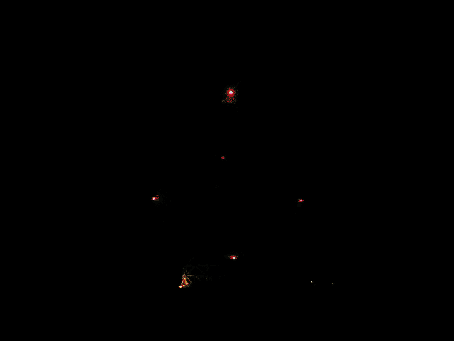
Robert C. Byrd Green Bank Telescope
2000 dedication.
100 x 110m, novel offset design.
Most versatile telescope: 100 MHz-100 GHz.

Slide 7
What is the Radio Universe Like?
Notes:
Just how are radio waves created in celestial objects?

Slide 8
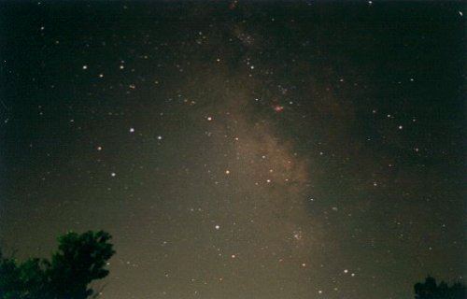
The Visible Sky, Sagittarius Region
Notes:
This is a photo of the summer sky looking toward the south. Sagittarius, the Archer (which looks like a teapot) can be seen, as well as the Milky Way. Ask: what do you see? To notice: the sky is full of stars, dark regions and glowing pink areas Glowing areas are nebulae – gas energized by hot new stars within. The dark areas are “space dust”, We cannot see into these regions with optical telescopes. Dust blocks light.

Slide 9
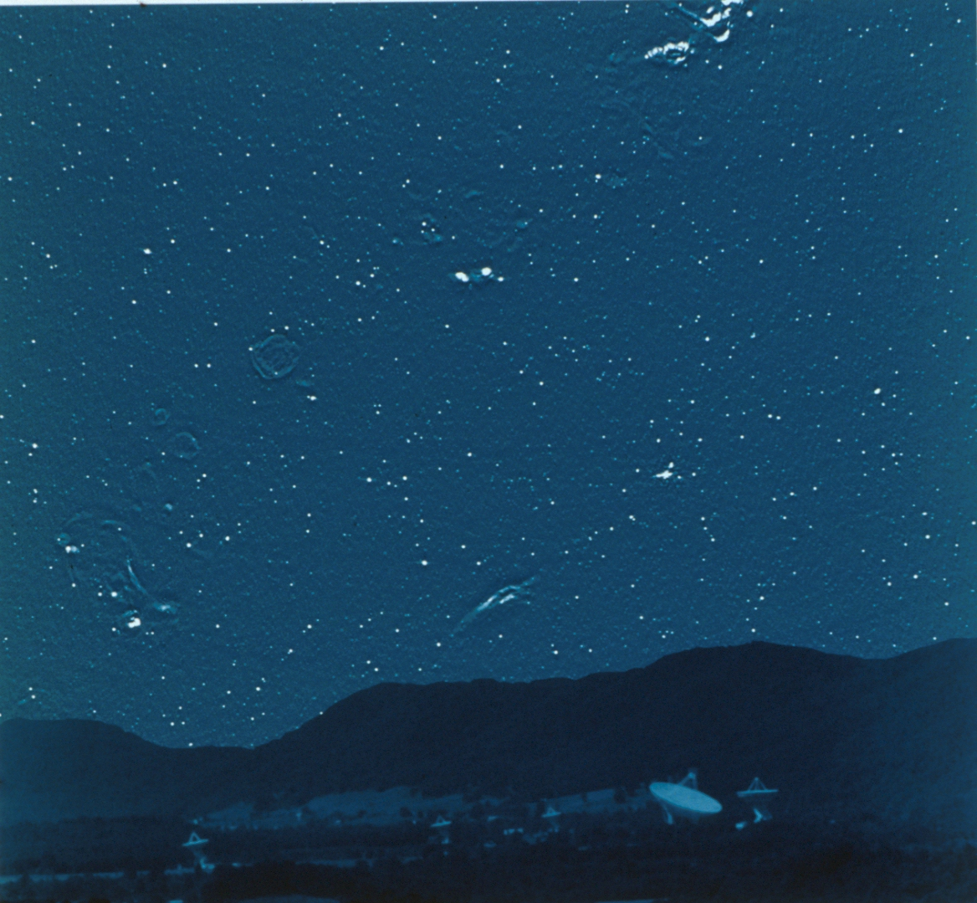
The
Radio
Sky
Notes:
This view of the radio sky. If your eyes ( which would be about 200 feet across!!) could see radio waves instead of light this is what the sky would look like Does it look similar to the night sky shown in the previous slide? You can see some large objects and many “point sources” which look like stars. What are these objects?

Slide 10
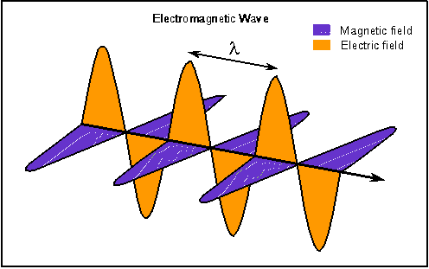
Electromagnetic radiation
A traveling, massless packet of energy --OR an oscillating electric and magnetic field
  Also known as: radiation, light wave, photon
Travels at the speed of light (by definition).
Remarkably, all radiation travels at this speed, regardless of whether is carries a lot of energy or only a little
Animation from Nick Strobel’s Astronomy Notes (www.astronomynotes.com)
Notes:
First, Radio waves are electromagnetic waves, like light. An oscillating electric field induces an oscillating magnetic field which in turn makes an oscillating electric field. You get the picture! Once you start an EM wave they keep going!

Slide 11
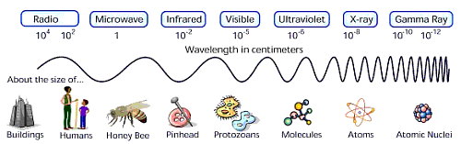
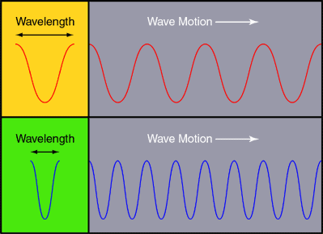
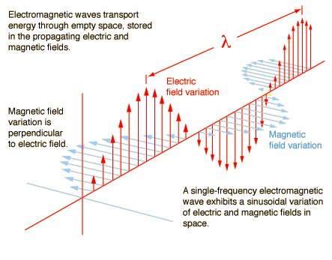
A light wave is a light wave, no matter how long...
Notes:
Just to help you understand about radio and light. This shows that visible light, and microwaves, and X-rays, and radio waves, are really all the same thing. The only difference is how long the waves are. If you’re very, very energetic, you’re called a gamma ray (it takes a lot of energy to get the waves to be that close together. Think of it as squishing together a spring. The smaller the spring, the more energy it takes to compress it.
To get gamma rays, you need some of the most energetic events in the Universe. Exploding stars, massive black holes, and other things create gamma rays. They’re smaller than some atomic nuclei.
You all have had X-rays, and they’re pretty energetic too. So energetic that they can pass right through skin (but not so easily through bone).
Visible light -- the stuff you see -- is made in pretty energetic places too (like burning wood, or when electricity runs through a wire). The different colors that you see are simply light waves of difference length.
When you get all the way down to the longest wave, you have radio waves. Which can be made by some relatively cool objects. And that’s very good when you’re studying space -- because not everything is lit up by a burning star.

Slide 12
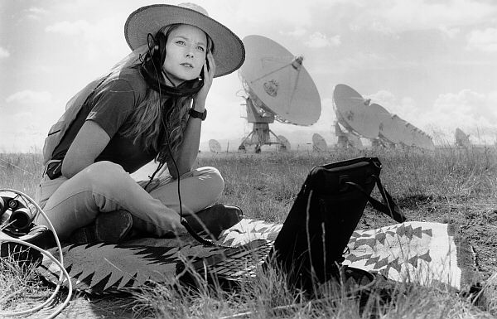
Radio Waves are NOT sound!
Notes:
Nuff said.

Slide 13
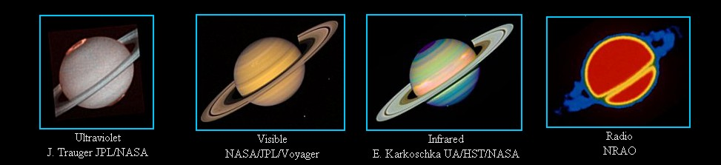
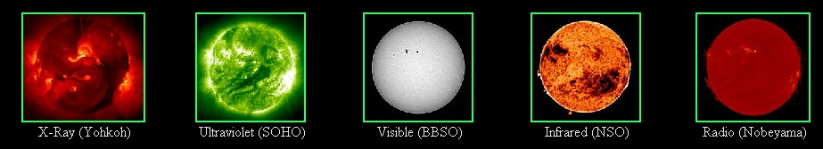
Notes:
Astronomers use telescopes to study objects at all wavelengths. Here you see examples of objects at multiple wavelengths: Saturn, and the Sun Taken from http://www.ipac.caltech.edu/Outreach/Multiwave/multiwave.html
Look at the cool aurora in the UV image of Saturn. Look at how different the radio image is. This is a false color image where red shows the most radio waves, blue the least. The rings of Saturn do not emit radio waves, but the planet does.
The images of the sun show a similarity between the visible light image and the radio image.

Slide 14
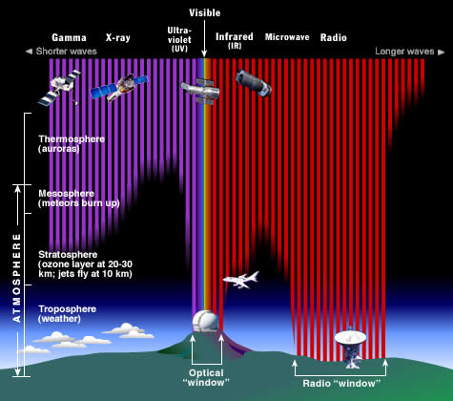
Optical and Radio can be done from the ground!
Notes:
Nice when you need to fix your telescope!

Slide 15
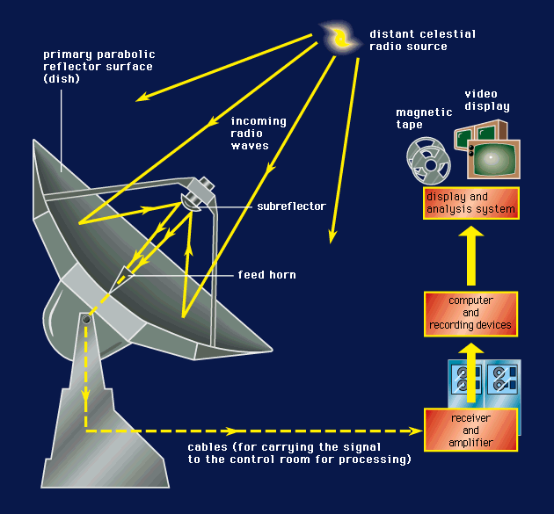
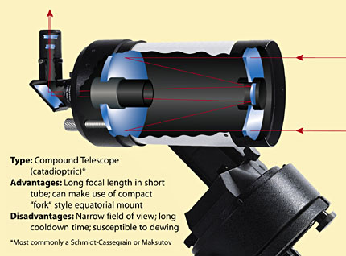
Radio Telescope
Optical Telescope
Nowadays, there are more similarities between optical and radio telescopes than ever before.
Notes:
Radio telescopes also have parabolic mirrors, but they’re not shiny enough to reflect visible light well. The receiver is at the focal point. We can’t see radio waves and so must put an electronic detector at the focal point.

Slide 16
What emits radio waves?
Notes:
Just how are radio waves created in celestial objects?

Slide 17
Recipe for Radio Waves
1. Hot Gases

Slide 18

Electron accelerates as it passes near a proton.
EM waves are released
Notes:
Electron is green. Proton is red. Situation where the gas is hot enough to ionize. The protons does not capture the electron to form an atom. But when the electron whizzes by its path is bent because it is attracted to the proton. That’s an acceleration. EM waves must be released.

Slide 19
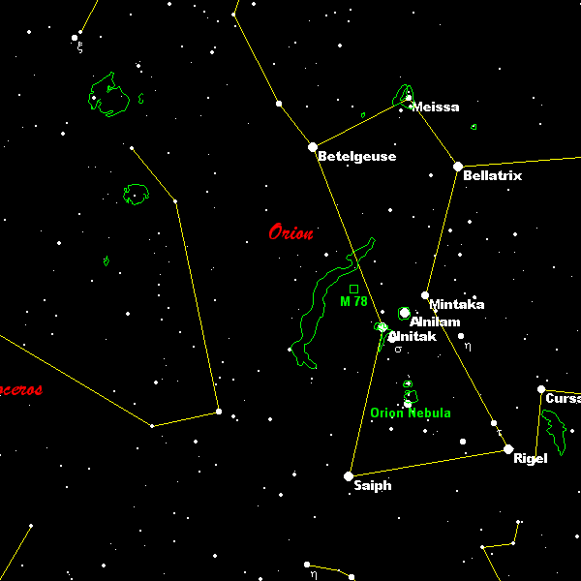
Notes:
Orion constellation – from a planetarium program. This slide shows objects that emit visible light: stars mostly, and also some nebulae.
For a free and excellent planetarium program try Cartes du Ciel: http://www.stargazing.net/astropc/index.html.

Slide 20
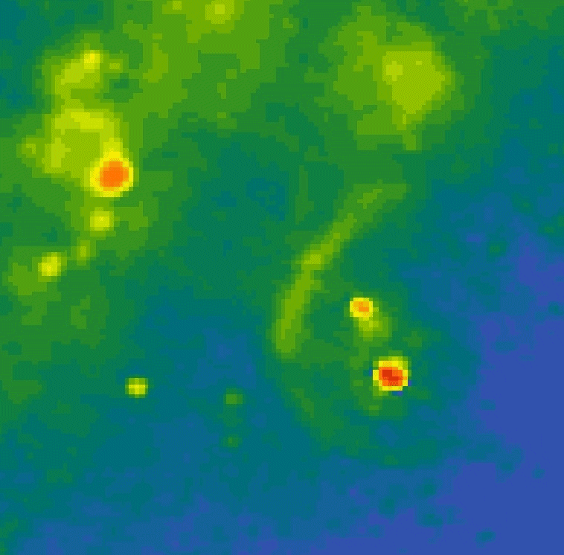
Notes:
This is the RADIO image of the same region, and to the same SCALE. You don’t see the stars here, but where the gas is. The stronger the radio waves, the redder the color. Nebulae emit radio waves because the gas is ionized and there are free electrons and free protons. The emission mechanism is called “free-free” emission because the protons and electrons remain unbound before and after a close encounter.

Slide 21
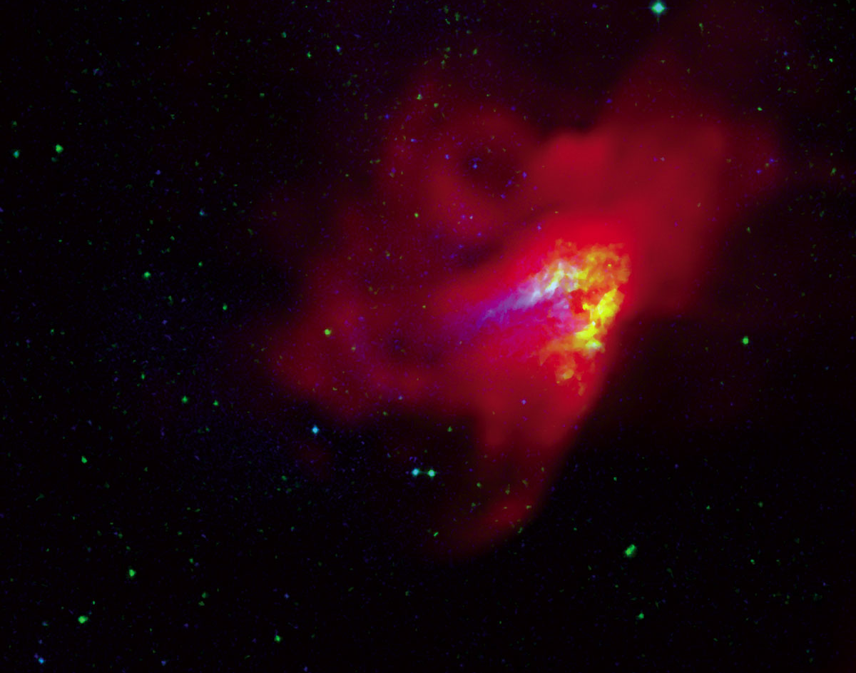
Notes:
The Omega Nebula – a star formation region. Blue = optical, green = IR, red = GBT radio image ( 8.6 GHz): wisps and swirls previously not seen by a radio telescope Radio waves are produced by the mechanism in previous slide

Slide 22
Recipe for Radio Waves
  2. Atomic and molecular transitions (spectral lines)
Notes:
You could do the spectrum tubes and diffraction gratings activity here.

Slide 23
Gas Spectra
Neon
Sodium
434 nm
486 nm
656 nm
Hydrogen
Notes:
Bottom one is hydrogen. Lines are produced as electrons jump from higher energy levels to lower ones. Energy released in the form of specific wavelengths or colors of light.

Slide 24
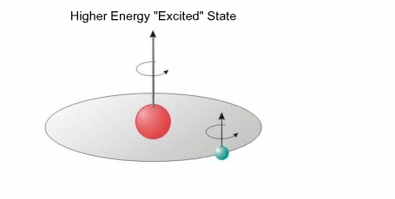
Electron accelerates to a lower energy state
Notes:
We also get radio spectral lines from hydrogen. This is called a spin flip transition. The atom has less energy after the electron flips – the energy equivalent to a 21 cm radio wave!

Slide 25
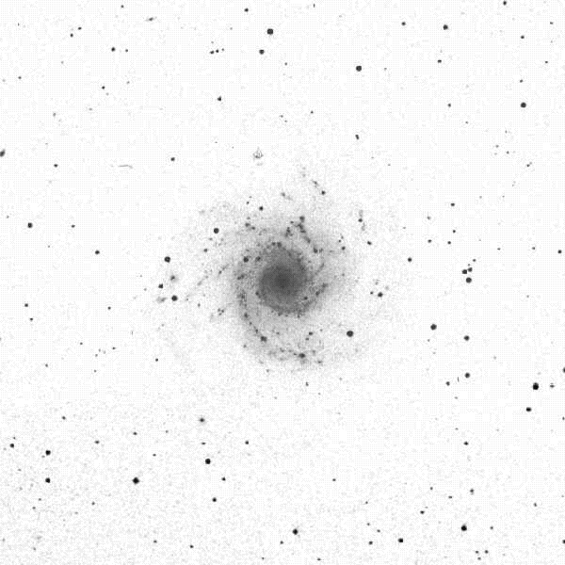
Notes:
NGC 628 – spiral galaxy, optical image

Slide 26
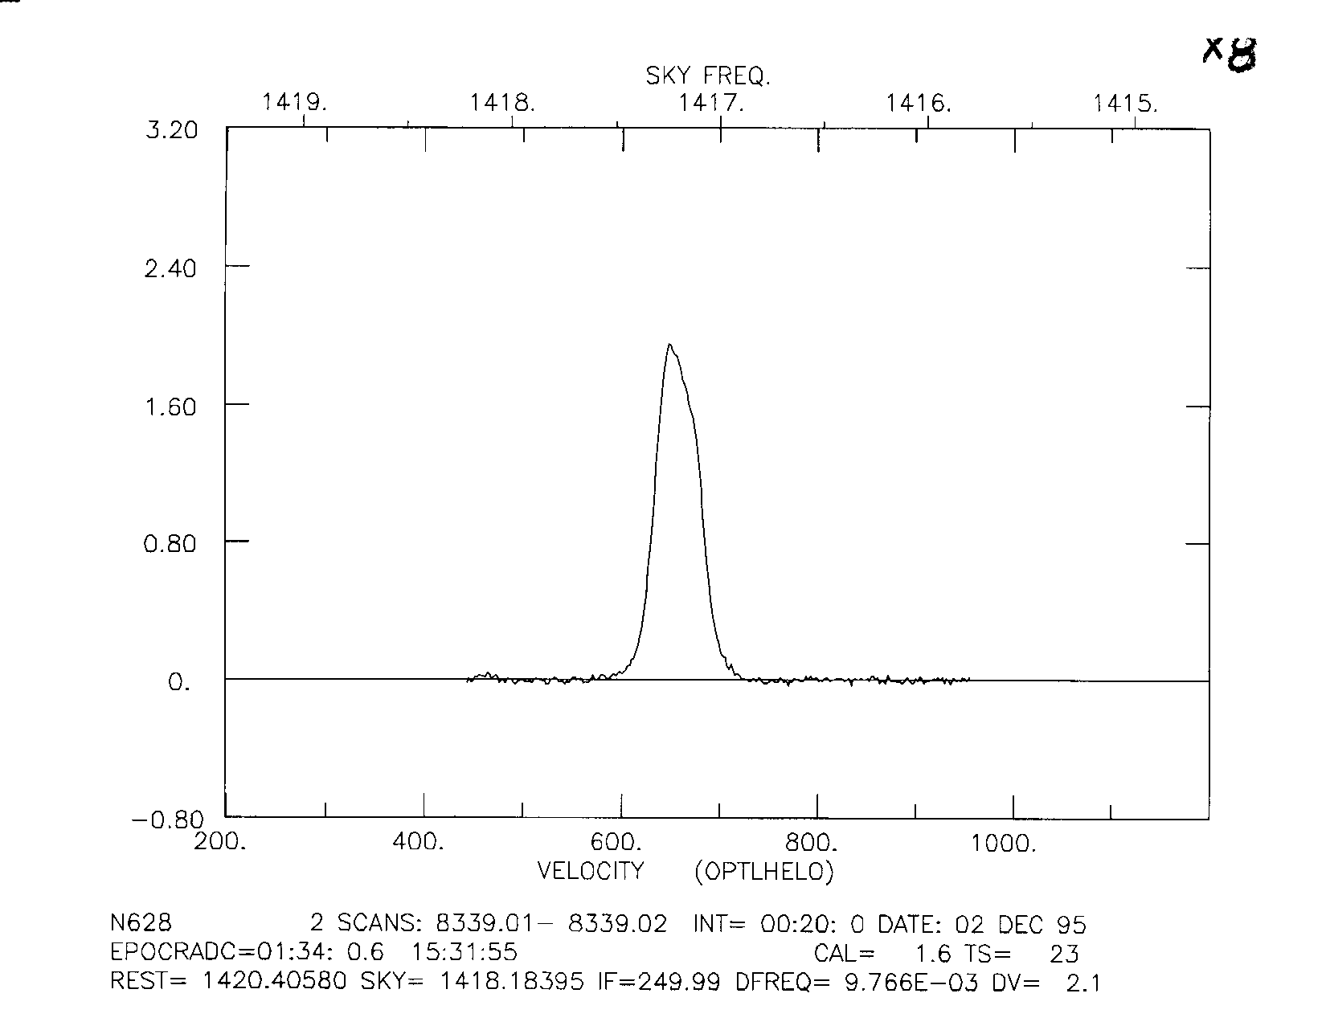
Notes:
NGC 628 21 cm Hydrogen profile
Hydrogen atoms emit radio waves at one wavelength: 21 cm. A 21 cm wavelength is equivalent to a frequency of 1420.41 MHz. This is a RADIO spectral line. This spectrum is cool because it tells us how much hydrogen is in this galaxy, AND how fast the galaxy is moving. This line is Doppler shifted!

Slide 27
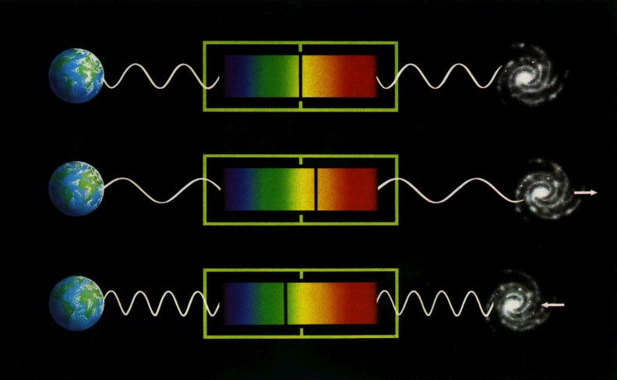
Doppler Shift

Slide 28
Recipe for Radio Waves
  3. Electrons and magnetic fields

Slide 29
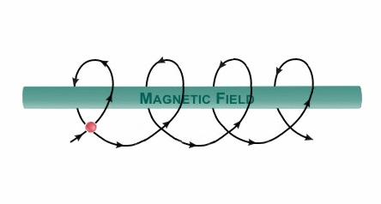
Electrons accelerate around magnetic field lines
Notes:
Since circular motion represents acceleration (i.e., a change in velocity), the electrons radiate photons of a characteristic energy, corresponding to the radius of the circle.
The following slides show examples of objects that emit radio waves this way

Slide 30
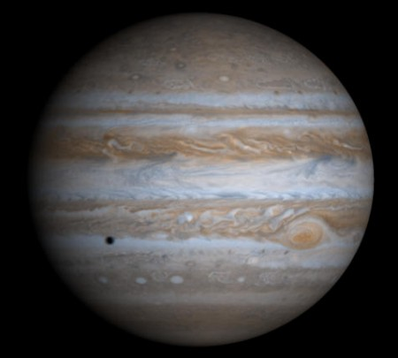
Notes:
Examples follow.
1.Jupiter: Jupiter – optically, we see reflected light – can study Jupiter’s cloud tops

Slide 31
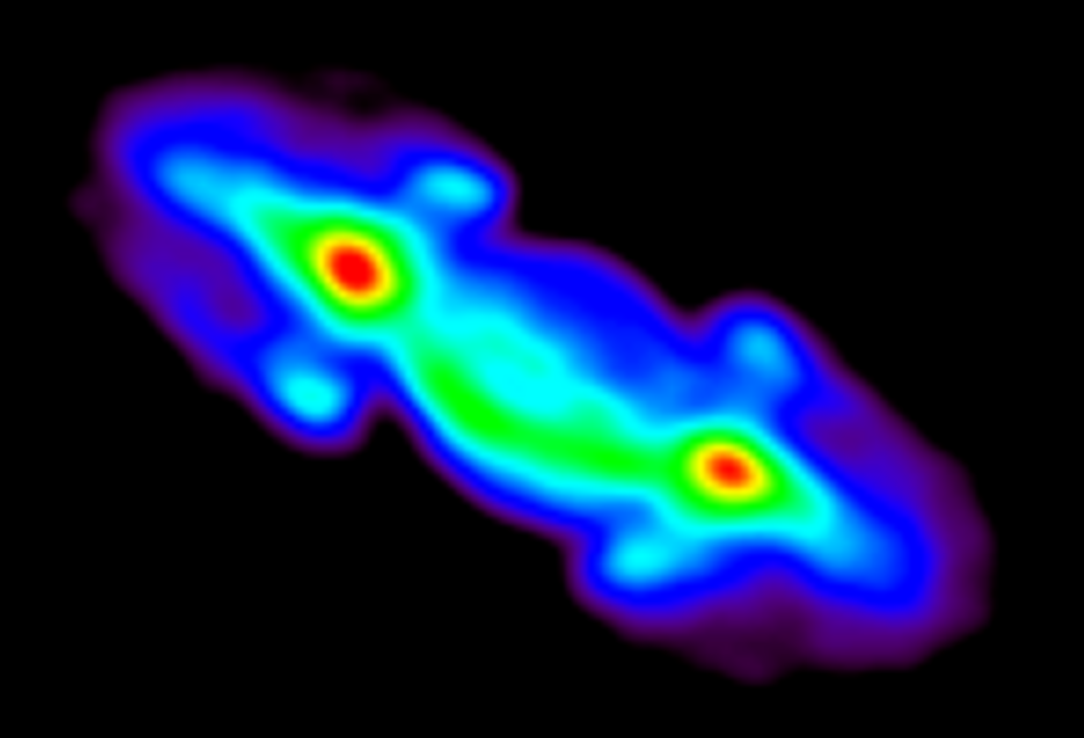
Notes:
Radio image of Jupiter – color palette: purple-red
Jupiter has a strong magnetic field + charged particles

Slide 32
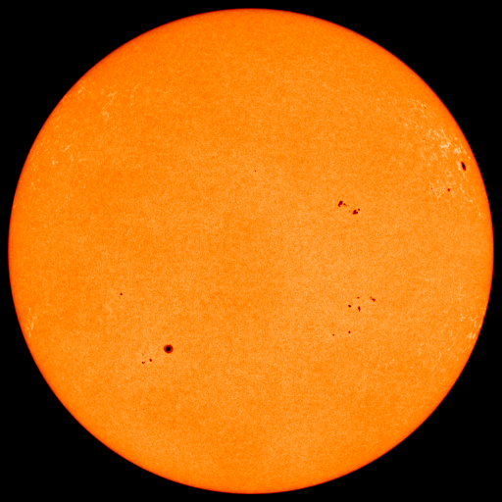
Notes:
Sun, optically

Slide 33
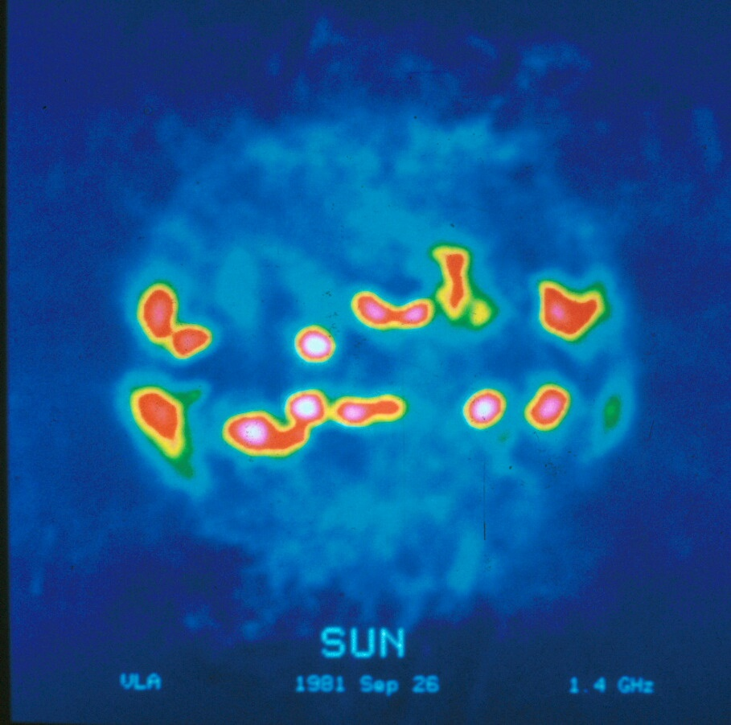
Notes:
Sun, radio – what places on the sun have intense magnetic fields? Sunspots!

Slide 34
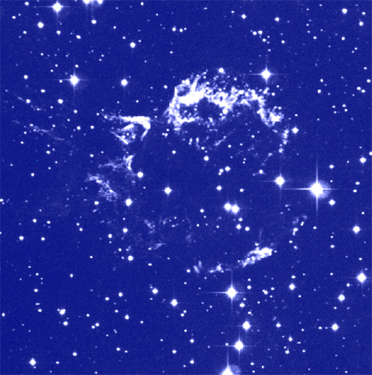
Notes:
Cas A SNR – optical photo
(from Chandra web site http://chandra.harvard.edu/pub.html)

Slide 35
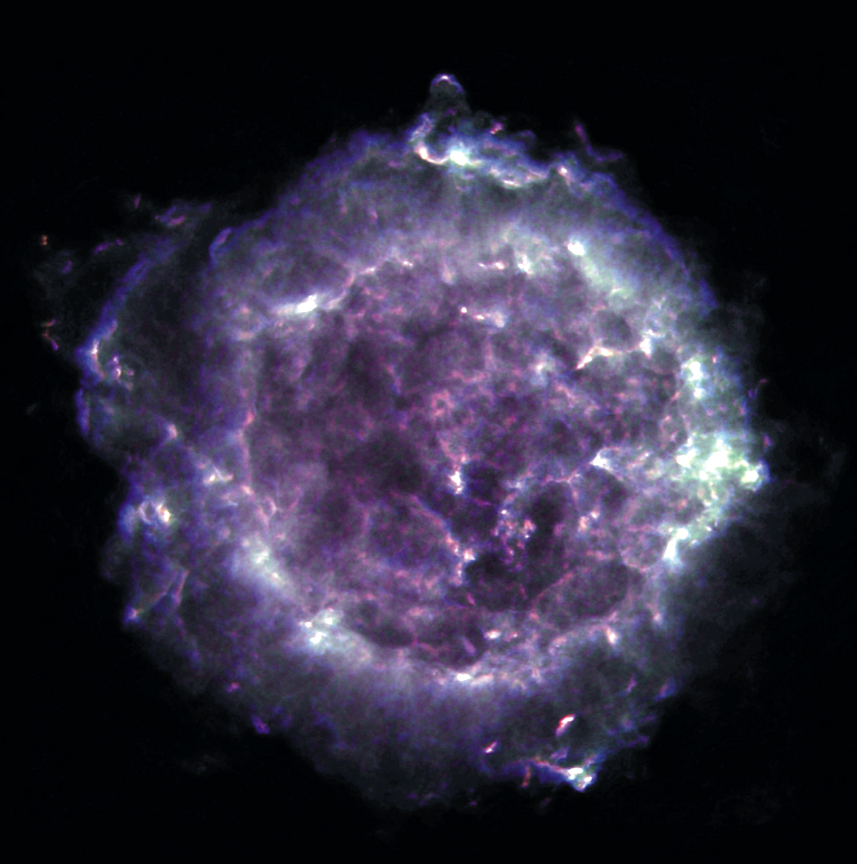
Notes:
Cas A in the Radio. Next to the sun, the “brightest” radio source in the sky. This is a supernova remnant and could have a neutron star at its center.

Slide 36
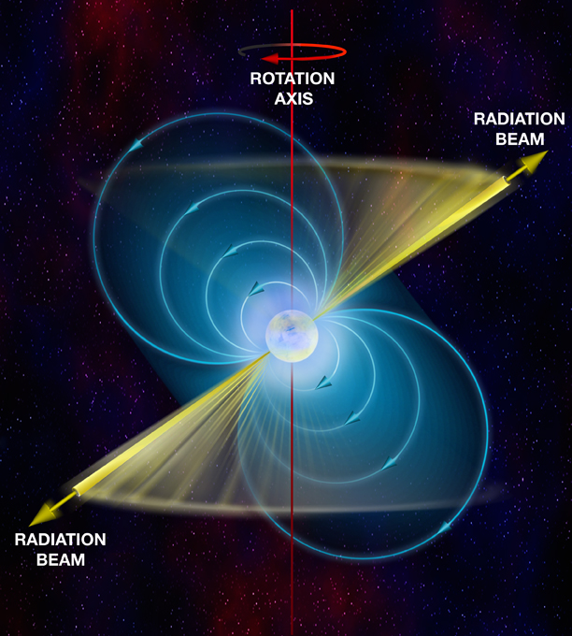

0329+54
Vela
0531+21
Notes:
Diagram of a pulsar. A pulsar is a stellar remnant – a neutron star. A pulsar has the mass of the Sun, but is as small as Milwaukee! We detect a narrow beam of radio waves each time the pulsar spins toward us.

Slide 37
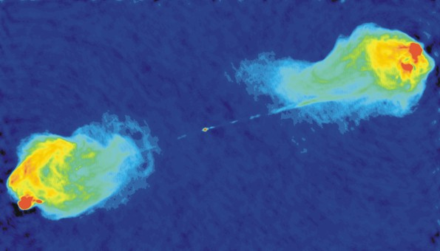
Notes:
A radio galaxy – so named because of the huge jets only seen in the radio. This one is Cygnus A – about 800 million light years away

Slide 38
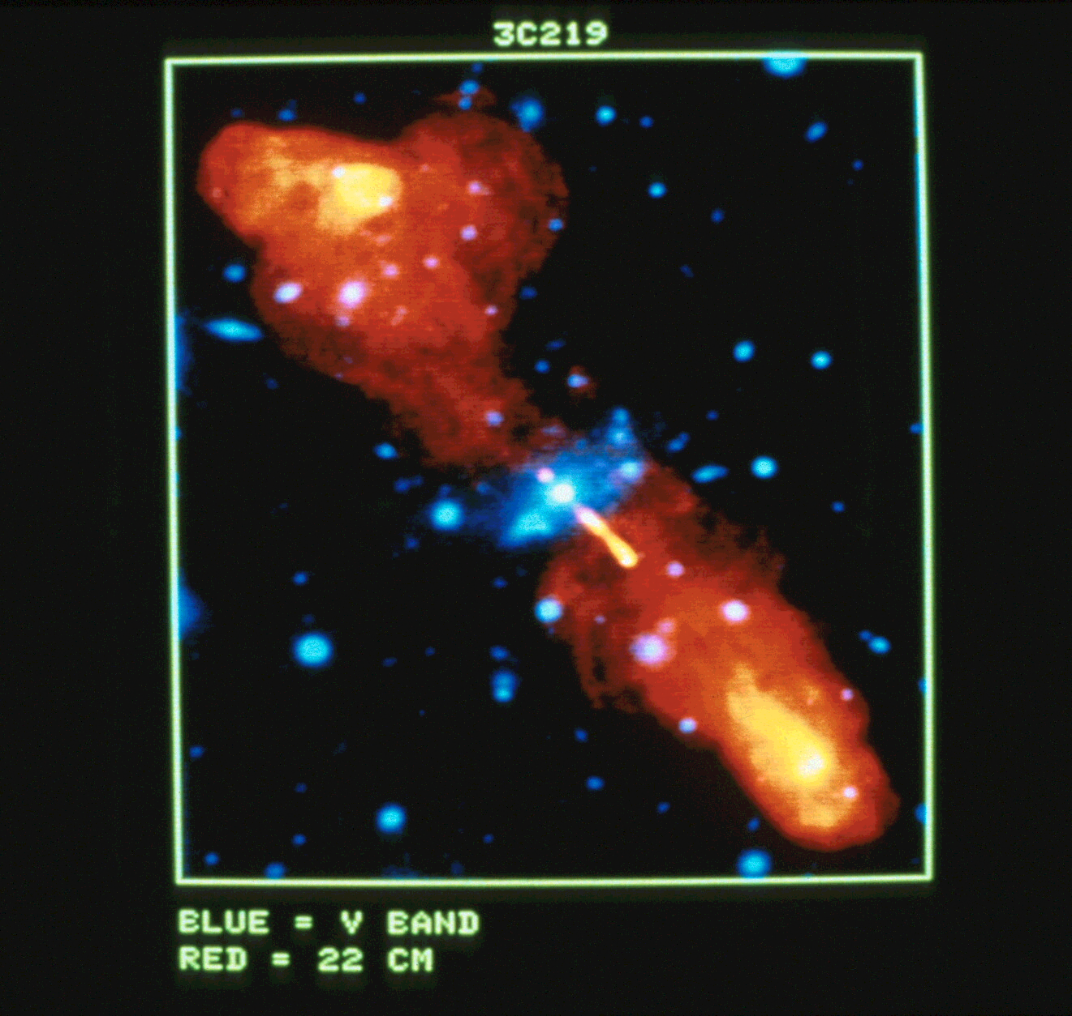
Notes:
3C219 composite image. Optical is in blue, radio in”flame” Notice the elliptical galaxy visible in the optical in the center. The radio jets (flame) are several times larger than a whole galaxy!! About 55 million light years away.

Slide 39
Notes:
So what do we have here? No stars! Faint circles are Supernova remnants, The elongated blob near the mountains is a nebula. The rest? The small bright objects? They are all radio galaxies and quasars – objects that can be 1,5 or even 10 billion light years away! ( or ago!)

Slide 40
Big Point:
Any accelerating charge emits radio waves!

Slide 41
Big Point # 2:
Celestial Objects at Enormous Distances Appear “dim”
0.00000000000000000000000001
watt/m²/Hz !!
Notes:
A Jansky is 1 x 10e-26 w/m squared/Hz

Slide 42
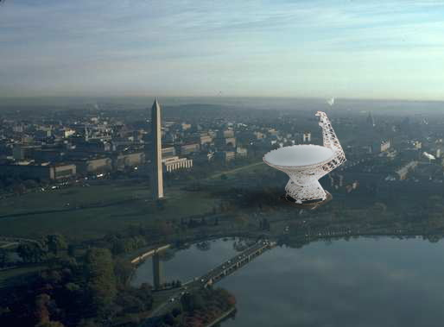

Slide 43
The Rest of the Story:
What else emits radio waves?

Slide 44
Everything!!
Notes:
At this point, let’s stop and investigate this claim. Materials include: PIDD(Portable Interference Detection Device, aka radio), and sources of RFI.
Activity is here: http://www.gb.nrao.edu/epo/interf.html

Slide 45
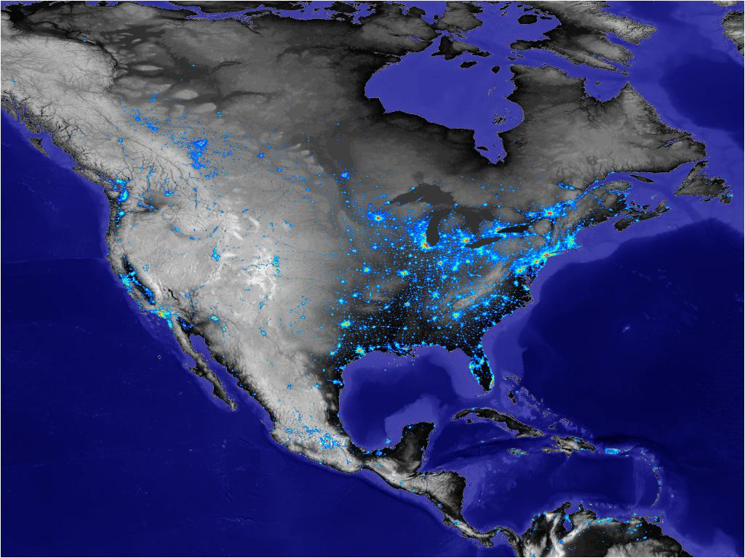
http://svs.gsfc.nasa.gov/index.html
Notes:
This shows light pollution in the US. We’re not worried about light pollution, but radio pollution.

Slide 46
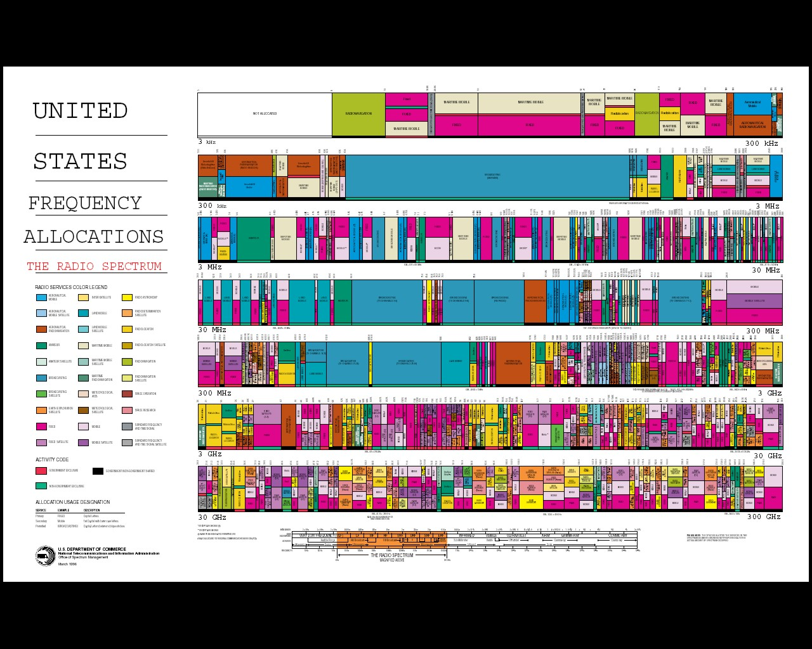
http://www.ntia.doc.gov/osmhome/allochrt.html
Notes:
Spectrum use chart. Only the bright yellow areas are protected for radio astronomy or other passive uses. From http://www.ntia.doc.gov/osmhome/allochrt.html
Not much for radio astronomy – and of course astronomers want to study objects at frequencies NOT assigned to radio astronomy as well!

Slide 47
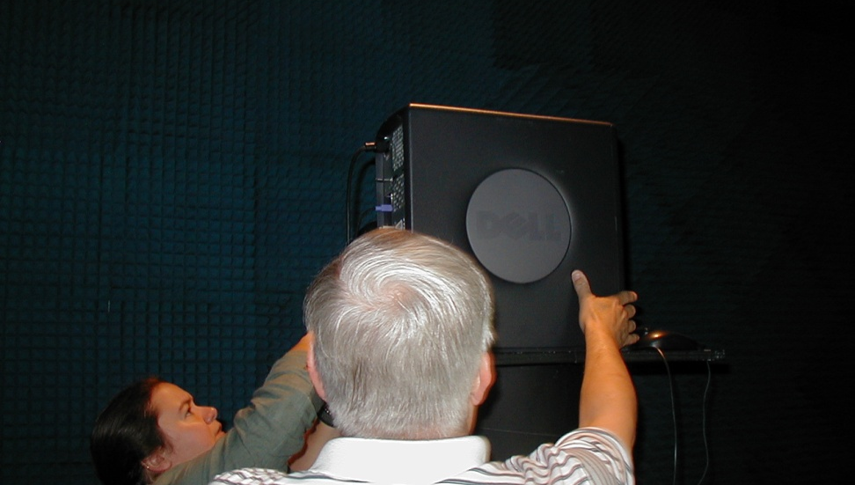
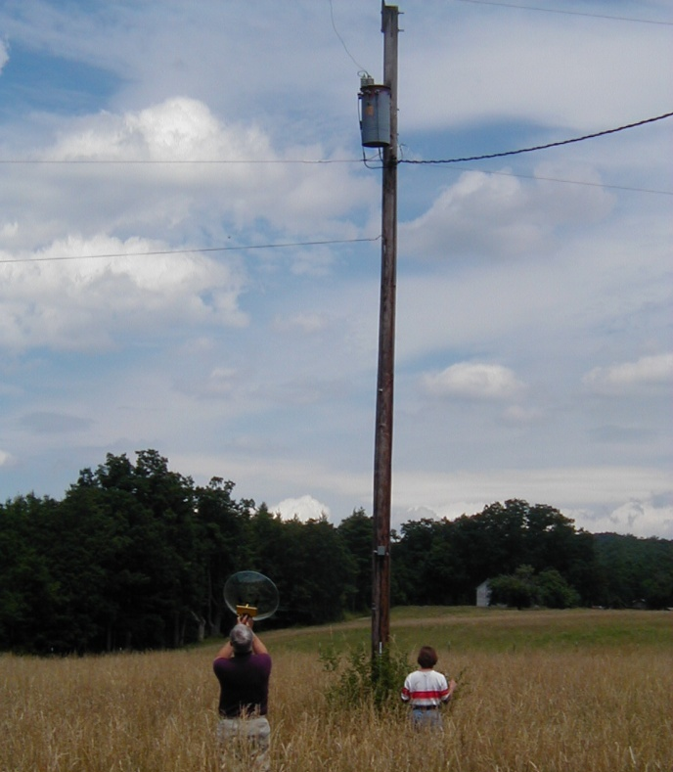
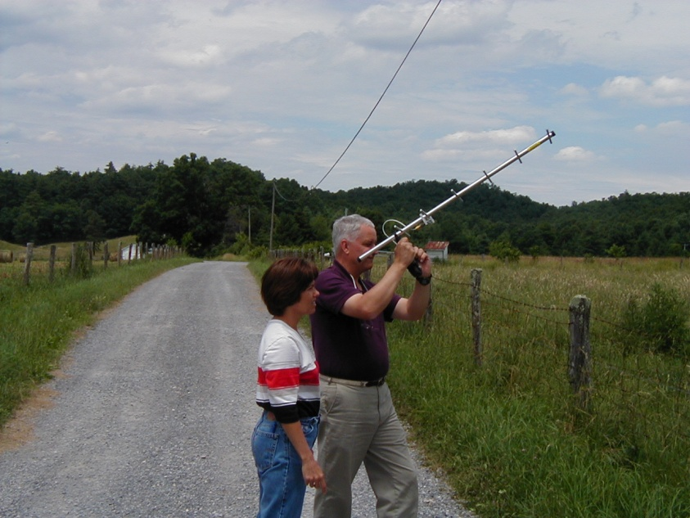
PCs
Unintentional
Emitters
TV Cable
Power Line
Notes:
Even devices like computers, microwave ovens, digital cameras and cell phones can cause detectable RFI at the GBT.

Slide 48
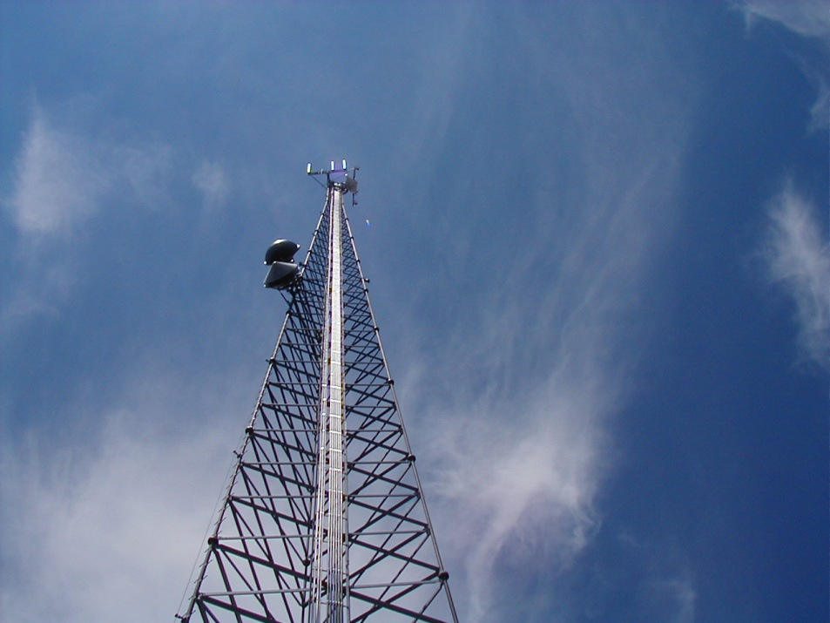
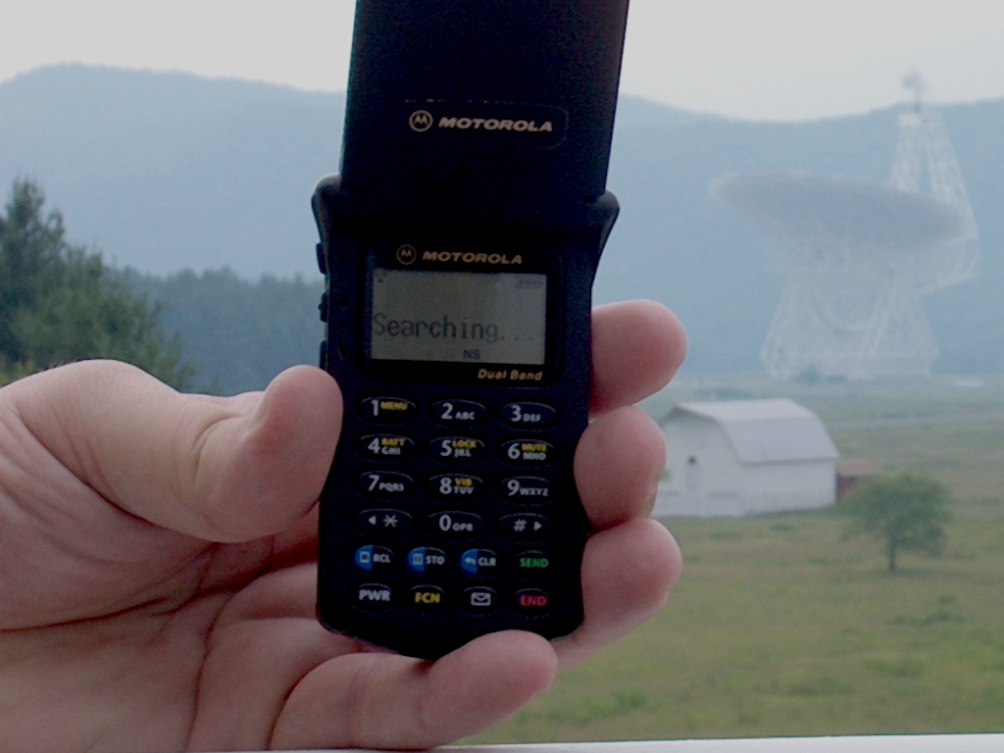
Intentional Emitters
Broadcast TV
Cell Phone Service
Radar
and…
824-849 MHz
Notes:
RFI sources can be intentional, like a radio tower or cell phone tower, or unintentional like bad connectors on TV cable and power lines.

Slide 49
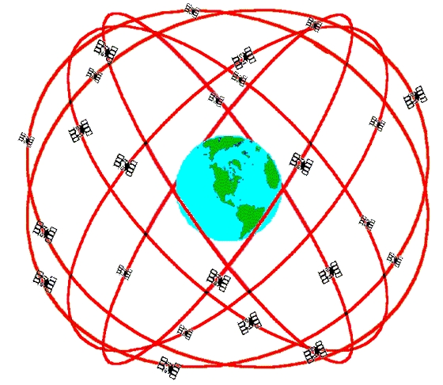
Satellites!
GPS (and GLONASS) 1.22-1.25 GHz
Notes:
Up all the time transmitting radio signals to earth. Note the transmitting frequency: 1.25 GHz is too close for comfort to the all important HI line!

Slide 50
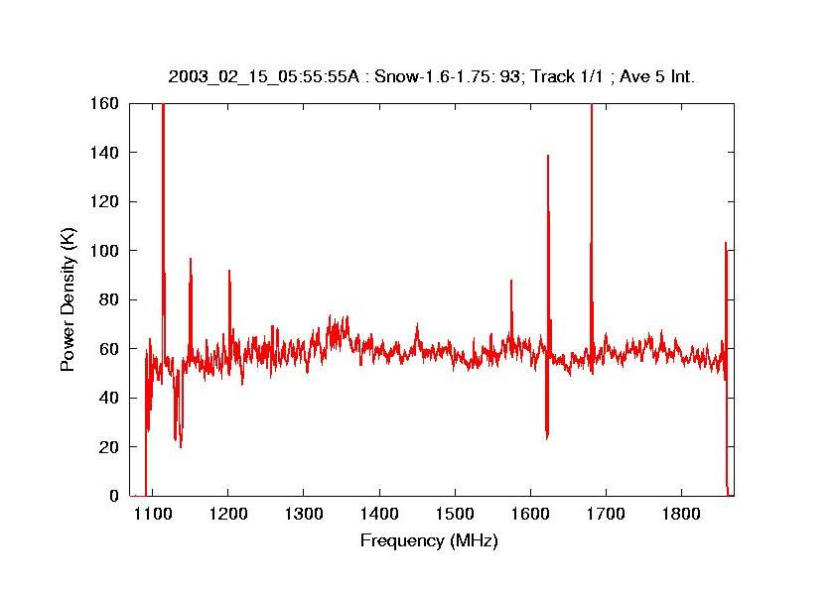
Radar altimeter
GPS
Notes:
Up all the time transmitting radio signals to earth. Note the transmitting frequency: 1.25 GHz is too close for comfort to the all important HI line!

Slide 51
What to do?
Build the GBT!

Slide 52

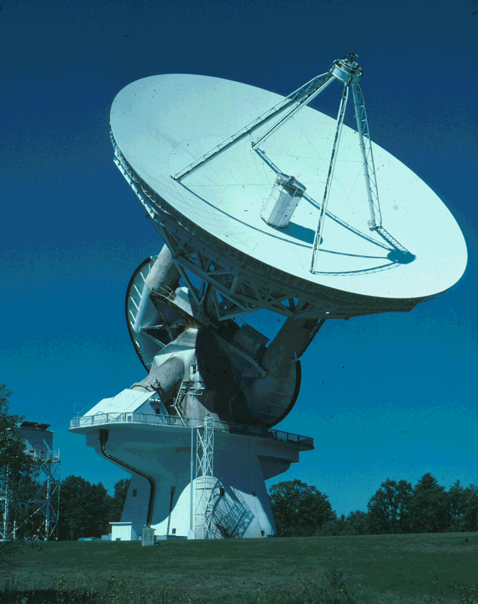

Notes:
Symmetrical radio telescopes like this are susceptible to interference from above.

Slide 53
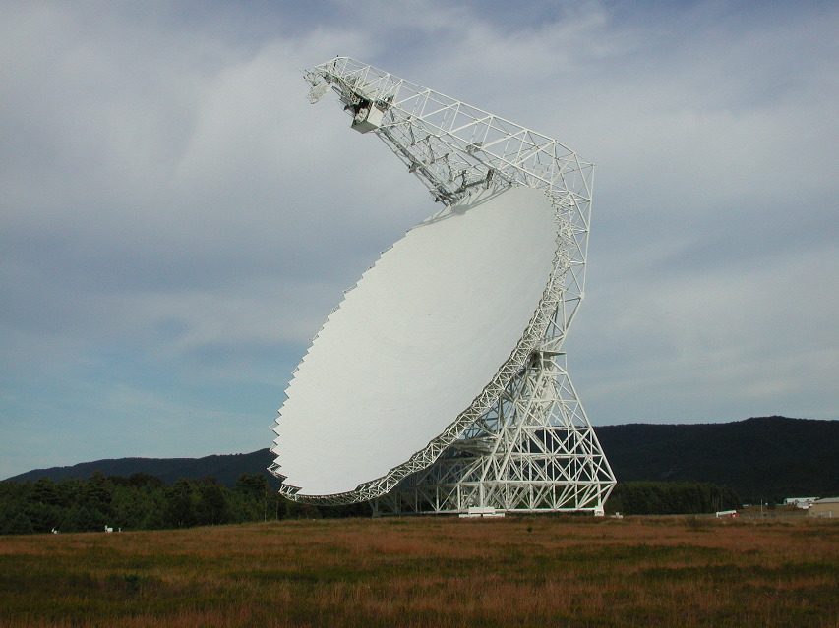
Notes:
The GBT dish is completely unblocked.

Slide 54
Robert C. Byrd Green Bank Telescope

Slide 55
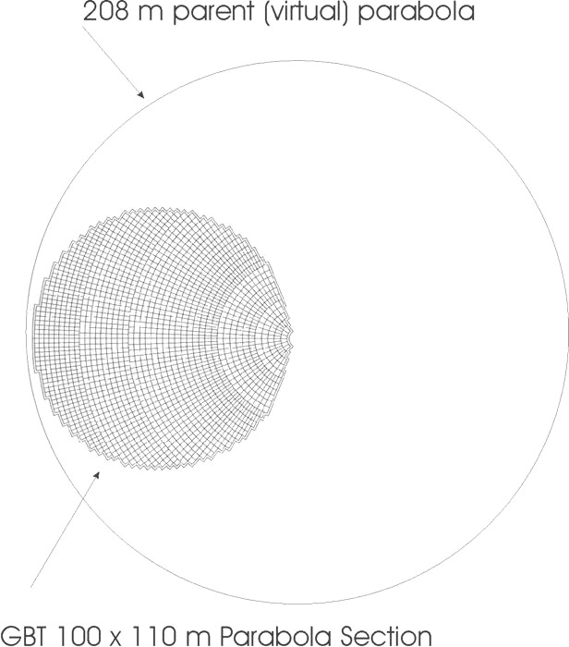
Notes:
This shows the GBT dish is really part of a much larger symmetrical dish. This is how we achieve an offset focal point.

Slide 56
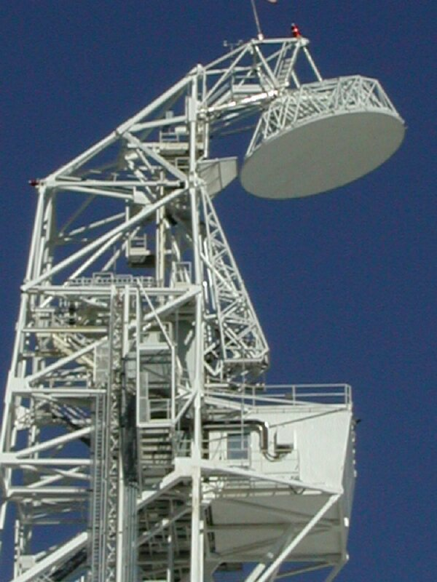
GBT Feed Arm
Notes:
After reflecting from the main dish, radio waves travel past the focal point to this small (30 foot diameter!) subreflector, bounce again, and end up in a receiver below.

Slide 57
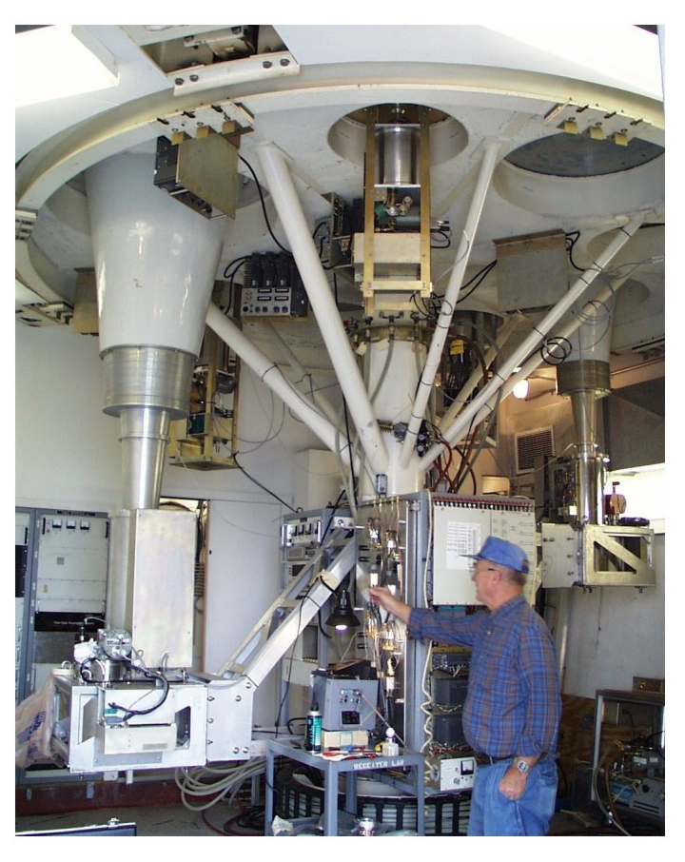

Notes:
Receivers are mounted in a turret – so that each one can be easily rotated into position under the subreflector.

Slide 58

Notes:
2209 motors under the dish can realign the surface.. The GBT dish is subject to gravity like everything else. When the telescope is tipped to different elevations, the dish can deform slightly.. The motors can make tiny adjustments in the surface – about 50 millionths of a meter!

Slide 59

Notes:
Before you adjust you need to measure. Embedded in the dish are 2209 reflectors called corner cubes or retroreflectors. What’s cool about them – light entering the reflectors will bounce back to its source. IE, in this picture the light from the camera flash hit all of these corner cubes and returned right to the camera.

Slide 60

The Observatory in Green Bank

Slide 61

Notes:
13,000 square miles – protected for radio astronomy
See here for the gory details about the quiet zone: http://www.gb.nrao.edu/nrqz/nrqz.html

Slide 62
Whew!
What do we get?

Slide 63



Pulsars
55 discovered in globular clusters (Ransom et al).
Ter5ad
Compact object orbiting the 23-millisecond pulsar PSR J0737-3039A, is not only another neutron star, but is also a detectable pulsar.
Powerful laboratory for GR!
Image Credit: Michael Kramer (Jodrell Bank Observatory, University of Manchester)
Notes:
One of the key areas where the GBT is making a huge contribution is in pulsar research. The plot on the left here shows 27 milliisecond pulsars discovered in the globular cluster Terzan 5. This was perviously known to contain three pulsars, and so was a good candidate target. Scott and collaborators looked at this for 6 hours with the GBT, and initially discovered 14 new ones, the most ever found in a single observation. As of now, the number is up to 27.
Another area is observartions of the double binary pulsar system 0737-3039. This was discovered using the Parkes 64m telescope, but the GBT is an ideal telescope for performing detailed observations of this unique system.
Already, four different effects beyond those predicted by Newton's laws of gravity have been measured and are completely consistent with Einstein's general theory of relativity.
The fact that both objects are detectable as pulsars enables completely new high-precision tests of gravitational theories. Future observations of the two stars will measure their slow spiral in towards each other as they emit gravitational waves - a dance of death leading to their ultimate fusion into what may become a black hole.

Slide 64


Galactic Super Bubble

Slide 65

Black Holes
Radio View of the Galactic Center
Notes:
Large scale structures in the Galactic Center

Slide 66



Organic Molecules;
Seeds of Life

Slide 67

Galactic Building Blocks
Notes:
So, what does all of this get you? Unparalleled sensitivity and dynamic range allowing scientists to discover hydrogen clouds(red) left over from the formation of this galaxy.

Slide 68


Distances to H₂O Megamasers
Goal:
  10+ distances to obtain H₀ with better than 3% uncertainty
NGC 4258

Slide 69

www.gb.nrao.edu
National Radio Astronomy Observatory, Green Bank, WV

