Slide 1
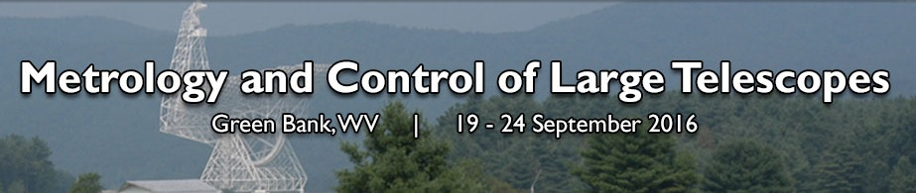
A control loop closure system for the Sardinia Radio Telescope active surface
C. Pernechele, Coordinator
C. Barbieri, CMOS camera
P. Bolli, mw holography
F. Buffa, photogrammetry
T. Pisanu, FEM, temperature sensor
S. Poppi, pointing, star tracker
G. Serra, mw holography
M. Morsiani, mounts & test
J. Roda, mechanics
G. Zacchiroli, mechanics
C. Nocita, test
M. Paternò test
INAF Astronomical Observatory of Cagliari &
National Institute for radioastronomy

Slide 2
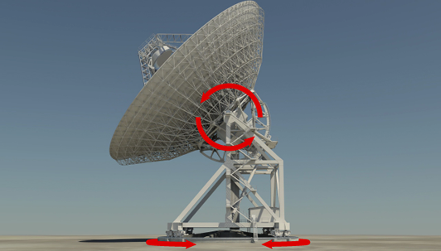
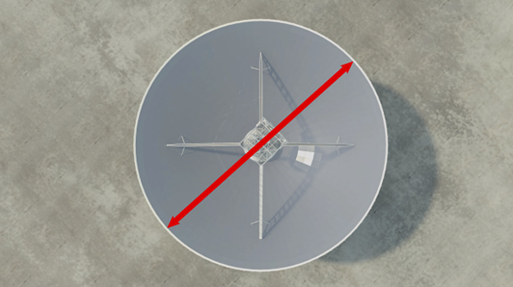
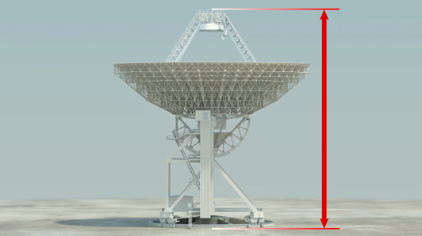


General parameters
EL
64 m
AZ
70 m
Weigth 3000 Tons
Notes:
Note
Note

Slide 3
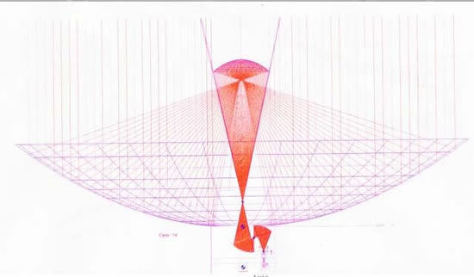
Gregorian Optical Configuration
F1/D = 0.33 -> 0.3 - 22 GHz
FG/D = 2.34 -> 7.5 - 100 GHz
F3/D = 1.38 -> 4.3 - 32 GHz
F4/D = 2.81 -> 4.3 - 32 GHz
Notes:
Note
Note

Slide 4
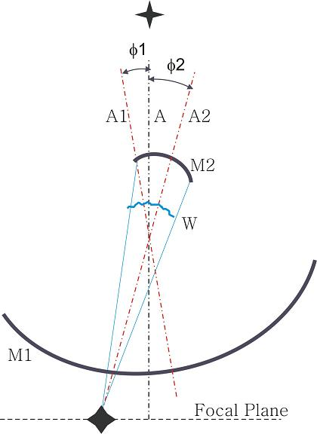
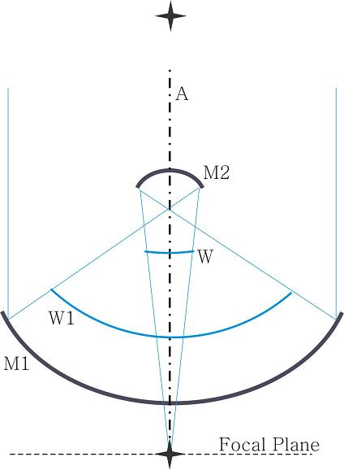
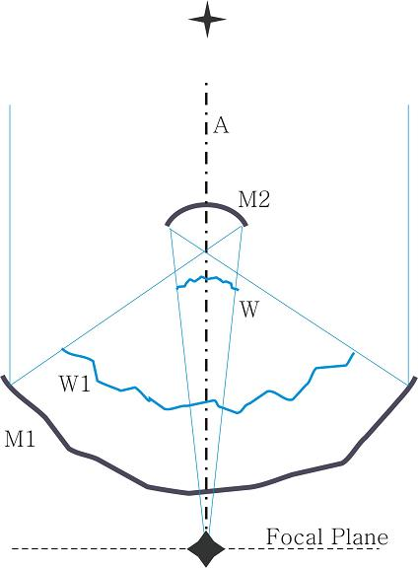
Metrology Tasks
Notes:
Note
Note

Slide 5
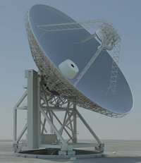
Metrology Tasks
PSD + rangefinder
(5 axes)
Star tracker (Poppi et al.,
(SPIE 7733, 2010)
FEM +
temp sensors
(Pisanu et al.,
SPIE 7739, 2010)
Optical methods
(reflector’s shape)
Notes:
Note
Note

Slide 6
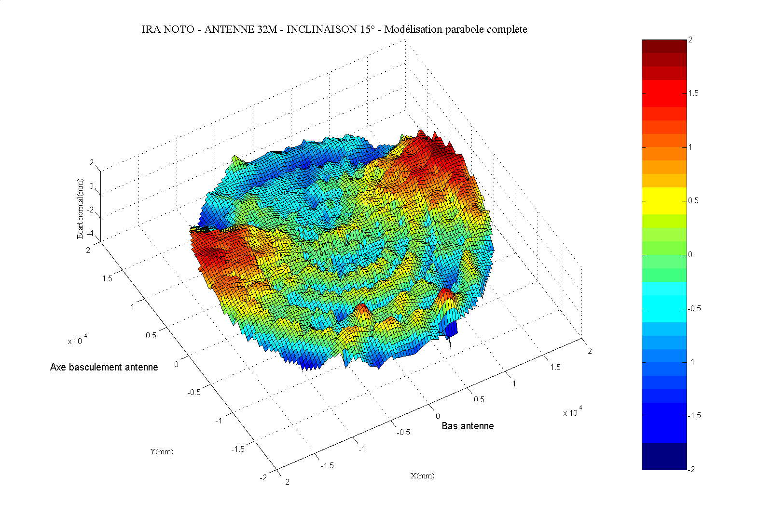
Photogrammetry results @ Noto station
SARDINIA RADIO TELESCOPE
Notes:
Note
Note

Slide 7
Operation @ 100 GHz
Surface shape < 0.15 mm (λ/20)
SARDINIA RADIO TELESCOPE
Notes:
Note
Note

Slide 8
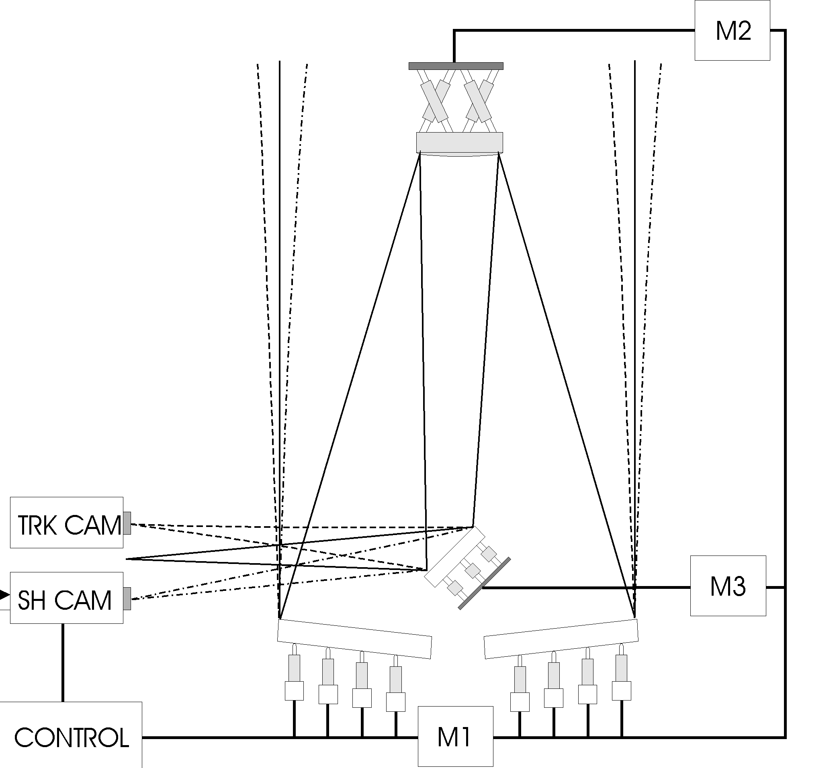
Radio vs Visible Active Optics
Visible Range
Closed loop control
Radio Range
Open loop only
SARDINIA RADIO TELESCOPE
Notes:
Note
Note

Slide 9
Primary’s shape measuring methods
Shape’s main reflector typical measurements systems
 | Time response | Accuracy | Meas. type | EL Angle
Laser Scanner | Hours/day | 0.7 mm | Absolute | Any
Photogrammetry | day(s) | 0.4 mm | Absolute | Any
Microwave Holography | Hours | 0.15 mm | Absolute | <45 for SRT
SRT optical meas. systems | Few minutes | 0.15 mm | Relative | Any
SARDINIA RADIO TELESCOPE
Notes:
Note
Note

Slide 10
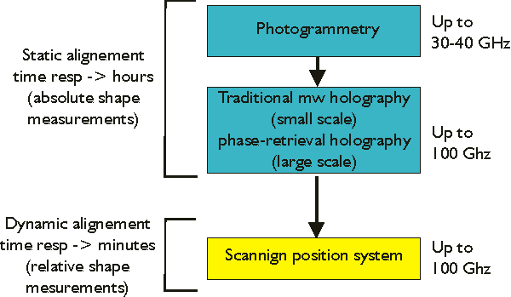
SRT actuators closing loop strategy
OOF Holography planned in collaboration with GBT (R. Prestage)
SARDINIA RADIO TELESCOPE
Notes:
Note
Note

Slide 11
General considerations
SARDINIA RADIO TELESCOPE
Notes:
Note
Note

Slide 12
The three tested systems
SARDINIA RADIO TELESCOPE
Notes:
Note
Note

Slide 13
General considerations
SARDINIA RADIO TELESCOPE
SARDINIA RADIO TELESCOPE
www.ca.astro/SRT
Notes:
Note
Note

Slide 14
Segmented Profiles
SARDINIA RADIO TELESCOPE
Notes:
Note
Note

Slide 15
Segmented Profiles
SARDINIA RADIO TELESCOPE
Notes:
Note
Note

Slide 16
Segmented Profiles
SARDINIA RADIO TELESCOPE
Notes:
Note
Note

Slide 17
Segmented Profiles
SARDINIA RADIO TELESCOPE
Notes:
Note
Note

Slide 18
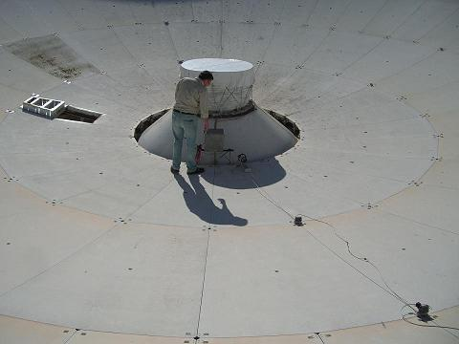
Hartmann like
SARDINIA RADIO TELESCOPE
Notes:
Note
Note

Slide 19
Hartmann like
SARDINIA RADIO TELESCOPE
Notes:
Note
Note

Slide 20
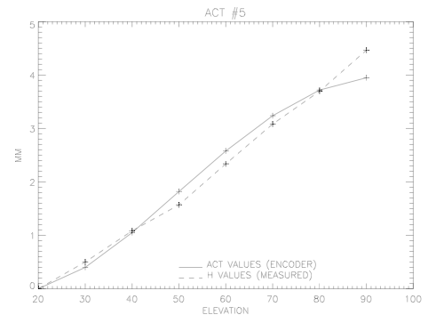
Hartmann like
Error bar +/- 70 μm
SARDINIA RADIO TELESCOPE
Notes:
Note
Note

Slide 21
Scanning Position System
SARDINIA RADIO TELESCOPE
Notes:
Note
Note

Slide 22
Comparison among the three systems
&
Conclusions
Notes:
Note
Note

