Slide 1
Measurement and Control of Large Telescopes

Slide 2
Welcome!
Your Name Tag is your Meal Ticket
Conference Dinner tonight: 6pm Starlight Cafe
All other meals: residence hall cafeteria
Exercise Room in basement of residence hall!

Slide 3
Welcome!
Gift Shop / Exhibit Hall open Today, Thursday, Friday, Saturday
Tours:
GBT: this morning, all invited
SETI / 140ft tour: Wednesday, 20 max ($15)
GBT Control Room: Thursday, optional

Slide 4
Welcome!
Conference is being live-streamed and will be recorded.
We plan to put all talks on-line; please remove any proprietary information before you give them to me.
Please give me electronic source, and PDF copy (for ease of editing talk recording)

Slide 5
Welcome!
Abstracts will be indexed on Astronomy Abstract Service (ADS).
Please make sure we have:
Full name and affiliation of all authors
Full title
Updated text, if you like
Please email to Kristine Sharp (krsharp@nrao.edu)

Slide 6
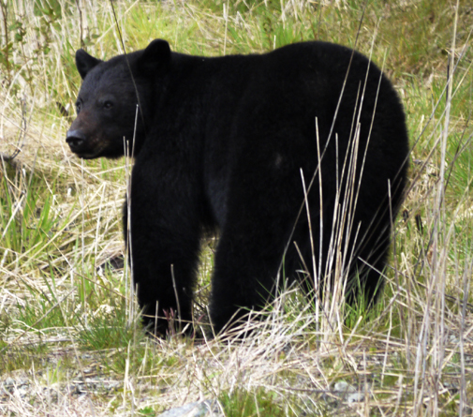
Basic Info/Site Safety
Please turn off all wireless devices while on site
No digital equipment or personal vehicles past parking lot
Non-digital (disposable) cameras are available for sale in the gift shop
You are welcome to walk the site as you please
We are a remote, natural area, and home to many types of wildlife
You will commonly see deer, bear, snakes, etc.
Wildlife are most active at dusk and dawn
Mother bear(s) and cubs live downsite
Do not approach wildlife. (Do not panic). Just walk away

Slide 7
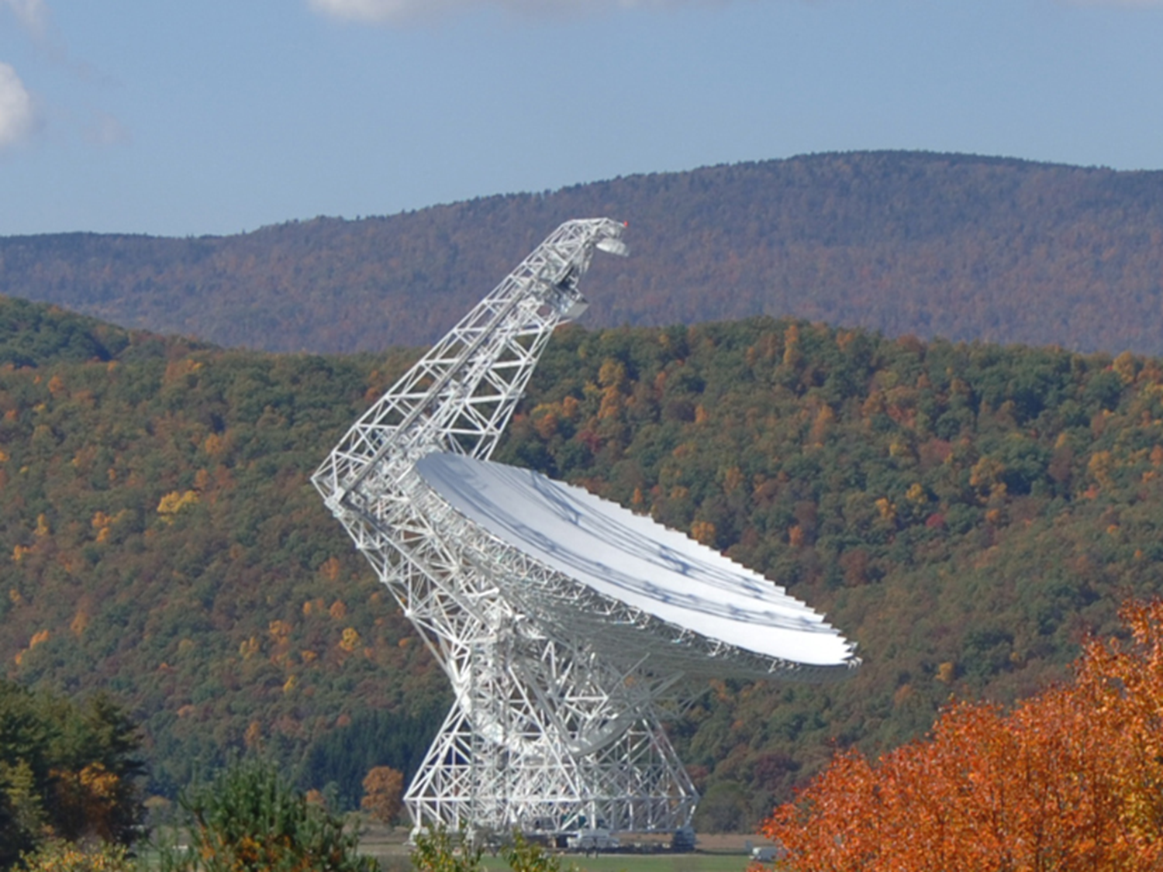
Enjoy!

