Slide 1
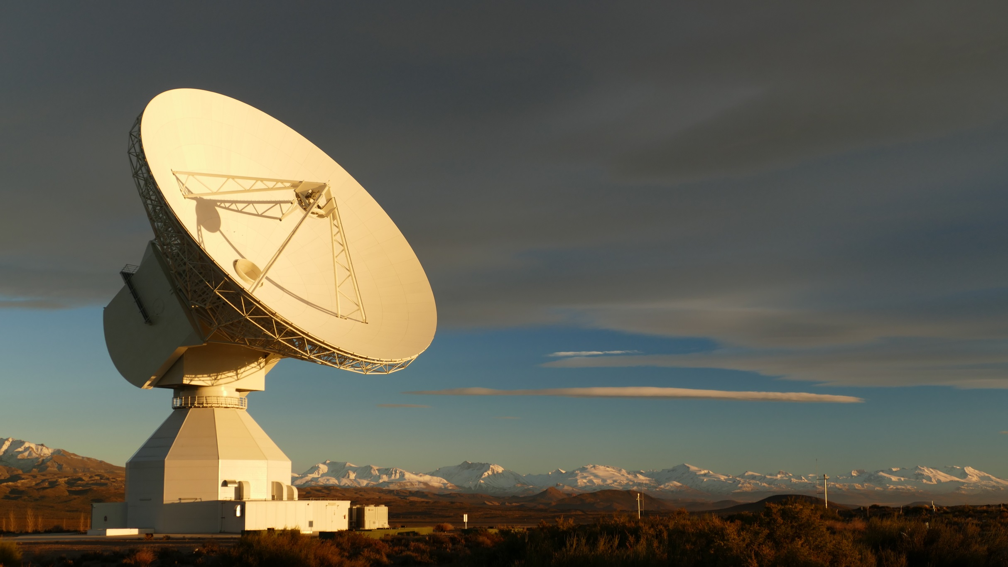
ESA’s Deep Space Antennas
Dr. Peter Droll, ESA
MetConf 19 – 24 Sept. 2016
Green Bank, WV, USA

Slide 2
Outline
ESA’s Deep Space Antenna Network
Characteristic of the 35m Beam Wave Guide Antennas
Pointing Error Model and Pointing Calibration System
Pointing Performance
Ka-Band Rx-Tx Beam Offset Generation and Performance

Slide 3
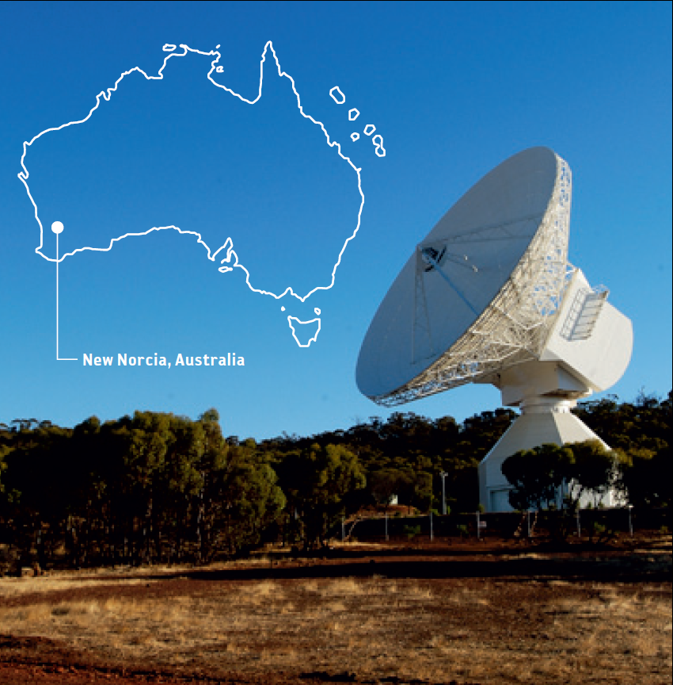
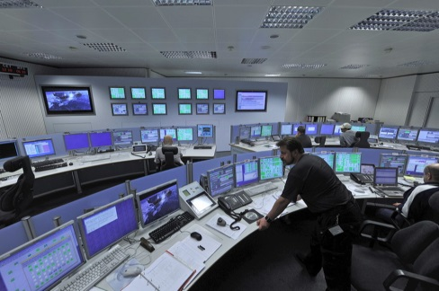
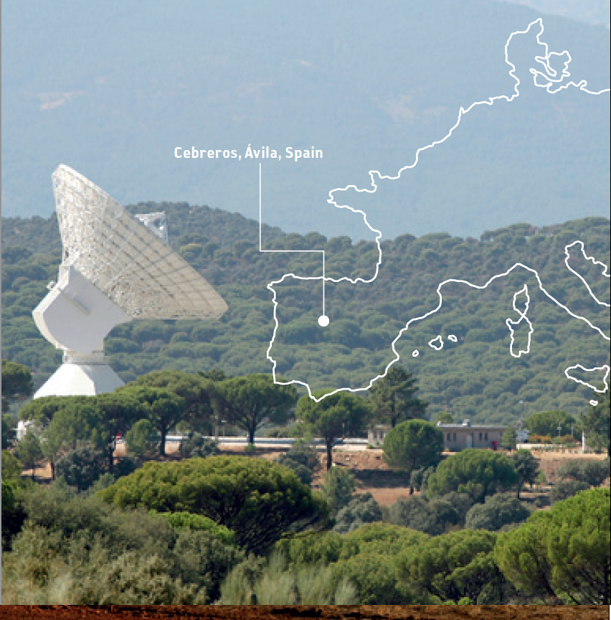
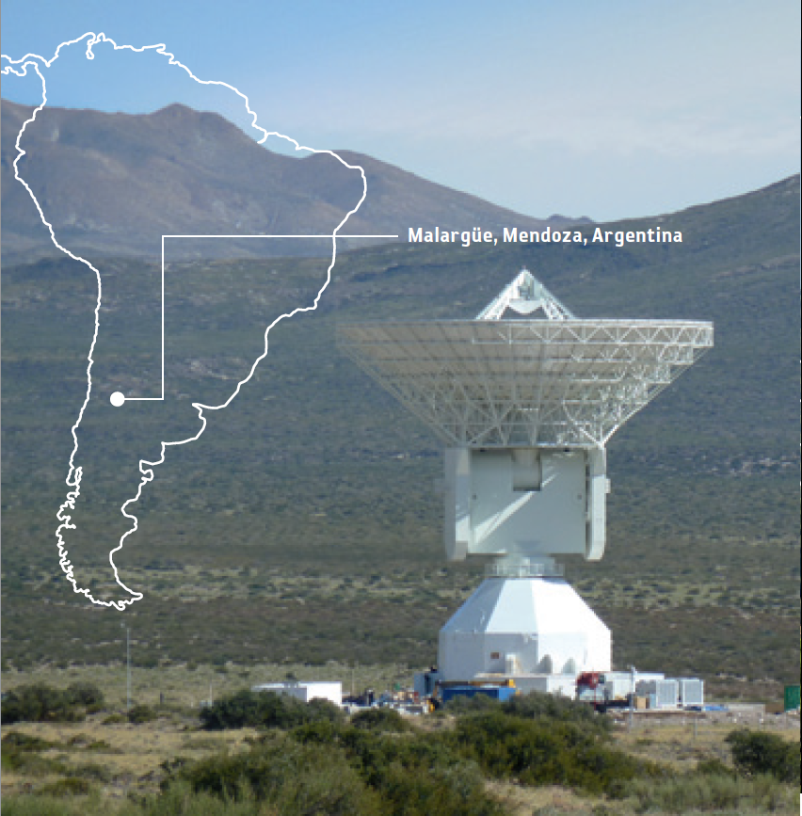
ESA’s Deep Space Antenna Network
Antennas are remote controlled from control centre at ESOC, Germany
DSA2 (Malargue)
Argentina
DSA1 (New Norcia)
Australia
DSA2 (Cebreros)
Spain

Slide 4
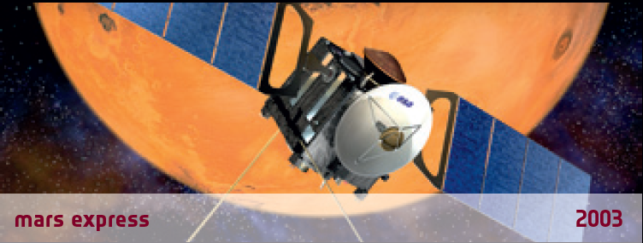
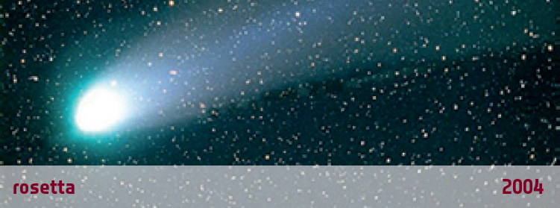

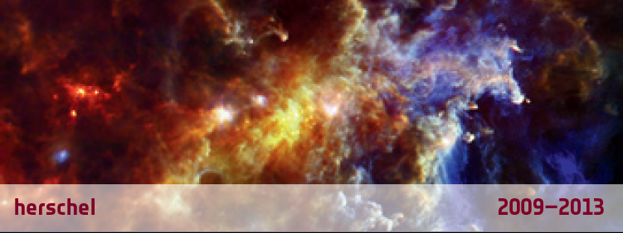
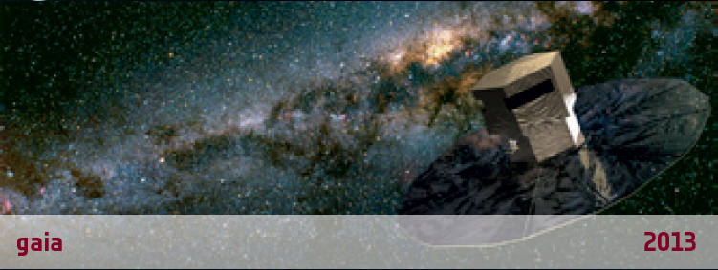
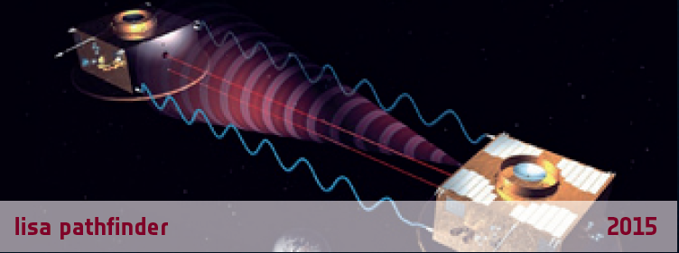
Missions supported by ESA’s 35 m Antennas

Slide 5
Characteristic of the 35m BWG Antennas
Operational Frequency Bands | Up to 32 GHz, Feeds with cryogenically cooled LNAs (X-Band, Ka-Band)
Uplink | 20 kW Klystron amplifier @ X-Band 500 W klystron amplifier @ Ka-Band
Main reflector surface accuracy | < 0.30 mm RMS @ wind at 45/60km/h
Dynamic pointing accuracy (open loop pointing) to be achieved @ 99.7 % of time | ≤ 5.5 mdeg @ wind 45 / 60 km/h ≤ 6.5 mdeg @ wind 50 / 70 km/h ≤ 20 mdeg @ wind 100 / 120 km/h
Lowest Antenna Eigenfrequency | > 2 Hz

Slide 6
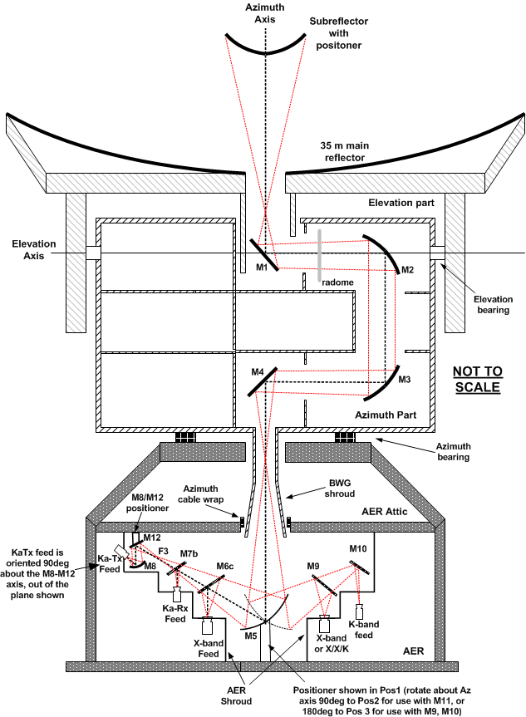
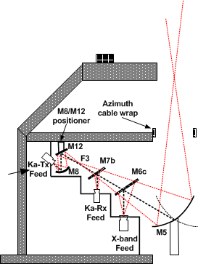
35m BWG Antenna I (DSA3)

Slide 7
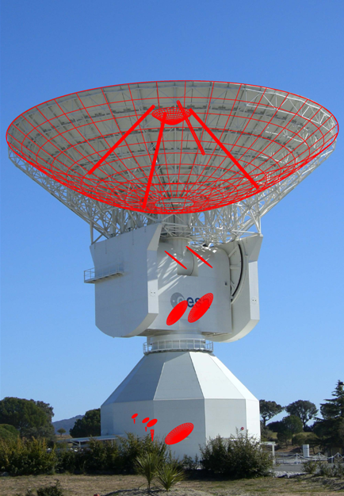
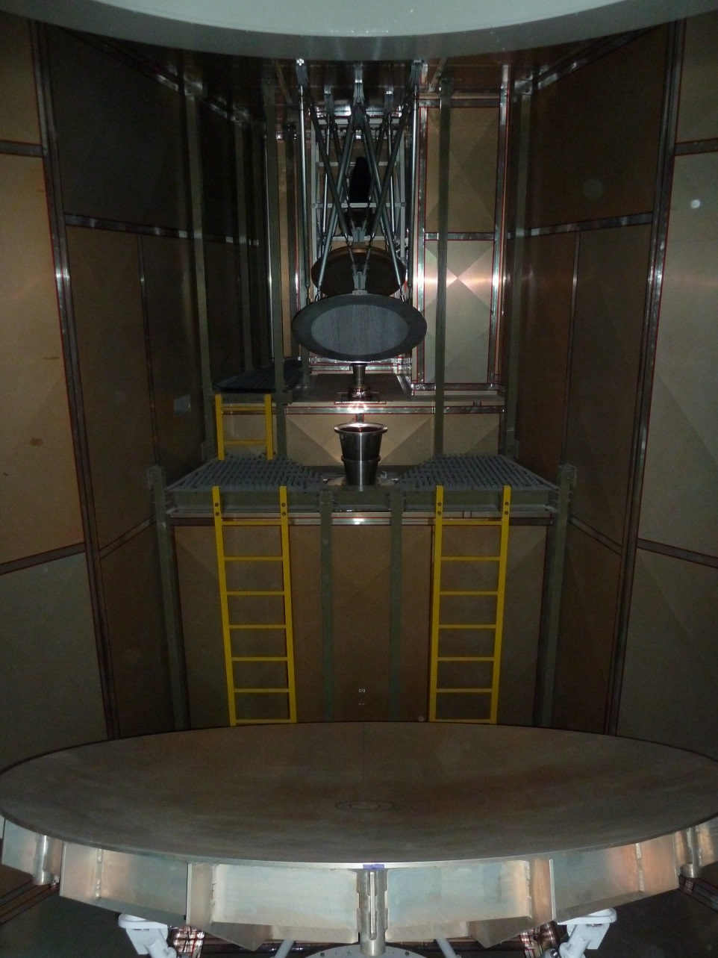
35m BWG Antenna II
Ka-Tx
Dichroic Mirrors
Ka-Rx
X-Rx/X-TX
Mirror M5

Slide 8

Antenna Servo System
Servo Controller is based on fully digitally implemented Cascade Controller Structure:
  P for position controller
  PI controller for velocity controller
  Identical controller structure for Az and El

Slide 9
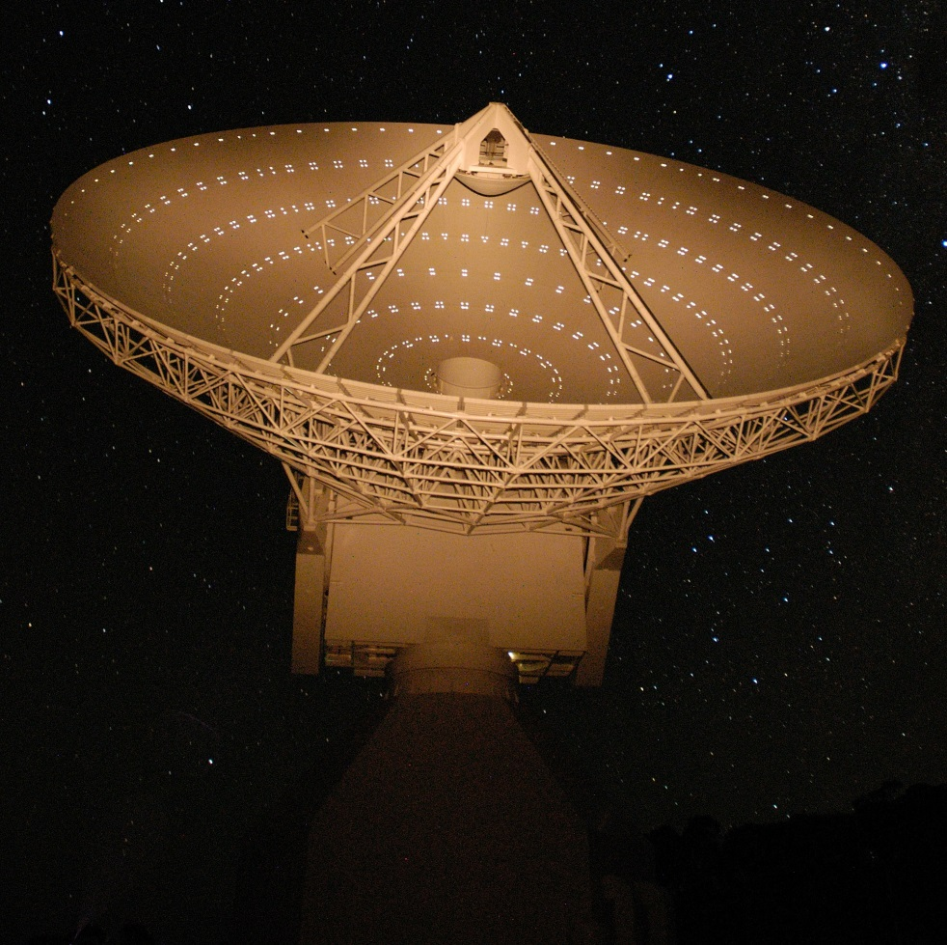
Alignment of panels with theodolite and photogrammetry measurements

Slide 10
Surface Accuracy – Performance under worst case conditions
Source of surface error | Surface accuracy [mm] RMS
 | Elevation angle [deg]
 | 0 | 30 | 90
Panel Manufacturing Panel Alignment Gravity (dead weight) Wind (50/70 km/h) Temperature gradient (dT = 1K) | 0.081 0.089 0.080 0.069 0.138 | 0.081 0.089 0.069 0.110 0.138 | 0.081 0.089 0.023 0.069 0.138
Gravity deformation (adjusted at 45^{O}) Wind load (50/70 km/h) Temperature gradient | 0.118 0.166 0.113 | 0.034 0.176 0.113 | 0.138 0.134 0.113
Total (RSS) | 0.304 | 0.299 | 0.287
Surface Error Budget for Main reflector surface accuracy.
Simulation results and measurement results are combined to determine performance under worst case conditions.

Slide 11
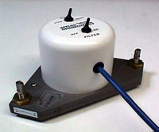
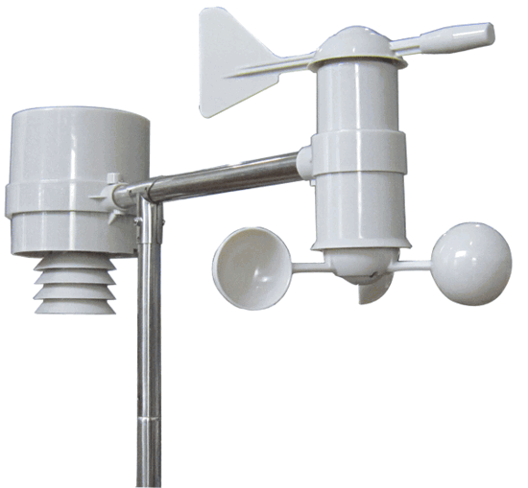

Block Diagram Antenna Pointing Error Compensation
Tiltmeter
Weather Station
TMS
Sub
Reflector
ACU
SPEM with 10 terms
RF refraction compensation
PCS
SLALib
Radiometer

Slide 12
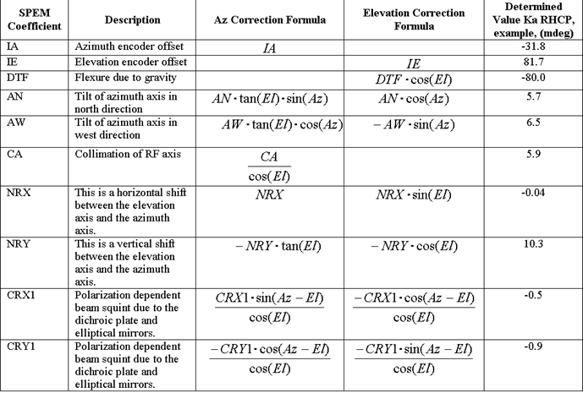
Systematic Pointing Error Model
The systematic pointing error model (SPEM) of the ESA DSAs consists of the following 10 terms:

Slide 13
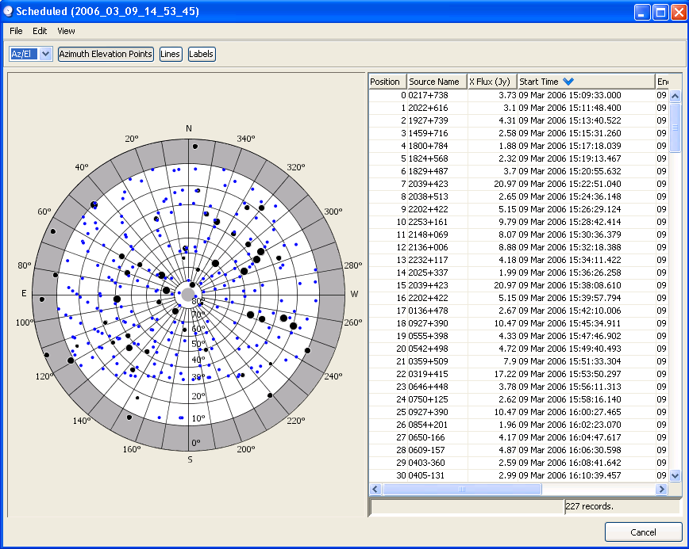
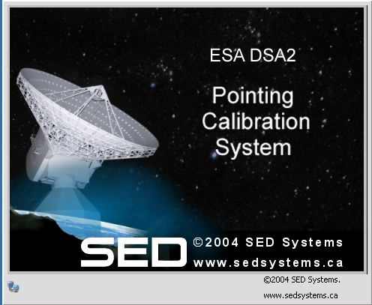
Pointing Calibration System I
Pointing Calibration System supports pointing measurements in X, K, Ka-Rx and Ka-Tx.
Fully automated scanning of pre-selected radio stars and semi-automated determination of SPEM coefficients.
Powerful graphical user interface
Currently limited to SPEM with 10 coeff.

Slide 14
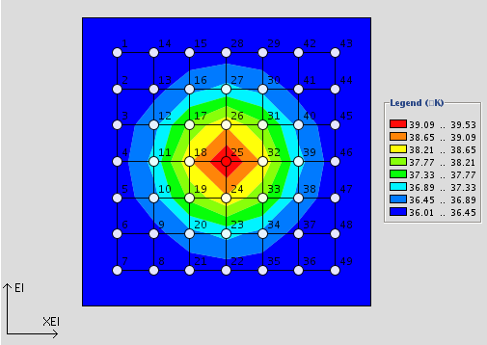
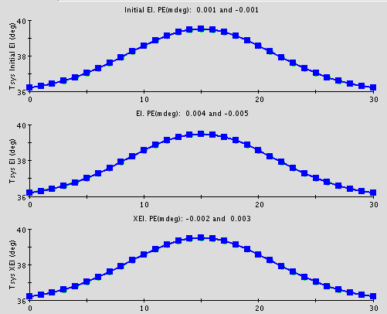
Pointing Calibration System II
2 Scanning methods available in PCS:

Slide 15
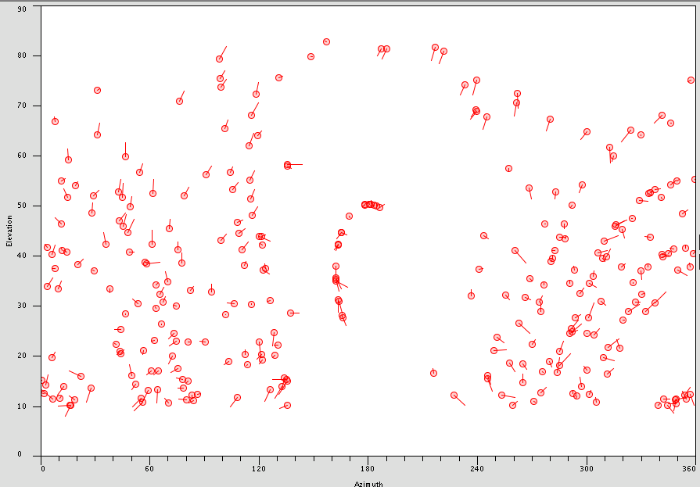
Pointing Calibration System III
Distribution of radio star measurements.
Arrows show direction of measured pointing offset.
Measurements cover well the hemisphere
Measurements are input for SPEM coefficient determination
Typically 100 – 300 measurements required for good model

Slide 16
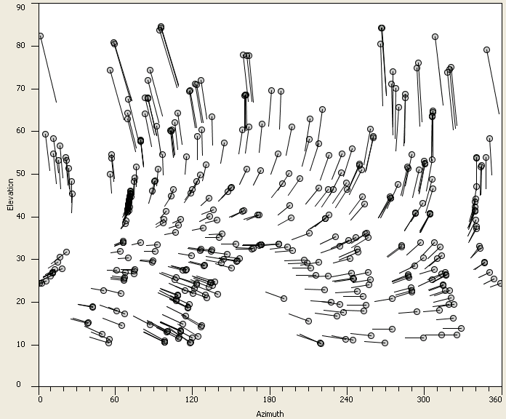
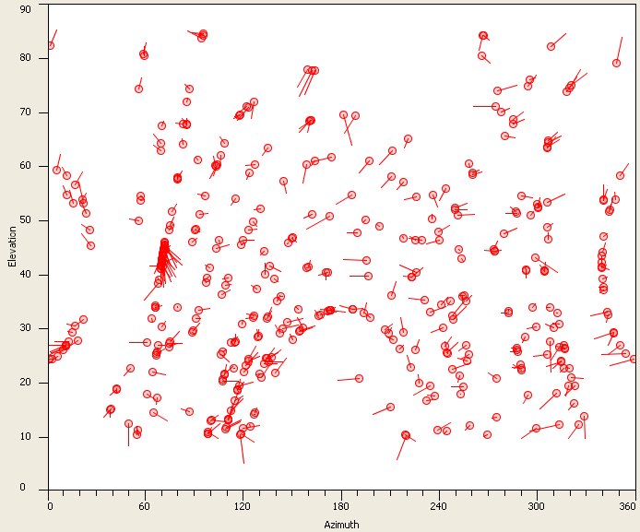
Pointing Calibration System IV
SPEM has to be determined for each frequency band and polarisation.
For proper determination of SPEM coefficients, full coverage of hemisphere is important.

Slide 17
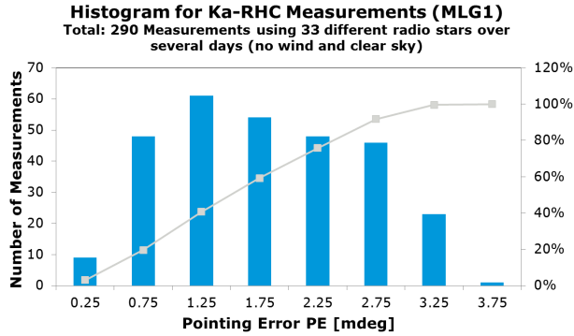
Antenna Pointing Performance, MLG1
32 GHz, RHCP
290 measurements over 4 days
Clear sky, cold and dry weather
approx. 80% of measurements better 2.25 mdeg
 | Max. total PE
32 GHz, RHCP, no wind, measured | 3.8 mdeg
32 GHz, RHCP, wind 45/60 km/h, extrapolated | 5.3 mdeg

Slide 18
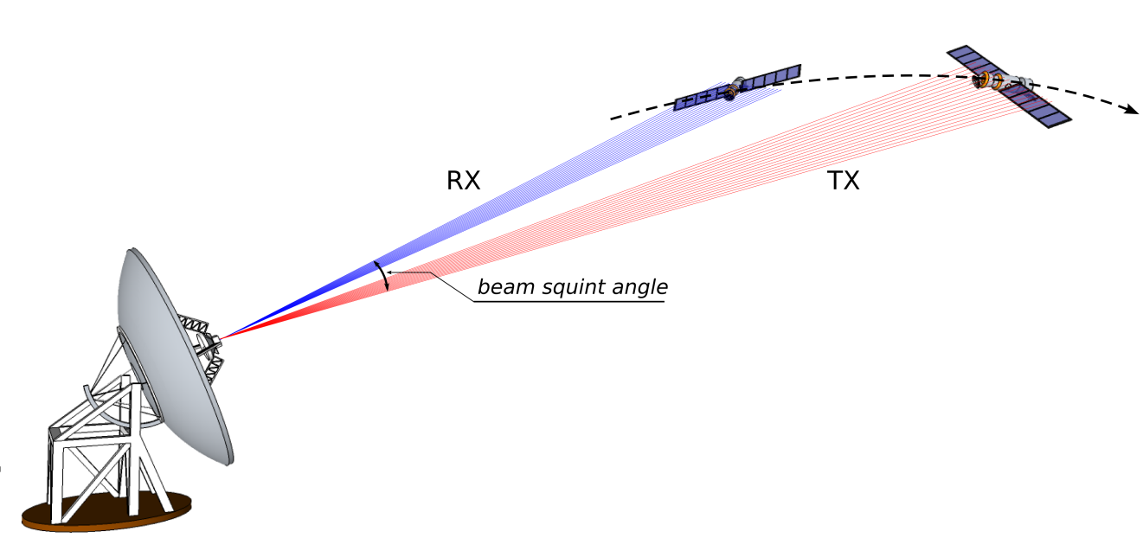
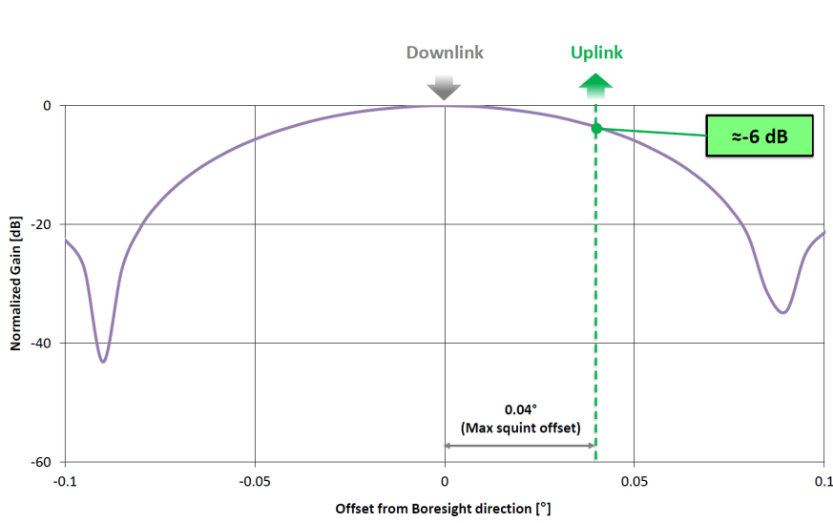
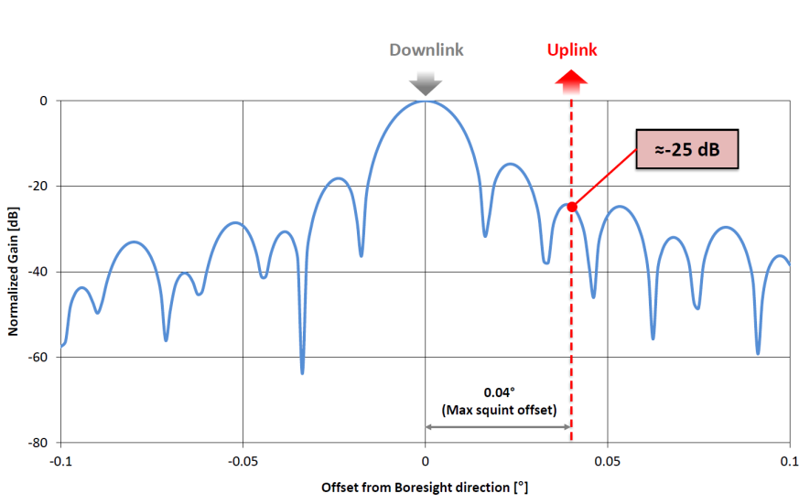

Generating Rx-Tx Squint at 32 GHz
Spacecraft in movement generates an offset between RX and the TX beams (RX-TX squint)
Worst case Receive (Rx) – Transmit (Tx) offset for future ESA missions (BepiColombo) ~ 40 mdeg
ψ
Ψ dependent on:
RTLT
Transversal velocity component
Beam offset
DSA3/X-band
DSA3/Ka-band

Slide 19
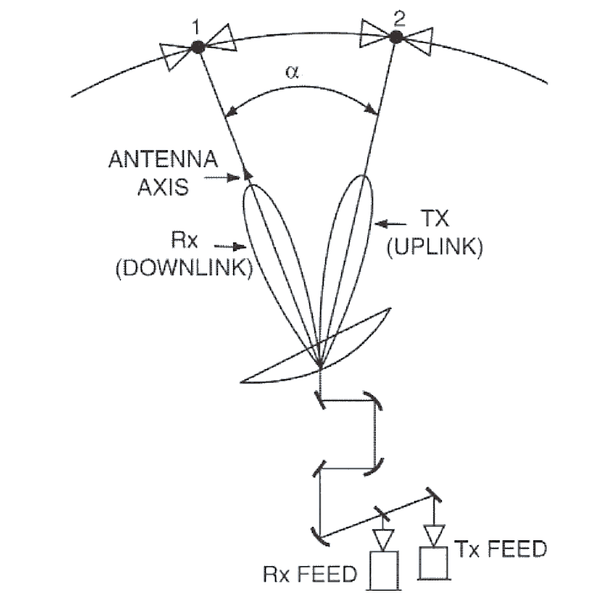
RX-TX Beam Offset Generation I
Rx-Tx offset compensation concept: M8/M12 BWG mirrors tilting system

Slide 20
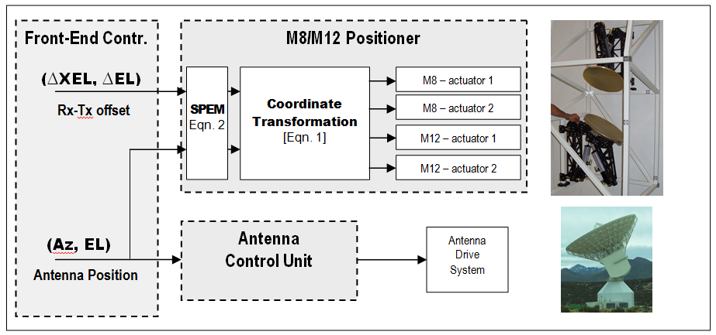
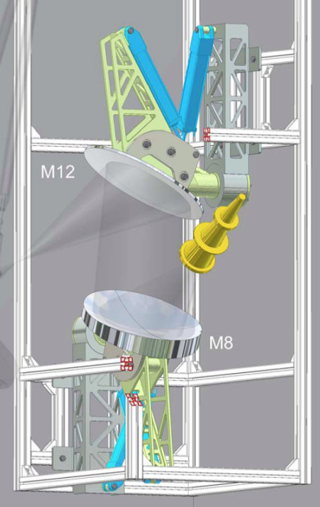
RX-TX Beam Offset Generation II
Accurate two-axes M8/M12 rotation implemented by linear actuators
Relationship between mirror tilts & beam aberration angles (θ_{BA}, ϕ_{BA} ) given by 16 degrees of freedom
The mirror tilting occurs after SPEM correction to automatically compensate systematic pointing error contributions

Slide 21
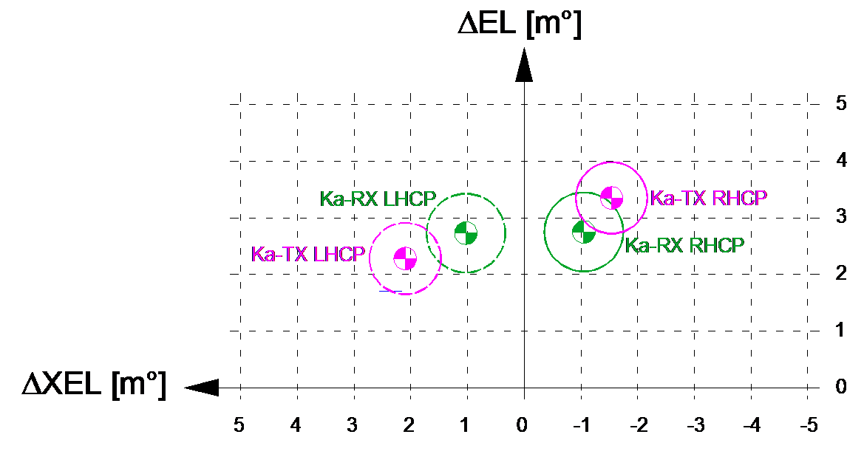
RX-TX Beam Offset Generation III
BWG design intrinsically introduces beam shifts (frequency and polarization dependent) → SPEM compensation based on CRX, CRY coefficients
Design of BWG aims at minimizing differences between the possible configurations
Remaining difference can however not be neglected
3.2 mdeg
Simulated for AZ/EL = 0/0 deg (with dichroics)
Effect modelled by CRX/CRY

Slide 22
Measuring of Rx-Tx beam offset & Ka-TX gain loss
Ka-Tx steering in open loop to verify:
  Pointing accuracy
  Gain degradation
Ka-Rx is the “zero” pointing reference
Both Ka-TX\x and Ka-Rx in “receive” mode (radiometer)
No simultaneous measurements at Ka-RX/TX

Slide 23
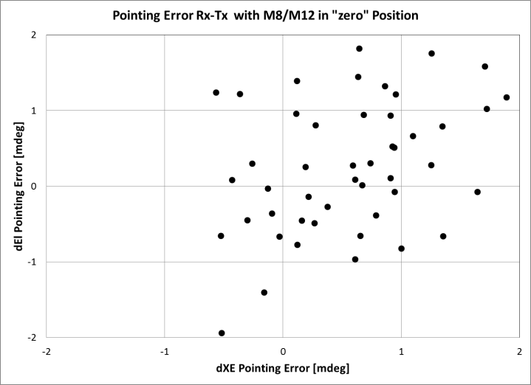
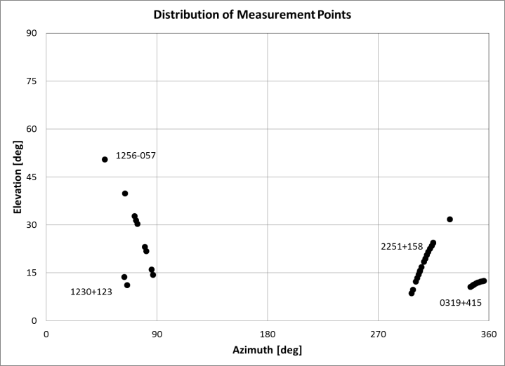
Rx-Tx beam steering performance I
No commanded offset → pointing error due to systematic effects (polarisation dependency, residual mechanical misalignment) → CRX = 0.54 mdeg, CRY = 0.26 mdeg
Need for more meas. to better
cover full hemisphere

Slide 24
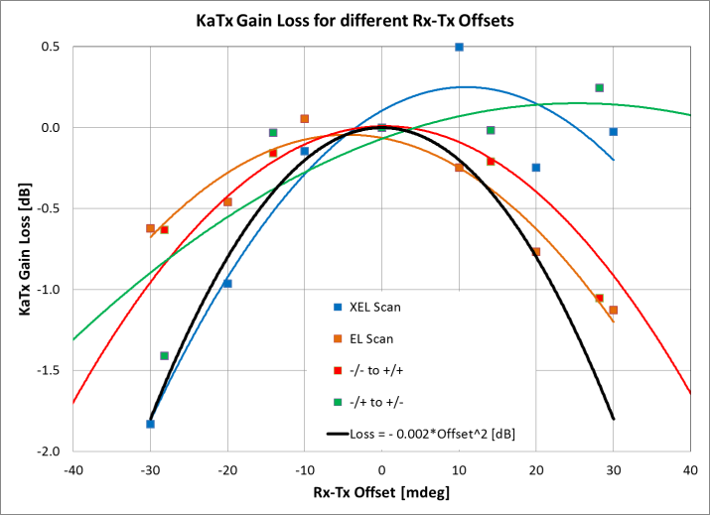
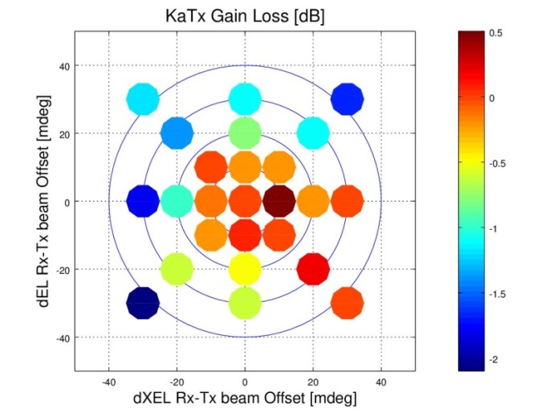
Rx-Tx beam steering performance II
Commanded offset → anomaly detected as gain increase for certain offset directions (i.e. XEL direction)
Worst case gain loss (black line) is worse than expected → due to meas. uncertainty?

Slide 25
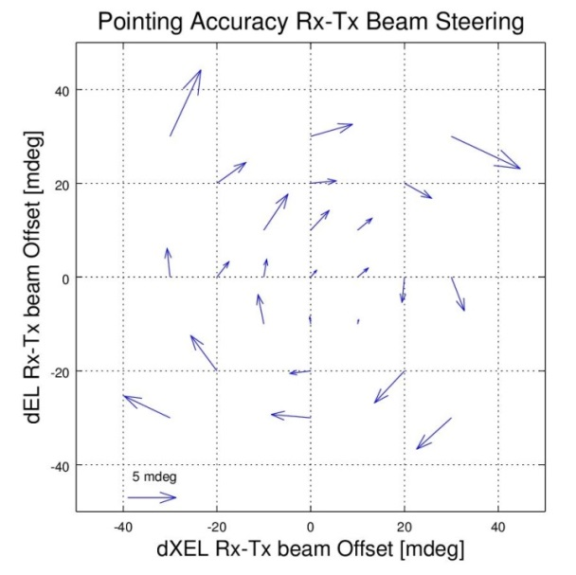
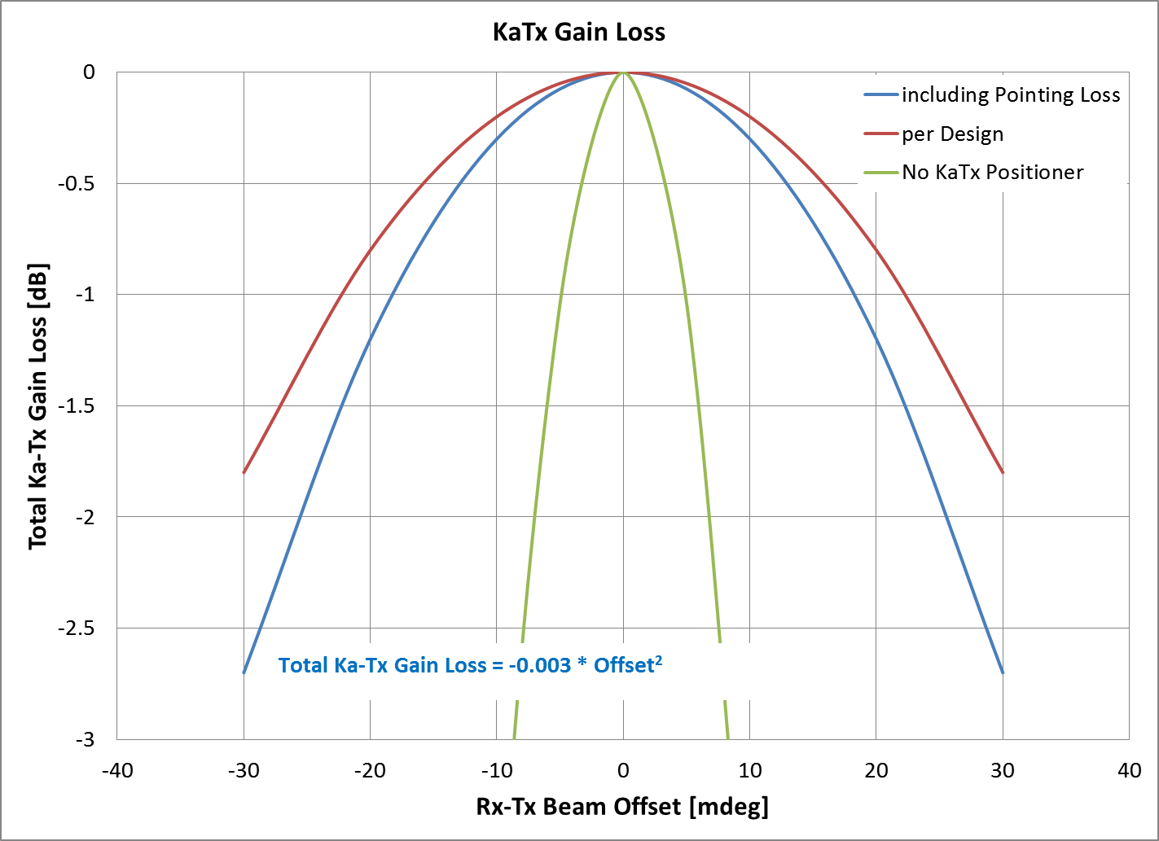
Rx-Tx beam steering performance III
Commanded offset → systematic residual pointing error vectors in a “vortex” around 0,0
Due to not optimum C-matrix coefficients?
Additional losses due to unexpected large pointing errors → -1.5 dB at 30 mdeg

Slide 26
Next Step: Optimizing Ka Rx-Tx pointing
Current limitations:
Same coefficients for all combinations Rx (RHC, LHC and TX (RHC, LHC)
Coefficients are based on a symmetric conditions, the different combinations hit however the elliptical mirror NOT in its vertex.
➔Introduction of “corrections” for each/some coefficient to consider the different combinations
Combination dependent coefficients
Feasible?

