Slide 1
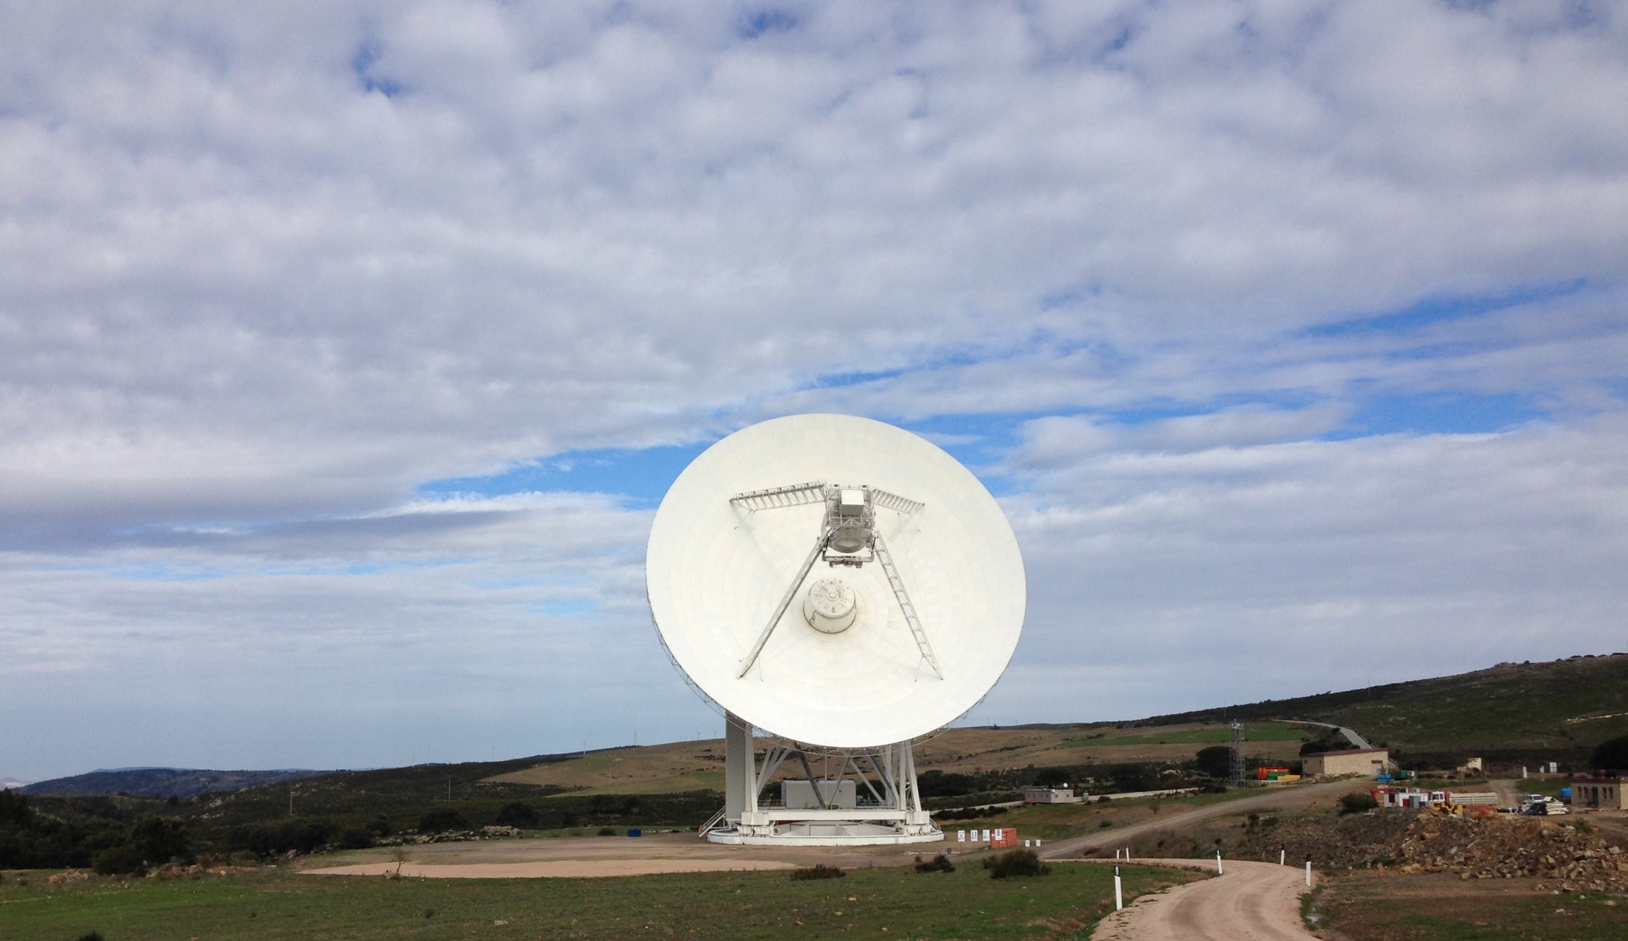


New tools for SRT metrology: laser tracker & simulator for photogrammetric survey
Green Bank, WV 19-24 September 2016, Workshop
Metrology and Control of Large Telescopes
Serra G. ¹, Buffa F.¹, Deiana G. L. ¹, Marongiu P. ¹, Pisanu T. ¹, Poppi S. ¹, Urru E. ¹, G. Sanna²
¹Astronomical Observatory of Cagliari (OAC) - Sardinia Radio Telescope (SRT)
Italian National Institute for Astrophysics (INAF)
²University of Cagliari,
Department of Civil, Environmental Engineering and Architecture, Italy

Slide 2
Agenda
SRT optical configuration
Laser tracker measurement of SRT subreflector
Simulation tool for close range photogrammetric survey for the SRT primary reflector
Summary and discussion
Agenda

Slide 3
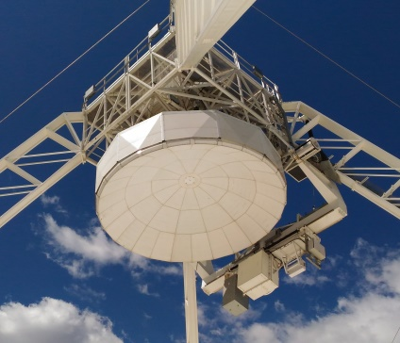
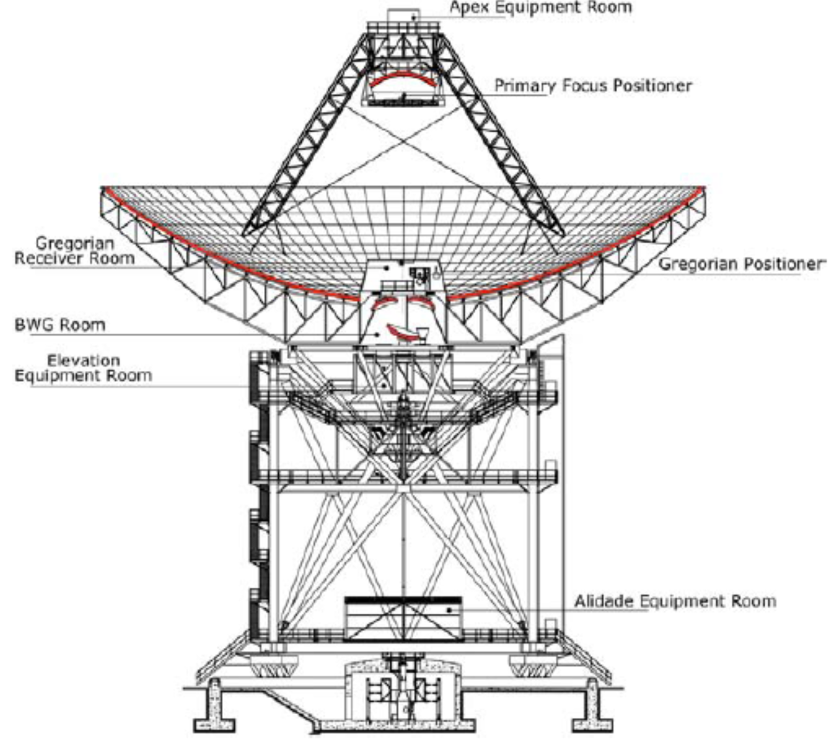
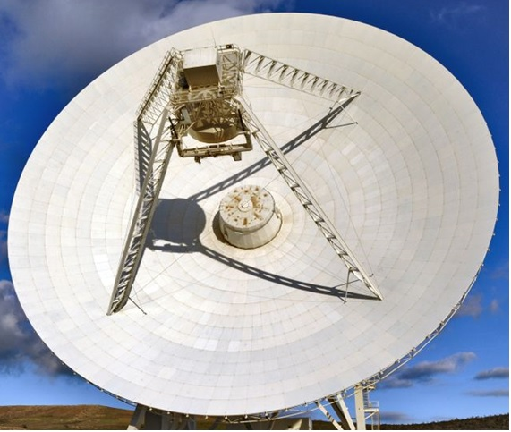
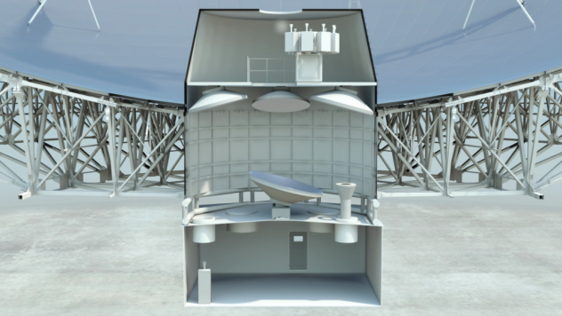
SRT gregorian configuration
7.9 m-dia
elliptical reflector
64 m-dia
Parabolic reflector
3 m-dia elliptical reflectors
SRT optical configuration
Notes:
Basically Gregorian configuration with two active surfaces ( 64-m diameter main reflector and a 7.9 m diameter secondary reflector) and a beam wave guide room under the gregorian focus floor host other 3 smaller reflectors to re-reflecting the beam on a the third and fourth focal position.

Slide 4
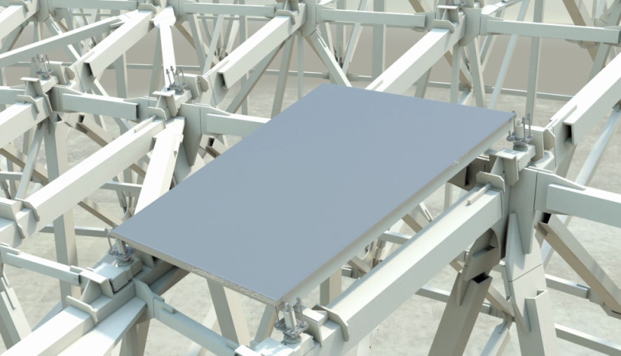
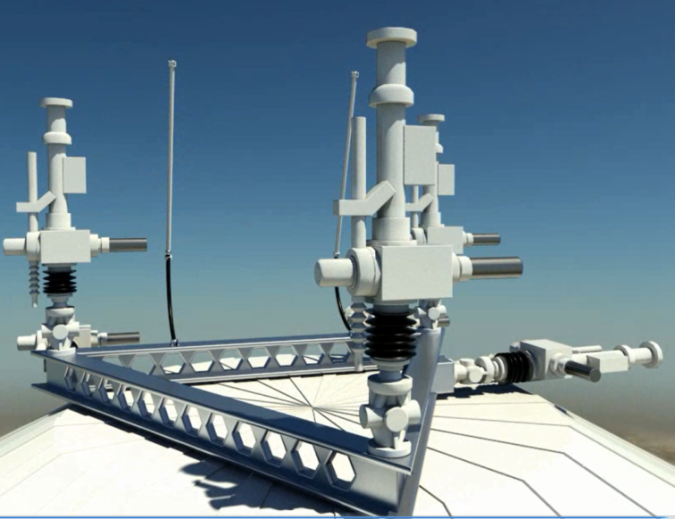
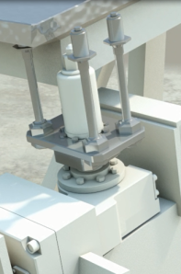
Active optics
Primary reflector actuators
Subreflector actuators
1116 electro-mechanical actuators (maximum stroke ± 15 mm)
from a shaped profile to a parabolic profile (increase primary focus operating frequency)
correct deformations induced by gravity
6 electro-mechanical actuators able to:
translate sub-reflector paralelly ( max ± 50 mm) and orthogonally ( max ± 110 mm) to elevation axes , and long optical axis (max ± 110 mm)
Rotate sub-reflector around the same three axis ( max ± 0.25 arcsec)
Correct primary-secondary mirror misalignment and focal distance
Compensate the rigid-body motions of the main mirror (those that primary mirror actuators can not correct)
SRT optical configuration
Notes:
In this way SRT can increase the maximum operating frequency observable from the primary focus. Moreover they are used of course to correct the deformations induced by gravity on the primary surface.
Compensate the rigid body deformations of the main mirror (those primary mirror actuators can not correct)

Slide 5
Laser tracker (LT) measurement
of the SRT subreflector

Slide 6
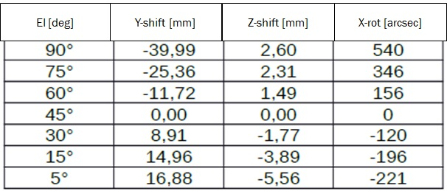
Primary–subreflector alignment
SIGMA 3D measurements (2012) with LT (Faro SN 3301)
Alignment of the reflectors best fit axes at @ 45°elevation
Measurements at 7 different elevations ( step of 15° up to 90°, 45° as reference alignment)
look-up table (LUT) corrections for the gravity deformations of the subreflector at all the elevation range by a polynomial fitting
Temporary subreflector LUT
Y is orthogonal to the elevation axis
Z is parallel to the antenna optical axis
X is parallel to the elevation axis
Laser tracker measurement of SRT subreflector
Notes:
Laser tracker (Faro SN 3301) measurement by SIGMA 3D in 2012
Subreflector position was manually aligned by varying the thickness of shims mounted between the apex structure
Final alignment of the secondary mirror w.r.t. the primary one was specified with:
± 2.5 mm distance between the actual and teoretical sub-reflector vertex
<= 250 arcsec tilt between the secondary and primary light of sight axes

Slide 7
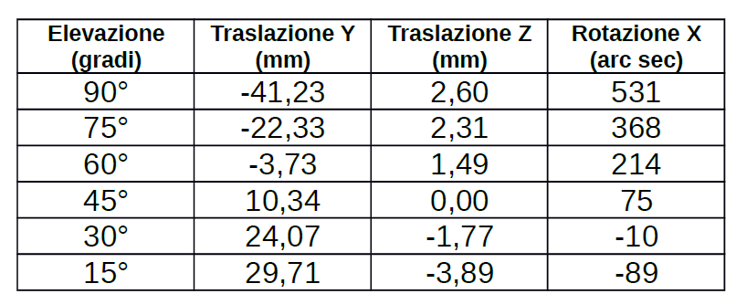
Primary–subreflector alignment
SRT technical commissioning (2013-14)
LUT was updated by astronomical observations:
Z- shift for focus adjustment
X-rotation and Y-shift to compensate for the rigid-body motion of the primary reflector (not being compensated by the primary mirror actuators once the active surface was enabled)
Current subreflector LUT
El [deg]
Y-shift [mm]
Z-shift [mm]
X-rot [arcsec]
Y is orthogonal to the elevation axis
Z is parallel to the antenna optical axis
X is parallel to the elevation axis
Laser tracker measurement of SRT subreflector

Slide 8
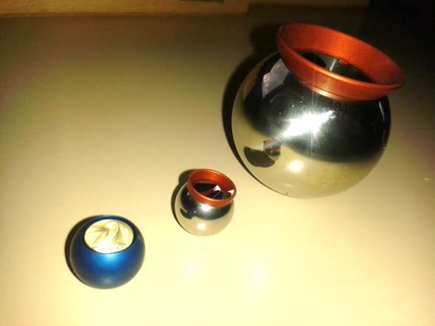
New laser Tracker meas. on the subreflector
Leica Absolute Tracker AT 402
(2016)
LT and target reflector features
Remotely controlled via Wireless or W-LAN connection
digital camera, whose software is able to recognise/track the targets
Angular accuracy: ± 15 μm + 6 μm/m
Distance accuracy: ± 10 μm
Target reflectors Acceptance Angle Use cost
Radius
19.05 mm ±0.0025 mm ±30° Inizializ/calibration expensive (K€) (red hardened steel sphere)
6.35 mm ±0.0025 mm ±30° Inizializ/calibration expensive (K€) (red hardened steel sphere)
6.35 mm ±50° fixed installation cheap (~10 €)
(blu anodized aluminium sphere)
Check the motions of the subreflector
Define a procedure to build a suitable reference frame for our LT meas.
Check the current subreflector look-up table
Laser tracker measurement of SRT subreflector
Notes:
At the beginning of 2016 the SRT metrology team bought Leica Absolute Tracker AT 402

Slide 9
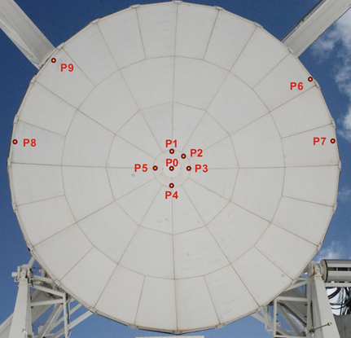
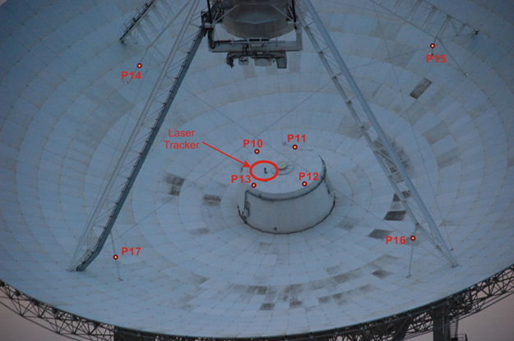
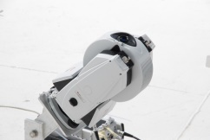
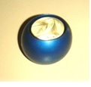
Laser Tracker measurement setup
April 2016
Remotely controlled
by W-LAN
10 targets on subreflector
Laser Tracker AT 402
4 targets on Gregorian room top
18 target reflectors
6 mm dia
P0,P1,…,P17
1 target for each quadrupod leg
Laser tracker measurement of SRT subreflector
Notes:
In 2016 we carried out LT measurement campaign on SRT. In order to do that laser racker was installed on a rigid support 45° inclined and bonded to the top of the gregorian room and remotely controlled by W-LAN connection
Then 18 target reflectors were attached on different parts of the antenna: 10 target on the subreflector (4 target on the subreflector central flange are known with good accuracy from mechanical design)
, 4 target on the top of the gregorian room and 1 target for each quadrupod leg
(6.35 mm radius anodized aluminium sphere)

Slide 10
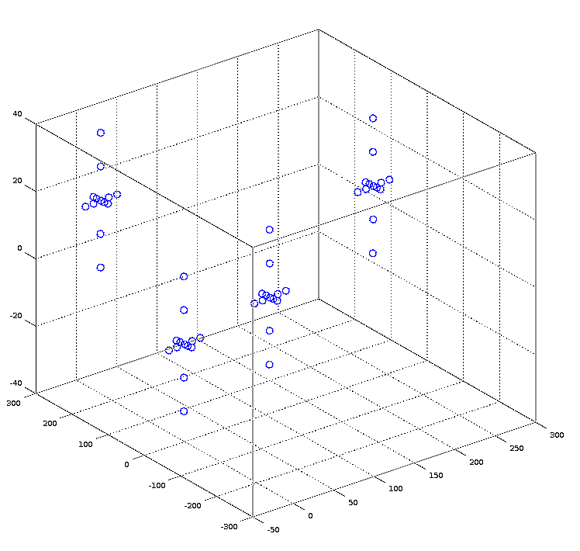
Subreflector motions and reference frame
April 2016, first LT measurement
antenna at 45°Elevation (best primary-subreflector alignment from Sigma 3D meas.)
With LUT enabled we moved remotely the actuators by 5 steps of 10 mm in X, Y and Z direction
Targets on the subreflector depicts 3D crosses
After a roto-translation the 3D crosses were referred to the mechanical reference frame (by exploiting P0, P1, P2, P3, P4 and P5 mechanical positions as reference points)
P1
P3
Z
Y
mm
X
P0
P4
Targets moved consistently with the commanded positions (same axis, sign and amount with 0.3 mm uncertaintly)
Roto-translation matrix to transform all the target coordinates to the mechanical reference frame of the subreflector
mm
mm
3D crossed after roto-translation on the mechanical reference frame
Laser tracker measurement of SRT subreflector
Notes:
First laser tracker measurement to check the subreflector motios and define the reference frame of the subreflector
Abbiamo scelto di fare le misure a 45° perché era il miglior allineamento e anche riferimento delle misure di SIGMA 3D
Roto-translation…..exployting as reference the known position of the targets P1, P2, P3, P4, P5 on the subreflectors central flange
So what we got:
The target reflectors on the subreflector moved coherently to the commanded positions same axis and same sign and same amount with an accuracy equal to a few ten of mm
Thanks to the 3D crosses we got a matrix of roto-translation which allows us to transform the measured coordinates of the targets to the reference frame of the actuator and then to apply it to all the coordinates othe other targets

Slide 11
Validation of the Subrefl. reference frame
April 2016: second LT measurement
Schedule
Measurements at 6, 15, 25, 35, 45, 55*, 65, 75, 85, 90 deg of the antenna elevation with
Subreflector LUT disabled (actuators parked ) → OFF
Subreflector LUT enabled (actuator working) → ON
Data processing
Each dataset (one for each target on the subreflector) was roto-translated in the mechanical reference frame of the subreflector (defined before)
Bias due to the small movements of the LT support were deleted from each dataset (bias detected thanks to the other targets)
Reference elevation 55 deg (arbitrarly chosen as best alignment)
Laser tracker measurement of SRT subreflector
Notes:
Le curve passano per lo zero a 55 perché dalle nostre misure è risultato che la posizione di miglior allineamento è a 55° e non più a 45°

Slide 12
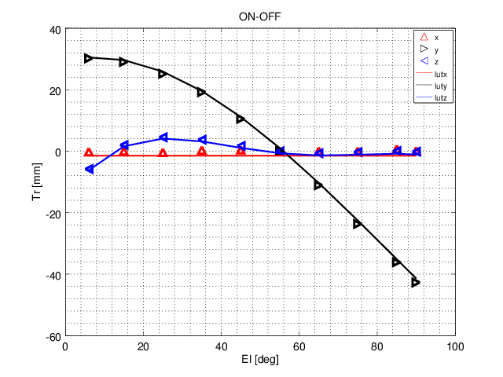
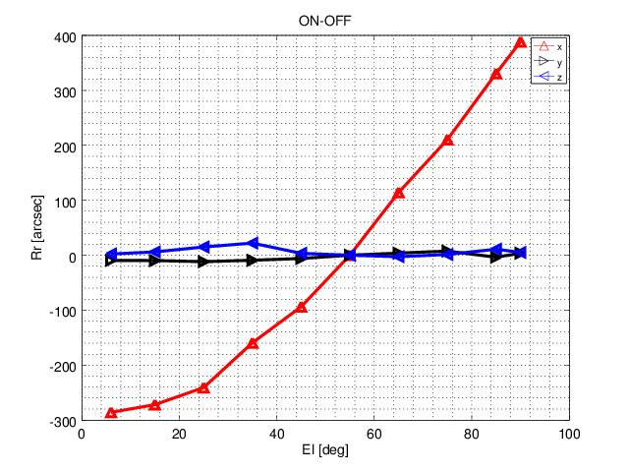
Validation of the Subrefl. reference frame
April 2016: second LT measurement
ON-OFF
ON-OFF
Shifts
Rotations
X-LTM
X-LTM
Y-LTM
Y-LTM
Z-LTM
Z-LTM
[mm]
[arcsec]
X-LUT
X-LUT
Y-LUT
Y-LUT
Z-LUT
Z-LUT
El [deg]
Subreflector motions are consistent with those commanded
Our mechanical reference frame is consistent with the reference frame of the subreflector
El [deg]
Subreflector motions are consistent with those commanded
Our mechanical reference frame is consistent with the reference frame of the subreflector
Laser tracker measurement of SRT subreflector
Notes:
All the dataset of the subreflector targets are used to get the ON-OFF plot.
In these plots,
1) the triangular dots are the ON-OFF laser tracker measurement changing with elevation angle, X-translation in red, Y-translations in black , Z-translation in blue on the left and
X-rotation in red, Y-rotations in black , Z-rotations in blue on the right
2) The lines are the respective translations and rotations of the current LUT
Basically LT measured the LUT translations and rotations. What does it mean?
Subreflector motions are cohetent with those commanded
Our mechanical reference frame is consistent with the reference frame of the subreflector any other choice would not allow us to overlap the triangle dots and LUT lines
although it is not an absolute measurement

Slide 13
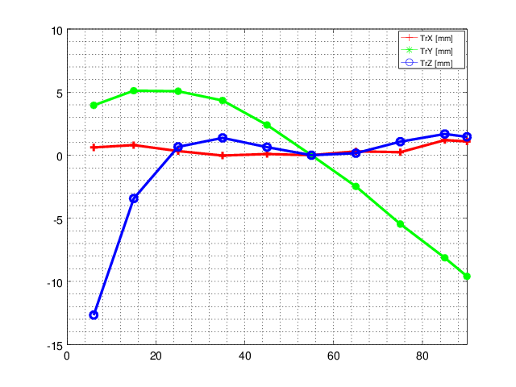
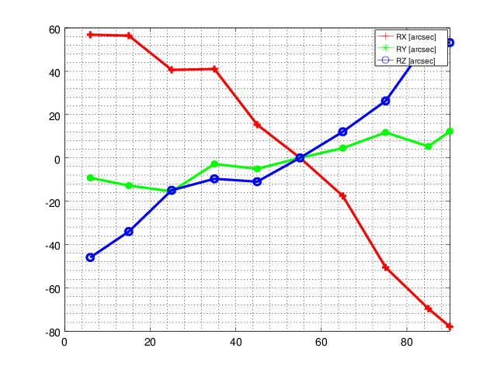
Validation of the Subreflector LUT
April 2016: second LT measurement
LUT ON
Shifts
Rotations
X-LTM
X-LTM
Y-LTM
Y-LTM
Z-LTM
Z-LTM
[mm]
[arcsec]
El [deg]
El [deg]
Residual misalignments w.r.t. 55° el
Y-axis shift → 5 mm @ 15° el and up -10 mm @ 90° el
Z-axis shift → Up to -3 mm @ 15°el
X-axis rotations → 56 arcsec @ 15° el, up -80 arcsec @ 90° el
Laser tracker measurement of SRT subreflector
Notes:
Then, looking at what the Laser Tracker measured when the LUT was on, residual misalignments w.r.t. the reference position at 55° are present due to:
an excess of Y-translation (up to 5 mm at lower elevation and 10 mm at higher elevation) and Z-translation at lower elevation angles and even X rotation.
the question is are these residual misalignment one of causes of the asymetrical features of SRT beam at K-band frequency?

Slide 14
Simulation tool
for close range photogrammetric survey
In collaboration with Prof. G. Sanna
University of Cagliari, Department of Civil, Environmental Engineering and Architecture, Italy

Slide 15
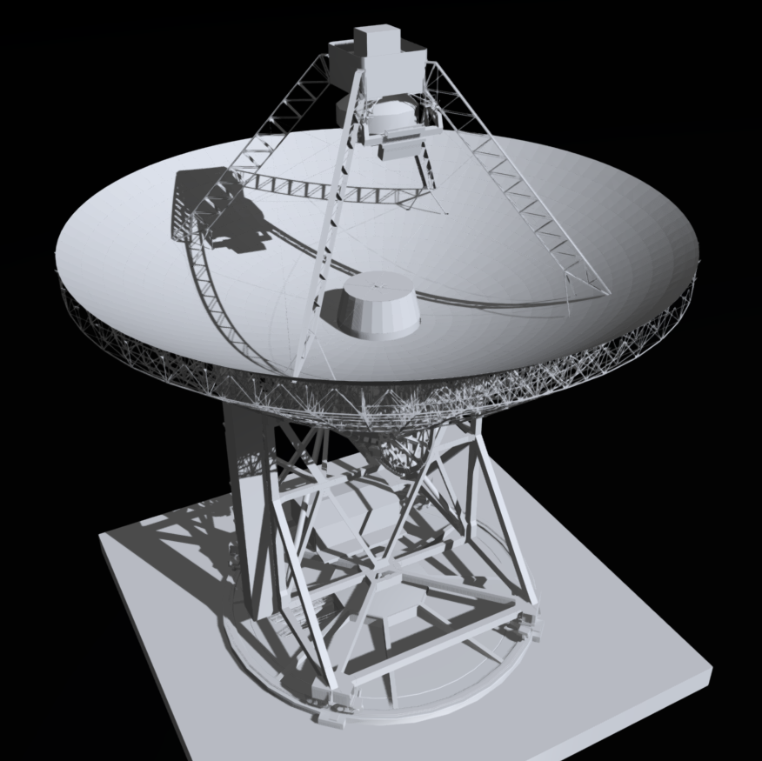
Simulation tool for Photogrammetry
Photogrammetry surveys on large antennas are not trivial task
We have implemented a simulation pipeline (3D-models of the antenna is needed) able to:
select the camera parameters, the image acquisition angle
Set the crane position or a configuration of fixed camera to be installed on the antenna (on robotic sled or rail)
evaluate different scenarios and select those providing the best measurement accuracy
In order to generate synthetic images we developed two software platform based on:
Matlab tool
Python-blender
3D model of SRT (320k vertices)
http://goo.gl/L1sucv
Simulation tool for close-range photogrammetry
Notes:
As well know, photogrammetry ……… in fact it require heavy efforts in terms of planning and execution, and even in terms of means and skilled operators involved.

Slide 16
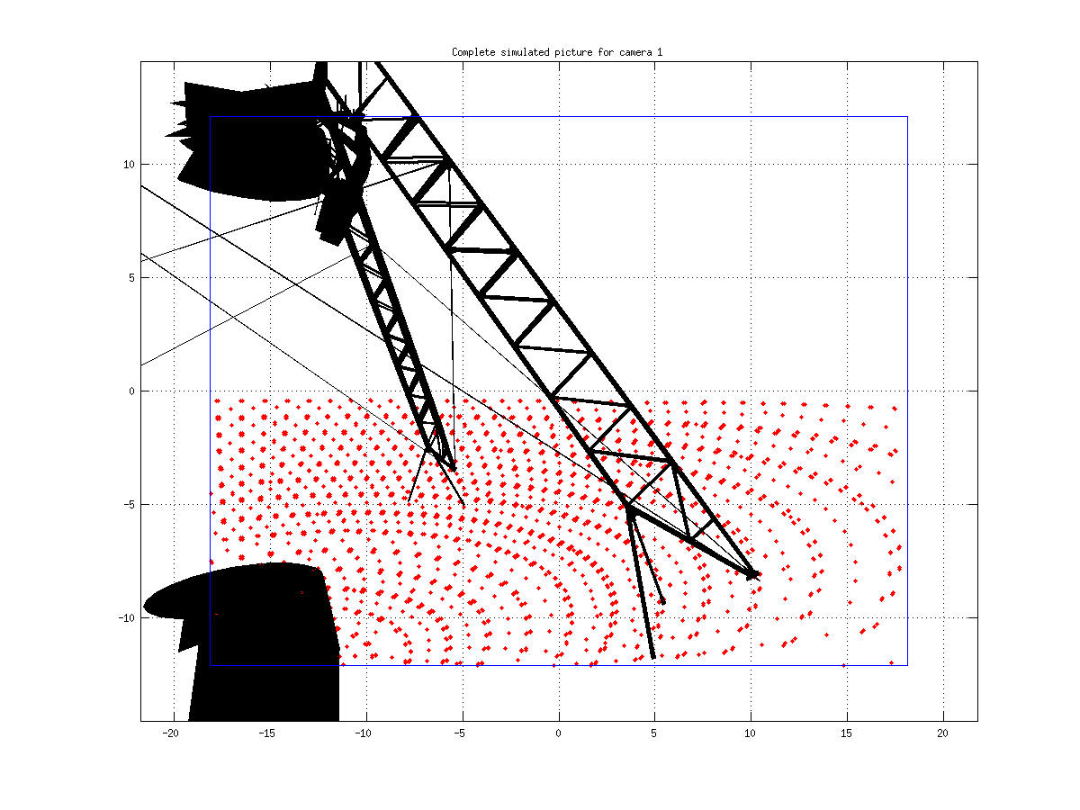
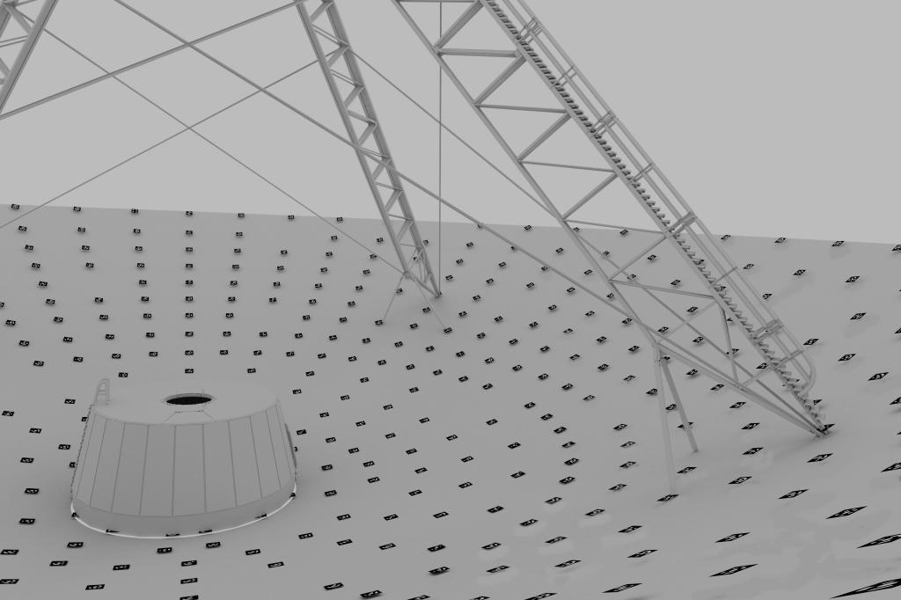
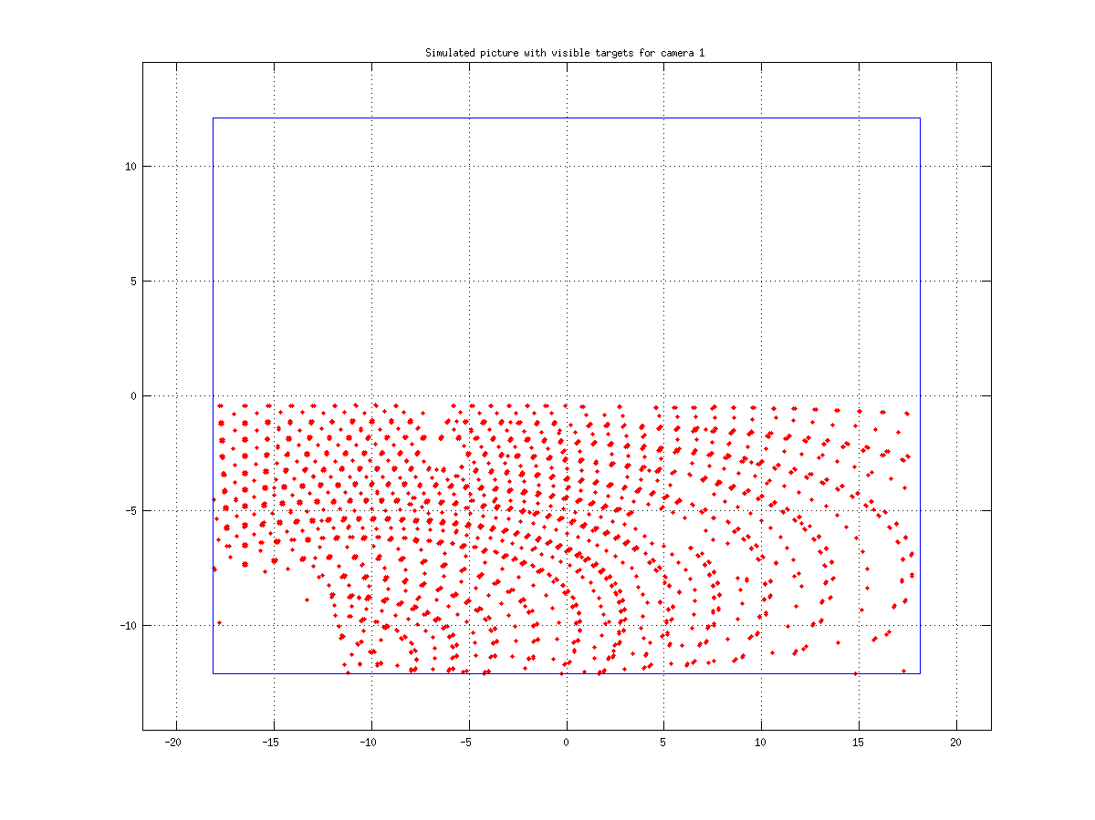
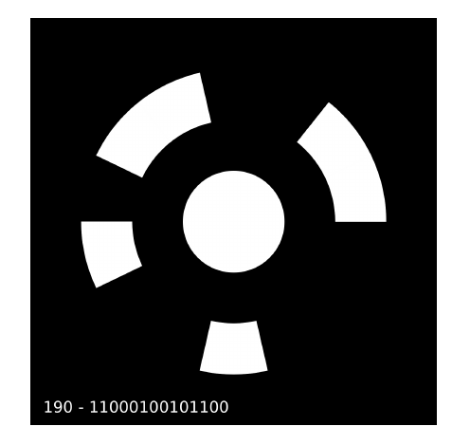
Matlab toolbox vs Python Blender
Matlab toolbox
simple 3D model (targets like point lists)
target recognition is not required (reference points)
fast (min) → less accurate synthetic images
Python Blender
High resol. 3D model (targets like physical object)
Coded target recognition (images orientation)
slow (hr) → photorealistic images
Blocks to the camera images are considered
Hidden reflector targets are masked
Matlab point lists or bender targets
are input to the bundle adjustment (MicMac, Aicon DPA pro)
Simulation tool for close-range photogrammetry
Notes:
Matlab tool→ → simple 3D model (targets like points)→ fast (minutes)→less accurate synthetic images
In realtà non genera immagini vere e proprie, ma una lista di punti 2D (coordinate immagine [pixel]) che rappresentano i baricentri dei target, raggruppati per immagini di appartenenza. Una survey (sintetica o reale) richiede centinaia di immagini. Queste liste sono l’input per il SW di bundle.
Python blender → Hi-res 3D model (targets like physical objects)→slow (hours)→ photorealistic images
Questo significa che se si vogliono valutare diversi scenari è meglio usare preliminarmente il toolbox per determinare i best cases e quindi usare Blender per una valutazione finale ottimale.

Slide 17
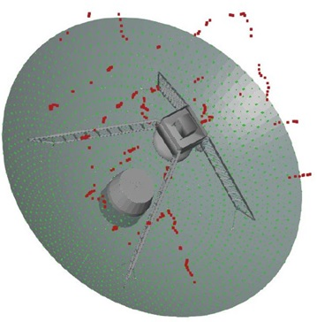
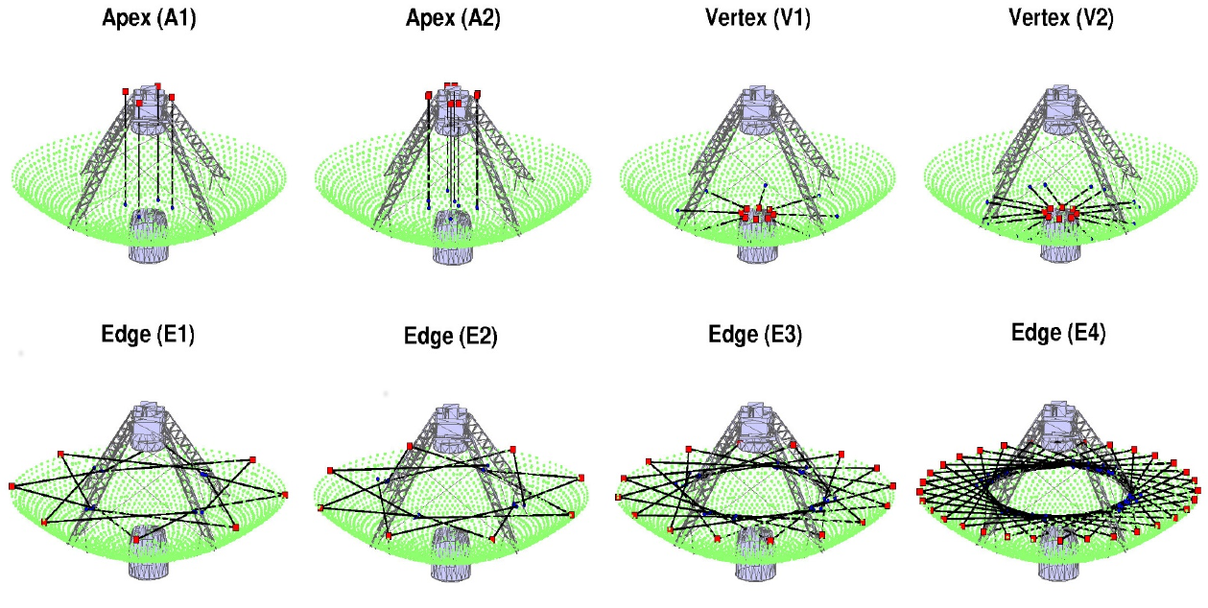
Matlab toolbox
In this preliminary study we use matlab toolbox (python bender has not tested yet) to estimate the errors in a photogrammetric survey ( for example due to different camera positions or bundle adjustment engine)
We have considered two different simulated scenarios by using and ideal 3D model of SRT (without any surface deformations), but adding statistical errors.
“Scenario A”
One camera moved on the space (“real” SRT survey Sigma 3D)
“Scenario B”
Combinations of many camera installed on the antenna
Target positions
Camera positions
Light of sight of the camera
Camera
Simulation tool for close-range photogrammetry
Notes:
Come esempio di utilizzo del toolbox Matlab presentiamo due scenari.
Lo scenario A è esattamente una delle survey di Paluszek. Abbiamo preso le posizioni (reali) delle sue camere e le coordinate 3D (reali) dei target e quindi abbiamo generato sinteticamente le sue prese.
Lo scenario B simula invece una configurazione di circa 160 camere (a basso costo) fisse controllabili remotamente montate sull’antenna. Robotic sled or mechanical rail
In Scenario A and B we considered as reference the “a priori” target coordinates used to generate the synthetic images.
We were able to evaluate the effects of interior (resolution, focal length) and exterior (camera orientations) parameters with respect the overall error budget.
The image number and the interior and exterior camera parameters can be optimized to reach a tradeoff between measurement accuracy and logistical constraints.

Slide 18
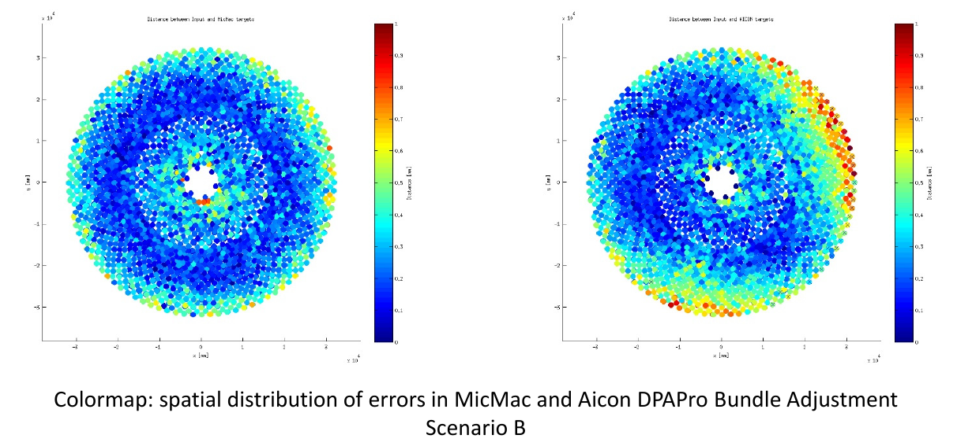
Bundle adjustment errors
Different bundle engines with the same input scenario (here a matlab point list of B-scenario) may give different results:
MicMac
“Scenario B”
Aicon Dpa pro
X 10⁴
X 10⁴
0.1
0.2
0.3
0.4
Distance [mm]
0
0.5
0.6
0.7
0.8
0.9
1
0.1
0.2
0.3
0.4
Distance [mm]
-3
-2
-1
0
1
2
3
-3
-2
-1
0
1
2
3
0
0.5
0.6
0.7
0.8
0.9
1
Y [mm]
Y [mm]
-3
-2
-1
0
1
2
3
X 10⁴
-3
-2
-1
0
1
2
3
X 10⁴
X [mm]
X [mm]
X 10⁴
Maps of error on the target positions
In a real photogrammetric survey this sort of errors are mixed with the surface deformations to be measured. Thus, they can not be distinguished.
Simulation tool for close-range photogrammetry
Notes:
Nel caso reale questi effetti sono mischiati agli errori sperimentali (per esempio turbolenza, incertezza nella determinazione dei baricentri dei target, incertezza nei ground control point ecc.) e alle deformazioni vere e proprie di M1. Quindi nel caso reale i vari contributi sono praticamente inestricabili.

Slide 19
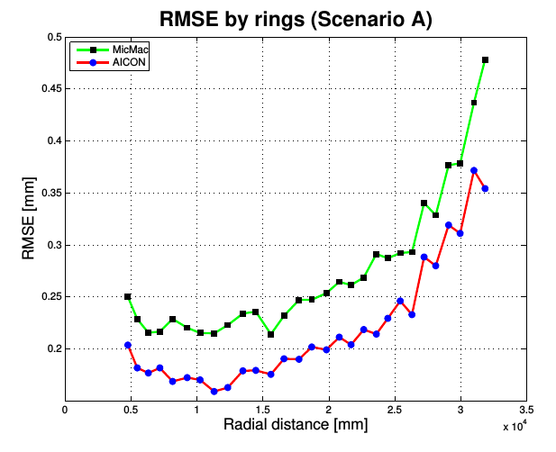
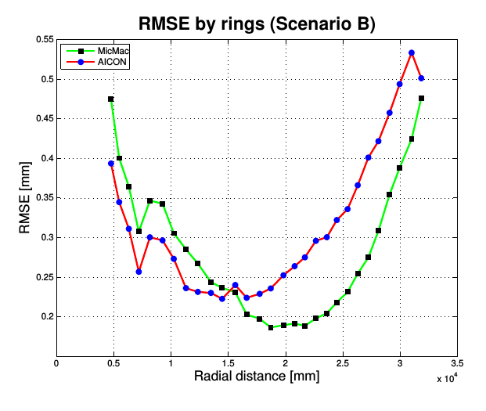
Evaluation of scenarios
A criterion to evaluate the best scenario simulated is to calculate radially the averaged rms errors on each sampled ring (about 2 samples for each ring)
AICON B.A: RMSE <= 0.2 mm up to 20 m
MICMAC B.A. RMSE <= 0.2 mm around 20 m
Simulation tool for close-range photogrammetry
Notes:
The two plots show the average of the rms error in function of the reflector radius for the scenario A, on the left and B on the right.
In each plot the green curves refer to the MIcMAC bundle adjustment and the curve red to the Aicon bungle adjustment.
The comparison shows that the scenario A is the best one at least in the inner part of the reflector and the AICON bundle adjustment is the more accurate with and RMSE <= 0.2 mm up to 20 m,
Then the RMSE gets worse in the outer part of the reflector on both plots. But It ‘s also true that in the scenario B RMSE is better in the central part of the reflector when MICMAC bundle adjustment is used.
The scenario “B” turns out to be worst in term of RMS due to there is no enough suitable position where to install the cameras on SRT

Slide 20
Summary and discussion
Laser tracker measurement of SRT subreflector
Recent LT measurement shows residual misalignments of the subreflector w.r.t. 55°el
Y-shift 5 mm at 15° el and up to -10 mm at 90°el
Z-shift 3 mm at 15°
X-axis rotation ~56 arcsec @ 15° el, up ~ -80 arcsec @ 90° el
New measurements have to be scheduled to:
figure out if such as misalignment (Y-shift at the lower and the higher elevations) can be the cause of the asymmetric features on the SRT beam at K-band frequencies
Create an absolute reference frame by using calibrated targets on the known points of the top of gregorian room
Refine the LUT so that only X-rotation and Z-shift of the subreflector are used for correcting the primary mirror rigid-body motions
Updating the pointing model in a such way to compensate for the Y-shift due to the primary mirror rigid-body motions
Summary and discussion
Notes:
Questo è un risultato interessante perché spiega l’utilità di un tool di simulazione come questo nella progettazione di una survey.

Slide 21
Summary and discussion
Simulation tool for close range photogrammetric survey
Simulating a photogrammetric survey is useful to find the proper scenario which minimizes the RMS error of the measurement set, over all in a large telescopes where you need a crane or fixed camera to take a lot of pictures
We have presented a flexible simulation tool which allows one to choise the best possible photogrammetric scenario in terms of minimum RMS error due to the meas. set-up.
New tests are needed to validate the tool also with the open source SW platform based on Python-Blender and in other different scenarios as well
Summary and discussion
Notes:
Questo è un risultato interessante perché spiega l’utilità di un tool di simulazione come questo nella progettazione di una survey.

Slide 22
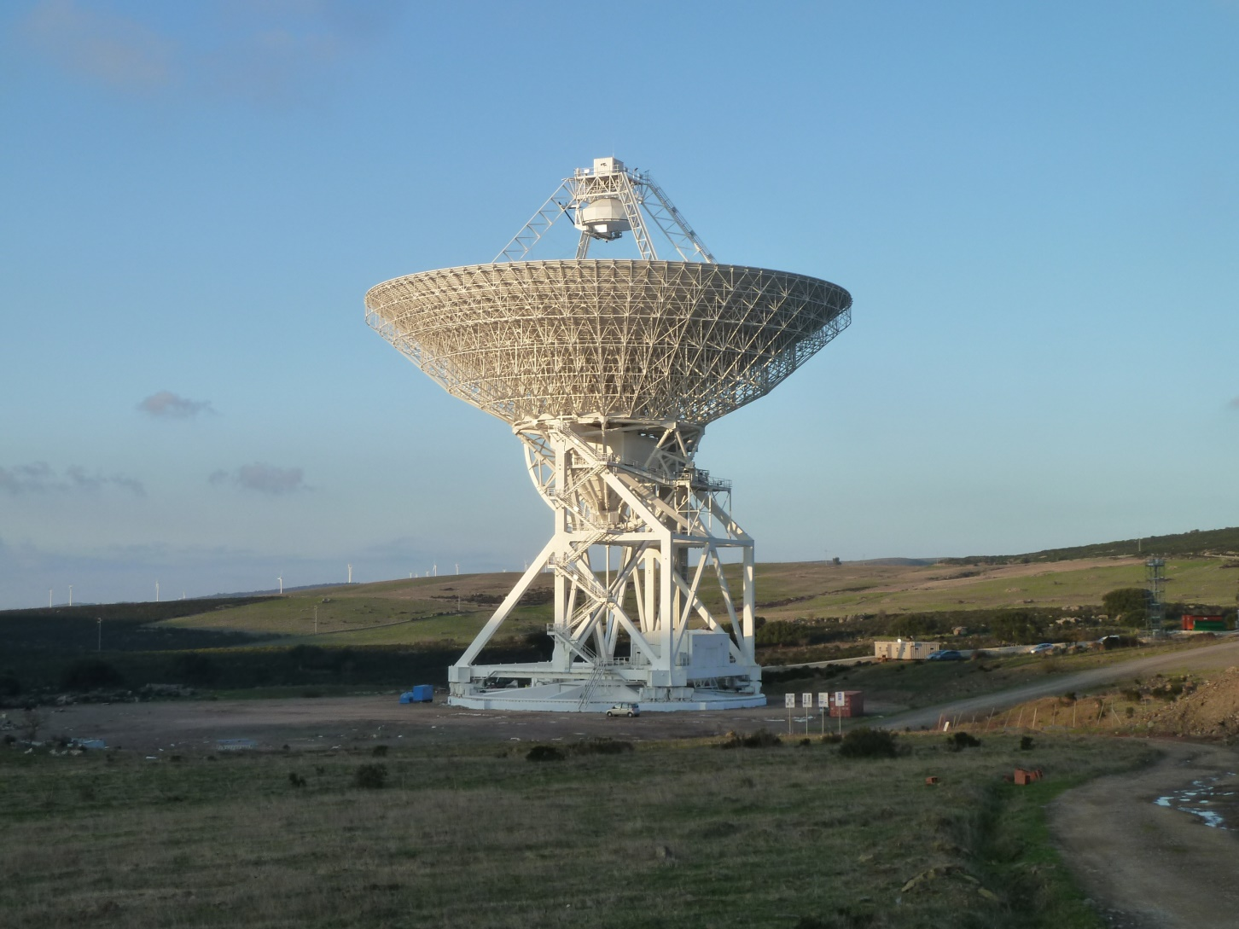
Thank you for your attention
Any questions?
Summary and discussion
Notes:
Questo è un risultato interessante perché spiega l’utilità di un tool di simulazione come questo nella progettazione di una survey.

Slide 23
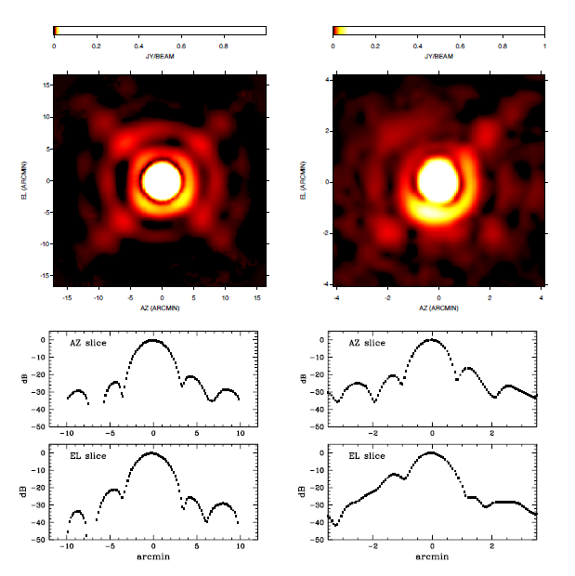
C-, K-band beam pattern characterization
7.2 GHz elevation-averaged
beam pattern
25.5 GHz elevation-averaged
beam pattern
Courtesy of SRT Astronomical Validation (Prandoni et al. in preparation)
Notes:
Obtained by stacking together several OTF scan of bright point

Slide 24
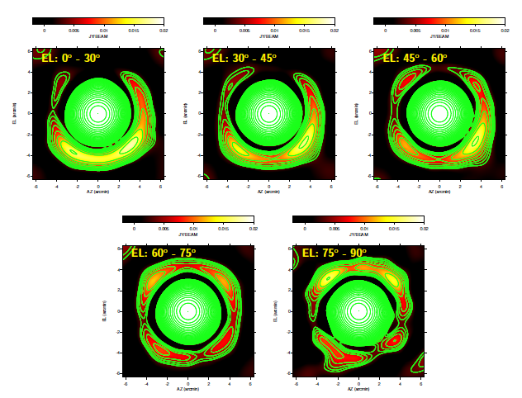
C-band beam pattern characterizzation
Courtesy of SRT Astronomical Validation (Prandoni et al. in preparation)

Slide 25
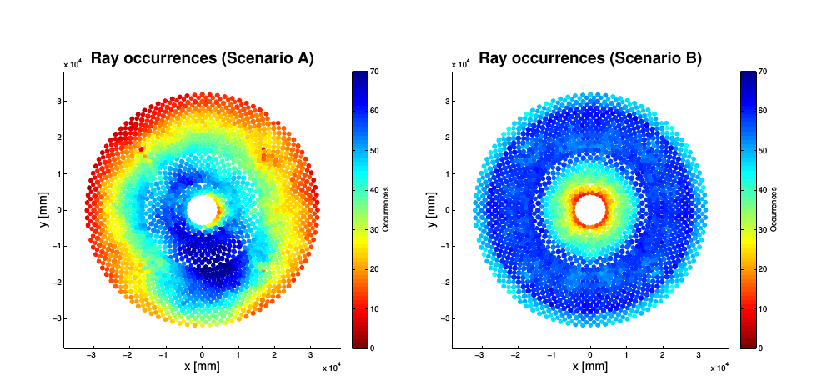
Matlab toolbox
The “ray occurrence” is the number of images referencing the same target. This parameter is related to the spatial error distribution.
Simulator tool for close-range photogrammetry
Notes:
Confrontando i due scenari per quanto concerne il numero di raggi (cioè quante immagini vedono un dato target) si nota che il rilievo di Paluszek è molto meno omogeneo. Ciò è dovuto al fatto che il crane non può muoversi a piacimento a causa degli struts, di M2 e dei cavi degli struts e quindi la mappatura è quella che è. Ovviamente tanto è più grande il numero di immagini che “vedono” un determinato target tanto è più robusta la soluzione che lo riguarda. Nel caso dello scenario B abbiamo avuto un altro genere di problema. Le equazioni di collinearità alla base del calcolo “impazzivano” a causa dell’eccessiva simmetria di questo scenario perchè contengono funzioni trigonometriche...

