Slide 1
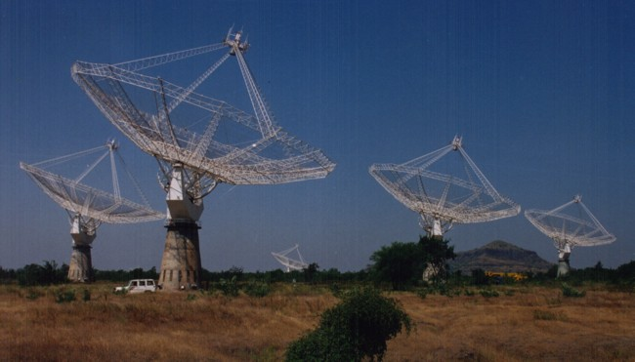
Metrology and Control of Large Telescopes
UPGRADED GMRT SERVO SYSTEM
SURESH Sabhapathy
Giant Meter Wave Radio Telescope
National Centre for Radio Astrophysics,
INDIA
e-mail
suresh@gmrt.ncra.tifr.res.in

Slide 2
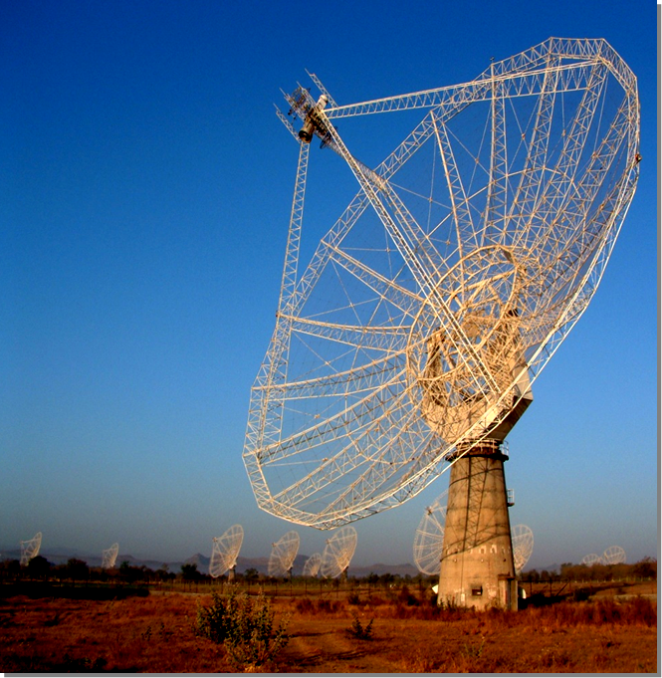
Giant Meter wave Radio Telescope - GMRT
The GMRT is a large aperture synthesis radio telescope operating at frequency range 50Mhz – 1450Mhz .
Designed, built and operated by National Centre for Radio Astrophysics is located 80 km north of Pune in India.
This telescope consists of:
30 identical antenna dishes of
45m reflector diameter.
14 antennas are spread over
area of about one km square.
16 are distributed along Y-formed
arms giving an interferometric
baseline of 25 kilometers.

Slide 3
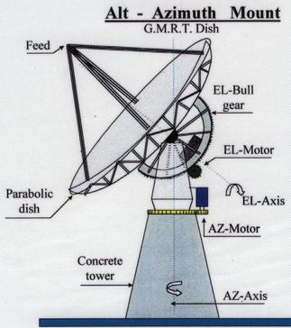
GMRT Servo System
Requirement of Servo System in Large Radio Telescopes,
  Ability to point anywhere in the sky,
  High Pointing and Tracking accuracy,
  Able to accelerate rapidly in the direction of source,
  Able to manoeuver remotely,
Dual Drive Closed Loop Position Feedback Control System.
Location: Base of the each Antenna

Slide 4
GMRT Servo System Specifications
Parameters | Values
Dish Mount | Altitude-Azimuth mount
Drive | Dual drive in Counter Torque mode
Dish Movement | AZ: ±270deg EL: 15deg to 110deg
Dish Slewing Speed | AZ: 30deg/min EL: 20deg/min
Min Tracking Speed | AZ: 5arcmin/min EL: 5 arcmin/min
Max. Tracking Speed | AZ: 150arcmin/min EL: 15 arcmin/min
Tracking acceleration | < 0.02 deg / sec / sec ( Az and EL)
Position measurement accuracy | 20 arc seconds
Tracking & Pointing accuracy | 1 arc min for wind speed < 20kmph
Design Wind Speed | 40 KMPH Operational 133 KMPH Survival

Slide 6
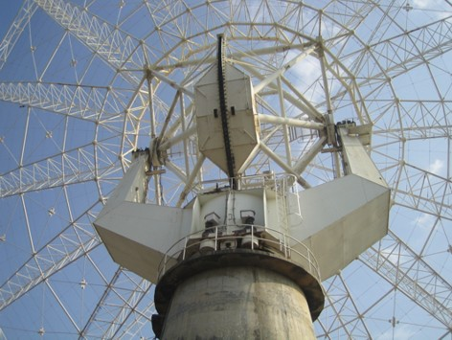
Older drive configuration
The existing motor drive system used on the azimuth and elevation axes of GMRT antenna dishes employs:
DC-brush motors, designed and manufactured over 20 years ago.
Reduction via 3-stage planetary gear boxes, driving toothed drive rings.
Reduction c. 25,000:1.
Load inertia c.10^6kg.m²
Stiffness c. 10^7Nm/Rad
Tracking accuracy = 1 arc min.
Backlash compensation by analog
The position controller is 86X
based running in ‘Pascal’

Slide 7
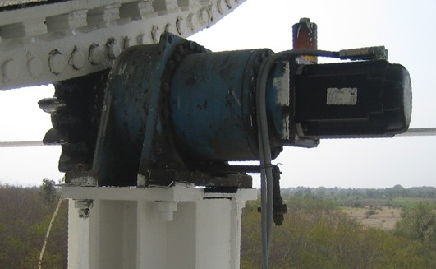
Need for upgrade
Motors
The existing drive and control system has worked well for many years, however exhibits
high maintenance costs(brush wear etc)
limited accuracy.
Obsolete.
It was decided to retrofit :
To increase life of basic telescope system
Reduce maintenance cost and down time
Motor maintenance being labour
intensive required schedule
down time. Almost 30 days in a year of
telescope time is lost.

Slide 8
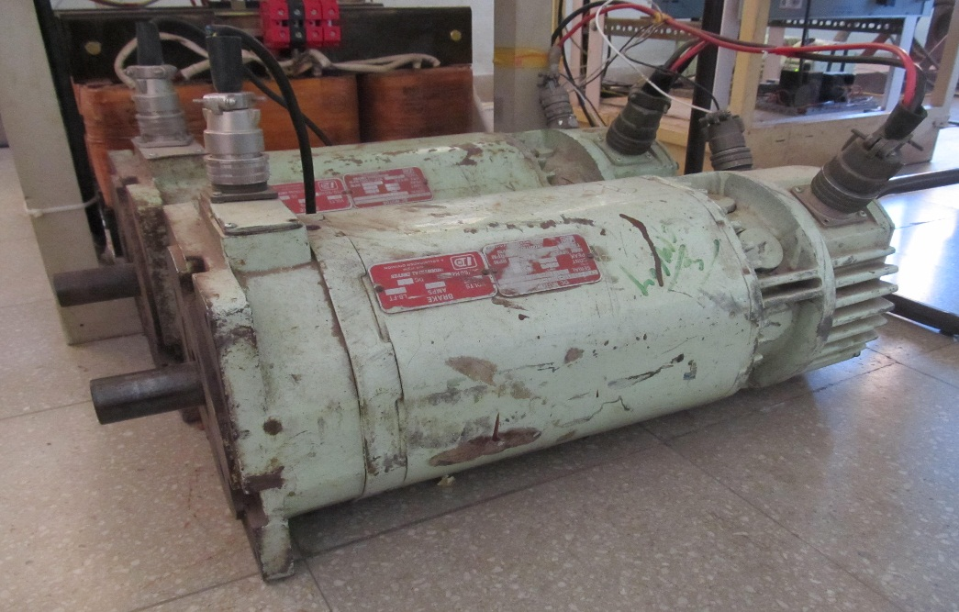
Need for upgrade
Savings in telescope Cost
Cost of motors of 30 antennas (in 1991) - Rs480 lakhs
~ $0.95 million
Cost of servicing @Rs25Lakhs per year
is Rs.500 lakhs in 20 yrs.
~ $1 million PM DC Brush Motor
Equivalent to a cost of
brush less drives
of 10 # antennas of GMRT.
Savings in telescope time
Time gained = 8hrs x 30 days
= 240 hrs per annum.

Slide 9
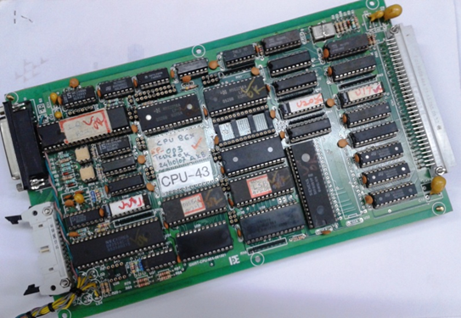
Need for upgrade
Position Controller
The position controller implemented in 86X based computer designed in 1991 was state-of-art as it implemented state machine to carry out the real time task and worked satisfactorily.
The main motivation to retrofit 86X with PC-104 single board computer(SBC) was due to :
Limitations in hardware 86X CPU board
Outdated development tools
of software
Custom made scheduler
Obsolescence
Implementing modern control algorithm
Was not possible.

Slide 10
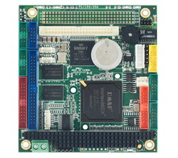
Retrofit and upgrade
The PC-104 based SBC is available commercially off the shelf.
Tools for firmware and software developments are ready made.
The control algorithm Software is developed on the Linux OS
therefore changes can be easily implemented in software.
PC-104 is based on PCI bus standard so the connector (signals) and
form factor do not change with processor.
Even if the processor changes the software will run on the new processor
without the need for major change in software. PC-104 SBC
The smaller version of Linux namely
“Puppy Linux” is the OS .
As the scheduling in Linux does not guarantee
a real time servicing of requests, a special
Linux - RTAI is used to control real time tasks.

Slide 11
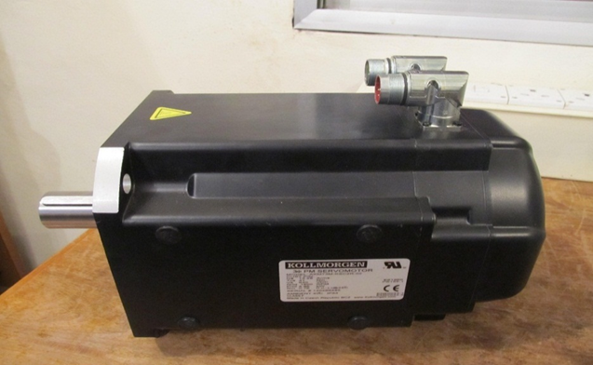
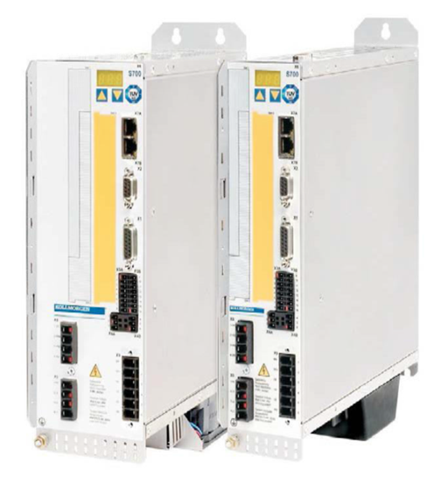
Retrofit and upgrade
The 4 brush motors in azimuth/elevation
are replaced by 4 brushless motors
with up to 20 N-m continuous torque,
1,500rpm max. speed, with resolver
feedback and holding brakes.
Modern, digital motor drive amplifiers
are employed, which have high resolution
and bandwidth.
The upgraded control system with high
Resolution sensors will provide a ten fold
Improvement in tracking accuracy
- 10 arcseconds.

Slide 12
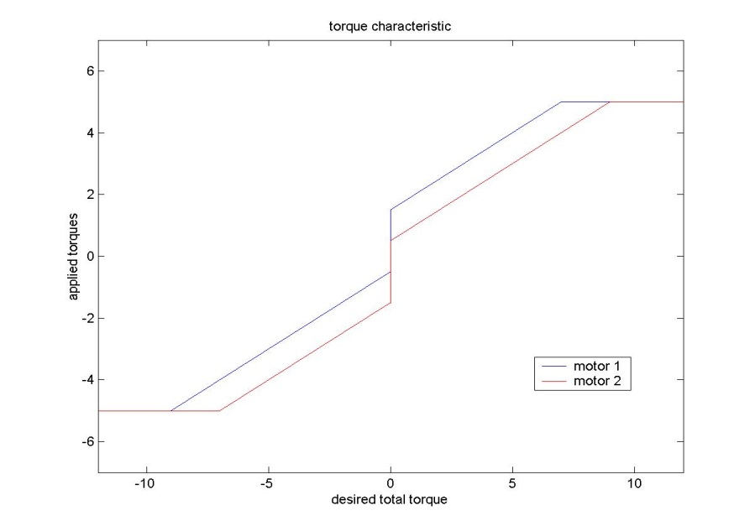
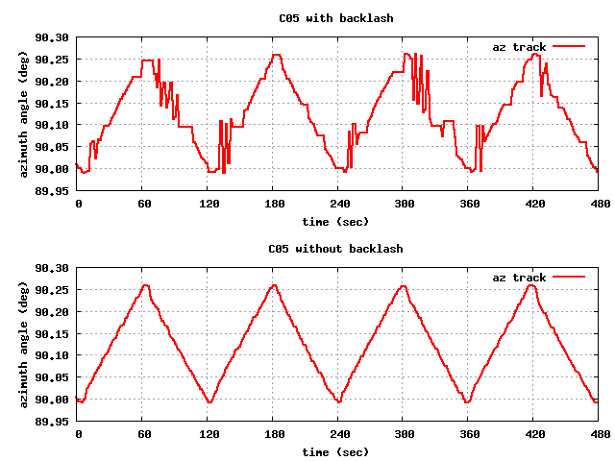
Backlash compensation
Backlash compensation is achieved
by using 2 motors with torque offset,
adjustable in software.
The characteristic is shown
It exhibits hysterisis on sign change
of position error polarity.
Typical offset is 10% of peak torque.
The gear train hysterisis or backlash
Is measured to be around +/- 3.5 arc
minute with reference to o/p encoder.
The second figure shows the effect
when positioning with reversing
Torque. This is as per expectation
In the book by Gawronski.

Slide 13
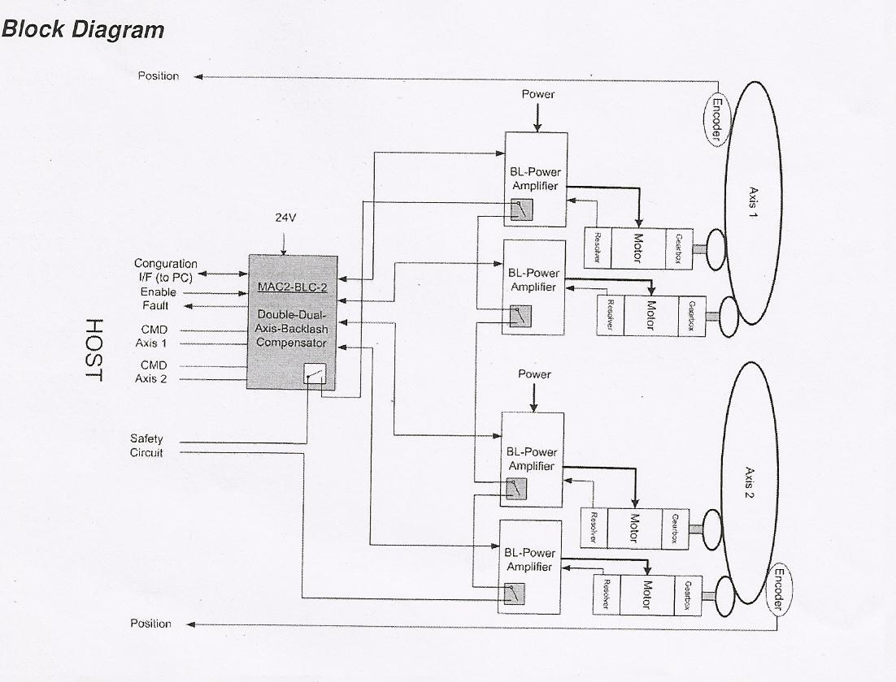
Upgraded Control system Configuration
Each Az / Elevation axis has:
1 backlash compensation unit
2 drives, 2 motors & resolvers .
The backlash units accepts a
speed command and applies
a differential torque offset
before commanding a
physical torque from each of
the two drives in each axis.
This configuration solely
provides precise torque
control in each axis.

Slide 14
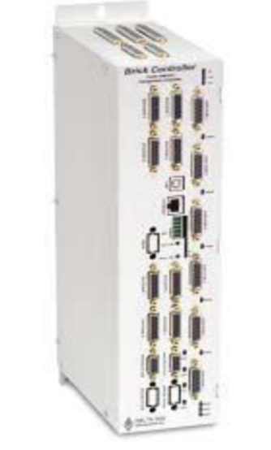
Upgraded Control system configuration
The backlash control unit has full velocity control capabilities and so supports complex algorithms like PID with notch filter, feed forward and others. The next slide shows the backlash control unit customized for GMRT.
The monitoring tools in the backlash
unit is used for performing tests like
speed characterization, step response
and locked rotor frequency.

Slide 15
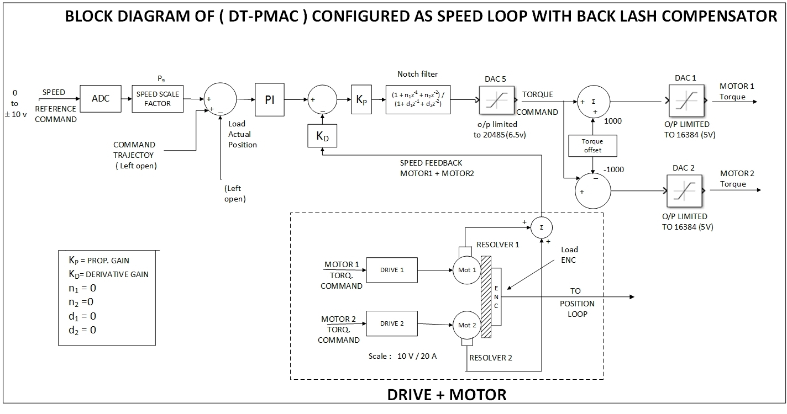

Slide 16
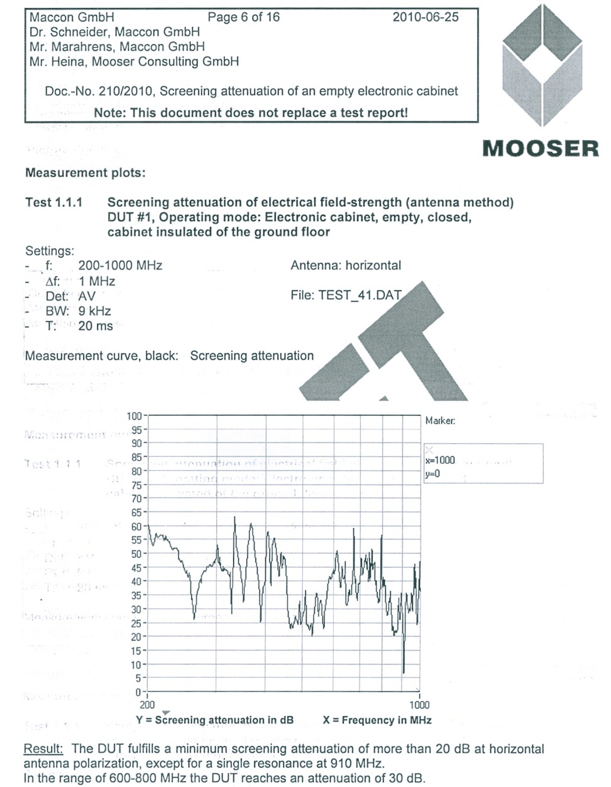
EMC of the electronic cabinet
The EMC cabinet housing the drives is developed specially to mitigate the self generated RFI due to the switching of transistors and devices with in.
The cabinet is tested at Mooser GmbH, labs in Germany.
The screening attenuation obtained is 20 dB in the frequency range 200Mhz - 1500Mhz.
Another test was performed at the telescope site after the brush less sys. is commissioned to verify RFI.
Two measurements are made:
i) BL drive power put out
Ii) BL drive energized
A log periodic antenna with an amplifier and Spectrum analyser was used to detect RFI in both polarizations.

Slide 17
RFI plot with & w/o brush less drive shows no extra lines

Slide 18
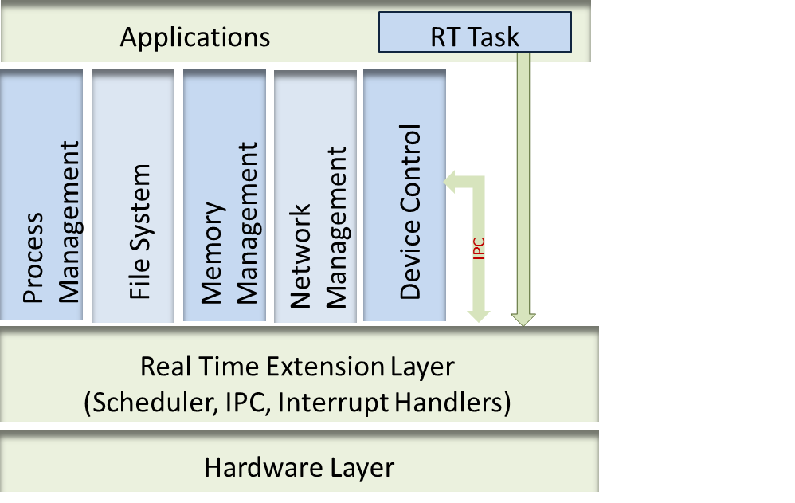
Position controller with Real Time Application Interface
The trajectory and position control is implemented in PC-104 based SBC operating on RTOS with features for modern control algorithms, self diagnostics etc.
Hybrid Kernel Approach,
Real time applications runs in the real time kernel,
Non real time tasks runs in the GPOS kernel,
Communication between real time task and GPOS through IPC.
API for timers, interrupts, soft irqs, schedulers etc.

Slide 19
software
The GMRT software is organized as a set of tasks, each task responsible for a particular function. These tasks are executed sequentially in every 100 m-sec.
The main tasks are
Data acquisition
Antenna controller
Output data
Host Communication handler
Another important feature is state machine based design.
A state machine is a task which may, at any instant of time be in one of
the several states.
A state is a condition of a system with regard to the completeness of a function.
It cannot spend a large block of time in servicing one requirement to the exclusion of all others.

Slide 20
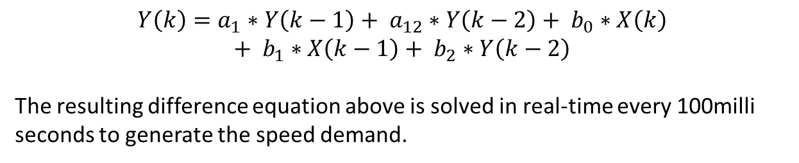
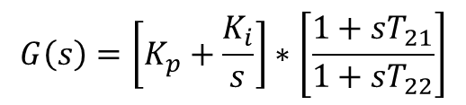

Position Loop Controller (PLC)
PI Compensator with Lead – Lag Filter
$$G\left(s\right)=\left[K_{p}+\frac{K_{i}}{s}\right]∗\left[\frac{1+sT_{21}}{1+sT_{22}}\right]$$
Digital Implementation using Tustin Transformation
s $= \frac{2}{T} \left[\frac{z−1}{z+1}\right]$
$$Y\left(k\right)=a_{1}∗Y\left(k−1\right)+ a_{12}∗Y\left(k−2\right)+ b_{0}∗X\left(k\right)$$
$$+ b_{1}∗X\left(k−1\right)+ b_{2}∗Y\left(k−2\right)$$
The resulting difference equation above is solved in real-time every 100milli seconds to generate the speed demand.

Slide 21
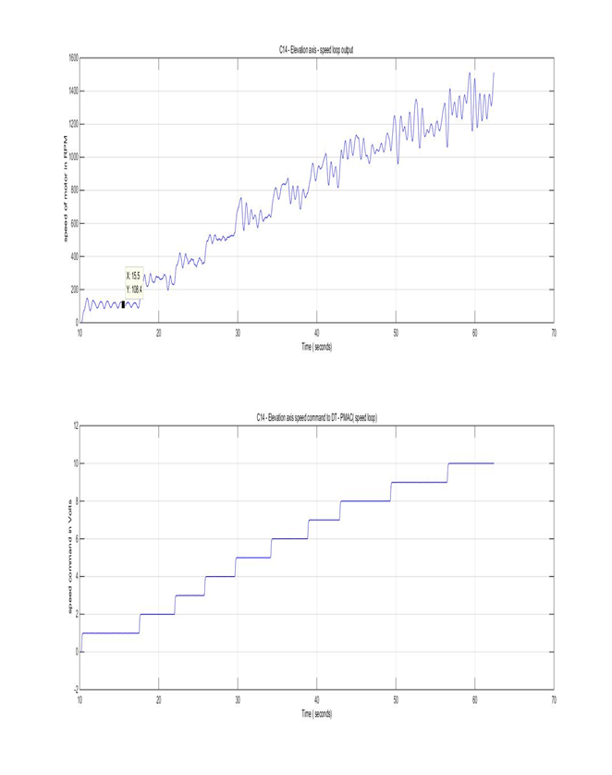
Measurements – speed characterization
Speed command output speed
0 -10 volts 1200 rpm - elevation axis
1500 rpm – azimuth axis

Slide 22
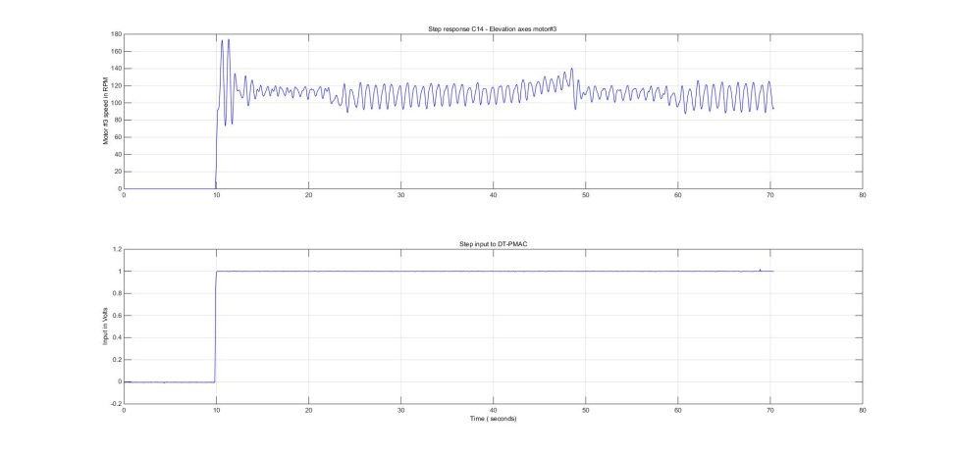
Measurement - speed loop step response
Step response
Rise time - 0.42 secs.
Peak time - 1.50 secs.
Over shoot % - 45.4

Slide 23
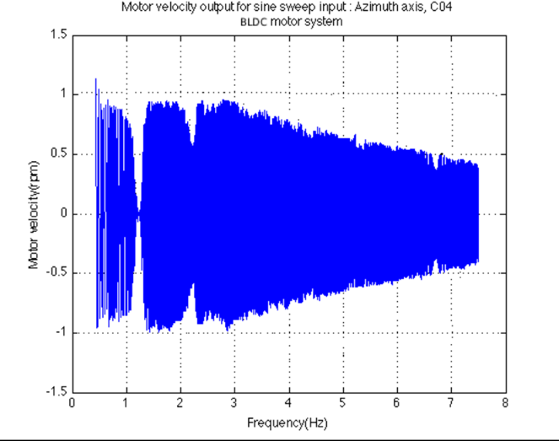
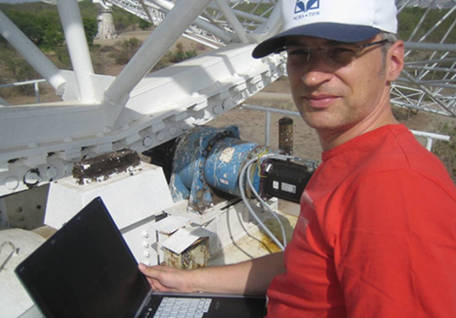
Measurements – Position control
Bandwidth
The closed loop position bandwidth is tuned to around 0.1 Hz in order to be below the locked rotor frequency around 1.4 Hz,of the mechanical system.
This provides best tracking and damping characteristics without un neccessarily exciting the natural mechanical resonances.

Slide 24
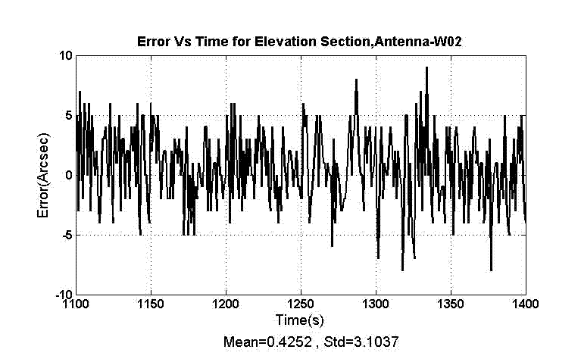
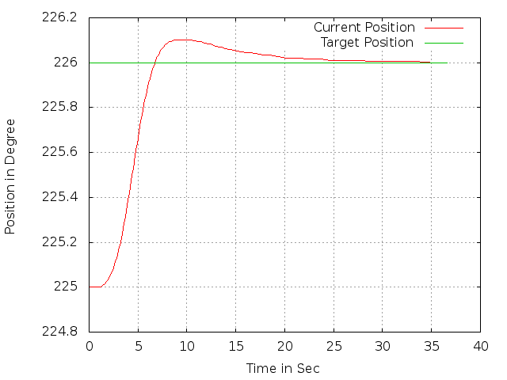
Measurements – Position control & Track
Tracking & Pointing performance
An excellent tracking performance and
low speeds pointing is achieved error =0.4252 arc seconds
RMS Error = 4 arc sec
Position loop control step response
Parameters measured
Rise time - 3.4 secs
Peak time - 8.8 secs
Overshoot - 10.13 %
Settling time - 21.5 sec
Steadt state error - 78.2 arc sec
Damping factor - 0.72

Slide 25
Future plans : System Identification - SI
Upgrade GMRT servo system (control laws) for improving tracking accuracy
Carry out SI to design modern high performance controllers like Linear Quadratic Gaussian (LQG) controller.
SI is to obtain an analytical model from experimental data.
The figure shows the experimental setup
This experiment is to gather time series data to determine the telescope open loop model in state space form.
Offline processing of data will give the SI
Telescope open loop system consists of telescope structure, drive chain and speed feedback.
SI is performed with closed speed loop and Telescope speed (voltage) is the input.
The position (encoder) and accelerometer data will be the output of the open loop system open position loop.

Slide 26
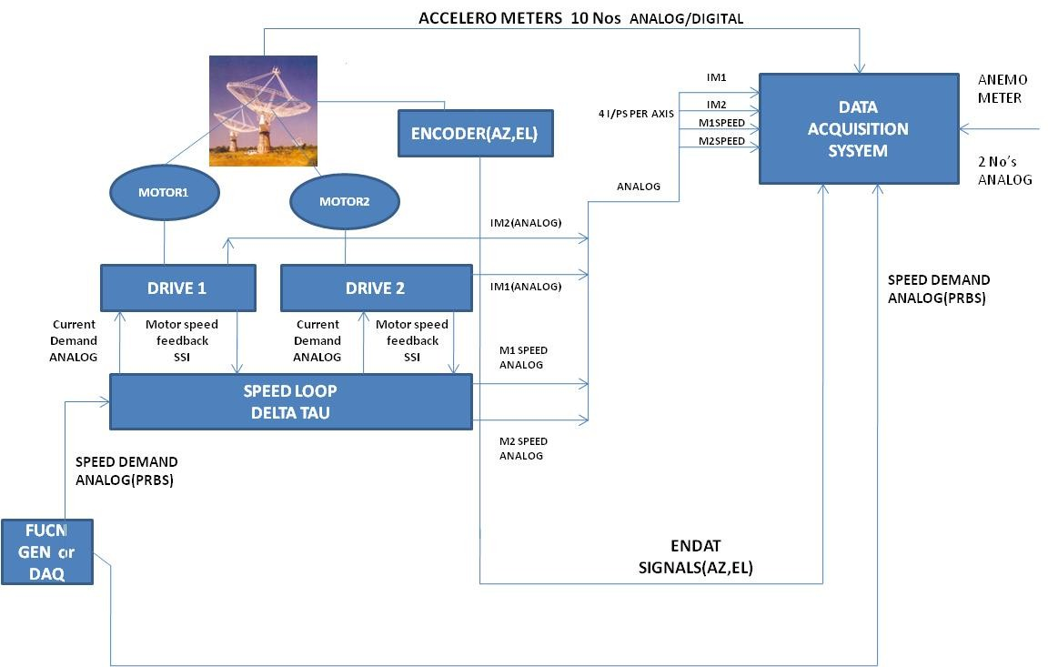
A DAQ is used for generating persistent excitation signals like pseudo random binary signal – prbs as well as record typically 5minutes data at a sampling rate of 100Hz.

Slide 27
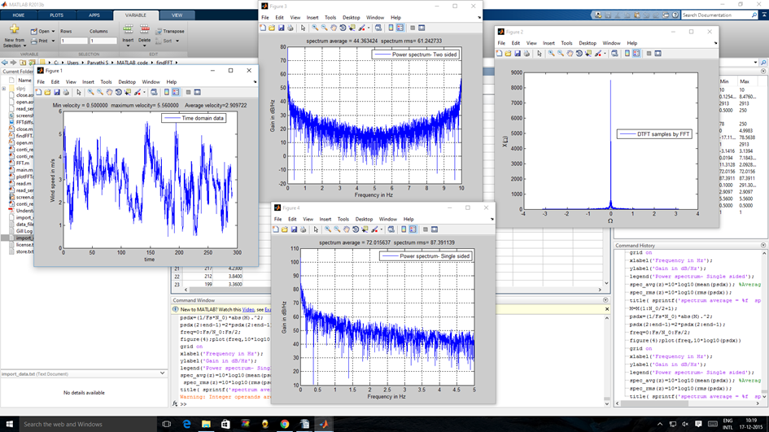
Wind spectrum at GMRT

Slide 28
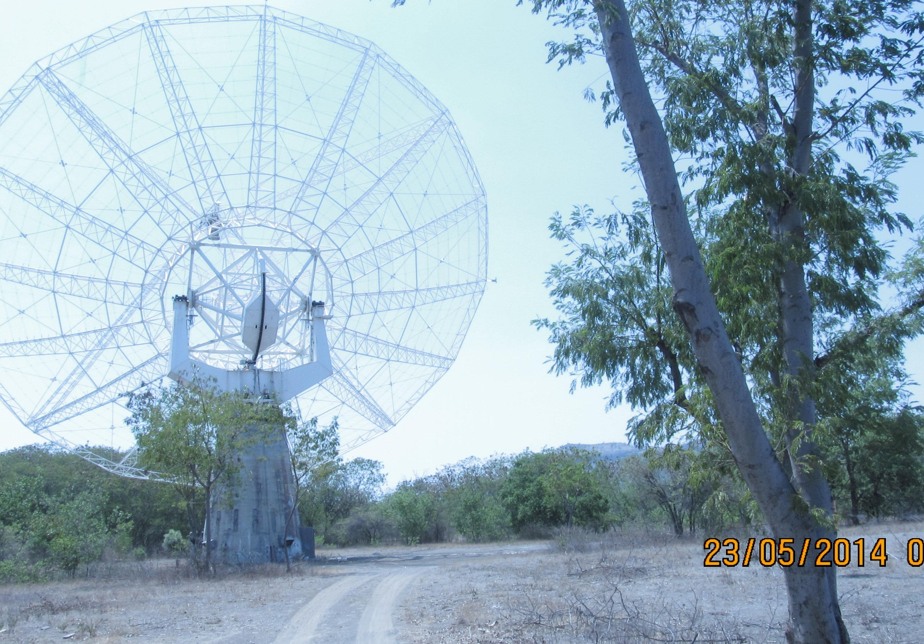
THANK YOU
Servo group members - AmitKumar, Bagde, Bhalchandra Joshi, , Bachal, Bhumkar, Burle, Gadekar,Ghorpade, Haokip, Malu, Poonattu, Suresh, Temgire, Thiyagarajan

