Slide 1
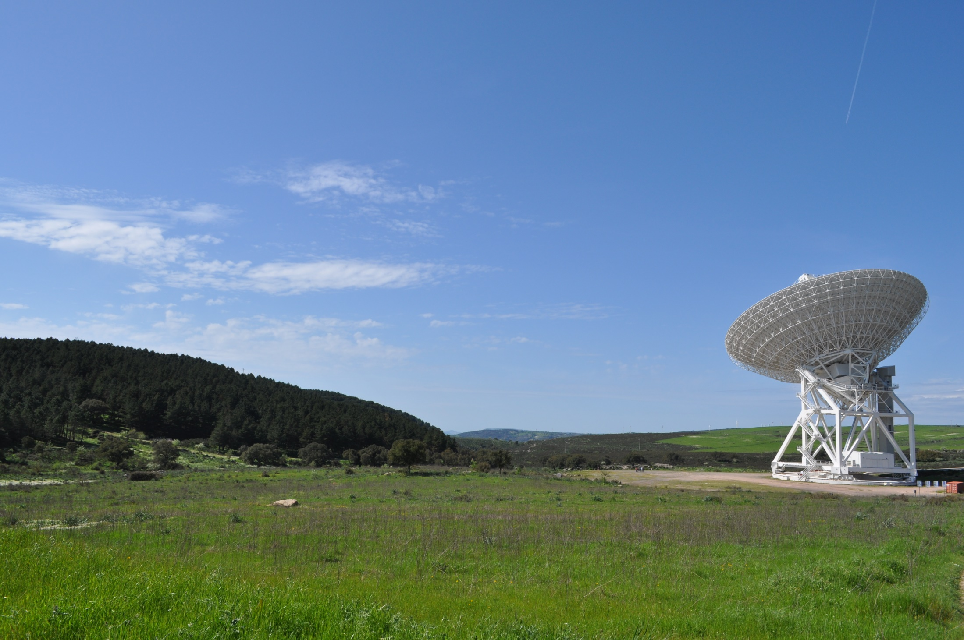


Metrology at the Sardinia Radio Telescope
T. Pisanu
tpisanu@oa-cagliari.inaf.it
on behalf of Metrology team*
*G. Serra, S. Poppi, F. Buffa, P. Marongiu, R. Concu,
G. Vargiu, P. Ortu, A. Saba, E.Urru, G. Deiana
Astronomical Observatory of Cagliari
Italian National Institute for Astrophysics
Astronomical Observatory of Cagliari
Sardinia Radio Telescope
Metrology and Control of Large Telescopes
Green Bank WV, USA, September 19-24, 2016
Notes:
30 minute slots, 25 minutes for the presentation, and 5 minutes for questions.
In this talk I would like to show you what has been done, what we have done and what we are planning to do in the near future about the Metrology for the SRT. In the following list you can see the people involved in the Metrology group. You can consider that all of them are involved only partially in the Metrology and that they are the same researchers and technicians that are part of the other research groups, like the receiver, back end group, maintenance, software and so on. Anyone of them is completelyc devoted to the Metrology work. I think that this is one of the biggest problems for Metrology, which is necessary only at high frequency and so it has been a little bit “trascurata” particularly in this moment for SRT in which there were too many things to do to be able to do the commissioning of the antenna.

Slide 2
Agenda
SRT main characteristics description
SRT status at the end of the astronomical validation
Work progress status of the first SRT metrology systems:
With-phase microwave holography
Inclinometers
Temperature probes
Optical laser and Position sensing devices (PSD)
Conclusions
Metrology at Sardinia Radio Telescope
Notes:
This is the agenda, I start with a brief description of the SRT main characteristics, the status of it at the end of the astronomical validation and then the work progress status of the first metrology systems we started to install and to test. The first was the inclinometer used to test the rail planarity situation, the plan to install the temperature probes, the microwave holography and the installation of the optical Position Sensing Device to measure and monitor the secondary mirror position. In the next talk, my colleague Giampaolo Serra will show you the new tests and systems we are planning to install and to use in the antenna. And then the Conclusions

Slide 3





SRT Project
64 m diameter fully steerable radiotelescope to cover 0.3-115 GHz:
- Single dish operation
- Part of VLBI and EPTA network
- Space science and geodynamical studies
September 30th 2013, SRT opening cerimony, 2014 end of the scientific commissioning and on 2016 started the early science. On 2017 we need to stop the antenna operation to start with the refurbishment of the primary reflector actuators.
Collaboration among three Research Structures of INAF:
INAF Astronomical Observatory of Cagliari, Cagliari
INAF Institute of Radio Astronomy, Bologna
INAF Arcetri Astrophysical Observatory, Florence
Cost ≈ 60 MEuro
Main Funding Institutions:
MIUR (Italian Ministry of Education and Scientific Research)
ASI (Italian Space Agency)
RAS (Sardinia Regional Government)
Metrology at Sardinia Radio Telescope
Notes:
The SRT is a 64 meters fully steerable wheel and track radiotelescope, designed to operate in the frequency range between 300 MHz and 115 GHz for single dish observations, as an element of the VLBI Network, and for space science DSN capabilities and eventually geodynamical studies. The SRT is managed by three research institutes of INAF, the OAC, IRA and OAAC. The total cost of the infrastructure is of more than 60 Meuros. The main funding Institutions of the SRT are the MIUR, ASI and RAS. The antenna bas been inaugurated on september 2013, at the end of 2014 we closed the scientific commissioning and this year we started the early science program, receiving about 12 scientific programs. Unfortunately now we have the actuators problem and we hope to be able to recover this problem by the end of 2017 by refurbishing all the actuators and repainting all the primary mirror panels. The company that built the antenna is the German MTA (MT Aerospace AG)

Slide 4
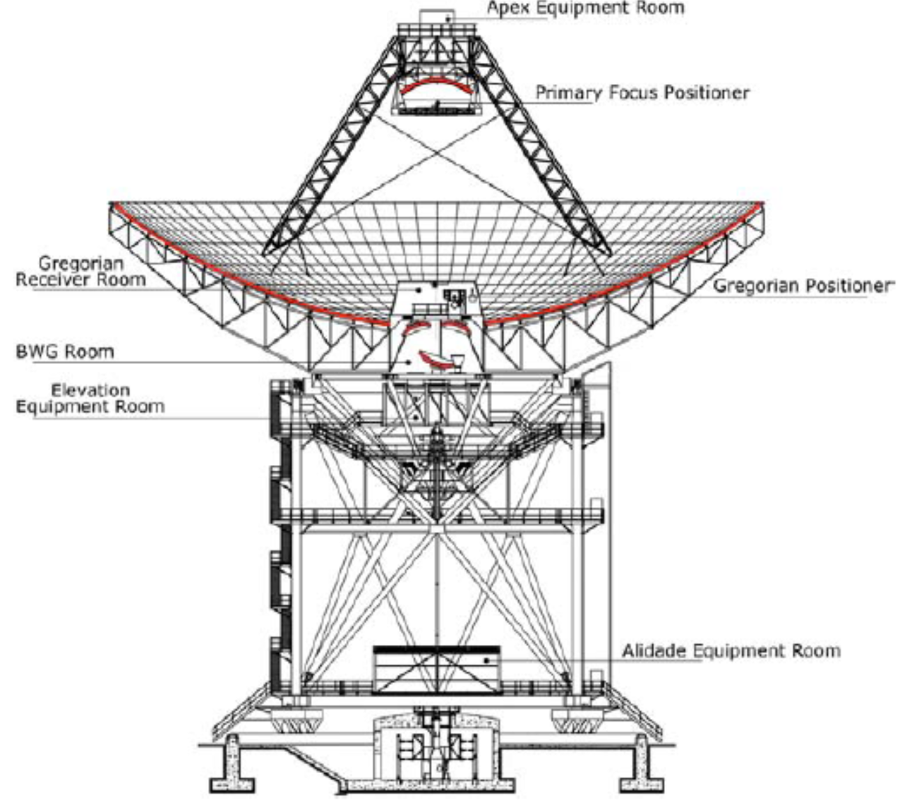
SRT technical specifications
Gregorian Configuration with shaped surfaces
Primary Mirror D=64 m – 1008 panels - 65 μm ; Secondary Mirror D=7.9 m – 49 panels - 50 μm
Active Surface: Primary mirror adjustable with 1116 actuators
12 motors (eight in azimuth and four in elevation)
29 bit absolute encoders (error 0,8 arcsec);
Six focal positions
Can host up to 20 dual polarization receivers;
ACU based on a BECKHOFF hardware
Primary surf. Accuracy goal: ≈ 150 μm RMS
Pointing accuracy goal (RMS): 2 ÷ 5 arcsec
Max antenna efficiency goal: ≈ 60 %
Gain exp. 0.50 to 0.70 K/Jy @ 0.3–50GHz
and 0.34 K/Jy @ (70– 115GHz).
Frequency agility
Metrology at Sardinia Radio Telescope
Notes:
In this slide I will show you the main characteristics of the SRT. Gregorian configuration with a quasi parabolic primary mirror and a quasi elliptical secondary of 7,9 meters. (The shaping of the surface has been introduced in order to reduce the standing waves between the primary and secondary mirror and the spill over. The primary mirror panels are supported by 1116 electromechanical actuators with a movement range of +/- 15 mm. The antenna has 6 focal positions, primary, Gregorian, and 4 in the Beam Wave Guide, In the 4 focal positions, it is possible to host up to 20 dual polarization receivers. The expected primary mirror surface should be around 150 microns, an expected antenna main efficinecy of about 60% at the highest frequency. We studied a frequency agility receiver positioning system, in order to be fast in switching the receiver and so to avoid as much as possible the human work and make a dynamical observation planning.

Slide 5
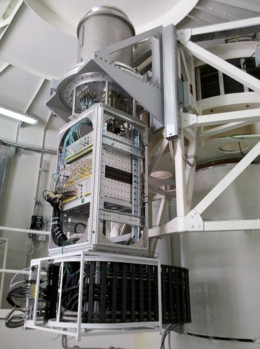
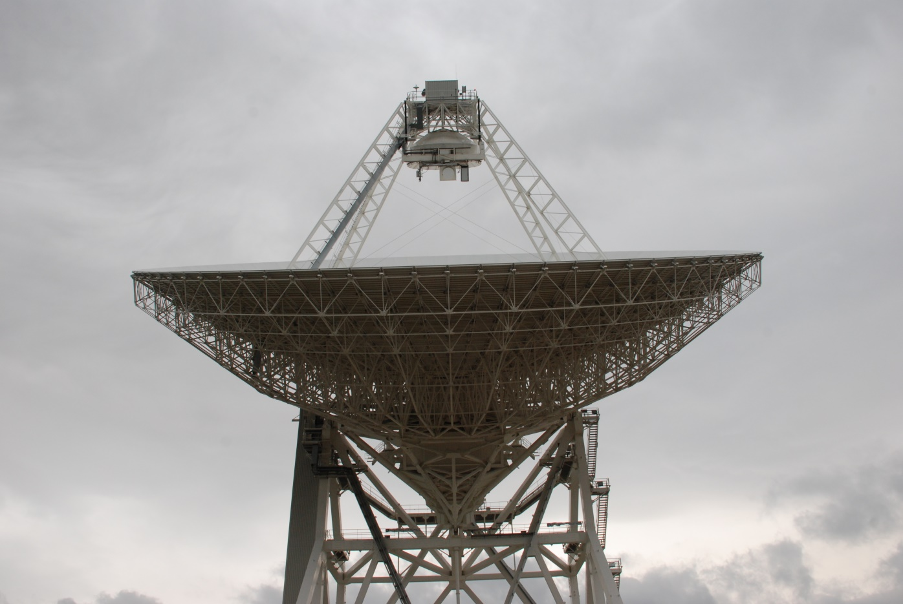
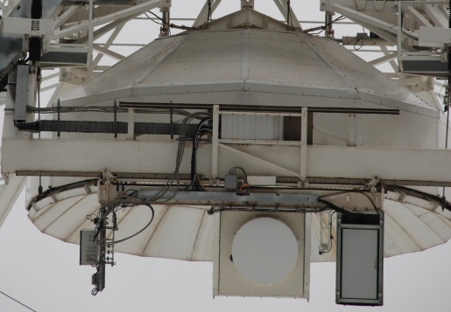
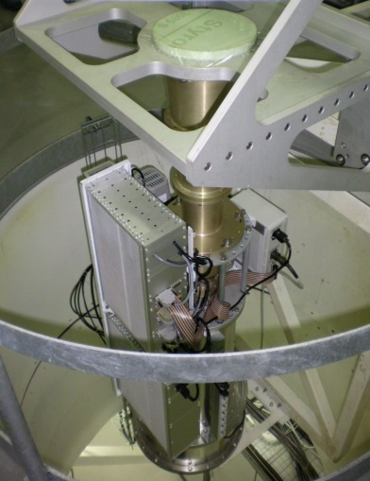
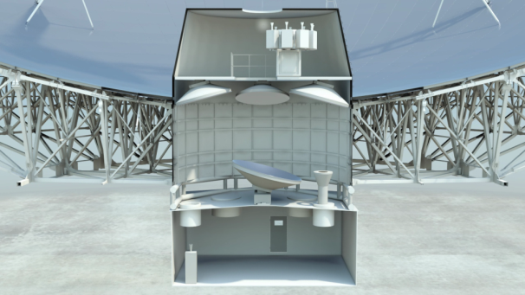
SRT status: installed receivers
F/D =2.35
7.5GHz < f < 115GHz
18-26,5 GHz
0.305-0.410 /1.3-1.8 GHz
P/L-band receiver
K-band receiver
F/D =0.33
300MHz < f < 20GHz
5.7-7.7 GHz
Gregorian Focus
C-band receiver
BWG foci
BWG F/D =1.37 & 2.81 1.4GHz < f < 35GHz
S-band (3-4.5 GHz) and Q-band (33-50 GHz) multifeed receivers founded and in developement. A 100 GHz receiver got from IRAM and an X-Ka band
Metrology at Sardinia Radio Telescope
Notes:
In this slide we show what are the three cryogenic cooled dual polarization receivers at the moment installed on SRT we installed :
a double frequency coaxial L-P receiver for the primary focal position,
a 7 beams K band receiver in the Gregorian focal position and
a C band receiver for the Beam Waveguide focal position.
In the primary focus there is also an ambient temperature receiver operating in the X-Ka band 8.2-8.6 GHz (X), 31.85-32.25 GHz (Ka), for spacecraft downlink data communication and the holographic receiver;

Slide 6
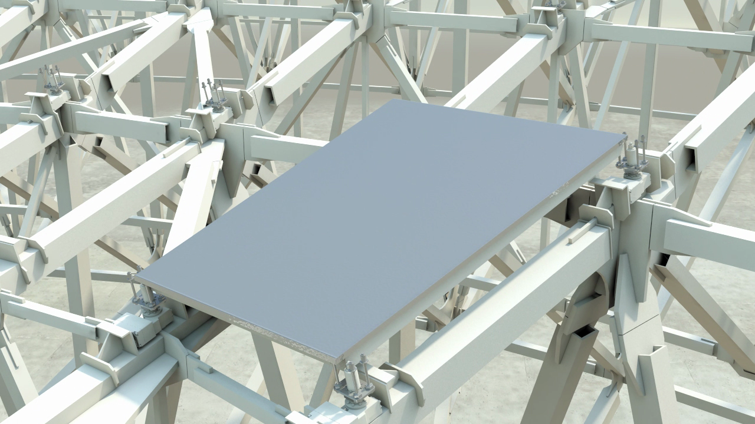
Active surface: shape of primary mirror controlled with actuators
Compensate deformations of the primary mirror
Convert shaped profile to a true-parabola (for primary focus)
Metrology at Sardinia Radio Telescope
Notes:
In this slide I show you a detail of the active surface of SRT. The active surface whicc constitute one of the main reasons of the development of the metrology systems will be used to compensate for primary mirror deformations caused by gravity and hopefully thermal and wind deformations. The other very important use of the actuators is to recover the shaped surface of the primary reflector to a purely parabolic one, for which we extended the actuators range to 30 mm. As you can see each actuator support 4 contiguos panels.
Stroke of the actuators is of 30 mm. Each actuator is supported by studs and the corners of the four (or the two) nearest panels can move at the same time, in the direction normal to the local surface. They are organized in 96 radial lines with a minimum of 9 and maximum of 16 actuators for each line. Actuators work in a way that they can remove the small-scale deformations, while large-scale deformations are reduced by a correction in pointing and by secondary mirror movements. The panels are made from an aluminum sheet 1,5 mm thick glued in an aluminum structure supporting it and maintaining in the correct shape.

Slide 7
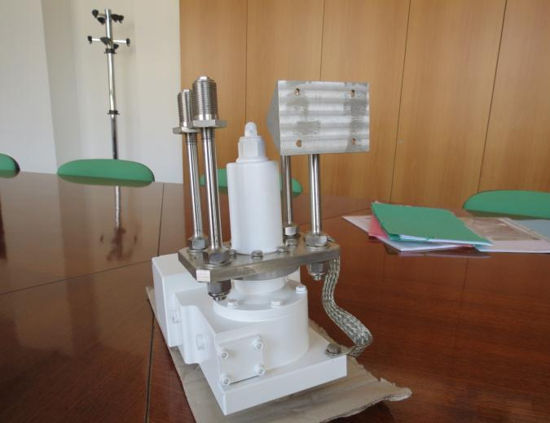
Actuators problem: Corrosion phenomena
The problem with the actuators was due to two concurring negative phenomena, like strain-induced-corrosion and galvanic currents. The coupling of two alloys, like steel and ERGAL contributed to increase those two phenomena, creating cracks in the ERGAL part and compromising the actuators integrity.
AlZn10Si8Mg UNI EN 1676 1706
ERGAL 55 UNI 9007/2 T6 7075 T6
AISI 304L UNI X2CrNi1811
Metrology at Sardinia Radio Telescope
Notes:
The problem we encountered with the actuators, was related to two concurring negative phenomena like strain-induced-corrosion and galvanic phenomenon. The coupling of two different alloys, in our case steel and ERGAL contributed to increase those phenomena, creating cracks in the ERGAL parts, compromising its structural integrity. As you can see in the figure, the main problem was in the interface between the steel plate in which there are installed the 4 supports shafts directly connected to the four consecutive primary mirror panels. The upper plate with the 4 holes is the one glued to the aluminum panels. Due to this deterioration of the parts, we were in a relative danger condition for the the actuator and the operator safety.

Slide 8
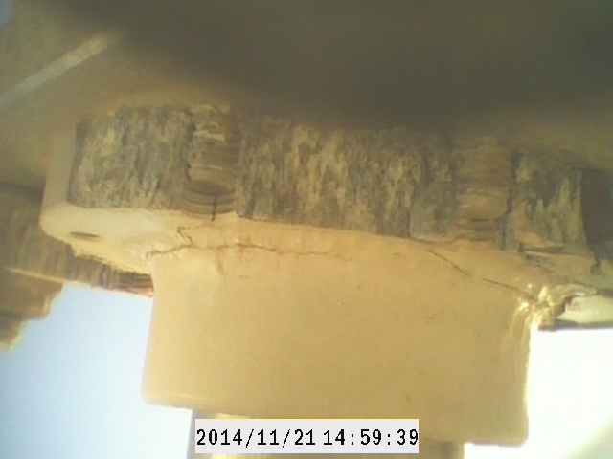
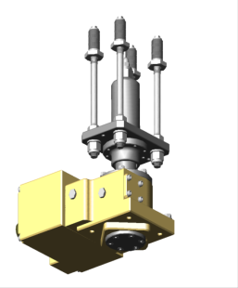
Metrology at Sardinia Radio Telescope
Notes:
In this slide you can see the effects of the strain-induced-corrosion and galvanic phenomenon. The problem is also related to the ERGAL mechanical performances and characteristics which are very good for compression but not good in case of stresses related to the delamination like for example in the case of bolt screwed on it. The thread in fact is the point where the cracks started and spread all over the structure, compromising the structural integrity of the mechanical part.

Slide 9
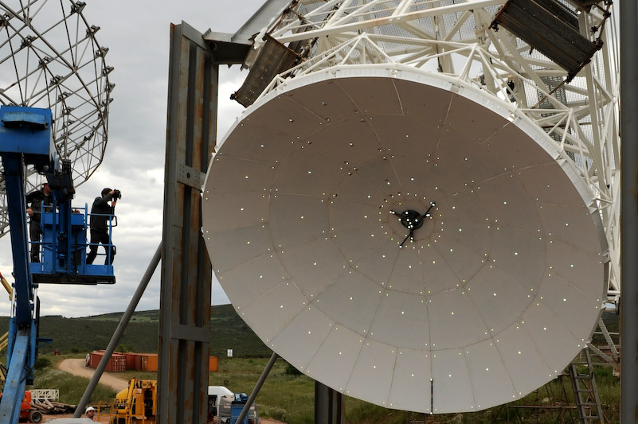
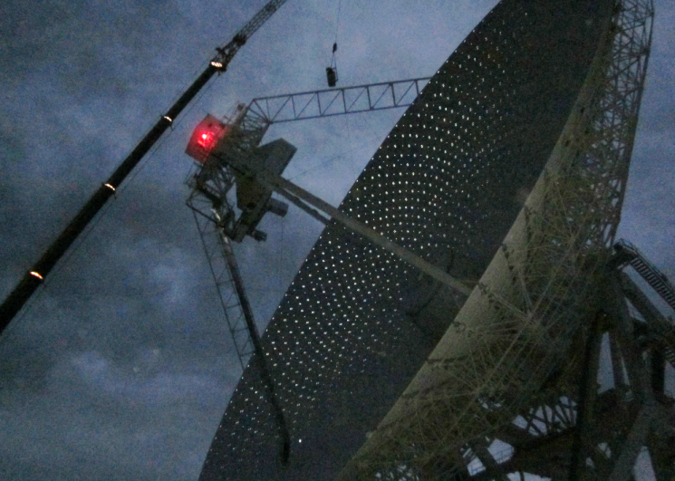
SRT status: surface accuracy
After the first panels alignment of the secondary and primary mirror with fotogrammetric measurement (by SIGMA 3D) AICON DPA mit Nikon D3X, 24.5 MPixel (6048 x 4032) 2 Scale bars, TrafoStar
Subreflector surface
Primary reflector surface
Accuracy: ~ 60 μm RMS @ 45° elevation
Accuracy: ~ 290 μm RMS @ 45° elevation
Accuracy in the adjacent panels corner alignment better than 100 μm
Overall RMS accuracy of the reflecting surfaces ε~ 310 μm (= λ/20 @ ~ 48 GHz)
Very good surface efficiency up to 48 GHz
Metrology at Sardinia Radio Telescope
Notes:
Therefore we expect a very good surface efficiency up to ~ 48 GHz (ε ~λ/20) adjusting active surface for gravitational effects by using lookup tables derived by photogrammetry measurement at different elevation.
Secondary mirror: Diameter 7.9 m, 49 Panels, 5 Targets per Panel, 45° Elev Number of pictures: 124
Primary mirror, successive accurate photogrammetry measurement campaigns have shown a lower limit in the total RMS of the primary mirror equal to 290 µm at 45⁰ of elevation. These measurements, carried out in six different elevation positions (45⁰, 60⁰, 75⁰, 90⁰, 30⁰, 15⁰) allowed the production of a look-up table, used to correct the gravity deformation with the actuators in an open loop configuration.

Slide 10
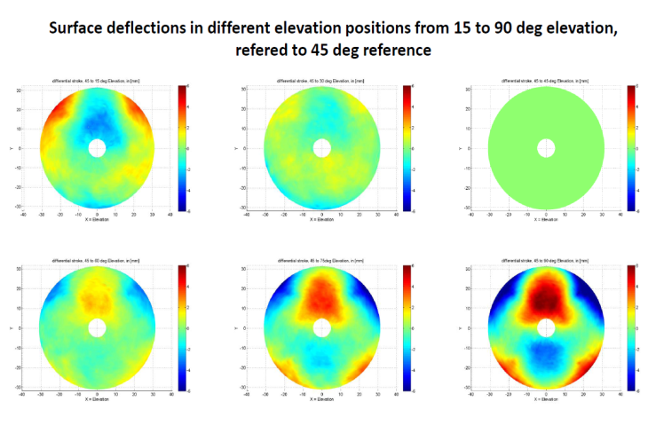
Primary mirror Fotogrammetry results
Metrology at Sardinia Radio Telescope

Slide 11
SRT status: antenna performances
Top:
Elevation-averaged beam patterns
(in Jy/beam) of 20 OTF scans
Bottom:
Beam cross-sections along the
Azimuth and Elevation axes (in dB).
Calibrator 3C147 @ 7,24 GHz
Calibrator 3C84 @ 25,54 GHz
Fitting a Gaussian we can find the
secondary lobe intensity averaged
over an annulus of
4.5’ radius and 3’ width is -24 dB and
the third lobe is – 33 dB in which it is
possible to see the effect of the trusses
of the quadripod but for the K band the secondary lobe is -12 dB so not in specific
Courtesty of SRT Astronomical Validation (Prandoni et al. in preparation)
Metrology at Sardinia Radio Telescope
Notes:
August 2014 and April 2015. We collected a total 86 OTF useful scans (43 for each polarization) in an Az/El movement. We intentionally saturated the color map to highlight the low intensity features of the second and third lobes. It is evident that we successfully detected the third lobe of the SRT beam pattern. The bottom-left panel of Fig. 1 shows two perpendicular beam cuts intercepting the peak.

Slide 12
SRT status: antenna performances
Map dimension 6’ x 6’
Maps of Contour
levels start at -25 dB
and increase by 1 dB.
HPBW 2.6 arcmin
The secondary lobe moves
from the upper part to the
lower moving from the 60° EL
Courtesty of SRT Astronomical Validation (Prandoni et al. in preparation)
Metrology at Sardinia Radio Telescope
Notes:
In those slides you can see the maps of 3C 147 were performed between August 2014 and April 2015. We collected a total 86 OTF useful scans (43 for each polarization) in an Az/El movement. In the maps you can see the variation of the SRT beam pattern as a function of elevation. The image was acquired using the total power backend at a central frequency of 7.24 GHz and with a bandwidth of 680 MHz. The expected size (HPBW) of the beam pattern main lobe at this frequency is 2.6 arcmin. Each image shows a field-of-view of 60’ x 60’ centered on the beam pattern peak. Note the flip of the secondary lobe asymmetry in the transition from mid to high elevations. Contour levels start at -25 dB and increase by 1 dB. The telescope scanning speed was
set to vscan = 3 arcmin/s while sampling interval and integration time were both set to 10 ms. Each scan was composed by 29 subs-scans separated by 42” on the sky. The discussion about this asymmetry will be shown by my colleague Giampaolo Serra in the next talk.

Slide 13
SRT status: antenna performances
After the fine tuning of the telescope with active surfaces working, the pointing model allows SRT to observe at 22 GHz with a:
focusing accuracy < 1 mm
an azimuth and elevation pointing errors < 4 arc sec
Courtesty of SRT Astronomical Validation (Prandoni et al. in preparation)
Metrology at Sardinia Radio Telescope
Notes:
Many pointing tests were recently performed by using a set of strong radio astronomical calibrators to provide SRT for an accurate pointing model.
The solid lines represent fourth order polynomial fits. The 25.54 GHz gain curve refers to the central feed of the K-band receiver. For data calibration and analysis we used the SCUBE data reduction software. The beam pattern was obtained through iterative GPA (Gershberg-Papoulis Algorithm, Papoulis et al. 1975) wavelet modeling. An increasingly refined baseline subtraction and a ’self-calibration’ to remove the residual elevation gain variations and pointing offsets from the individual OFT scans were applied.

Slide 14
SRT metrology short-term goals
Waiting for the higher frequency receivers, the metrology team is working to further improve the current SRT efficiency
Short-term goals:
To measure the primary surface accuracy better than 150 µm (i.e. an overall surface accuracy 190 µm, a very good efficiency up to ~80 GHz ) with Microwave holography system to measure RT far-field pattern by pointing a Ku-band GEO satellite (elevation angle 44 deg );
To contribute to correct azimuth and elevation pointing errors < HPBW/10 ( ~ 1 arcsec with HPBW =12 arcsec @ 100 GHz ) with two inclinometers on top of the alidade structure;
Temperature sensors for reducing detrimental thermal gradient effects on the pointing errors;
To correct pointing errors and focusing accuracy < λ/10 (~0.3 mm @ 100 GHz ) with optical laser-PSDs behind the subreflector central panel;
Metrology at Sardinia Radio Telescope
Notes:
In the next slides I will show you what we have done up to now in metrology and what we are planning to do in the short to mid period for using the SRT at high frequencies. The short term goals regard the primary reflector surface accuracy, by performing the microwave holography measurement, to get an accuracy better than 150 microns, to use two inclinometers in the alidade structure to map the rail status and the thermal gradients effects in the deterioration of the pointing performances. The other system we are working on, is the installation of two optical PSD’s behind the central part of the subreflector.

Slide 15
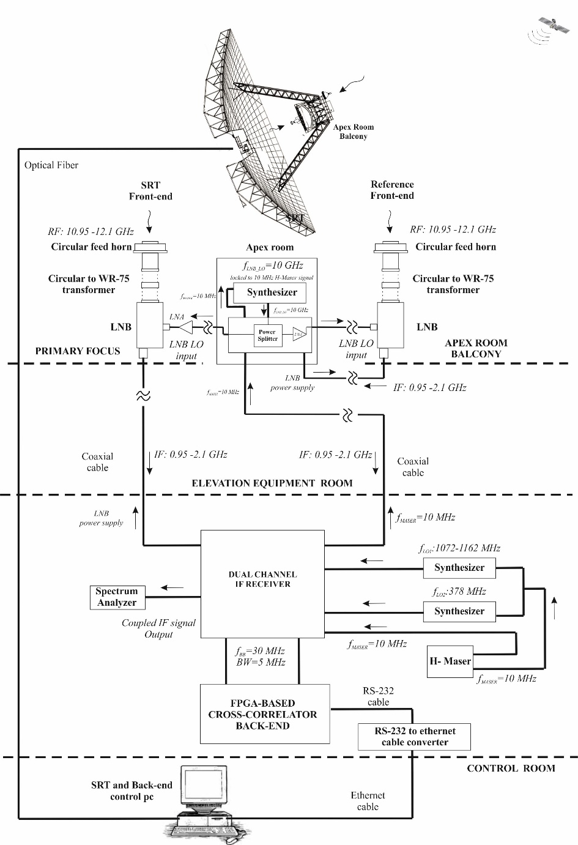
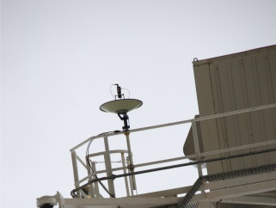
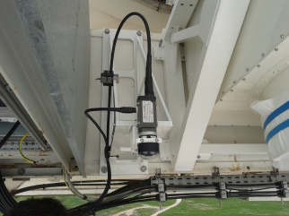
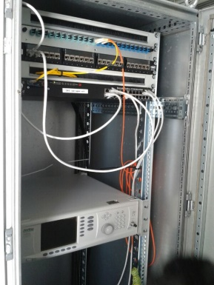
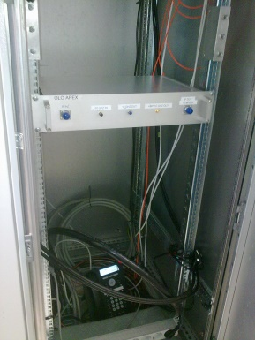
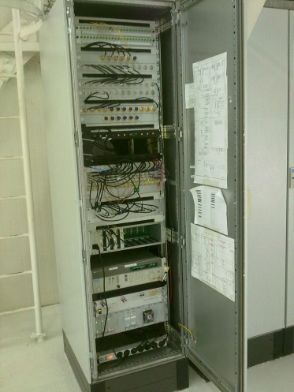
Status of holography system
New measurement set-up for SRT holography system
RT front-end
Apex balcony
Reference front-end
0.6m-diameter antenna and modified LNB
modified LNB
on the primary focus
RF equipment for injecting the 10 GHz LO signal to LNBs
at the apex room
RF electronics rack at EER (where IF-BOX and digital backend will be soon installed)
Installation completed by 2014 and few months ago we started the first holography campaign at SRT
Metrology at Sardinia Radio Telescope
Notes:
In this slide we show you the status of the holographic system installed on the SRT. The front end, is a commercial LNB, modified for allowing the injection of the phase locking sygnal of the local oscillator. It is installed on the primary focus positioner. The reference front end as you can see is installed on the Apex structure and is composed of a 0,6 m parabola with the same modified LNB installed in the primary focus of the SRT. The holograpy back end in installed in the apex room, where there is also the LO which is locked to the MASER and generate the 10 GHz reference signal. The RF electronics rack is installed in the Elevation Equipment room where there will be installed also the IF box and the digital back end.

Slide 16
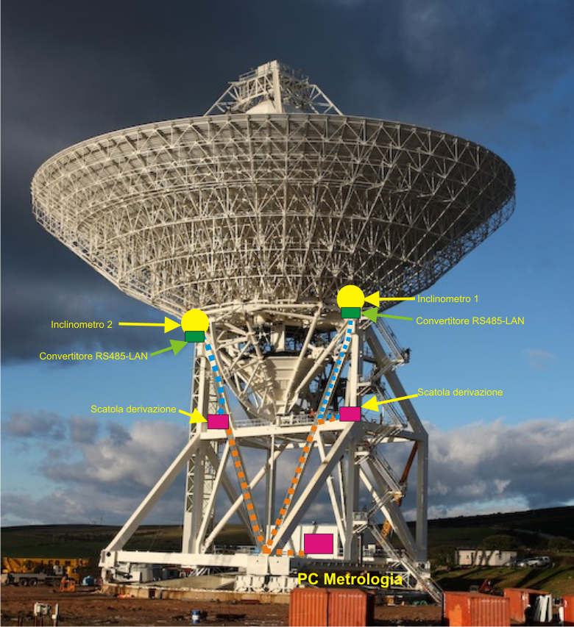
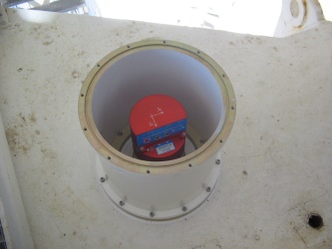
Status of Inclinometer
On the base of the recommendations coming from the SRT thermal design study
Inclinometer #2
(not installed yet)
Inclinometer #1
RS485-LAN converter
Inclinometer control PC
Metrology at Sardinia Radio Telescope
Notes:
The initial design of the SRT was with a total enclosure of the primary reflector back up structure, with thermal isolating panels, to maintain the temperature gradient under 0,5°. Following the positive experience in GBT, we made some FEM studies to simulate the most important trusses, responsible of structural deformations that cause pointing errors. On the base of the recommendations coming from the SRT thermal design study, we are planning the installation of

Slide 17
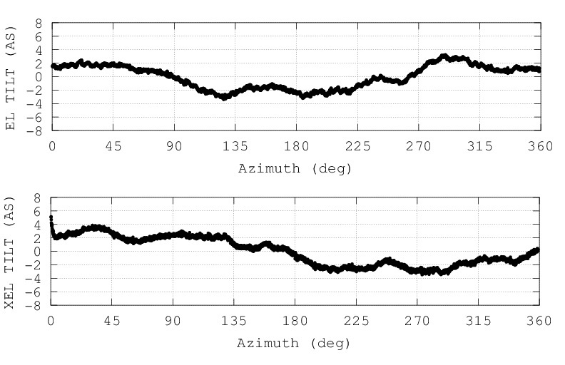
Status of inclinometer
Tests to check the planarity of the azimuth rail
Elevation axis errors measured during a full rotation in azimuth
Cross-elevation axis errors during a full rotation in azimuth
Systematic errors not far from the expected one (±3 arcsec) deriving from the rail planarity tolerance.
However they can be included in the antenna pointing model
Metrology at Sardinia Radio Telescope
Notes:
After the instrument calibration in our labs and after connecting the device to the SRT LAN, some tests have been performed to check the inclinometer response in operative measurement condition during a 360 deg rotation in azimuth of SRT @ 0.1 degrees/sec. A Kalman filter was used to remove the noisy components affecting the measurements due for instance to the antenna acceletation on the sensor. Systematic errors can be included in the pointing model.

Slide 18
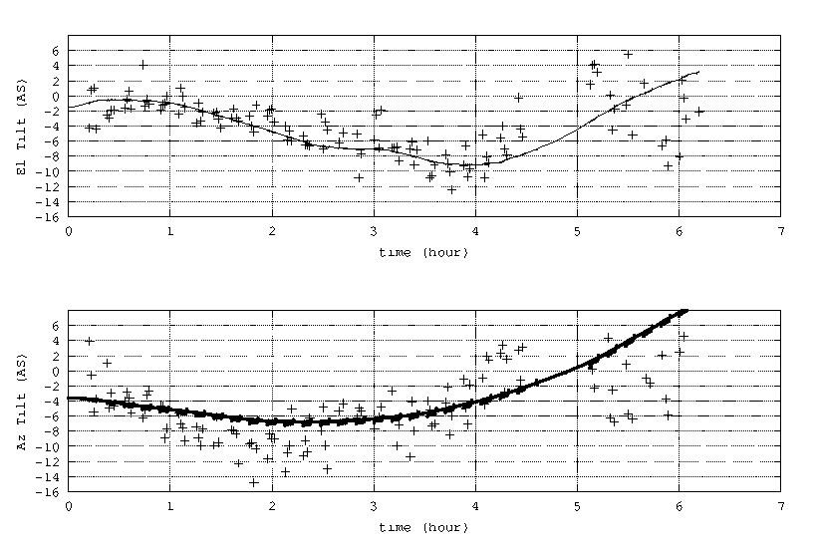
Work progress status of inclinometer
Inclinometer measurement during astronomical observation on a circumpolar radio source at 23 GHz (K-band receiver) from sunrise to noon.
Elevation axis errors caused by antenna thermal deformations
+ residual offset
- inclinometer meas
Residual offsets calculated from
a Gaussian fit of the antenna beam after a cross-scan.
Kalman filter was used to remove the noisy high frequency components due to antenna acceleration.
Azimuth axis errors caused by antenna thermal deformations
+ residual offset
- inclinometer meas
NOTE. With the antenna pointing model working, residual offsets take into account both alidade and quadripod temperature variation (not only alidade as in the inclinometer measurement)
Metrology at Sardinia Radio Telescope
Notes:
The test consisted in estimating the elevation and azimuth axis errors of SRT caused by the alidade temperature variation (about 8 deg):
from the inclinometer measurement
from a Gaussian data fit of the antenna beam after a cross-scan (schedule On-the-Fly strategy combined with a source tracking at sidereal rate)
The antenna pointing model was working during the survey to compensate for the systematic pointing errors, so only the azimuth and elevation residual offsets was calculated at the end of each cross-scan.
Finally, at end of each cross-scan the remaining errors with respect to the pointing model (hereafter called residual offsets) due mainly to the temperature gradient effects was calculated by performing a Gaussian data fit of the antenna main beam. Such a schedule, composed mainly by 10-minute cycles repeated for the whole duration of the survey, allowed to

Slide 19
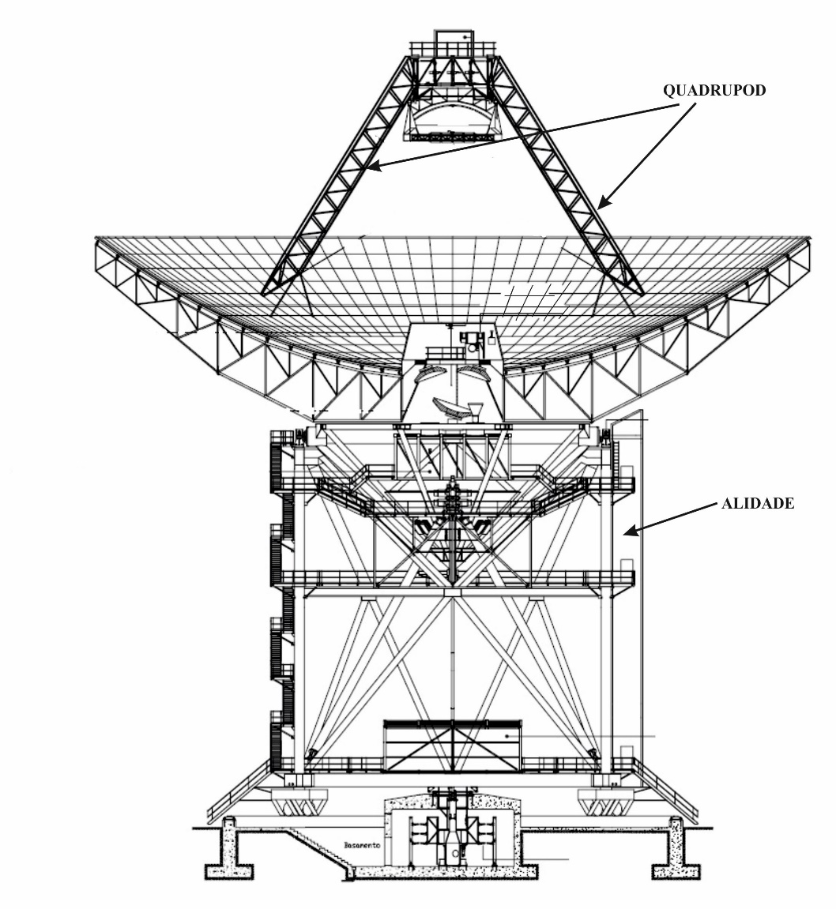
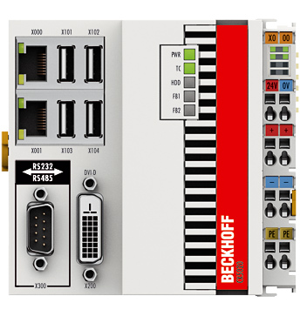
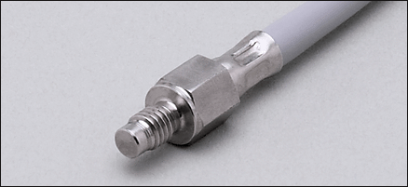
Status of temperature probes
The number and position of the temperature probes on SRT structure were inferred by FEM model:
16 probes on the alidade
8 probes on the quadrupod
Probes installation, cabling and interfacing with Beckhoff embeddes PC will be soon accomplished
Metrology at Sardinia Radio Telescope
Notes:
The initial design of the SRT was with a total enclosure of the primary reflector back up structure, with thermal isolating panels, to maintain the temperature gradient under 0,5°. Following the positive experience in GBT, we made some FEM studies to simulate the most important trusses, responsible of structural deformations that cause pointing errors. In the design we show the number and position of the 24 temperature sensor we are planning to install on the SRT. 16 probes on the main trusses of the alidade supporting structure and 8 probes on the 4 quadrupod legs structure. With this system we plan to monitor and to compensate the thermal gradients that deteriorate the antenna pointing performances. To acquire the sensors readings we are planning to use a Beckhoff system which sell PLC like systems with embedded PC and ready modules for acquiring the sensors values.

Slide 20
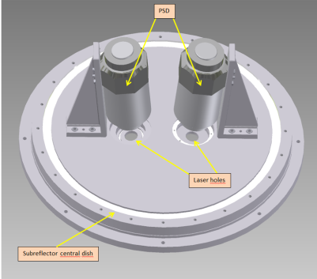
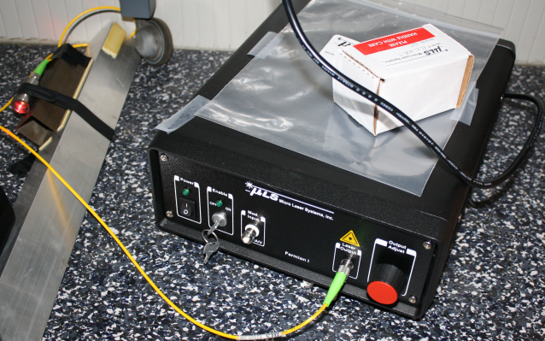
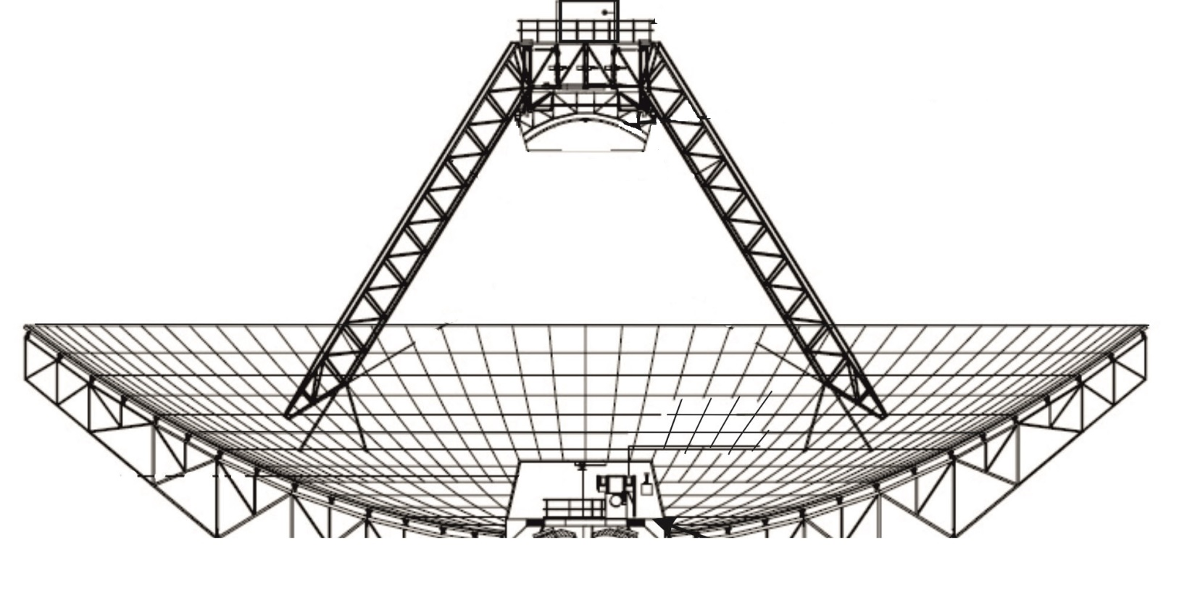
Status of optical laser PSD
Two PSD for a real-time measurement of the secondary mirror misalignments, one is already installed behind the central panel of the sub-reflector and we are testing its performances
PSDs
Laser diodes
x
y
z
Sensitive area = 22.5 x 22.5 mm^2
Operational spectral range : 350-1100 nm
power range: 0.1-5 mW
Accuracy over calibrate area= ± 50 µm
Angular measur. range = ± 2 deg
Angular resolution = ± 1 arcsec
Wavelength = 658 nm
Power = 10 mW
23 m
PSDs can measure X, Y, Z translation (derived by two X measur.) and X,Y axes rotation of the subreflector. Only one at the moment is installed.
Metrology at Sardinia Radio Telescope
Notes:
Another metrology system we are testing on SRT, is made of two optical Position Sensing Devices. The aim of this system, is to measure the secondary mirror displacements induced by the gravity and by the thermal deformations, that produce shifts and tilts with respect to its ideal optical alignment. The characteristics of those devices are of having about 22 mm in range and an accuracy in shift pf +/- 50 microns and of +/- 1 arcsec in angular measurement. At the moment we installed only one PSD and we performed some test moving the antenna in elevation, but due to the problems we have with the LUT implemented, we cannot maintain the subreflector inside the 22 mm maximum range.

Slide 21
SRT metrology future plans
Include inclinometer, PSD and temperature probe data in the antenna pointing model in order to reduce the errors and to try to compensate for alidade and quadrupod thermal deformations
Beside the traditional holography, we plan to use the Out-of-Focus method on SRT for a quasi-real time mapping of the primary surface deformations, due even to thermal gradients effects and the linear sensors
New systems: Laser Tracker and Real Time photogrammetry
Metrology at Sardinia Radio Telescope

Slide 22
Conclusions
Many thanks to Richard for his efforts in organizing this workshop;
I think that if we could have this workshop few years ago we could be in a better condition in the development of an efficient and well organized Metrology plan for SRT.
Thanks for your attention!
Any questions?
Metrology at Sardinia Radio Telescope
Notes:
Up to now due to the fact that we are working up to 22 GHz we don’t had the need of the metrology and this is froma certain point of view a good news but froma another one a bad one, because if you don’t have a very exciting and exigent request from the astronomical world at least for us is very difficult to involve the right energy to try to solve the problem. We are here to understand what radiotelescopes in a more advanced stage have done as metrology activities that are mature to be installed and routinely applied to improve the antenna efficiency at high frequency. Our final aim is as you can imagine, to close the loop and to maintain the better antenna efficiency in whatever situation and during daytime and nightime.

