Slide 1
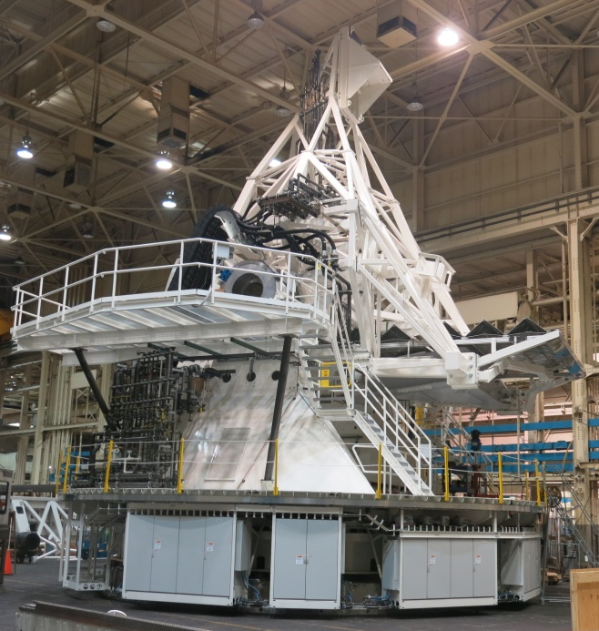

Flexible Body Control of Large Telescope Structures
SOFIA
Pointing Requirement
0.4 arcsec rms
LMT/GTM
DKIST
HWFE Requirement 75 µm rms
Pointing Requirement 1.0 arcsec rms
(at 10m/s operational wind speed)
Jitter Requirement
0.075 arcsec rms
Hans J. Kärcher
MT-Mechatronics, Mainz
Jacob W. M. Baars
Max-Planck Institut für Radioastronomie, Bonn
Notes:
Most of the attendees of this workshop are probably “users” of large telescopes. I myself, I’m not such an user, I’m a “designer” of telescopes.
As a “user” you have to live with what you have gotten from the designers and builders of the telescope; it is your tool for your astronomical tasks, and the “metrology and control” as announced in the title of our workshop are means to improve the functionality and operational performance of your tool, the telescope as it is, to the utmost. For this purpose you can use the outcome of your metrology data, but also your “intuition” to interpret them.
The goal of my talk is to add to your “intuition” some additional help by a better insight into “structural mechanics”!
The hardware part of a large telescope is physically a complex “structure”, and the deformation behavior of this structure has influence onto the shape of the reflecting surfaces and thereby on the optical respectively HF performance.
“Structural mechanics” is part of “applied physics”, and “engineers” have developed – starting with Galileo Galilei about 400 years ago – sophisticated tools particularly for the “design” of “special structures”. These “design tools” are going beyond the more analytic approach of “normal” physics. Examples are the design of “bridges” and the design of “aircraft or space structures”. These tools were in previous times “hand calculations” and particularly graphic methods as the Cremona diagram. Modern computer aided methods for this purpose are Finite Elements (FEM).
Intention of my talk is to introduce the knowledge of computer based structural mechanics for further improvement of telescopes. We call this “Flexible Body Control” FBC, a wording introduced by guys of NASA’s Ames Research Center in the course of the design of the airborne telescope SOFIA in the late 1990ies. I’ll explain it by examples of the 50m Large Millimeter radio Telescope LMT/GTM in Mexico; by the airborne infrared telescope SOFIA; and by the solar telescope DKIST.

Slide 2
Flexible Body Control of Large Telescope Structures
Mechatronic Point of View!
Relying not only on “Metrology alone”
but adding “Structural Intelligence”
to the control architecture
H. J. Kärcher, “Telescopes as Mechatronic Systems”,
IEEE Antennas and Propagation Magazine, vol.47, 2005
Notes:
The left sketch explains my “mechatronic point of view” on the telescope. In this view, the telescope consists of:
1. The optical elements as reflectors and receivers (in blue);
2. The telescope structure as the backbone, holding together all telescope components (in yellow);
3. The main axes mechanics, which point the optical systems to the celestial target (in red);
4. The main axes position sensors (encoders, in green), which are needed as feed back for the main axes controllers;
5. Actuators between the optical elements and the main telescope structure (in red), which are additional to the main axes drives and are used for what is called “active optics” AO;
6. “State sensors” on the telescope structure, which are measuring the “deformation state” of the structure and are used for the feed back of the AO;
7. The main position controller (in violet), which coordinates the main axes drives according the position status measured by the main axes encoders;
8. The “Flexible Body Controller”, which interprets the data of the state sensors and commands adequate corrections to the AO actuators;
9. The master controller, which acquires the position request of the astronomers and coordinates the main position controller and the FBC controller accordingly.
The purpose of FBC is, to rely for the identification of the deformation state of the telescope not only on “external” shape metrology, but also on “internal structural intelligence”.

Slide 3
Position Control vs. Flexible Body Control
Standard cascaded main axes
control architecture
Basic FBC control architecture
FBC sensing alternatives:
Existing information of the classical main axes control system
External metrology
State sensors on the structure
Imaging sensors in the focal plane
H. J. Kärcher, “Telescopes as Mechatronic Systems”,
IEEE Antennas and Propagation Magazine, vol.47, 2005
Notes:
The diagram on the left shows the architecture of a classical position control system for a telescope with an elevation over azimuth mount. The position is defined by two axes.
The controllers of the axes are of “cascaded” type, with three cascaded control loops:
the inner motor current loop;
the middle velocity loop;
the outer position loop.
The controllers are classically of PID type, controlled by position encoders on the axes, velocity sensors (“tachos”) on the motors, and current sensors on the motor amplifiers.
The traditional position control system doesn’t take care of the deformations, and is limited by the resonance behavior of the structure and mechanisms as a whole.
The right diagram shows the control architecture of the position control system with a first step introducing more intelligence called FBC.
The idea is to extract from the sensor readings not only the basic position of the axes, but also information on structural deformations.
Some sensing alternatives are listed on the right side of the slide:
I. Use of the existing information of the classical main axes controllers as axes positions, motor speeds and motor currents (proportional to the motor torques) and use them for more sophisticated interpretation than only the geometric position of the axes itself;
II. Use of external metrology as laser trackers etc;
III. Use of state sensors on the structure as strain gauges, temperature sensors, inclinometers, accelerometers etc;
IV. Imaging sensors in the focal plane of the optics.

Slide 4
Flexible Body Control vs. Adaptive Optics
Flexible Body Control (FBC)
Adaptive Optics (AO)
H. J. Kärcher, “Telescopes as Mechatronic Systems”
IEEE Antennas and Propagation Magazine, vol.47, 2005
Notes:
All very large optical telescopes are now equipped with so called Adaptive Optics (AO). Adaptive optics is based on “closed loop” feed back of any kind of disturbances in the optical path of the telescope including atmospheric turbulences. Optical AO is based on the availability of a “wave front sensor” in the focal plane of the telescope, which identifies the disturbances. The wave front sensor depends on the existence of an “image” in this focal plane. Radio telescopes observe normally only one pixel in the focal plane, they produce no image there. Imaging is only done by scanning. (Modern millimeter, submillimeter telescopes may have some more pixels in the image plane, and the upcoming Terahertz telescopes do some imaging).
Due to this fact – the missing imaging capability of the radio telescopes – up to now for radio telescopes no adaptive optics is known. This is the reason why the improvement of radio telescope performance beyond the classical limits as defined by Sebastian von Hoerner in the early 1960ies here in Green Bank is only feasible with “open loop” corrections, which are not able to compensate atmospheric disturbances as the optical adaptive optics.
We call this “open loop” corrections here FBC, to distinguish them from the optical AO.
The left diagram shows the FBC control architecture as used today in large millimeter and submillimeter radio telescopes. The sensors of the FBC system consists of the main position sensors etc as explained before, additional inclinometers etc on the alidade, and temperature sensors etc on the backup structure. This information is fed into a FBC model, which evaluates the deformation state of the overall structure, and extracts position commands for the main axes drives as well as corrections for the shape and relative position of the optical elements versus surface actuators, subreflector positioners etc. These corrections are “open loop”, they are only as good as the FBC model, and are not able – as mentioned before – to correct other effects as e.g. atmospheric disturbances not covered by the FBC model.
The “closed loop” features of the optical AO (right diagram) covers all disturbances, atmospheric as well as telescope internal disturbances and would not need the underlay of a FBC model as shown in the right diagram. But some FBC features may improve the performance of the AO system as we will the for the example of the DKIST.

Slide 5
Astronomical Pointing Calibration & Related Optics
Best-fitting Algorithm – Ray Tracing
Astronomical Pointing Model
H. J. Kärcher, “Telescopes as Mechatronic Systems”
IEEE Antennas and Propagation Magazine, vol.47, 2005
Notes:
Normally, telescopes are calibrated at the beginning of the observation by astronomical calibration models. The left diagram shows, how the astronomical calibration process fits into the FBC concept of telescope control.
The right diagram remembers, that for the evaluation of the image position and quality from the overall identified finite element model a best-fitting or ray-tracing algorithm is needed, which correlates the structural deformations with the optical quality and direction of the optical beam (right sketch.)

Slide 6
Deformation Sensing
Overview
Notes:
Major task of a FBC system is the identification of the actual deformation status of the telescope. For this purpose, a lot of different types of sensors are available.
The table gives a an overview and information on the main applications:
For earthbound telescopes, angular encoders are used for measuring the position of the adjacent structural components; tachos for measuring the motor speed; and current sensors, which identify via the motor currents the applied motor torques.
The following sensors can be used for FBC purposes at radio telescopes:
inclinometers identifying inclinations of structural components against the gravity vector;
laser trackers for measuring the spatial position of reference points equipped with optical targets;
temperature sensors for identification of temperature models;
pressure sensors for the aerodynamic wind pressure e.g. on reflector surfaces;
strain gauges for the identification of deformation states of backup structures etc.
Position control and FBC sensors for airborne telescopes:
Imagers for measuring the position of a reference star;
Gyroscopes for measuring angular velocities;
Accelerometers for measuring lateral accelerations;
Wave front sensors as discussed before.

Slide 7
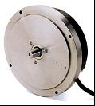
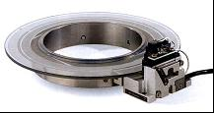
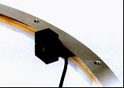
Deformation Sensing II
Examples of Sensors
Angular Encoders
Inclinometers
Separate housing,
no through hole
Direct attached,
small through hole
Temperature
Sensors
Direct attached,
large through hole
H. J. Kärcher, “Telescopes as Mechatronic Systems”,
IEEE Antennas and Propagation Magazine, vol.47, 2005
Notes:
Here some examples of sensors:
Angular encoders (left picture) are used for measuring the position of the adjacent structural components;
Inclinometers (upper right picture) identifying inclinations of structural components against the gravity vector (e.g. inclinations of the alidade at the attachment flange of the elevation bearings and encoder, right sketch in the middle);
Temperature sensors for identification of temperature models (unit layout MERLIN telescope Cambridge UK, right lower sketch).

Slide 8
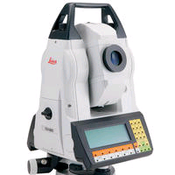
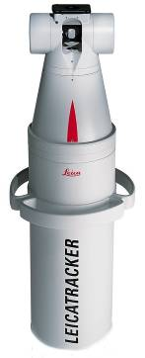
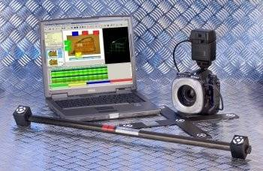
Metrology Methods Overview
Total Station
Laser Tracker
Photogrammetry
Accuracy
Accuracy
Accuracy
Angular 0.5’’
Length 200µm + 2µm/m
Angular 1’’
Length 10µm + 5µm/m
5µm + 5µm/m (all directions)
Targets
Targets
Targets
Coded permanent targets
Mobile retro-reflector
Coded permanent targets

Slide 9
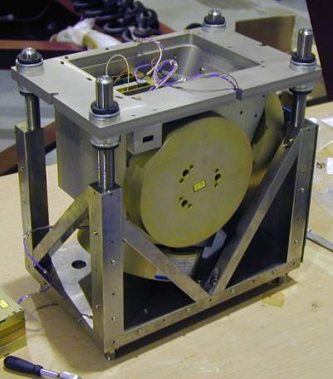
Deformation Sensing III
Example of Sensors
Fiber-optical Gyros
Inertial Stabilization System SOFIA
H. J. Kärcher, “Telescopes as Mechatronic Systems”,
IEEE Antennas and Propagation Magazine, vol.47, 2005
Notes:
The left figure shows some principles of the inertial stabilization system of the SOFIA airborne observatory. The problem for an airborne (and also a space telescope) is, that no absolute reference against the earth via a foundation is feasible.
The absolute reference is realized via imager cameras, which observe the position of known reference stars on the sky. These imagers are normally not fast enough for the fine position control, because the reference stars may be faint and need sample times longer than acceptable for the position control.
Therefore, the fast position control is realized via fast fiber-optical gyros (in all three axes; SOFIA gyros unit see picture on the right.)
The gyros are very fast and very accurate, but have a remarkable drift (they measure accelerations, the velocities and positions are achieved via integration.) Therefore, the position needs regular update against the absolute position measured by the imagers.
One of the problems with the gyros is the placement of the gyros on the telescope (left sketch.) The gyros are attached, due to practical reasons, on the warm side of the telescope in the cabin. The gyros measure thereby not the position of an absolute reference frame of the telescope, but the position of the attachment flange. The position of the overall reference frame must be evaluated via the end-to-end model of the telescope. The behavior may be disturbed by the resonance modes of the telescope.
For SOFIA, the situation is further complicated by the fact, that the main axes of inertia are tilted against the optical axes of the telescope. This is a result of the restricted space available for the telescope in the aircraft cavity.

Slide 10
Structural Mechanics as Theoretical Basis for FBC
The three basic engineering disciplines when designing a telescope:
Optics
Structural Mechanics
Control
Underlying mathematics:
Optics => Maxwell's EM theory – ZEMAX/GRASP
Structural Mechanics => elasto-mechanics – FEM
Control => control theory, transfer functions – MATLAB
Concept for FBC:
Combining “optics”, “structural mechanics” and “control” by a “modal observer”!
Notes:
Now I start some “theoretical part” of my talk, in total six slides, which will be followed by examples.
The overall system design of a telescope have to cover three major engineering disciplines,
1. Optics;
2. Structural mechanics;
3. Control.
The underlying physics and related mathematics of these disciplines is very different, and an engineer is normally specialized only in one of those disciplines.
I will focus here my talk on the needs of the FBC concept, which is understanding the deformation behavior of the structure and adequate reaction by the control system. The optical issues are taken here as granted, and their influence onto the telescope design may be treated somewhere else.
Main issue of my following slides is to introduce the concept of the “modal observer”, which is combining the mathematical model of the telescope structure with the algorithms of the control system.

Slide 11
Basic mechanical system equations
Time dependency
Distinguishing “Dynamic Regimes”
Eigenvalue Problem
The Rigid Body Regime
The Quasi-static (= steady state) Regime
The Flexible Body Regime (“Jitter”)
“Orthogonality” of the eigenmodes
“System identification” – Modal Survey Test
“Modal Observer” Concept
Sensor placement
Also for the quasi-static regime
Sensor readings
Quasi-static regime
“Observability”
Notes:
Mathematical basis for the FBC theory presented here is the description of the flexibility of the telescope – including the structure, the mechanics and the optics – in form of second order elliptical differential equations (1).
M is the mass matrix, D is the damping matrix, K is the stiffness matrix, f are the exterior forces, and q are the displacements. For numerical purposes the system equations are represented in the computer by finite element models, and these models are normally of very high order (hundred of thousand degrees of freedom). Standard available finite element software allows the calculation of the telescope status as a function of the external forces based on these mathematics.
In modal transformation the telescope system is described using the natural modes as interpolation functions in the manner of a Fourier-Series or in the manner of Zernike polynomials as used in optics. The natural modes or “eigenmodes” are defined by the “eigenvalue” problem related to the system equations in (2). The “ellipticity” of the system equations assure that those eigenvalues and eigenmodes exist.
With the standard “ansatz” function (3), where omega-j are the eigenfrequencies and q-ej are the mode shapes of the eigenmodes, we get the “numerical eigenvalue problem” (4), which can be solved by the computer.
An important feature of the eigenmodes is their “orthogonality” in regard of stiffness (5) and mass (6). (5) is equivalent to the “elastic energy” stored in the system, (6) is equivalent to the corresponding “dynamic energy”.

Slide 12
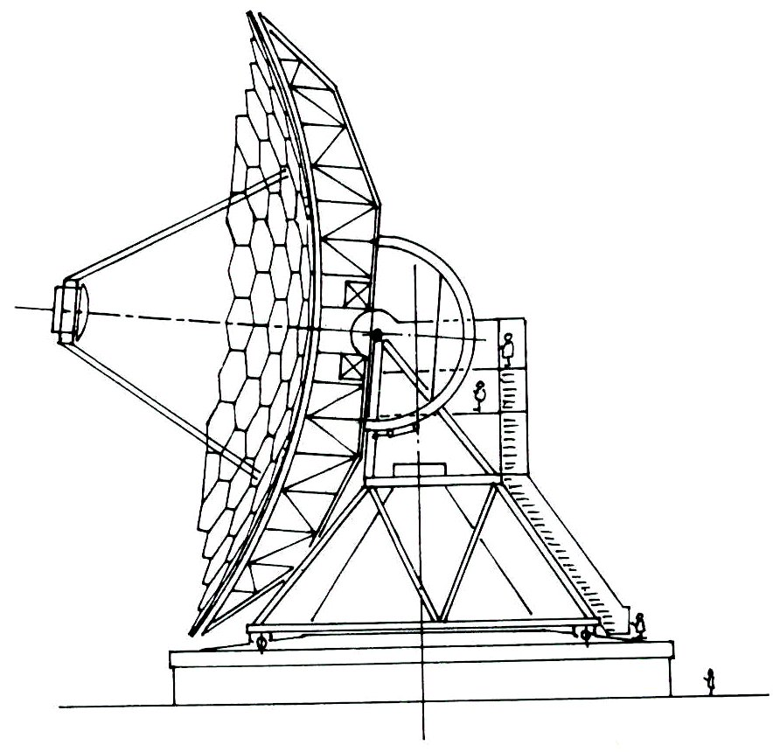
Requirements
FBC
Example LMT/GTM
HWFE better 75µm rms
Pointing at operational conditions 1.0 arcsec rms
Maximal operational wind speed 10m/s
During Design
During Commissioning
Notes:
I’ll now explain some of the details of FBC for some selected examples. The first example will be the 50m large millimeter telescope LMT/GTM, the second example the 2.7m airborne infrared telescope SOFIA, and the third the 4m solar telescope DKIST.
Let me start with the LMT/GTM. It is the largest single dish millimeter telescope in the world, and we (MTM, former MAN, headed by myself as lead system engineer) did join the project during its design phase by proposing an exposed design (left sketch) similar to that of the IRAM 30m (Juan Penalver has reported on this yesterday). Before our arrival the Project was focused on an enclosed design inside a radom, later a very large co-rotating dome.
T
he LMT/GTM has a very challenging performance specifications, with 75µm rms surface error HWFE (half wavefront error) under operational conditions including operational wind loads at 10m/s wind speed and thermal exposure. The related pointing accuracy is specified as 1 arcsec rms, and we investigated at the beginning of the “exposed” design study in 1997 nearly all possibilities of active optics and flexible body control.

Slide 13
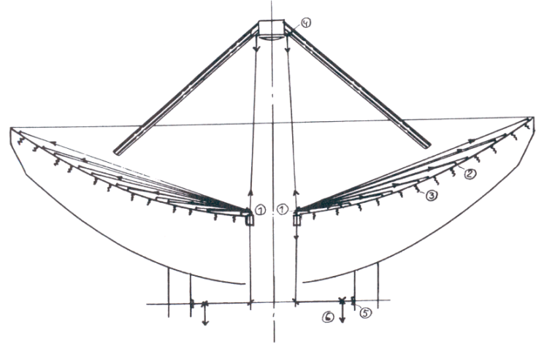
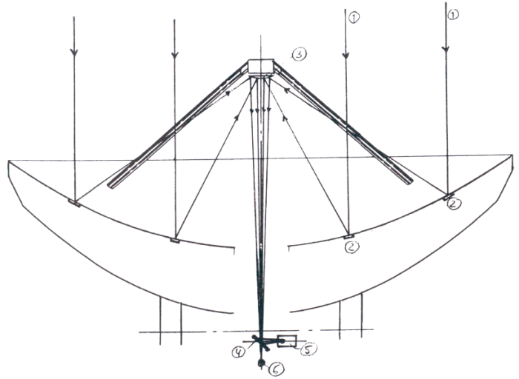
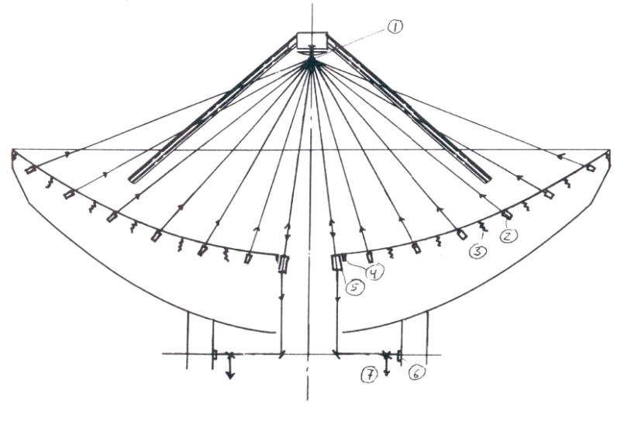
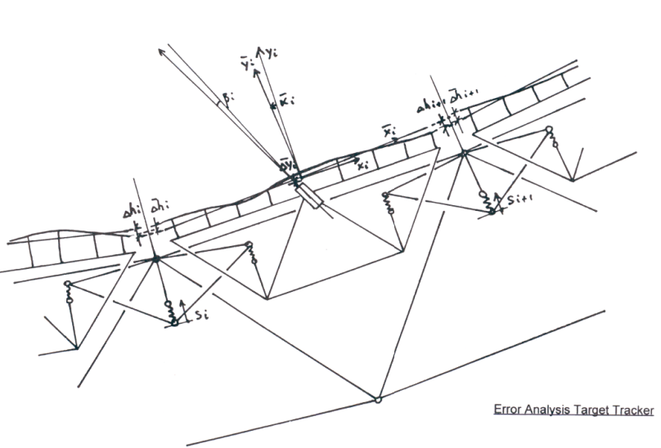
LMT “Exposed” Design Study 1997
Active Surface Trade-off
MAN June 1997
Scanning Mirror Principle
Global Star Tracker Principle
Error Analysis
Target Tracker
Target Tracker Principle
Notes:
The 1997 conceptual design study assumed that a closed loop active surface control system for the main reflector would be necessary. Such a system would compensate all three types of environmental influences on the backup structure (gravity, temperature, wind), but obviously not atmospheric disturbances in the optical path above the reflector.
One obvious system was with laser trackers similar to that envisaged for the GBT, and some trade studies were done to look on alternatives, avoiding the problems with the sensitivity of the length measurements against atmospheric effects. Three alternatives were investigated:
The Scanning Mirror Principle (left upper sketch) was based on the arrangement of some scanning units in the apex area of the main reflector, which measure permanently in a serial way the angle of reflecting targets on the panel units.
The Global Star Principle (upper right sketch) simulates the adaptive optics of the optical telescopes by arranging small optical reference mirrors in the panel units, and would need an artificial star as used by the large optical telescopes.
The Target Tracker Principle would replace the artificial star by laser trackers in the vicinity of the subreflector. The laser trackers would measure the angular position of the panel units, and the “phase lag” would have to be additionally measured and compensated by edge sensors similar to the previous Keck concept.
If a closed loop active optic system would be necessary, the last concept would be obviously the best candidate for realization.
The further course of the detailed design showed that the closed loop concept could be replaced by an open loop system, which reduced dramatically the realization efforts.

Slide 14
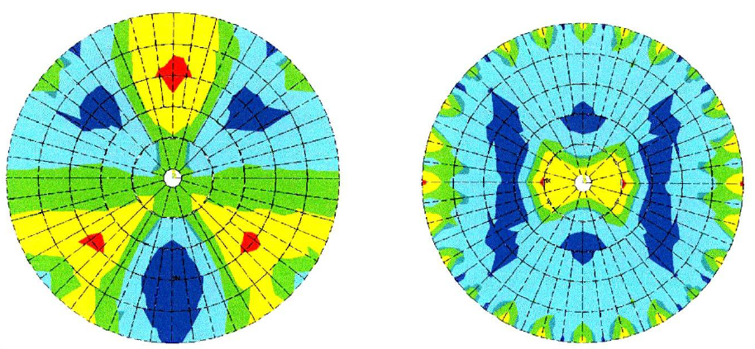
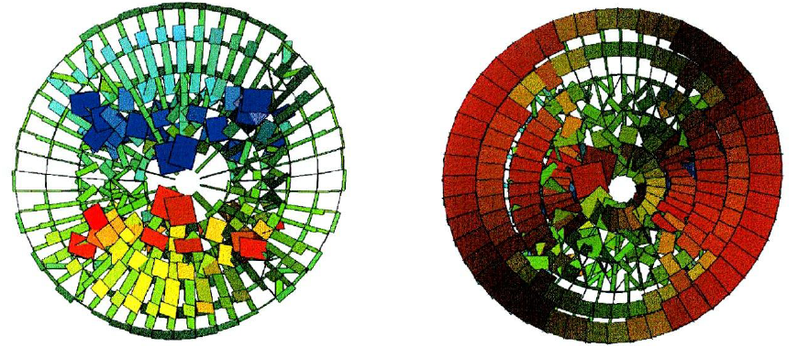
LMT “Exposed” Design Study 1997
Gravity Deformations ~ 400 µm rms
Active Surface Trade-off
MAN June 1997
Use of strain gauges for the identification of deformation states?
Horizon
Zenith
Later abandoned and replaced by lookup tables.
Strains in Backup Structure
Notes:
One alternative to the closed loop system was the idea to identify the deformation status of the backup structure be strain gauge measurements in the upper and lower chords of the truss system. The slide shows on top the gravity deformations in horizon and zenith position in the range of some hundred micrometers HWFE, and on the bottom the related strains in the truss members to be identified by the strain gauges.
The placement of the sensors on the truss could be optimized by the “modal observer” theory explained in slide 16. The active open loop control of the reflector surface would have to reduce the overall surface deformations by a factor better ten, which deems feasible.
Such a system would automatically also compensate the steady-state wind deformations, but not the temperature induced deformations. For that an additional thermal model with temperature sensors would be necessary.
The strain gauge concept was latter abandoned in regard of complexity, and after a simpler solution with lookup tables for the gravity deformations was available (see below).

Slide 15
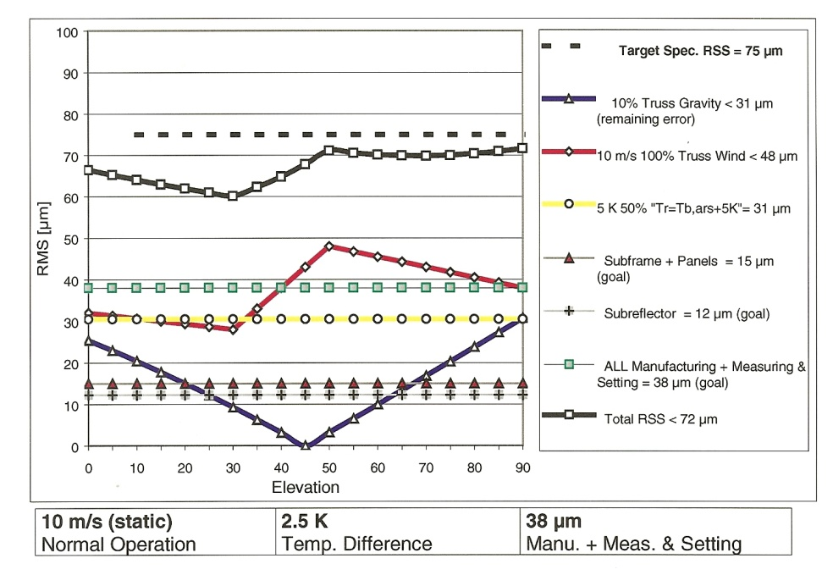
Main Reflector Backup Structure
Structural Optimization MAN 1998
Gravity Deformations
FBC of the gravity deformations
via Lookup Tables
HWF Error Budget
Horizontal Position
415 µm rms
Zenith Position
316 µm rms
Notes:
This slide shows the final outcome of the structural optimization of the LMT, as it was later realized and built. The right diagram shows the half wavefront error budget with the different contributors to the overall error as a function of the elevation angle.
Let me go through the individual contributors and their design driving aspects. Ill start from bottom to top in the right diagram:
Manufacturing and setting of the main reflector panels was assumed as 38 microns – defined as a goal!
For the subreflector a goal of 12 microns was set. The idea was to make it of carbonfiber composites like the subreflector of the 30m IRAM in Spain.
For the subframes, on which the individual panels are supported, a contribution of 15 microns to the overall surface error was defined.
For the temperature influences was assumed, that a thermal model – based on distributed temperature sensors on the backup structure – could reduce the overall error contribution via the active surface to 31 micron, 50% of the nominal calculated absolute values.
For the gravity influence deformations was assumed that the reflector would be aligned at 45 degree elevation, and that the resulting absolute deformations at the limits of the movement range in zenith and horizon of about 300 microns could be reduced by lookup table to about 30 microns, 10% of the absolute values.
Most critical was the wind influence, and let me change to the next slide.

Slide 16
Main Reflector Backup Structure
Structural Optimization MAN 1998
Wind Deformations
Deformation patterns
10m/s operational wind speed
Passive in the limits, no FBC!
HWF Error Budget
Notes:
Main goal for the optimization of the LMT structure in 1998 was the avoidance of FBC measures for the wind as discussed in slide 19. We were at this point able to reduce the wind induced contribution in selected load cases to maximal 43 microns passively, without active means (FBC), and the maximal values fit just into the overall surface error budget.

Slide 17
Improvement of the Blind Pointing by FBC with Inclinometers
10m/s operational wind speed
Placement of the Inclinometers
EL
XEL
[arcsec]
[arcsec]
EL FBC
XEL FBC
[arcsec]
[arcsec]
Notes:
The goal for avoidance of FBC under wind was related to the surface error, as explained in the previous slide. For the pointing error, the FE calculations showed that this was impossible. The maximal blind pointing errors were in the range of five arcsec, and for cross elevation in the range of three arcsec, and this values depend on the overall stiffness of the whole telescope structure, and could passively only be reduced by increasing the cross sections of main beams, which would add additional steel mass, and is prohibitive from the practical point of view. This is the point where FBC makes sense.
The usual means for the compensation of wind induced pointing errors is the placement of inclinometers on top of the alidade in the area of the elevation bearings (top right sketch). These inclinometers are able to identify the two main deformation states as explained in the right lower sketches. Important is now, that not only the measured tilts of the bearing attachments are fed into the servo system, but that additionally the bending of the structure above the location of the inclinometers is extrapolated by “modal observer” means as explained in slide 16.
The outcome of the related finite element calculations is shown in the lower diagrams. The pointing error under wind loads is reduced by about a factor of ten and well within the requirement.

Slide 18
“Jitter”
Gustiness of the Wind
End-to-end Simulation
Wind on Pointing, Time Domain
Wind Induced Pointing Error
Notes:
In the previous slide, only the steady-state part of the wind was investigated. In this slide some remarks to gusty effects on pointing, which I like to call now “wind induced jitter”. For the evaluation of these effects we developed end-to-end simulations in MATLAB, and the “architecture” of those end-to-end models is shown in the left diagram.
The core of the end-to-end model is the finite element model (left diagram). I have here not the time to go into the details of this modeling, and want only to mention some further possibilities to apply “dynamic FBC” also to radio telescopes, as used in SOFIA, which I’ll later explain. I’ll focus here on the two right diagrams, which show end-to-end simulations in the time domain for the LMT. The upper diagram shows the gust loads on the structure gotten from wind load power spectra which can be found in the literature, as e.g. in the books of Wodek Gawronski. The lower diagram shows the related pointing error as gotten from the end-to-end simulation, and a comparison of the two diagrams shows a clear correlation between the low frequent wind gusts and the related low frequent components of the pointing error.
This correlation indicates a possible application of “dynamic FBC”, if this would be necessary, and which is used in a similar way at SOFIA. The gusty wind loads are obviously related to the motor torques, which are known to the servo system, and they are also related to the inclinometer measurements, described before. And both informations could be used for low frequent dynamic FBC, if this would be necessary, (which is up to now not the case).

Slide 19
Example LMT/GTM
Thermal Subsystem
Forced
Air Circulation
Reflector
Cladding
Thermal Time Constants
τ =
C
H
Backup Structure 9,4 h
Ballast Arms 53,7 h
Alidade 69,0 h
Alidade
Cladding
Notes:
At the end some remarks to the thermal issues of large telescope design. The GBT and the 100m Effelsberg telescope are exposed designs, just due to their size. The thermal issues are handled mainly by overall white paint. Snow and ice are not an issue due to their location in a low elevation and a moderate climate.
For a millimeter telescope like the 30m IRAM and the 50m LMT/GTM, which are located on a high mountain with snow and icy weather conditions, the exposed design ala GBT is not a solution. The LMT/GTM had to be protected against the outside weather condition by an outside cladding similar to that of the 30m IRAM.
This outside cladding protects also again direct sunshine onto the structure, and the remaining issue is a thermal stratification of the enclosed air, which can be prevented by a forced air circulation installed in the 30m IRAM and foreseen, but up to now not installed in the LMT/GTM.
Also an issue are the thermal time constants of the structural masses, which depend on the filigreeness of the structural components and are rather different between the backup structure, the ballast arms and the alidade, and which cause thermal constraints between them, which can be seen in the measured deformations (see slide 26).
The influence of these constraints could be compensated by the active surface via a thermal model, for which temperature sensors would have to be placed on the structure.

Slide 20
Pointing Accuracy
(arcsec rms)
Example LMT/GTM
Error Budgets Design Phase
Look Up Table
Modal Observer
Surface Accuracy
(µm rms)
Thermal Model
Astronomical Pointing Model
Drive Pretension
Disturbance feed Forward
Dynamic Trajectory Generator
Notes:
A lot of details were discussed in the previous slides. At some stage, the system engineer must make a summary on all those influences to get an overview on all effects and their singular importance in the overall context. Most valuable in this regard are “error budgets”.
The left table in the slide shows a surface error budget of the LMT/GTM. The active surface is used only for two environmental effects, the gravity and thermal deformations.
The gravity deformations are corrected by look-up-tables (LUT), the thermal deformations by temperature sensors and a thermal model (ThM). The maximal wind deformations are, as explained, just below the budget requirements, and not actively corrected.
The right table shows the pointing error budget of the LMT. The table is much more complex as the surface error budget, because all the influences of the main axes mechanisms and position controllers must be taken into account.
Seven major effects are corrected in the pointing control process. Major effects are: 1. The gravity deformations by look up tables; 2. The steady-state wind influences by inclinometer measurements on the alidade heads; 3. The thermal influences by temperature measurements and a thermal model; 4. The axis alignment by astronomical calibration; 5. The backlash of the drive mechanisms by pre-tension; 6. The friction in the axis, particularly of the azimuth wheel-on-track system, by disturbance feed-forward; 7. Disturbances in the position commands by a dynamic trajectory generator.
The table shows an improvement by the active control features of the absolute errors by more than one order of magnitude.

Slide 21
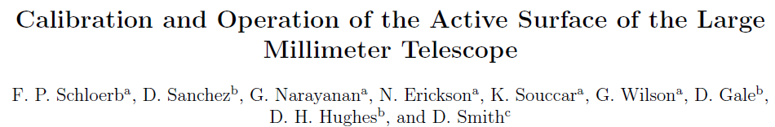
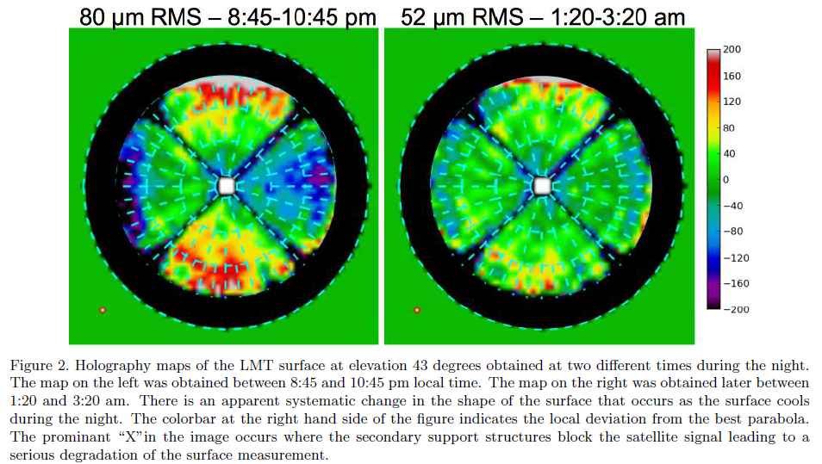
Example LMT/GTM
Verification after Commissioning
SPIE 9906, 2016
From MAN Analysis Report, 2000
ΔT = 5° between Alidade
and Elevation Structure
28 µm rms
Notes:
Up to now I have discussed all the effects only from the viewpoint of a designer, having in mind the fulfillment of requirements defined at the beginning of the design process by astronomers due to their science case.
Now is the time to look onto the outcome, after the telescope is built.
The verification of the telescope performance and possible improvements are subject of “metrology”, the title of our small conference here. Unfortunately, some of the major effects discussed by me before, are not easy to measure. It is e.g. difficult to get real data for the wind, because wind is a random incidence. (For SOFIA the situation is different. The occurrence of the aero-acoustic loads there, the equivalent to the wind in earthbound telescopes, is permanent. See my later slides).
But for the LMT/GTM we have since this summer some holographic measurements by Pete Schloerb and his team (left diagrams), and they show in comparison with the calculated shapes (right diagram) very good accordance of the outcome.

Slide 22
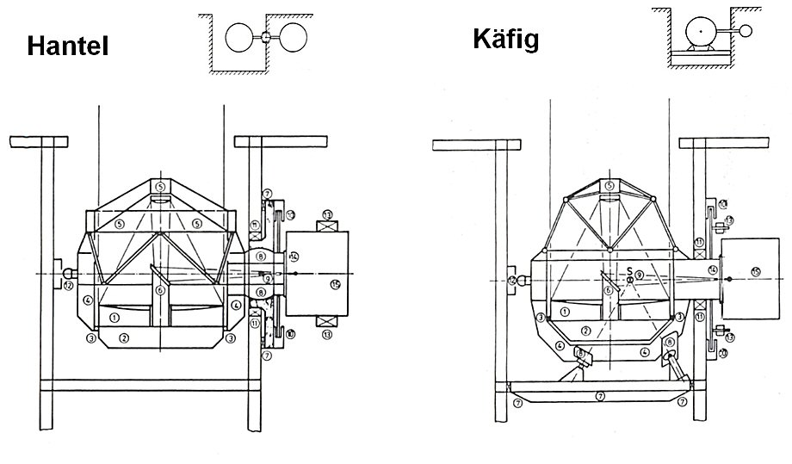
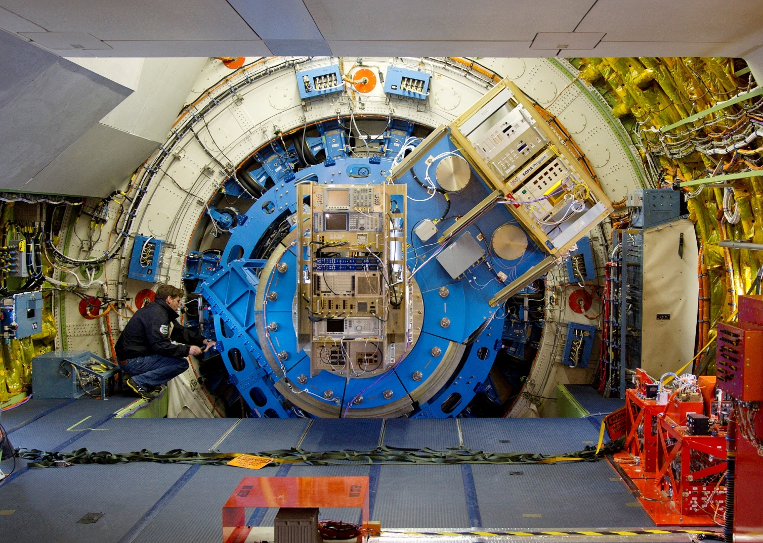
Example SOFIA
Pointing Requirement
0.4 arcsec rms
Design Concept 1987
After Commissioning

Slide 23
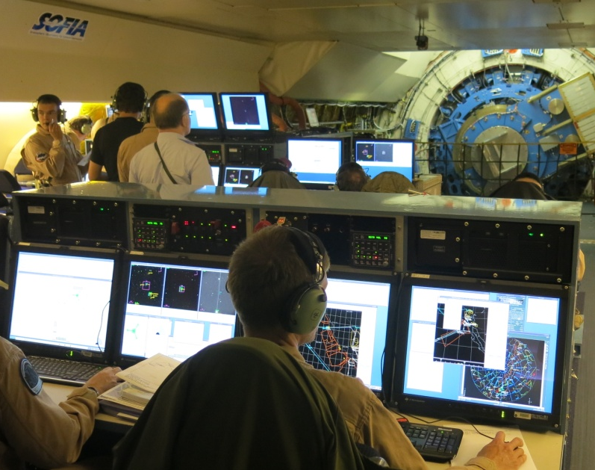
FBC
Example SOFIA
Pointing Requirement
0.4 arcsec rms
During Design
During Commissioning

Slide 24
SOFIA
Pointing Requirement
0.4 arcsec rms
Overview on the Pointing Subsystem

Slide 25
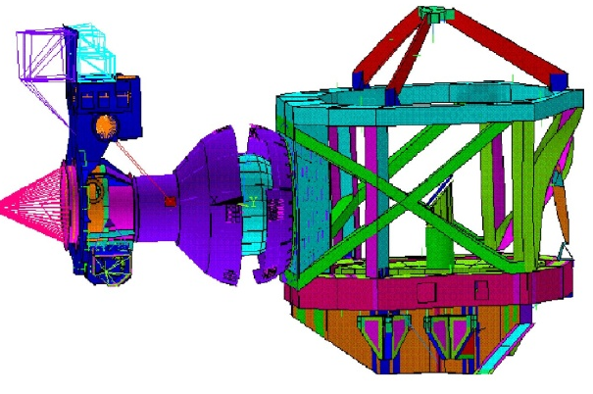
Inertial Stabilization System of SOFIA

Slide 26
SOFIA End-to-end Simulations Pointing
CDR Status

Slide 27
SOFIA Pointing Budgets CDR Status
Subsystem Contributions
Environmental Influences
Notes:
2. POINTING BUDGETS
The verification business of pointing is formally handled by „pointing budgets“. Figure 4 shows the pointing budget tables as presented at the CDR.
The „pointing budget“ consists of two separate tables. The left one in figure 4 describes the contributions of the internal features of the subsystems to the pointing, as sensor resolution, torque ripple, bearing friction etc. The right table decribes the contributions of the environmental influences via the overall system.
Now, August 2002, all hardware is produced and the telescope is assembled on ground in an integration hall at the MAN premisses in Augsburg. Something could be done in regard of pointing tests, but obviously not every thing. The resulting verification strategy, dealing with the complicated integration process of the telescope into the aircraft, and dealing with the situation, that real flight conditions are somewhat uncertain and will be known definitely only after flying, is explained in the following.

Slide 28
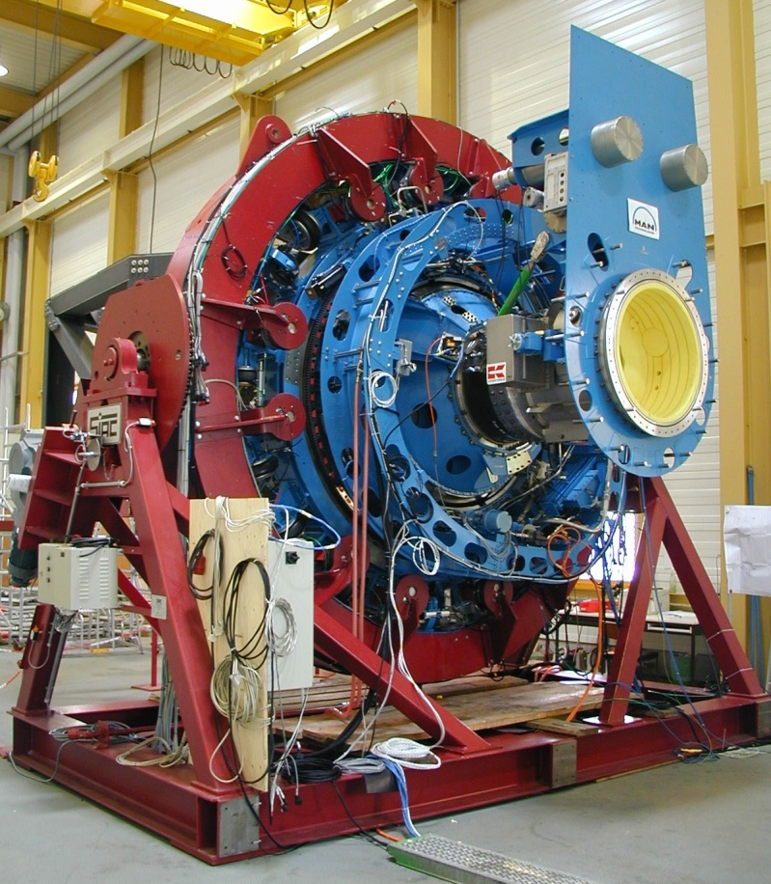
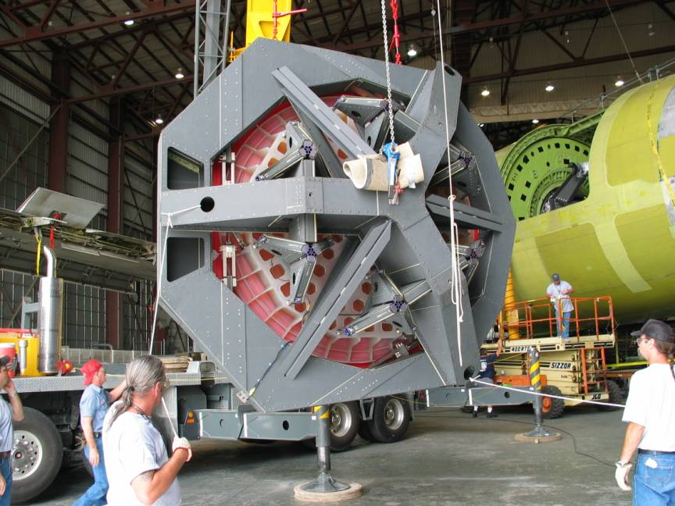
Manufacture, preassembly, pre-shipment tests 1999-2001 in Augsburg
Integration into aircraft 2002-2003 in Waco

Slide 29
SPIT Activities 1999 to 2002
“SOFIA Pointing Improvement Team”, co-chaired by Hans Kärcher and Nans Kunz
SPIT Workshop 2000 on mechanical improvements in Mainz
SPIT Workshop 2001 on “Image Motion Compensation” in Berkeley
Pointing improvement predictions SPIT October 2001

Slide 30
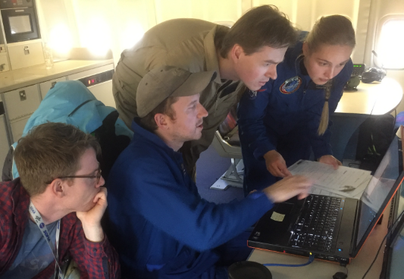
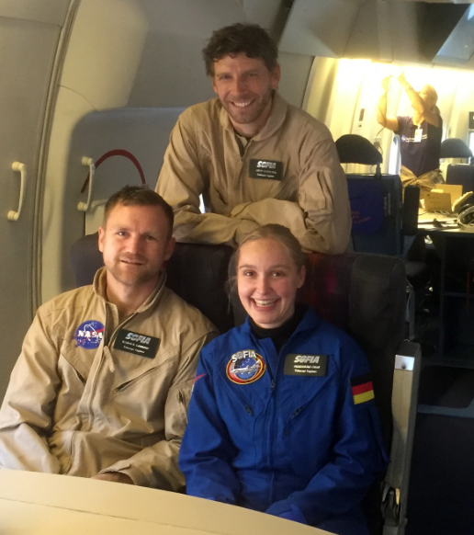
FBC
Example SOFIA
In-flight improvement after commissioning
See separate presentation by Friederike Graf SPIE 9906, 2016

Slide 31
FBC
Example DKIST
Wind induced Pointing Error < 0.1 arcsec rms
“Jitter” < 0.075 arcsec
Factory Acceptance Tests
Jitter tests on IMT Gantry machine

