Slide 1
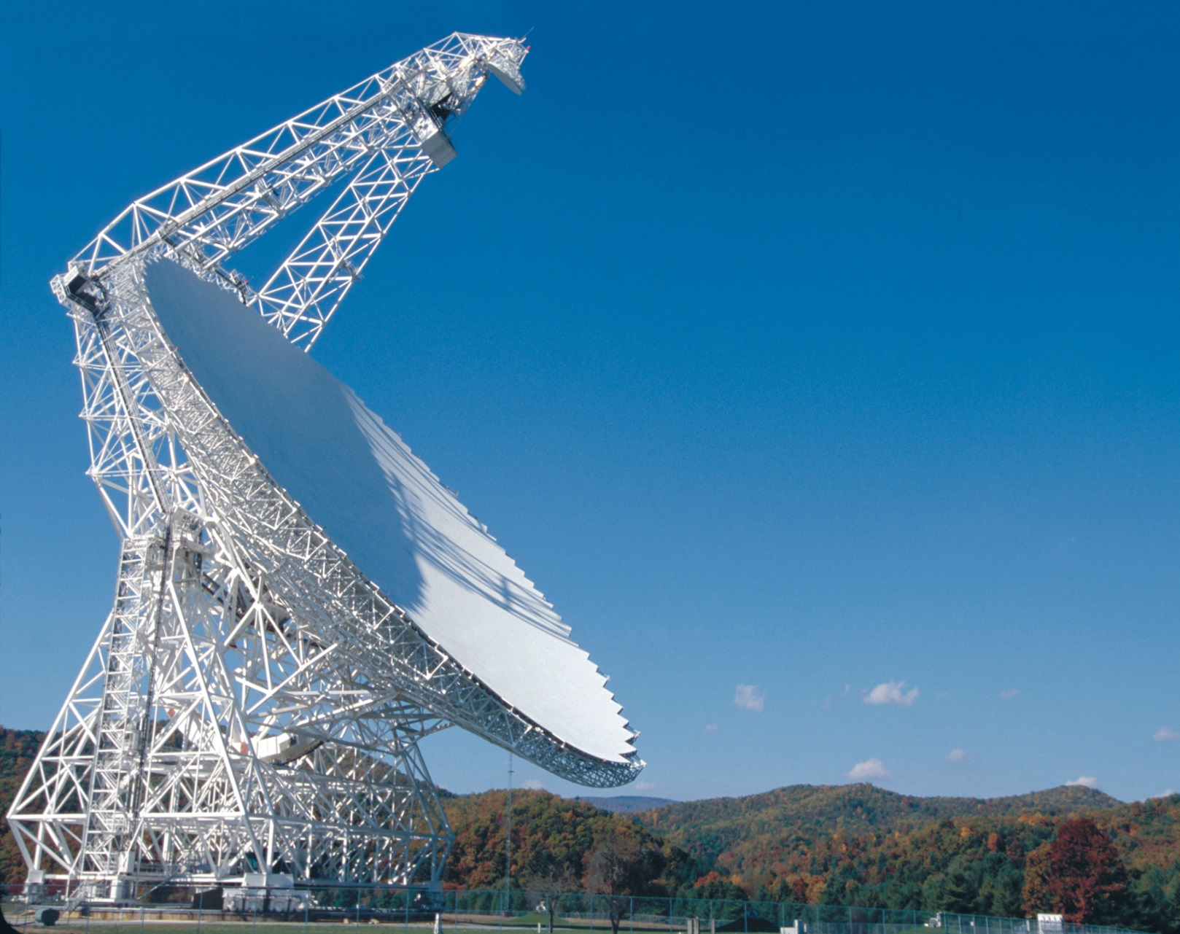
Green Bank Telescope Sub-reflector Stabilization (Wind)
Fa Wang
Advisor (GBT): Richard Prestage
Randy McCullough
Advisor (CWRU): Mario Garcia-Sanz
NRAO 2016 Summer Program
05/31/2016~08/19/2016

Slide 2


Contents
GBT Geometry and Coordinate
Sub-reflector Pointing Accuracy Requirement
Sub-reflector Platform
Proposed Idea and Solution
Future Work

Slide 3
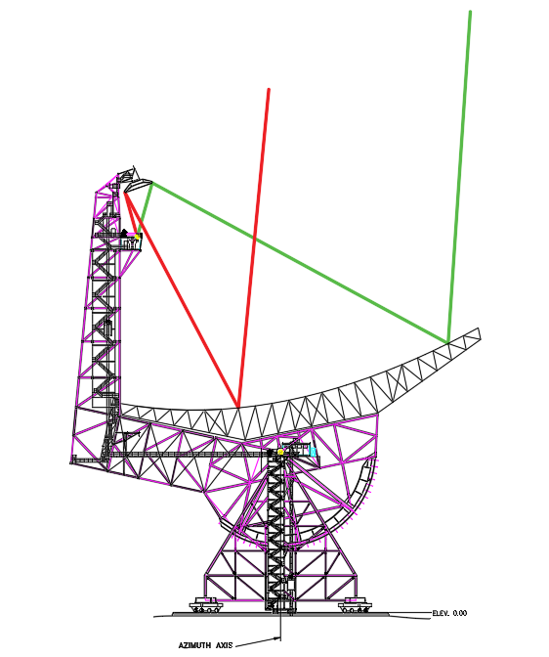
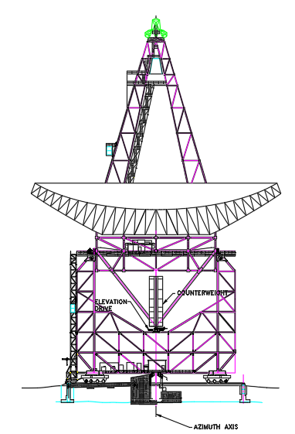
GBT Geometry and Coordinate

Slide 4
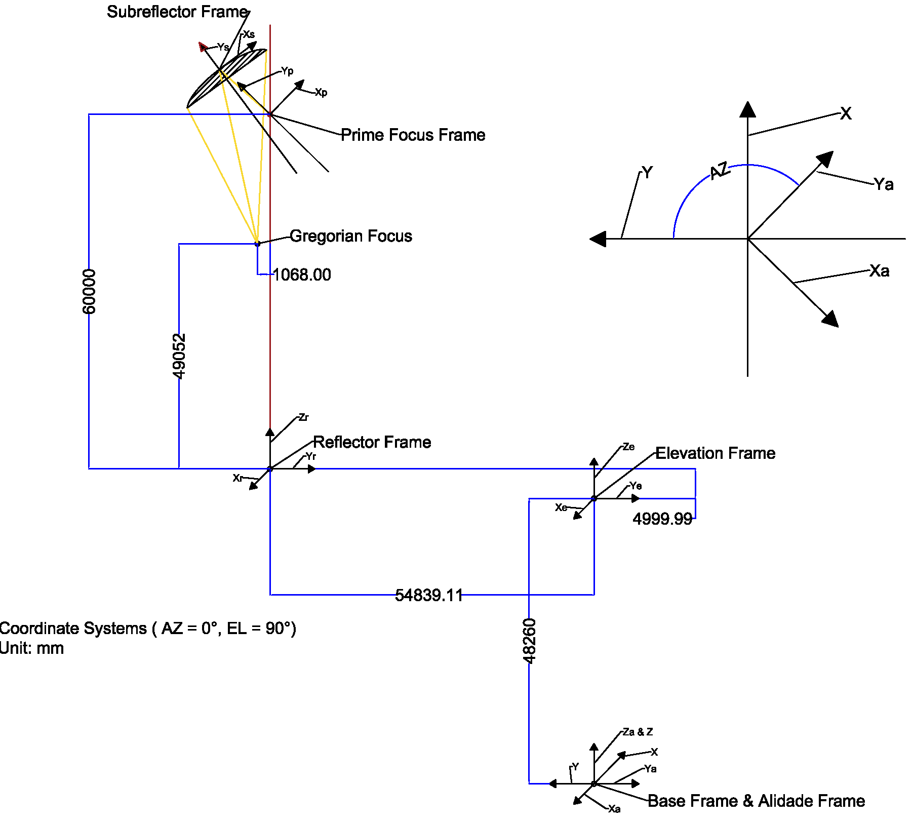
GBT Geometry and Coordinate
Frame #1
The Base Frame.
Unit Frame Vectors: X, Y, Z
Frame #2
The Alidade Frame.
Origin Point-Ad
Unit Frame Vectors: Xad, Yad, Zad
Frame #3
The Elevation Frame.
Origin Point-Ed
Unit Frame Vectors: Xed , Yed , Zed
Frame #4
The Reflector Frame.
Origin Point-Rd
Unit Frame Vectors: Xrd, Yrd, Zrd

Slide 5
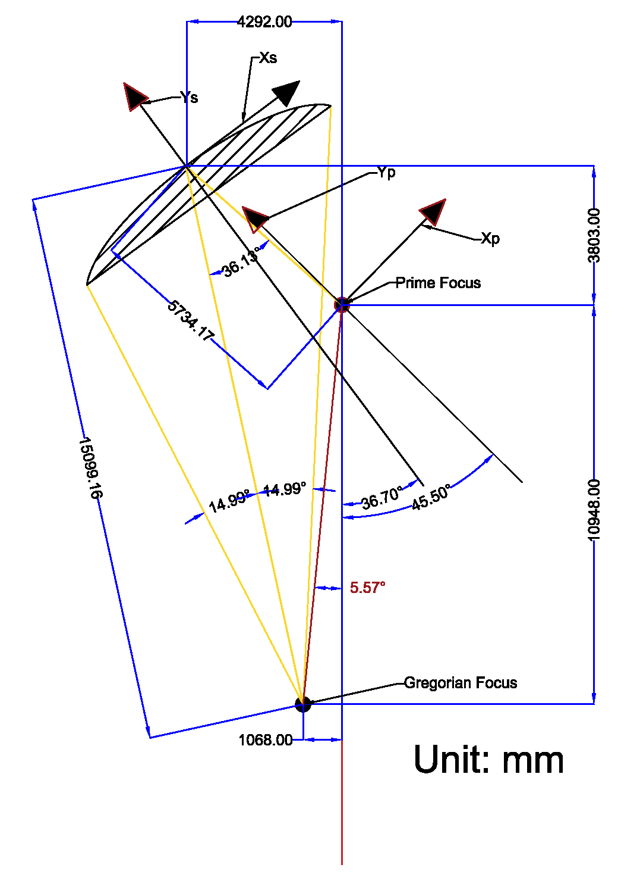
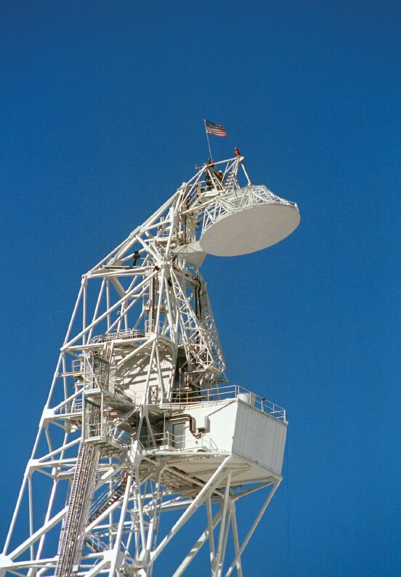
GBT Geometry and Coordinate
Frame #5
The Prime Focus Frame.
Origin Point-Pd
Unit Frame Vectors: Xpd, Ypd ,Zpd
Frame #6
The Sub-reflector Frame.
Origin Point-Sd
Unit Frame Vectors: Xsd , Ysd ,Zsd
Frame #9
The Receiver House Frame.
Origin Point-Hd
Unit Frame Vectors: Xhd, Yhd ,Zhd

Slide 6
Final Goal
Table.1. Acceptable pointing error.
GBT Point Error | 5’’ (Useful) | 1.83”(Good) | 1”(Better) | 0.23”(Best) | 0.1”(Ultimate)
Xs in EL | 1.3566 mm | 0.4965 mm | 0.2731 mm | 0.0624 mm | 0.0298 mm
Zs in Cross EL | 1.2941 mm | 0.4736 mm | 0.2588 mm | 0.0595 mm | 0.0259 mm
Zt | 28.8615” | 10.5633” | 5.7723” | 1.3276” | 0.5772”
Xt | 35.1643” | 12.8701” | 7.0329” | 1.6176” | 0.7033”
The Frame # 6; Table data are in Sub-reflector frame.
First Line is the Error of the GBT Point Error
5 level Requirement from “Useful” to “Ultimate”
Unit is mm and arc Second

Slide 7
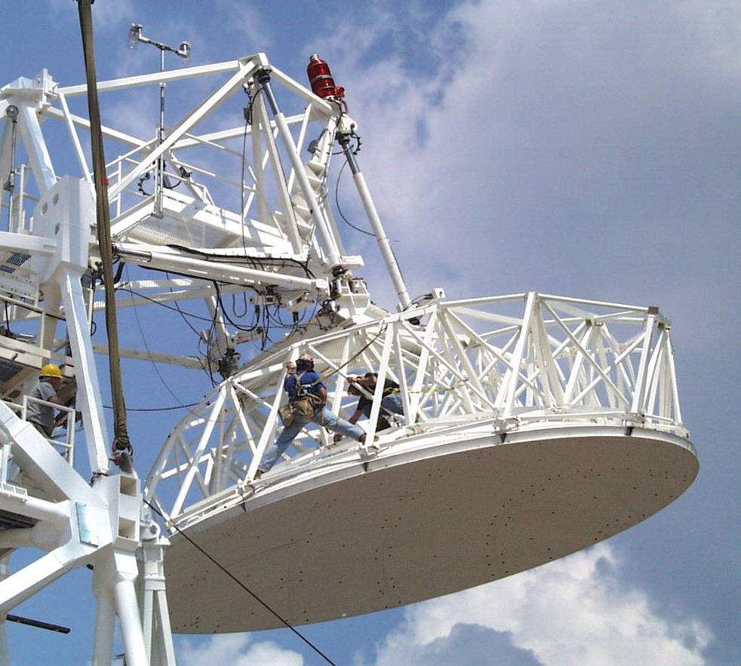
Sub-Reflector Platform
6 Linear Actuator
3 In Ys Axis Direction
2 in Xs Axis Direction
1 in Zs Axis Direction
Name | Travel Range (mm)
Y1 | 2540 ~ 3454.4
Y2 | 2489.2 ~ 3403.6
Y3 | 2489.2 ~ 3403.6
X1 | 2819.4 ~ 4013.2
X2 | 2819.4 ~ 4013.2
Z1 | 1473.2 ~ 1955.8

Slide 8
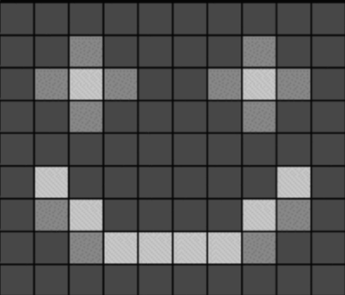
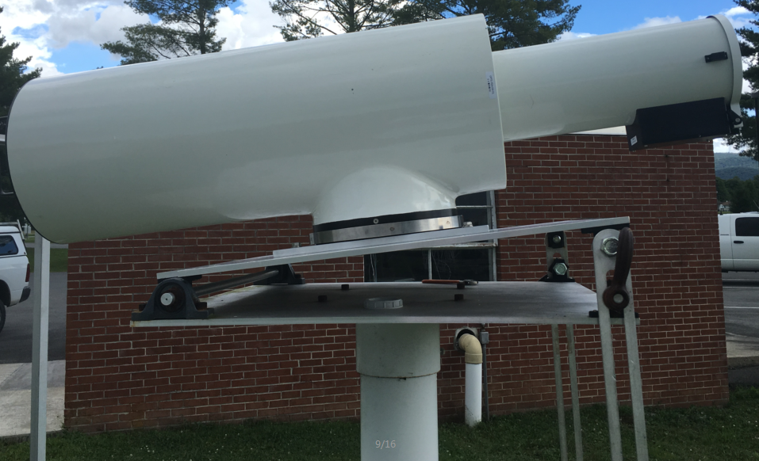

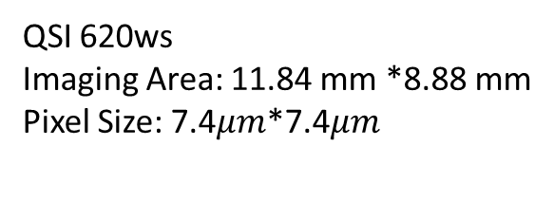

Proposal #1 Optical Pointing Telescope
1200 Pixel
QSI 620ws
Imaging Area: 11.84 mm *8.88 mm
Pixel Size: 7.4$μm$*7.4$μm$
1600 Pixel
$$\frac{ArcSec}{Pixel}=\frac{4500 mm}{7.4 μm}∗206.3=0.34"/Pixel$$

Slide 9
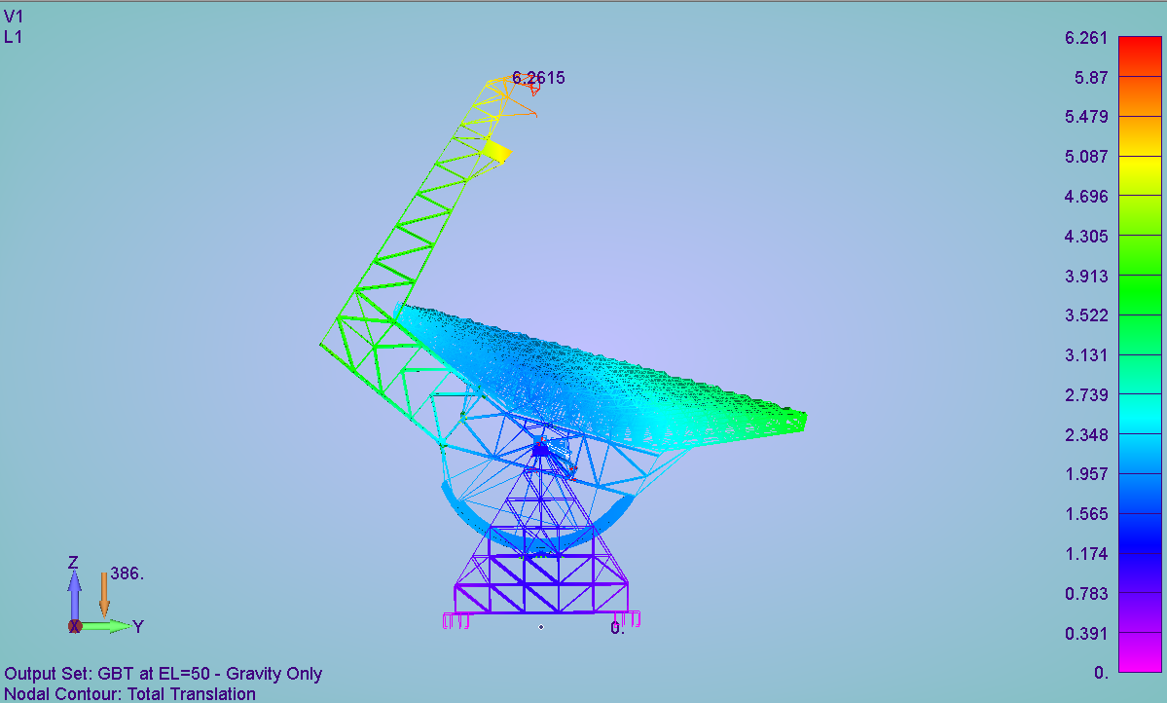
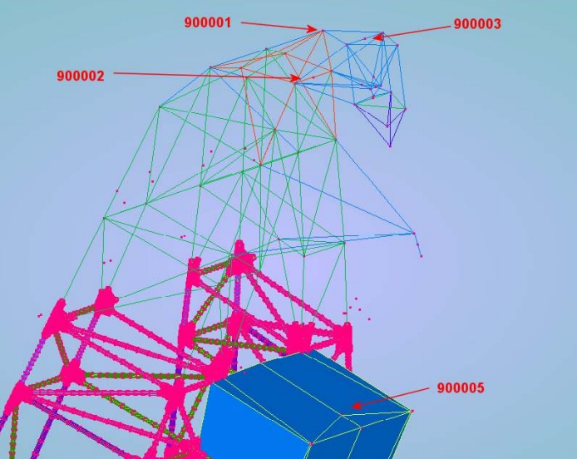
Proposal #1 Optical Pointing Telescope
900001 & 900002 node: OPT Mounting
GBT FE Model: Deflection on Gravity at EL =50 degree. (Unit: Inch)

Slide 10
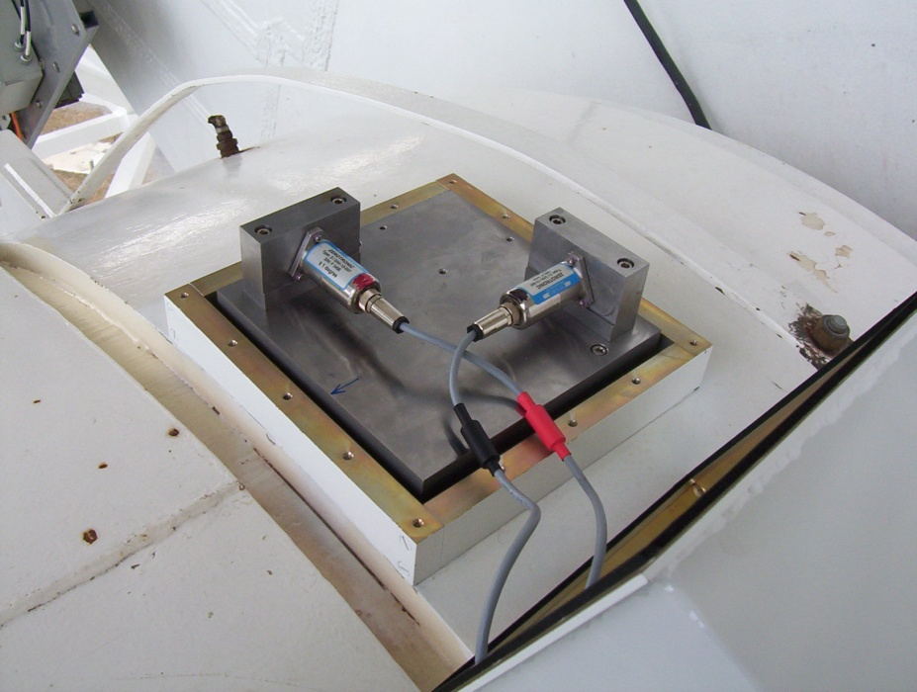
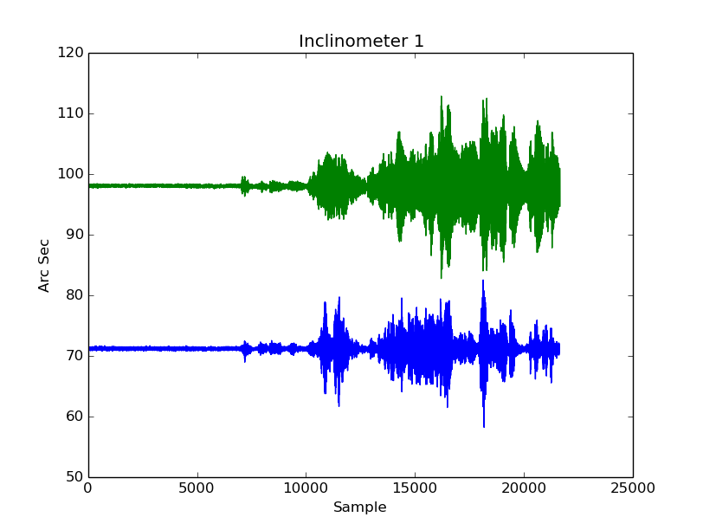

Proposal #2 Inclinometer
Elevation Bearing Casting
Inclinometer Data in One Hour. Sample rate: 0.03 s
Y Inclinometer
X Inclinometer
0.1” Short term Accuracy
0.01” Resolution
$±1$ degree Range

Slide 11
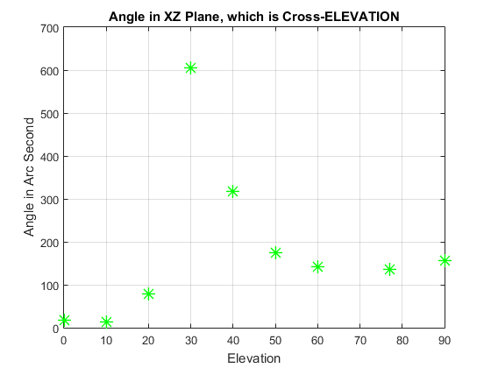
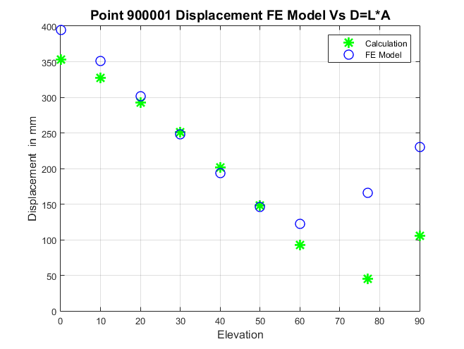
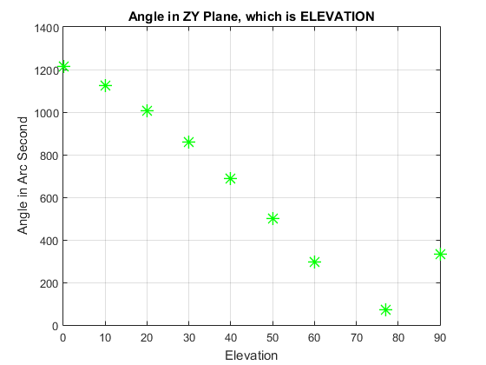
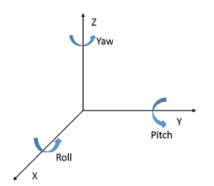

Proposal 1&2 Mathematic Calculation
$D≈L∗α$
L is the Length of the feed arm, 60 m
Lookup table for the Deflection.

Slide 12

Proposal #3 Laser Ranger
Sub-reflector
Assume the wind cause sub-reflector translation ONLY. Laser Accuracy: 0.1mm (Good Case)
Laser spot #1
Laser spot #3
D1, D2 and D3 is the distance measured by Laser Ranger
Laser reflector: Sub-reflector
Sub-reflector: 0.1 mm RMS surface error
Each Elevation, D1 should have a unique value.
D2 and D3 is using to tell the sub reflector movement direction.
Laser spot #2
D2
D1
Ellipsoid :
$\frac{X^{2}}{10417}+\frac{Y^{2}}{10417}+\frac{Z^{2}}{8846}=1$
D3
Laser #1
Laser #2&#3

Slide 13
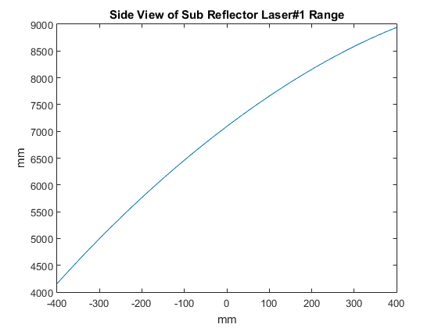
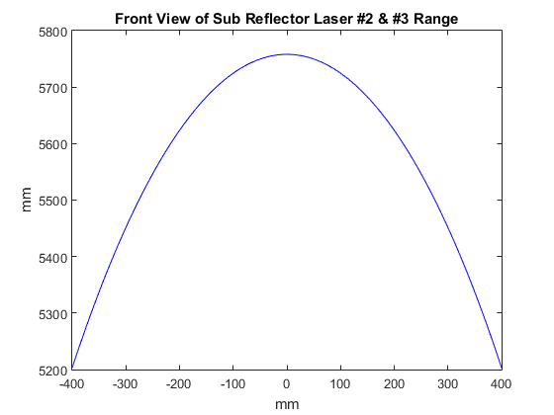

Proposal #3 Laser Ranger
Sub-reflector
Sub-reflector Moving Direction:
Laser spot #1
D2: Increase D3: Decrease => LEFT
D2: Decrease D3: Increase => Right
D1 Increase =>Backward
D1 Decrease=>Forward
Laser spot #3
Laser spot #2
D1
|D3-D2| <$∆$
D2
Direction
D3
Sub-reflector
Actuator
D1
EL
+
Laser #1
D1(EL)
PID
-

Slide 14
Summary
Three Ideas
OPT: Mount on the top of the GBT 900001 and 900002
Inclinometer: Mount in the receiver room
Laser Ranger: Measure the distance to Sub-reflector surface.
Future Work
OPT: Device is ready. Under testing in Jansky Lab
Inclinometer: Need to order one more pair.
Laser Ranger: More detail research to prove it works.

Slide 15
Acknowledgements
Special Thank You to:
Advisor: Richard Prestage and Randy McCullough
Everyone in the first floor laboratory.
All of the staff, scientists and engineers.
All Summer Students.

Slide 16
Thank You!
Q & A

