Slide 1
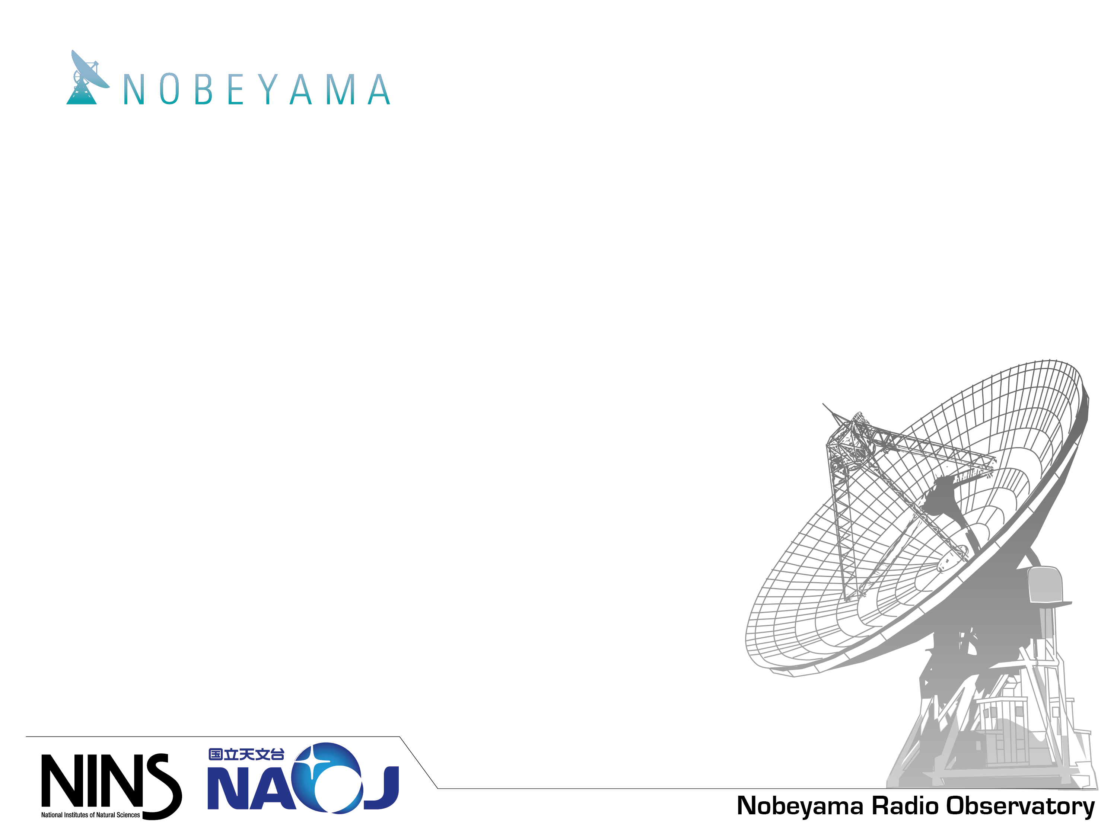
Nobeyama 45-m Telescope
Masao Saito*
Nobeyama Radio Observatory
*with support from Miyamoto and Wada

Slide 2
Outline
Nobeyama 45-m Telescope
Performance and previous Metrology
Future Metrology System

Slide 3
Nobeyama 45-m Telescope

Slide 4
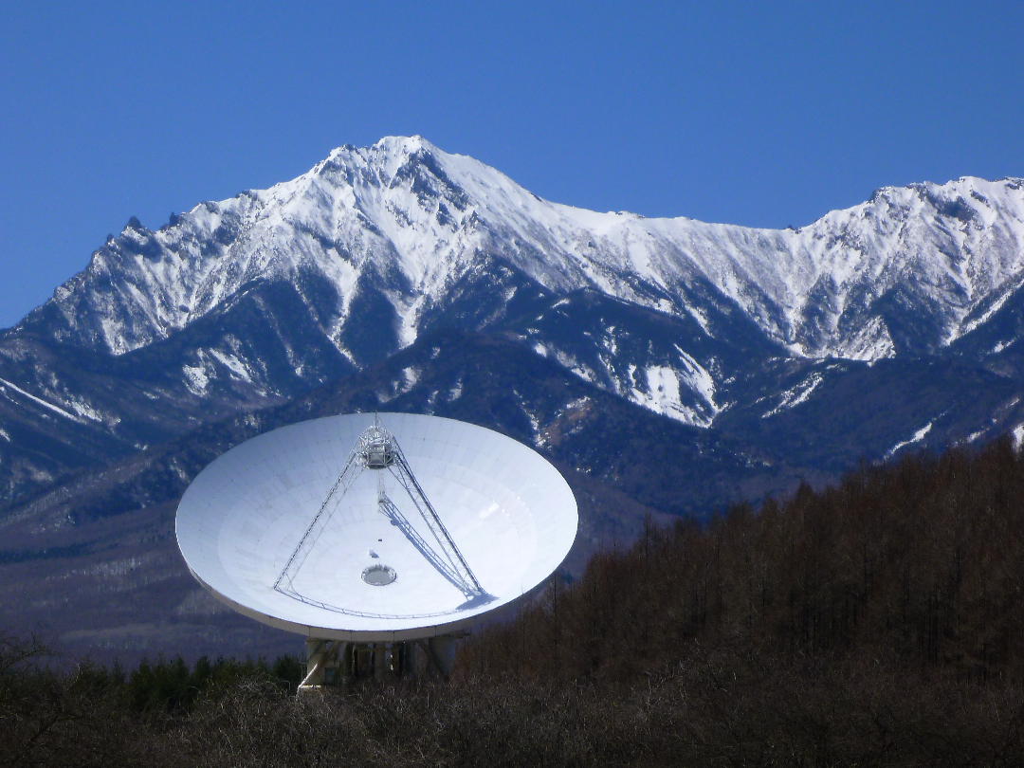

Slide 5
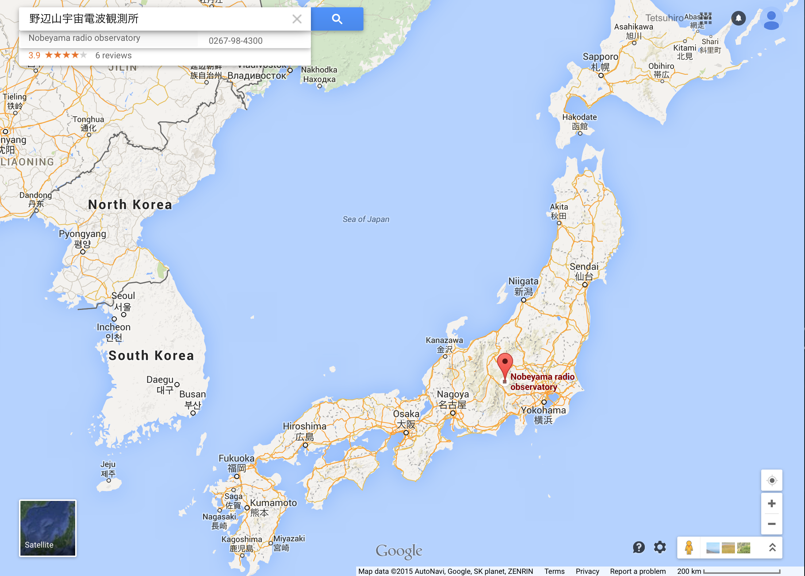
Nobeyama 45-m Telescope
Nobeyama Radio Observatory (NRO)
1350 m altitude
45m Diameter (homologous)
Optics: Beam waveguide
Master Collimator
Pointing accuracy: 2-3”
Surface accuracy: 100 μm
Beam size: 14” @ 115GHz
η_{A}: 0.35 @ 110 GHz
Receivers (20 – 116 GHz)
Digital/VLBI Backend
Open sky policy

Slide 6
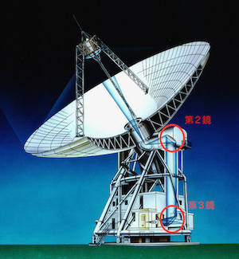
Sub Reflector
(CFRP honeycomb sandiwitch)
Main Reflector Panel
(CFRP honeycomb sandiwitch)
Fan
BUS
Steel
Fan
Mount
Steel
M2/M3 mirror
(CFRP honeycomb sandiwitch)

Slide 7
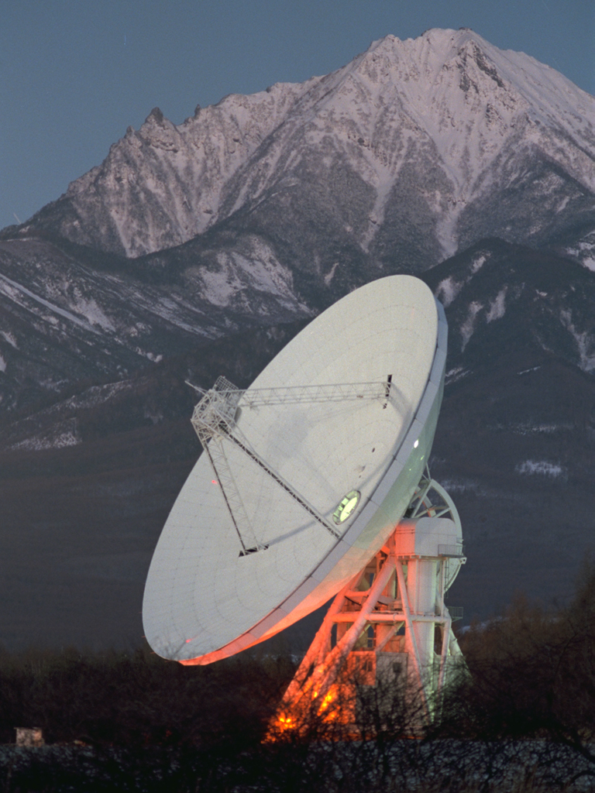
Current System
OPEN USE
Commissioning
Antenna
Optics
Receiver
IF chain
Backend
Switch
H22
Holography
Continuum BE
H40
Master pointing model
45m
Z45
T70
TZ
SAM45
PolariS
New IF
FOREST
VLBI BE

Slide 8
Issues as of 2014
Large surface errors: 180 μm (η_{A,110 GHz} :0.25)
High antenna noise temperature: 30 K
Single pixel Rx only at 3 mm
Rust on mount structure

Slide 9
Holography
Measurement
Frequency 19.45 GHz (CS satellite)
Rx: H22
Ref Ant: CS dish (1.8 m)
Adjustment (700 panels)
2015 sep-oct
Motorized part are broken
Manually adjusted

Slide 10
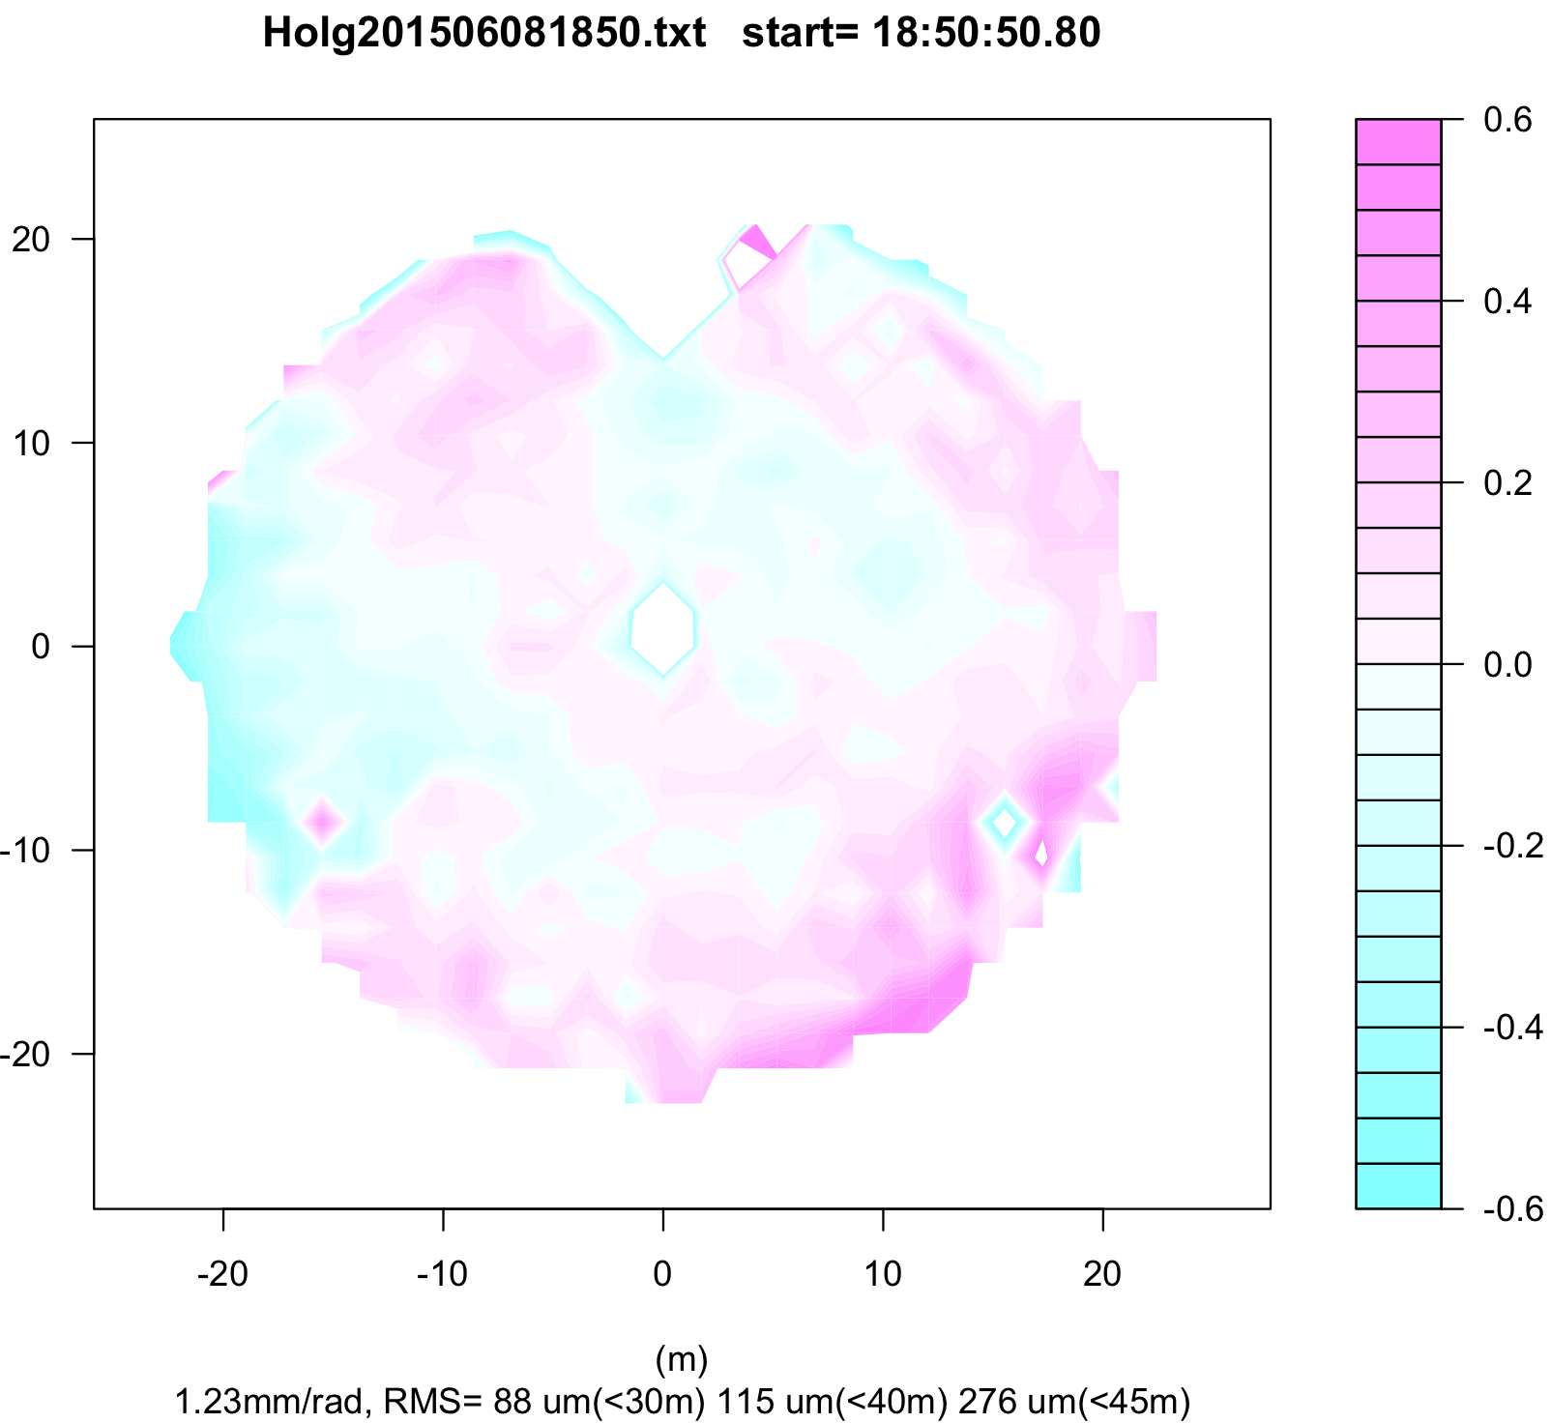
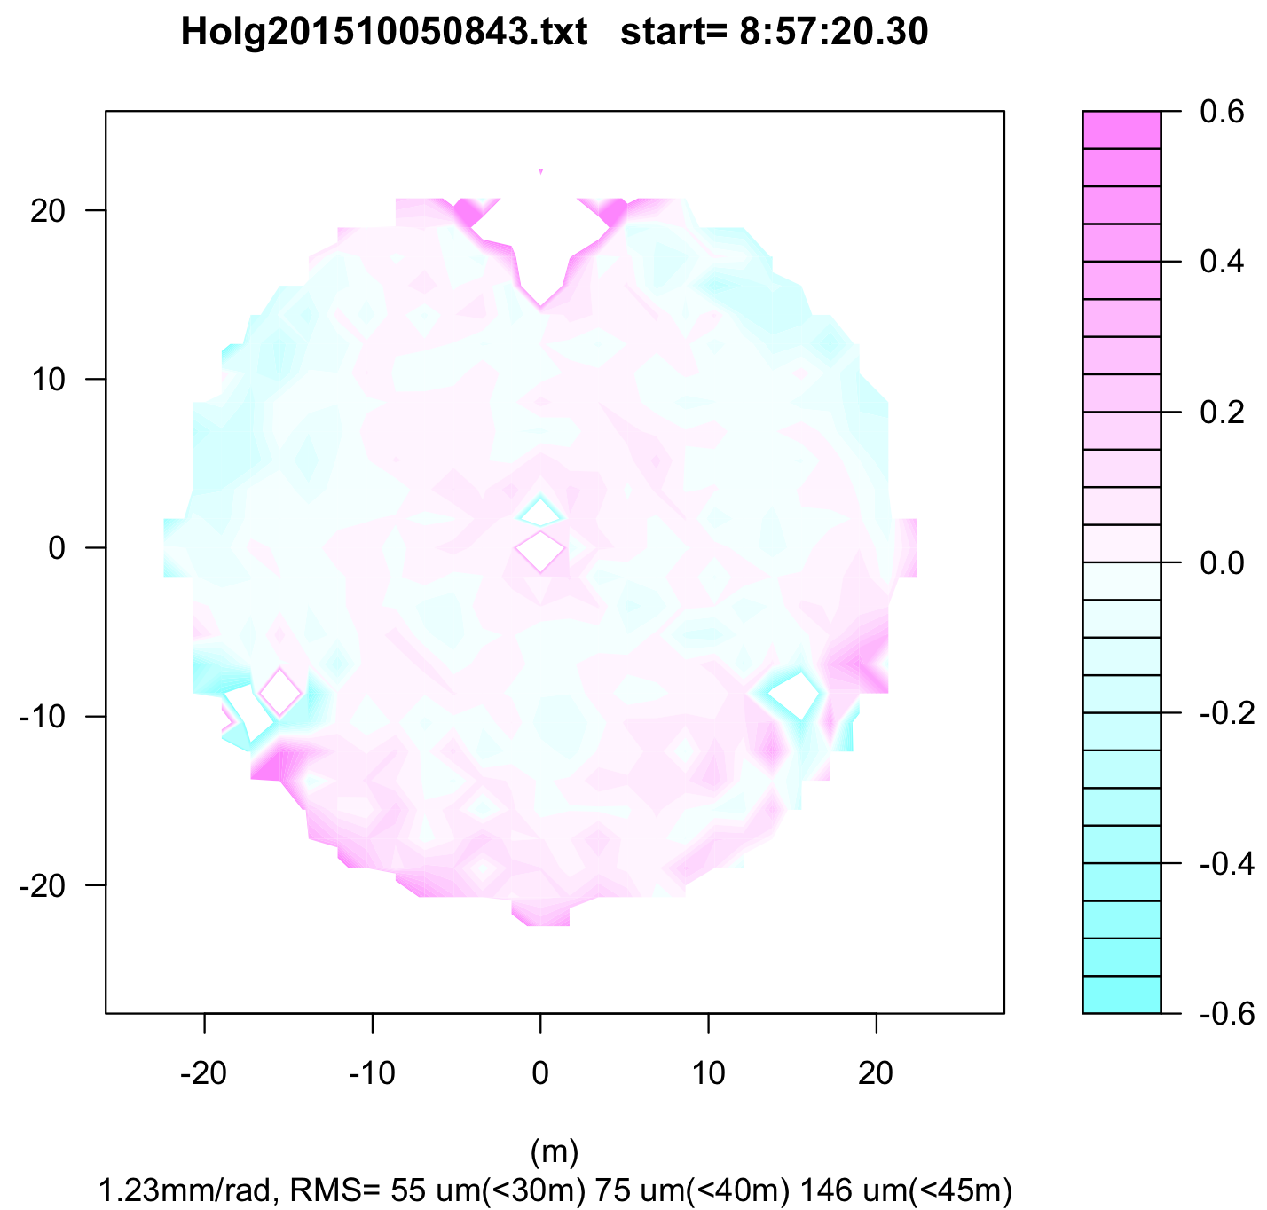
Surface Adjustment
Before (2015-06-08)
After (2015-10-05)
K band Rx at 19.45 GHz using satellite beacon
Include M1, M2, and beam waveguide optics
180 μm rms → 100 μm rms (nominal)
η_{A} :0.25 -> 0.35 at 110 GHz

Slide 11
These two mirrors were degraded.

Slide 12
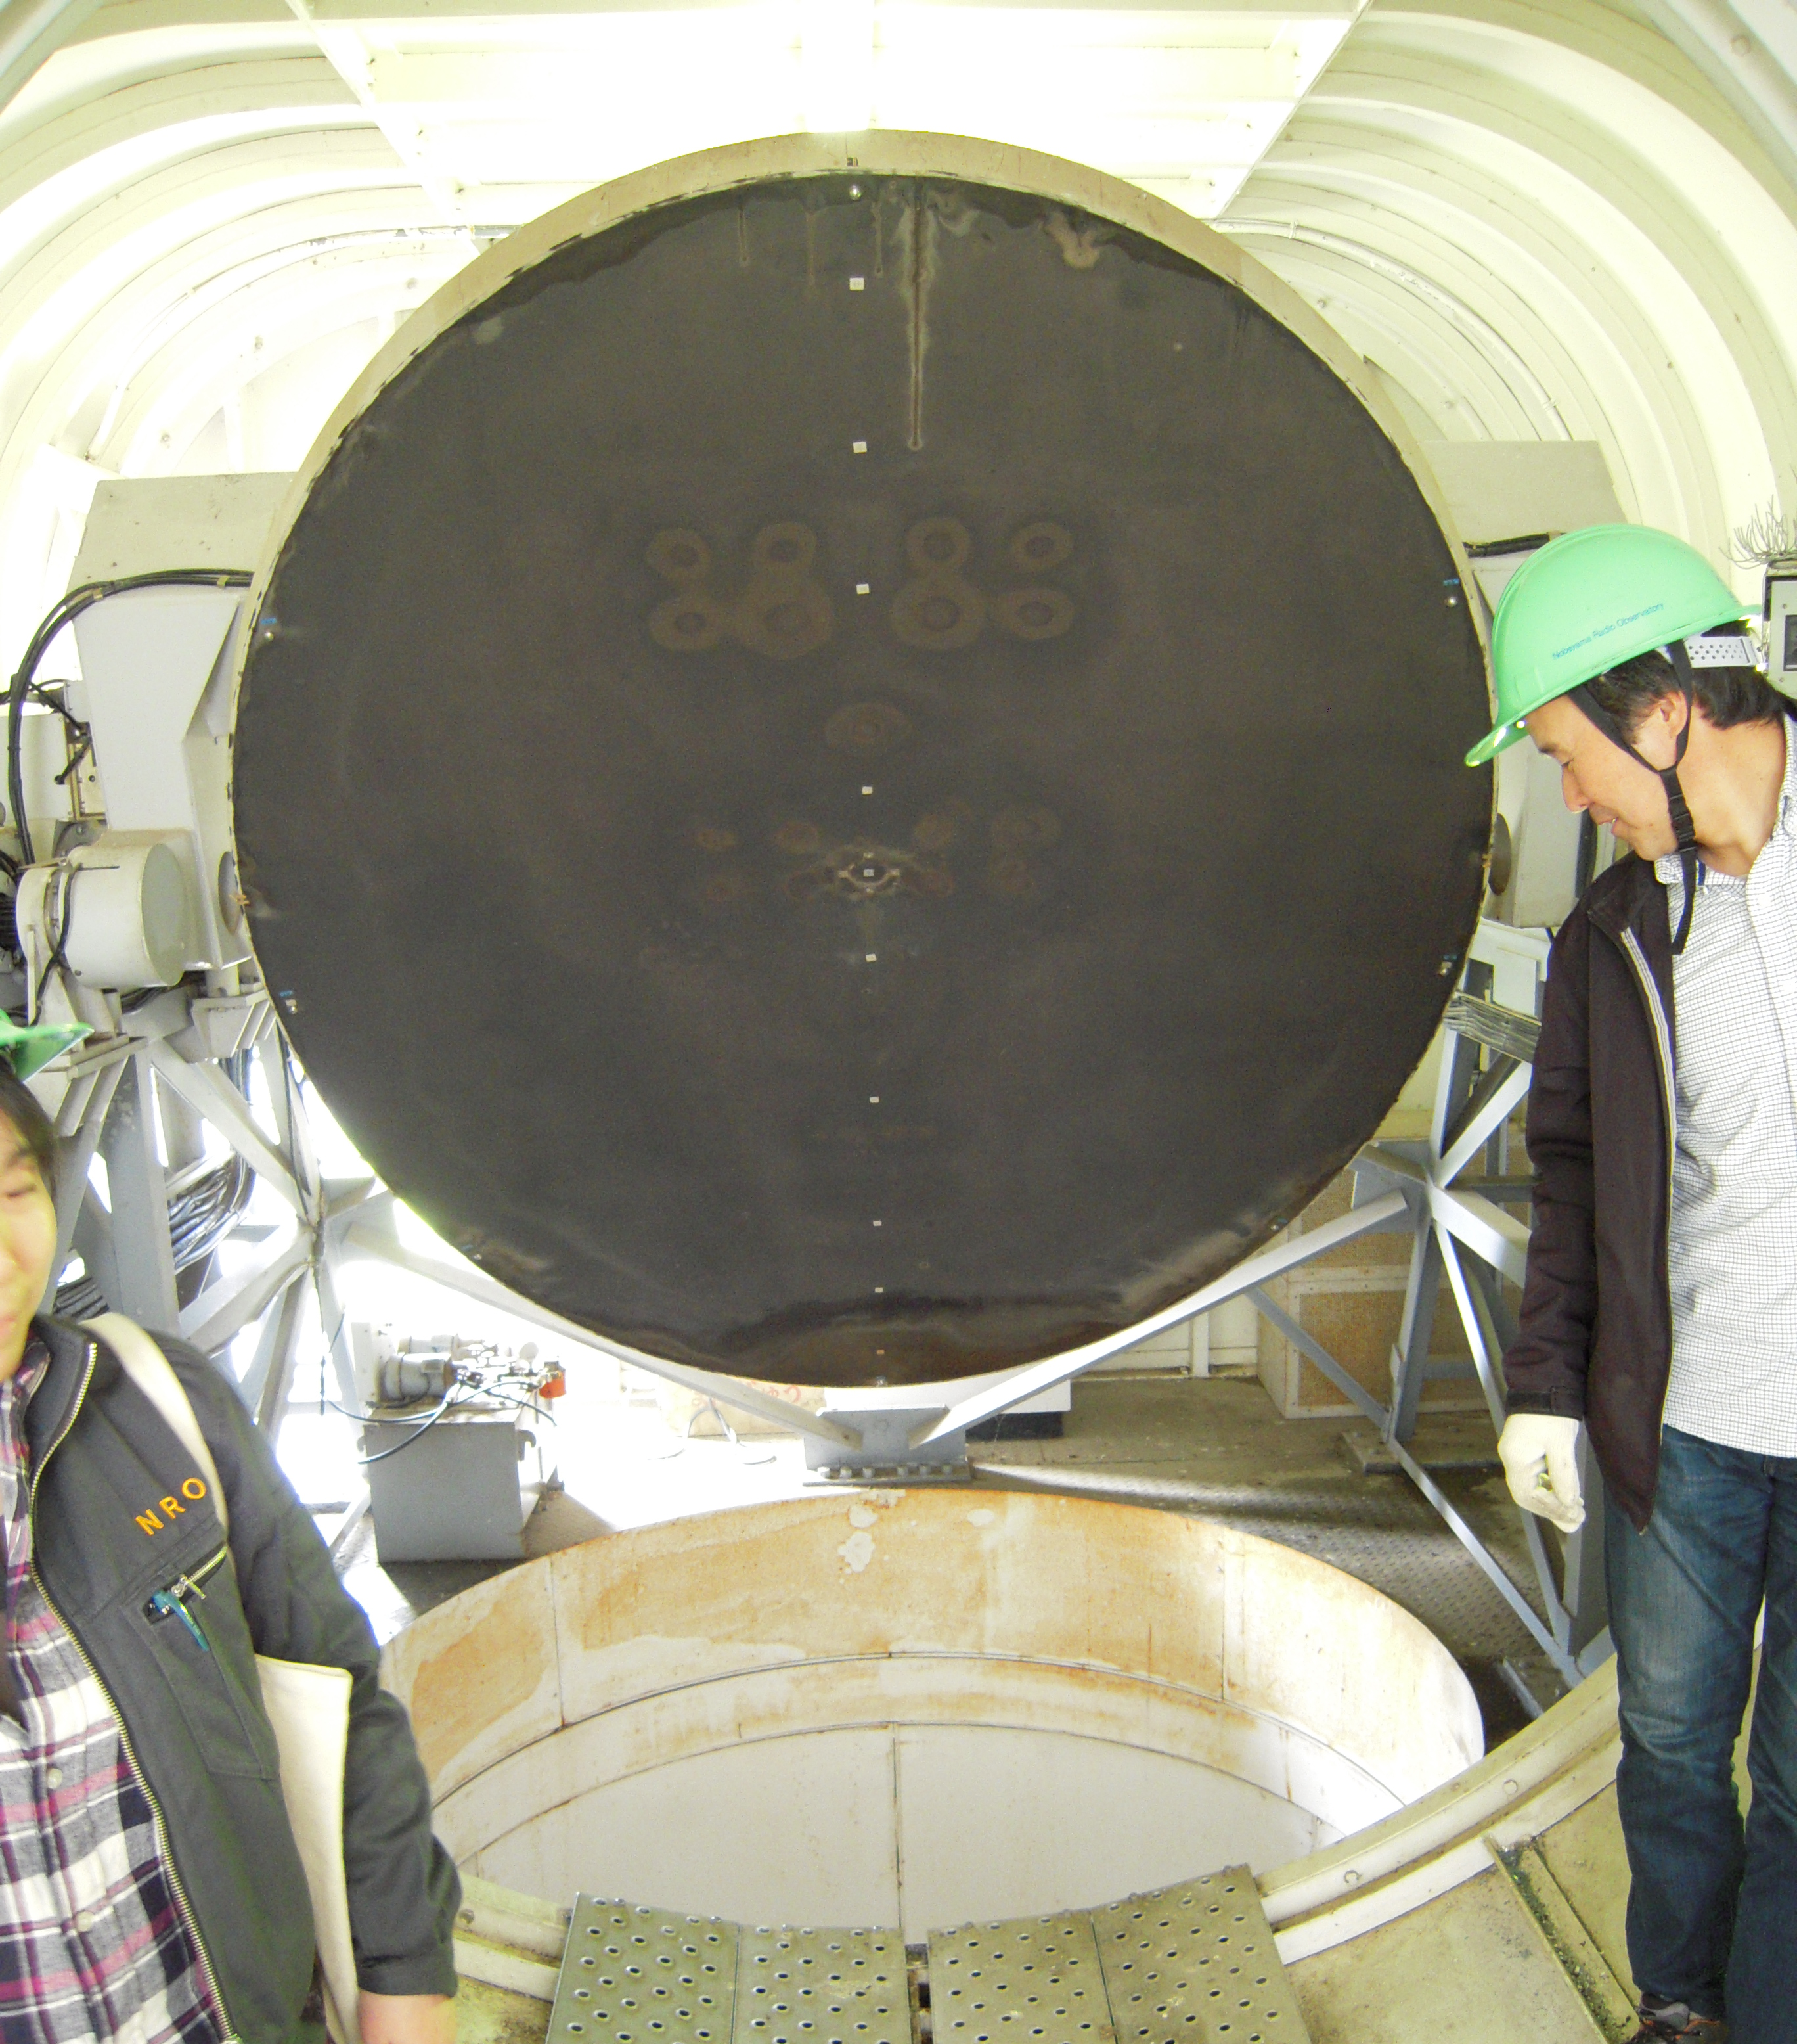
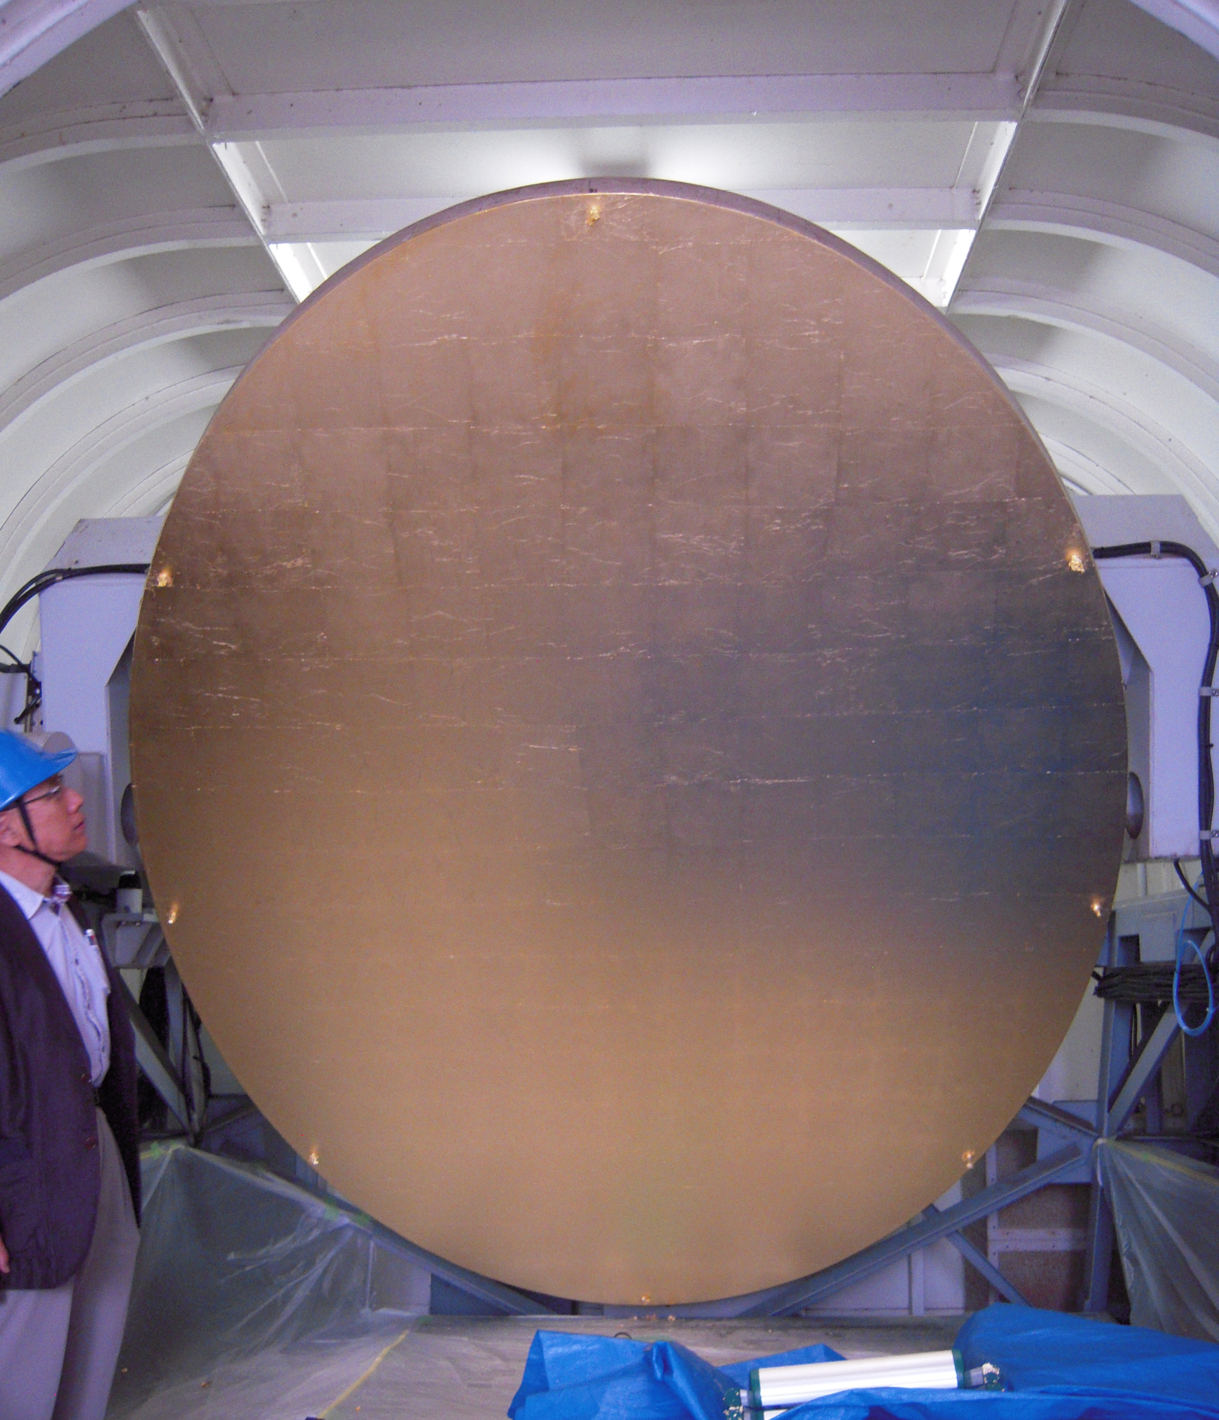
Put (Stick) metal foils to M2 and M3
Put (Stick) metal foils to M2 and M3 (3 um thick)
Tsys is reduced by ~ 11K @ 3mm
Notes:
Surface adjustment: ➔ 40% improve (1.4)
Optics: 10K / 200K ➔ 10% improve (1.1)

Slide 13
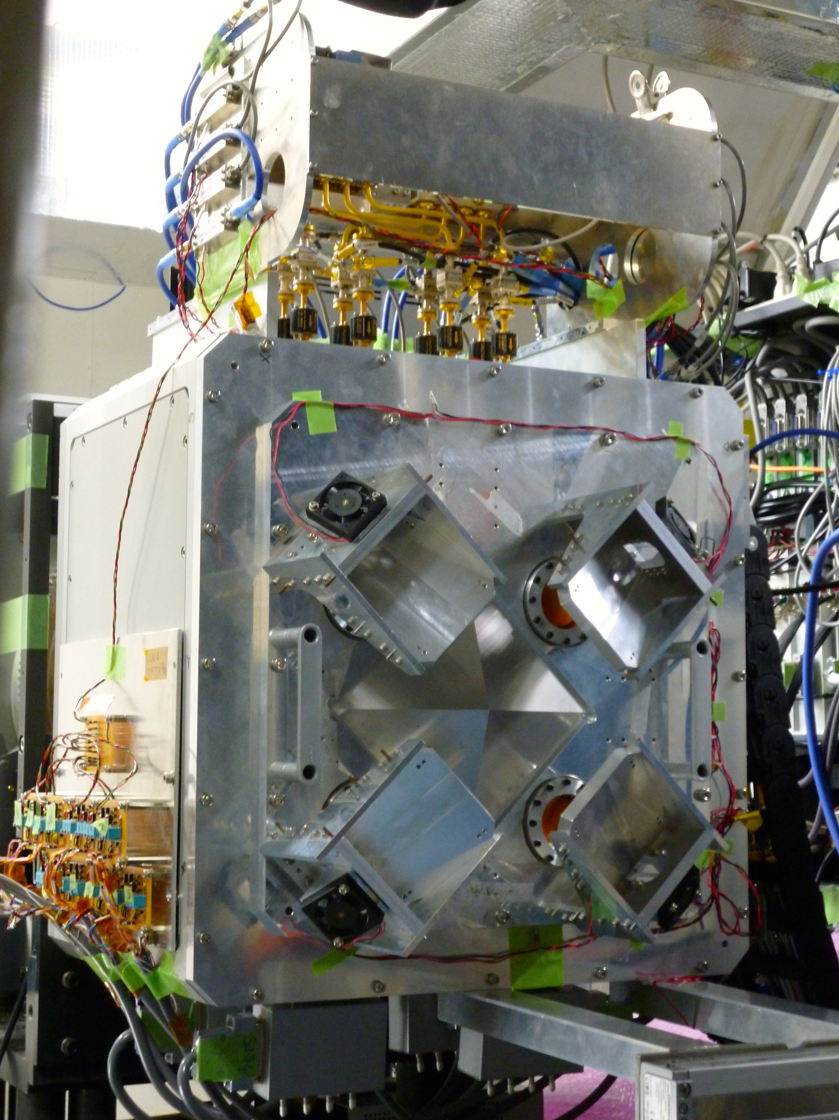
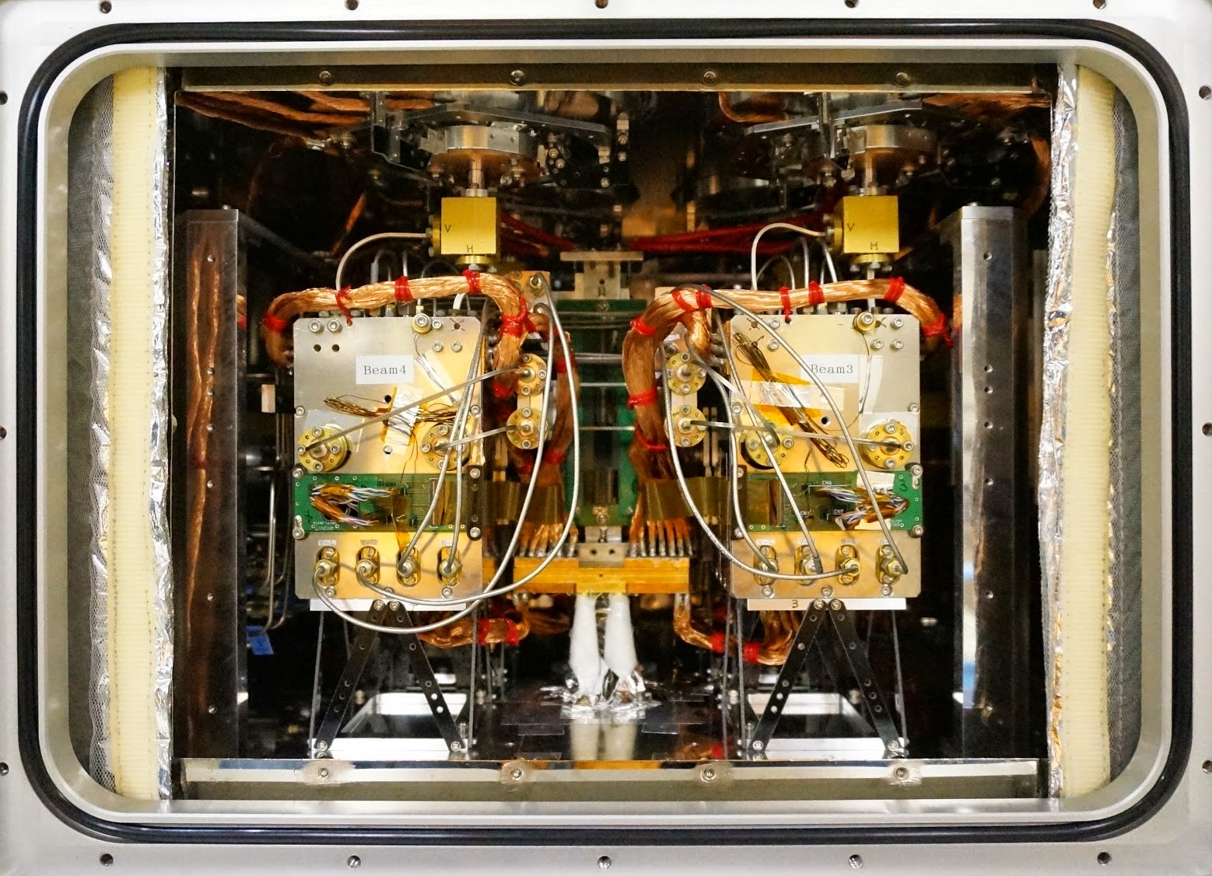
“FOREST” FOur beam REceiver System on 45-m Telescope
4-beam x 2-pol.(H/V) x 2-sideband = 16 IFs
Beam separation ~ 50”
Beam size ~ 14” @ 115GHz
IF: 4-12 (4-11) GHz ➔ simultaneous ¹²CO, ¹³CO, C¹⁸O observation
Dewar rotation system to track same sky position
(Minamidani +16 Proc. SPIE)
Notes:
“FOREST” comes from
It is 4-beam, 2-pol., 2-sideband receiver.
Separation between beams is 50” at sky
Beam size is 15” @ 115GHz
IF frequency is 4-12GHz realizing simultaneous 12CO, 13CO, C18O observations
Dewar rotation system is implemented in order to track same sky position.

Slide 14
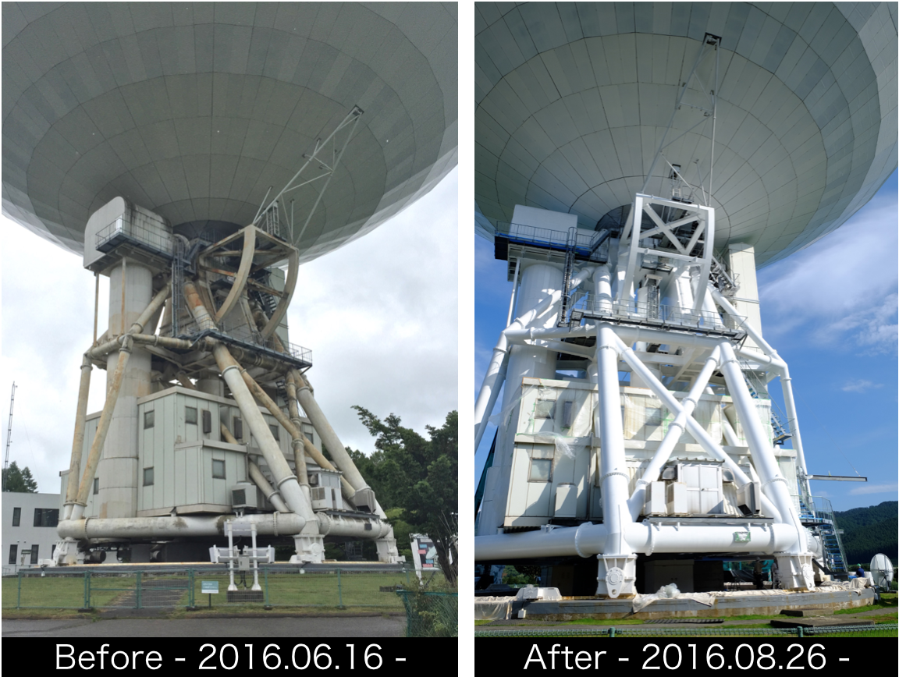
Paintings
Different thermal behavior?

Slide 15
Issues
Large surface errors: 180 μm (η_{A,110 GHz} :0.25)
Improved to be 100 μm (η_{A,110 GHz} :0.35)
High antenna noise temperature: 30 K
Reduced to be 19 K (w/o atmosphere)
Single pixel Rx only at 3 mm
Expanded to be 4 pixels
Rust on mount structure
Painting of mount structure
Overall a factor of 10 improvement in 3 mm mapping

Slide 16
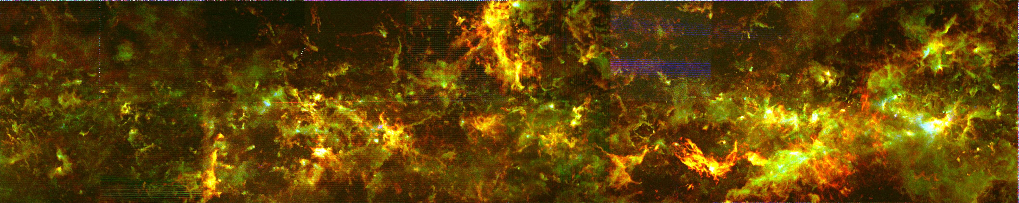
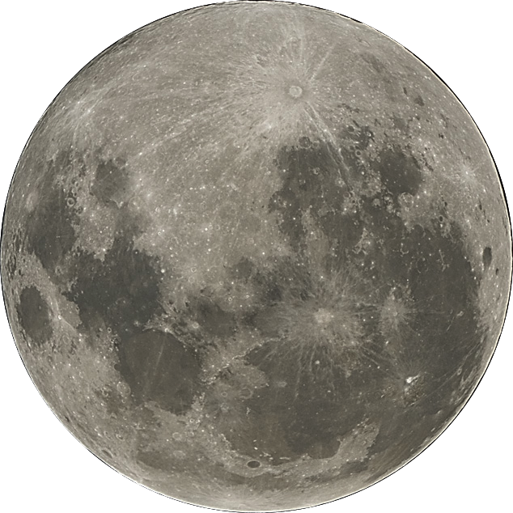
Galactic Plane Survey
1°
b
0°
-1°
20°
19°
18°
17°
Umemoto et al.
l
Notes:
これがこれまで電波写真 視力0.1
（マダムの裸眼の視力？）
それでは、昨シーズンの試験的科学観測の結果の一部を「特別に」紹介します。
プロには見せてありますが一般の方には今夜が初めてなんですよ
これが一酸化炭素分子の３種類の電波に色をわけたカラーの電波強度図です！
お断りしておきますが本当の色ではありませんので。
おお、すごい、まさに写真！
これまでに取得した48平方度（満月192個分）にわたる観測データから、複雑に絡み合った多数の“ひも状構造”が新たに発見されるなど、天の川銀河の中で星の材料がどのような形でどのように分布しているのか、鮮明に描き出されました。
これはまさしく高解像度観測のおかげですね。
ところで、アルマはどれくらいの広さを観測しているの？
確かにアルマは凄い成果が出ていますね。でもALMAはこのほんの数ピクセル
45mもすごい！満月４個分。空をみあげて自分の目でわかる！
わかる！！
今後２年間をかけて、最終的には156平方度、満月６２４個ぶん、総点数３０メガピクセルの世界最大の電波写真を完成させます。
今後の成果に乞うご期待。

Slide 17
Performance and Previous Metrology System
Ukita, N. 1999, Publ. Natl. Astron. dbs. Japan Vol. 5. 139 147
Kuno+ 2006, NRO Users Meeting

Slide 18

Pointing error equations

Slide 19
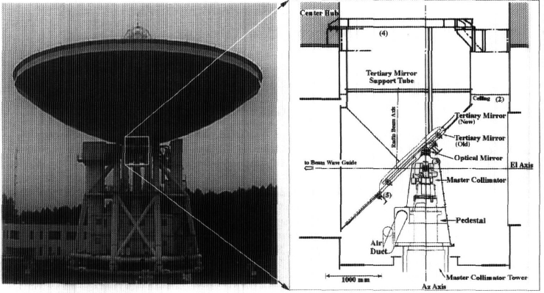
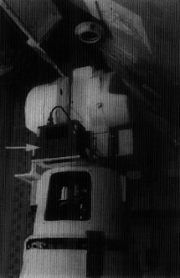
Thermal Deformation
Ukita 1999

Slide 20
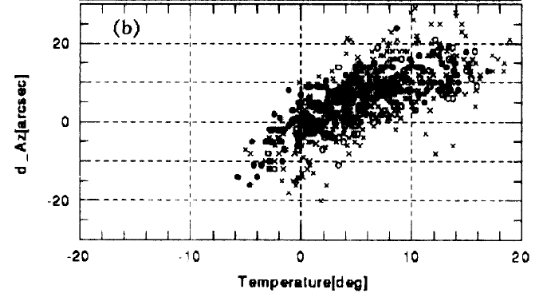
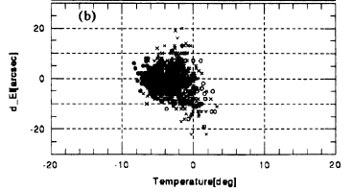
Thermal behavior
Ukita 1999
dAz
dEl
-10
0
10
20
-10
0
10
Temperature [deg]
Temperature [deg]
Observed pointing offsets in azimuth against the temperature at the bottom of the tertiary mirror support tube (Ts)

Slide 21
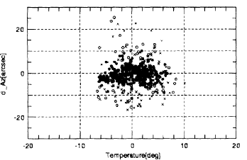
Thermal Metrology
Before and After thermal metrology implemented
Ukita 1999
Left) Before, Right) After
But, …

Slide 22
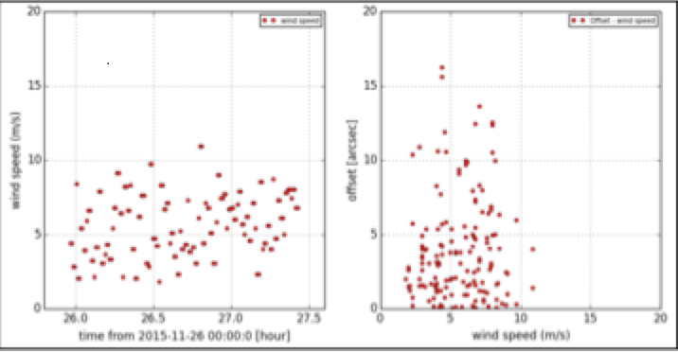
Pointing under Wind
Homology design – susceptible to wind e.g. pointing offset 0-15” under > 10 m/s wind
10
Pointing error [“]
10
Wind [m/s]
0
0
Time
Wind [m/s]

Slide 23
Wind metrology
OPT+CCD/LED sensor experiment
OPT at center hub and LED at dish edge
Four directions
0.1 sec sampling
100 um or better accuracy

Slide 24
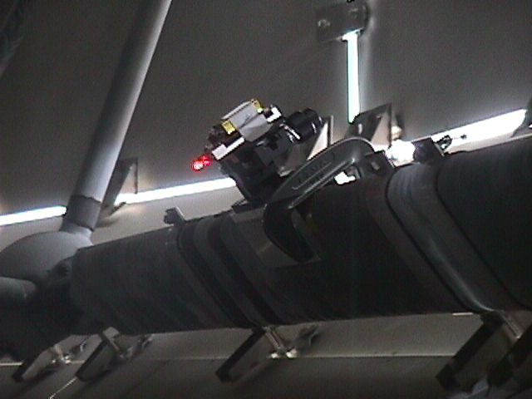
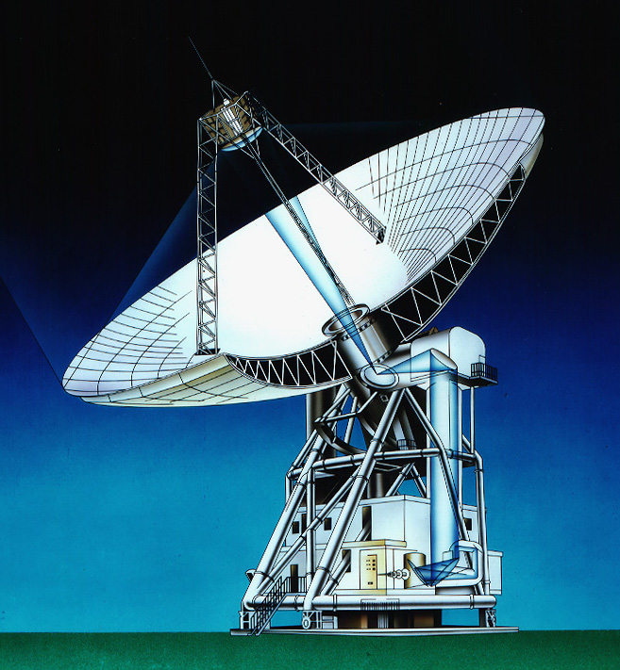
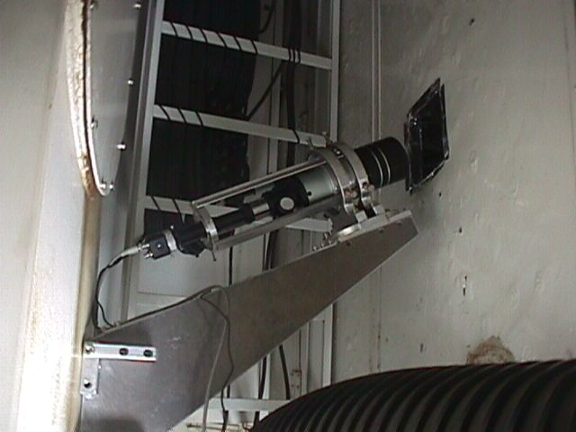
LED
Measurement Setup
Kuno 2006
OPT+CCD

Slide 25
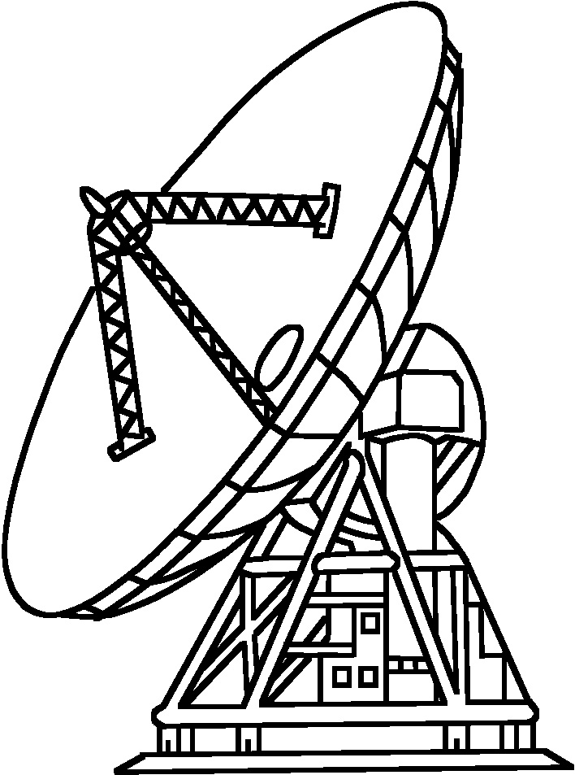
X
Y
Left
Y
X
Bottom

Slide 26
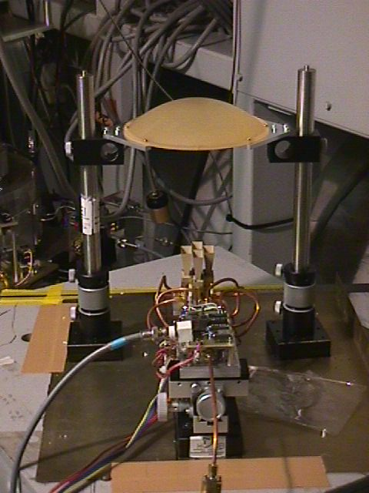
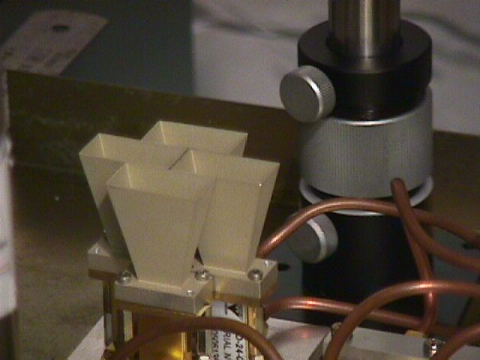
Four beam pointing monitor Rx
N-STAR（19.45GHz）
Kuno 2006

Slide 27
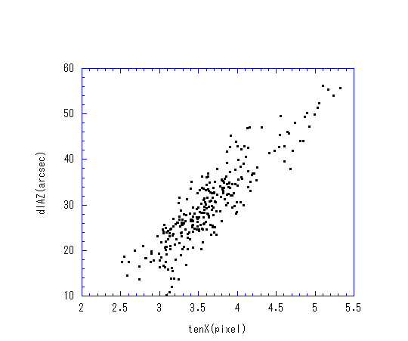
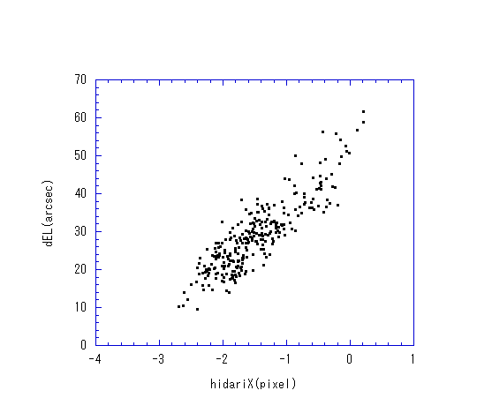
Pointing error and dish movement Azimuth/Elevation
Kuno 2006
左Y ｖｓ ｄAZ
天X ｖｓ ｄAZ
20”
20”
dEl [arcsec]
Top X [Pixel]
Left X [Pixel]

Slide 28
Beam patter @23GHz＞10m/s
Kuno 2006
Before
After offline correction

Slide 29
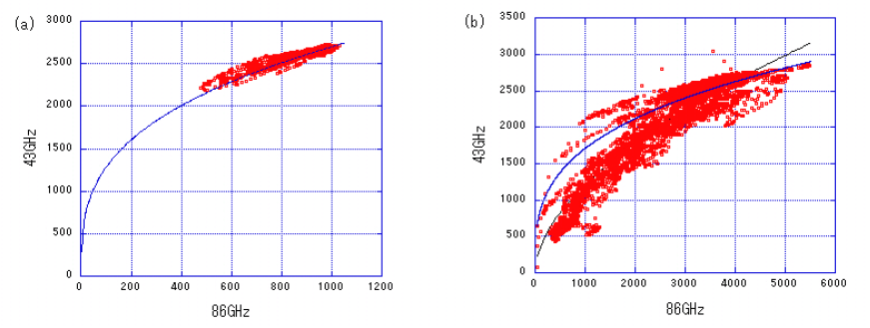
Beam deformation
5 m/s
15 m/s
Kuno 2006
Correlation between the intensities of Venus measured at 43 GHz and 86 GHz simultaneously. The unit of the intensity is arbitrary. (a) MWS = 5 m/s. The blue curve shows a model which assumes the beam sizes of 18.2” at 86 GHz and 38.4” at 43 GHz. (b) MWS = 15 m/s

Slide 30
Future Metrology System

Slide 31
Thermal Metrology
Re measure the correlation (update current thermal metrology)
Temperature distribution and pointing errors (after painting)
Solar irradiation effect
Simultaneous Inclinometer measurement

Slide 32
Wind Metrology
Update the previous wind metrology system
Set more stable LED mount structure
Enclosure around LET to avoid unwanted sunlight
Simplify pointing telescopes
Jupiter or Venus observations with FOREST yields accurate pointing errors in both Az/El.

Slide 33
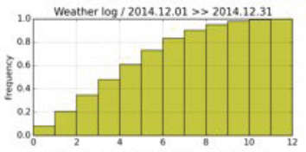
Metrology goal
Push wind limit further from 3 to 5 m/s by meterology
Goal
Very good
Current
Very good

Slide 34
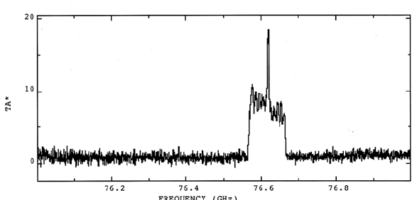
New Discovery?
TA* ~ 18 K
Automobile Radar at 76 GHz
Now 76-81 GHz is allocated for automotive radars
TA*

Slide 35

More to come in WRC-19
Higher and higher
IMT, Satellite, Automotive radar
> 275 GHz application also on the table
Nobeyama Observing Frequency Range
Automotive radar
(allocated already)
Satellite Systems

Slide 36
Summary
Nobeyama 45-m telescope (34 yrs old)
One of the largest single dish antennas operated at 20-116 GHz.
Pointing behavior
Thermal effect
Wind effect
Current thermal metrology system
Experimental wind metrology system (on hold)
Future metrology system under discussion

Slide 37
And more learnt in this WS
OOF (gravitational/thermal effect)
Subref position monitor

