Slide 1
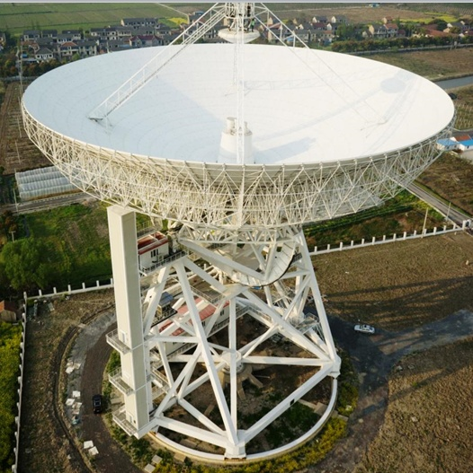


Report on TianMa Telescope
(Shanghai 65m radio telescope)
Shanghai
Astronomical
Observatory
Liu Qinghui
Tianma telescope team

Slide 2
TianMa Telescope Team
No. | Name | Job
1 | Shen zhiqiang | scientist/ team leader
2 | Liu qinghui | technique
3 | Li bin | receiver
4 | Wang junzhi | scientist
5 | Yan zhen | scientist
6 | LI juan | scientist
7 | Fan qingyuan | telescope
8 | Ling quanbao | mechanical
9 | Wang jinqing | telescope
10 | Zhao rongbing | software
11 | Fu li | mechanical
12 | Zhong weiye | receiver
13 | Wang lingling | Time/freq.
14 | Dong jian | software
No. | Name | Job
15 | Wu yajun | terminal
16 | Xia bo | observation
17 | Jiang yongbin | observation
18 | Yu linfeng | observation
19 | Gou wei | observation
20 | Zuo xiuting | observation
21 | Jiang yongchen | observation
22 | Sun yunxia | observation
23 | Chen ying | observation
24 | Guo wen | observation
25 | Lu xuejiang | observation
26 | Chen qiang | observation
27 | Shao jie | observation
28 | He wenting | secretary
29 | Wu fang | secretary

Slide 3
Content
1. Construction and test
2. Radio astronomical observation
3. Applications in deep spacecraft

Slide 4
Brief introduction
Tianma Telescope is a steerable radio telescope with a diameter of 65 m, built during 2009-2013. Tianma Telescope greatly improves the measurement capabilities of Chinese VLBI network and plays an important role in deep space exploration and astronomy researches.

Slide 5
Preliminary results of Tianma telescope
Tianma telescope has successful tracked Chinese lunar mission ChangE-2 in 2012, Lunar soft landing mission ChangE-3 in 2013, ChangE-5 flight test mission in 2014 for VLBI orbit determination, and has made "outstanding contributions".
Tianma telescope successfully carries out observations for spectra lines, pulsar and VLBI radio astronomy, and opened to the outside world.

Slide 6
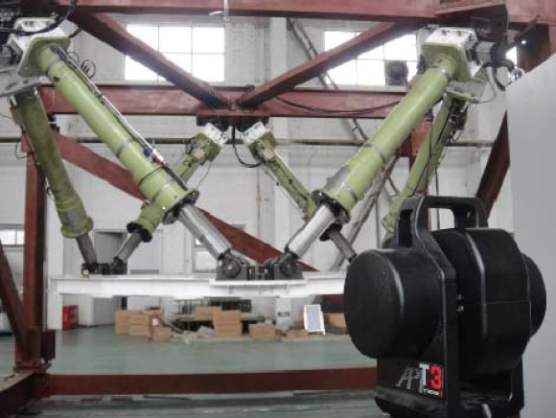
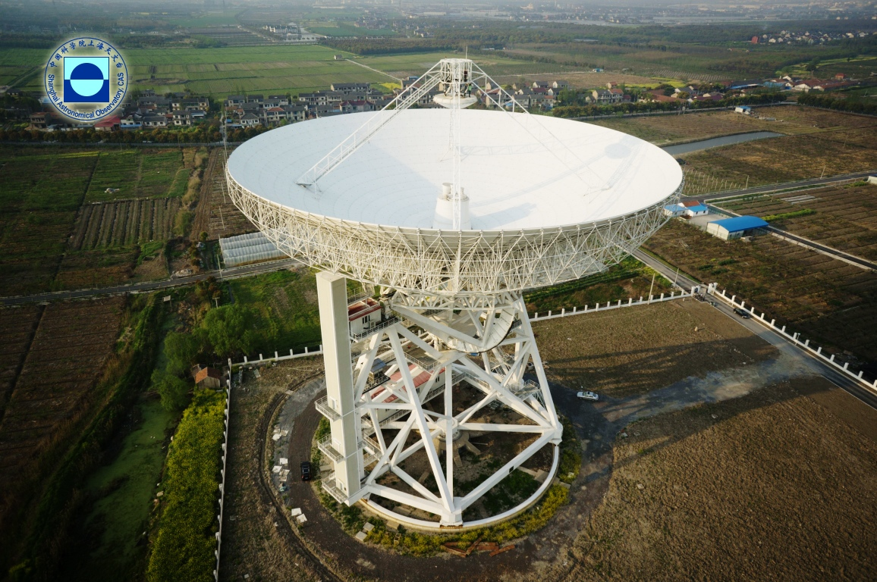
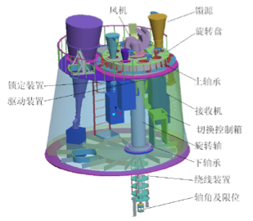
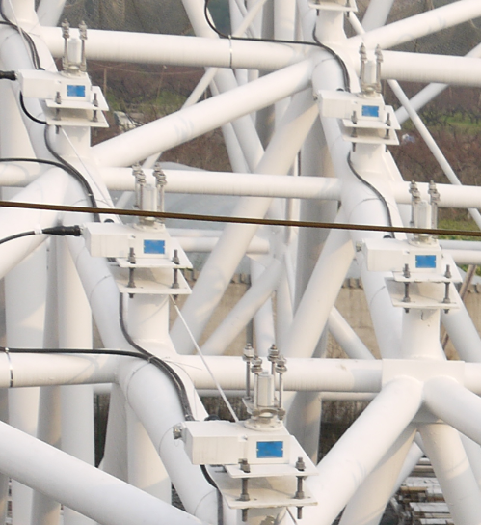
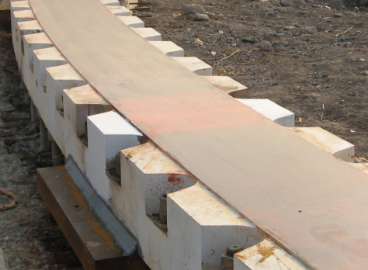
Tianma Telescope major innovative points
Six-link parallel adjustment of sub-reflector
0.05mm
自动换馈
8个波段
Automatic feed-rotating 1min
Seamless welded azimuth track 0.5mm
Active Surface System 0.015mm

Slide 7
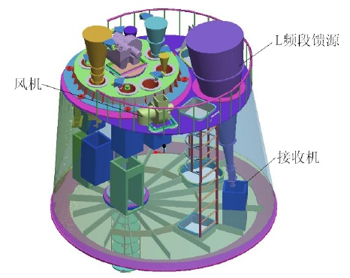
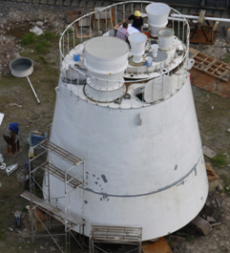
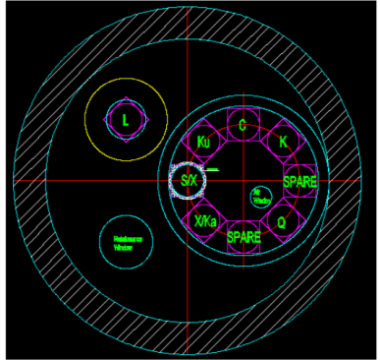
Automatic feed-rotating mechanism
Completing observation band switching
within 1 min

Slide 8
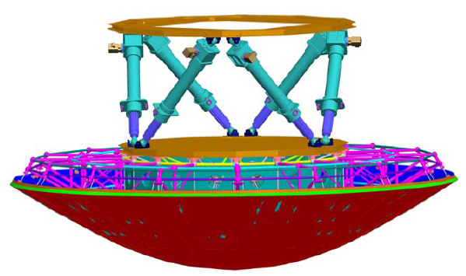
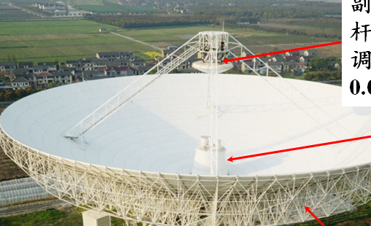
Six-link parallel adjustment of sub-reflector
X、Y、Z
Adjustment amount:
A few centimeters
The left- and right-hand circular polarization efficiency of X band before and after adjustment of sub surface position and orientation.
after adjustment
before adjustment

Slide 9
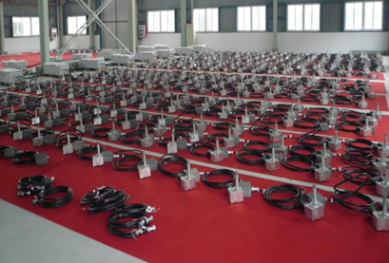
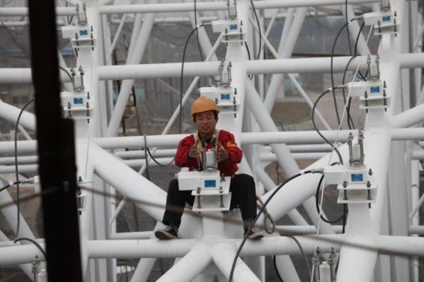
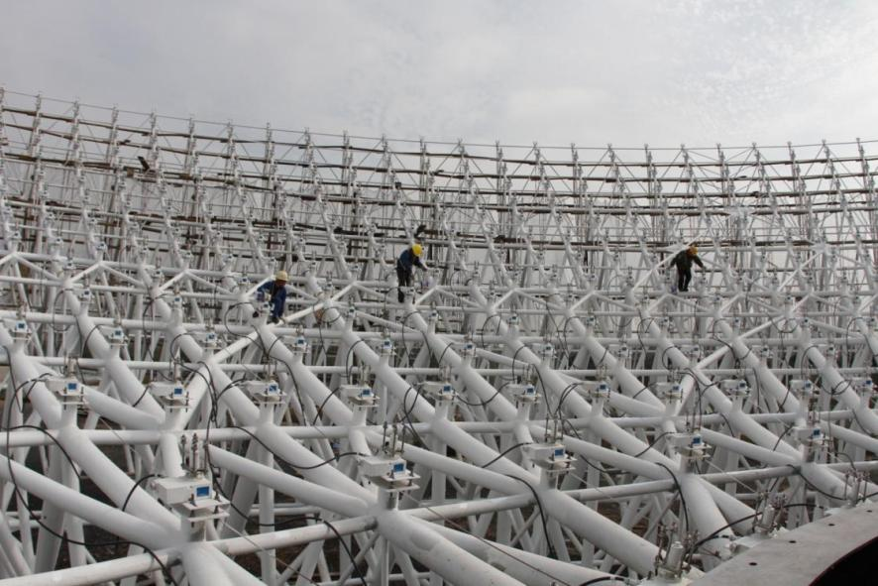
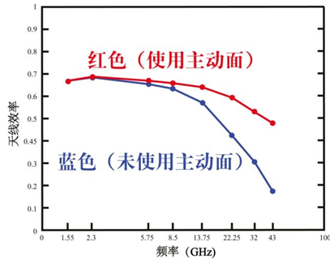
Active surface system
Actuators: 1104
Range±15mm, accuracy 0.015mm
With active surface system
Without

Slide 10
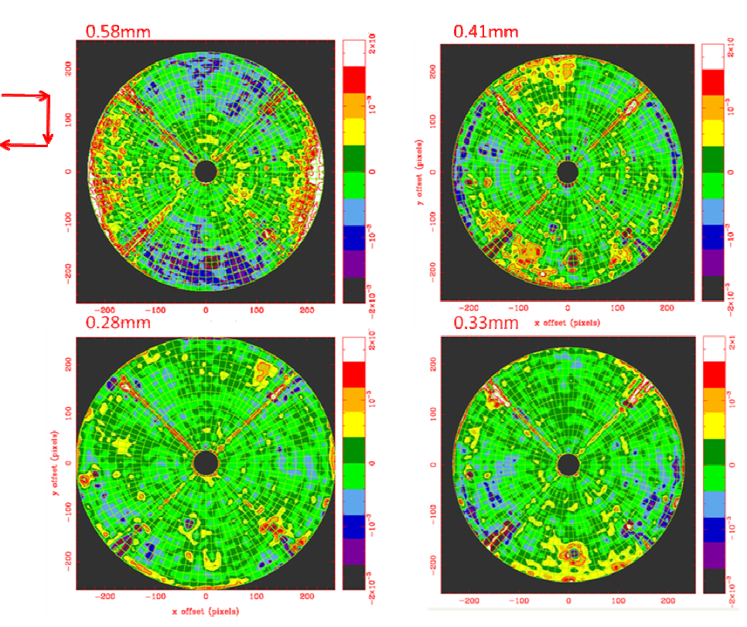
Surface accuracy of main reflector
measured by using holographic technique
Elevation
52deg

Slide 11
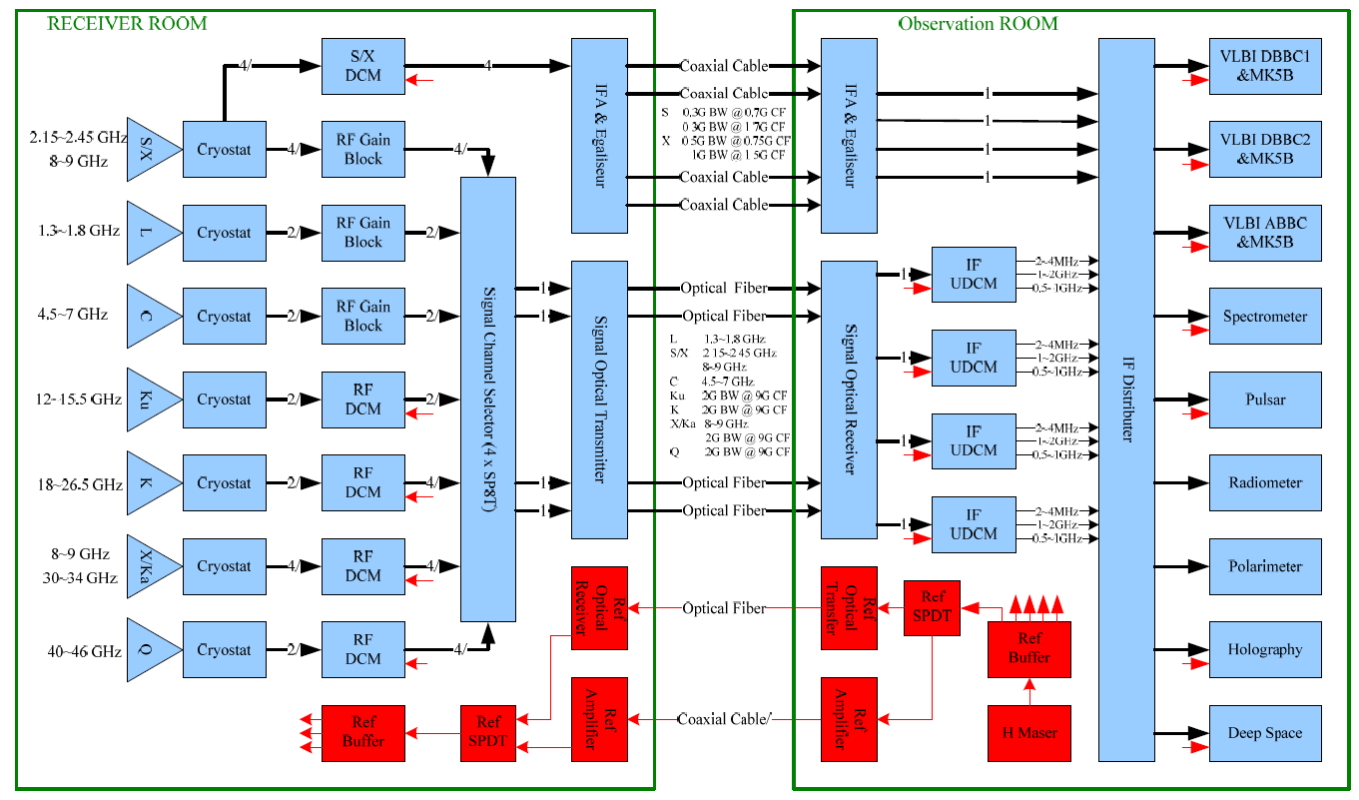
Receiving system of Tianma telescope

Slide 12
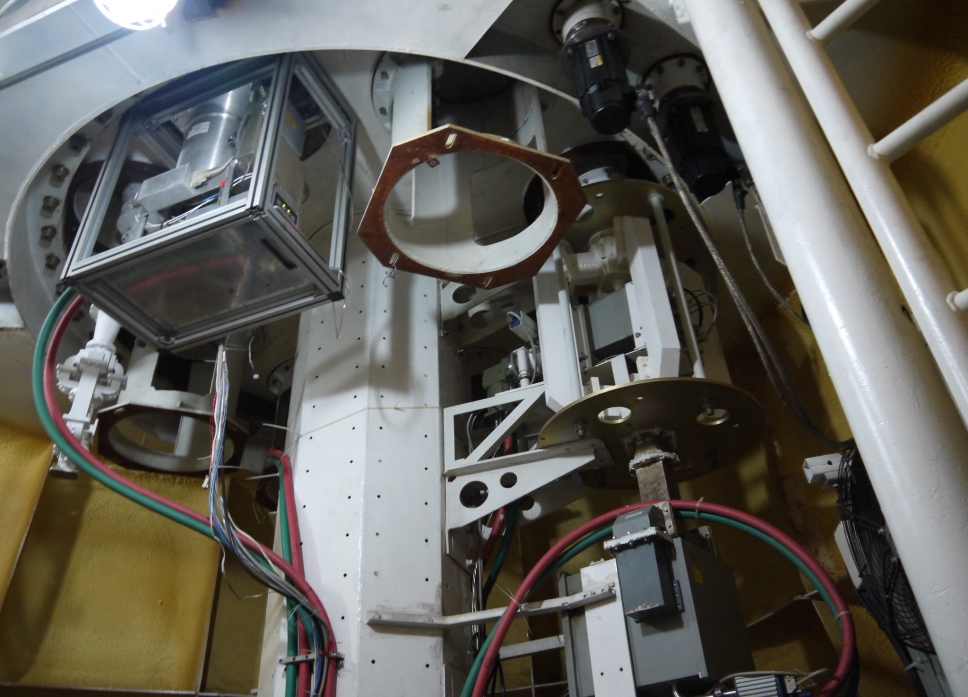
S/X and C-band receivers
C-band（4-8 GHz）
X-band（8.2-9.0 G）
S-band（ 2.2-2.4 G ）

Slide 13
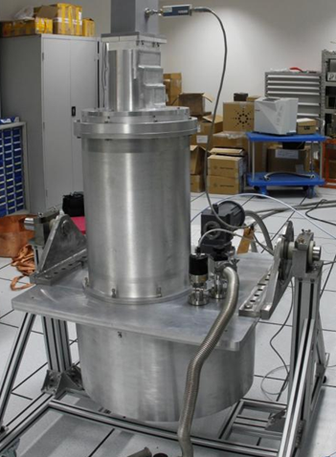
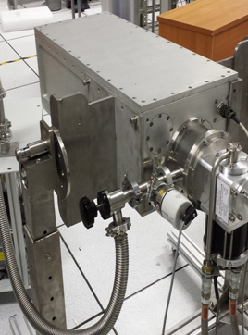
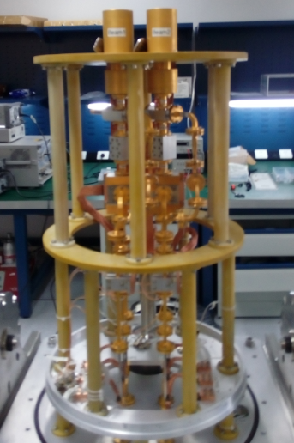
L, K, Q-band receivers developed by SHAO
1.25-1.75 18-26.5 35-50 GHz

Slide 14
Receiving system
Band | L | S | C | X | Ku | K | Ka | Q
Wavelength | 18&21cm | 13cm | 5&6cm | 3.6cm | 2.2cm | 1.3cm | 9mm | 7mm
Freq(GHz) | 1.25-1.75 | 2.2-2.4 | 4-8 | 8.2-9.0 | 12-18 | 18-26.5 | 30-34 | 35-50
BW(GHz) | 0.50 | 0.20 | 4.00 | 0.80 | 6.00 | 8.50 | 4.00 | 15.00
BW/CF(%) | 33 | 9 | 67 | 9 | 40 | 38 | 13 | 35
T(Sky)(k) | 12 | 12 | 10 | 10 | 12 | 25 | 25 | 26
T(Rx)(K) | 10 | 21 | 10 | 22 | 15 | 35 | 35 | 40
T(Sys)(K) | 26 | 33 | 20 | 32 | 27 | 60 | 60 | 66
Feed Type | Compact | Conical | Conical | Conical | Conical | Compact | Conical | Compact
Efficiency | 55% | 60% | 65% | 55% | 55% | 50% | 50% | 45%
Polarization | Dual Circ | Dual Circ | Dual Circ | Dual Circ | Dual Circ | Dual Circ | Dual Circ | Dual Circ
Refrigerator | 1020 | 1020 | 350 | 1020 | 350 | 408S2 | 408S2 | 1020
Status | Installed | Installed | Installed | Installed | Installed | Installed | Installed | Installed

Slide 15
Comparison TMRT with other telescopes
 |  | GBT | Effelsberg | Parkes | Lovell | Tianma
L | Freq | 1.15-1.73 | 1.27-1.45, 1.59-1.73 | 1.2-1.8 | 1.25-1.50, 1.55-1.73 | 1.25-1.75
 | SEFD | 10 | 20,19 | 31 | 36,65 | 31
S | Freq | 1.73-2.6 | 2.20-2.30 | 2.2-2.5 | ----- | 2.2-2.4
 | SEFD | 12 | 300 | 25 | ----- | ≥31
C | Freq | 3.95-5.85 | 5.75-6.75 | 4.5-5.1 | 6.0-7.0 | 4.0-8.0
 | SEFD | 10 | 25 | 61 | 80 | 28
X | Freq | 8.00-10.1 | 7.9-9.0 | 8,1-8.7 | ----- | 8.2-9.0
 | SEFD | 15 | 18 | 170 | ----- | ≥38
Note: System Equivalent Flux Density (SEFD):

Slide 16
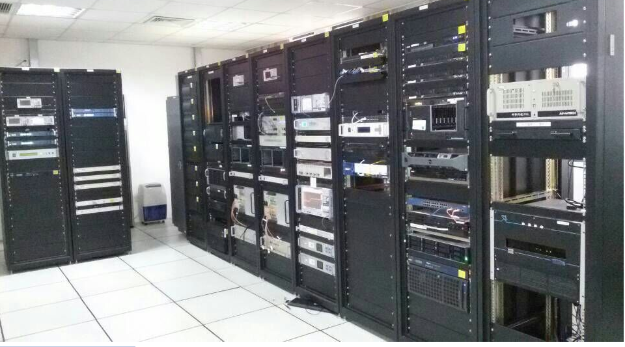
Terminals
spectra/
pulsar
PC
VLBI
IF
Time/
freq.
DBBC

Slide 17
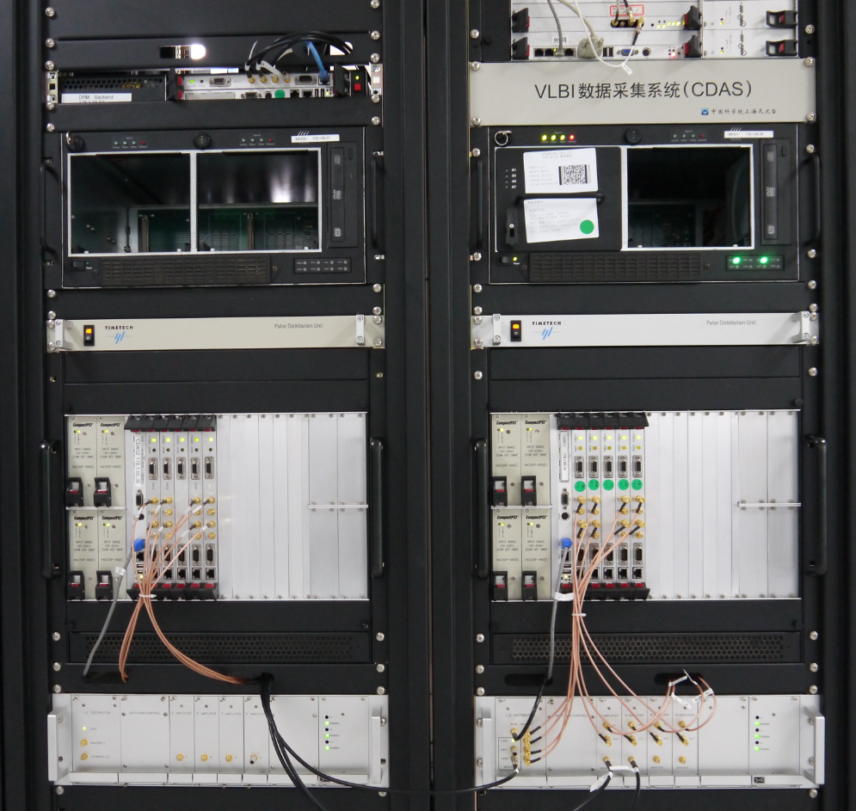
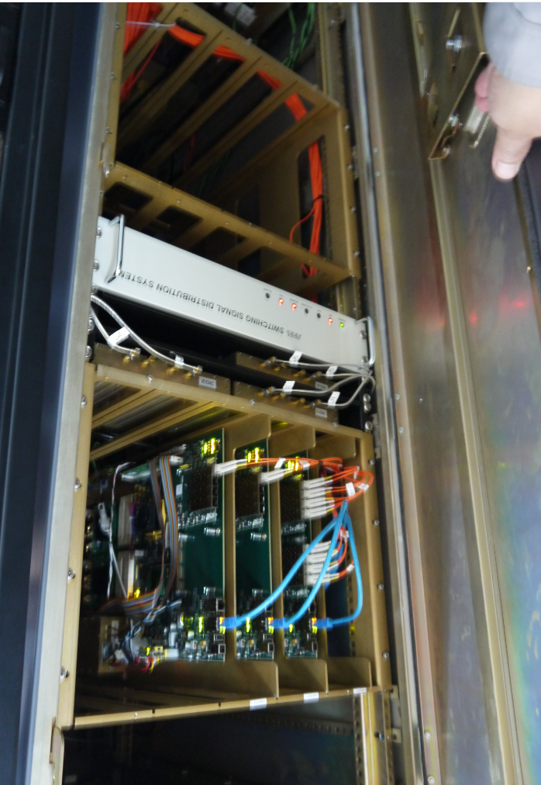
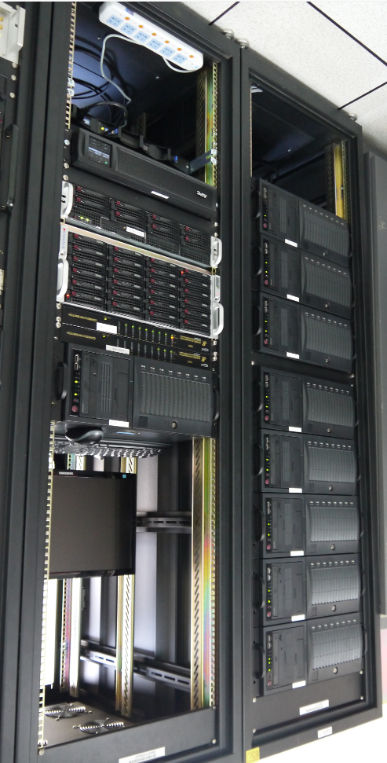
Terminals
VLBI（CDAS,DBBC）
Spectra line/pulsar（DIBAS）

Slide 18
Content
1. Construction and test
2. Radio astronomical observation
3. Applications in deep spacecraft

Slide 19
EVN and IVS VLBI observations
Tianma telescope has taken part in EVN VLBI observations at L , C and S/X band since 2015, and sometime was selected as the reference telescope in data processing.
Tianma telescope also took part in EVN e-VLBI observations with a data transfer rate of 1 Gbps.
Tianma telescope took part in IVS conventional observations for 5 times in 2015, and planning for 7 times in 2016.
coordinate | position (mm) | Position error (mm) | velocity (mm/yr) | Velocity error (mm/yr)
X | -2826708649.89 | 7.305 | -31.42 | 5.600
Y | 4679237081.85 | 11.773 | -17.47 | 7.517
Z | 3274667547.20 | 8.408 | -16.80 | 6.114

Slide 20
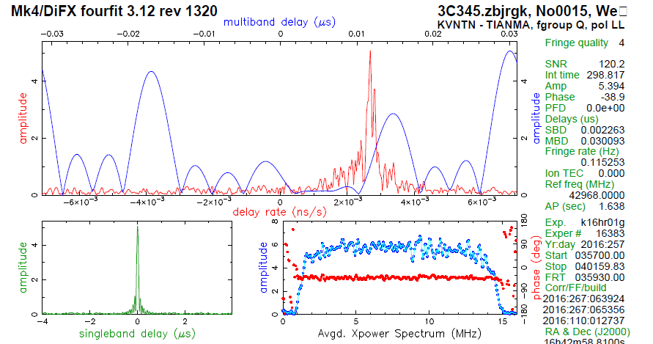
East Asia VLBI observations
Tianma telescope successfully participates in VLBI observations with Korea 3 stations and Japan 4 stations at 43 GHz.These results show that Tianma telescope has VLBI observation ability at Q-band.

Slide 21
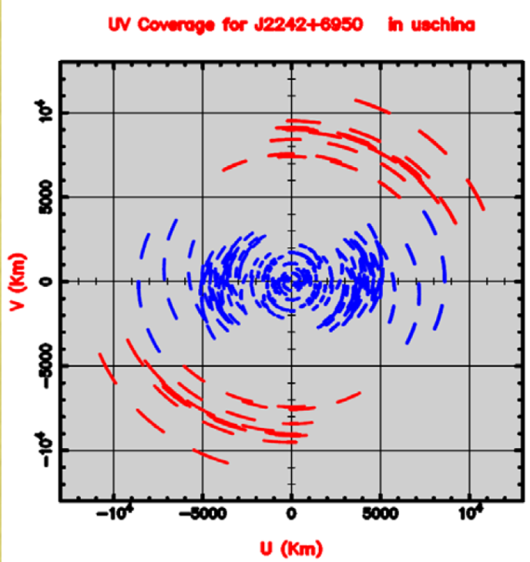
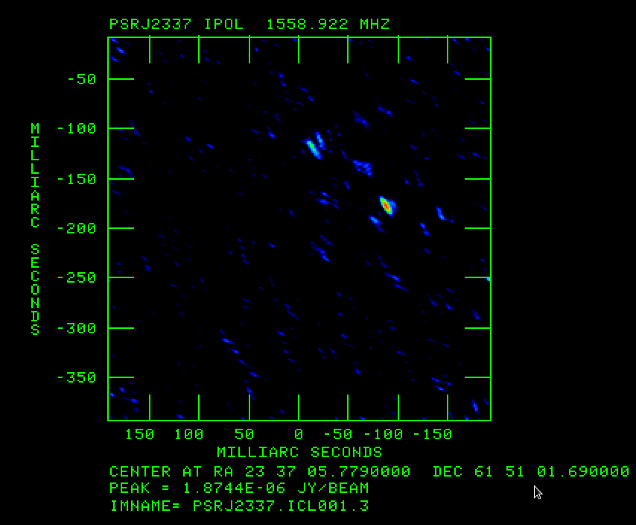
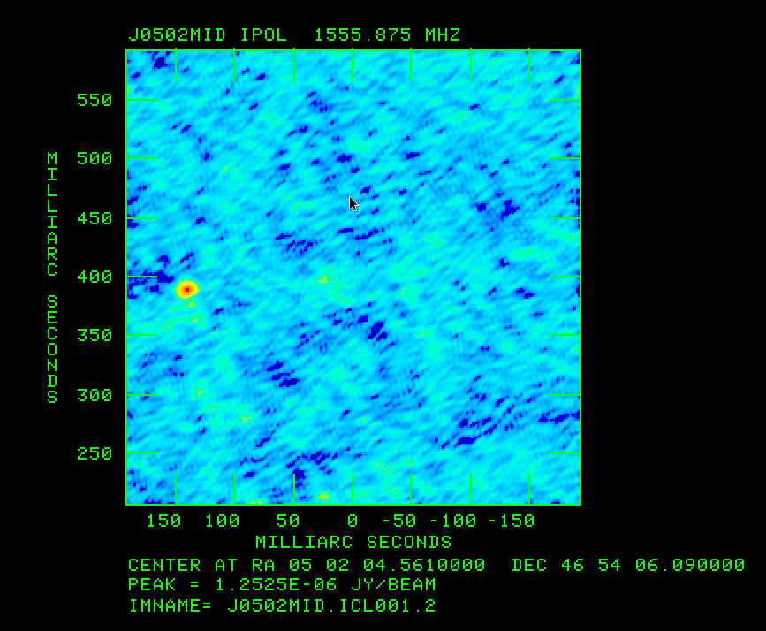
Tianma-VLBA VLBI observation
Mapping results for pulsar B2334 + 61 and B0458 + 46. The measuring accuracy was improved by about three times.

Slide 22
Tianma pulsar observation
The DIBAS pulsar observation modules were finished and installed at Tianma telescope in June 2014. This backend supports four principal pulsar observation modes:
[1] coherent dedispersion search;
[2] incoherent dedispersion search;
[3] coherent online folding;
[4] incoherent dedispersion online folding.

Slide 23
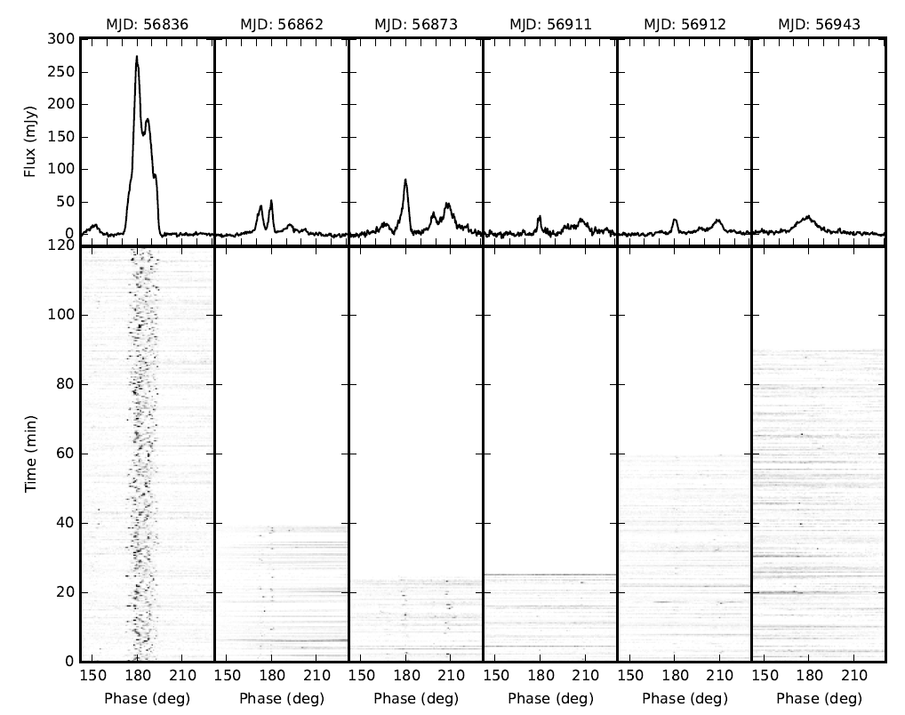
Pulsar observation
A batch of pulsars have been detected at L、S、C and X band, including the pulsar with the shortest rotational period on the northern sky and the magmetar around the Galactic center. One case of strong radio flare of the magmetar PSR J1745-2900 was detected by the TMRT at X-band.
Integrated profiles and phase–time plots of magnetar J1745–2900

Slide 24
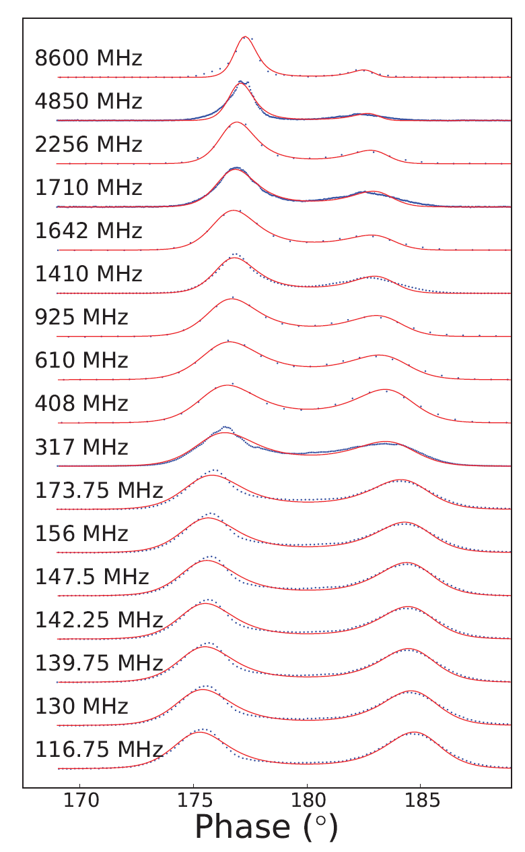
The pulsar PSR B1133 + 16 multi-frequency integral profiles. The highest frequency (8600 MHz) results were obtained by using Tianma telescope.
Pulsar observation
Tianma

Slide 25
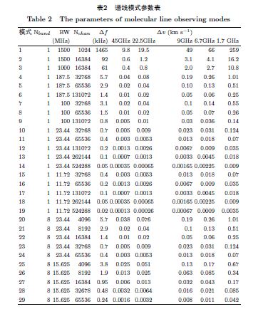
DIBAS spectra line observation model
Total support 29 observation model
The highest resolution is 20 Hz
The maximum bandwidth is 1.5 GHz

Slide 26
Detection of long carbon-chain molecules in Serpens South with TMRT (Li et al. 2016, ApJ, 824, 136)
HC₇N
HC₉N
Friensen et al. 2013
C₆H
C₈H
We detect several long carbon-chain molecules, including HC₅N, HC₇N, HC₉N, C₆H, C₈H, HC₃N and its ¹³C isotopes toward Serpens south 1a with TMRT. We detected some new transitions and resolved some hyperfine components for the first time in the ISM. This is the third molecular cloud detected in HC₉N and C₈H. The column densities of these long carbon-chain molecules are almost comparable to those in TMC-1, and hence, like Lupus-1A, this source could also be regarded as "TMC-1 like cloud".

Slide 27
Tianma Running time (2015.4-2016.6)
Running time (h)
Total single dish VLBI test maintenance

Slide 28
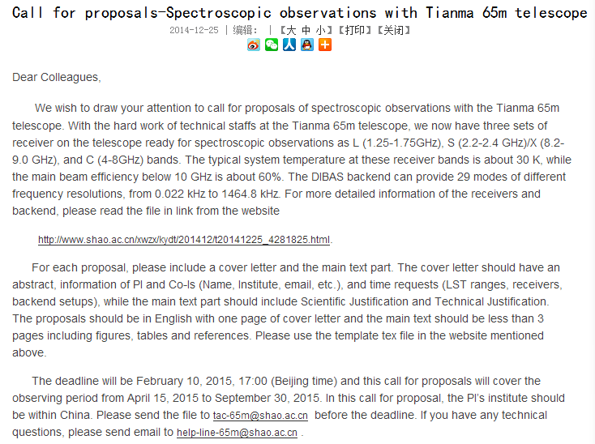
Tianma telescope is open to researchers

Slide 29
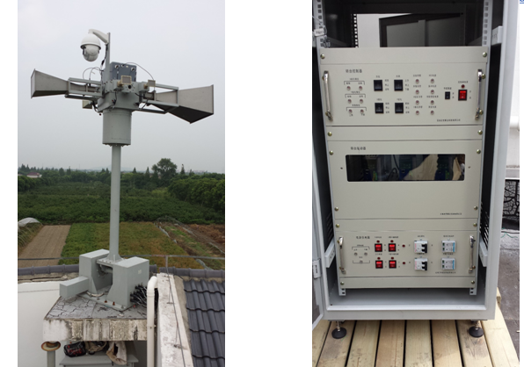
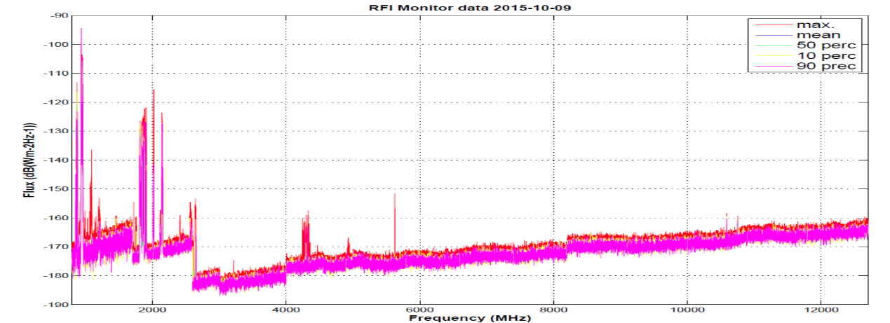
We built RFI monitoring platform at Tianma telescope.
RFI is strong at L and S band, very little at X and above bands. C band has a little interference
2 4 6 8 10 12GHz

Slide 30
Content
1. Construction and test
2. Radio astronomical observation
3. Applications in deep spacecraft

Slide 31
VLBI for tracking spacecraft
Tianma telescope has successful tracked Chinese lunar mission CE-2, CE-3 and CE-5T1
Range/Doppler
VLBI
delay
Range/
Doppler
VLBI
(Very Long Baseline Interferometer)

Slide 32
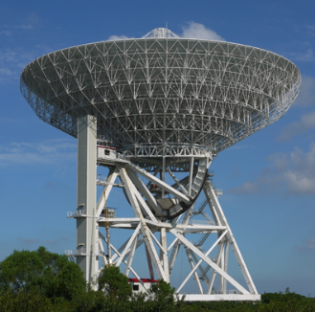
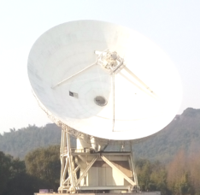
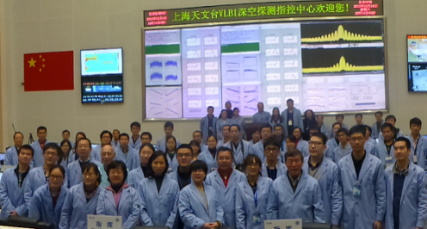
Chinese VLBI network
Chinese VLBI network
Beijing 50m
Urumqi 25m
Shanghai 65m/25m
FAST500m
Kunming
40m
VLBI center

Slide 33
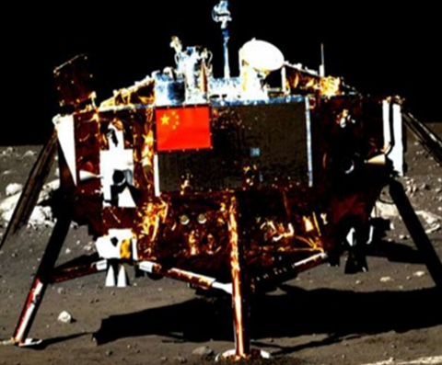
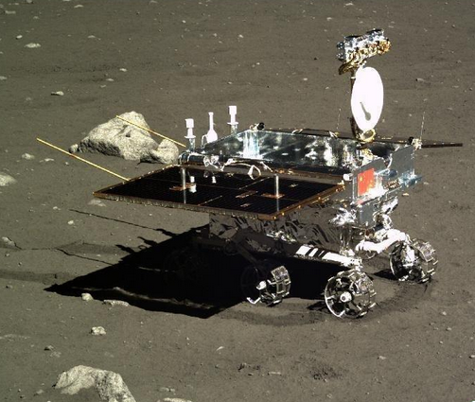
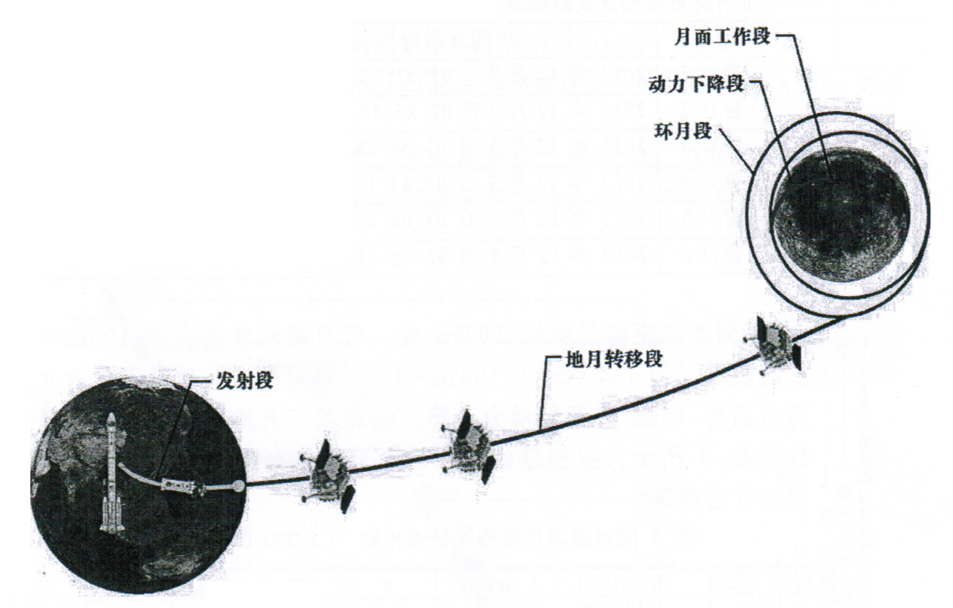
CE-3 Orbit
Flying to moon
100×100km, 4 days.
100×15km, 4 days
Softly landing Dec.14
Rover relative position
→Same-beam VLBI
ΔDOR VLBI
Launch
2013-12-1 17:31:32
4.7days

Slide 34
High-accuracy VLBI
Observation mode
satellite
Quasar
sat
quasar
sat
quasar
sat
ionosphere
（2m+fluc）
quasar
5m 5m 5m 5m 5m 5min
Tianma telescope contribution
A substantial increase in observation sensitivity.
A large expansion of choice of the radio source near spacecraft, improve the accuracy of the calibration.
A substantial increase in the success rate of Delta DOR VLBI delay.
The above 3 points significantly improve the accuracy of the VLBI measurement system, to make a significant contribution to the lunar soft landing .
atmosphere
（5m+fluc）
instrument
PLO
PLO
～
～
H-Maser
PLO
H-Maser
PLO
～
～
correlation

Slide 35
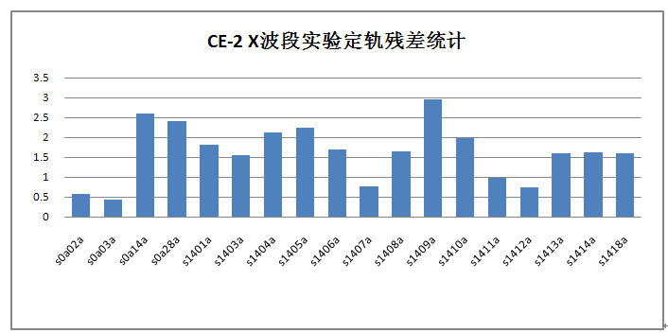
CE-2 and CE-3 VLBI delay residual
after orbit determination
CE-2
1.77ns
CE-3
3
2
1
0
Delay error 0.67ns
Delay residual ns
Observation code
Orbit determination error (VLBI+Doppler/Range)
Flying to the moon: hundreds meters
Circling the moon: tens meters
Landing site: tens meters

Slide 36
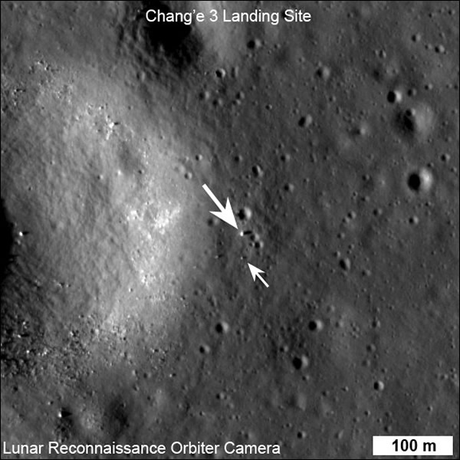
CE-3 landing site
Position difference measured by SHAO and NASA was less than 50m
 | longitude | latitude | height
NASA | -19.5116 | 44.1214 | -2640.0
SHAO | -19.5124 | 44.1206 | -2632.0
Position | 17m | 24m | 8m
Lander
Rover

Slide 37

Same-beam VLBI in CE-3 and CE-5
CE-3
CE-5
rover
lander
Moon
Lander
Orbiter
Return
τ
₁
τ
₂
τ
₃
τ
₄
X-Band
0.1deg
S-Band
0.4 deg
BJ
UR
Liu 2010
Chinese Sci.
SH
KM
Measuring relative position/orbit by using differential phase delay of same-beam VLBI

Slide 38
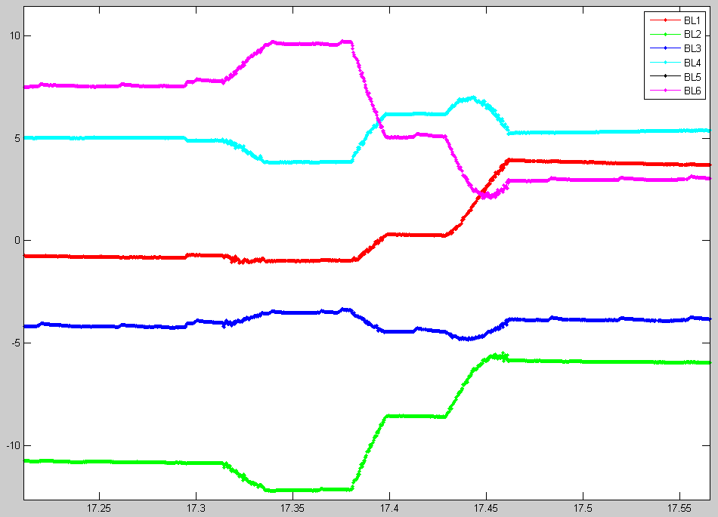
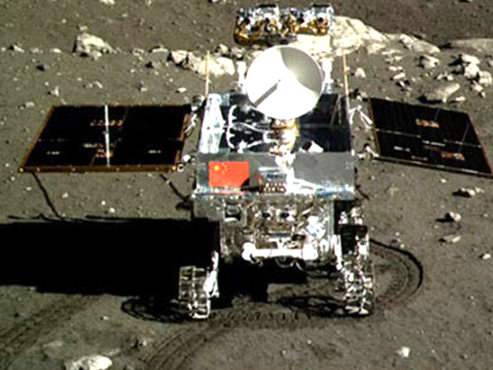
Monitor rover movement with a sensitivity of 5 cm
d
e
a
b
c
f
g
h
Differential phase delay
a-b: a little movement，c-d: several meter movement
e-f: several meter movement ，
g-h: make a turn

Slide 39
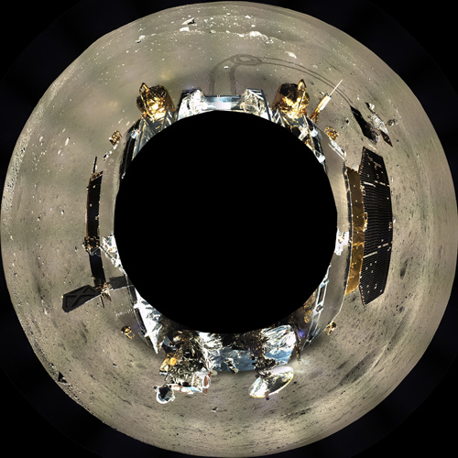
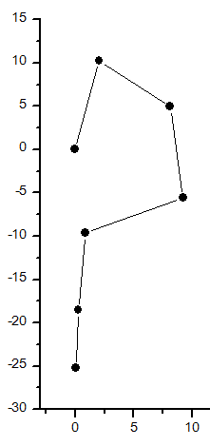
Rover relative position determination
with an accuracy of 1m.
north
A
m
A
Rover
B
B
lander
Lander
C
D
C
E
Liu 2014
Radio Sci.
D
S1
east
E
m

Slide 40
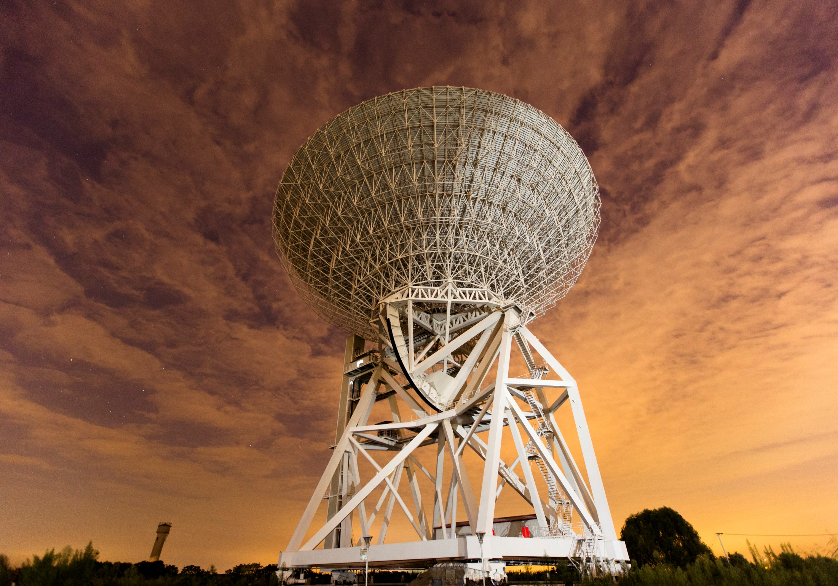
Tianma telescope team will continue to work in all aspects of radio astronomy, deep space exploration, science research and education,
Welcome to use Tianma telescope

