Slide 1
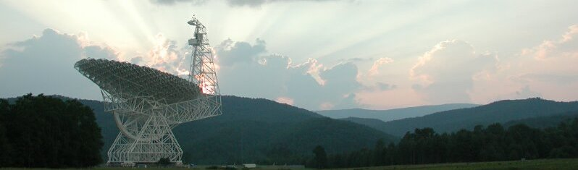

The Green Bank Observatory
Science and Discovery Space
David Frayer (GBO)

Slide 2
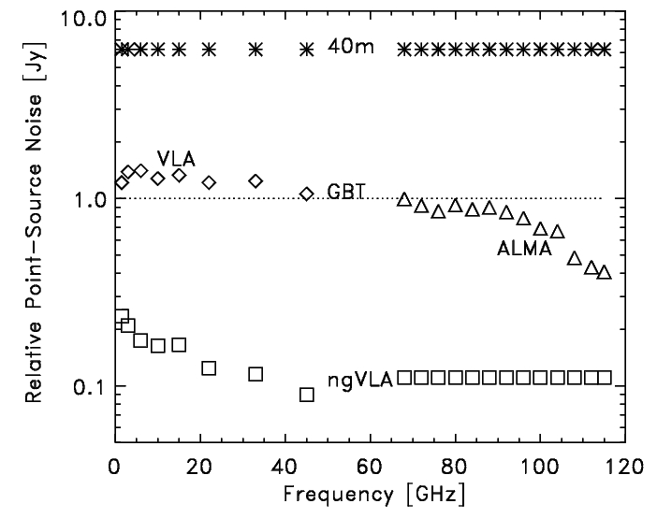
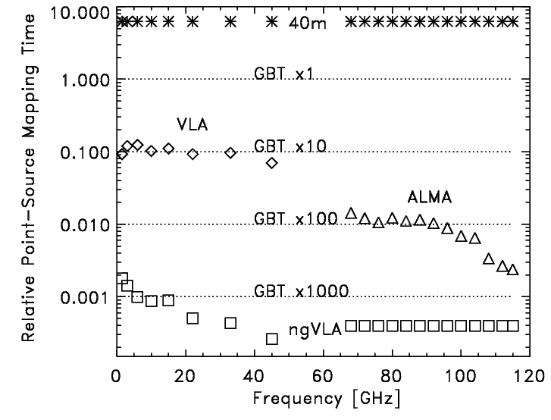
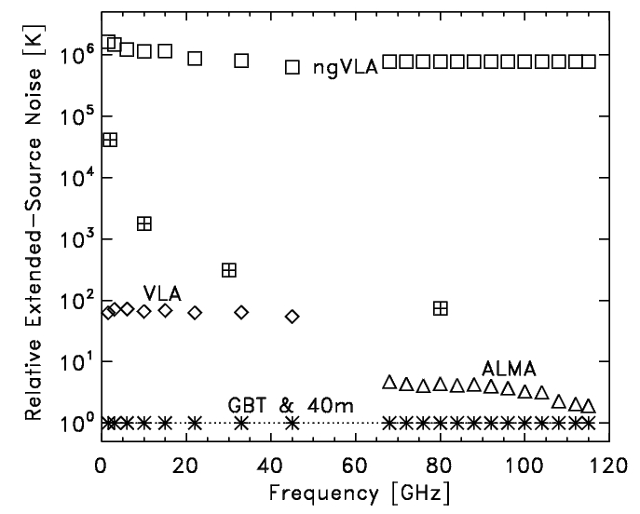
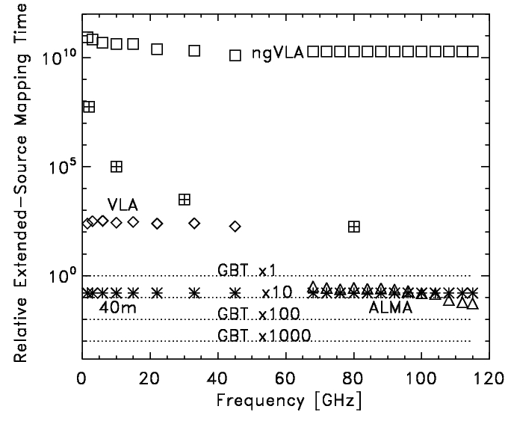
GBT Sensitivity and Mapping Speeds
ngVLA Memo#14
Large single dishes are needed for surface brightness sensitivity and wide-area mapping.
The GBT with multi-pixel cameras can provide unmatched mapping power.

Slide 3
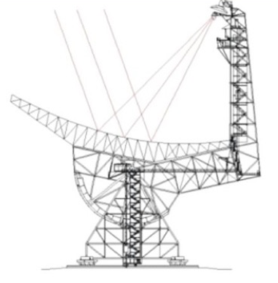
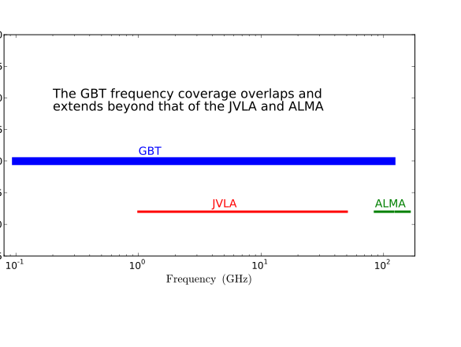
Key Capabilities of the GBT
100 meter diameter unblocked
Receivers cover 0.1 to 116 GHz
Excellent point-source sensitivity
Unsurpassed sensitivity for extended objects
>85% of total sky covered (δ≥-46°)
Location in the National Radio Quiet Zone
Notes:
Three things make the GBT the best radio telescope on the planet – Size 100m class (big light bucket whose active surface enables 3mm obsevations). Off-axis design gives low side-lobes and enables low surface brightness observations. Low RFI envirerment (quiet zone plus no sidelobes)

Slide 4
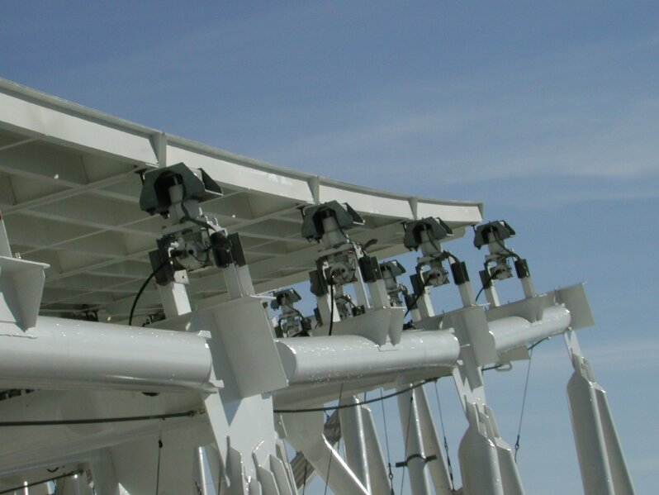

The Active Surface
2209 actuators
Currently rms ~230μm at night, the goal is ~200μm
Makes the GBT the largest single-dish operating efficiently at 3mm in the world
Telescope | Surface RMS/Diameter
GBT | 2.3e-6
ALMA | 2.0e-6
VLA VLBA NGVLA | 2.0e-5 1.4e-5 ~1.0e-5
4
University of Georgia, Sept 2011
Notes:
50% of year < 10mm H20 (good for 3mm obs) good fraction of winter < 5mm H20

Slide 5
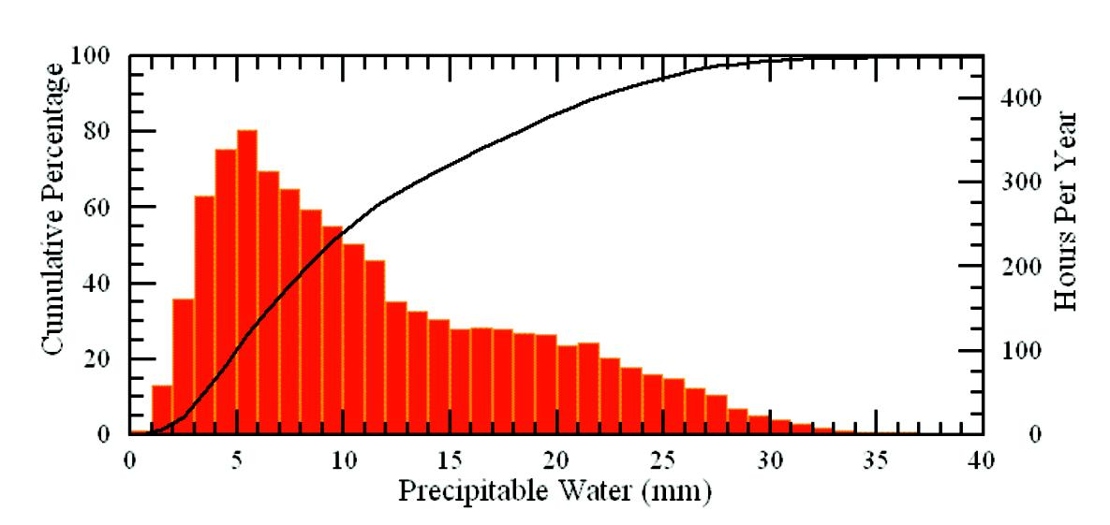
~50% of time in Green Bank has less than 10mm of H2O (acceptable for 3mm observations)

Slide 6
Wide Range of GBO Science Areas:
Pulsars: Discovery of new pulsars, the most massive pulsar, gravity waves via pulsar timing
Neutral Hydrogen HI: Masses of local galaxies, Kinematics of galaxy and local group/dark matter
High-redshift/Cosmology: Galaxy clusters, CO in the early universe, HI intensity mapping at high-redshift
Interstellar Organic Molecules/Astro-chemisty
Masers: black hole masses, distances via proper motions and independent measurement of Ho
Star Formation: NH3 mapping, cold and dense gas tracers at 3-4mm
Basic Physics: The search for Gravitational Radiation, Limits on Fundamental “constants”
Solar system astronomy -- planetary radar
Solar Physics
SETI – Breakthrough Listen
6

Slide 7
“Key” GBT science highlighted in this workshop
Astrochemistry – complex molecules within the extended ISM and around hot cores ➔ want instantaneous bandwidth and Rx coverage (Ku,K,Ka,Q,W optimized for spectroscopy)
Galactic star formation – modes/processes of formation within filaments and colliding flows ➔ wide-area [sq-degs] mappping (K and W)
Star formation in nearby galaxies -- dense gas and physical processes probed by molecular lines ➔ deep mapping of moderate size regions [many sq-arcmins] (W) ➔ Argus+ and KFPA/K-band PAF
Pulsars – timing for NanoGrav and physics/GR and wide area deep searches for pulsars and FRBs ➔ wide-band feed and dedicated pulsar telescope
HI (and OH) extended gas within and around galaxies ➔ very deep and wide-area surveys ➔ FLAG+

Slide 8
GBT&GBO Instruments in the 2020’s?
GBT
FLAG+ (L-band PAF) for mapping (Prime-focus)
Wide-band feed for pulsars (Prime-focus: 0.6-3.6 GHz)
8 Gregorian positions (drop S if wide-band feed?):
  KFPA ➔ K-band PAF (10x or more beams)
  Argus ➔ Argus+ (10x more beams)
  Mustang-2+ (with upgraded technology)
  L single beam (pointed observations)
  C-band/X-band
  K/Ka/Ku dual beams Rx’s {optimized for spectroscopy}
  Q/W-band/Holography
  (Ka-band radar system or new customer?)
Pulsar Timing Telescope
Solar Telescope
HERA Telescope

Slide 9
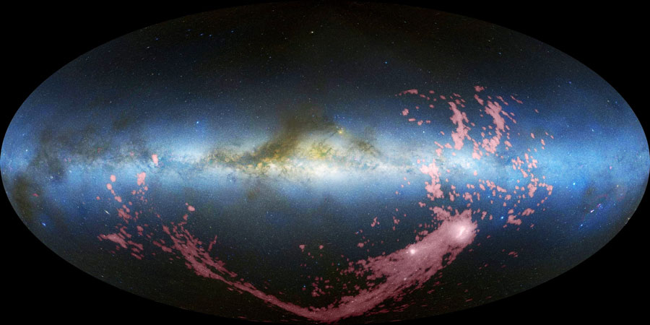
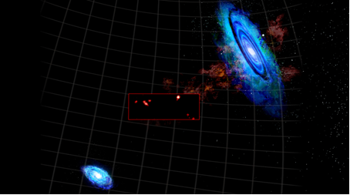
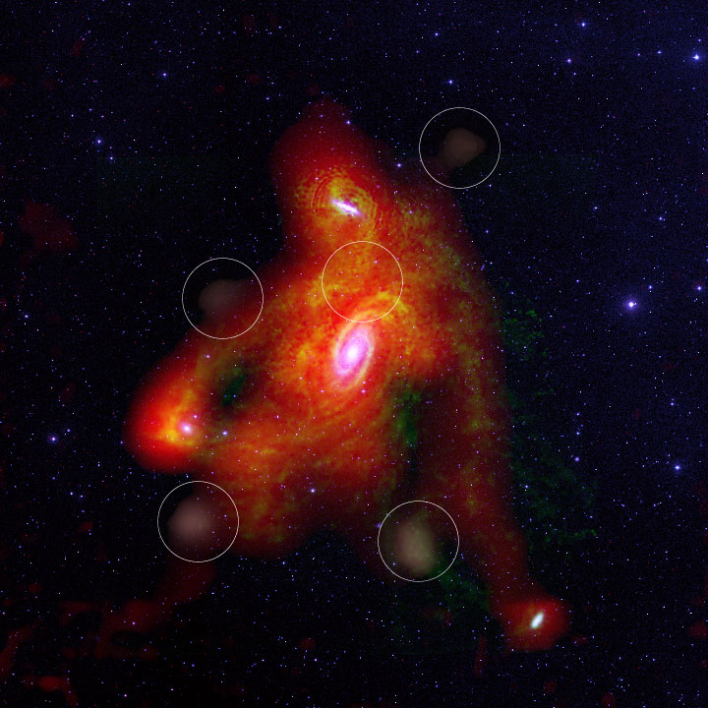
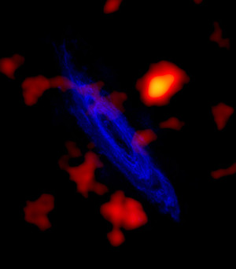
GBT Studies of faint HI -- unequalled sensitivity
Magellanic Stream -- Nidever et al. 2010
GBT offers ability to detect HI to NHI ~10¹⁷ cm⁻²
Interactions
Outflows from winds and fountains
Cool gas accretion
HI Clouds between M31 and M33 -- Wolfe et al 2013
M81 group HI clouds -- Chynoweth et al. 2008
High-velocity cloud system around M31 -- Thilker et al 2004
Notes:
Because of its filled aperture, excellent receivers and clean optics the GBT is the only telescope that can measure the faintest low surface-brightness HI reliably. GBT studies have shown faint gas associated with galaxy interactions and high-velocity gas associated with outflows/winds and cool gas accretion.

Slide 10
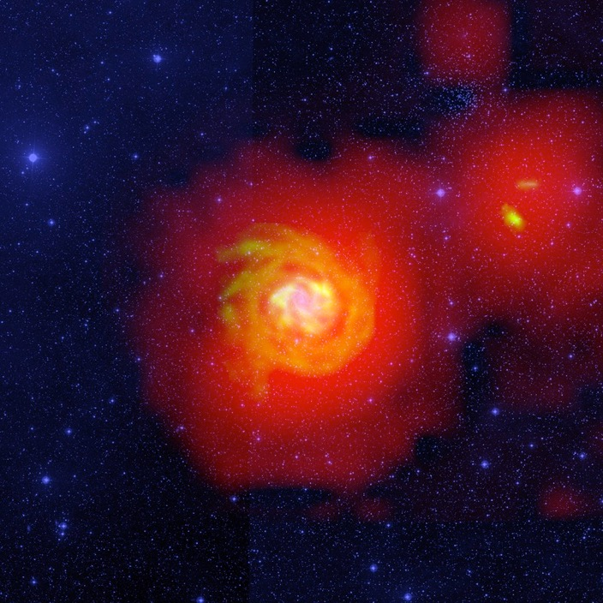
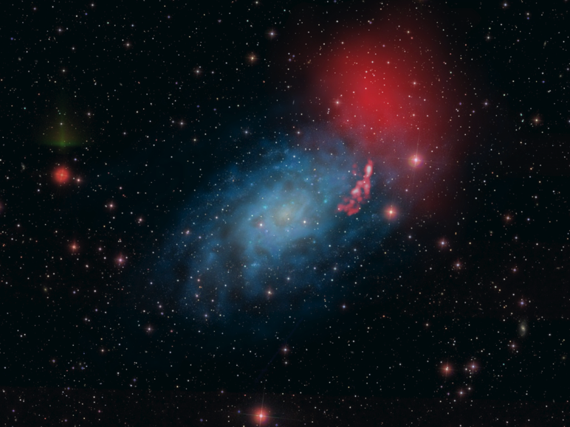
N_{HI} ~ 10¹⁸ cm⁻² around nearby galaxies
de Blok et al. 2014
Pisano (2014)
Boomsma et al. (2008)

Slide 11
The GBT Achieves its Theoretical Beam at 110 GHz
2017 GBT memo #296 – demonstrates the success of the pointing-and-control system, the gravity and thermal modeling with active surface corrections – lots of work by many people over the last decade….
GBT/X-band 9.0 GHz
GBT/Argus 109.4 GHz
Unblock GBT aperture ➔first side-lobe predicted at -27dB

Slide 12
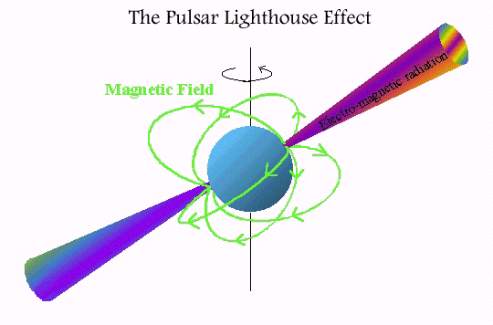
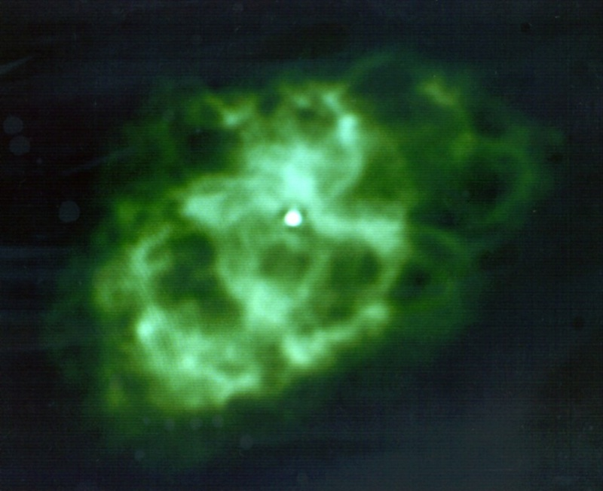
The GBT remains
the world’s premier pulsar observatory
(Quiet Zone, collecting area, receivers, detectors, sky coverage)
The Pulsar Renaissance:
Fastest Pulsar
Most Massive Pulsar (constrains equation of state of matter)
Pulsars in Globular Clusters
Tests of General Relativity
Relativistic Spin Precession
Pulsar in a three-body system
Coolest white dwarf star (carbon – diamond star)

Slide 13
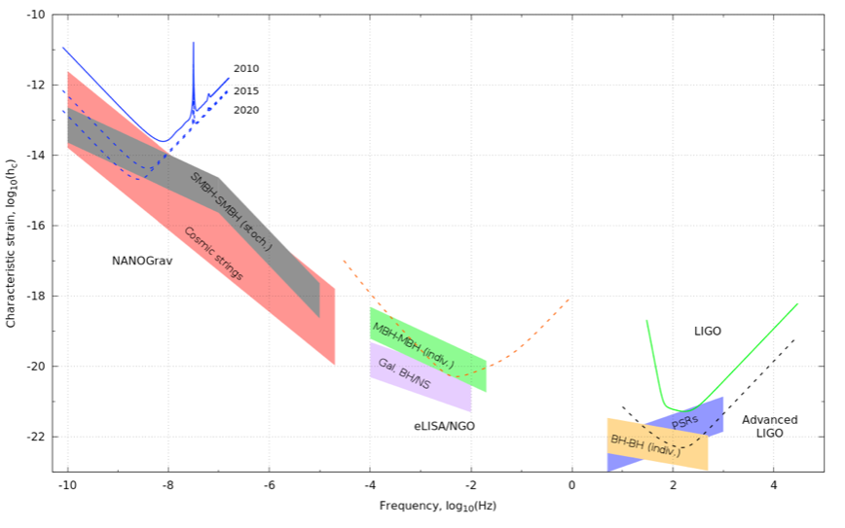
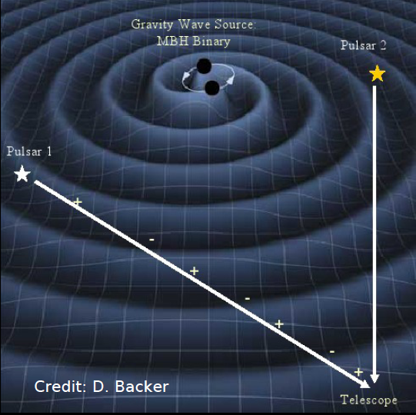
Searching for a detection of Gravitational Waves via Pulsar timing (NANOGrav)

Slide 14
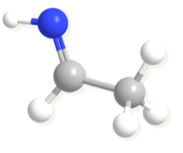
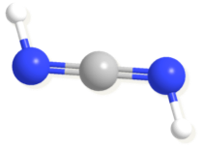
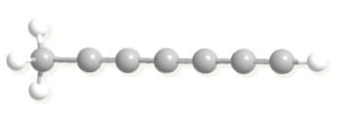
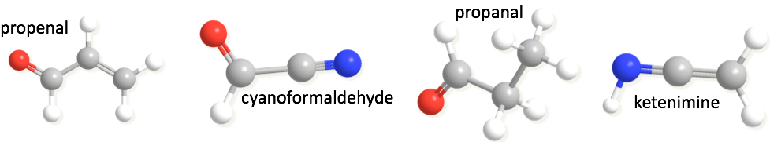
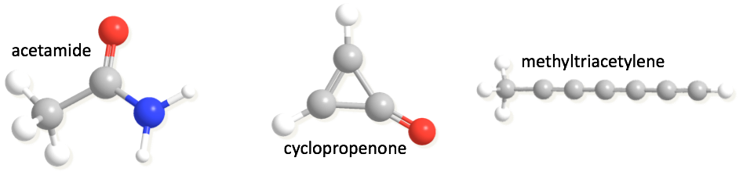
Some (of the ~20) New GBT Molecules
Linking ISM chemistry to origin of life
Chemistry as tool for understanding star-formation
Chemistry of its own sake
carbodiimide
Interstellar anions
ethanimine

Slide 15
Example: Perseus Barnard 1

Slide 16
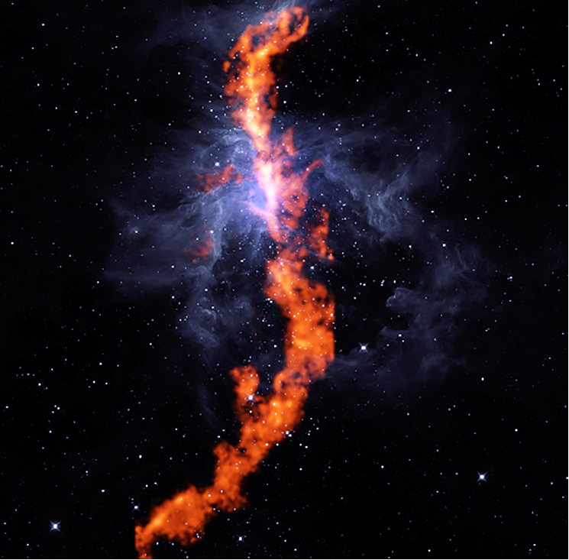
GBT NH3 image of Orion molecular cloud (red, 1.5deg) with WISE infrared image in blue showing warm dust
Friesen et al. 2017

Slide 17
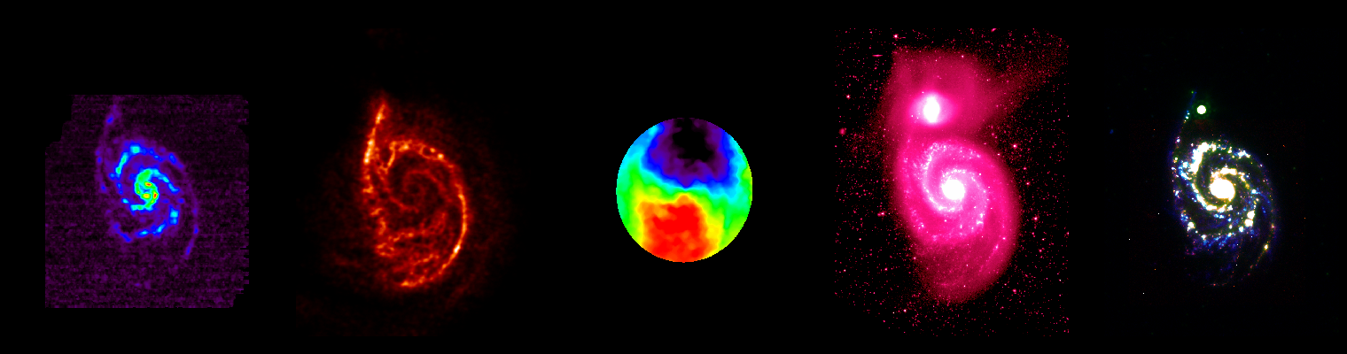
Gas and Star Formation in Galaxies III
Star formation happens in dense molecular gas
Gas consumption timescales for the molecular reservoir, 𝛕_{dep}=M(H₂)/SFR, are short (<<𝛕_{Hubble}), requiring HI→H₂ and accretion
How does the regulation work?
CO
HI
kinematics
stars
SFR
Images from HERACLES (Leroy+ 2008), THINGS (Walter+ 2008), SINGS (Kennicutt+ 2003)

Slide 18
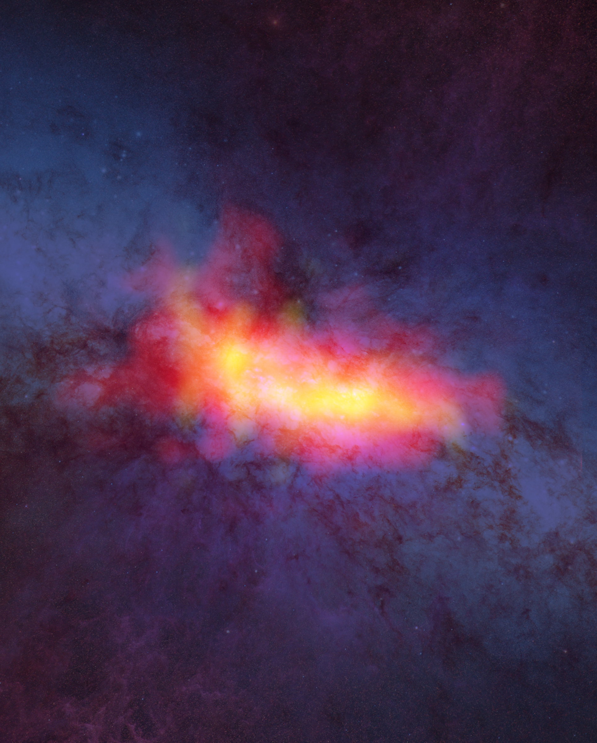
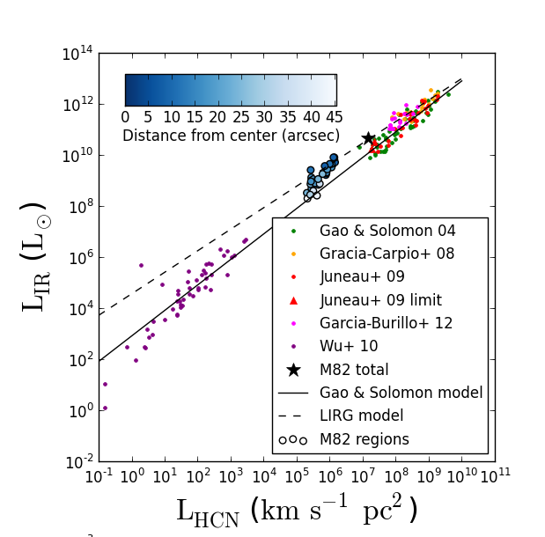
The GBT has demonstrated that it can do deep observations of dense molecular gas tracers.
HCN
HCO+
Deepest map to date!
Only 16 hours with the GBT!
Kepley + 2014

Slide 19
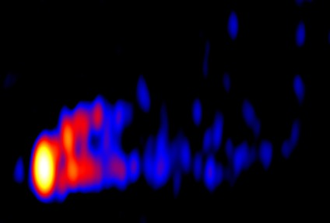
M87 3mm VLBI Jet
The M87 jet at an angular resolution of
0.25x0.08 mas (~10 Schwarzchild radii) in 3mm VLBI (Hada et al 2016)

Slide 20
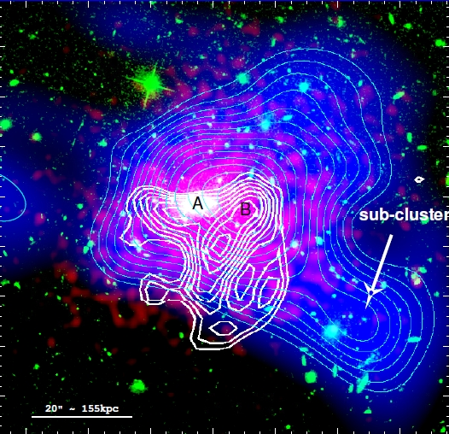
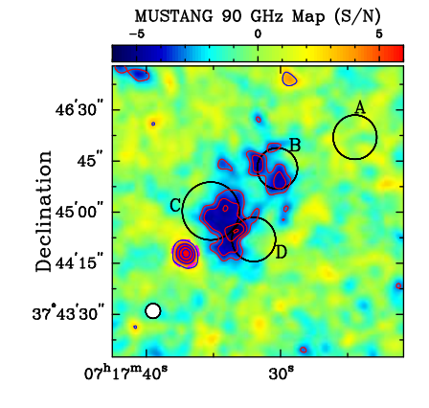
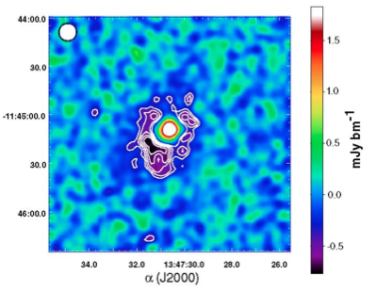
Galaxy Clusters/SZE – measurements of large-scale structures at 90 GHz that probe the cluster environment in which galaxies form
Viewing the Early Universe
(Left) Mustang SZE image of the triple merger MACSJ0717+3745 (Mroczkowski 2012). (Right) Mustang image of RXJ1347-1145 which shows deviations from equilibrium first shown by high angular resolution SZE measurements (Mason et al. 2010).
Image of CL1226.9+3332 (z = 0.89); White is MUSTANG; Green is optical (HST); Red is X-ray (Chandra); Blue is mass density (HST) Courtesy Korngut, et al.
Notes:
MUSTANG is a uniquely capable instrument for studies of the SZE in that it has 5+x higher resolution than the other instruments in use.
Includes High resolution imaging of the Sunyeaev-Zel’dovich effect
IMAGE: In our highest redshift system, CL1226, we find a
multiply peaked pressure distribution with an asymmet-
ric morphology. The location and orientation of a ridge
found in the SZE, along with a south-westerly elongated
shape, are qualitatively supportive of the merger scenario
proposed by Jee & Tyson (2009).
Composite image of CL1226. Red shows the Chandra surface brightness in the 0.7keV to 7.0keV band. Blue color scale and
cyan contours show the surface mass density distribution of Jee & Tyson (2009). Contours are linearly spaced in 15 intervals between
= 0:25 and = 0:59. Green traces the optical emission as measured by the HST/ACS in the F814W band. White contours show
the MUSTANG measurement in units of 0:5 starting at 3. Location A demarcates the BCG and is coincident with the X-ray surface
Brightness peak. Location B shows the Dark Matter peak which is coincident with the northern lobe of the SZ ridge revealed by MUSTANG
imaging.

Slide 21
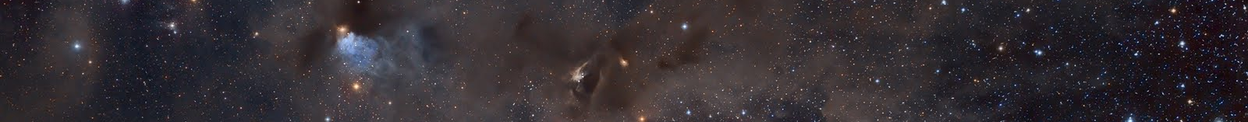
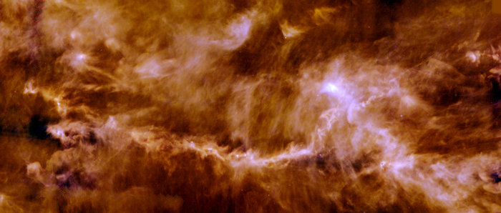
V. DISCUSSION & CONCLUSIONS
Two Modes of Star Formation
Overall: Pressure-confined structure → gravitationally bound structure → Star formation
In detail: two modes, Fast and Slow
[Seo et al. in prep]
At the hub(L1495A-N)
Within filament(L1521D)
Fast star formation
by converging large-scale flows
Stellar group/cluster formation
Slow star formation
by quasi-static gravitational collapse
Isolated star formation

