Slide 1
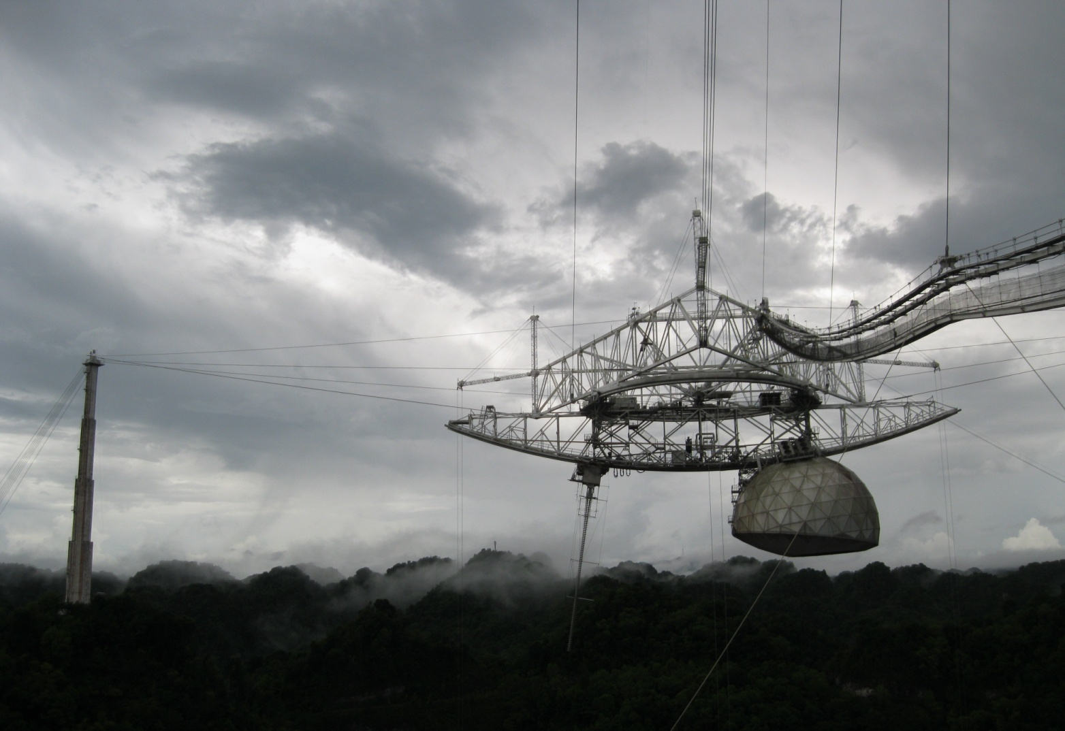
The Virgo Cluster Through The AGES
arXiv:1203.3094
Rhys Taylor

Slide 2
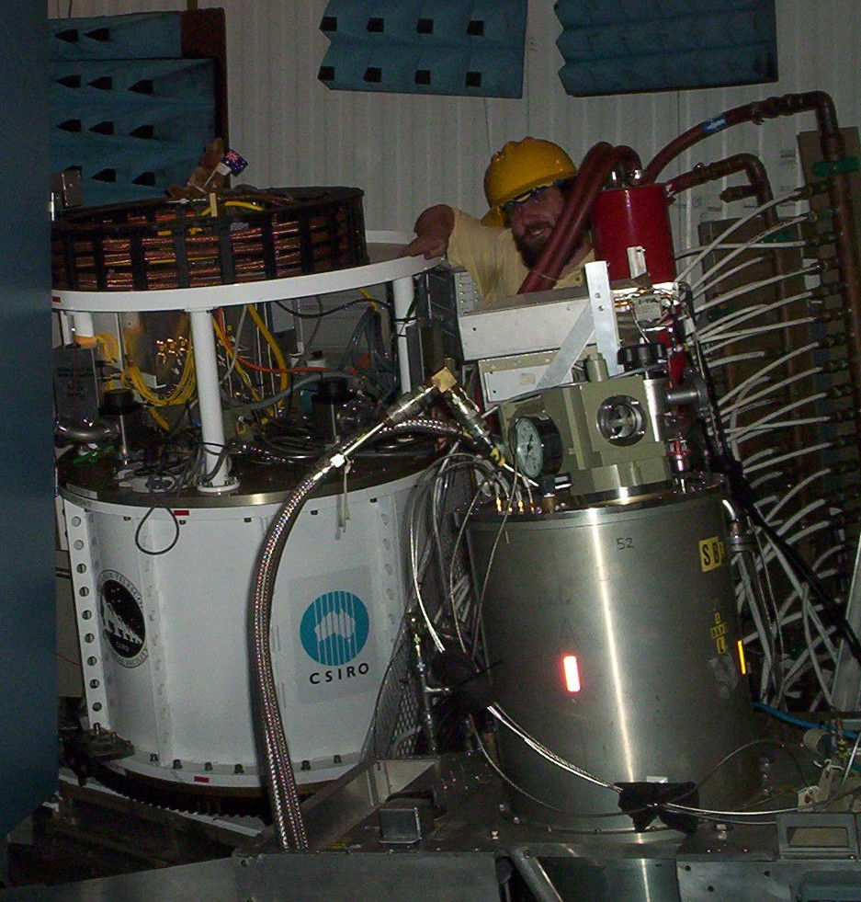
The Arecibo Galaxy Environment Survey
3.5’ angular resolution
0.6 mJy rms
8.5 x 10⁶ M_{ʘ}
-2,000 < cz < 20,000 km/s
25 square degrees in Virgo
108 detections
Visual and automatic source extraction
Notes:
Mass sensitivity assumes a 4sigma, 50 km/s velocity width tophat profile at 17 Mpc (Virgo distance)
Two areas selected in Virgo, one of 20 square degrees, one of 5 square degrees
338 detections over full redshift range for both areas combined

Slide 3
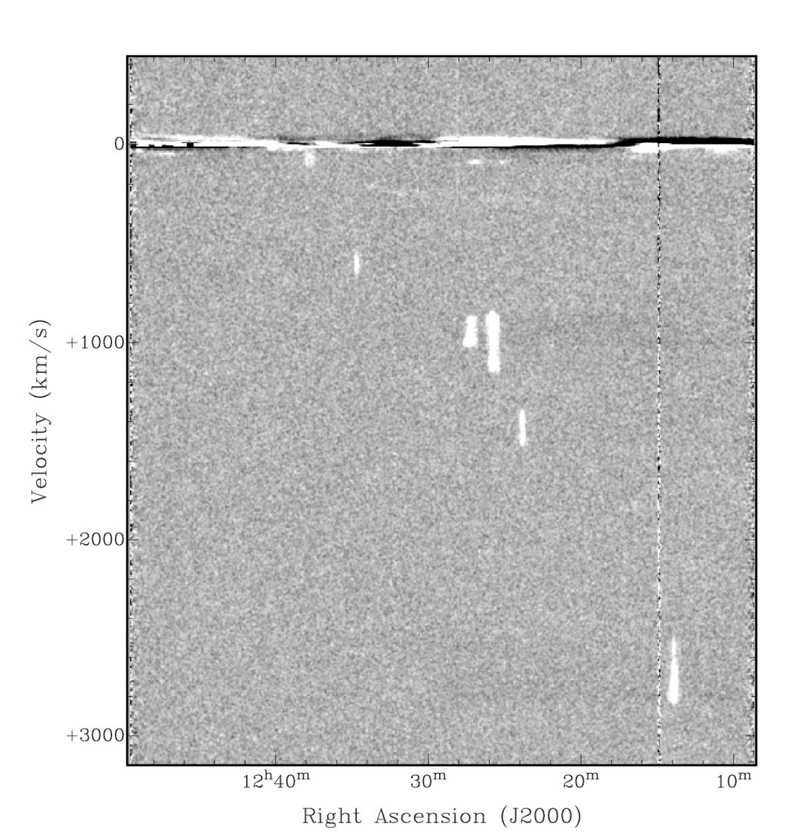
Source extraction 1 : Visual inspection
Scan through cube in different projections
Totally subjective !
Almost no strict flux limits on what can be detected
Can be used in regions where RFI present
Requires tea
Very high reliability
Notes:
Slice through Virgo cube to show what data looks like
Easy to spot bright objects, harder to detect 4sigma sources – can be done, but time consuming

Slide 4
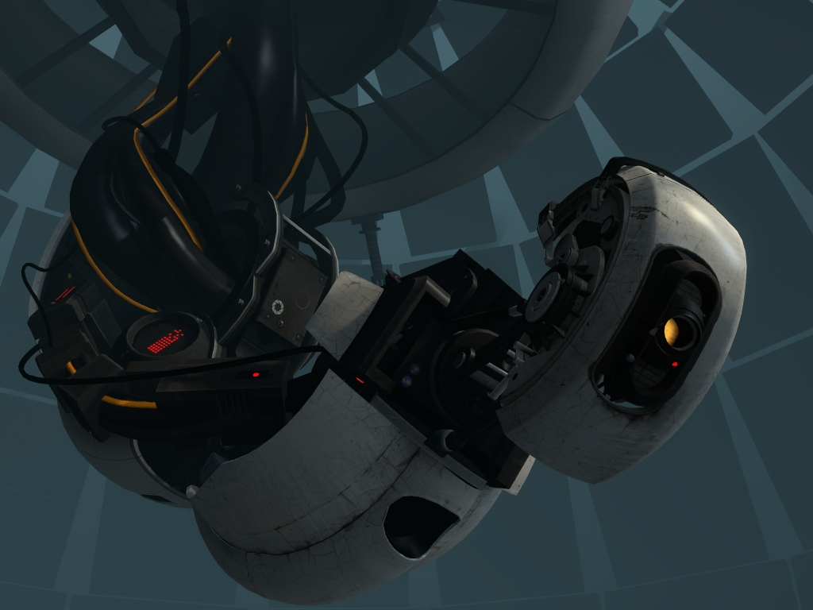
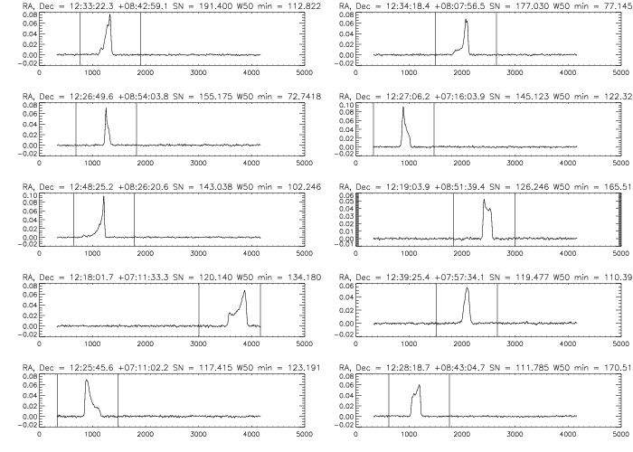
Source extraction 2 : GLADOS
Galaxy Line Analysis for Detection Of Sources
Finds S/N peaks along each spectra
Source must be resolved in velocity and present in 3 pixels
Checks individual polarisations
Reliability ~30%
Completeness > 90% at S/N = 4
Notes:
Individual polarisations are Hanning smoothed to increase sensitivity
Since don’t really care about anything that’s only 5km/s wide, this isn’t losing anything interesting
Candidate lists are a few hundred strong
Reliability : 30% of all sources found by GLADOS turn out to be real objects
Completness : GLADOS detects 90-95% of all objects found by other methods (visual + other automatic programs)

Slide 5
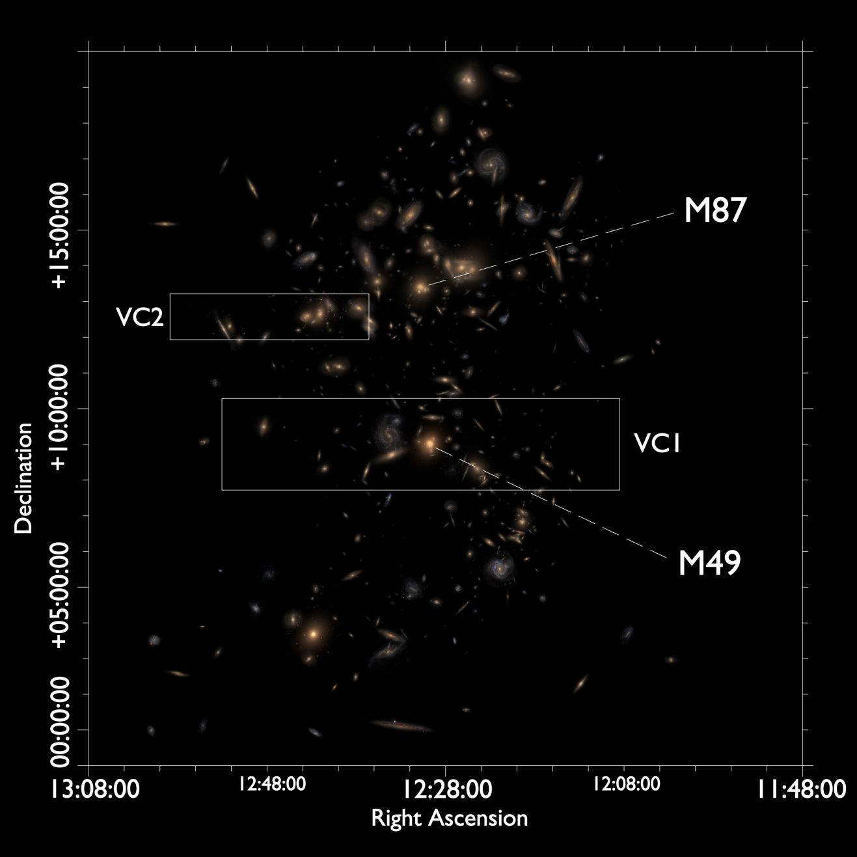
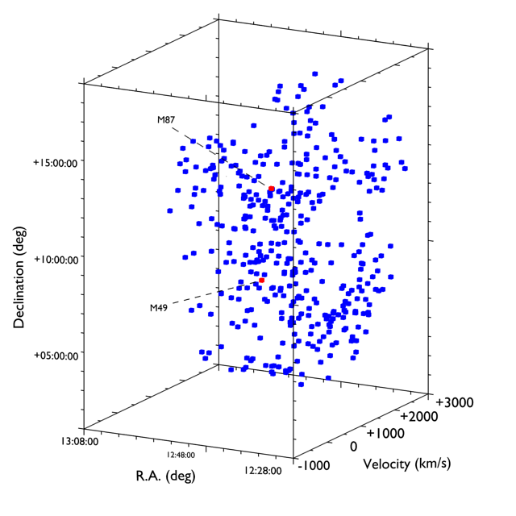
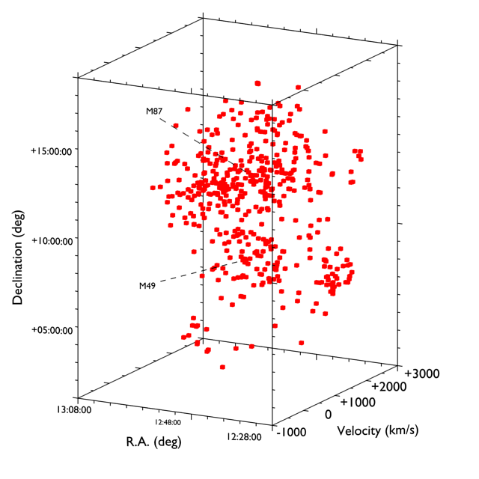
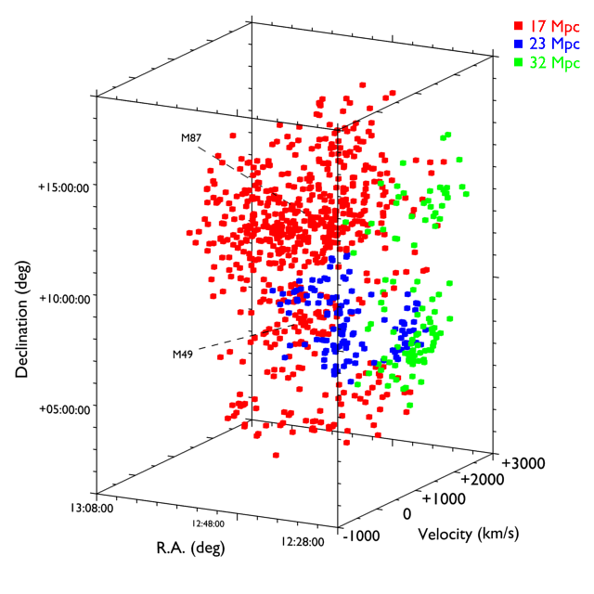
The Virgo Cluster
Notes:
SDSS images of Virgo Cluster Catalogue galaxies (GOLDMine data)
Complex structure of clouds at at least 3 different distances
Late-type galaxies in blue
Early-types in red show more clustering
Structure from TF + FJ more complex than PV would suggest

Slide 6
The VC1 Region
Notes:
Movie 1 : VC1 optical SDSS images
Movie 2 : VC1 HI (realtime 3D FITS viewer – it would have been quite impressive if the movie had worked !)
Lots of small, low-mass detections
Most small, faint detections are non-VCC galaxies

Slide 7
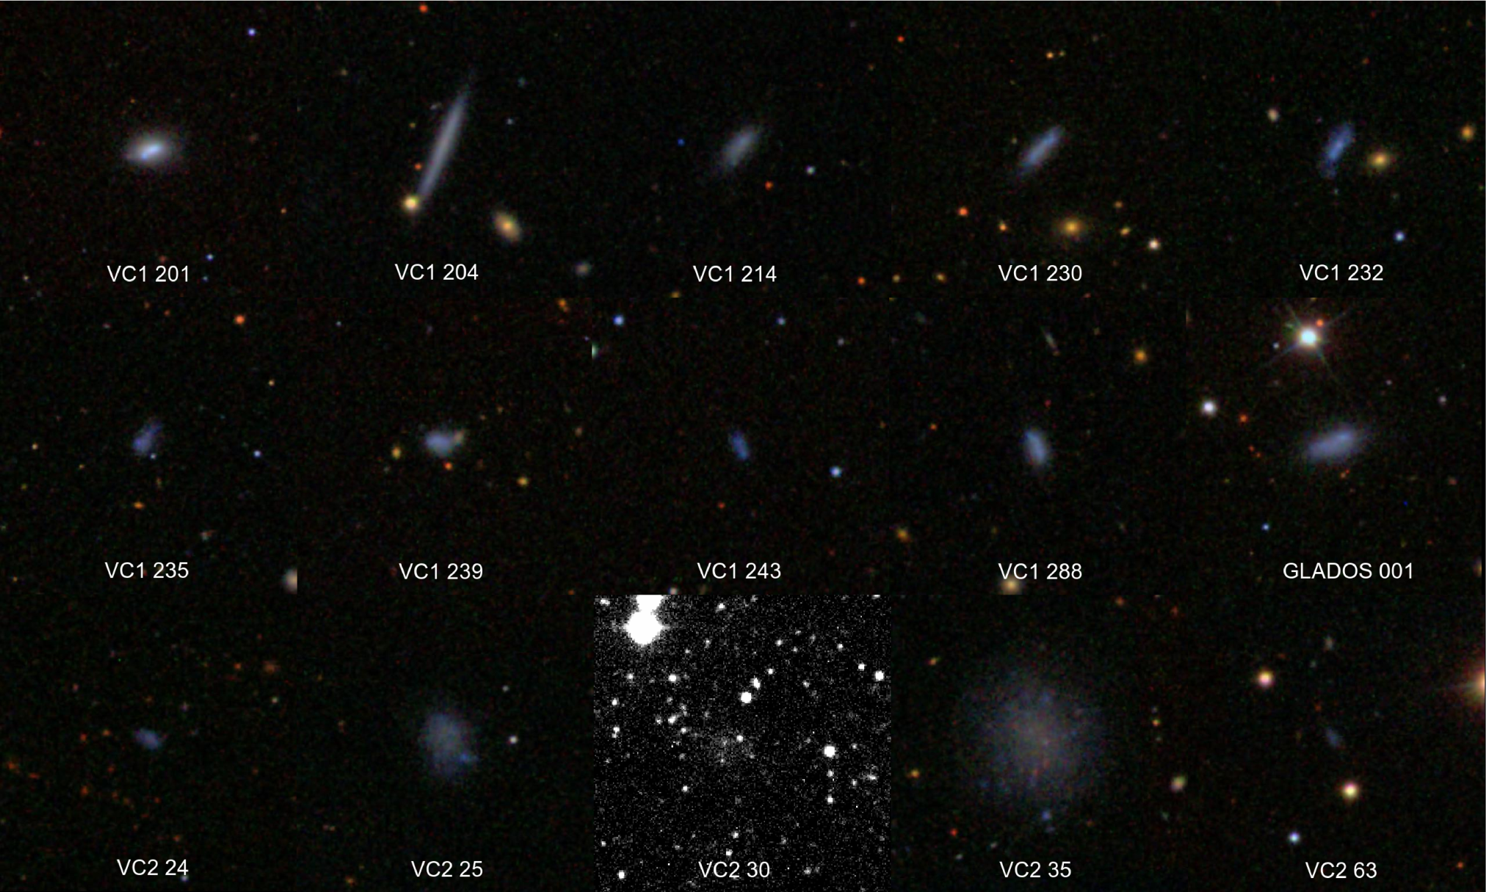
Non-VCC galaxies detected in HI
(Binggeli et. al. 1985)
Notes:
MHI ~ 10^7
Mg < -16.5
g-i ~ 0.4
MHI/L > 0.3
OptD < 5 kpc
VC2 30 is an INT WFS image, others are SDSS RGB images

Slide 8
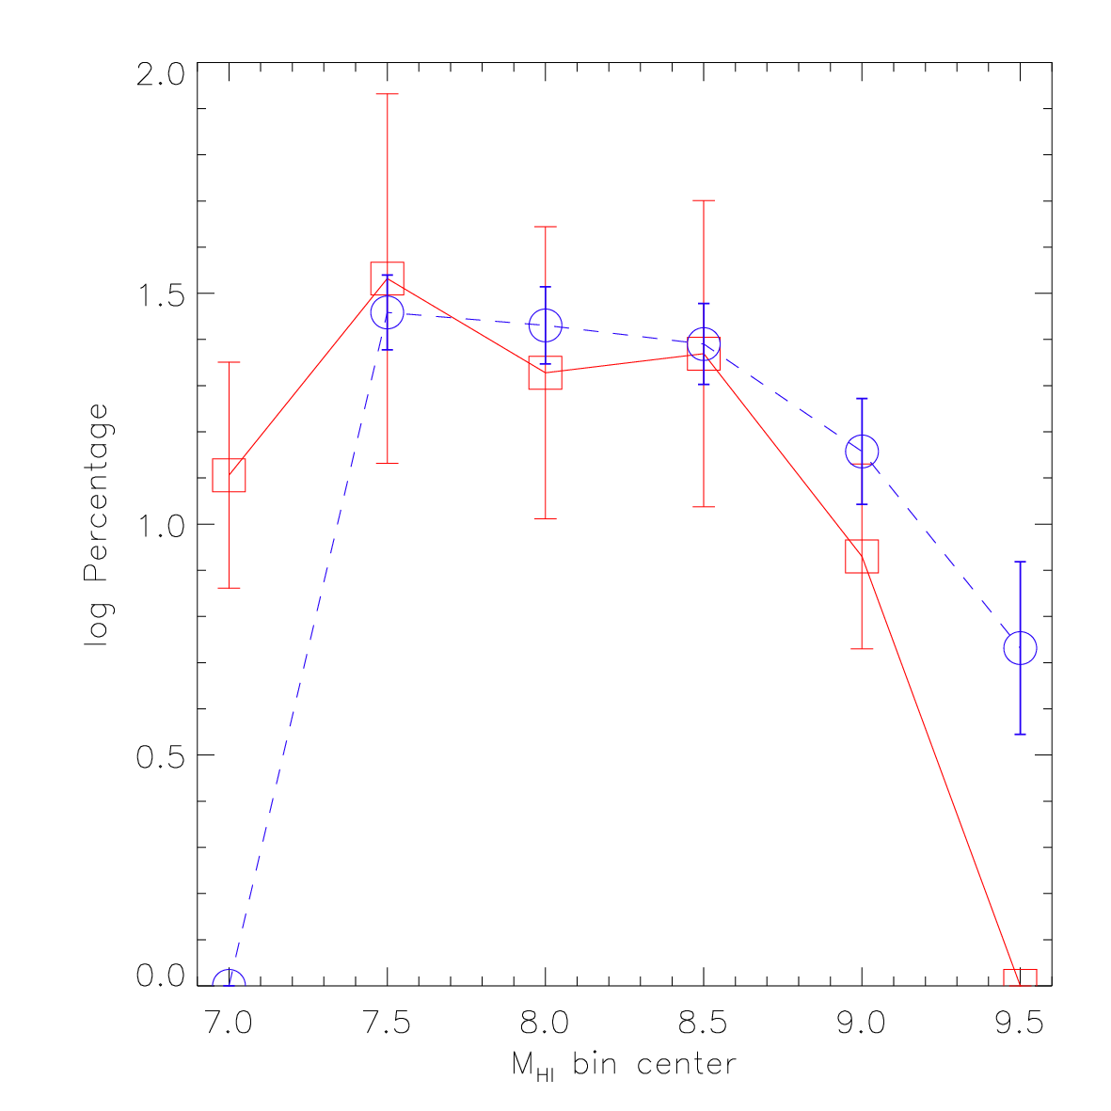
The HI Mass Function
Notes:
47 AGES detections (red line) at 17 Mpc
167 ALFALFA detections at 17 Mpc (blue dashed line - selected only those within the VCC survey area assigned a distance of 17 Mpc in GOLDMine)

Slide 9
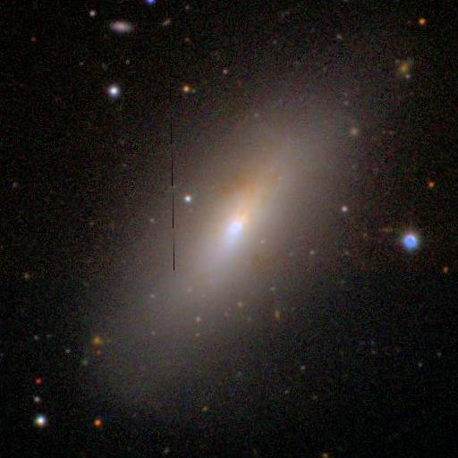
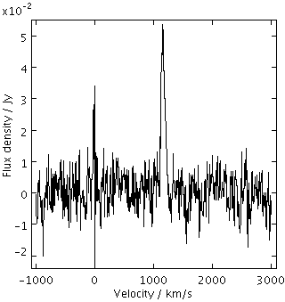
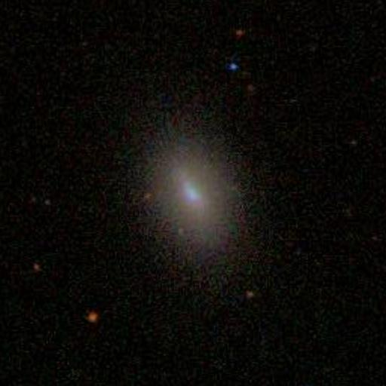
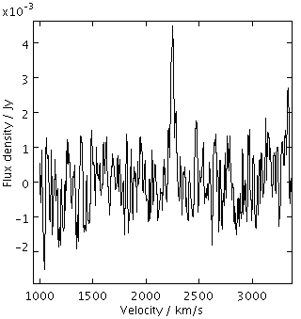
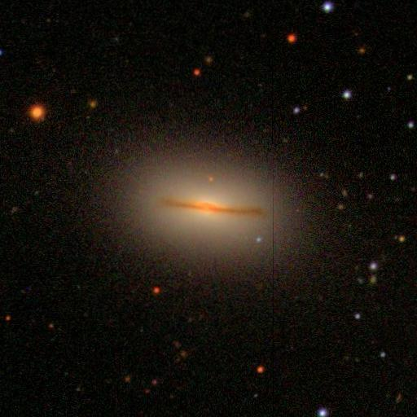
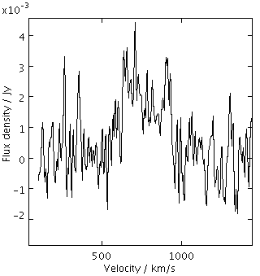
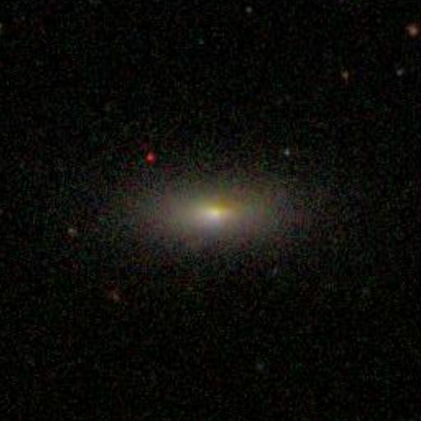
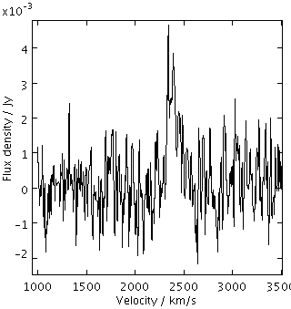
Early-type galaxies detected in HI : S0s
VCC 2066
VCC 180
VCC 758
VCC 450
Notes:
25% of all S0s in the VCC (in these regions) detected in HI
SDSS RGB images, 1.7’ across
Note quite narrow velocity widths in some cases
Low masses : 3-9x10^7 (except VCC 2066/2062 which has 2x10^8)
Some evidence of structure : dust lane(s) in VCC 2066, VCC 758, and small central bar in VCC 180

Slide 10
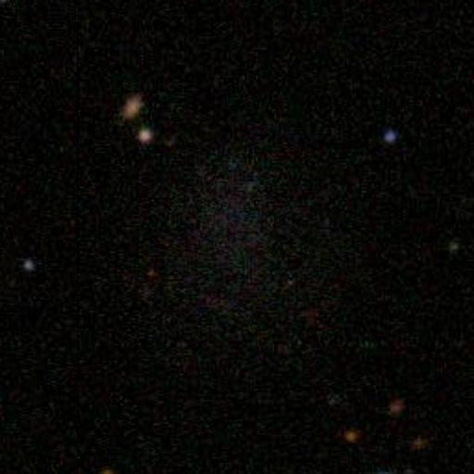
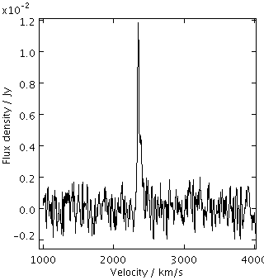
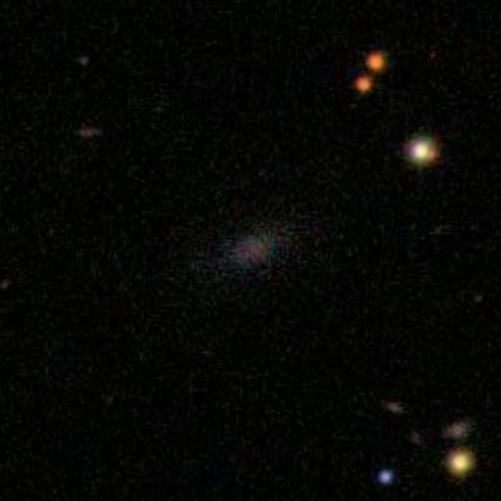
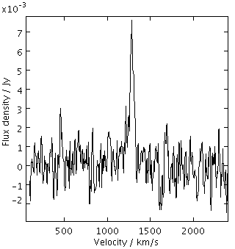
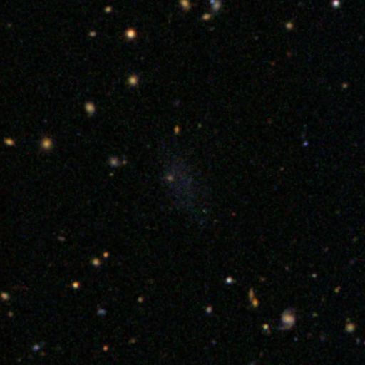
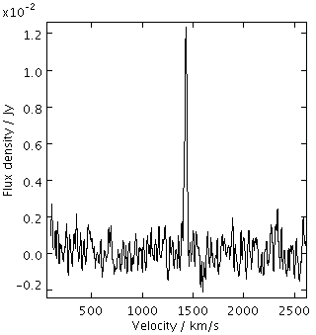
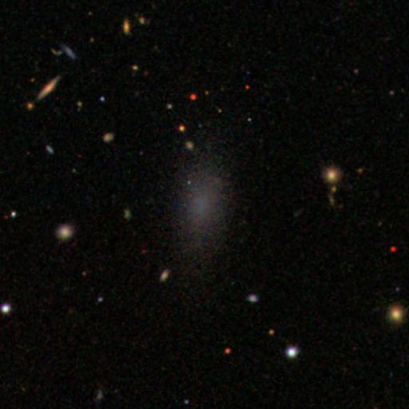
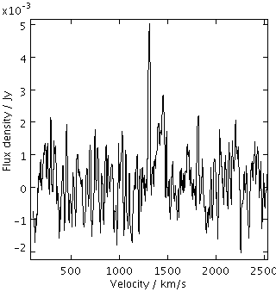
Early-type galaxies detected in HI : dEs
VCC 190
VCC 1394
VCC 1964
VCC 611
Notes:
Only 3% of dEs listed in VCC for these regions are detected in HI
Masses all ~2x10^7 except VCC 190 which is at 9x10^7
Are these really early-types ? Could be irregulars, especially VCC 190 and 1964
Low rate of detection implies that these are very unusual objects, unlike the S0s

Slide 11
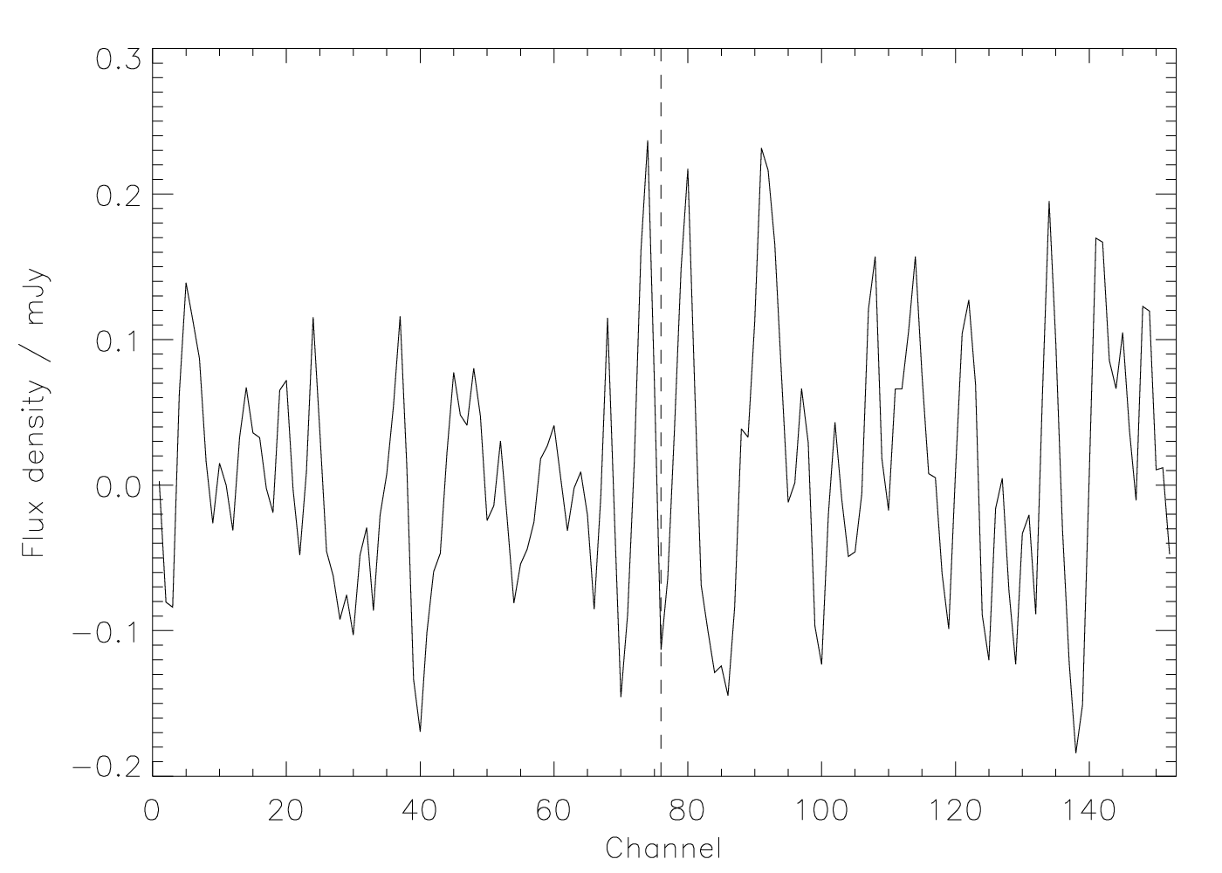
Stacking
Notes:
Tried to improve statistics through stacking HI spectra of non-detected dE’s (41 objects)
Mass sensitivity ~10^6 - no detection => the detected dEs are really unusual
Also tried stacking for the undetected S0s – no detection, but only 15 objects so not much increase in sensitivity

Slide 12
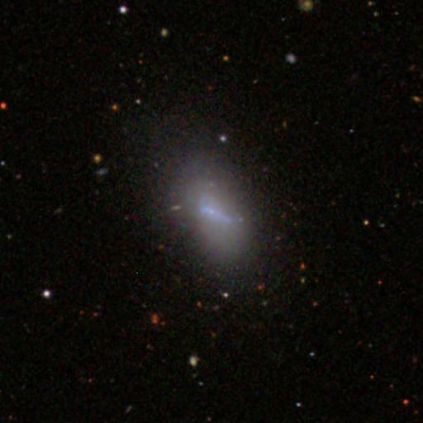
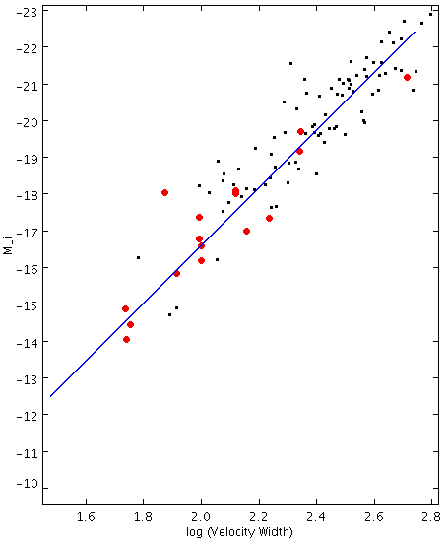
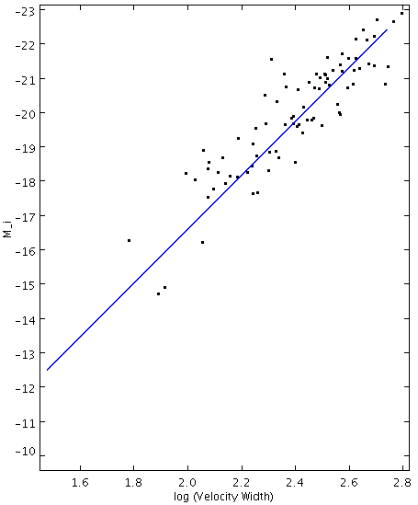
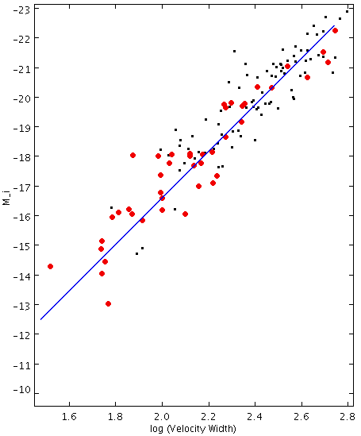
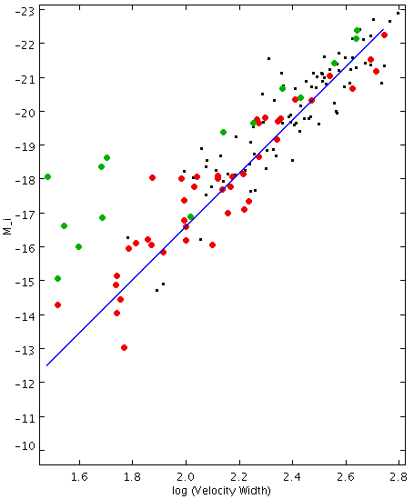
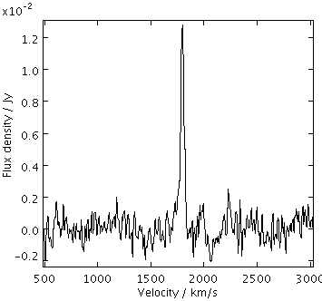
Tully-Fisher Relation (I)
VCC 1675
VCC 180
Notes:
Blue line is Masters 2006 relation
Very deficient galaxies fall off relation
Non deficient = < 0.4 (first image)
Moderate deficient : 0.4 – 1.0 9 (second image)
Highly deficient : > 1.0 (third image, green circles)
Collaborative effort in progress to determine via simulation whether gas loss alone can explain galaxies falling off the TF

Slide 13
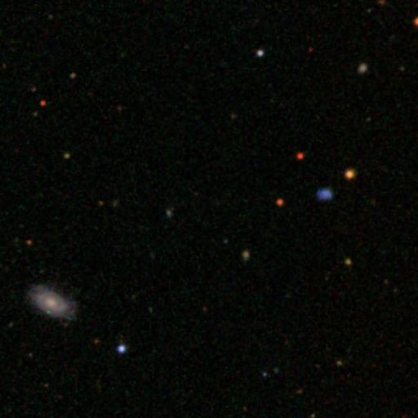
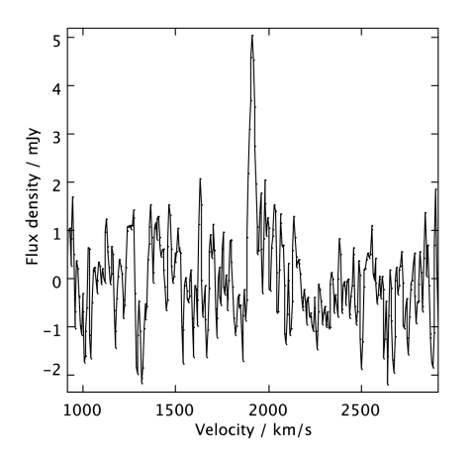
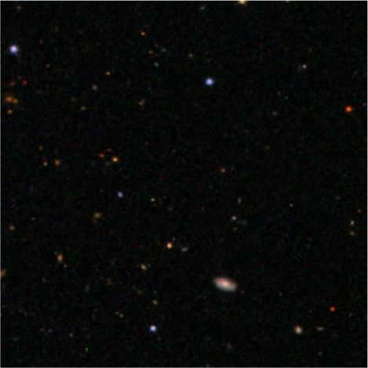
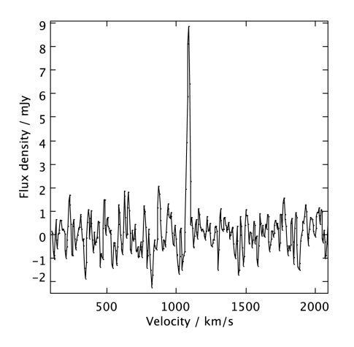
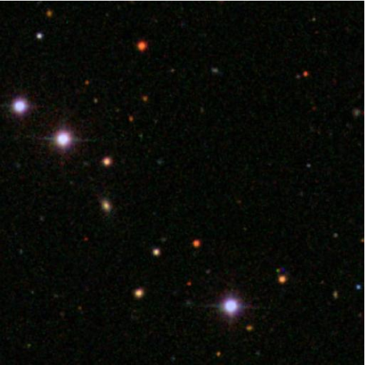
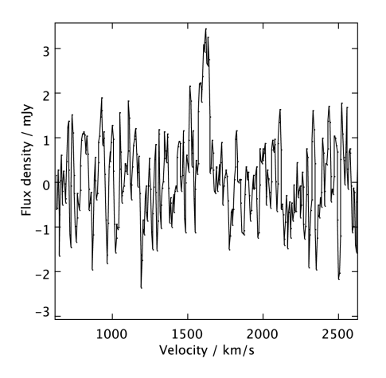
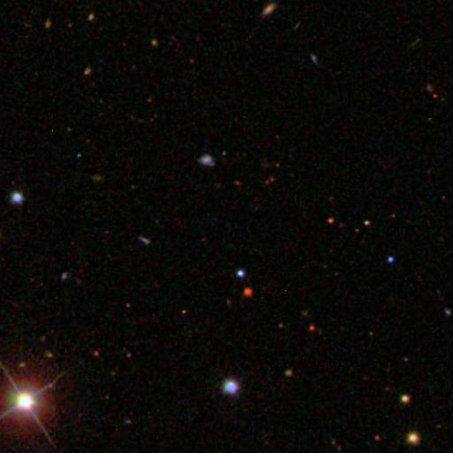
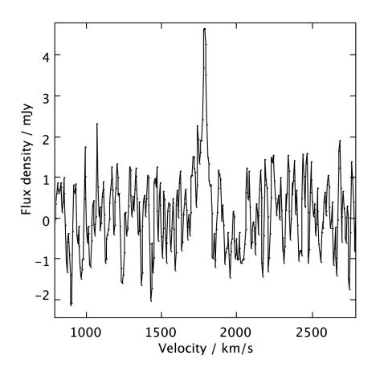
Dark Galaxies ?
MHI = 2.7 x 10⁷ M_{ʘ}
W20 = 208 km/s
Notes:
Lowest-mass detections (all within Virgo cluster)
Have follow-up HI observations, all are confirmed
SDSS RGB images, 1.7’ across
Discs seen in top two images are at redshifts >> HI

Slide 14
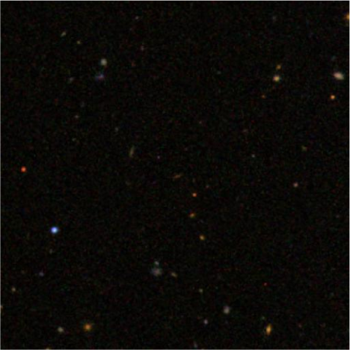
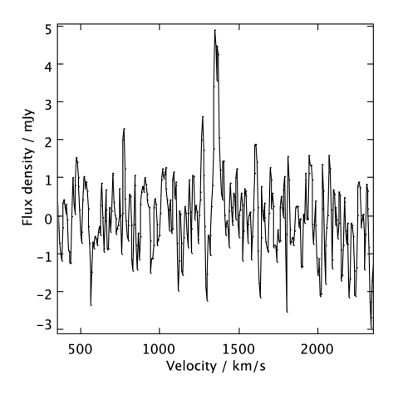
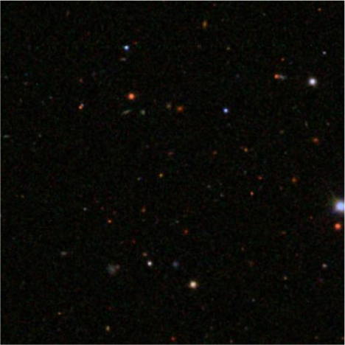
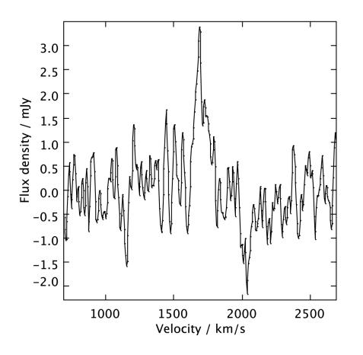
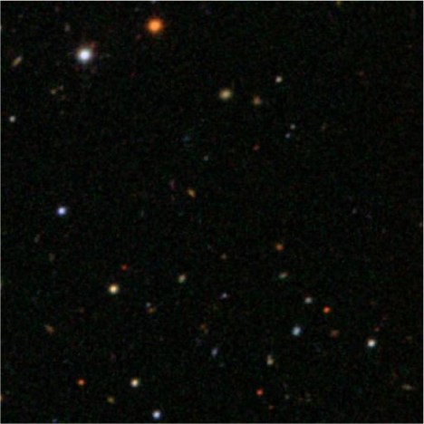
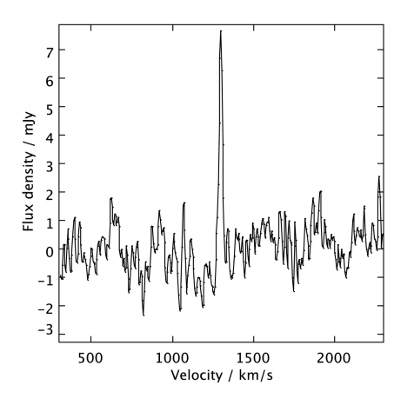
Dark Galaxies ?
Masses < 4x10⁷ M_{ʘ}
Velocity widths 35 – 150 km/s
Notes:
Not ruling out tidal origin. Some are ~0.5 degrees from the nearest VCC or other AGES detection

Slide 15
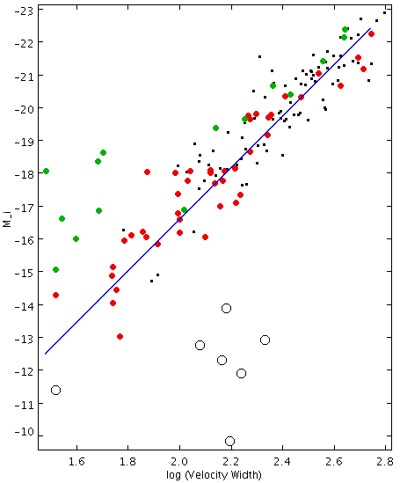
Tully-Fisher Relation (II)
Notes:
“Dark galaxies” shown as black circles. Here selected best possible optical counterpart candidates from SDSS images – all bar one lie far to the right of TF
Although we might not see faint objects in the SDSS, we would need to see BRIGHTER candidates for these HI detections to lie on TF. Deeper optical imaging won’t resolve this.
Interestingly, the non-VCC HI detections all lie on the TF just fine
HI velocity widths inconsisent with optical properties of these detections. Either these objects are really weird, or they have no optical counterparts at all (which is also quite weird...)

Slide 16
Summary
More HI detections in infalling clouds
Many galaxies detected not in the VCC
S0s detected in HI may be morphologically evolving
dEs detected in HI are weird
7 detections with no optical counterparts

