Slide 1
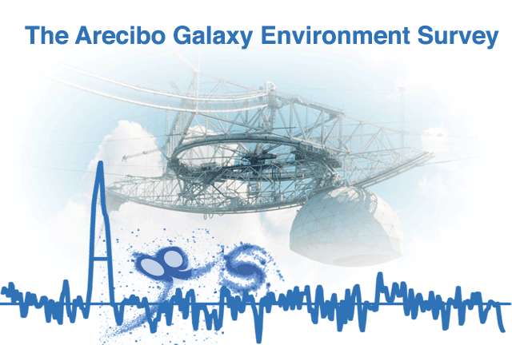

Slide 2
Plan of the Talk
What is AGES
The AGES volume
High density environments
Groups and clusters
Low density environments
Galaxy pairs, isolated galaxies and voids
Future AGES

Slide 3
What is AGES
Arecibo Galaxy Environment Survey
200 square degrees in thirteen fields
Four 5 sq. deg. regions
Nine 20 sq. deg. regions
Covers environments from the Local Void to the Virgo Cluster
0.7 mJy beam⁻¹ noise level

Slide 4
Survey Design
Uses the ALFA 7-beam feed array
Makes 3 Nyquist-sampled maps with each beam
Provides robustness against beam failure
WAPP correlators – 100 MHz bandwidth, 5 km s⁻¹ velocity resolution
Mock spectrometers – 300 MHz bandwidth, 4 km s⁻¹ velocity resolution

Slide 5
The AGES Volume
AGES WAPP cubes are bandpass limited at ~18,000 km s⁻¹ (z ~ 0.06)
AGES Mock cubes are bandpass limited at ~45,000 km s⁻¹ (z ~ 0.15)
There is a large volume not included in the targeted environment that can be used for ‘blind survey’ science

Slide 6
Galaxy at z ~ 0.1
Notes:
F_HI = 0.74 Jy km/s. Hanning smoothed with width 9

Slide 7
Galaxy at z ~ 0.1
Found in 200s of Mock data
M_{HI} = 3.6 × 10¹⁰ M☉, ΔV₅₀ = 430 km s⁻¹
Such galaxies should be visible to beyond z ~ 0.13 in full-depth data
Most M_{HI} ~ 10^{10.5} M☉ galaxies will be beyond z = 0.1
95 sq. deg. of AGES to be covered with Mock spectrometers
Notes:
F_HI = 0.74 Jy km/s

Slide 8
AGES HIMF

Slide 9
AGES HIMF
Full sample: α = -1.52±0.05, ϕ = 8.6±1.1 × 10⁻³ Mpc⁻³, M* = 5.1±0.3 × 10⁹ M☉
Field only: α = -1.47±0.06, ϕ = 6.2±0.9 × 10⁻³ Mpc⁻³, M* = 5.6±0.4 × 10⁹ M☉
~ 2σ steeper than ALFALFA (Martin et al. 2010) or HIPASS (Zwaan et al. 2005)
Errors just Poisson noise – including cosmic variance removes inconsistency
Notes:
Davies et al. (2011). Total error on alpha (including cosmic variance) 0.10

Slide 10
AGES – High Density Regions
Virgo Cluster – 25 sq. deg. completed
See talk by Rhys Taylor
Abell 1367 – 5/20 sq. deg. completed
N7448 Group – 20 sq. deg. completed
N3193 Group – 20 sq. deg. completed
Data currently being reduced
Leo Group – 20 sq. deg. in progress

Slide 11
Abell 1367

Slide 12
Abell 1367
Inner strip covering cluster core and infall regions to east and west surveyed (Cortese et al. 2008)
Data also used by Scott et al. (2010) and Scott et al. (2012)
Infall regions to north and south currently being observed, expected to be completed in 2013

Slide 13
NGC 7448

Slide 14
NGC 7448
Southern 60% published (Davies et al. 2011)
Full cube now completed and cataloged (Herbst et al. 2012)
Found 10 new dwarfs in the redshift range of the group and 1 in the foreground.

Slide 15
AGES – Low Density Regions
NGC 7332/9 – 5 sq. deg. completed
NGC 4302/4298 – 20 sq. deg. not started
NGC 1156 – 5 sq. deg. completed
UGC 2082 – 5 sq. deg. completed
NGC 5523 – 20 sq. deg. in progress
Local Void – 20 sq. deg. not started

Slide 16
NGC 7332/9
Published in Minchin et al. (2010)
NGC 7339: a spiral with known HI
NGC 7332: a lenticular with ionized gas
Found two M_{HI} ~ 10⁷ M☉ dwarfs nearby

Slide 17
NGC 7332/9

Slide 18
NGC 7332/9
Published in Minchin et al. (2010)
NGC 7339: a spiral with known HI
NGC 7332: a lenticular with ionized gas
Found two M_{HI} ~ 10⁷ M☉ dwarfs nearby
Found solid evidence that NGC 7332 is accreting gas from NGC 7339

Slide 19
NGC 7332/9

Slide 20
NGC 1156 & UGC 2082
Minchin et al. (2010); Taber et al. (2011)
Closest M_{HI} > 10⁹ M☉ isolated galaxies
Selection criteria make companions with M_{HI} > 10^{7.8} M☉ unlikely
AGES has 1 – 1.6 decades of sensitivity below this to look for dwarfs
Found one M_{HI} ~ 10⁶ M☉ companion to each galaxy – fewer than expected

Slide 21
NGC 1156 & UGC 2082

Slide 22
NGC 1156 & UGC 2082

Slide 23
NGC 1156 & UGC 2082
3σ underdensity

Slide 24
NGC 1156 & UGC 2082
7σ underdensity
Notes:
ALFALFA HIMF – smaller errors

Slide 25
NGC 1156 & UGC 2082
5σ underdensity
Notes:
Normalising to > 10^9 rather than 10^9 – 10^9.5

Slide 26
Future AGES
Wider survey of the Virgo Cluster to AGES depth
Deep survey of Virgo and other environments to see what is missed
Targeted survey for low-mass dwarfs around isolated galaxies
Notes:
AO40 will cover four times the area in the same time on the telescope

